Slide 1

Graph Attention Networks
P Veličković, G Cucurull, A Casanova, A Romero, P Liò, Y Bengio
ICLR 2018
Yunseob Shin
Information & Intelligence System Lab.
Sungkyunkwan University
2019/01/18

Slide 2
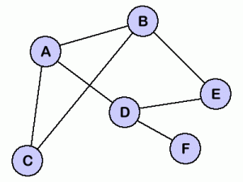
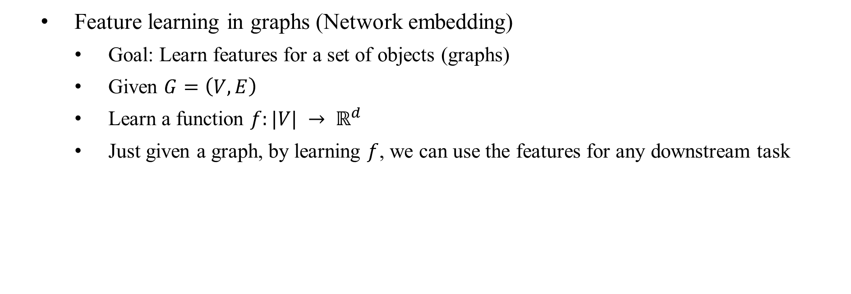
Introduction
Feature learning in graphs (Network embedding)
Goal: Learn features for a set of objects (graphs)
Given $G=\left(V, E\right)$
Learn a function $f:|V| → ℝ^{d}$
Just given a graph, by learning $f$, we can use the features for any downstream task
A
B
C
D
E
F
Notes:
downstream task: learning algorithm, model

Slide 3
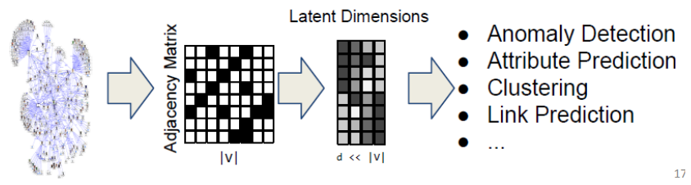
Introduction
Why network embedding?
Vector spaces are more amenable to data science than graphs
We can only use specific mathematics and toolsets for graph data
Notes:
downstream task: learning algorithm, model

Slide 4
Introduction
Matrix Factorization
Not incremental
No parameter sharing
Not incorporate node features
Network Embedding
Random Walk
Graph Neural Network
Graph Convolutional Network
Graph Attention Network

Slide 5
Introduction
Contributions
Attention-based architecture node classification of graph-structured data
The model is efficient because it is parallelizable
It can be applied to solve inductive learning problem, generalizing unseen graphs

Slide 6
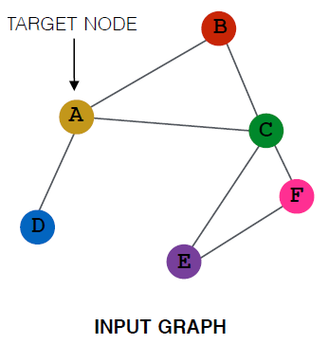
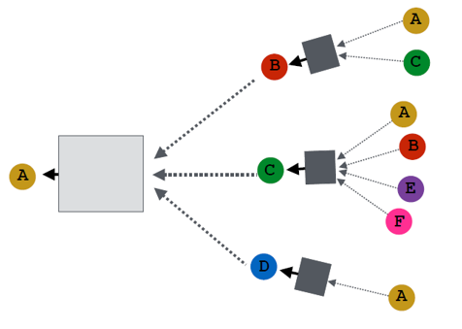
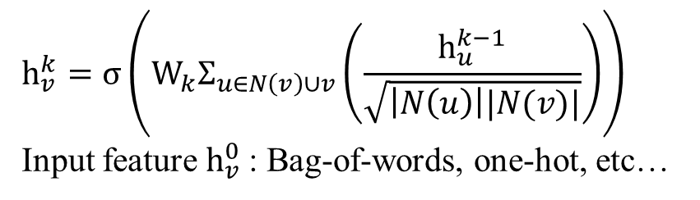
Related work
Graph Convolutional Network
A
B
C
D
B
A
C
D
$$h_{v}^{k}=σ\left(W_{k}Σ_{u∈N\left(v\right)∪v}\left(\frac{h_{u}^{k−1}}{\sqrt{\left|N\left(u\right)\right||N(v)|}}\right)\right)$$
Input feature $h_{v}^{0}$: Bag-of-words, one-hot, etc…

Slide 7


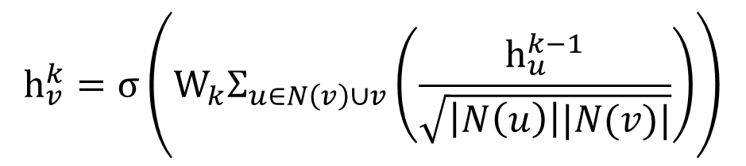

Related work
Graph Convolutional Network
Effective implementation using batch operations
$O\left(\left|E\right|\right)$ time complexity
$$h_{v}^{k}=σ\left(W_{k}Σ_{u∈N\left(v\right)∪v}\left(\frac{h_{u}^{k−1}}{\sqrt{\left|N\left(u\right)\right||N(v)|}}\right)\right)$$
$$H^{k}=σ({\tilde{D}}^{−\frac{1}{2}}\tilde{A}{\tilde{D}}^{−\frac{1}{2}}H^{k−1}W_{k−1})$$
where$\tilde{A}=A+I$, $D_{ii}=Σ_{j}A_{i,j}$

Slide 8

Related work
Graph Convolutional Network
In $H^{k}=σ({\tilde{D}}^{−\frac{1}{2}}\tilde{A}{\tilde{D}}^{−\frac{1}{2}}H^{k−1}W_{k−1})$, the full graph Laplacian (${\tilde{D}}^{−\frac{1}{2}}\tilde{A}{\tilde{D}}^{−\frac{1}{2}}$) should be known
Since weight matrix $W$ is trained depending on the structure of A,
GCN cannot be applied to unseen graphs during the training

Slide 9
Related work
Transductive learning
Reasoning from observed training cases to general rules
Cannot infer a data not in the training set
ex) “Out of vocabulary” problem in word embedding
Inductive learning
Infer data unseen the training process based on observed training cases
For, network embedding, this has been difficult

Slide 10
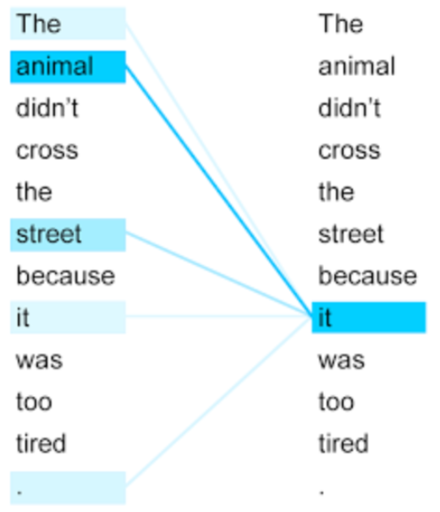

Related work
Attention mechanism
Focusing on the most relevant parts on the input to make decisions
Self-attention (intra-attention):
an input element $x_{i}$ attends differently to all the other input elements

Slide 11
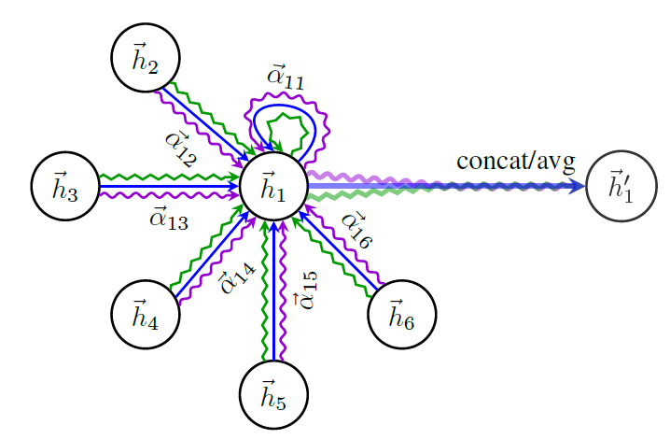






Proposed Method
$$h_{i}$$
$$W$$
$$q$$
$$softmax_{j}$$
$$α_{ij}$$
$$h_{j}$$
$$W$$
Calculating attention coefficient
Multi-head attention on neighborhood

Slide 12








Proposed Method
Pair-wise masked attention
$α_{ij}=\frac{exp⁡(LeakyReLU\left(q\left[Wh_{i}||Wh_{j}\right]\right))}{Σ_{k∈𝒩_{i}}exp⁡(LeakyReLU\left(q\left[Wh_{i}||Wh_{j}\right]\right))}$
$W$: a weight matrix
$q$: a weight vector
$$h_{i}$$
$$W$$
$$q$$
$$softmax_{j}$$
$$α_{ij}$$
$$h_{j}$$
$$W$$
Calculating attention coefficient
Notes:
원래는 소프트맥스 분모에 모든 노드에 대해 하지만 여기선 이웃노드에 대해서만 계산함 (masked attention)

Slide 13

Proposed Method
Generating the embedding of a node
$h_{i}^{′}=||_{k=1}^{K}σ\left(Σ_{j∈𝒩_{i}}α_{ij}^{k}W^{k}h_{j}\right)$
$||$: concatenate operation
$K$: the number of heads
Multi-head attention on neighborhood

Slide 14
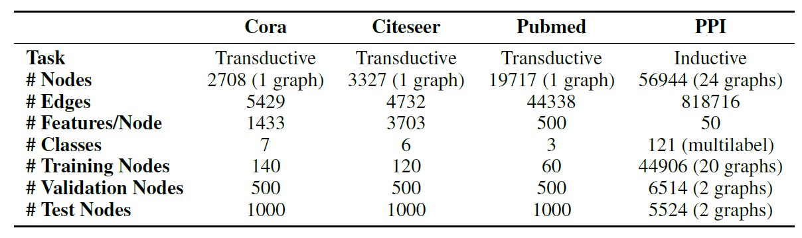
Experiments
Node classification task in both transductive and inductive settings
3 citation networks for transductive learning
Initial feature: bag-of-words
Protein-Protein Interactions (PPI) for inductive learning
24 different graphs, 20 for training, 2 for test, and 2 for validation

Slide 15
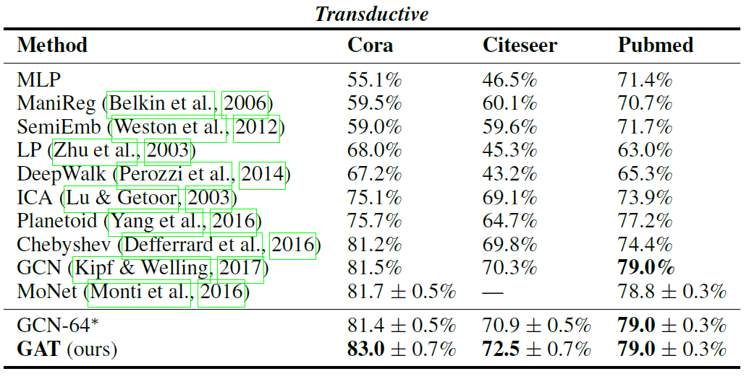
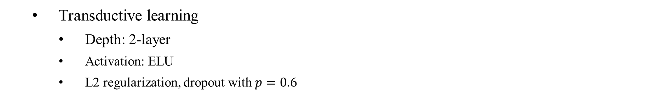
Experiments
Transductive learning
Depth: 2-layer
Activation: ELU
L2 regularization, dropout with $p=0.6$

Slide 16
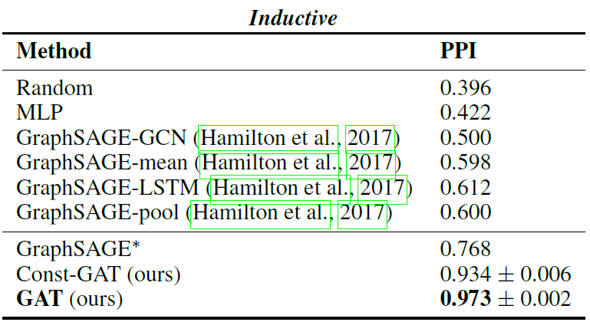
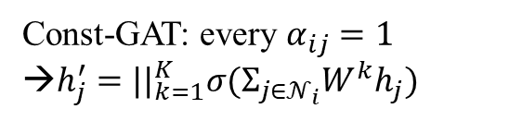
Experiments
Const-GAT: every $α_{ij}=1$
→$h_{j}^{′}={||}_{k=1}^{K}σ(Σ_{j∈𝒩_{i}}W^{k}h_{j})$
Inductive learning
Depth: 3-layer
Activation: ELU
Skip connection

Slide 17
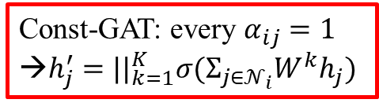
Experiments
Const-GAT: every $α_{ij}=1$
→$h_{j}^{′}={||}_{k=1}^{K}σ(Σ_{j∈𝒩_{i}}W^{k}h_{j})$
Even GAT without any attention mechanism performs much better than previous works
It seems that multi-head approach makes an effect like “ensemble” generalizing the model

Slide 18
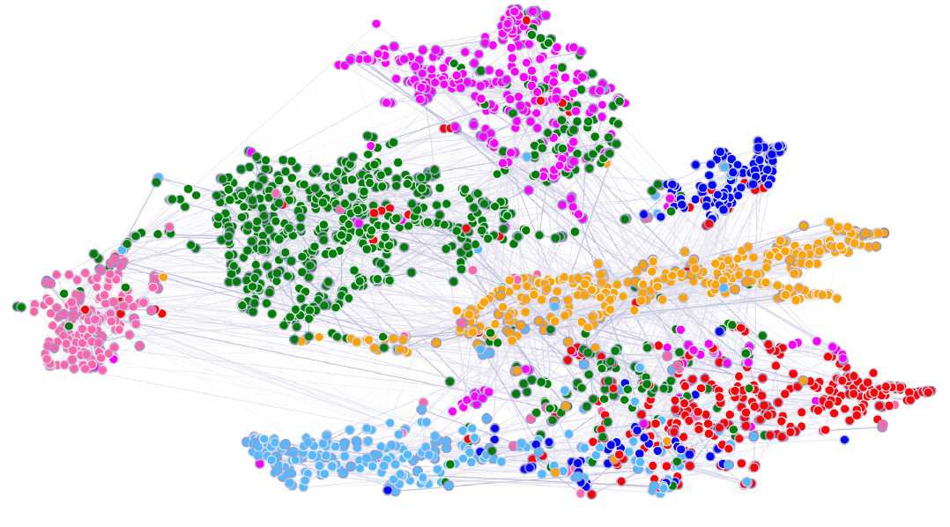
Experiments
Visualization by t-SNE (Cora dataset)

Slide 19
Conclusion
Network embedding model based neighborhood aggregation using self-attention
A simple but powerful neural network structure
Very high performance on inductive problem of network data

Slide 20
Conclusion
Additional related works: PeerNets
“augment a standard CNN architecture for image classification with GAT-like layers over a graph of “neighboring” feature maps from related images in a training dataset. This makes the learnt feature maps substantially more robust, providing a strong defense against a variety of adversarial attacks while sacrificing almost no test accuracy.”
Notes:
This makes the learnt feature maps substantially more robust, providing a strong defence against a variety of adversarial attacks while sacrificing almost no test accuracy.

Slide 21
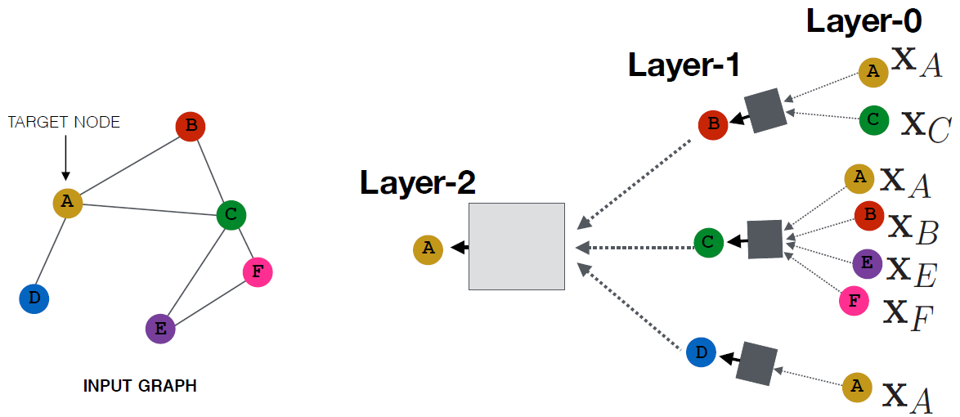
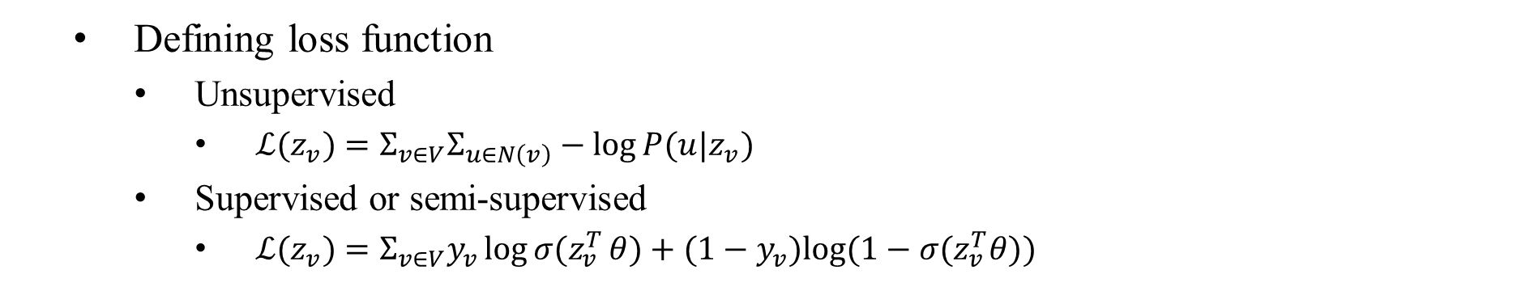

Appendix: loss function examples
$$z_{A}$$
Defining loss function
Unsupervised
$ℒ(z_{v})=Σ_{v∈V}Σ_{u∈N\left(v\right)}−\log{P(u|z_{v})}$
Supervised or semi-supervised
$ℒ(z_{v})=Σ_{v∈V}y_{v}{\log{σ(z}}_{v}^{T}θ)+(1−y_{v})log⁡(1−σ(z_{v}^{T}θ))$

