Slide 1

Balancing information exposure in social networks
Kiran Garimella et al., NIPS, 2017
Yunseob Shin,
Information & Intelligence System Lab.
2018/04/02

Slide 2
Balancing Information Exposure
Social-media platforms have revolutionized the way people are exposed to information.
Despite providing many merits such as searching, personalization, and recommendation, one point of criticism is that social media amplify echo chamber
Users get less exposure to conflicting viewpoints and isolated in their own informational bubble which causes online polarization.

Slide 3
Information Propagation in Social Networks
As called as “Information Diffusion”, or “Influence Maximization”
A social network is modeled as a graph with nodes and edges.
Influence are propagated in the network according to a cascade model, such as “Independent Cascade model”
The goal is to find a set of seed nodes which maximize the final influence spread.

Slide 4
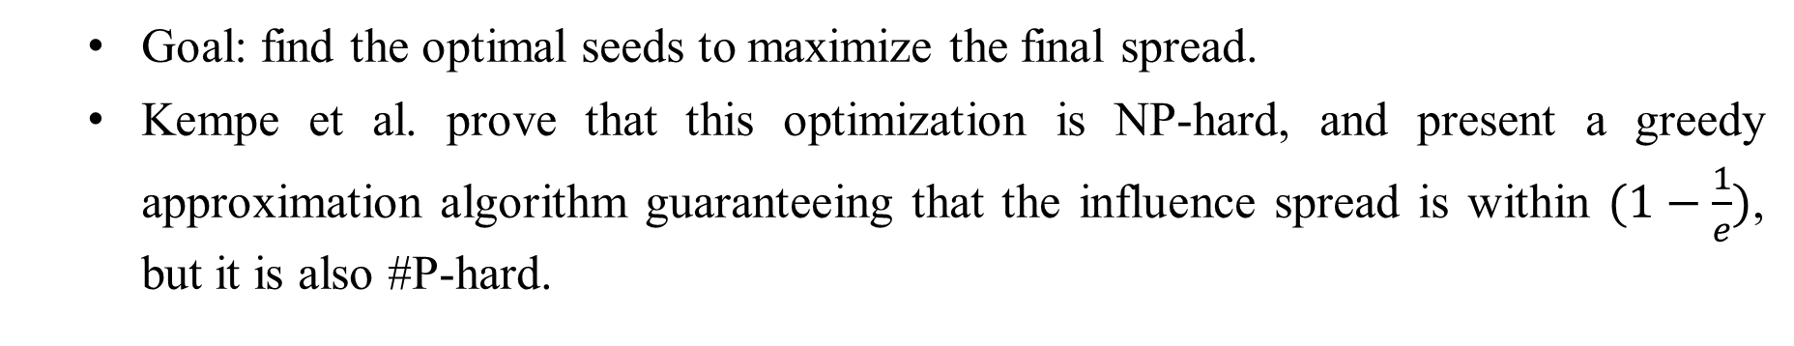
Information Propagation in Social Networks
1
4
12
1
1
4
12
4
12
2
8
2
8
2
8
5
14
5
14
5
14
3
9
3
9
3
9
6
10
15
6
10
15
6
10
15
11
11
7
11
7
7
13
13
16
13
16
16
Goal: find the optimal seeds to maximize the final spread.
Kempe et al. prove that this optimization is NP-hard, and present a greedy approximation algorithm guaranteeing that the influence spread is within $(1−\frac{1}{e})$, but it is also #P-hard.
Notes:
Approximation도 #P-hard라서 다양한 휴리스틱 존재

Slide 5
Balancing Information Exposure with Information Propagation
The first paper to address the problem of balancing information exposure using the Influence Maximization (IM) methodology.
The goal of this problem is to find a limited number of seed users for each campaign (=viewpoint) which maximize the number of users exposed to both sides.
Although this paper approached to IM problem in different manner, the algorithm it provides showed approximation guarantees.

Slide 6



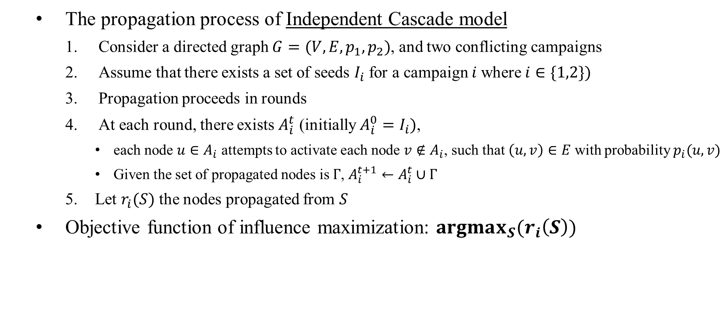
Problem Definition – Information Propagation
The propagation process of Independent Cascade model
Consider a directed graph $G=(V, E, p_{1},p_{2})$, and two conflicting campaigns
Assume that there exists a set of seeds $I_{i}$ for a campaign $i$where$i∈\{1,2\})$
Propagation proceeds in rounds
At each round, there exists $A_{i}^{t}$ (initially $A_{i}^{0}=I_{i})$,
each node $u∈A_{i}$ attempts to activate each node $v∉A_{i}$, such that $\left(u, v\right)∈E$ with probability $p_{i}(u, v)$
Given the set of propagated nodes is $Γ$, $A_{i}^{t+1}←A_{i}^{t}∪Γ$
Let $r_{i}(S)$ the nodes propagated from $S$
Objective function of influence maximization: $argmax_{S}(r_{i}\left(S\right))$
$$u$$
$$p_{i}(u, v)$$
$$v$$
Notes:
Computing $r_{i}\left(S\right)$ is #P-hard problem, but can be approximated via Monte-Carlo simulations within an arbitrary small factor $ε$.

Slide 7
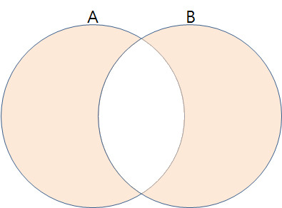
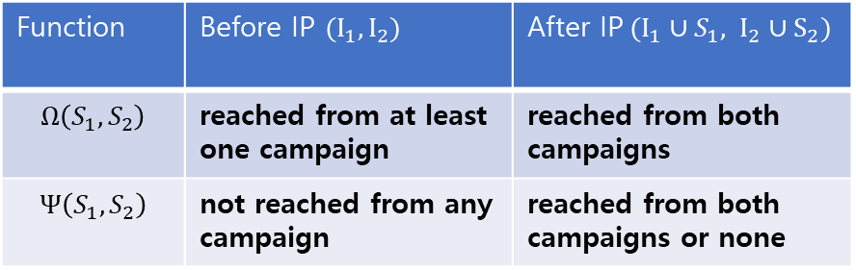
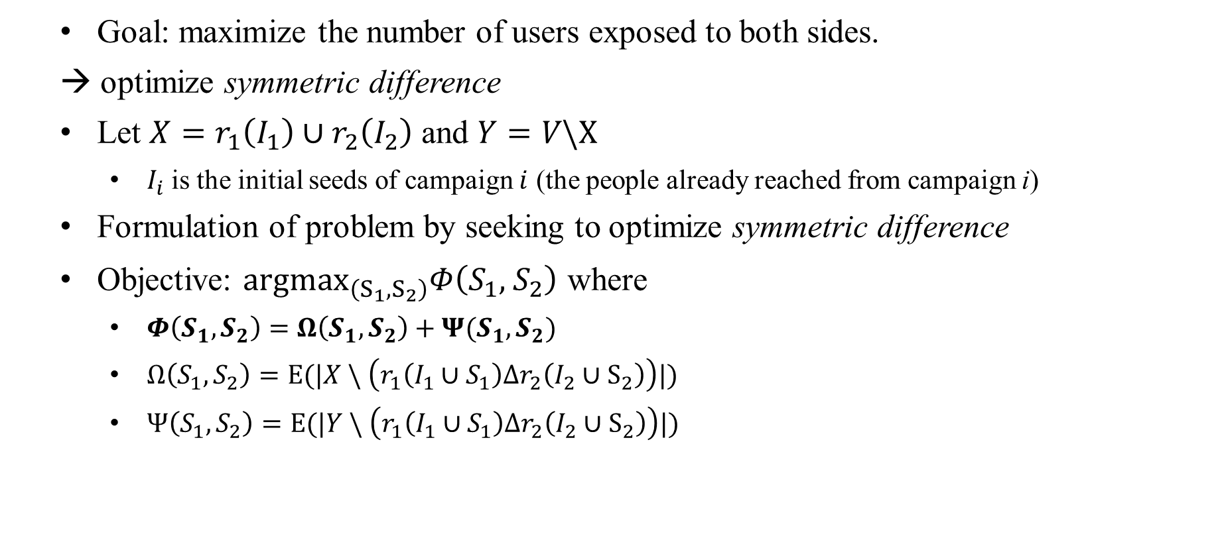
Problem Definition – Balancing information exposure
Goal: maximize the number of users exposed to both sides.
→ optimize symmetric difference
Let $X=r_{1}\left(I_{1}\right)∪r_{2}\left(I_{2}\right)$ and $Y=V\backslash X$
$I_{i}$ is the initial seeds of campaign $i$ (the people already reached from campaign i)
Formulation of problem by seeking to optimize symmetric difference
Objective: ${argmax}_{\left(S_{1}, S_{2}\right)}Φ\left(S_{1},{ S}_{2}\right)$ where
$Φ\left(S_{1}, S_{2}\right)=Ω\left(S_{1}, S_{2}\right)+Ψ(S_{1}, S_{2})$
$Ω\left(S_{1}, S_{2}\right)=E(|X \backslash \left(r_{1}\left(I_{1}∪S_{1}\right)Δr_{2}\left(I_{2}∪S_{2}\right)\right)|)$
$Ψ\left(S_{1},S_{2}\right)=E(|Y \backslash \left(r_{1}\left(I_{1}∪S_{1}\right)Δr_{2}\left(I_{2}∪S_{2}\right)\right)|)$
Function | Before IP $(I_{1}, I_{2})$ | After IP$(I_{1}∪S_{1}, I_{2}∪S_{2})$
$$Ω\left(S_{1}, S_{2}\right)$$ | reached from at least one campaign | reached from both campaigns
$$Ψ\left(S_{1},S_{2}\right)$$ | not reached from any campaign | reached from both campaigns or none
Notes:
오메가: 둘 다 알고 있던 사람 + 하나만 알다가 둘다 알게 된 사람
프사이: 둘 다 모르고 있다가 둘 다 알게 된 사람 + 여전히 둘 다 모르는 사람

Slide 8


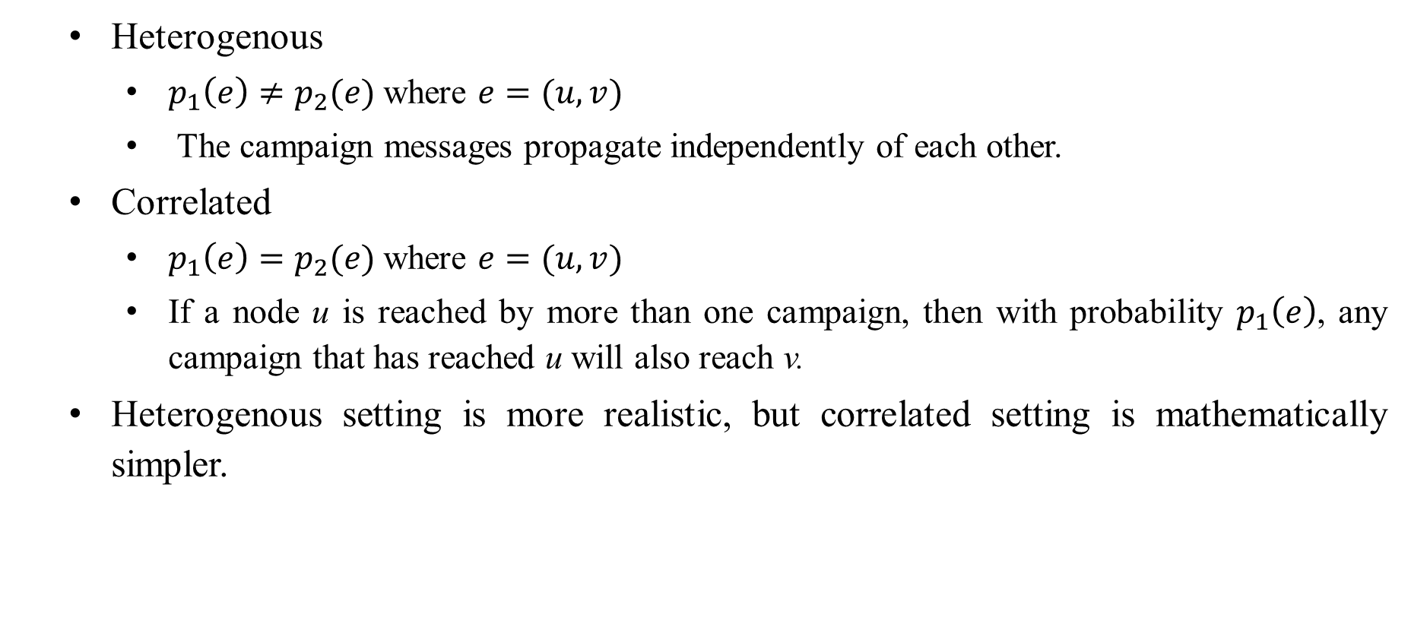

Problem Definition – Two settings
Heterogenous
$p_{1}\left(e\right)≠p_{2}(e)$ where $e=(u,v)$
The campaign messages propagate independently of each other.
Correlated
$p_{1}\left(e\right)=p_{2}(e)$ where $e=(u,v)$
If a node u is reached by more than one campaign, then with probability $p_{1}\left(e\right)$, any campaign that has reached u will also reach v.
Heterogenous setting is more realistic, but correlated setting is mathematically simpler.
$$u$$
$$p_{1}(e)$$
$$v$$
$$p_{2}(e)$$
$$u$$
$$p(e)$$
$$v$$
Notes:
Hetero가 더 현실적이지만 correlated가 수학적으로 계산하기 더 편리함

Slide 9
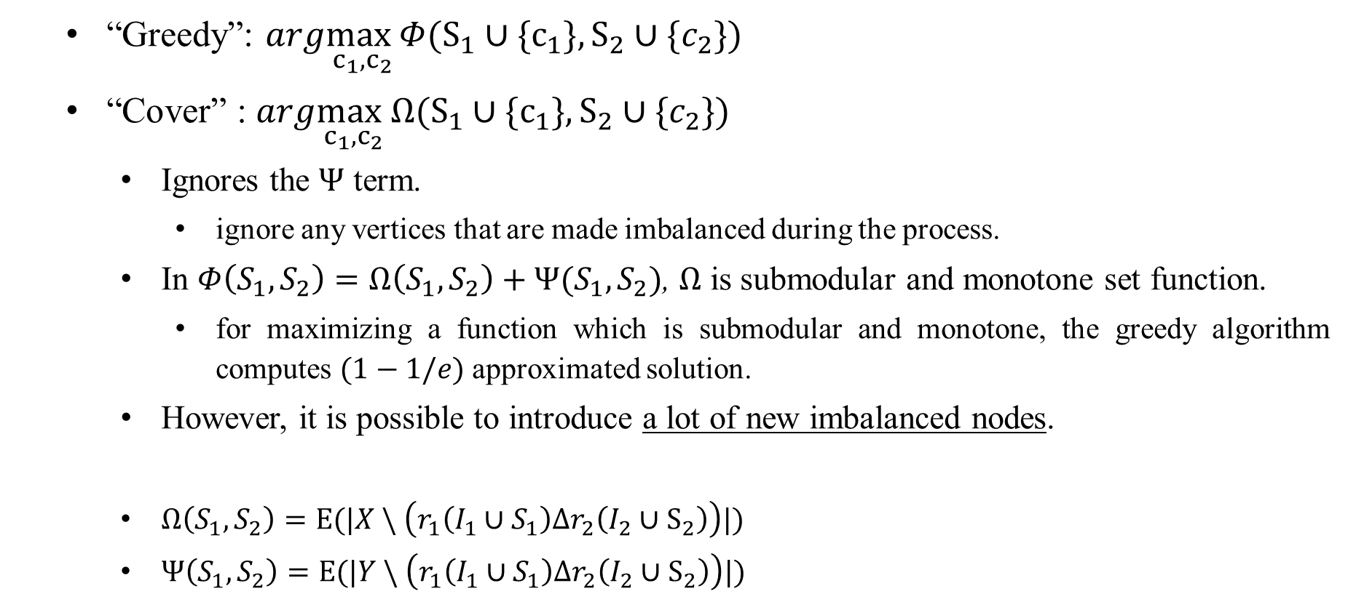
Proposed Method – Algorithm “Greedy” and “Cover”
“Greedy”: $arg\max_{c_{1}, c_{2}}Φ(S_{1}∪\{c_{1}\}, S_{2}∪\{c_{2}\})$
“Cover” : $arg\max_{c_{1}, c_{2}}Ω(S_{1}∪\{c_{1}\}, S_{2}∪\{c_{2}\})$
Ignores the $Ψ$ term.
ignore any vertices that are made imbalanced during the process.
In $Φ\left(S_{1}, S_{2}\right)=Ω\left(S_{1}, S_{2}\right)+Ψ(S_{1}, S_{2})$, $Ω$ is submodular and monotone set function.
for maximizing a function which is submodular and monotone, the greedy algorithm computes $(1−1/e)$ approximated solution.
However, it is possible to introduce a lot of new imbalanced nodes.
$Ω\left(S_{1}, S_{2}\right)=E(|X \backslash \left(r_{1}\left(I_{1}∪S_{1}\right)Δr_{2}\left(I_{2}∪S_{2}\right)\right)|)$
$Ψ\left(S_{1},S_{2}\right)=E(|Y \backslash \left(r_{1}\left(I_{1}∪S_{1}\right)Δr_{2}\left(I_{2}∪S_{2}\right)\right)|)$
Notes:
Submodular: for every $X, Y⊆Ω$ with $X⊆Y$ and every $x∈Ω\backslash Y$, we have set $f\left(X∪\left\{x\right\}\right)−f\left(X\right)≥f\left(Y∪\left\{x\right\}\right)−f(Y)$.
Monotone: for every $X⊆Y$, we have that $f(X)≤f(Y)$

Slide 10
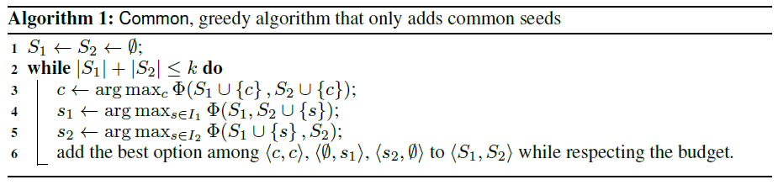
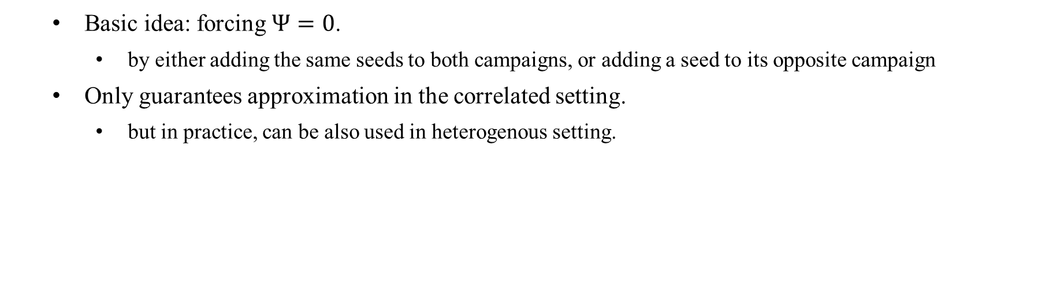
Proposed Method – Algorithm 1: “Common”
Basic idea: forcing $Ψ=0$.
by either adding the same seeds to both campaigns, or adding a seed to its opposite campaign
Only guarantees approximation in the correlated setting.
but in practice, can be also used in heterogenous setting.
Notes:
k는 짝수

Slide 11
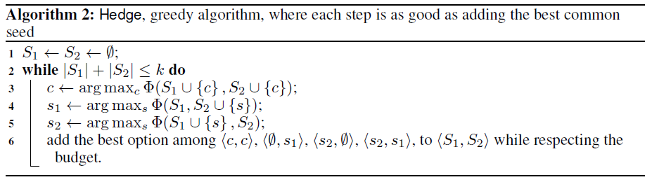
Proposed Method – Algorithm 2: “Hedge”
Not allowing new imbalanced nodes may be too restrictive.
Relax this condition by allowing new imbalanced nodes as long as the gain is at least as good as adding a common seed.
Only guarantees approximation in the correlated setting.
but in practice, can be also used in heterogenous setting.
Notes:
k는 짝수

Slide 12


Experimental Results
Let $G=(V,E)$ be the twitter follower graph (a directed graph).
The propagation probability of campaign $i$ can be defined as bellow
$α=0.8$ for heterogenous setting, and $α=0$ for correlated setting
User’s own bias
Friends` influence

Slide 13
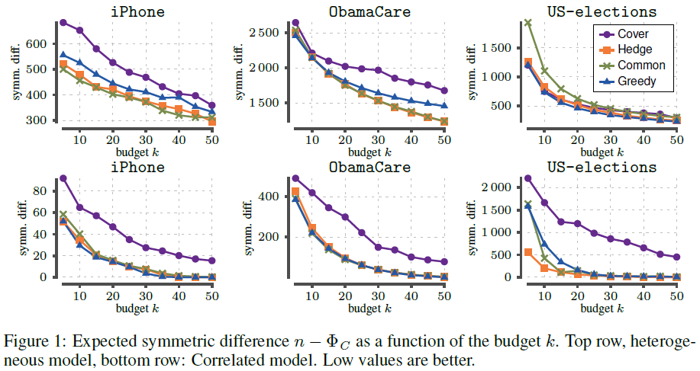
Experimental Results
Heterogenous
Correlated
Notes:
H: Cover performs, in general, worse than the other two heuristics, Cover does not optimize directly the objective function
Hedge performs better than Greedy
C: Cover performs again the worst
Common, Greedy, and Hedge perform very similar to each other without a clear winner.

Slide 14
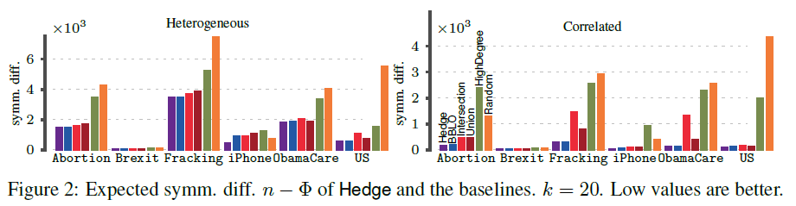
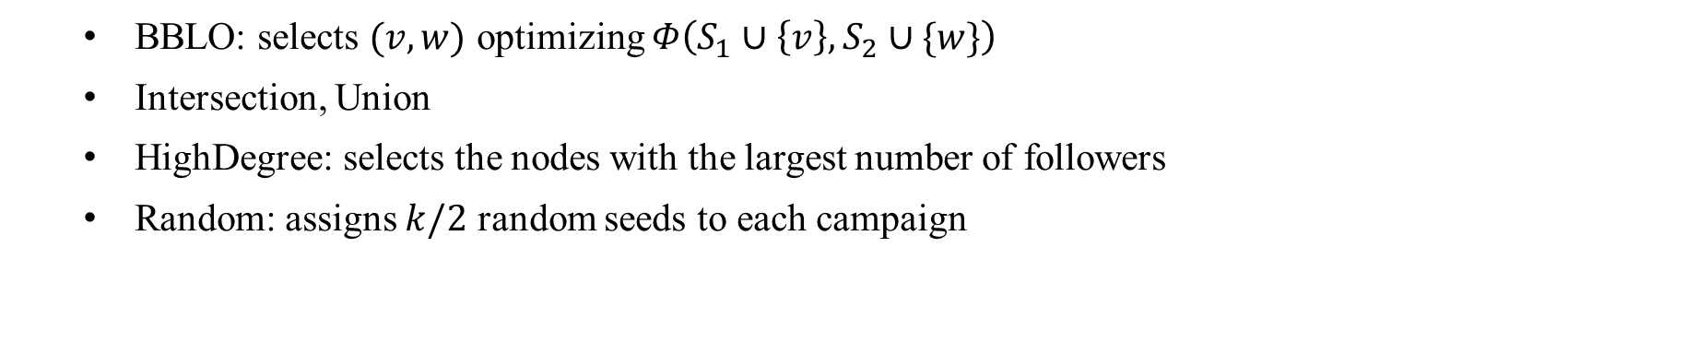
Experimental Results
BBLO: selects $(v, w)$ optimizing $Φ\left(S_{1}∪\left\{v\right\}, S_{2}∪\{w\}\right)$
Intersection, Union
HighDegree: selects the nodes with the largest number of followers
Random: assigns $k/2$ random seeds to each campaign

Slide 15
Conclusion
The first study of the problem of balancing information exposure in social networks using techniques from the area of information propagation.
Formulation of problem by seeking to optimize symmetric difference function.
Future work:
improve the approximation guarantee
extend the problem for multiple campaigns more than two

