Slide 1

Abstractive Document Summarization with a Graph-Based Attentional Neural Model
Jiwei Tan, Xiao Wan and Jianguo Xiao (Peking University)
ACL 2017
Yunseob Shin
Information & Intelligence System Lab.
Sungkyunkwan University
2018/08/03

Slide 2
Contents
Introduction
Graph Attention Model
Decoding Algorithm
Experiments
Conclusion

Slide 3
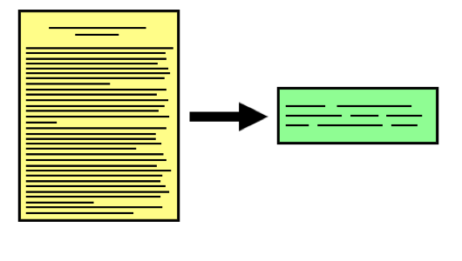
Introduction
Document Summarization:
A task to generate a fluent, condensed summary for a document, and keep important information.
Extractive Methods
Abstractive Methods

Slide 4
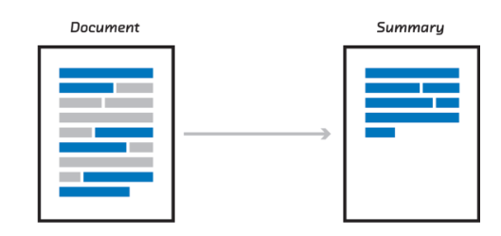
Introduction (Cont’d)
Extractive methods
Extract original sentences to form the summary
+ Salient content
+ Fluent sentences
- Incoherent discourse
- Redundant information

Slide 5
Introduction (Cont’d)
Abstractive methods
Generate the summary using arbitrary words
+ Concise, coherent, fluent and scalable summary
+ Ultimate goal
- Natural language generation is difficult

Slide 6
Introduction (Cont’d)
Contributions:
Teach seq2seq model to identify salient information from massive input content
Graph-based attention to attend to important original sentences
Make the decoder generate qualified summaries
Improved decoding algorithm to meet the qualification of summary

Slide 7
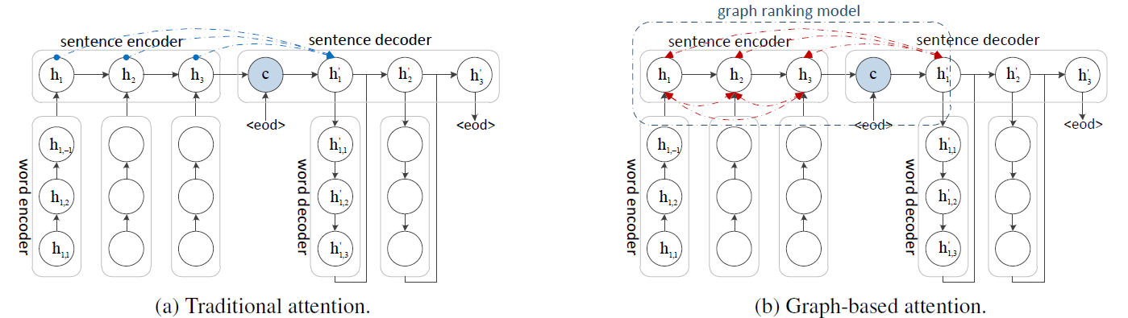
Graph Attention Model

Slide 8
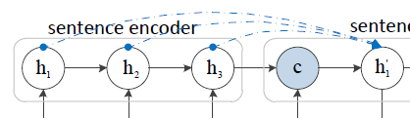
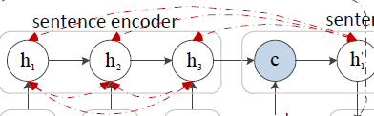
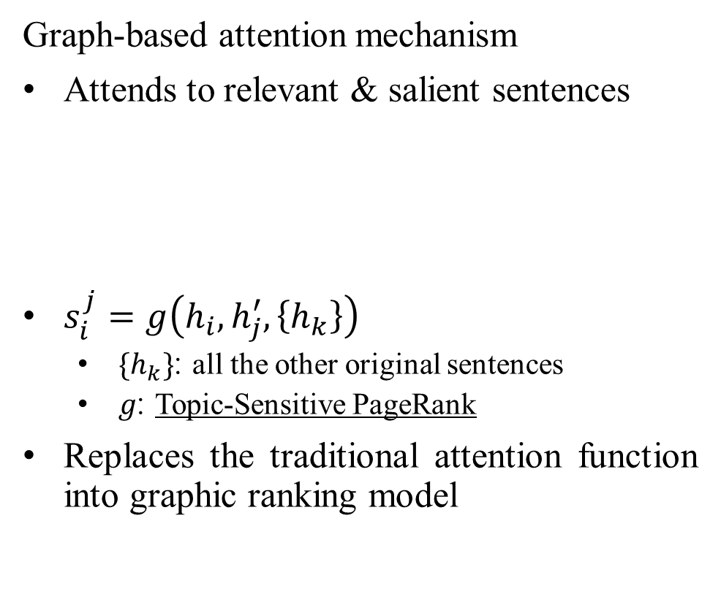

Graph Attention Model
Traditional attention mechanism
Attends to relevant sentences
$s_{i}^{j}=f\left(h_{i}, h_{j}^{′}\right)$
$α_{i}^{j}=\frac{exp⁡(s_{i}^{j})}{Σ_{k}exp{(s_{k}^{j})}}$
Graph-based attention mechanism
Attends to relevant & salient sentences
$s_{i}^{j}=g\left(h_{i}, h_{j}^{′}, \left\{h_{k}\right\}\right)$
$\{h_{k}\}$: all the other original sentences
$g$: Topic-Sensitive PageRank
Replaces the traditional attention function into graphic ranking model

Slide 9
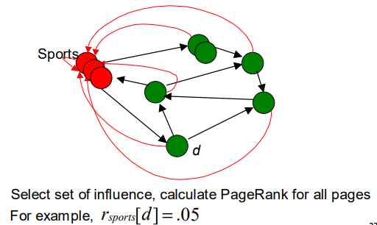
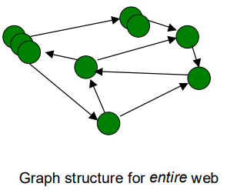
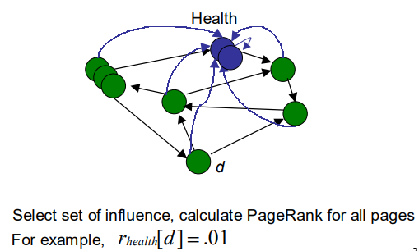


Graph Attention Model (Cont’d)
Topic-Sensitive PageRank
$$d$$
The PageRank of d $r\left[d\right]=.03$

Slide 10




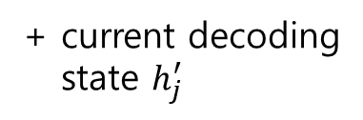




Graph Attention Model (Cont’d)
In this method, each decoding state $h_{j}^{′}$ is treated as a “Topic”.
$$h_{j}^{′}$$
The set of influence
$$h_{2}$$
$$h_{1}$$
$$h_{3}$$
$$h_{6}$$
$$h_{4}$$
$$h_{5}$$
Weighted graph of
original sentences
+ current decoding
state $h_{j}^{′}$
Notes:
The graph is constructed by several methods: dot product, cosine similarity, feed-forward neural networks

Slide 11



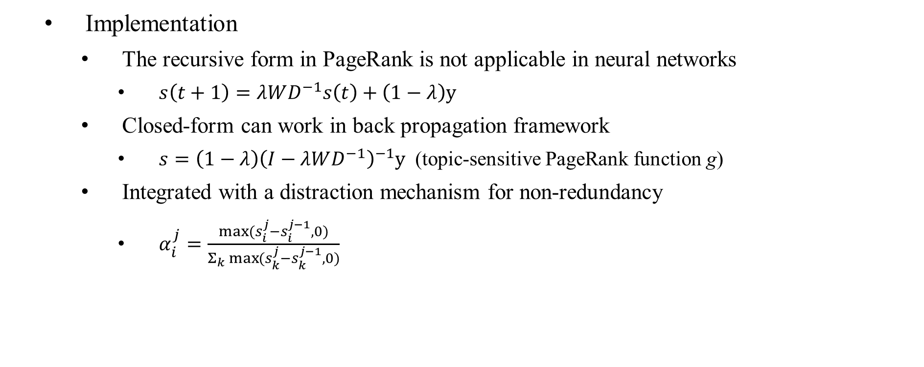
Graph Attention Model (Cont’d)
Implementation
The recursive form in PageRank is not applicable in neural networks
$s\left(t+1\right)=λWD^{−1}s\left(t\right)+\left(1−λ\right)y$
Closed-form can work in back propagation framework
$s=\left(1−λ\right){\left(I−λWD^{−1}\right)}^{−1}y$ (topic-sensitive PageRank function g)
Integrated with a distraction mechanism for non-redundancy
$α_{i}^{j}=\frac{\max{(s_{i}^{j}−s_{i}^{j−1}, 0)}}{Σ_{k}\max{(}s_{k}^{j}−s_{k}^{j−1}, 0)}$
$$W_{ij}=h_{i}Mh_{j}$$
$D_{ii}=$degree of i
$y_{i}$=1 for topic sentence

Slide 12
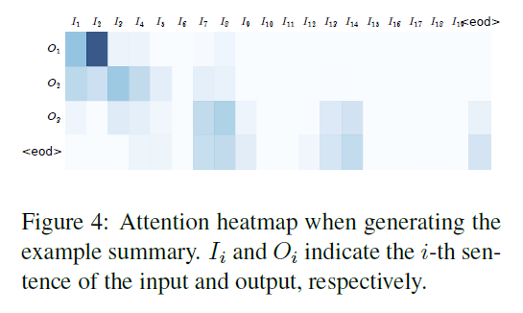
Graph Attention Model (Cont’d)
Visualization of graph-based attention

Slide 13
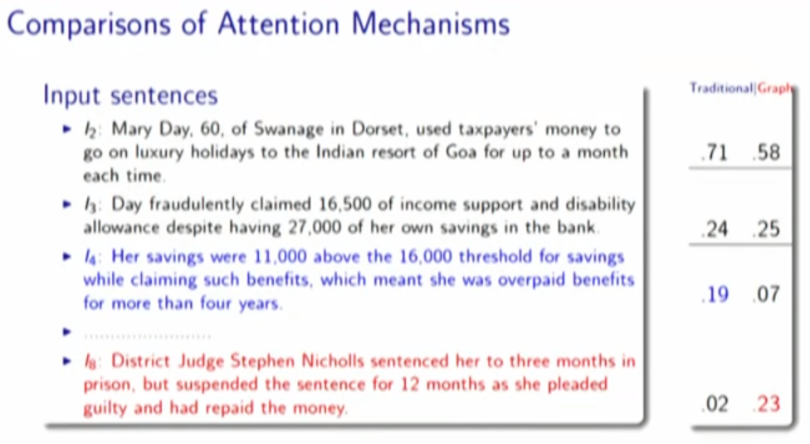
Graph Attention Model (Cont’d)
Notes:
Traditional attention model 은 처음부터 consequent 한 것에 어텐션을 줌.
Graph attention model은 첫 문장이랑 멀리 떨어져 있는 것에도 어텐션을 줌.

Slide 14
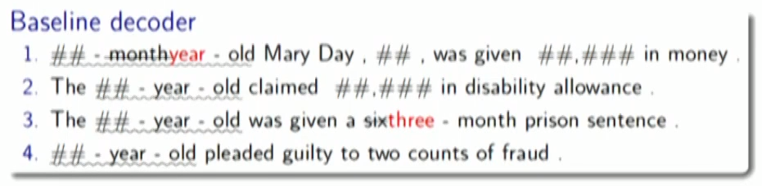
Decoding Algorithm
Problems in decoding
Repetition
Information incorrectness

Slide 15
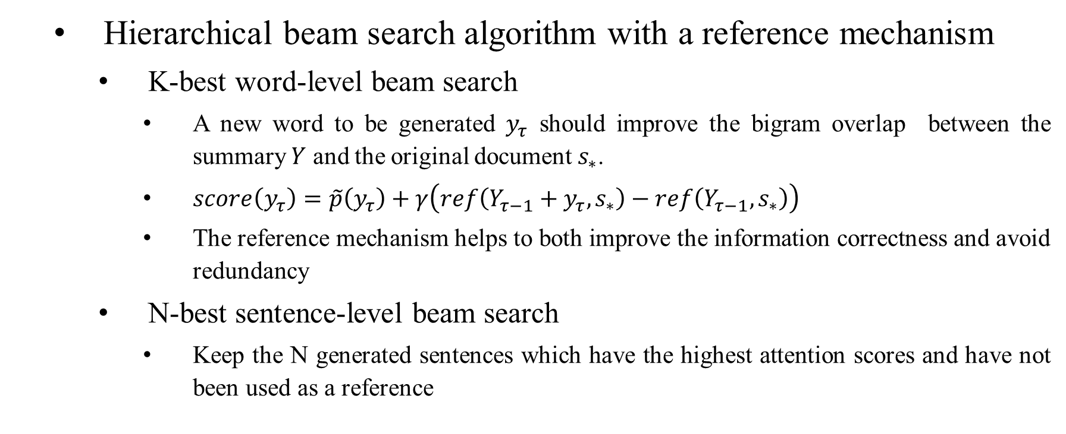
Decoding Algorithm (Cont’d)
Hierarchical beam search algorithm with a reference mechanism
K-best word-level beam search
A new word to be generated $y_{τ}$ should improve the bigram overlap between the summary $Y$ and the original document $s_{∗}$.
$score\left(y_{τ}\right)=\tilde{p}\left(y_{τ}\right)+γ\left(ref\left(Y_{τ−1}+y_{τ}, s_{∗}\right)−ref\left(Y_{τ−1}, s_{∗}\right)\right)$
The reference mechanism helps to both improve the information correctness and avoid redundancy
N-best sentence-level beam search
Keep the N generated sentences which have the highest attention scores and have not been used as a reference

Slide 16
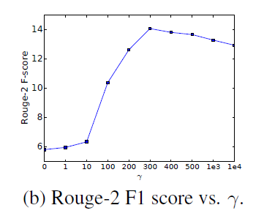
Decoding Algorithm (Cont’d)
Hierarchical beam search algorithm with a reference mechanism
Benefits:
Consistent with original document
Reduces repetition
Hierarchical beam search → coherence

Slide 17
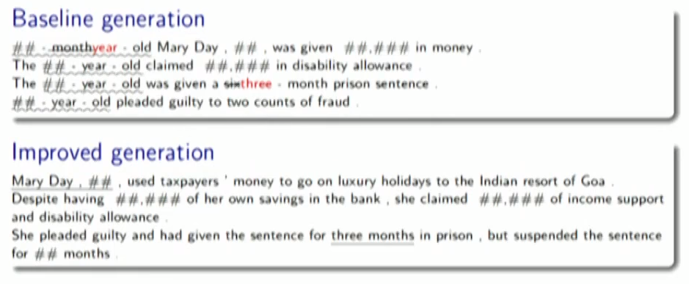
Decoding Algorithm (Cont’d)

Slide 18
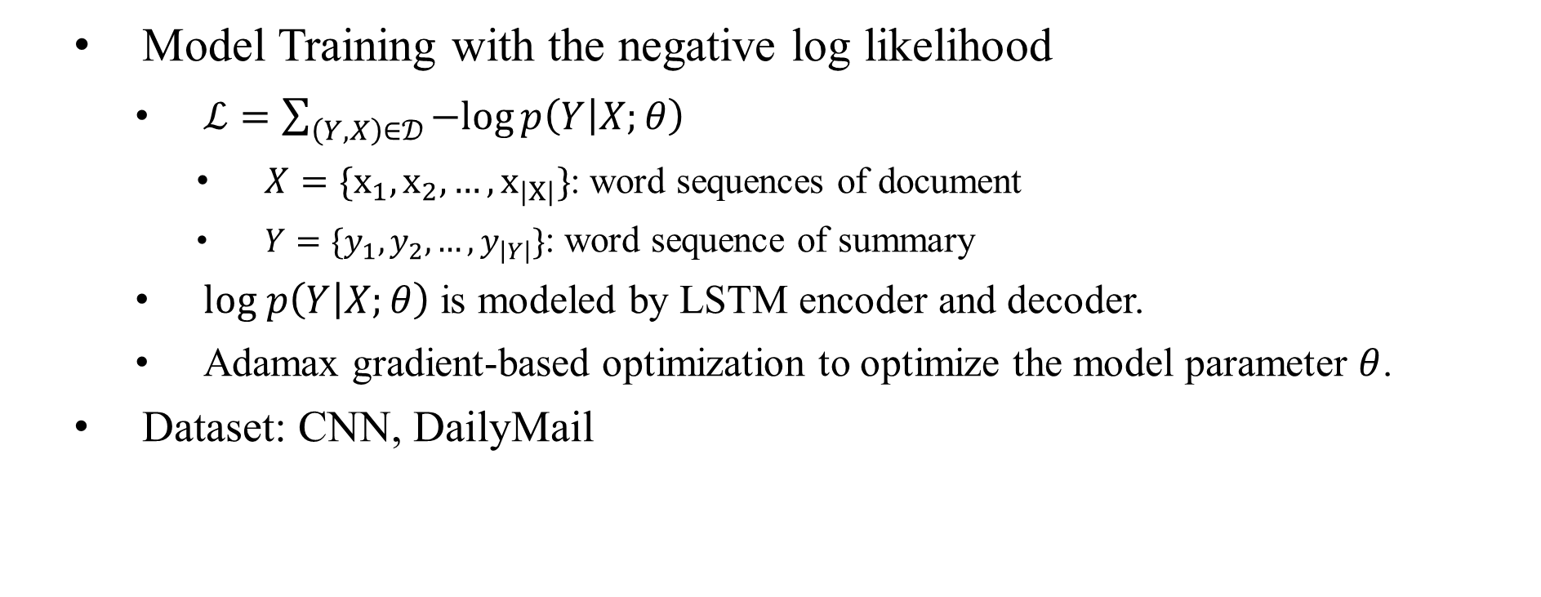
Experiments
Model Training with the negative log likelihood
$ℒ=\sum_{\left(Y,X\right)∈𝒟}{−log}p\left(Y | X;θ\right)$
$X=\{x_{1},x_{2}, …, x_{\left|X\right|}\}$: word sequences of document
$Y=\{y_{1},y_{2},…, y_{\left|Y\right|}\}$: word sequence of summary
$log p\left(Y | X;θ\right)$ is modeled by LSTM encoder and decoder.
Adamax gradient-based optimization to optimize the model parameter $θ$.
Dataset: CNN, DailyMail

Slide 19
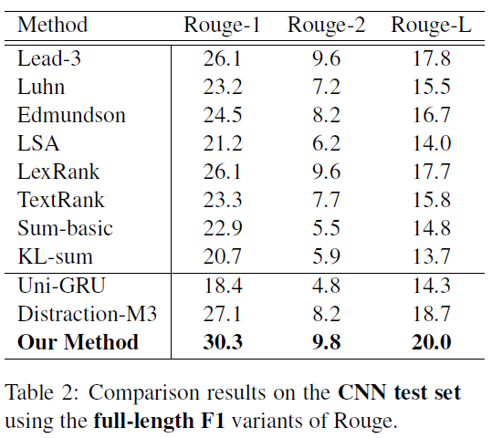
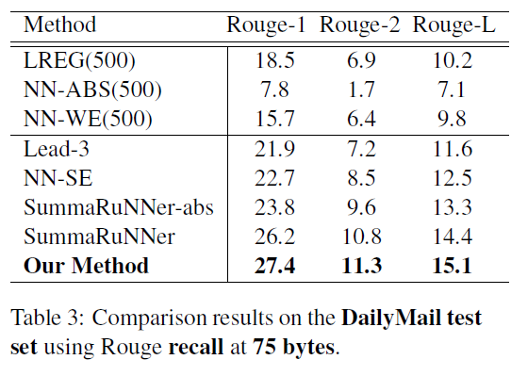
Experiments (Cont’d)

Slide 20
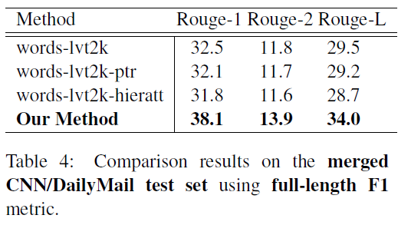
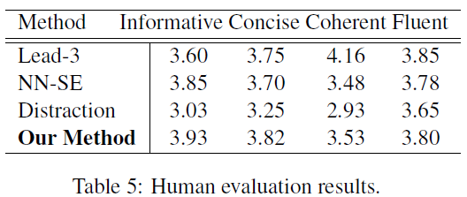
Experiments (Cont’d)

Slide 21
Conclusion
Novel graph-based attention mechanism in hierarchical encoder-decoder framework
Hierarchical beam search algorithm to generate multi-sentence summary

