Slide 1

Large Scale Semantic Indexing with Deep Level-wise Extreme Multi-label Learning
Dingcheng Li, Jingyuan Zhang, Ping Li (Baidu Research)
WWW 2019
Yunseob Shin
Information & Intelligence System Lab.
Sungkyunkwan University
2019/07/18

Slide 2
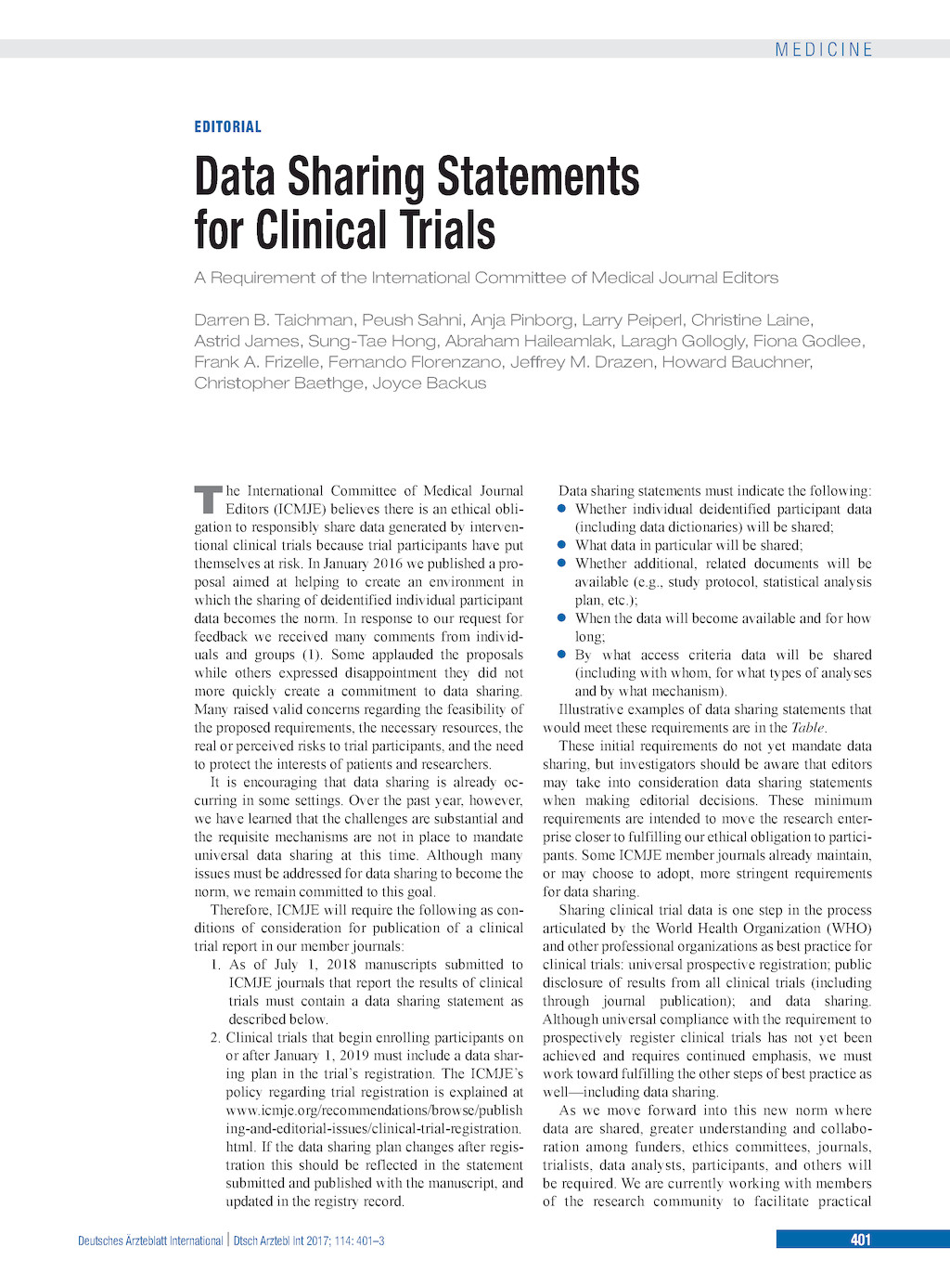
Introduction
Semantic Indexing in MeSH
MeSH (Medical Subject Headings): medical vocabulary ontology
a medical article → main topics
domain knowledge is required to manually index articles
topic 1
topic 2
topic 3
…

Slide 3
Introduction
Extreme Multi-label Classification (XMLC)
co-existence of thousands (or millions) of labels for each data sample
= Semantic Indexing, Recommendation problem

Slide 4
Introduction
Contributions
large-scale semantic indexing by level-wise learning and merging
achieved state-of-the-art performance in MEDLINE and AmazonCat13K

Slide 5
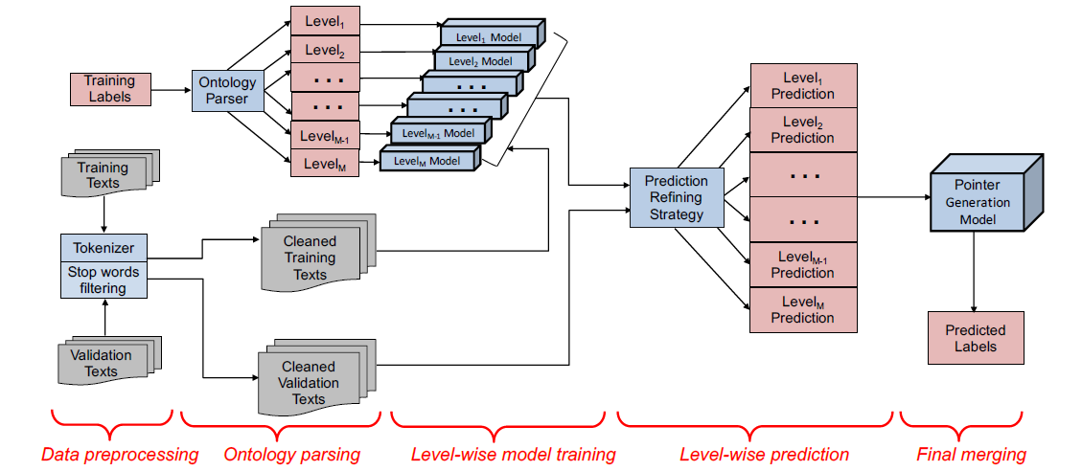
Proposed method
Overview of Deep Level-wise XMLC

Slide 6
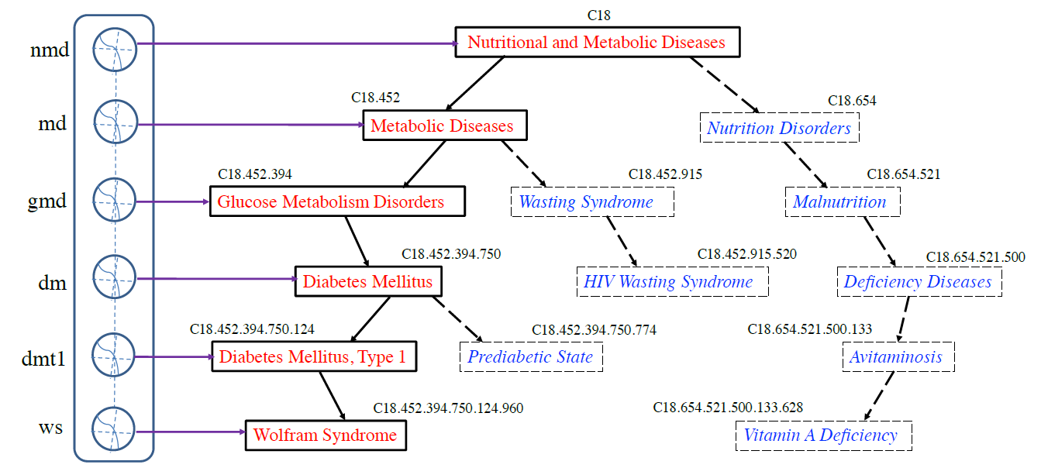
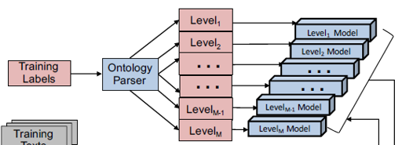
Proposed method
Level-wise learning
dviding labels into M levels according to their hierarchy
train dependent models and predict labels for each level

Slide 7
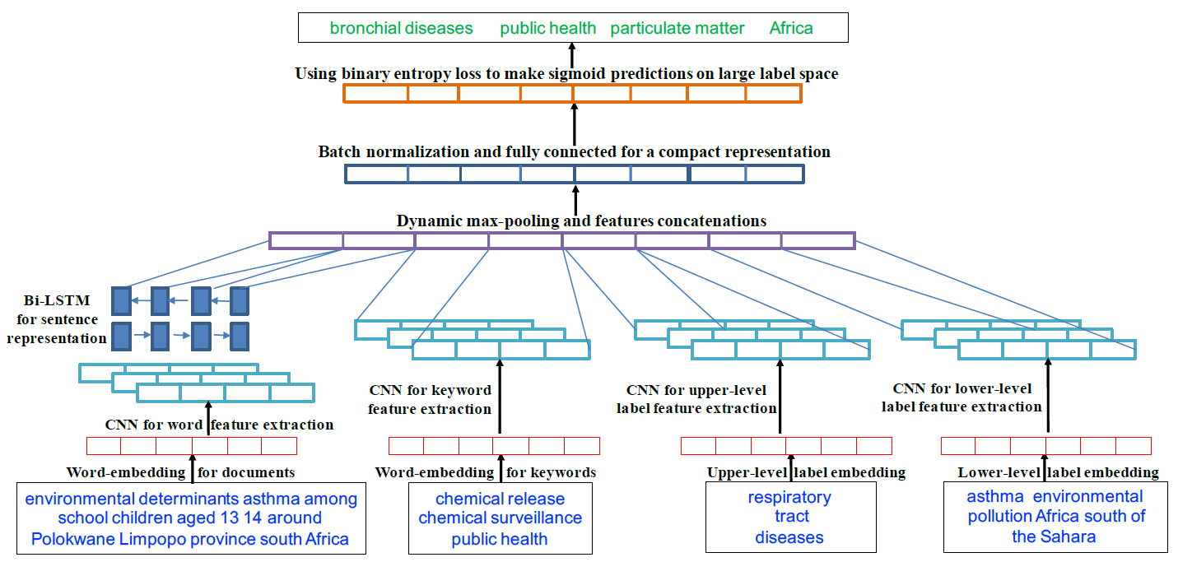
Proposed method
model structure for each level
4 types of text inputs → CNN → dynamic max-pooling →FCN
predicted labels are used as upper or lower labels for another level
content
keyword
upper-level
labels
lower-level
labels

Slide 8
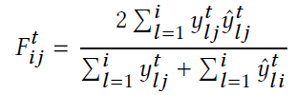
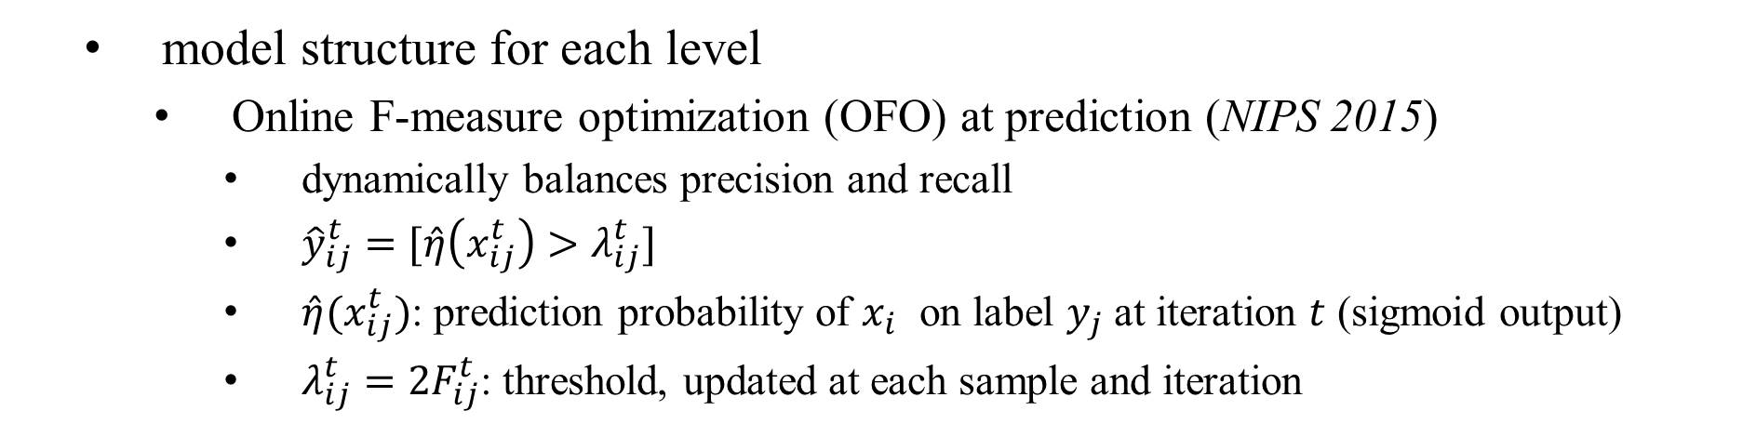
Proposed method
model structure for each level
Online F-measure optimization (OFO) at prediction (NIPS 2015)
dynamically balances precision and recall
${\hat{y}}_{ij}^{t}=[\hat{η}\left(x_{ij}^{t}\right)>λ_{ij}^{t}]$
$\hat{η}(x_{ij}^{t})$: prediction probability of $x_{i}$ on label $y_{j}$ at iteration $t$ (sigmoid output)
$λ_{ij}^{t}=2F_{ij}^{t}$: threshold, updated at each sample and iteration

Slide 9
Proposed method
Merging predictions
➔ Summarizing sentences with Pointer Generagion model (ACL 2017)
humans
young adults
child
level 1
humans
adolescent
child
asthma
environmental
exposure
smoke
follow-up studies
bronchial diseases
chemical surveillance
…
environmental exposure
level 2
…
…
longitudinal studies
risk factors
…
risk
level M
level-wise prediction
pointer generator network
final prediction

Slide 10
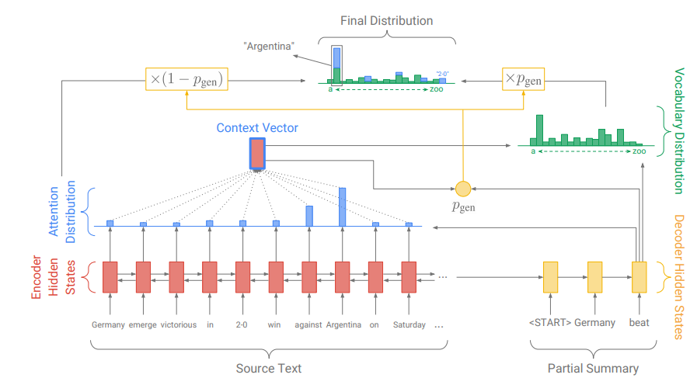
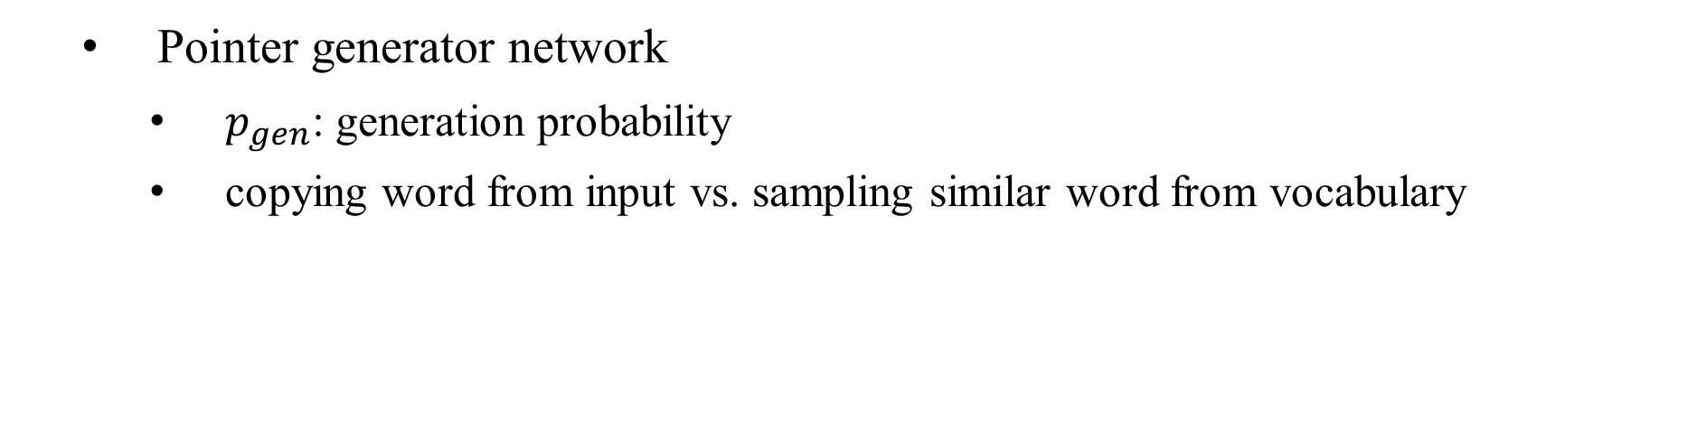
Proposed method
Pointer generator network
$p_{gen}$: generation probability
copying word from input vs. sampling similar word from vocabulary

Slide 11
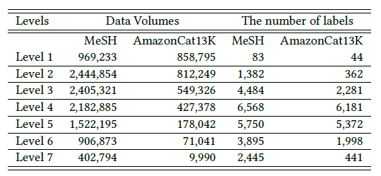
Experiments
Datasets

Slide 12
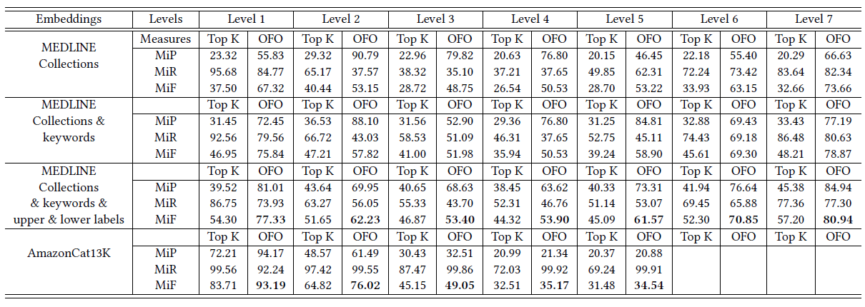
Experiments
Level-wise performance to show OFO’s effect
K=5 (best)

Slide 13
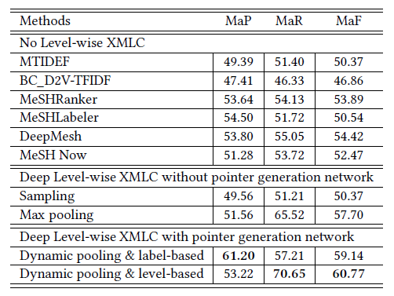
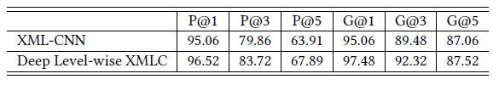
Experiments
Final prediction performance against other SOTA methods
label-based: a label = a sentence
level-based: a level (a group of labels) = a sentence
AmazonCat13K dataset
MeSH dataset

Slide 14
Conclusion
Proposed a novel deep learning framework for XMLC
Better performance than other works which requires heavy expert knowledge
Shows possibility to be applied to various multi-label data

