Slide 1

PeerNets: Exploiting Peer Wisdom Against Adversarial Attacks
Jan Svoboda, Jonathan Masci, Federico Monti, Michael M. Bronstein, Leonidas Guibas
ICLR 2019 (Accepted)
Yunseob Shin
Information & Intelligence System Lab.
Sungkyunkwan University
2019/02/21

Slide 2
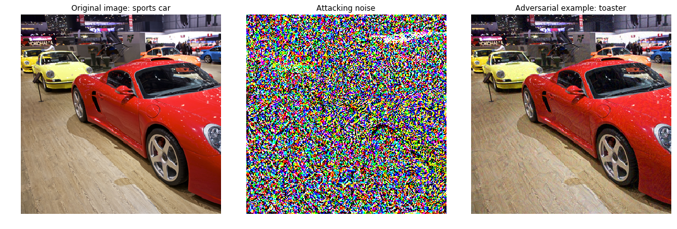
Introduction
Adversarial Attack
Deep neural networks learn very discontinuous input-output mappings
It can be caused to misclassify an image with imperceptible adversarial perturbation
Notes:
downstream task: learning algorithm, model

Slide 3
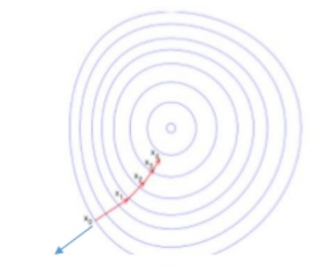

Introduction
Sample-specific adversarial perturbation
Fast Gradient Sign Method (FGSM, 2014)
$x_{adv}=x+εsign\left(∇_{x}J\left({\hat{θ}}_{c}, x, y\right)\right)$
Move in the opposite direction of optimization (Gradient Ascent)
Notes:
downstream task: learning algorithm, model

Slide 4
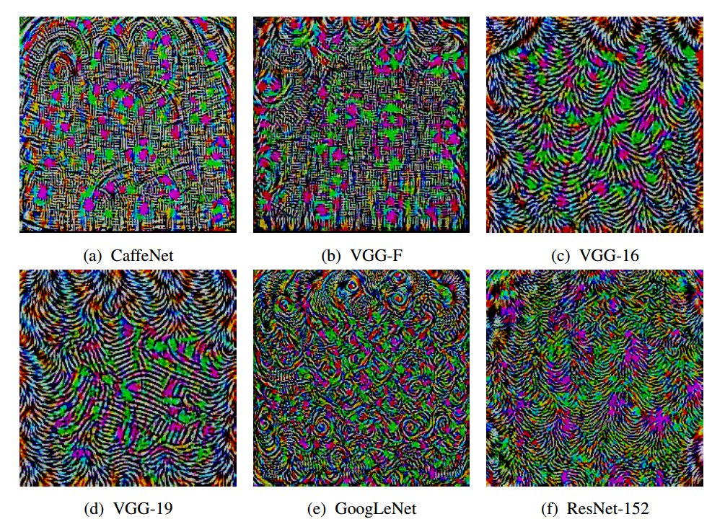
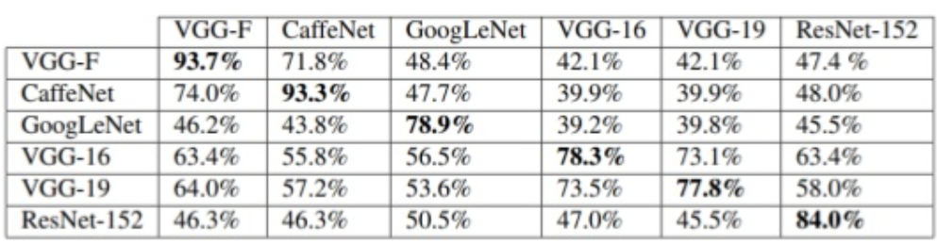
Introduction
One-pixel Attack (2017)
Universal adversarial perturbation (2016)
network-specific but input-agnostic
Notes:
downstream task: learning algorithm, model

Slide 5
Introduction
How to defend?
Ensemble adversarial training (2017)
Defensive distillation training (2016)
Deep dictionary learning (2018)
Still an open question
Notes:
downstream task: learning algorithm, model

Slide 6
Introduction
Main contribution
New deep models using graph of samples to perform non-local forward propagation
leads to substantially higher robustness (up to 3x)
Notes:
downstream task: learning algorithm, model

Slide 7
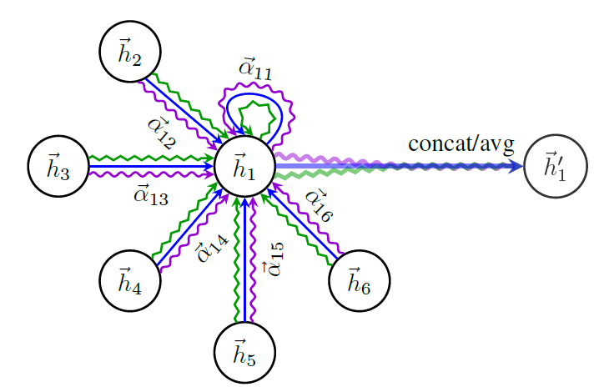






Related work
Graph Attention Networks
$$h_{i}$$
$$W$$
$$q$$
$$softmax_{j}$$
$$α_{ij}$$
$$h_{j}$$
$$W$$
Calculating attention coefficient
Multi-head attention on neighborhood

Slide 8








Related work
Pair-wise masked attention
$α_{ij}=\frac{exp⁡(LeakyReLU\left(q\left[Wh_{i}||Wh_{j}\right]\right))}{Σ_{k∈𝒩_{i}}exp⁡(LeakyReLU\left(q\left[Wh_{i}||Wh_{j}\right]\right))}$
$W$: a weight matrix
$q$: a weight vector
$$h_{i}$$
$$W$$
$$q$$
$$softmax_{j}$$
$$α_{ij}$$
$$h_{j}$$
$$W$$
Calculating attention coefficient
Notes:
원래는 소프트맥스 분모에 모든 노드에 대해 하지만 여기선 이웃노드에 대해서만 계산함 (masked attention)

Slide 9

Related work
Generating the embedding of a node
$h_{i}^{′}=||_{k=1}^{K}σ\left(Σ_{j∈𝒩_{i}}α_{ij}^{k}W^{k}h_{j}\right)$
$||$: concatenate operation
$K$: the number of heads
Multi-head attention on neighborhood

Slide 10
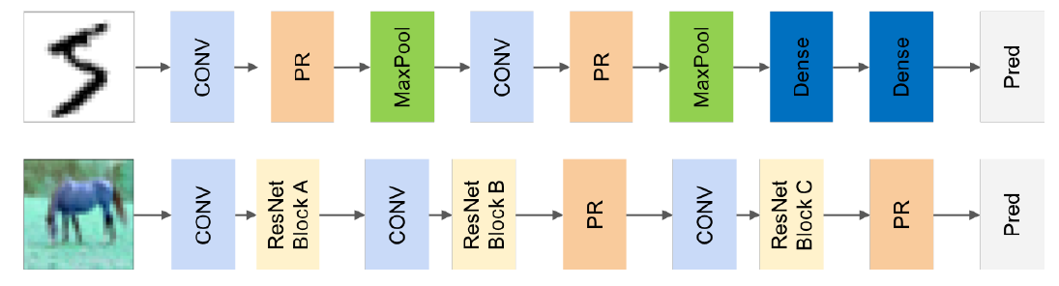
Proposed Method
Peer Regularization layer (PR)
Added into traditional CNNs
PR-LeNet
PR-ResNet
Notes:
원래는 소프트맥스 분모에 모든 노드에 대해 하지만 여기선 이웃노드에 대해서만 계산함 (masked attention)

Slide 11
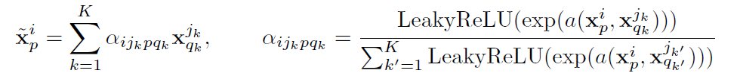
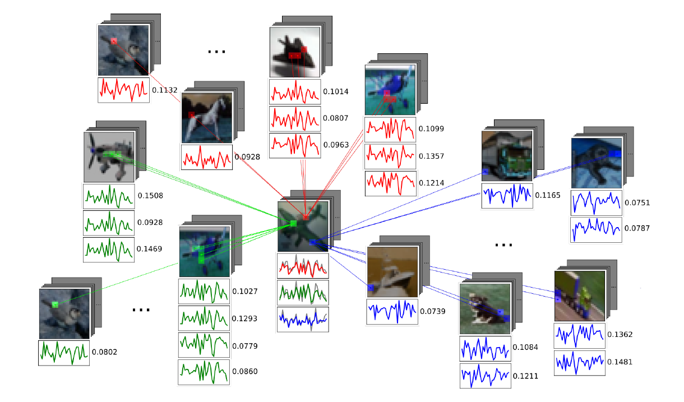

Proposed Method
For all pixels in an image $i$, get K nearest neighbor pixels from other images in same batch
Update the pixel’s feature using the generated graph with GAT
$x_{p}^{i}$: $p^{th}$ pixel of image $i$
Notes:
원래는 소프트맥스 분모에 모든 노드에 대해 하지만 여기선 이웃노드에 대해서만 계산함 (masked attention)

Slide 12
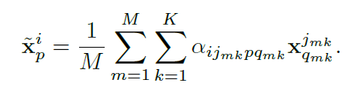
Proposed Method
Searching all training samples to build a graph is not computationally feasible
Get M sample batches by Monte Carlo Approximation
M=1 during training, and larger value in inference
Notes:
원래는 소프트맥스 분모에 모든 노드에 대해 하지만 여기선 이웃노드에 대해서만 계산함 (masked attention)

Slide 13
Experiments
Datasets and target models
MNIST → LeNet-5
CIFAR-10 → ResNet-32
CIFAR-100 → ResNet-110
Attack methods
Gradient Descent attack
FGSM
PGD (multi-step FGSM)
DeepFool – universal adversarial example
Black-box attack
Sample-specific adversarial perturbation

Slide 14
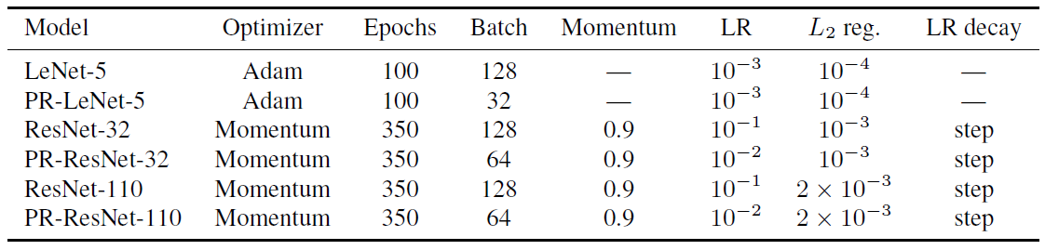
Experiments
Settings
Timing
2x-3x slower than existing models

Slide 15
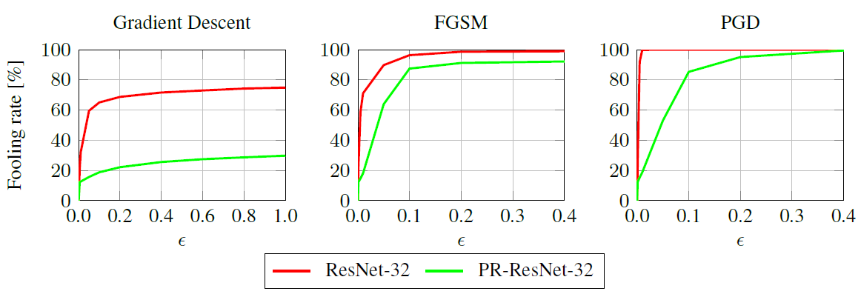
Experiments
Experiments on sample-specific adversarial perturbation on CIFAR-10

Slide 16
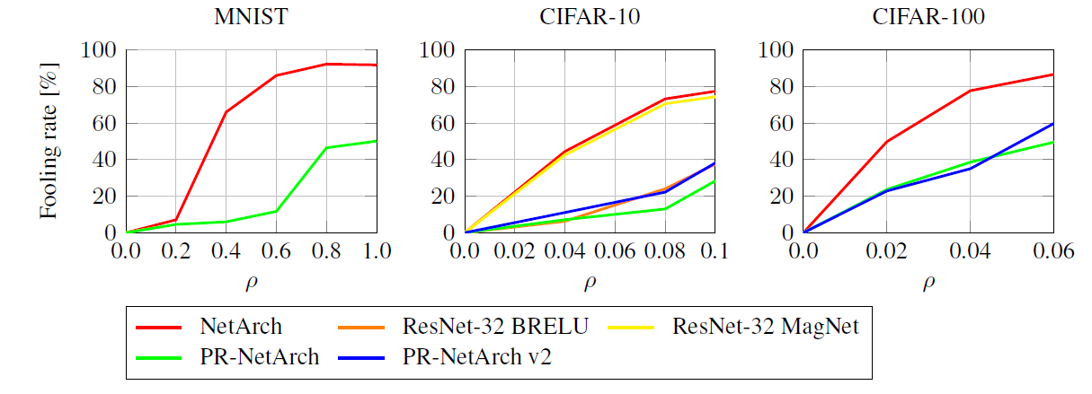
Experiments
Experiments on universal adversarial example

Slide 17
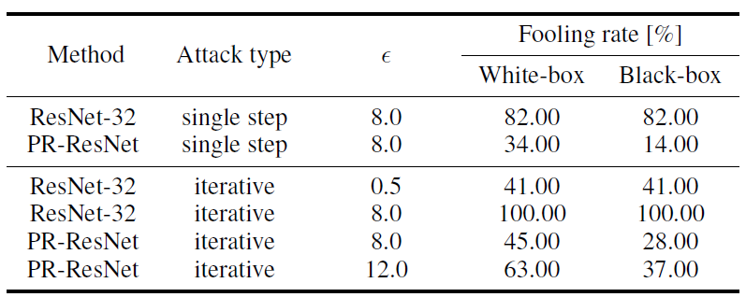
Experiments
Experiments on black-box attack

Slide 18
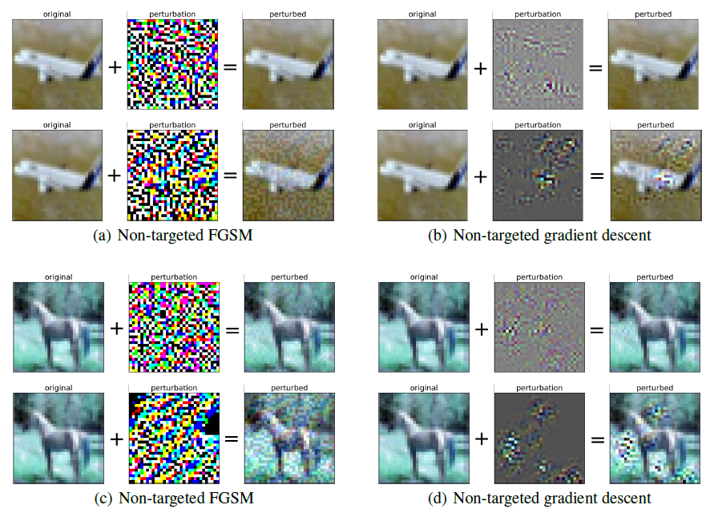
Experiments
ResNet-32
PR-ResNet-32
ResNet-32
PR-ResNet-32
The amount of noise required to fool PeerNets is much higher

Slide 19
Conclusion
A novel family of deep networks alternating Euclidean and Graph convolutions
Simple to use and can be added to any baseline model with minimal changes
Scalability and computational cost issues are still remained

