Slide 1

Semi-supervised Classification with Graph Convolutional Networks
Thomas N. Kipf and Max Welling
ICLR 2017
Yunseob Shin
Information & Intelligence System Lab.
Sungkyunkwan University
2018/11/20

Slide 2
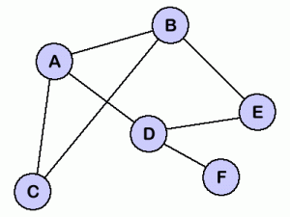
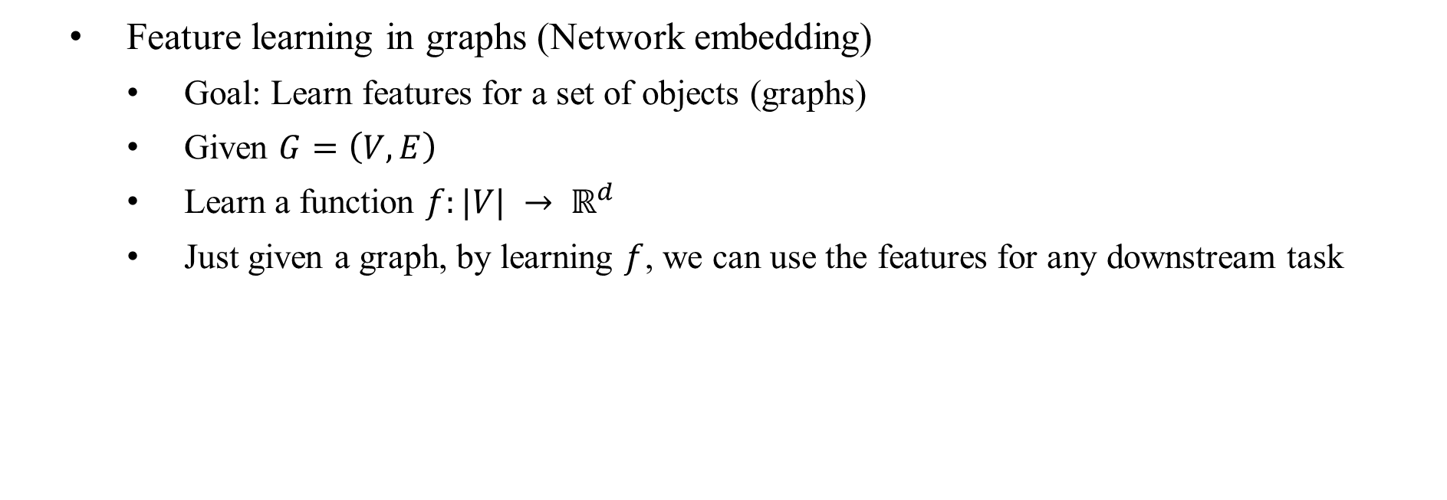
Introduction
Feature learning in graphs (Network embedding)
Goal: Learn features for a set of objects (graphs)
Given $G=\left(V, E\right)$
Learn a function $f:|V| → ℝ^{d}$
Just given a graph, by learning $f$, we can use the features for any downstream task
A
B
C
D
E
F
Notes:
downstream task: learning algorithm, model

Slide 3
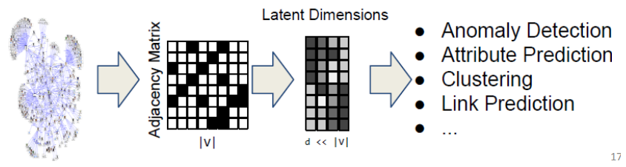
Introduction
Why network embedding?
Vector spaces are more amenable to data science than graphs
We can only use specific mathematics and toolsets for graph data
Notes:
downstream task: learning algorithm, model

Slide 4
Introduction
Matrix Factorization
Not incremental
No parameter sharing
Not incorporate node features
Network Embedding
Random Walk
Graph Neural Network
Graph Convolutional Network

Slide 5
Introduction
Contributions
Slight variation of Graph Neural Network (GNN)
More parameter sharing
Fast and scalable semi-supervised classification of nodes in a graph

Slide 6

Related work
What is GNN?
Given a graph $G=\left(V, E\right)$
The adjacency matrix $A$
node features $X∈R^{m×\left|V\right|}$
Any attribute of a node
category, text, image, personal profile
structural attributes: degrees, clustering coefficients, etc.
one-hot encoding

Slide 7
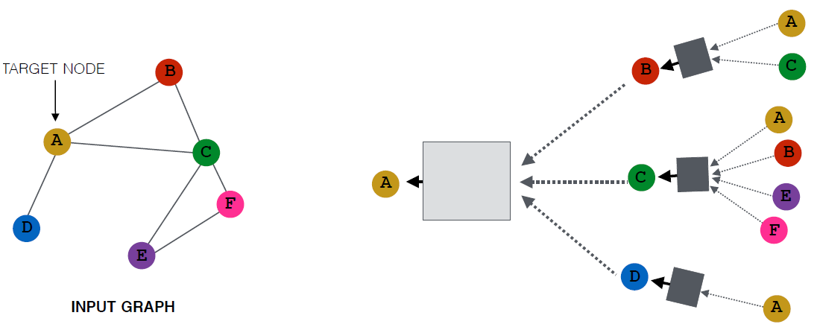
Related work
What is GNN?
Key Idea: Neighborhood Aggregation
generate node embeddings based on local neighborhood
Nodes aggregate information from their neighbors using neural networks

Slide 8
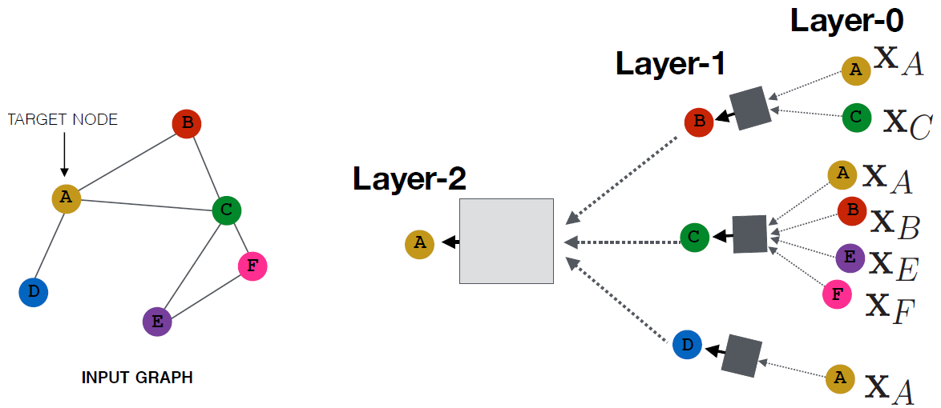
Related work
What is GNN?
Nodes have embeddings at each layer
Input embeddings (features) in Layer-0
Depth can be arbitrary

Slide 9
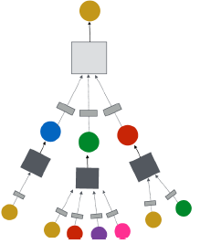
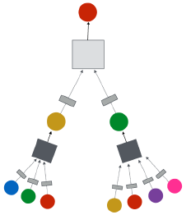
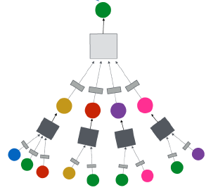
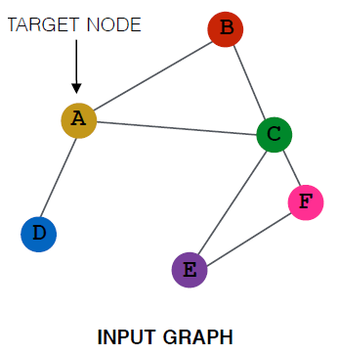

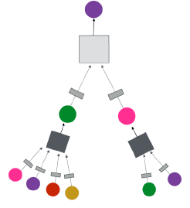
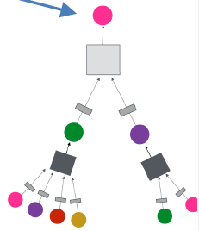
Related work
What is GNN?
Intuition: Network neighborhood defines a computation graph
A
B
C
D
E
F

Slide 10
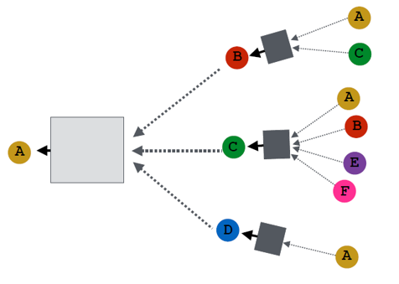
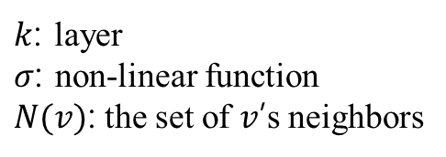
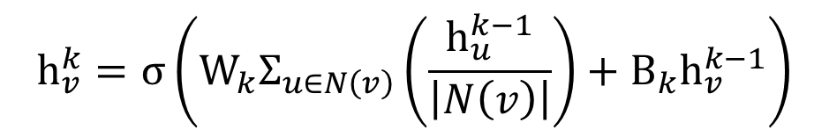

Related work
$$h_{v}^{0}=x_{v}$$
$$h_{v}^{k}=σ\left(W_{k}Σ_{u∈N\left(v\right)}\left(\frac{h_{u}^{k−1}}{\left|N\left(v\right)\right|}\right)+B_{k}h_{v}^{k−1}\right)$$
$k$: layer
$σ$: non-linear function
$N(v)$: the set of $v$’s neighbors

Slide 11
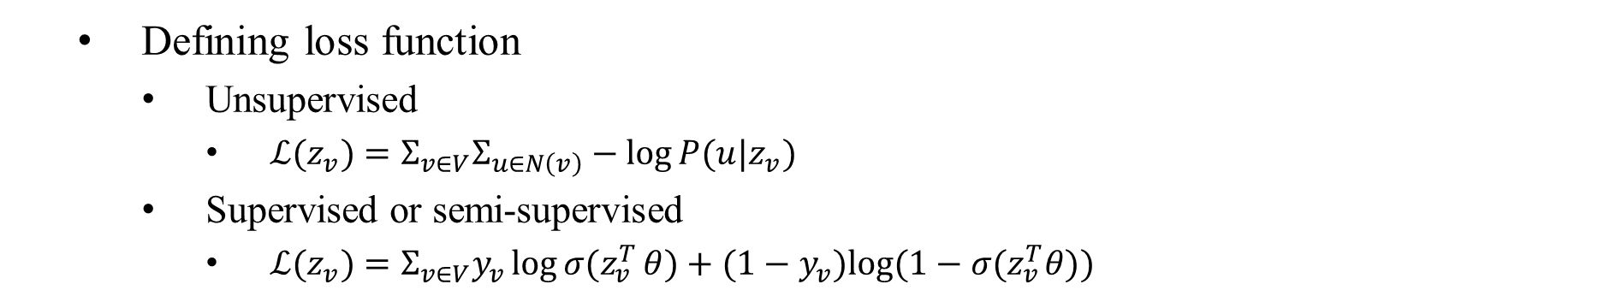

Related work
$$z_{A}$$
Defining loss function
Unsupervised
$ℒ(z_{v})=Σ_{v∈V}Σ_{u∈N\left(v\right)}−\log{P(u|z_{v})}$
Supervised or semi-supervised
$ℒ(z_{v})=Σ_{v∈V}y_{v}{\log{σ(z}}_{v}^{T}θ)+(1−y_{v})log⁡(1−σ(z_{v}^{T}θ))$

Slide 12
Related work
Parameter Sharing
Train for A
Train for B

Slide 13
Related work
Parameter Sharing
Train for E
No need much further training for C, D, F

Slide 14
Related work
Incremental learning
simple to generate embeddings for new nodes
G

Slide 15
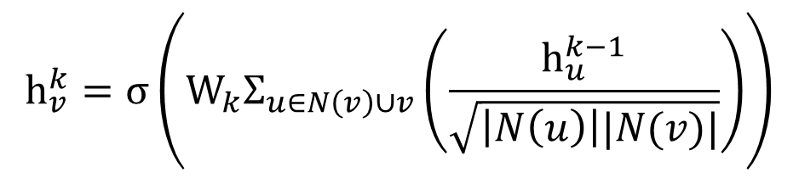
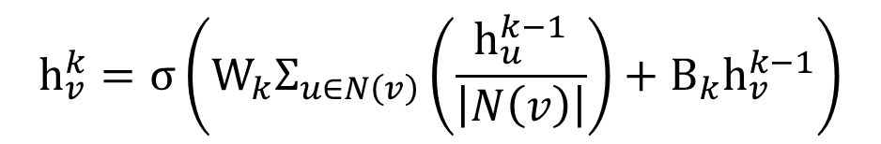
Proposed method
Graph Convolutional Network
Slight variation on the neighborhood aggregation
Basic
GNN
$$h_{v}^{k}=σ\left(W_{k}Σ_{u∈N\left(v\right)}\left(\frac{h_{u}^{k−1}}{\left|N\left(v\right)\right|}\right)+B_{k}h_{v}^{k−1}\right)$$
$$h_{v}^{k}=σ\left(W_{k}Σ_{u∈N\left(v\right)∪v}\left(\frac{h_{u}^{k−1}}{\sqrt{\left|N\left(u\right)\right||N(v)|}}\right)\right)$$
GCN
Penalty for
Popular nodes
More parameter sharing

Slide 16
Proposed method
Graph Convolutional Network
A
B
C
D
B
A
C
D

Slide 17


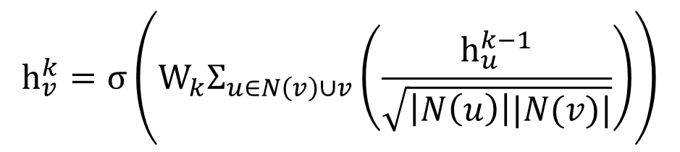

Proposed method
Graph Convolutional Network
Effective implementation using batch operations
$O\left(\left|E\right|\right)$ time complexity
$$h_{v}^{k}=σ\left(W_{k}Σ_{u∈N\left(v\right)∪v}\left(\frac{h_{u}^{k−1}}{\sqrt{\left|N\left(u\right)\right||N(v)|}}\right)\right)$$
$$H^{k}=σ({\tilde{D}}^{−\frac{1}{2}}\tilde{A}{\tilde{D}}^{−\frac{1}{2}}H^{k−1}W_{k−1})$$
where$\tilde{A}=A+I$, $D_{ii}=Σ_{j}A_{i,j}$

Slide 18
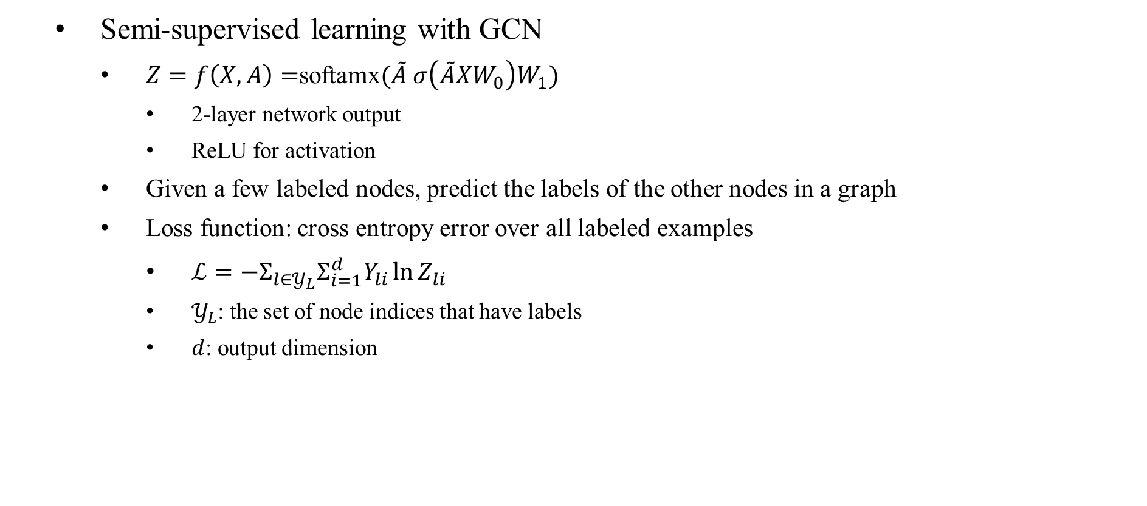
Proposed method
Semi-supervised learning with GCN
$Z=f\left(X,A\right)=$softamx$(\tilde{A} σ\left(\tilde{A}XW_{0}\right)W_{1})$
2-layer network output
ReLU for activation
Given a few labeled nodes, predict the labels of the other nodes in a graph
Loss function: cross entropy error over all labeled examples
$ℒ=−Σ_{l∈𝒴_{L}}Σ_{i=1}^{d}Y_{li}\ln{Z_{li}}$
$𝒴_{L}$: the set of node indices that have labels
$d$: output dimension

Slide 19
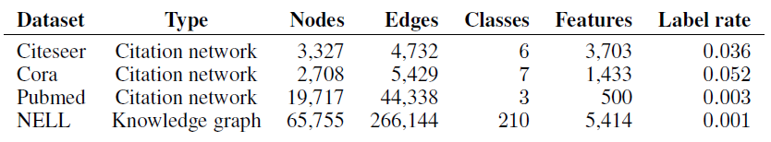
Experiments
Datasets
Three citation networks
treated as undirected
use sparse bag of words as node feature
Knowledge graph and random graph
use one-hot encoding as node feature

Slide 20
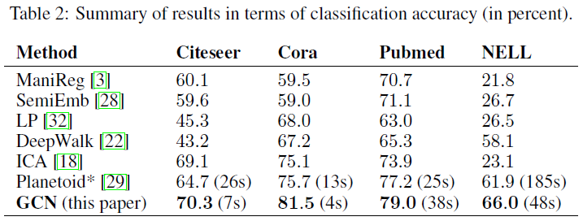
Experiments
Prediction results on a test set of 1,000 labeled examples
Settings
dropout rate: 0.5
epochs: 200
early stopping with window size of 10
L2 regularization

Slide 21
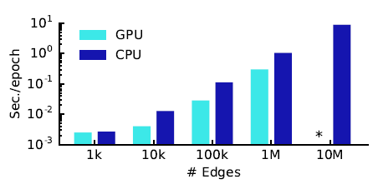
Experiments
Training time per epoch
* indicates out-of-memory

Slide 22
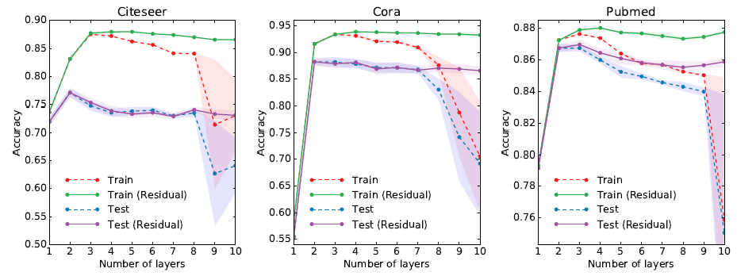
Experiments
Performance evaluation by number of layers
Residual: use skip-connection between hidden layers

Slide 23
Conclusion
Novel approach for semi-supervised classification on graph data
Efficient layer-wise propagation based on spectral convolutions on graphs
Limitations
Memory requirement
Limited to undirected graphs

