Slide 1
Computer Organization 2024 Assignment III

Slide 2
Overview
Caches enhance the processor performance by accommodating recent or frequent-used data items in the fast memories
To reduce memory access overhead, there are two ways for hardware-software co-design
Application-aware cache design
Cache-architecture aware memory access

Slide 3
Assignment
Part 1. (Programming)
Implement FIFO data cache replacement policy on Spike
Reduce memory access overhead of the given two programs
Part 2. (Demo)
Explain how the Spike cache replacement policy works
Explain the design philosophy of your revised programs, e.g., the techniques/concepts you used in the revised program

Slide 4
Part 1. Preliminary
Cache specifications
4 ways
8 sets
32 bytes cacheline
Miss penalty = 30 cycles
Hit latency = 1 cycle
Only RV64GC instruction set are allowed
To enable data cache in Spike simulator
Add –dc=<set>:<ways>:<cacheline>

Slide 5
Part 1. Implement FIFO in Spike
Implement FIFO data cache replacement policy to Spike
Two files to modify in Spike source code
{PATH_TO_SPIKE}/riscv/cachesim.h
{PATH_TO_SPIKE}/riscv/cachesim.cc
Recompilation is needed after implement FIFO replacement policy
Please refer to HW0 on NCKU Moodle
You can add new data structures in your implementation

Slide 6
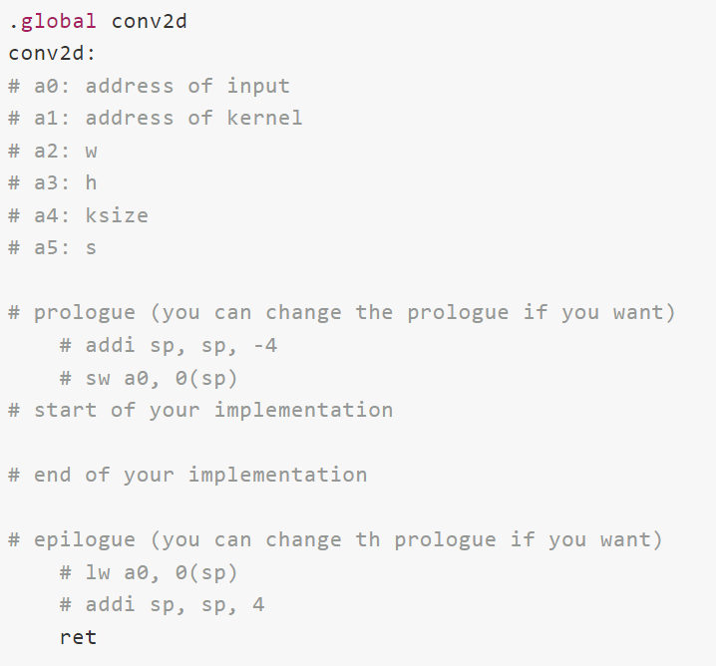
Part 1. 2D Convolution
Provided implementation is in:
{PATH_TO_HW3}/Q1/conv2d.S
Implement Your better version in:
{PATH_TO_HW3}/Q1/conv2d-better.S
Write in pure assembly code
https://riscv.org/wp-content/uploads/2015/01/riscv-calling.pdf

Slide 7
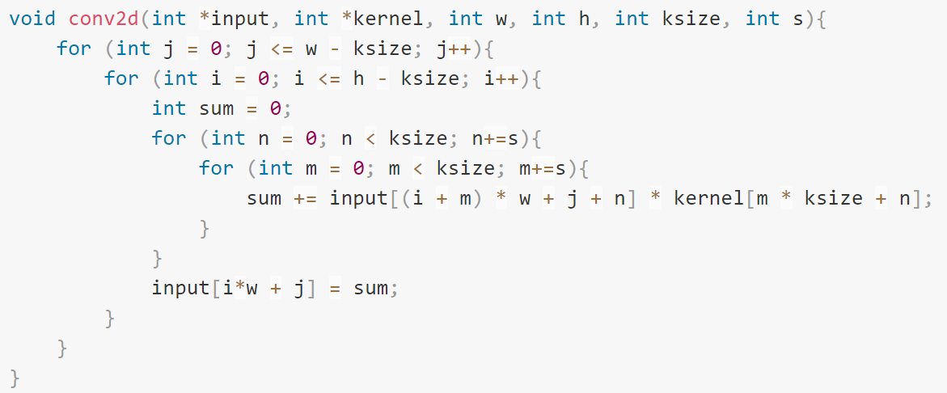
Part 1. 2D Convolution
This is the C code of original version (Q1/conv2d.S)
You can start from improve this C code first before delved into assembly code

Slide 8
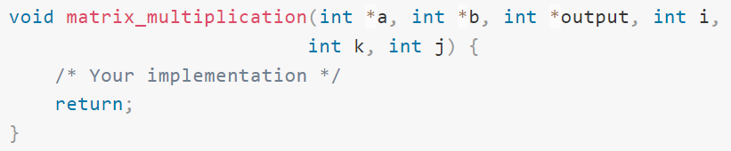
Part 1. Matrix Multiplication
Provided implementation is in:
{PATH_TO_HW3}/Q2/mm.c
Implement your better version in:
{PATH_TO_HW3}/Q2/mm-better.c
Write in C code

Slide 9
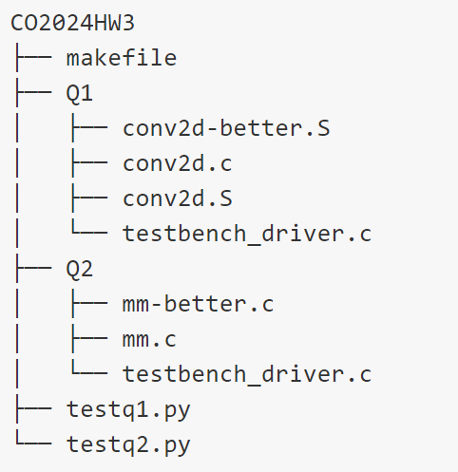
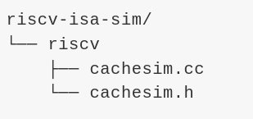
Files you need to change in this assignment

Slide 10
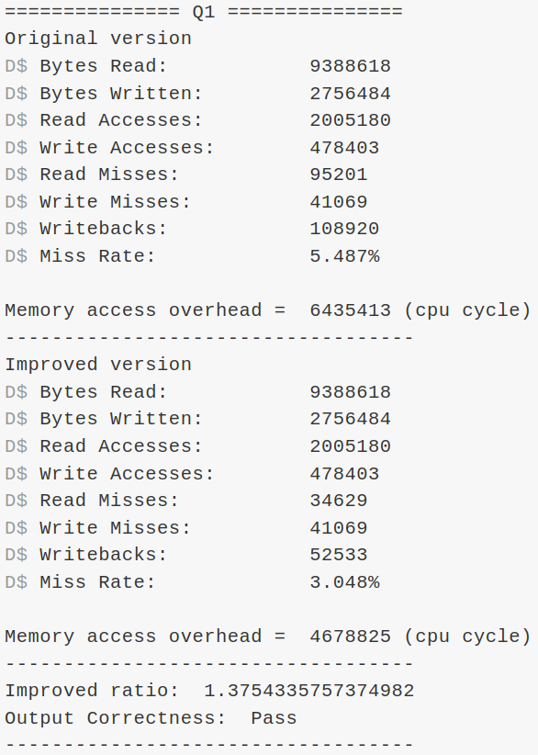

Test Your Code
Use `make check` for checking the algorithm correctness and the memory access overhead
Cache miss penalty is 30 cycles in this assignment, and the cache hit latency is 1 cycle
Memory Access Cycles:
Improved ratio:

Slide 11
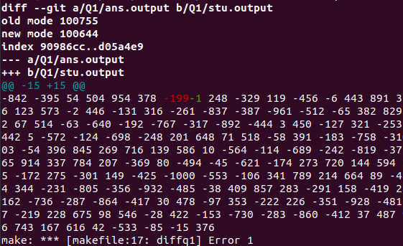
Test Your Code
Use `make diffq1` to check the ouput:
This will compare your 2D convolution output with correct answer
Use `make diffq2` to check the output:
This will compare your matrix multiplication output with correct answer
(Example) make diffq1

Slide 12
Part 2. Demo
Demo session on
June 20-21, 2024 (all days)
Demo session at
Room 65704 (Advanced Systems Research Lab)
We will download the code you submit before June 19, 2024 23:59 in demo section. You don't need to prepare PC in demo session
Please register your preferred time on the Google Sheet on NCKU Moodle

Slide 13
Scoring Criteria
Part 1. (Programming) 40%
Implement FIFO data cache replacement policy on Spike (10%)
Reduce the memory access overhead of 2D convolution (15%)
Improved > 1.3 (15/15)
Improved > 1 (10/15)
Reduce the memory access overhead of matrix multiplication (15%)
Improved > 1.8 (15/15)
Improved > 1 (10/15)
Note: If you cannot implement FIFO replacement policy, you can still work on other questions

Slide 14
Scoring Criteria
Part 2. (Demo) 80%
Explain how cache mechanism work in Spike simulator (10%)
Explain how you reduce overhead on 2D convolution (25%)
Explain how you reduce overhead on matrix multiplication (25%)
Bonus: Does your method can apply on any matrix size? Why or Why not? (20%)

Slide 15
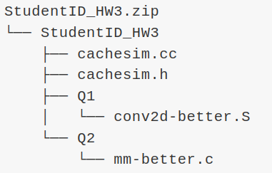
Submission
Compress your source files into a zip file
Submit your zip file to NCKU Moodle
The files organization of your zip file should be as follow
NOTE: Change all StudentID to your student ID, e.g. F12345678_HW3.zip
Incorrect format will lose 10 points

Slide 16
Submission
Office hours: Every Friday 10 a.m. to 12 p.m.
At room 65704 (Advanced Systems Research Lab)
If you have any problem, please contact TA via Lab's email
asrlab@csie.ncku.edu.tw
Email subject starts with "[Comp2024]"
Deadline: 2024/06/19 23:59
Late submission are limited to one week after deadline, and the score for late submissions will be reduced to 70%

Slide 17
QA

Slide 18
Thanks.

