Slide 1


Smart Device Usage of Customers
Customers using non-Bellabeat Smart Devices
Presented By: Yunus Selim Aytekin
Last Updated: September 9th, 2024

Slide 2
Smart Device Usage of Customers
Purpose Statement (What is the purpose of this slide?)
Description of All Data Sources Used
Process of Data
Story (Analysis of Data)
Conclusion

Slide 3
Purpose Statement
I am going to analyse consumers' data who use non-Bellabeat devices to understand why they chose other devices.
Understanding those consumers' interests and their use of devices can help us attract them to our devices.

Slide 4
Description of All Data Sources Used
I used FitBit Fitness Tracker Data for analysis. It includes information about daily activity, steps, heart rate, etc.
I analysed five of them that can be used to explore users' habits.

Slide 5

Process of Data
I imported pandas and sqlite3 libraries for data cleaning and manipulation.
I also used Matplotlib and Seaborn libraries for data visualisation
I turned date columns to Timestamp format with pandas to manipulate the data with SQL
I used different date functions to turn them into the format I can use.
And I did all of the processes above for five tables.
Lastly, I used the Pearson correlation coefficient to find the correlation between variables.

Slide 6
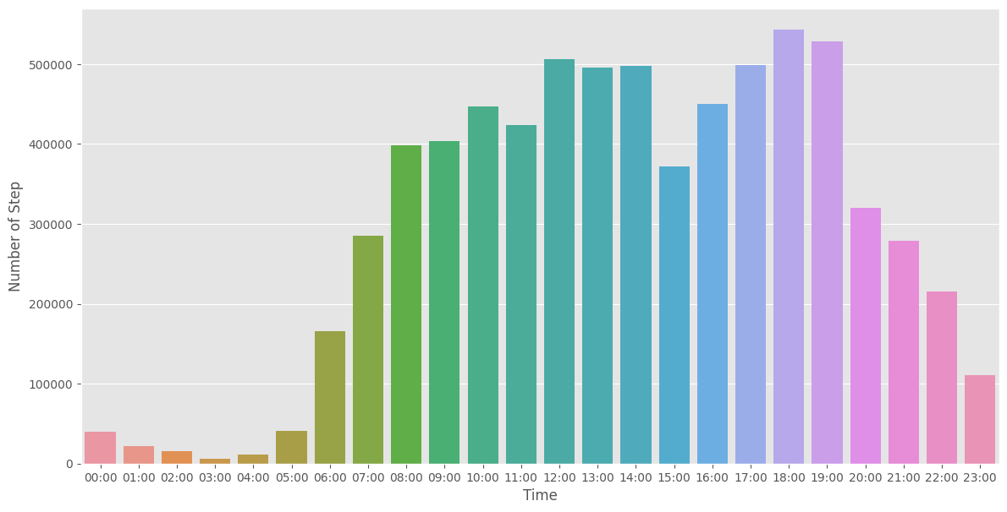
Story Step-Time Relation
The number of steps varies widely over time.
The number of steps increases during active hours (8:00 to 19:00).

Slide 7
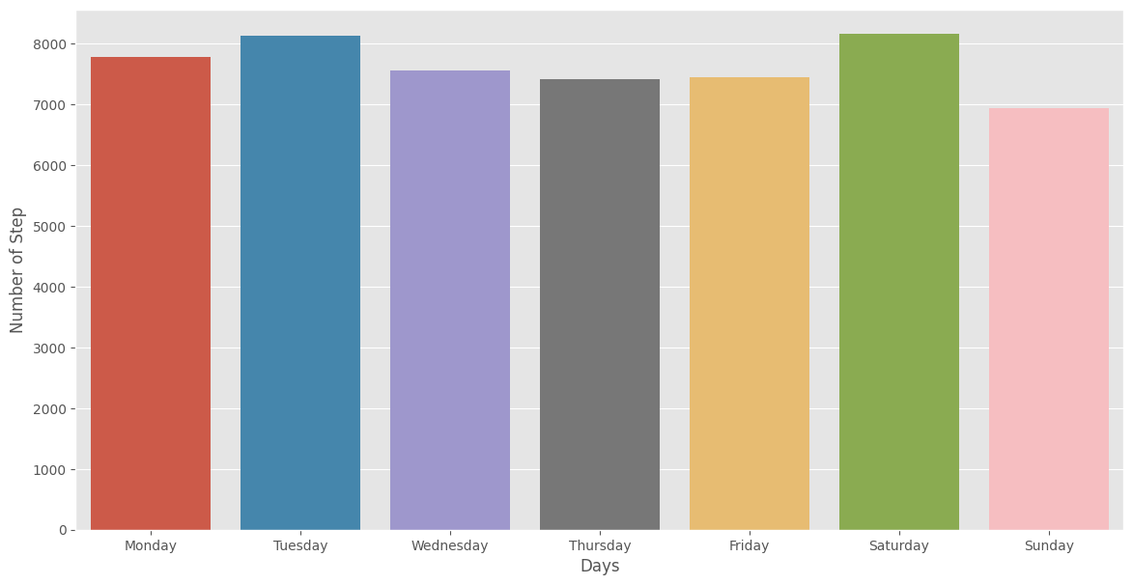
Step-Weekday Relation
Little to no correlation between the number of steps and days.

Slide 8
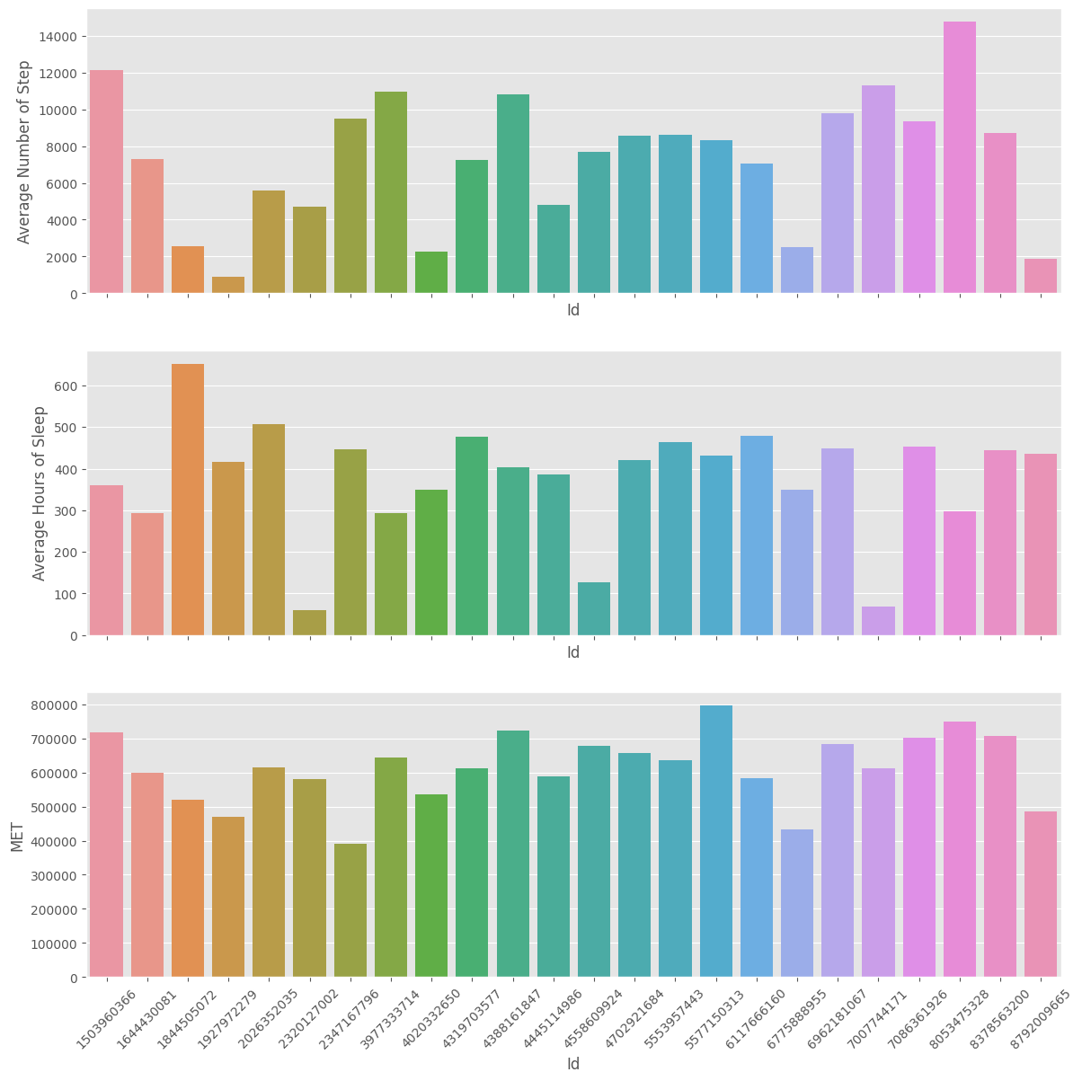
Hours of Sleep Relation
Positive correlation between MET(metabolic equivalent of task) and average number of steps
Average hours of sleep affect MET value (too low and high hours of sleep reduce MET value).

Slide 9
Conclusion

Slide 10
Conclusion
To increase the MET value, just walking or running isn't enough.
We need to increase the sleep duration and quality of our customers.
We should update our app to be sensitive to sleep duration and quality.
Decisions that the app makes should distinguish between active hours and sleeping hours.

Slide 11

Thank you

