Slide 1


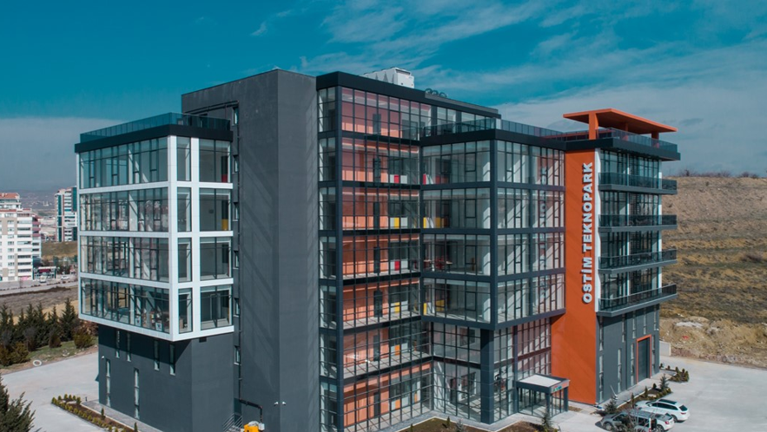
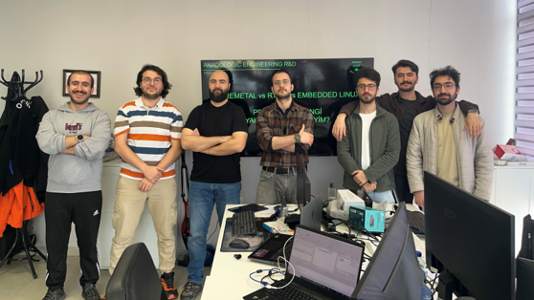
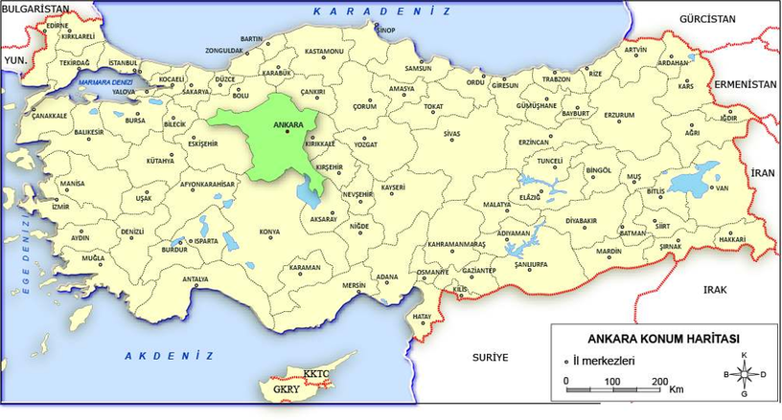
ANADOLOGIC
2024 - ...

Slide 2
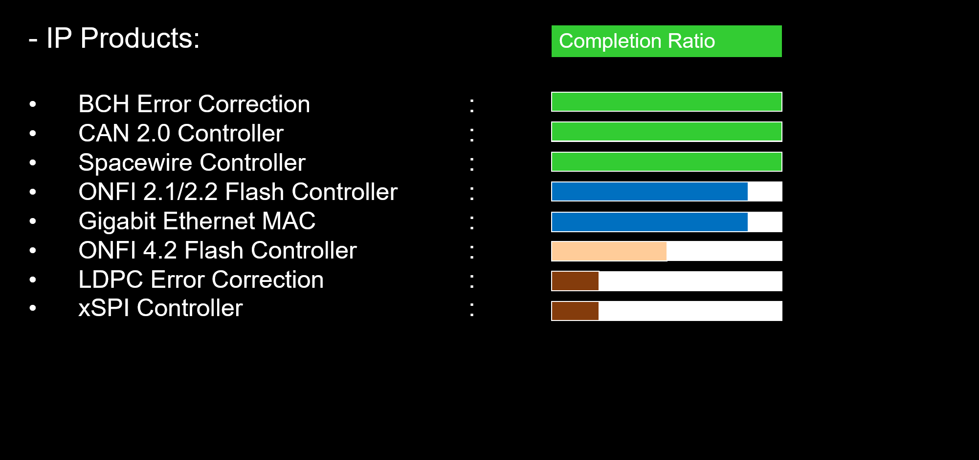
ANADOLOGIC
IP Portfolio

Slide 3

ANADOLOGIC
REFERENCES

Slide 4
PROJECT
FPGA-accelerated industrial inspection
Real-Time Defect Detection with AMD Kria KR260
Notes:
2

Slide 5

OUTLINE
What we'll cover today
1
Problem
2
Solution & System Overview
3
Developing on Kria
4
Inference
5
Preprocessing
6
Our Model
7
Pipeline
8
Results & Conclusion

Slide 6
PROBLEM
What are we solving?
The Challenge
Industrial lines need fast, accurate defect detection
CPU: Bottleneck at preprocessing and AI inference
GPU: High power + non-deterministic latency
Our Goal
Fast & accurate detection: FPGA-based pipeline with deterministic latency
No CPU bottleneck: Hardware pre-processing + DPU inference fully offloaded to PL
No GPU power/latency issues: Kria KR260 gives low power, real-time deterministic processing

Slide 7
SOLUTION OVERVIEW
End-to-end defect detection on KR260
One board does it all: capture on the PS, accelerate preprocessing and inference in the PL, then activate the actuator
Camera
GigE · Mono8
Capture
Aravis (PS)
Preprocess
v_multi_scaler (VVAS) (PL)
Inference
DPU B4096 (PL)
Actuator
OK / Defective

Slide 8
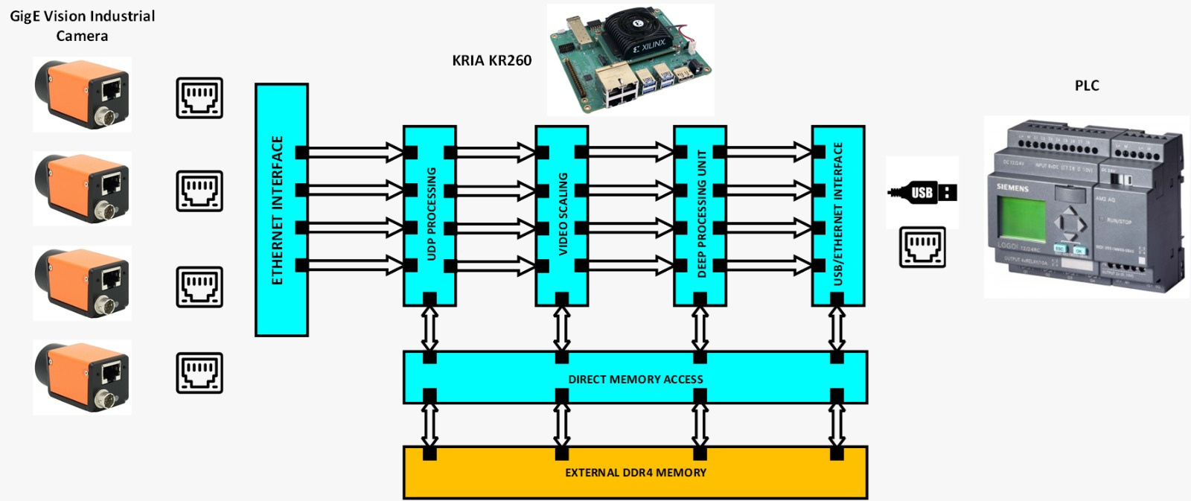
SYSTEM OVERVIEW
How the system works

Slide 9
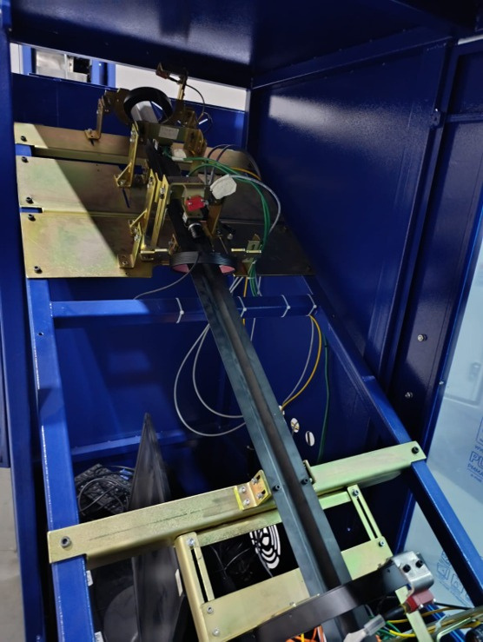
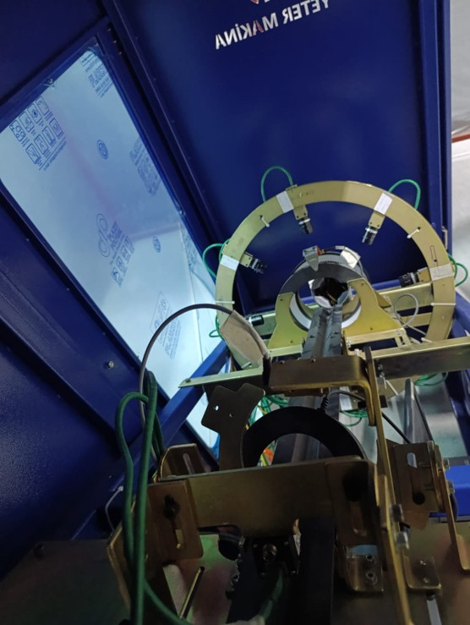
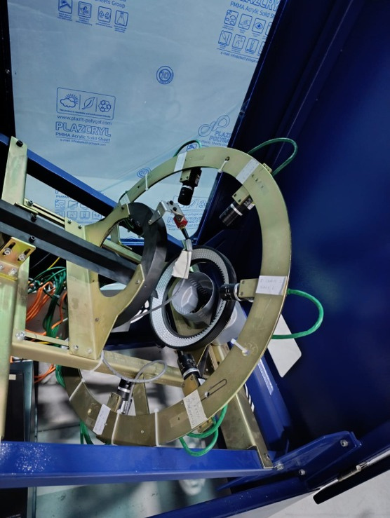
CARTRIDGE CASE INSPECTOR
Scratch, dent, crack inspection

Slide 10
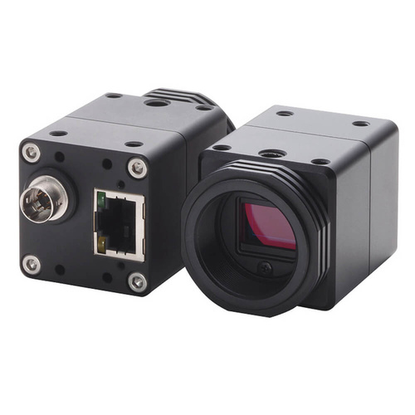
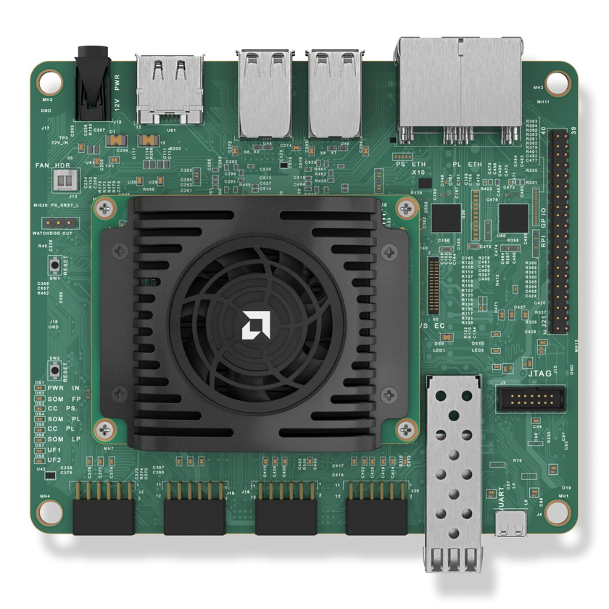
DEVELOPING ON KRIA
System Hardware
Camera
OMRON SENTECH STC-MBS202POE
Protocol: GigE Vision 2.1
Pixel Format: Mono8
Interface: Gigabit Ethernet (PoE)
Processing Unit
SoM: Kria K26
Zynq UltraScale+ MPSoC
4× ARM Cortex-A53
FPGA fabric (PL)
Carrier Board: KR260
Gigabit Ethernet, USB 3.0, DisplayPort
OS/Environment: Ubuntu, PetaLinux

Slide 11
DEVELOPING ON KRIA
What is the Kria SOM?
AMD Kria K26 SOM designed for edge AI, robotics and industrial applications
Contains both ARM processors (PS) and FPGA fabric (PL), ZynqMP SoC
Runs standard Ubuntu, no custom OS needed
Low-power consumption, suitable for industrial environments
Kria KR260 Robotics Starter Kit
https://www.amd.com/en/products/system-on-modules/kria/k26/kr260-robotics-starter-kit.html

Slide 12
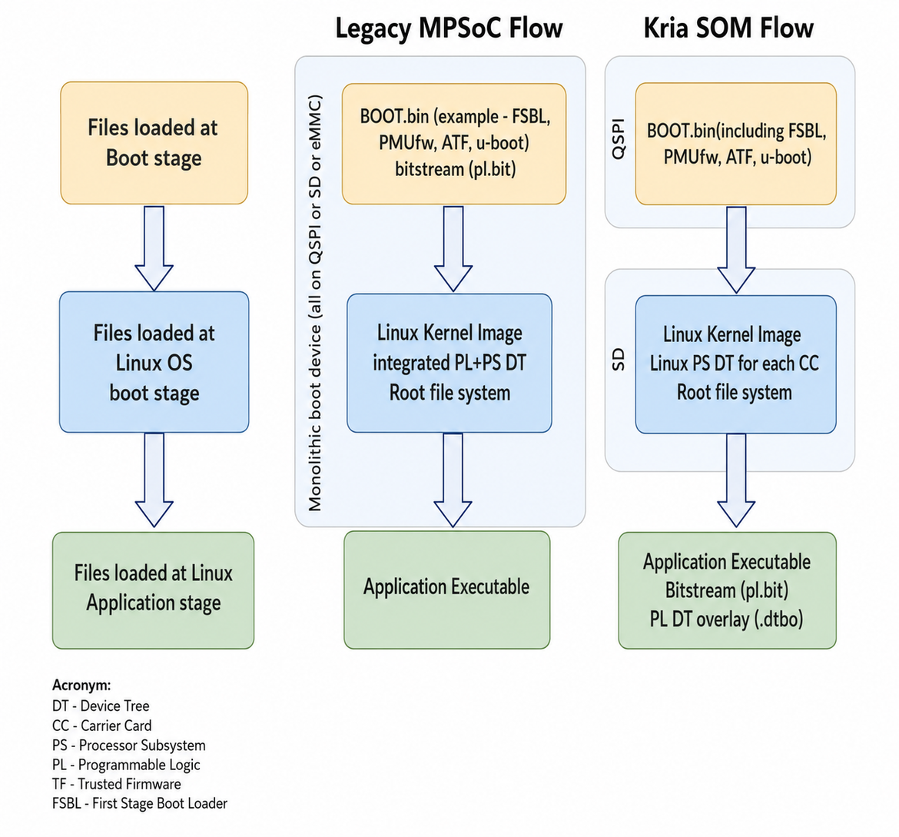
DEVELOPING ON KRIA
Bitstream Management: Legacy vs Kria SOM
Legacy MPSoC Flow (static boot image flow)
Bitstream baked into BOOT.bin and loaded at boot
One OS per app
Reboot to switch app
Kria SOM Flow (KV260, KR260)
Bitstream not in boot image and loaded at runtime
Single OS, multiple apps
No reboot to switch app
https://xilinx.github.io/kria-apps-docs/creating_applications/2022.1/build/html/docs/bitstream_management.html

Slide 13
DEVELOPING ON KRIA
Producing the PL: Vivado Flow vs Vitis Flow
Vivado flow
Hand-built block design in IP Integrator
You wire every IP (DPU, scaler, VDMA) manually
Maximum control, most manual effort
Vitis flow (our choice)
Start from a base platform (AMD-provided or custom) + accelerator kernels
The tool links the platform + accelerator kernels (e.g. DPU, multiscaler) automatically, no manual wiring
Skips re-synthesizing the platform each iteration, only the kernel is synthesized
Bottom line: we use the Vitis acceleration flow, less manual wiring and reusing the platform saves synthesis time

Slide 14
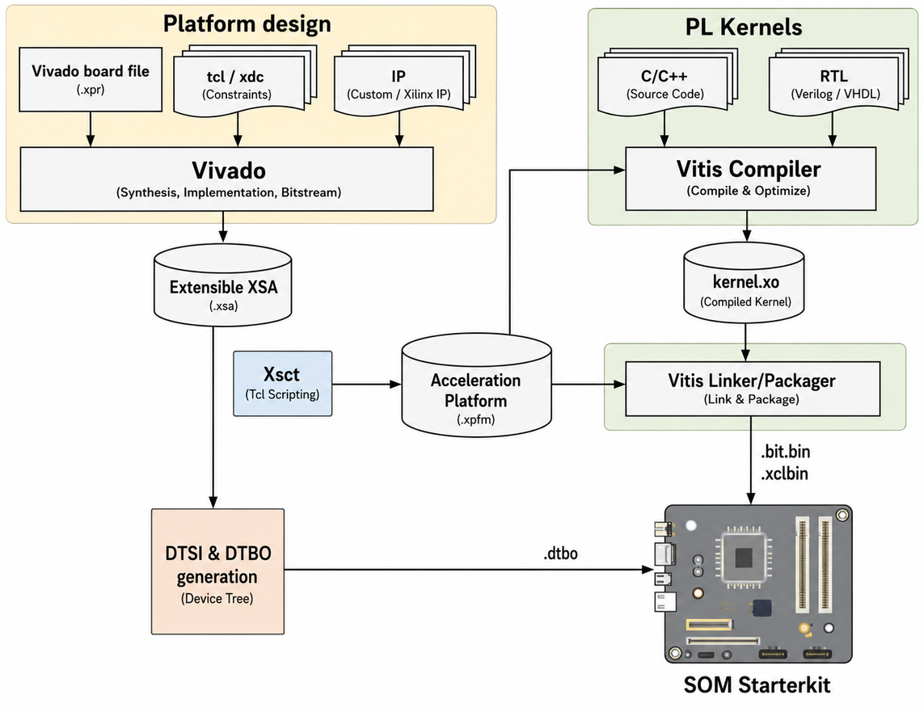
DEVELOPING ON KRIA
Vitis Acceleration Flow
Platform + Accelerators → v++ --link → 3 output files
Platform (.xpfm): KR260 base hardware design, two options:
Use AMD provided platform (e.g. kv260_ispMipiRx_vcu_DP, kr260_pmod_gps)
Create custom platform with Vivado
Accelerators (.xo): PL kernels written in HLS or RTL
v++ --link: combines platform + accelerators → generates .bit.bin + .xclbin + .dtbo
https://xilinx.github.io/kria-apps-docs/creating_applications/2022.1/build/html/docs/overview.html

Slide 15
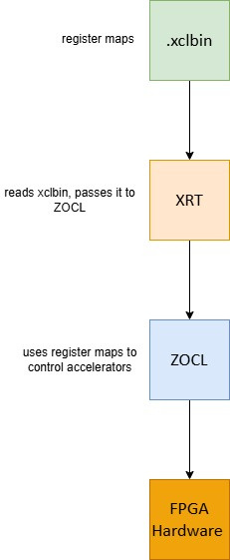
DEVELOPING ON KRIA
Runtime Software Stack: XRT & ZOCL
Run Phase
Load: overlay is activated at runtime via the Linux FPGA manager (xmutil loadapp) without a reboot
.bit.bin → programs the PL fabric
.dtbo → tells Linux what hardware appeared in PL
Run: once active, the application drives the accelerators through XRT + ZOCL
XRT (Xilinx Runtime): Software library running on PS (ARM) side that manages buffer allocation, DMA, kernel control
ZOCL (Zynq OpenCL driver): Linux kernel driver that physically maps/drives the PL registers
.xclbin → read by XRT for register maps + kernel metadata

Slide 16
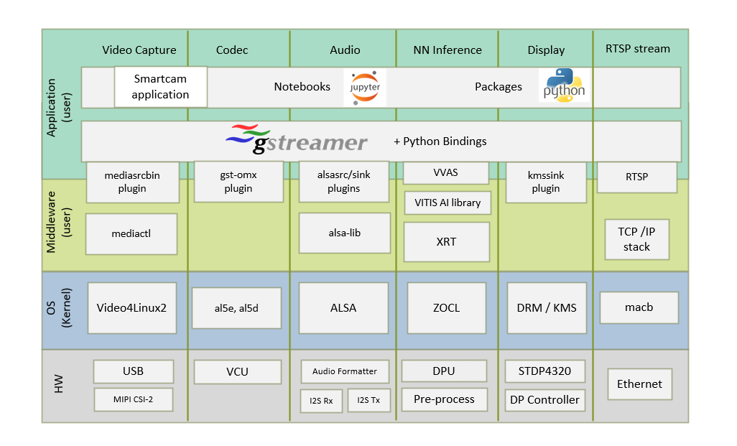
OUR IMPLEMENTATION
Custom FPGA overlay
Custom FPGA overlay for Kria KR260 targeting real-time industrial defect detection
Camera: OMRON SENTECH STC-MBS202POE — GigE Vision/ Mono8
Platform: Minimal custom Vitis platform (clock/interrupt/AXI only, no extra fixed IP), built in Vivado
Accelerators: DPU B4096 (Inference) + v_multi_scaler (HW preprocessing)
Software stack: Ubuntu 22.04 / XRT 2.15 / Vitis AI 2.5 / VVAS 2.0 / GStreamer / Aravis
Build flow: Vitis Acceleration Flow → v++ --link → .bit.bin + .xclbin + .dtbo
Output: Binary defect classification — OK / Defective
Software Architecture of the Platform — Kria™ KV260 2022.1 documentation
Notes:
10

Slide 17
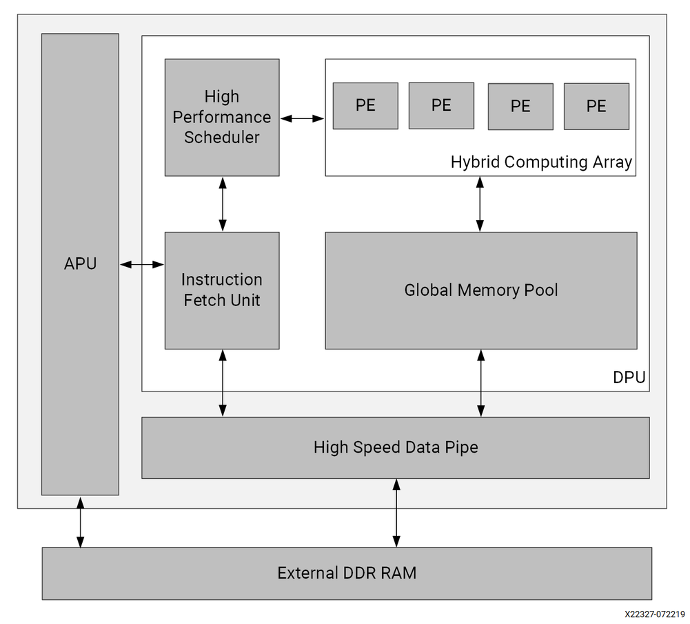
INFERENCE
What is the DPU?
Deep Learning Processing Unit: Xilinx's hardware IP for running neural network inference on the FPGA
Runs our custom-trained defect detection model directly in PL, no CPU involved
Comes in different sizes (architectures), B512 up to B4096
https://docs.amd.com/r/en-US/pg338-dpu/Core-Overview

Slide 18
INFERENCE
What do B4096 and B3136 mean?
The “B” number = peak operations per clock — what the convolution engine can do each cycle (1 MAC = 2 ops)
B4096 = 4096 ops/clock; B3136 = 3136; B512 = 512. Bigger = more parallel MAC units
Set by three parallelism factors: pixel (PP) × in-channel (ICP) × out-channel (OCP), × 2
– B4096 = 8 × 16 × 16 × 2
– B3136 = 8 × 14 × 14 × 2
More parallelism → higher throughput (more FPS) but more LUT / FF / BRAM / DSP
A bigger DPU is faster but costs more PL resources — the budget problem on the next slides
Peak operations per clock
B512
512
B1024
1024
B2304
2304
B3136
3136
B4096
4096

Slide 19
INFERENCE
Resource budget vs K26
We want a powerful DPU like B3136 or B4096 but BRAM isn't enough. What can we do?
Table 1: Resources of Different DPUCZDX8G Architectures
Table 2: PL Resources
DPUCZDX8G Architecture | LUT | Register | Block RAM | DSP
B512 | 26922 | 34543 | 72 | 118
B800 | 29721 | 41147 | 90 | 166
B1024 | 34074 | 48057 | 104 | 230
B1152 | 32169 | 47374 | 121 | 222
B1600 | 38418 | 58831 | 126 | 326
B2304 | 42127 | 68829 | 165 | 438
B3136 | 46714 | 79710 | 208 | 566
B4096 | 52161 | 98249 | 255 | 710
Resource | K26 SOM | Description
System logic cells | 256,200 | Programmable logic cells for available
CLB flip-flops | 234,240 | Configurable logic block (CLB): Total number of flip-flops
CLB LUTs | 117,120 | Configurable logic block: Total number of look-up tables
Distributed RAM (Mb) | 3.5 | Distributed memory
Block RAM | 144 | Number of 36 Kb block RAMs
Block RAM (Mb) | 5.1 | Total block RAM memory footprint
UltraRAM blocks | 64 | 288 Kb dual-port, 72-bit-wide memory with error correction
DSP slices | 1,248 | 27 x 18 signed multiplier with 48-bit adder/accumulator
CMTs | 4 | Clock management tiles
Video Codec | 1 | H.264 and H.265 supported simultaneous encode/decode
HDIO | 69 | High-density I/O supports 1.2V to 3.3V rails
HPIO | 116 | High-performance I/O differential pairs supports 1.0V to 1.8V rails
GTH transceivers | 4 | Up to 12.5 Gb/s serial transceivers
Transceiver fractional PLLs | 8 | Specialized PLL used in high-speed serial communication transceivers
PCI Express | 1 | Controller for integrated PCIe that is in addition to the integrated controller for PCIe in the PS
https://docs.amd.com/r/en-US/pg338-dpu/Resource-Utilization
https://docs.amd.com/r/en-US/ds987-k26-som/Programmable-Logic
Notes:
12

Slide 20
INFERENCE
The answer: URAM
Table 3: Resources of DPUCZDX8G using UltraRAM
We can use URAM so that we can use a powerful DPU architecture
Kria SOM has 64 URAM blocks available
Configuring DPU to use URAM frees up BRAM for the scaler
DPUCZDX8G Architecture | LUT | Register | Block RAM | UltraRAM | DSP
B512 | 26767 | 34538 | 0 | 18 | 118
B800 | 29578 | 41153 | 0 | 40 | 166
B1024 | 33752 | 48093 | 0 | 26 | 230
B1152 | 31901 | 47797 | 0 | 44 | 222
B1600 | 38197 | 58859 | 0 | 56 | 326
B2304 | 41736 | 69604 | 0 | 60 | 438
B3136 | 46260 | 80079 | 0 | 64 | 566
B4096 | 51843 | 98567 | 0 | 68 | 710

Slide 21
PRE-PROCESSING
Getting frames into the format the model expects
A trained CNN expects a fixed input tensor — our ResNet-18 needs a set size, layout and value range, not the raw camera frame
Color space conversion: the camera gives Mono8 (grayscale); the model needs a defined format and channel order (e.g. 3-channel BGR)
Scaling (resize): the full frame (e.g. 1920×1080) is resized to the model input (e.g. 224×224)
Normalization / quantization: pixel values are scaled to the INT8 range the DPU runs on
On the CPU this is a bottleneck → we offload it to the v_multi_scaler in PL (next slide)
Raw frame
1920×1080 Mono8
Color
Convert
Resize
224×224
Quantize
INT8
DPU

Slide 22
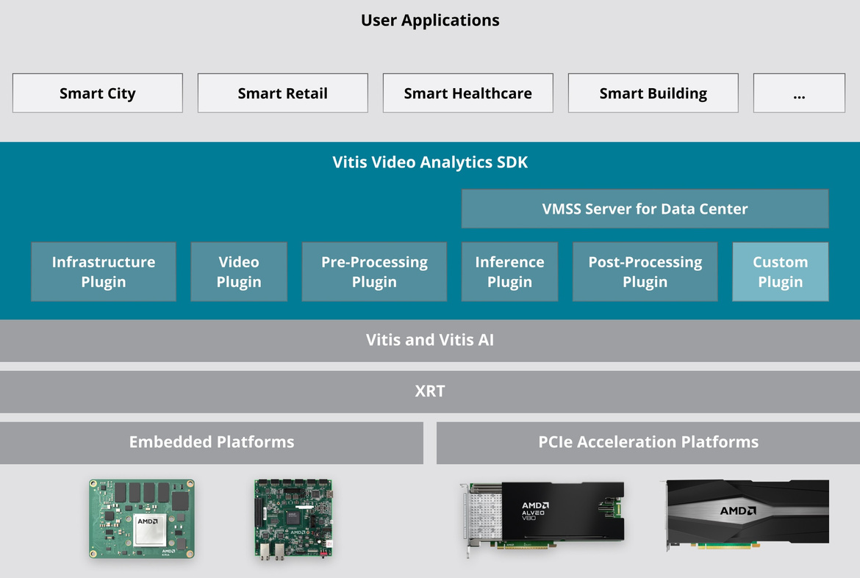
PRE-PROCESSING
What is VVAS / Multiscaler?
VVAS (Vitis Video Analytics SDK): Xilinx's open-source framework providing GStreamer plugins and hardware kernels for video processing on FPGA
v_multi_scaler: the HLS IP from VVAS that does hardware image preprocessing (resize, format conversion)
Takes the load off the CPU, frees ARM cores for other tasks
Inference runs through VART (Vitis AI Runtime), wrapped by the VVAS plugin
https://www.amd.com/en/developer/resources/vitis-video-analytics-sdk.html

Slide 23
OUR MODEL
Computer Vision Tasks
Classification
“What is in the image?”
One label for the whole image (e.g. OK / Defective)
▶ Our task
Detection
“What and where?”
A bounding box + a class for each object
Segmentation
“Which pixels?”
A per-pixel class mask - the exact object shape
We do binary classification: OK / Defective - one decision per frame

Slide 24
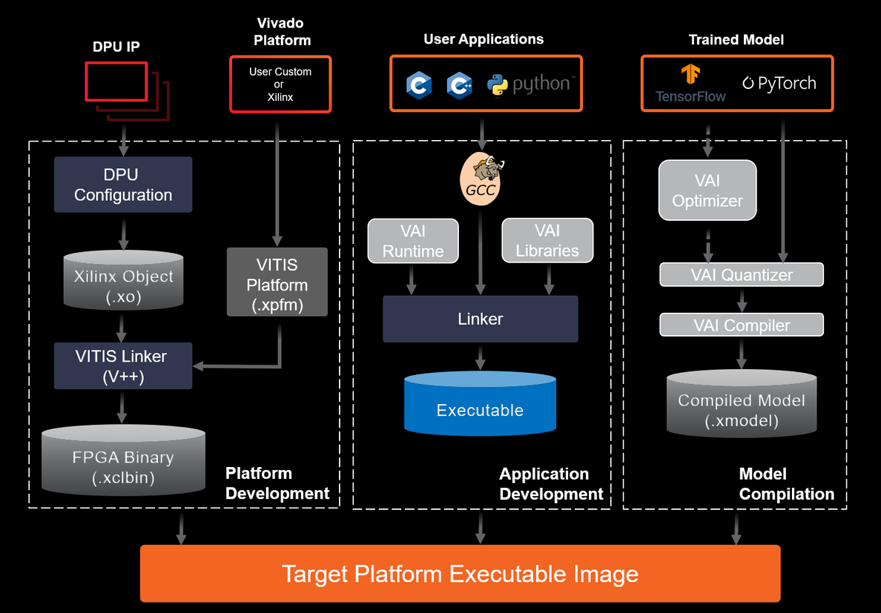
OUR MODEL
Custom defect detection, from PyTorch to the DPU
Model: ResNet-18 (PyTorch)
Binary classification: OK / Defective
From model to FPGA, Vitis AI 2.5 flow:
Train: ResNet-18 in PyTorch (FP32)
Quantize: Vitis AI 2.5 → INT8
Compile: Vitis AI compiler → .xmodel for the DPU
Deploy: Runs on DPU
https://xilinx.github.io/Vitis-AI/3.0/html/docs/workflow-model-deployment.html

Slide 25
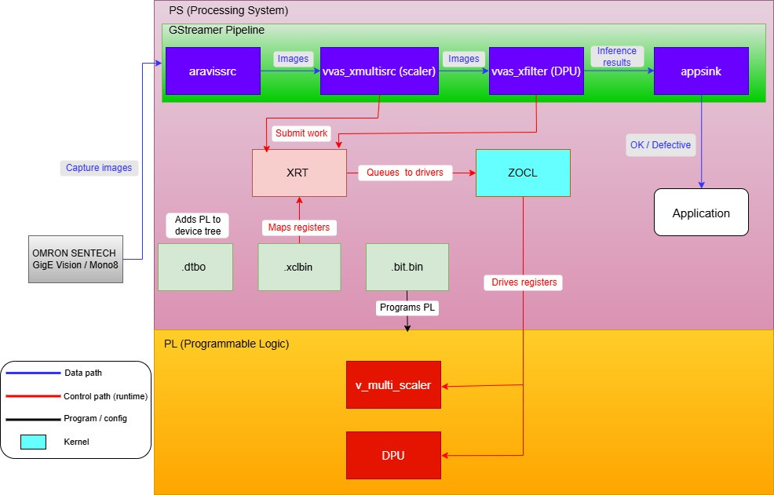
PIPELINE
Runtime architecture

Slide 26
PIPELINE
Example GStreamer pipeline (VVAS)
gst-launch-1.0 -v \
aravissrc camera-name="Sentech-STC-MBS202POE" \
! queue \
! vvas_xmultisrc kconfig="/opt/xilinx/defect-detect/share/vvas/preprocess.json" \
! video/x-raw,format=BGR,width=224,height=224 \
! queue \
! vvas_xfilter kernels-config="/opt/xilinx/defect-detect/share/vvas/aiinference.json" \
! queue \
! kmssink driver-name=xlnx fullscreen-overlay=true
aravissrc — GStreamer source plugin from Aravis, an open-source GigE Vision driver; pulls Mono8 frames from the camera into the pipeline
vvas_xmultisrc — HW preprocessing (resize + color convert) on the v_multi_scaler, config set via preprocess.json
vvas_xfilter — runs the ResNet-18 .xmodel on the DPU via VART, config set via aiinference.json; attaches the OK / Defective result as metadata
kmssink — displays the frame on DisplayPort (Xilinx DRM/KMS driver)

Slide 27
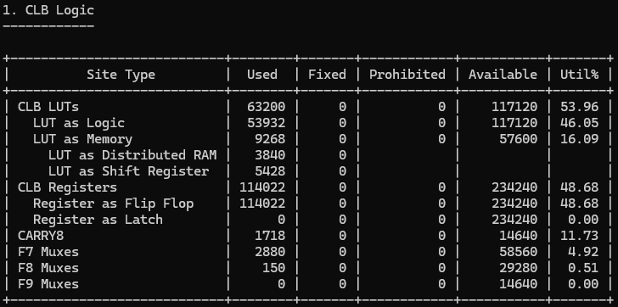
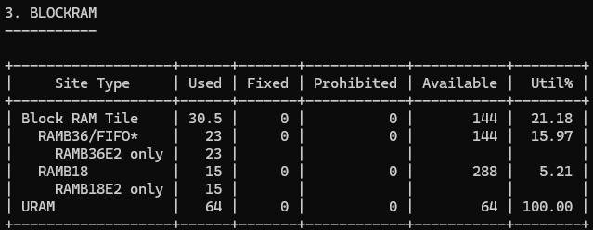
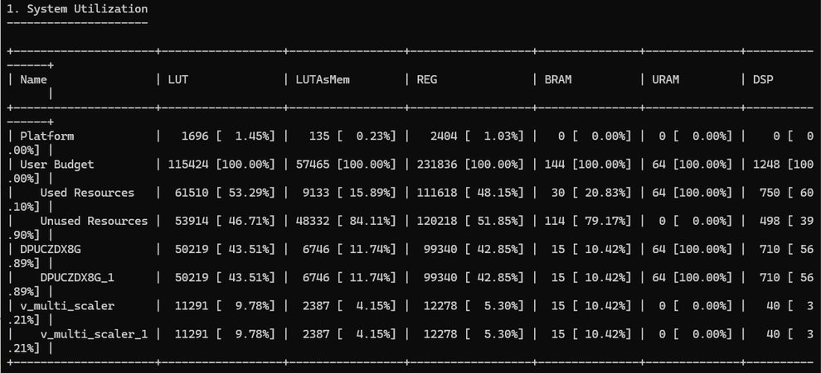
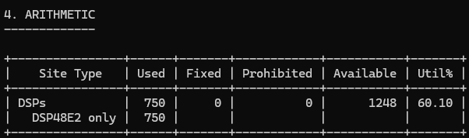
RESULT AND CONCLUSION
Resource Utilization

Slide 28
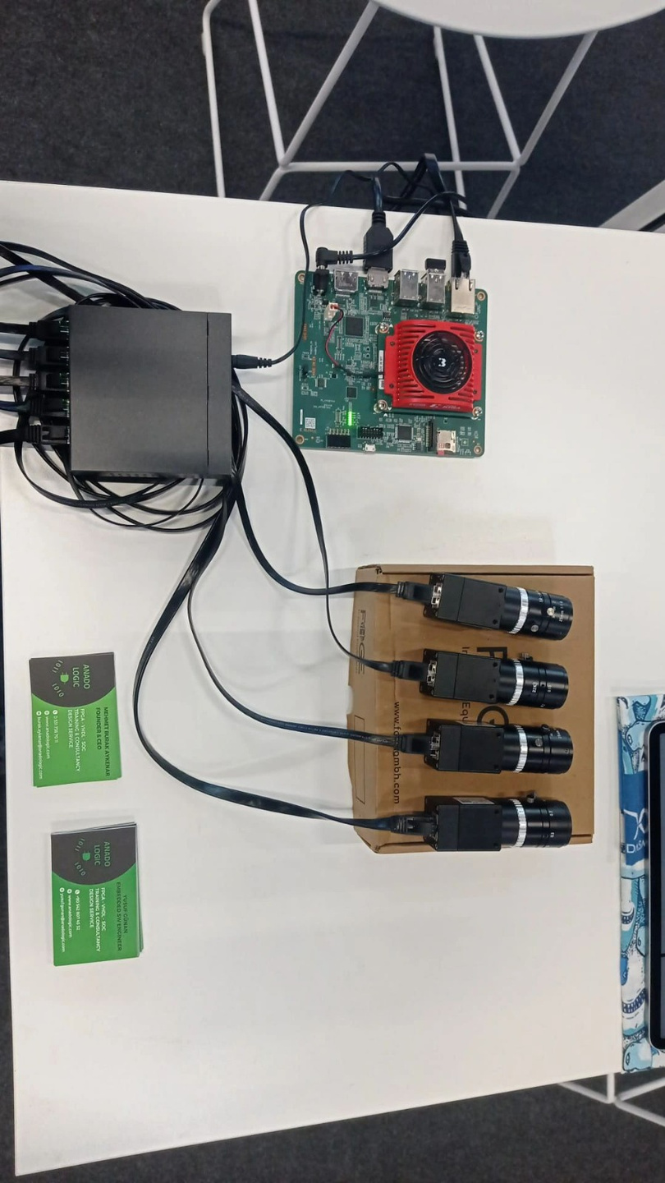
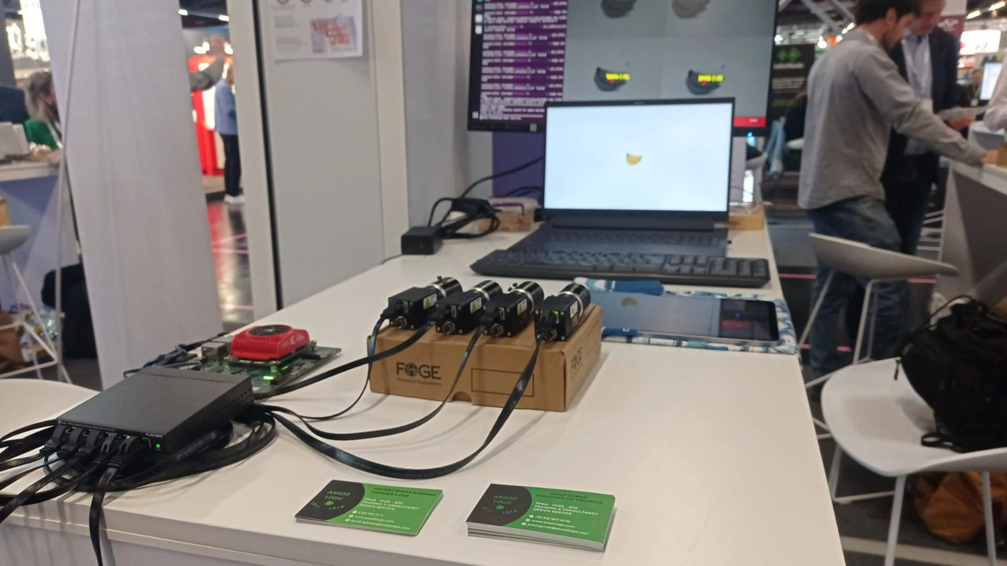
RESULT AND CONCLUSION
Embedded World - 2026

Slide 29
ANADOLOGIC
REFERENCES

