Slide 1
Black and White Image Colorization with Deep Learning
AIN420 Final Project
Yunus Emre BAYRAKTAR– 2210765023
Ali Yiğit ŞENYURT - 2200765023

Slide 2
PROBLEM STATEMENT
Black and white photos have long been colorized by hand, but now deep learning allows computers to do it quickly. Colorization turns black and white images into color and helps models learn about textures and shapes. Our project will use convolutional neural networks and U-Net architecture to teach these models to add color.

Slide 3


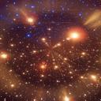

dataset
Mirflickr25k – "MIRFLICKR" dataset is a popular dataset used for research in computer vision and machine learning.
This dataset consists of 25,000 images collected from Flickr, a popular photo-sharing website.
The MIRFLICKR dataset contains a large number of images covering various topics, scenes, and objects, making it suitable for training and evaluating algorithms for tasks such as image classification, object recognition, and image retrieval.
SOME SAMPLES FROM DATASET

Slide 4
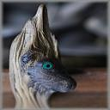
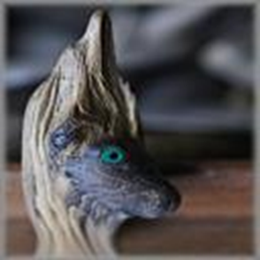
PREPROCESSING
First, we removed the black-and-white images from our dataset.
Next, we resized the remaining images to equal dimensions by applying the resize operation. (320 x 320)
Since our models do not perform well at low image size, we choose an image size that is as large as possible to get better results, but small enough to make the model run fast enough.

Slide 5
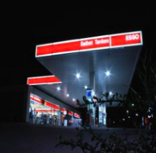
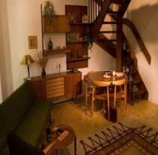
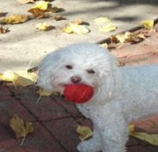
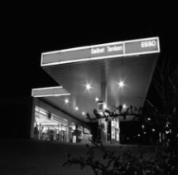
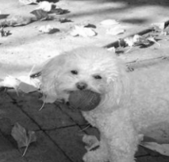
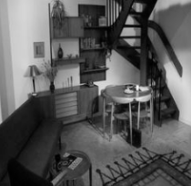
preprocessıng
Since there are no black-white versions of the image in dataset, we also created black-white versions of RGB images.
We divided our model into 3 different parts. Train-set for training, test-set to evaluating best model results.

Slide 6
preprocessıng
Since we used U-Net architecture for image colorization, our inputs had to be one-dimensional and our outputs had to be 2-dimensional. Thats why we converted the RGB format images to ‘lab’ format.
While the L layer represent the grayscale images, the ab layer represent the remaining layers.
Finally, we created a DataLoader to transfer images to our model and completed the preprocessing phase.

Slide 7
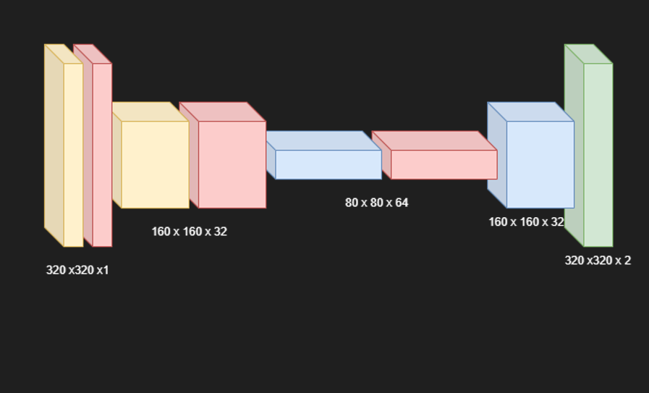
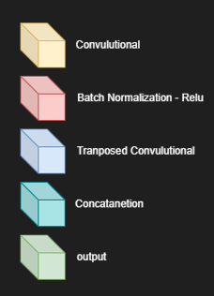
Model 1 archıtecture
TYPE | W/H | C In | C Out | K | S | P
Conv2D | 320 | 1 | 32 | (4,4) | 2 | 1
Conv2D | 160 | 32 | 64 | (4,4) | 2 | 1
T Conv2D | 80 | 64 | 32 | (4,4) | 2 | 1
T Conv2D | 160 | 32 | 2 | (4,4) | 2 | 1
Output | 320 | 2 | - | - | - | -
LOSS → MSE
OPTIMIZER → ADAM
BATCH SIZE → 128
EPOCH → 120
Learning Rate → 0.001

Slide 8
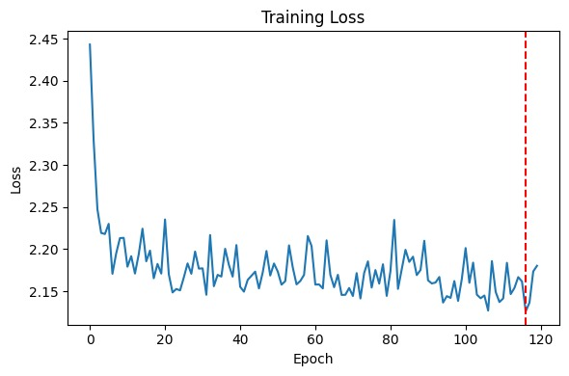
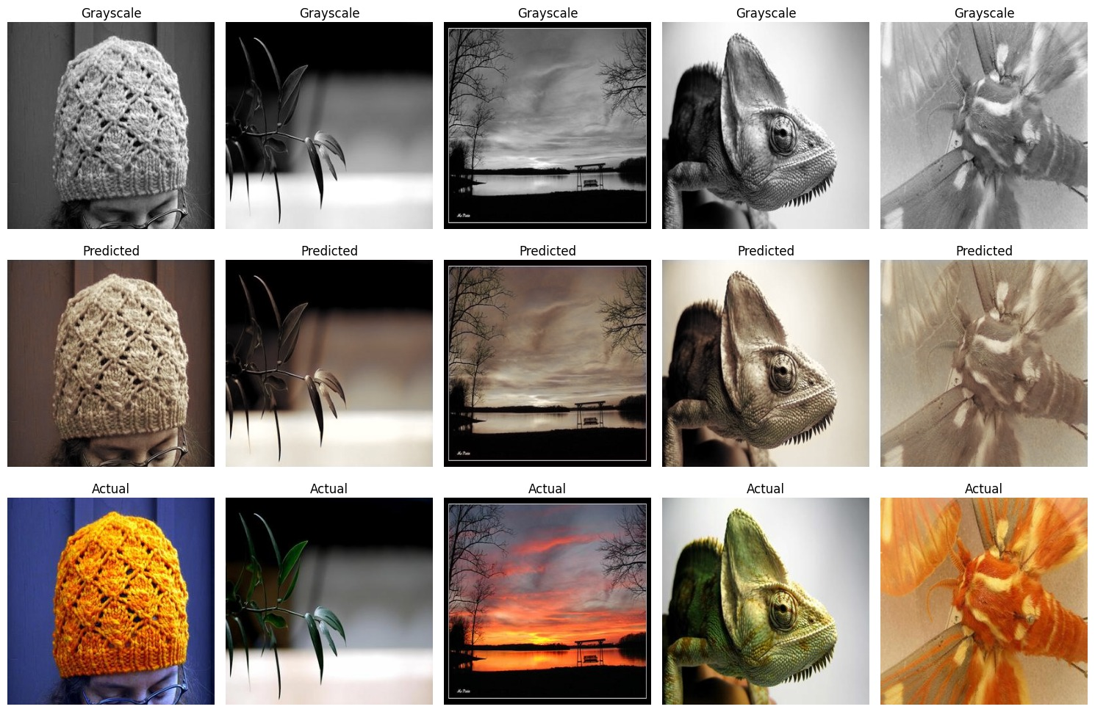
Model 1 loss values and predıcts comparıng wıth actual ımages

Slide 9
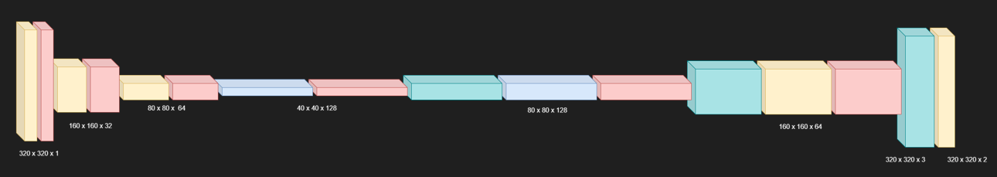
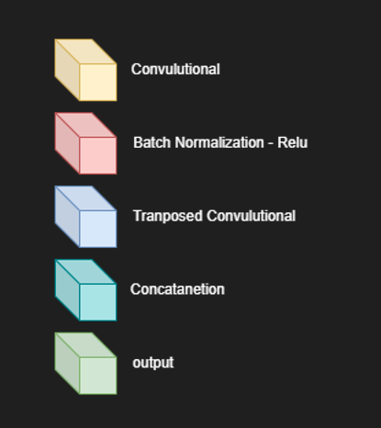
MODEL 2 ARCHITECTURE
TYPE | W/H | C In | C out | K | S | P
Conv2D | 320 | 1 | 32 | (4,4) | 2 | 1
Conv2D | 160 | 32 | 64 | (4,4) | 2 | 1
Conv2D | 80 | 64 | 128 | (4,4) | 2 | 1
T Conv2D | 40 | 128 | 64 | (4,4) | 2 | 1
Concat | 80 | 64 | 128 | - | - | -
T Conv2D | 80 | 128 | 32 | (4,4) | 2 | 1
Concat | 160 | 32 | 64 | - | - | -
T Conv2D | 160 | 64 | 2 | (4,4) | 2 | 1
Concat | 320 | 2 | 3 | - | - | -
Conv2D | 320 | 3 | 2 | (3,3) | 1 | 1
LOSS → MSE
OPTIMIZER → ADAM
BATCH SIZE → 128
EPOCH → 120
Learning Rate → 0.001

Slide 10
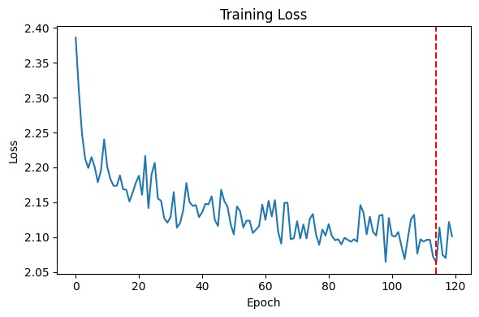
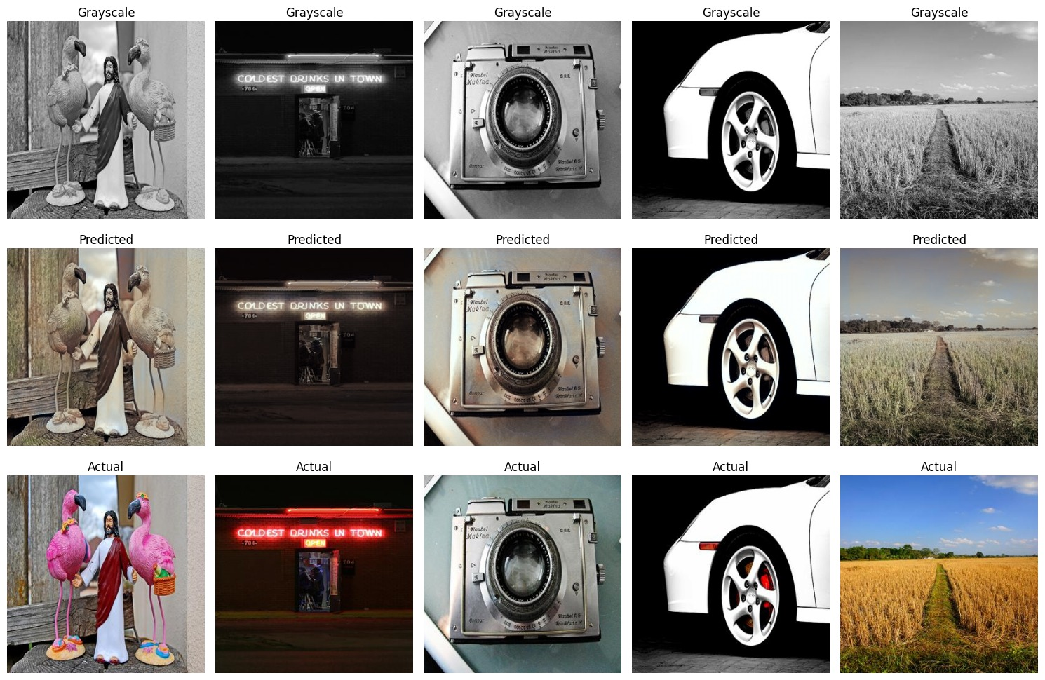
Model 2 loss values and predıcts comparıng wıth actual ımages

Slide 11
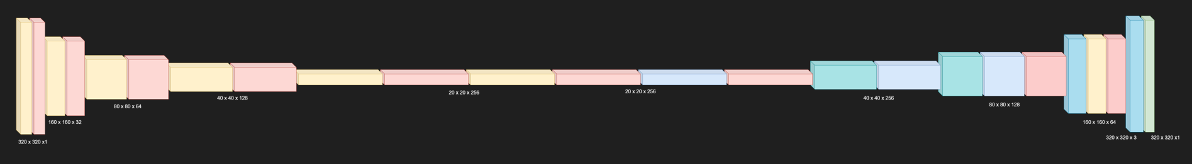
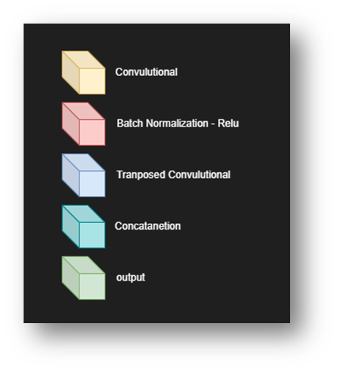
MODEL 3 ARCHITECTURE
LOSS → MSE
OPTIMIZER → ADAM
BATCH SIZE → 128
EPOCH → 120
Learning Rate → 0.001

Slide 12
TYPE | W/H | C In | C Out | K | S | P
Conv2D | 320 | 1 | 32 | (4,4) | 2 | 1
Conv2D | 160 | 32 | 64 | (4,4) | 2 | 1
Conv2D | 80 | 64 | 128 | (4,4) | 2 | 1
Conv2D | 40 | 128 | 256 | (4,4) | 2 | 1
Conv2D | 20 | 256 | 256 | (4,4) | 2 | 3
Conv2D | 20 | 256 | 256 | (4,4) | 2 | 3
T Conv2D | 20 | 256 | 128 | (4,4) | 2 | 1
Concat | 40 | 128 | 256 | - | - | -
T Conv2D | 40 | 256 | 64 | (4,4) | 2 | 1
Concat | 80 | 64 | 128 | - | - | -
T Conv2D | 80 | 128 | 32 | (4,4) | 2 | 1
Concat | 160 | 32 | 64 | - | - | -
T Conv2D | 160 | 64 | 2 | (4,4) | 2 | 1
Concat | 320 | 3 | 3 | - | - | -
Conv2D | 320 | 2 | 2 | (3,3) | 1 | 1

Slide 13
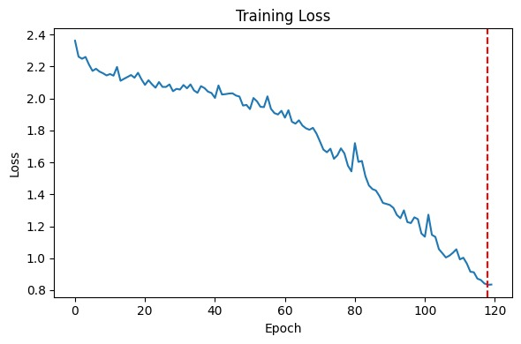
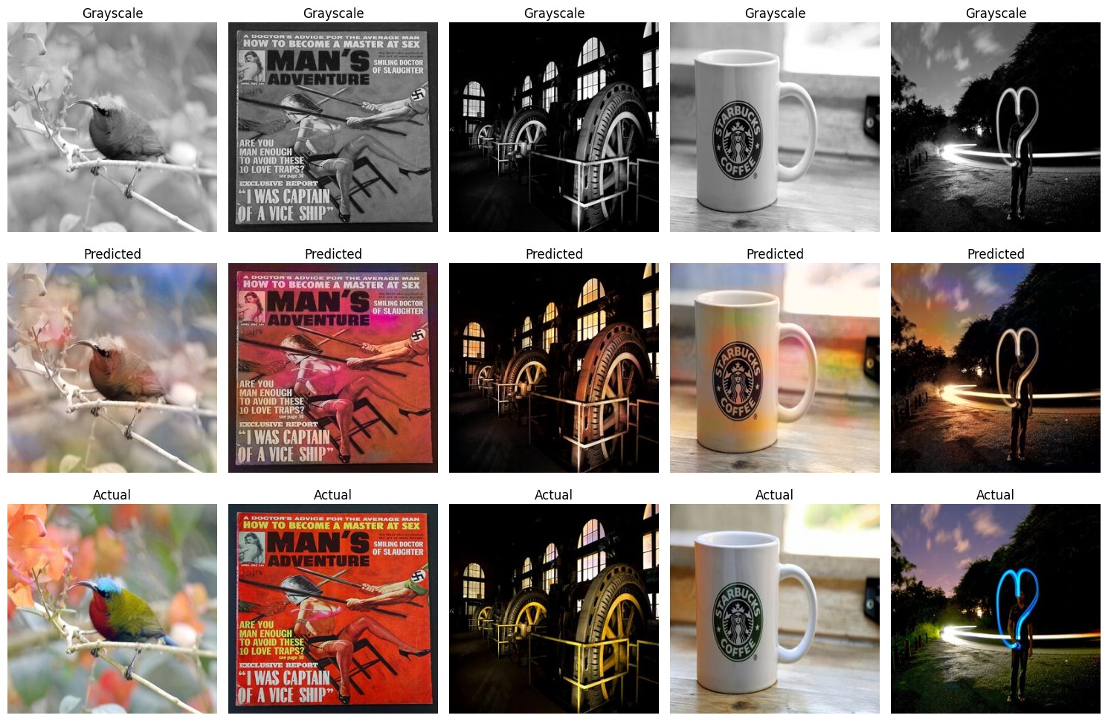
Model 3 loss values and predıcts comparıng wıth actual ımages

Slide 14
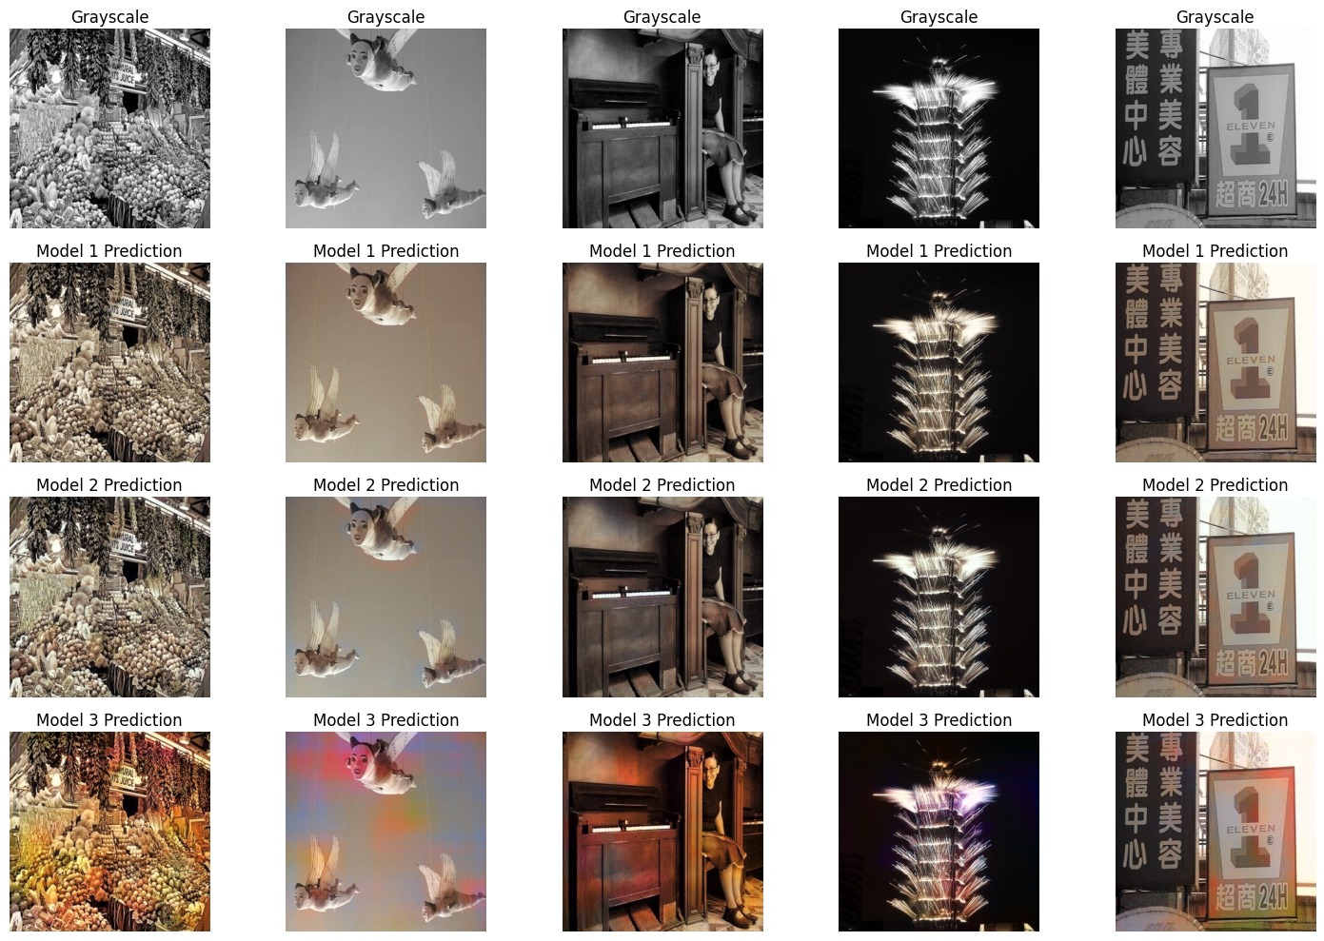
COMPARE for models predıcts

Slide 15
THANKS FOR LISTENING

