Slide 1
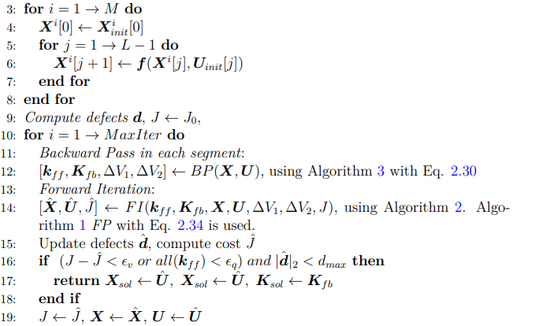
DDP-based Trajectory Optimization and Stabilization for Constrained Underactuated Robotic Systems
Yunxi TANG
Supervisor
Prof. K. W. Samuel Au
Committee Members
Prof. LIU Yunhui
Prof. CHEN Benmei
Prof. K. W. Samuel Au

Slide 2
Contents
Introduction
DDP-based Trajectory Optimization
Hyb-CDDP Variant
Validation and Comparisons
Conclusion and Future Work

Slide 3
Introduction

Slide 4
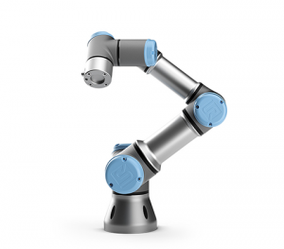
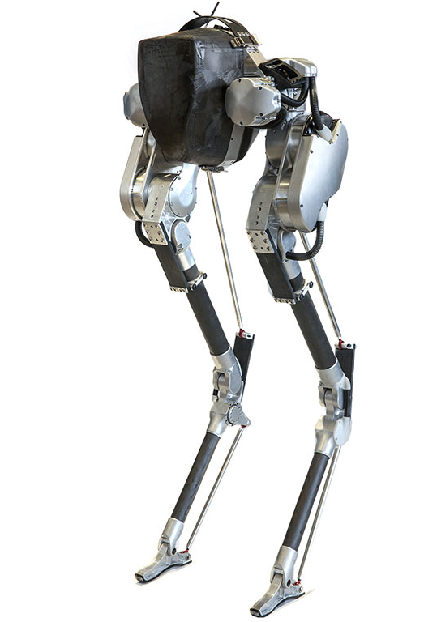
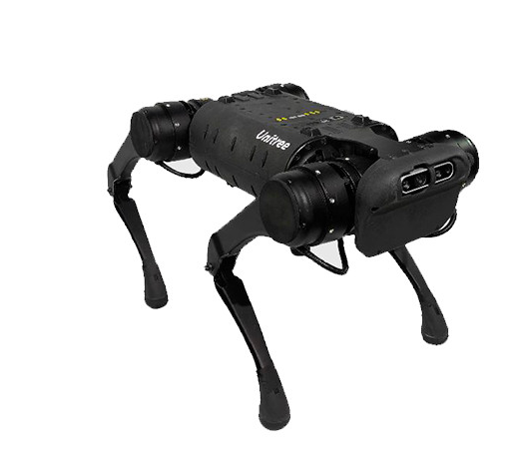
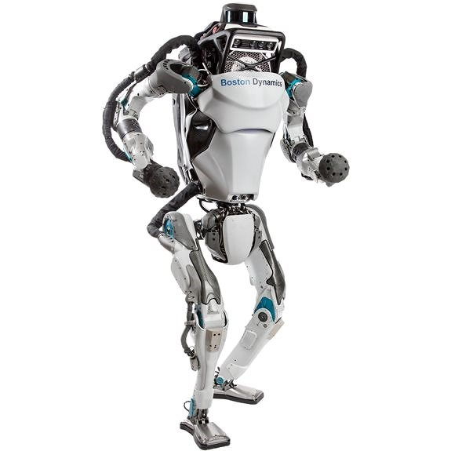
Introduction
Mechatronic systems are getting complex and high-dimensional now.
Agile manoeuvres and complicated motion tasks → more challenging.

Slide 5
Introduction
Limitations
Traditional feedback approach may not support complex motion tasks.
Kinematic motion planning is not enough.
Dynamics need be considered in many tasks.
Underactuated robotic systems highlight this point.

Slide 6
Introduction
Controlling underactuated robots is more challenge than fully-actuated robots.
Highly coupled dynamics
Floating base brings underactuated property
Limited or less actuation
Unstable internal dynamics
Constraints satisfaction is not straightforward.
Efficient control?
Exploit passive dynamics: Passive bipedal walking
Specific geometry/physical metric: Null space avoidance for systems with specified kinematics, energy shaping for double inverted pendulum
Difficulties of control

Slide 7






Introduction
Example: consider swing up following robots from the perspective of energy
Very Easy. PD controller if there is no torque limitation; Invert the direction of gravity;
Easy. Injecting energy to the system and switch to a LQR controller once the state go into the basin of attraction of LQR (not easy);
Difficult. The manifold is getting more complicated and the robot may even do not go through the upward position.
More difficult. Don’t know how the robot behave when energy is accumulating…
$$Active Joint$$
$$Passive Joint$$
Optimization!
If traditional feedback and nonlinear control principle meet difficulties to do these, any other tools can we employ?
$$(a)$$
$$(b)$$
$$(c)$$
$$(d)$$
7

Slide 8
Introduction
Trajectory Optimization
Optimization is a powerful and general framework for creating goal-directed behavior in robots
Solving the control problem using optimization theory and methods.
Control task → objective function & additional constraints
System dynamics → equality constraints
Implicit but high-level descriptions of control tasks,
Exploit the underlying system properties.

Slide 9
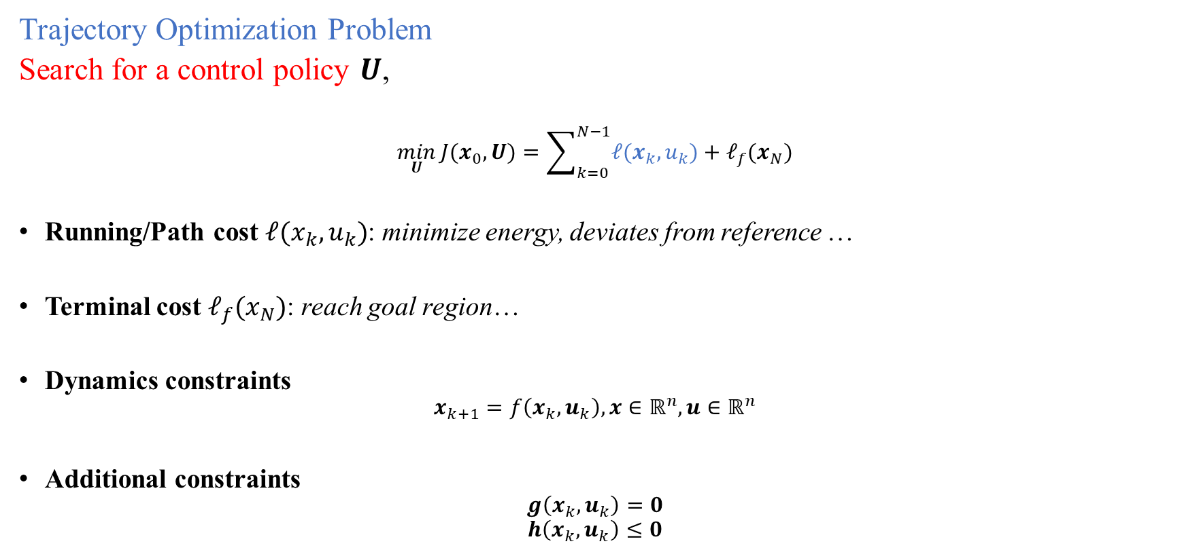
Introduction
Trajectory Optimization Problem
Search for a control policy $U$,
$$\min_{U}{J(x_{0},U)}=\sum_{k=0}^{N−1}{ℓ(x_{k},u_{k})}+ℓ_{f}(x_{N})$$
Running/Path cost $ℓ(x_{k},u_{k})$: minimize energy, deviates from reference …
Terminal cost $ℓ_{f}(x_{N})$: reach goal region…
Dynamics constraints
$$x_{k+1}=f\left(x_{k},u_{k}\right), x∈ℝ^{n}, u∈ℝ^{n}$$
Additional constraints
$$g\left(x_{k},u_{k}\right)=0$$
$$h\left(x_{k},u_{k}\right)≤0$$

Slide 10

Introduction
Solve TO?
Direct methods (transcription):
using discrete decision variables to approximate the original problem.
Original decision variable $u\left(t\right),x(t)$ → $u\left(k\right),x\left(k\right),k=0,1,2,…,N$
NLP solvers are needed, SQP…; Easy to handle constraints.
Slow but robust; open loop solution, extra stabilizing controller is need, e.g., time-varying LQR
Differential Dynamic Programming
Exploit Markov structure of system, solve subproblems iteratively.
Linear time complexity.
Closed loop solution → compensate the introduced approximation error and uncertainty in real-world application.
Fast but less stable; Cannot handle state constraints.

Slide 11
II. DDP-based Trajectory Optimization

Slide 12
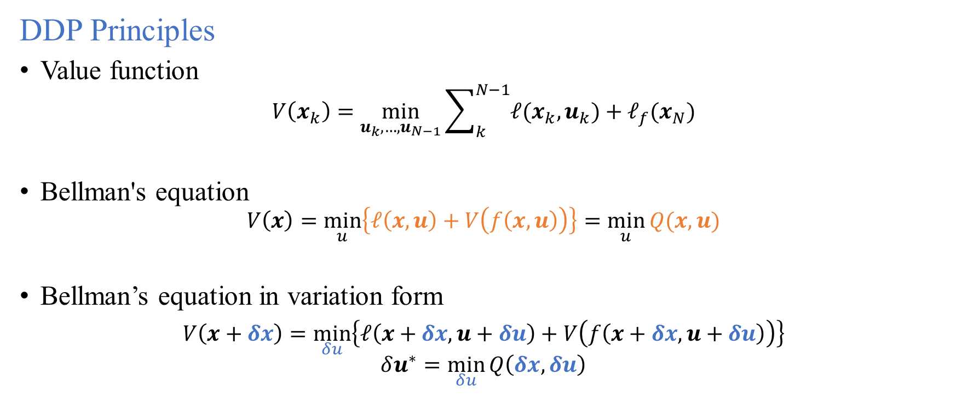
DDP-based Trajectory Optimization
DDP Principles
Value function
$$V\left(x_{k}\right)=\min_{u_{k},…,u_{N−1}}{\sum_{k}^{N−1}{ℓ(x_{k},u_{k})}+ℓ_{f}(x_{N})}$$
Bellman's equation
$$V\left(x\right)=\min_{u}\left\{ℓ\left(x,u\right)+V\left(f\left(x,u\right)\right)\right\}=\min_{u}{Q(x,u)}$$
Bellman’s equation in variation form
$V\left(x+δx\right)=\min_{δu}\left\{ℓ\left(x+δx,u+δu\right)+V\left(f\left(x+δx,u+δu\right)\right)\right\}$
$$δu^{∗}=\min_{δu}{Q\left(δx,δu\right)}$$

Slide 13





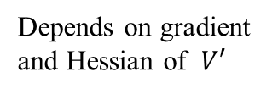

DDP-based Trajectory Optimization
DDP Principles
LQ Approximation and solve QPs
$$δu^{∗}\left(δx\right)=\underset{δu}{argmin}{\frac{1}{2}{\left[\begin{matrix}1 \\ δx \\ δu\end{matrix}\right]}^{T}}\left[\begin{matrix}1 & Q_{x} & Q_{u} \\ Q_{x} & Q_{xx} & Q_{xu} \\ Q_{u} & Q_{ux} & Q_{uu}\end{matrix}\right]\left[\begin{matrix}1 \\ δx \\ δu\end{matrix}\right]$$
Control modifications
$$δu^{∗}\left(δx\right)=k_{ff}+K_{fb}δx$$
$$−Q_{uu}^{−1}Q_{ux}$$
Depends on gradient and Hessian of $V′$
$$−Q_{uu}^{−1}Q_{u}$$
Optimal trajectory
…
$$\left(x^{∗},u^{∗}\right)$$
…
Improved trajectory
$$\left(x^{i},u^{i}\right)$$
Initial trajectory
$$x_{0}$$
$$\left(x^{0},u^{0}\right)$$

Slide 14
DDP-based Trajectory Optimization
DDP Principles
LQ Approximation and solve QPs
$$δu^{∗}\left(δx\right)=\underset{δu}{argmin}{\frac{1}{2}{\left[\begin{matrix}1 \\ δx \\ δu\end{matrix}\right]}^{T}}\left[\begin{matrix}1 & Q_{x} & Q_{u} \\ Q_{x} & Q_{xx} & Q_{xu} \\ Q_{u} & Q_{ux} & Q_{uu}\end{matrix}\right]\left[\begin{matrix}1 \\ δx \\ δu\end{matrix}\right]$$
Control modifications
$$δu^{∗}\left(δx\right)=k_{ff}+K_{fb}δx$$

Slide 15
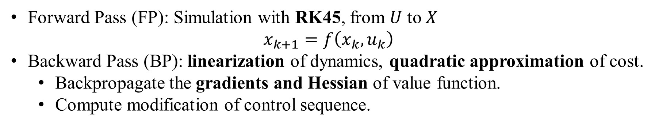
Differential Dynamic Programming (DDP)
Forward Pass (FP): Simulation with RK45, from $U$ to $X$
$$x_{k+1}=f\left(x_{k},u_{k}\right)$$
Backward Pass (BP): linearization of dynamics, quadratic approximation of cost.
Backpropagate the gradients and Hessian of value function.
Compute modification of control sequence.
Unstable: The longer trajectory is, linearization of explicit discrete dynamics makes forward simulation diverge easier.
Sensitive to initial controller: Initial controller must be stable.
Cannot provide infeasible guess: Only control is optimized over directly, but I know some intermediate states candidate.
Multiple shooting variant
Motivations
Control constraints: clamp or squash in FP; box-QP in BP
State Constraint: Not easy, states are not optimized over directly
Sacrifice feedback control policy: Many constrained variants cannot keep this term
Lose the complexity of each step: Involving many extra factorization and inverse operations of matrix
Hybrid constrained variant

Slide 16
III. Hyb-CDDP Variant

Slide 17
Hyb-CDDP Variant
Goal: Develop an efficient solver for FTOCP.
Motivation
Start from dynamical infeasible trajectory
Feedback Law
Inequality constraints
Contribution
Improved globalization strategy
Inequality constraints handling under multiple shooting framework
Solver developing
Validation and Comparison
Validation
Comparison

Slide 18

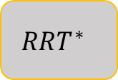
Overall Framework
Classical DDP/SLQ
(SS)
Multiple Shooting Method
Constrained Single Shooting Method
MS-DDP
(infeasible guess)
Constrained DDP
(state/control cons.)
Contact Constraints
$$RRT^{∗}$$
$$?$$
Constrained Multiple Shooting Method

Slide 19
Hyb-CDDP
In [1][2][3], multiple shooting DDP are used.
Introduce part of intermediate states as decision variables.
Close the defects using equality constraints.
Pros:
Optimizing each segments separately, less nonlinear.
Provide initial guess of node states, (infeasible traj from DIRCOL, sampling-based planner)
Encourage explore better local optimal solution.
Suitable for application with Augmented Lagrange method in constrained case.
Cons:
More decision variables, a little bit more computational time of each iteration, but with reasonable initial guess, the whole computational time is reduced.
Bad initial state guess can cause diverge, require a large regularization.
High-dimensional underactuated system, require good initial guess

Slide 20


Illustrative Pendulum Example
$$Initial$$
$$Converge$$

Slide 21
Illustrative Pendulum Example

Slide 22
Illustrative 2D Car Example
Multiple shooting

Slide 23
Illustrative Falling Cat Example

Slide 24






Combination with AL in constrained case: 2D Car
$$M=1$$
$$M=2$$
$$M=5$$
$$M=20$$
$$M=40$$
$$M=80$$

Slide 25
Hybrid Constrained DDP
Augmented Lagrange method can fit in the multiple shooting well,
AL method:
Fast first several iterations
Slow tail convergence
ill conditioning
Low accuracy of constraint stratification
One more step to eliminate the constraint violations, but I still want to keep the complexity of each step and linear feedback policy.
Solve series of constrained QPs at each step of BP or FP, with active-set method or primal-dual interior point method[5][6][7][8]?
Penalty method may be a better choice for DDP. Another interior point method: Barrier function

Slide 26
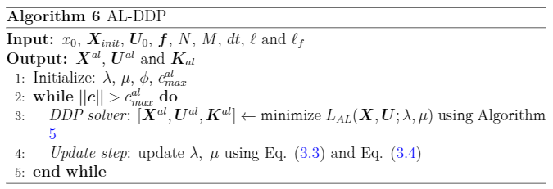
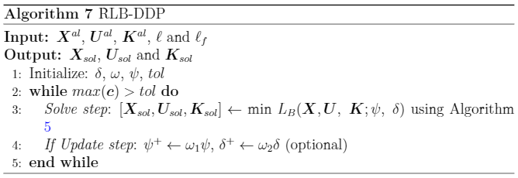
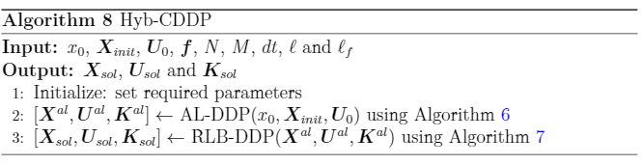
Hyb-CDDP outline

Slide 27
Globalization strategies
Using backtracking line search
Introduce a multiplier control the update step of feedforward term of action.
Using regularization for state and action updates
Two cases trigger regularization:
Non-PD Hessians exist → the trajectory may or almost diverge.
Line search failed → getting closer to a local optima.
Larger regularization on action in first few iterations is helpful when warm-start is available.
Larger regularization on state in first few iterations is helpful avoiding diverge and closing defects.
Accepting an Iteration
Strategies to make DDP-type methods stable and robust. These strategies involve some hyperparameters in the solver, which may influence the solution directly.

Slide 28
Hybrid Constrained DDP
Two stages: DDP with AL method (AL-DDP) and DDP with relaxed log barrier function (RLB-DDP)
Coarse solution from AL-DDP rapidly.
Refined solution from RLB-DDP with better constraint feasibility. Relaxed log barrier function is more suitable.
Both absorb constraints into objective function as penalty, share similar implementation and computational framework.
Flexible usage and easy to tune optimization hyperparameters.
Pros:
Fast and good constraint satisfaction.
Reserve the linear feedback policy term.
Suitable for warm-start.
Cons:
Only inequality constraints. For equality constraints, two inequality constraints can be used to approximate, but performance is not guaranteed. Works for soft constraint.
Approximation of RLB cause the local optimal, e.g. the obtained cost can be higher than DIRCOL or DSS.

Slide 29
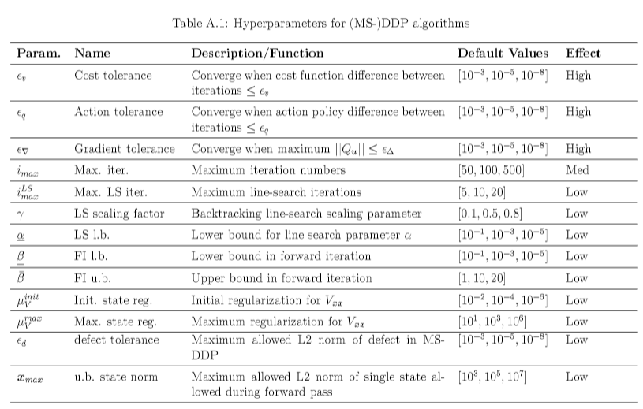

Slide 30
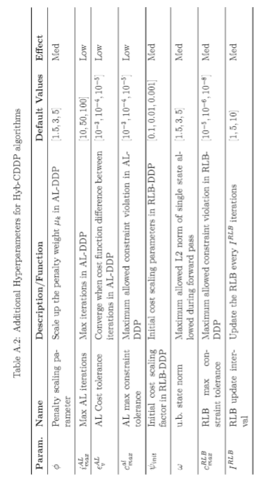

Slide 31
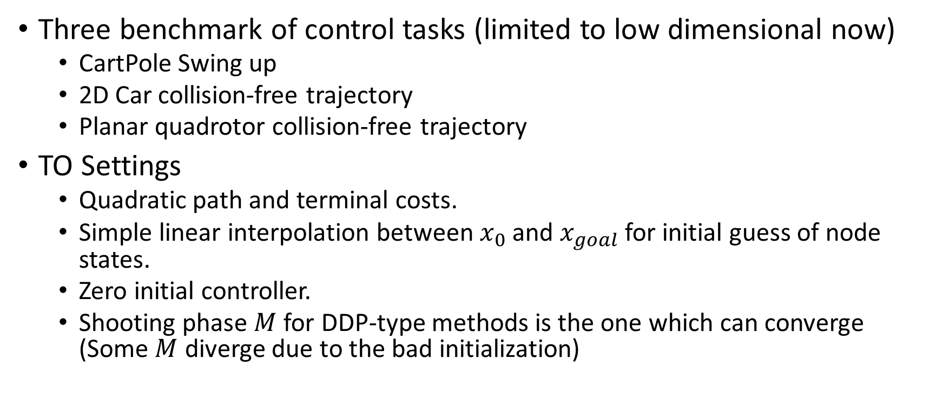
Validation and Comparisons
Three benchmark of control tasks (limited to low dimensional now)
CartPole Swing up
2D Car collision-free trajectory
Planar quadrotor collision-free trajectory
TO Settings
Quadratic path and terminal costs.
Simple linear interpolation between $x_{0}$ and $x_{goal}$ for initial guess of node states.
Zero initial controller.
Shooting phase $M$ for DDP-type methods is the one which can converge (Some $M$ diverge due to the bad initialization)

Slide 32
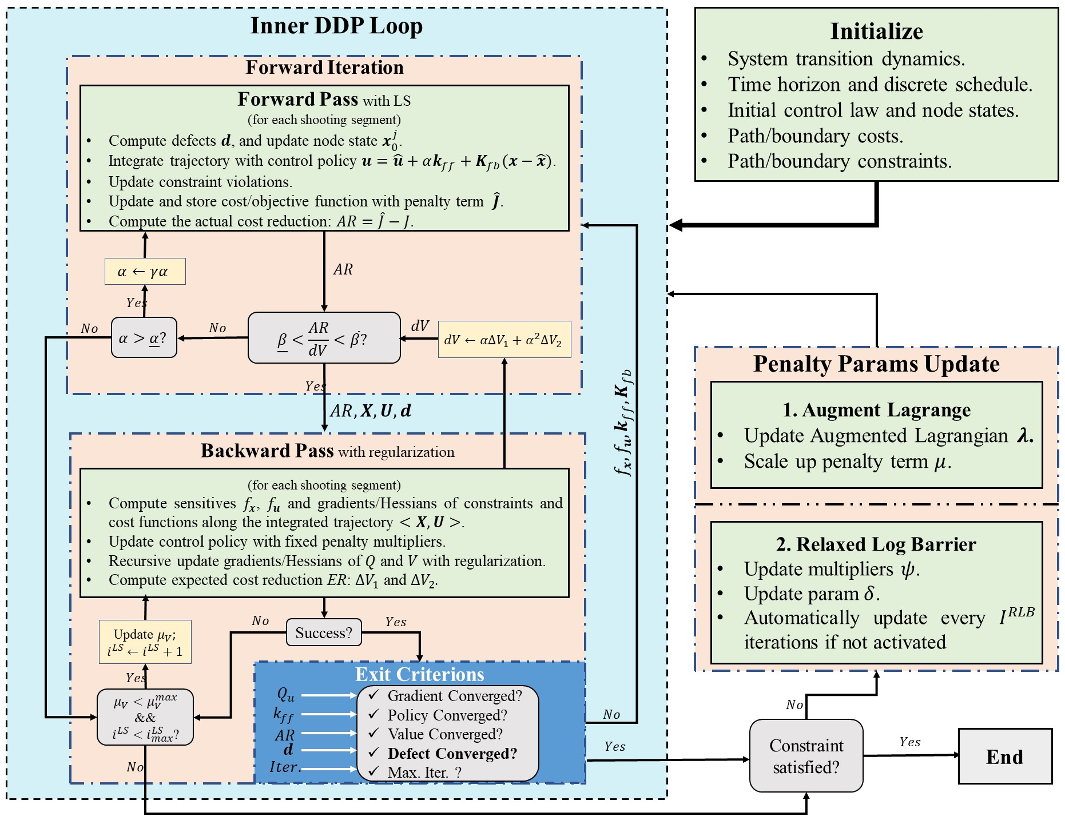
Algorithmic Framework

Slide 33
Validation

Slide 34
Comparisons with DIRCOL and DSS

Slide 35
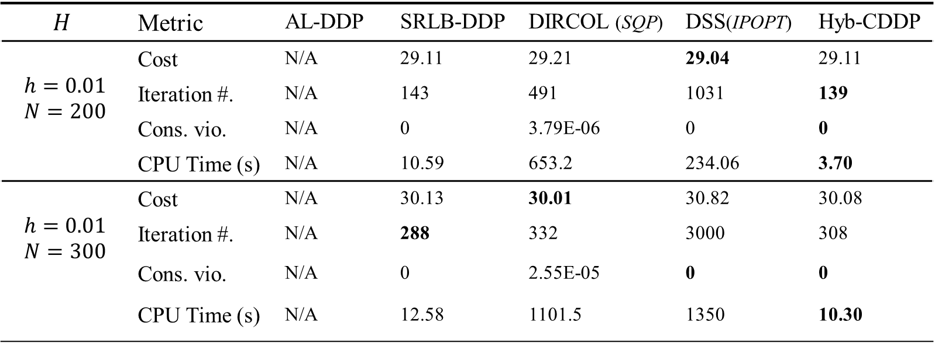
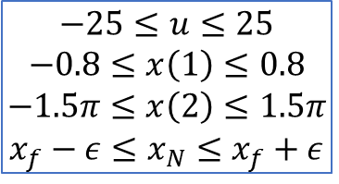
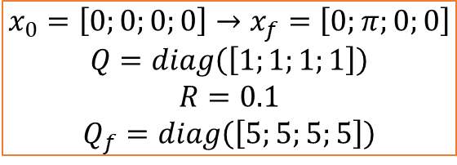
CartPole Swing-Up (M=5 for DDP-type methods)
$$H$$ | Metric | AL-DDP | SRLB-DDP | DIRCOL (SQP) | DSS(IPOPT) | Hyb-CDDP
$$h=0.01$$ $$N=200$$ | Cost | N/A | 29.11 | 29.21 | 29.04 | 29.11
 | Iteration #. | N/A | 143 | 491 | 1031 | 139
 | Cons. vio. | N/A | 0 | 3.79E-06 | 0 | 0
 | CPU Time (s) | N/A | 10.59 | 653.2 | 234.06 | 3.70
$$h=0.01$$ $$N=300$$ | Cost | N/A | 30.13 | 30.01 | 30.82 | 30.08
 | Iteration #. | N/A | 288 | 332 | 3000 | 308
 | Cons. vio. | N/A | 0 | 2.55E-05 | 0 | 0
 | CPU Time (s) | N/A | 12.58 | 1101.5 | 1350 | 10.30
* M=5 for DDP-type methods, except SRLB-DDP.
$$x_{0}=\left[0;0;0;0\right]→x_{f}=\left[0;π;0;0\right]$$
$$Q=diag\left(\left[1;1;1;1\right]\right)$$
$$R=0.1$$
$$Q_{f}=diag\left(\left[5;5;5;5\right]\right)$$
$$−25≤u≤25$$
$$−0.8≤x\left(1\right)≤0.8$$
$$−1.5π≤x\left(2\right)≤1.5π$$
$$x_{f}−ε≤x_{N}≤x_{f}+ε$$

Slide 37
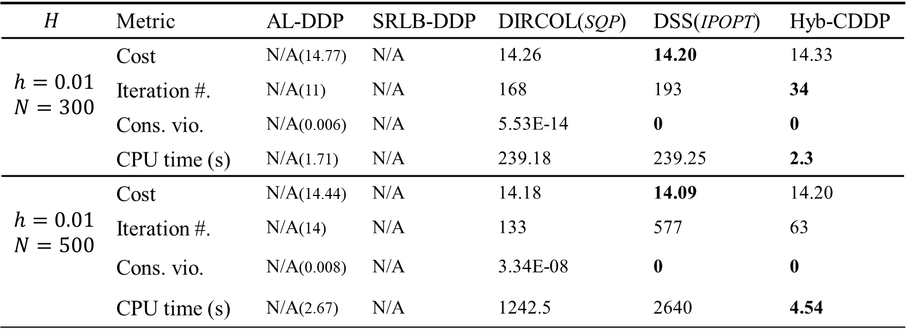
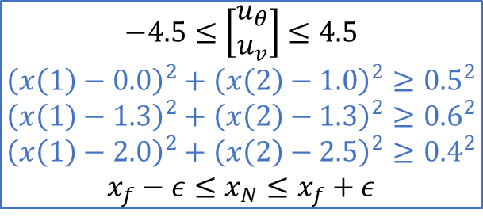
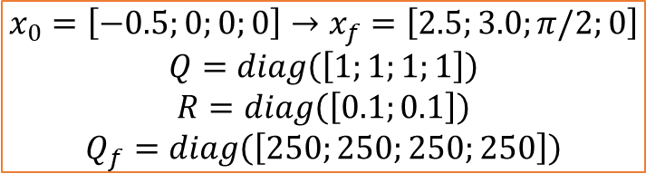
Collision-free 2D Car (M=100 for DDP-type methods)
$$H$$ | Metric | AL-DDP | SRLB-DDP | DIRCOL(SQP) | DSS(IPOPT) | Hyb-CDDP
$$h=0.01$$ $$N=300$$ | Cost | N/A(14.77) | N/A | 14.26 | 14.20 | 14.33
 | Iteration #. | N/A(11) | N/A | 168 | 193 | 34
 | Cons. vio. | N/A(0.006) | N/A | 5.53E-14 | 0 | 0
 | CPU time (s) | N/A(1.71) | N/A | 239.18 | 239.25 | 2.3
$$h=0.01$$ $$N=500$$ | Cost | N/A(14.44) | N/A | 14.18 | 14.09 | 14.20
 | Iteration #. | N/A(14) | N/A | 133 | 577 | 63
 | Cons. vio. | N/A(0.008) | N/A | 3.34E-08 | 0 | 0
 | CPU time (s) | N/A(2.67) | N/A | 1242.5 | 2640 | 4.54
* M=100 for DDP-type methods, except SRLB-DDP
$$−4.5≤\left[\begin{matrix}u_{θ} \\ u_{v}\end{matrix}\right]≤4.5$$
$${\left(x\left(1\right)−0.0\right)}^{2}+{\left(x\left(2\right)−1.0\right)}^{2}≥{0.5}^{2}$$
$${\left(x\left(1\right)−1.3\right)}^{2}+{\left(x\left(2\right)−1.3\right)}^{2}≥{0.6}^{2}$$
$${\left(x\left(1\right)−2.0\right)}^{2}+{\left(x\left(2\right)−2.5\right)}^{2}≥{0.4}^{2}$$
$$x_{f}−ε≤x_{N}≤x_{f}+ε$$
$$x_{0}=\left[−0.5;0;0;0\right]→x_{f}=\left[2.5;3.0;π/2;0\right]$$
$$Q=diag\left(\left[1;1;1;1\right]\right)$$
$$R=diag\left(\left[0.1;0.1\right]\right)$$
$$Q_{f}=diag\left(\left[250;250;250;250\right]\right)$$

Slide 39
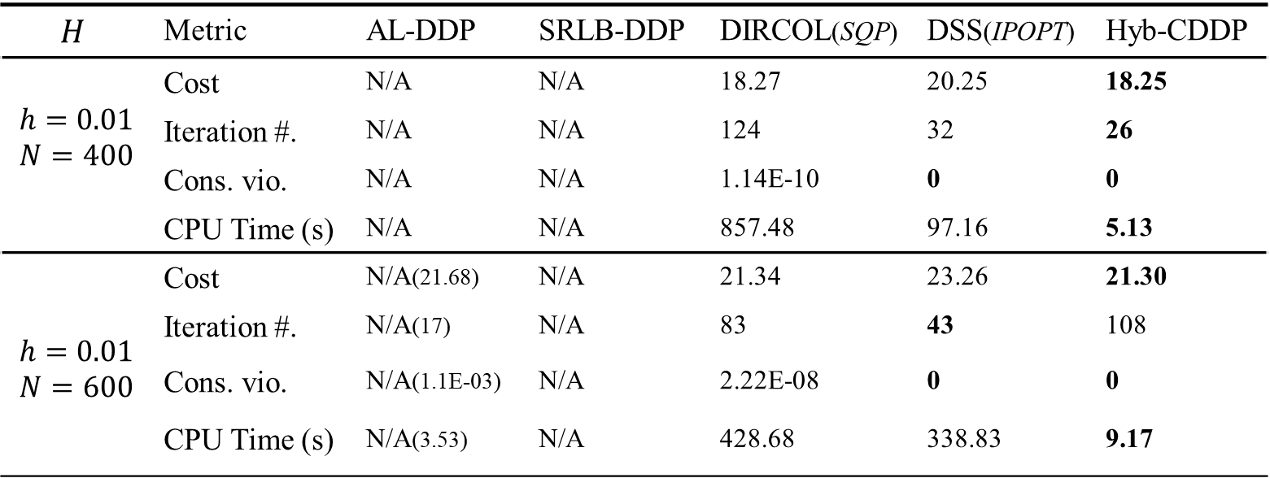
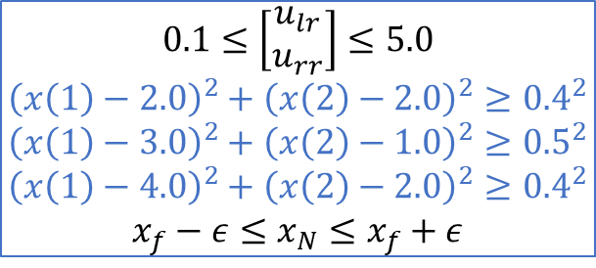
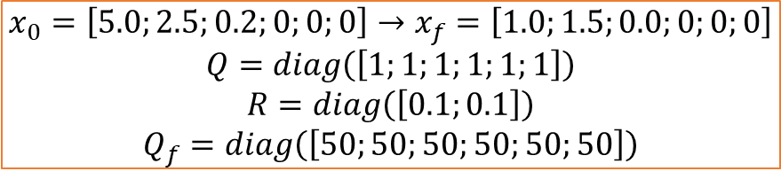
Collision-free Planar Quadrotor
(M=50 for DDP-type methods)
$$H$$ | Metric | AL-DDP | SRLB-DDP | DIRCOL(SQP) | DSS(IPOPT) | Hyb-CDDP
$$h=0.01$$ $$N=400$$ | Cost | N/A | N/A | 18.27 | 20.25 | 18.25
 | Iteration #. | N/A | N/A | 124 | 32 | 26
 | Cons. vio. | N/A | N/A | 1.14E-10 | 0 | 0
 | CPU Time (s) | N/A | N/A | 857.48 | 97.16 | 5.13
$$h=0.01$$ $$N=600$$ | Cost | N/A(21.68) | N/A | 21.34 | 23.26 | 21.30
 | Iteration #. | N/A(17) | N/A | 83 | 43 | 108
 | Cons. vio. | N/A(1.1E-03) | N/A | 2.22E-08 | 0 | 0
 | CPU Time (s) | N/A(3.53) | N/A | 428.68 | 338.83 | 9.17
* M=50 for DDP-type methods, except SRLB-DDP.
$$0.1≤\left[\begin{matrix}u_{lr} \\ u_{rr}\end{matrix}\right]≤5.0$$
$${\left(x\left(1\right)−2.0\right)}^{2}+{\left(x\left(2\right)−2.0\right)}^{2}≥{0.4}^{2}$$
$${\left(x\left(1\right)−3.0\right)}^{2}+{\left(x\left(2\right)−1.0\right)}^{2}≥{0.5}^{2}$$
$${\left(x\left(1\right)−4.0\right)}^{2}+{\left(x\left(2\right)−2.0\right)}^{2}≥{0.4}^{2}$$
$$x_{f}−ε≤x_{N}≤x_{f}+ε$$
$$x_{0}=\left[5.0;2.5;0.2;0;0;0\right]→x_{f}=\left[1.0;1.5;0.0;0;0;0\right]$$
$$Q=diag\left(\left[1;1;1;1;1;1\right]\right)$$
$$R=diag\left(\left[0.1;0.1\right]\right)$$
$$Q_{f}=diag\left(\left[50;50;50;50;50;50\right]\right)$$

Slide 41
DDP-based trajectory optimization solver development
Tested on several classical low-dimensional systems.
Pendulum
Acrobot/Pendubot
Planar quadrotor
2D car
Falling cat
RR manipulator
Three link bipedal walking robot (testing)
User interface
Function generation and solver interface are done.

Slide 42
clc;clear;close all;
%%%%%% Parameters %%%%%%
options = struct('x0',x0,'xf',xf,'dt', 0.01,…);
%%%%%% create robot, constraints & cost mdl %%%%%%
%%% build a robot
rbt = rbt_mdl();
%%% cost model (quadratic)
cost = cst_mdl(options.Q, options.R, options.Qf);
%%% create constraint objects
PathCst = path_constraint(Nineq_path);
BndCst = final_constraint(Nineq_final);
%%% path constraint function
pathcstfunc = @(x,u)(PathCstFunc(x,u));
%%% boundary constraint function
bndcstfunc = @(xf)(BndCstFunc(xf));
%%%%%% Function Generation %%%%%%
Setup_Functions(options, rbt, cost, pathcstfunc, bndcstfunc);
%%%%%% Solver %%%%%%
solver = ddp_solver(options);
%% Solve
[xsol, usol, Ksol] = solver.Solve(rbt,cost,path_cons,final_cons);

Slide 43
Some references
[1] C. Mastalli et al., ``Crocoddyl: An Efficient and Versatile Framework for Multi-Contact Optimal Control," 2020 IEEE International Conference on Robotics and Automation (ICRA), 2020, pp. 2536-2542.
[2] M. Giftthaler, M. Neunert, M. Stäuble, J. Buchli and M. Diehl, ``A Family of Iterative Gauss-Newton Shooting Methods for Nonlinear Optimal Control," 2018 IEEE/RSJ International Conference on Intelligent Robots and Systems (IROS), 2018, pp. 1-9.
[3]Lantoine, Gregory, and Ryan Russell. ``A hybrid differential dynamic programming algorithm for robust low-thrust optimization." AIAA/AAS Astrodynamics Specialist Conference and Exhibit. 2008.
[4] T. A. Howell, B. E. Jackson and Z. Manchester, ``ALTRO: A Fast Solver for Constrained Trajectory Optimization," 2019 IEEE/RSJ International Conference on Intelligent Robots and Systems (IROS), 2019, pp. 7674-7679, doi: 10.1109/IROS40897.2019.8967788.
[5] Aoyama, Yuichiro, et al. ``Constrained Differential Dynamic Programming Revisited." arXiv preprint arXiv:2005.00985 (2020).
[6] Z. Xie, C. K. Liu and K. Hauser, ``Differential dynamic programming with nonlinear constraints," 2017 IEEE International Conference on Robotics and Automation (ICRA), 2017, pp. 695-702, doi: 10.1109/ICRA.2017.7989086.
[7] R. Grandia, F. Farshidian, R. Ranftl and M. Hutter, ``Feedback MPC for Torque-Controlled Legged Robots," 2019 IEEE/RSJ International Conference on Intelligent Robots and Systems (IROS), 2019, pp. 4730-4737, doi: 10.1109/IROS40897.2019.8968251.

Slide 44
Connection with quadrupedal locomotion
Gait generation at each step with Hyb-CDDP.
Trajectory optimization for the motion of floating base (single rigid body), taking the wrench as decision variables, under pre-defined contact sequences. Then employ a whole body controller to tracking the planned trajectory of the floating base.

