Slide 1
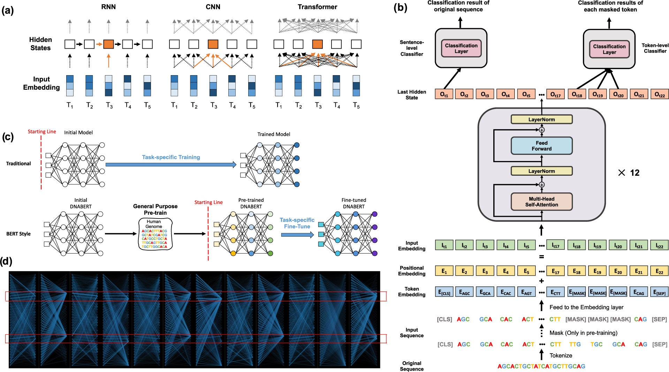

Fig. 1. Details of architecture and characteristics of DNABERT model.(a) Differences between RNN, CNN and Transformer ...
Notes:
Fig. 1. Details of architecture and characteristics of DNABERT model.(a) Differences between RNN, CNN and Transformer in understanding contexts. T1 to 5 denotes embedded tokens which were input into models to develop hidden states (white boxes, orange box is the current token of interest). RNN propagates information through all hidden states, and CNN takes local information in developing each representation. In contrast, Transformers develop global contextual embedding via self-attention. (b) DNABERT uses tokenized k-mer sequences as input, which also contains a CLS token (a tag representing meaning of entire sentence), a SEP token (sentence separator) and MASK tokens (to represent masked k-mers in pre-training). The input passes an embedding layer and is fed to 12 Transformer blocks. The first output among last hidden states will be used for sentence-level classification while outputs for individual masked token used for token-level classification. Et, It and Ot denote the positional, input embedding and last hidden state at token t, respectively. (c) DNABERT adopts general-purpose pre-training which can then be fine-tuned for multiple purposes using various task-specific data. (d) Example overview of global attention patterns across 12 attention heads showing DNABERT correctly focusing on two important regions corresponding to known binding sites within sequence (boxed regions, where self-attention converged)
Unless provided in the caption above, the following copyright applies to the content of this slide: © The Author(s) 2021. Published by Oxford University Press. All rights reserved. For permissions, please e-mail: journals.permissions@oup.comThis article is published and distributed under the terms of the Oxford University Press, Standard Journals Publication Model (https://academic.oup.com/journals/pages/open_access/funder_policies/chorus/standard_publication_model)© The Author(s) 2021. Published by Oxford University Press. All rights reserved. For permissions, please e-mail: journals.permissions@oup.com

