Slide 1
Healthcare – drug persistency
Explanatory data analysis (EDA) - Yunxin Gan

Slide 2

Explanatory data analysis (EDA)
Data Summary and Distribution:
Count the number of unique values for categorical features like Race, Region, Ethnicity, Gender, and others.
Visualize the distribution of categorical features using bar charts.
Target Variable Analysis
Visualize the distribution of the target variable using a bar chart or pie chart to understand the class balance
Correlation Analysis
Visualize the correlations between numerical features and the target variable using a heatmap to Identify which numerical features have the highest correlation with persistency.
Relationship analysis
Visualize the relationship between age, gender and race, dexa scan, risk segment, comorbidity, etc with the persistency of the medicine.

Slide 3
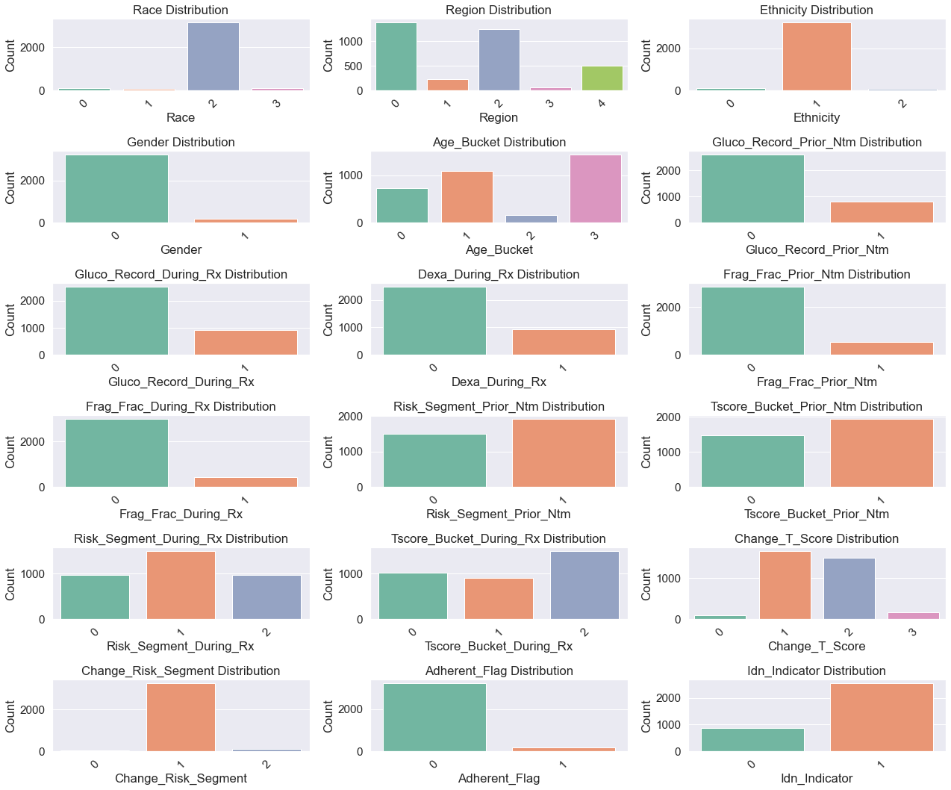
Data Summary and Distribution
Distribution of demographic features clinical features, risks and comorbidities

Slide 4
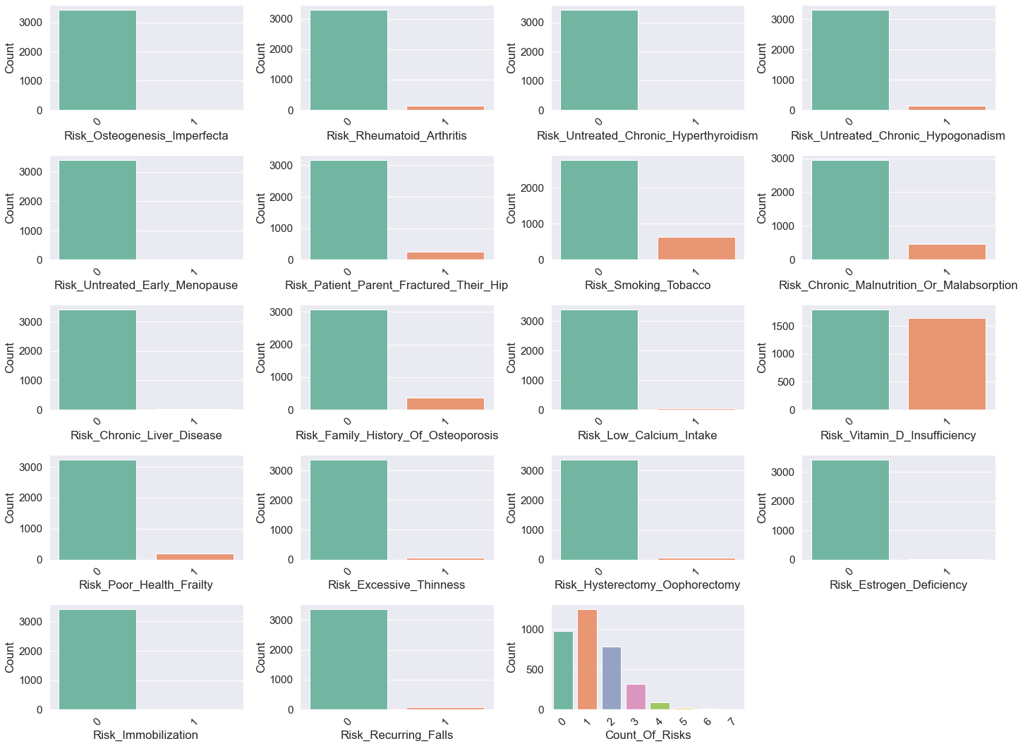

Slide 5
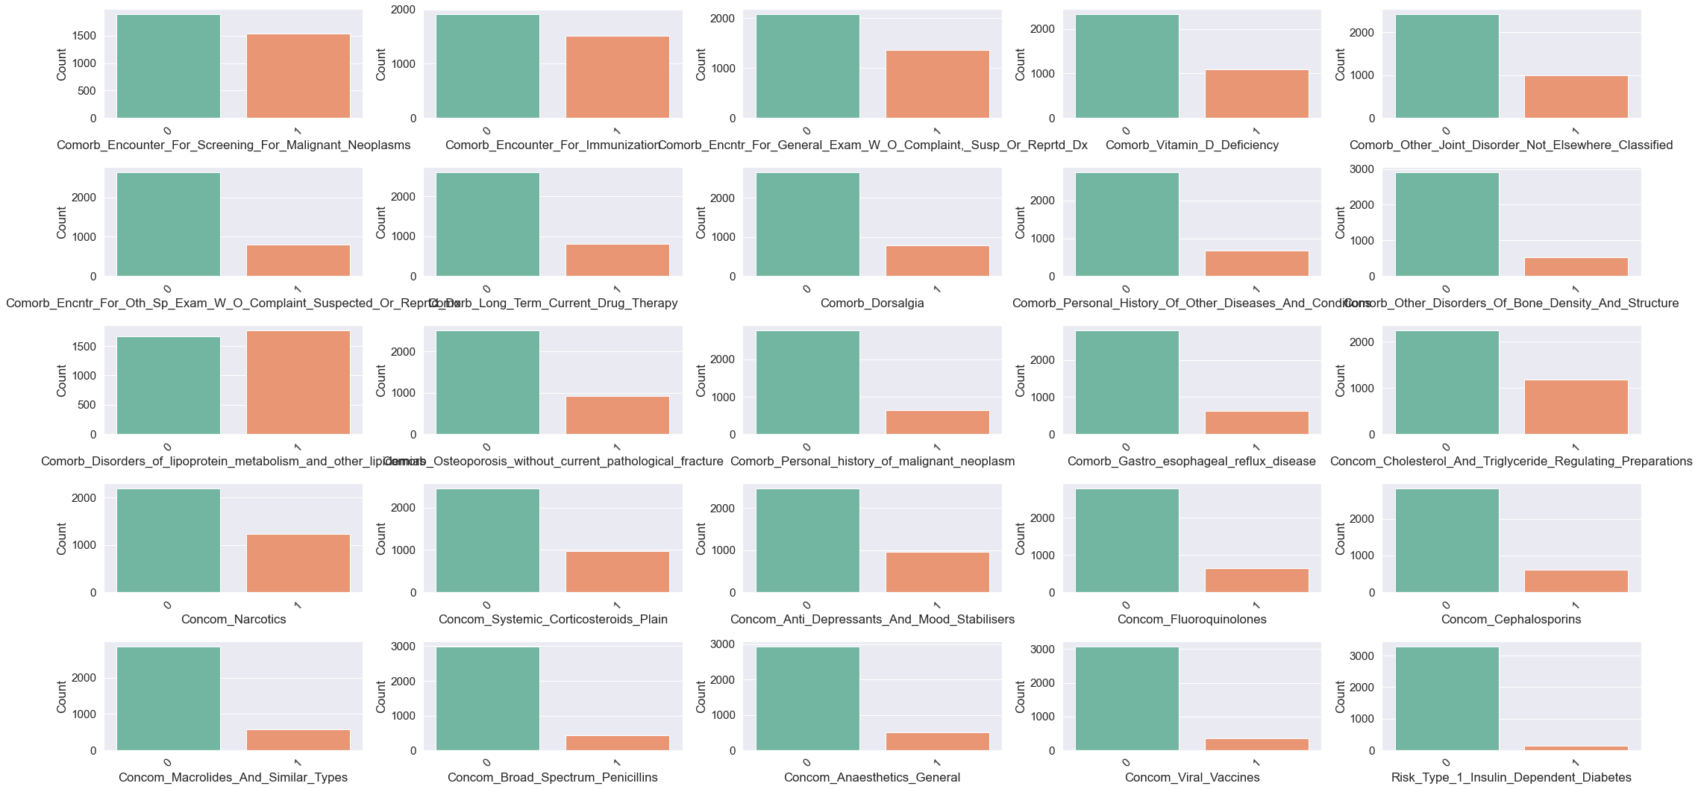

Slide 6
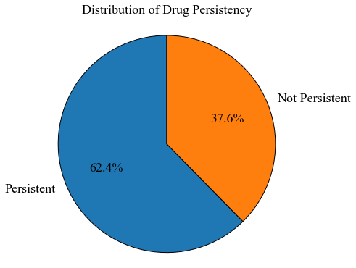
Target variable analysis

Slide 7
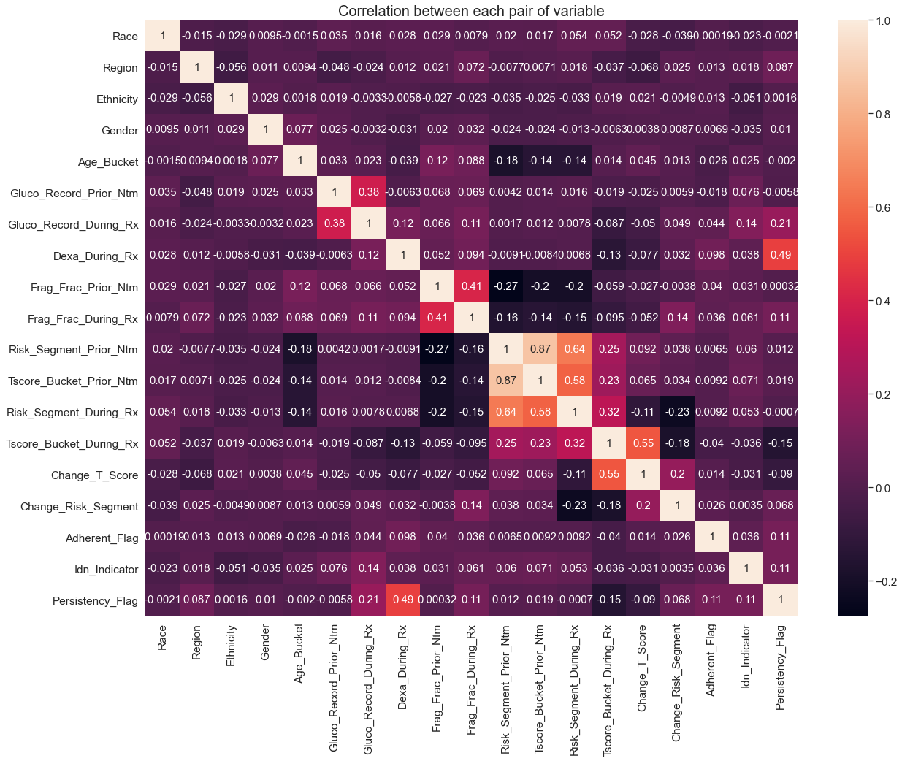
Correlation Analysis
Correlation heatmap between each pair of variables and target variable
Features that have a higher correlation with involve
Dexa_During_Rx
Dexa_Freq_During_Rx
Comorb_Long_Term_Current_Drug_Therapy
Comorb_Encounter_For_Screening_For_Malignant_Neoplasms omorb_Encounter_For_Immunization

Slide 8
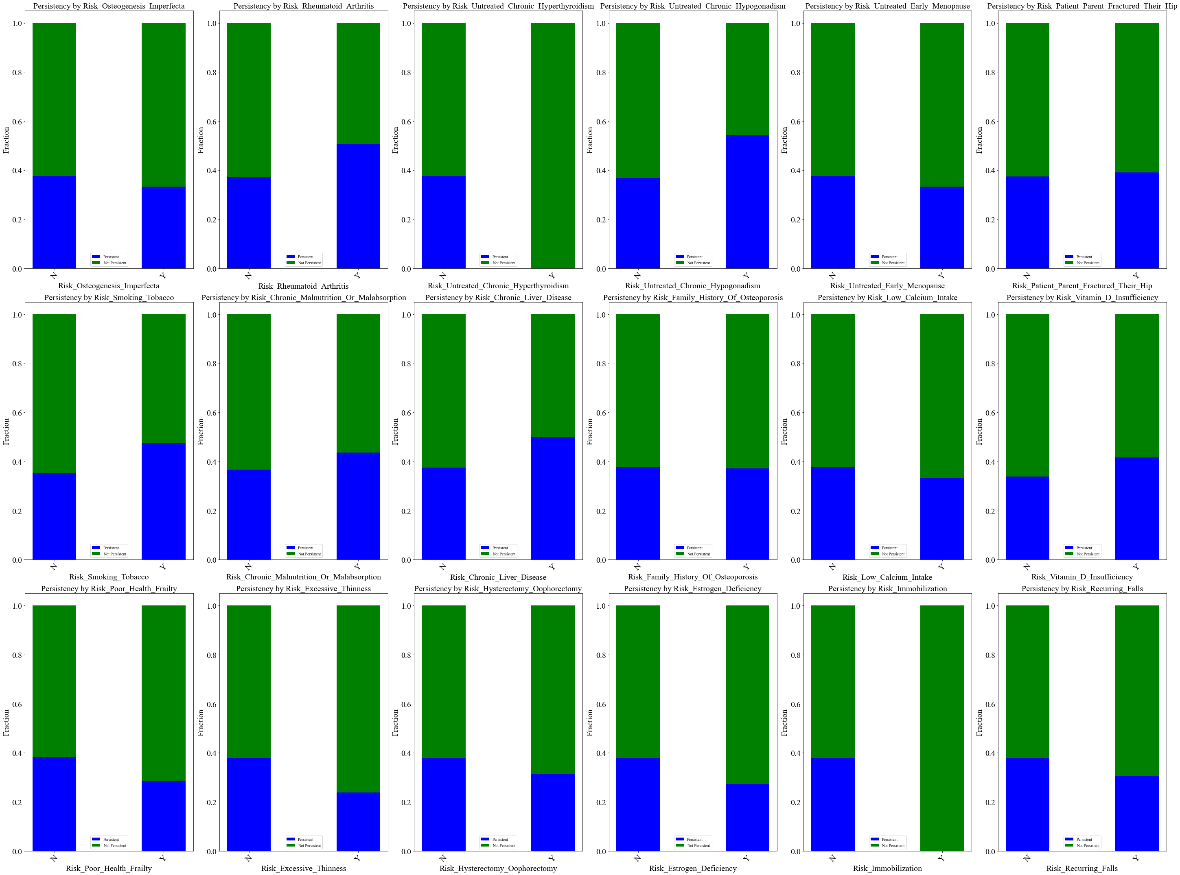
Relationship analysis
Bar charts of the fraction of not persistent and persistent drugs grouped by different features (i.e. risks and comorbidities )

Slide 9
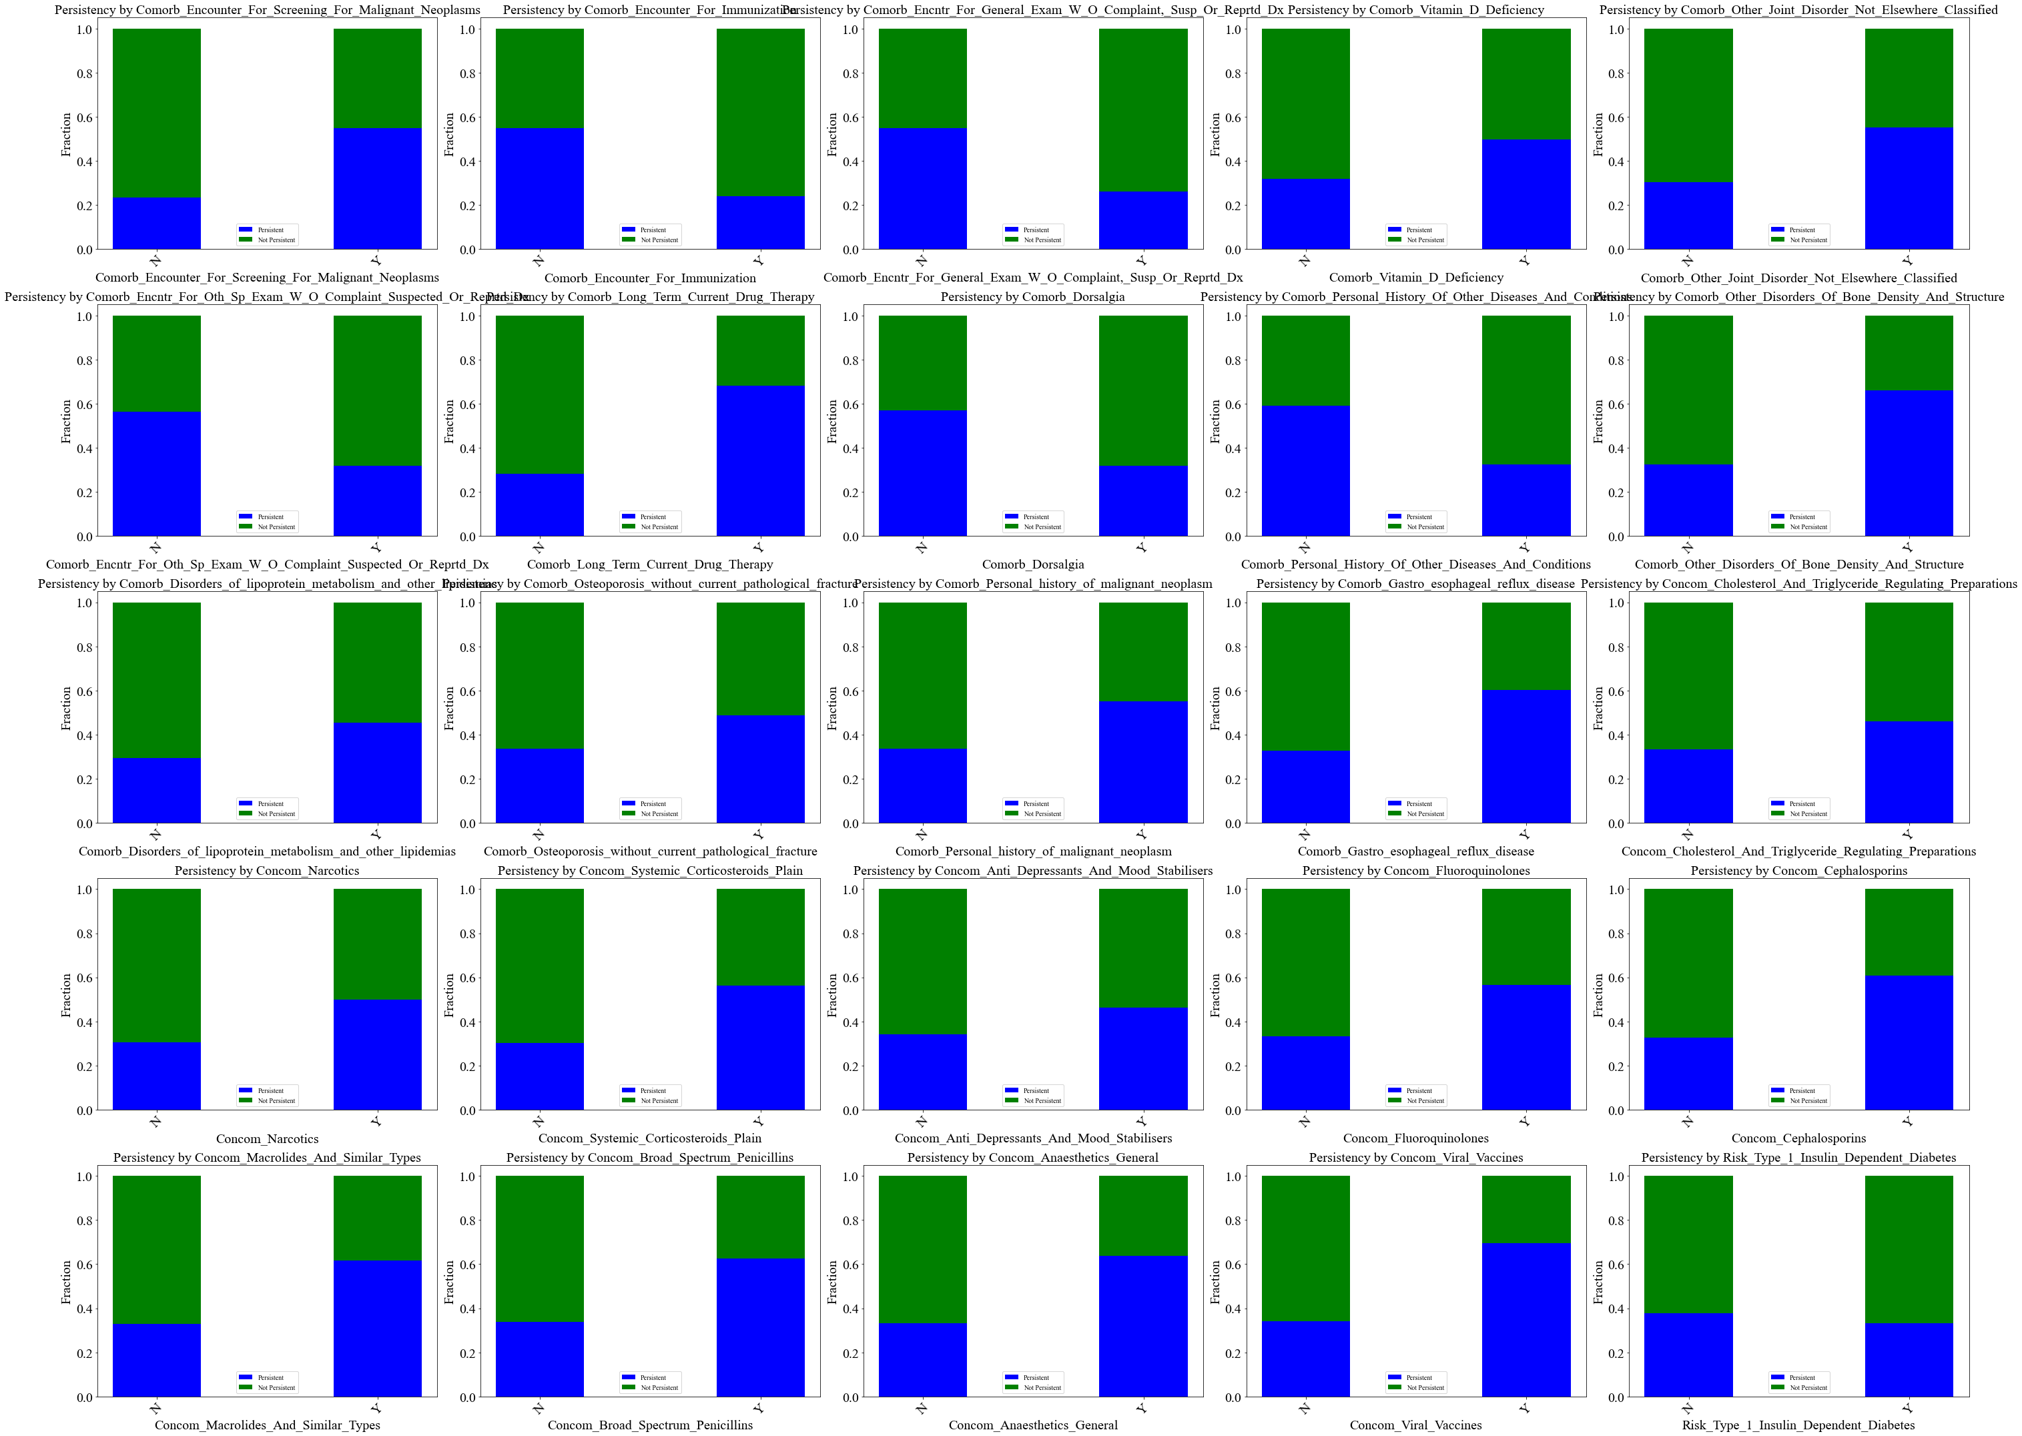

Slide 10

Insights and recommendations (1)
Demographic Factors:
Age: Patients aged over 75 years tend to have a higher rate of drug persistency. This suggests that age is a significant factor influencing drug adherence.
Gender: Females are more likely to be persistent in taking medications. Understanding the reasons behind this gender difference can help tailor interventions.
Region and Ethnicity: Patients from the midwest region and those with ethnicity not Hispanic exhibit higher drug persistency rates. Explore region-specific healthcare practices and cultural factors that contribute to this trend.

Slide 11

Insights and recommendations (2)
Clinical Factors:
Gluco_Record_During_Rx: Patients with glucose records during treatment are more likely to be persistent. Ensuring regular monitoring of relevant clinical parameters could improve adherence.
Dexa_During_Rx: Patients receiving DEXA scans during treatment are more persistent. Consider promoting the importance of bone density monitoring.
Frag_Frac_During_Rx: Patients with fragility fractures during treatment show higher persistency. Identify patients at risk of fractures and provide appropriate interventions.
Change_T_Score and Adherent_Flag: Patients showing improvement in T-score and adherence tend to be more persistent. Implement strategies to enhance patient education and engagement in treatment plans.
Idn_Indicator: Patients mapped to an Integrated Delivery Network (IDN) are more likely to be persistent. Collaborate with IDNs to understand their practices that contribute to better persistency.

Slide 12

Insights and recommendations (3)
Risk Factors and Comorbidities:
Patients with certain risk factors such as 'Risk_Poor_Health_Frailty' and 'Risk_Recurring_Falls' are less likely to be persistent. Tailor interventions for patients with these risk factors to improve adherence.
Patients with specific comorbidities like 'Comorb_Encounter_For_Immunization' exhibit lower drug persistency, which could address comorbidity-related challenges in treatment plans.

Slide 13

Insights and recommendations (4)
Correlation Analysis:
Features highly correlated with drug persistency, such as 'Dexa_During_Rx' and 'Dexa_Freq_During_Rx,' should be given special attention in model development.
Understanding the clinical relevance of these features can help healthcare providers tailor interventions.

Slide 14

Thank you

