Slide 1
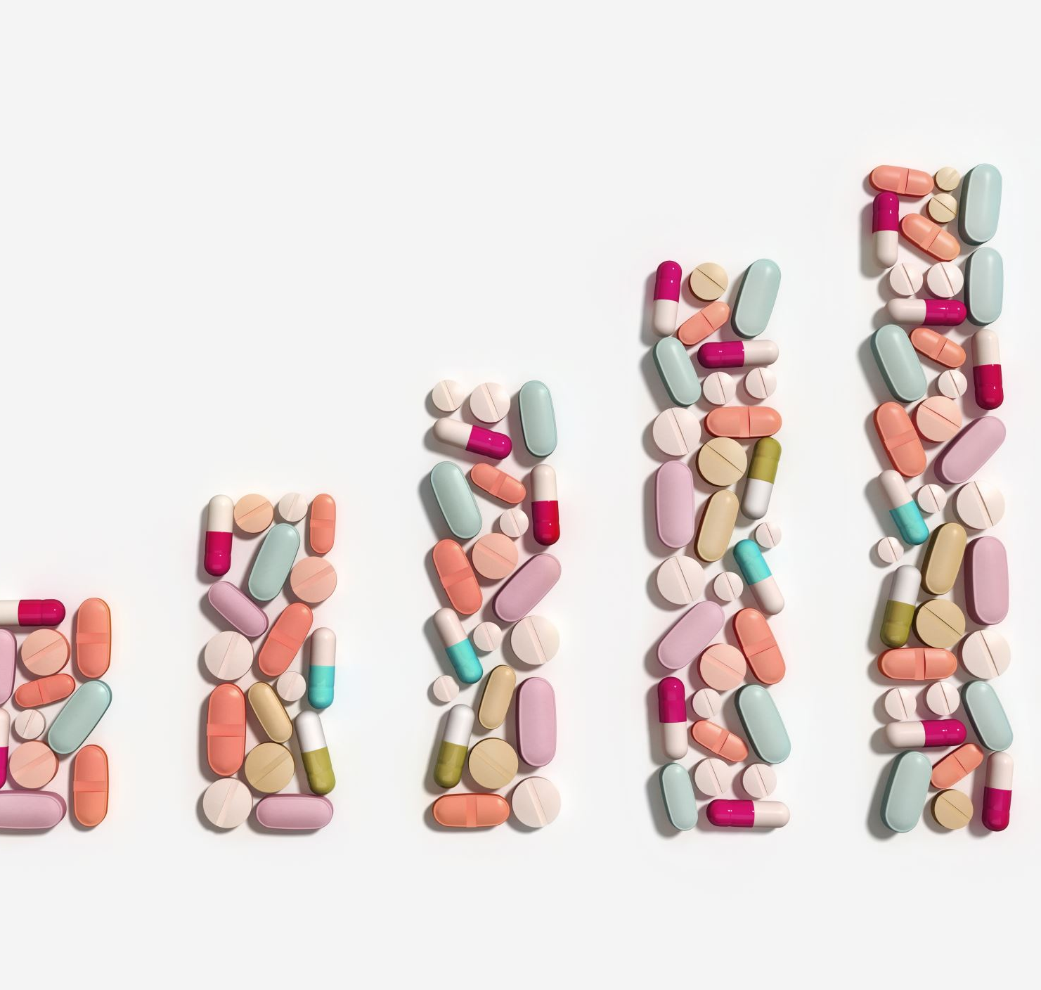
Healthcare – drug persistency
Group : PharmaPersist

Slide 2
Project Structure
Problem description: To gather insights on the factors impacting the persistency, build a classification model for the given dataset.
Data cleaning
Deal with missing values
Encode categorical variables
Explanatory data analysis
Model development and performance comparison

Slide 3
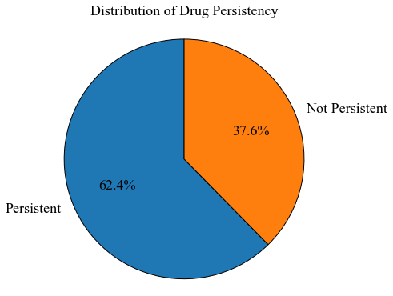
Target variable analysis

Slide 4
Explanatory data analysis insights
Demographic Factors:
Age: Patients aged over 75 years tend to have a higher rate of drug persistence. This suggests that age is a significant factor influencing drug adherence.
Gender: Females are more likely to be persistent in taking medications. Understanding the reasons behind this gender difference can help tailor interventions.
Region and Ethnicity: Patients from the midwest region and those with ethnicity not Hispanic exhibit higher drug persistence rates. Explore region-specific healthcare practices and cultural factors that contribute to this trend.

Slide 5
Explanatory data analysis insights
Clinical Factors:
Gluco_Record_During_Rx: Patients with glucose records during treatment are more likely to be persistent. Ensuring regular monitoring of relevant clinical parameters could improve adherence.
Dexa_During_Rx: Patients receiving DEXA scans during treatment are more persistent. Consider promoting the importance of bone density monitoring.
Frag_Frac_During_Rx: Patients with fragility fractures during treatment show higher persistency. Identify patients at risk of fractures and provide appropriate interventions.
Change_T_Score and Adherent_Flag: Patients showing improvement in T-score and adherence tend to be more persistent. Implement strategies to enhance patient education and engagement in treatment plans.
Idn_Indicator: Patients mapped to an Integrated Delivery Network (IDN) are more likely to be persistent. Collaborate with IDNs to understand their practices that contribute to better persistence.

Slide 6
Explanatory data analysis insights
Risk Factors and Comorbidities:
Patients with certain risk factors such as 'Risk_Poor_Health_Frailty' and 'Risk_Recurring_Falls' are less likely to be persistent. Tailor interventions for patients with these risk factors to improve adherence.
Patients with specific comorbidities like 'Comorb_Encounter_For_Immunization' exhibit lower drug persistency, which could address comorbidity-related challenges in treatment plans.

Slide 7
Model development
Baseline model
Logistic regression model
SVM model
Random forest model
Gradient boost model

Slide 8
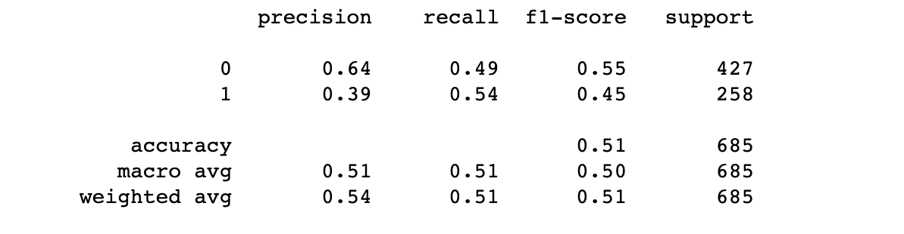
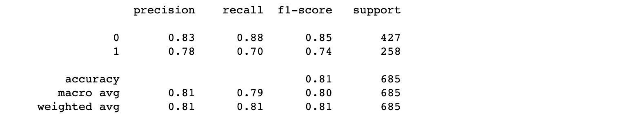
Model performance (baseline and logistic regression)

Slide 9
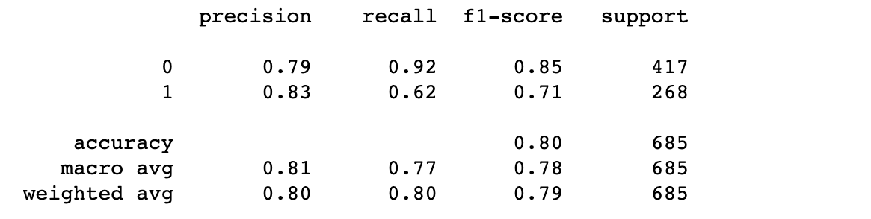
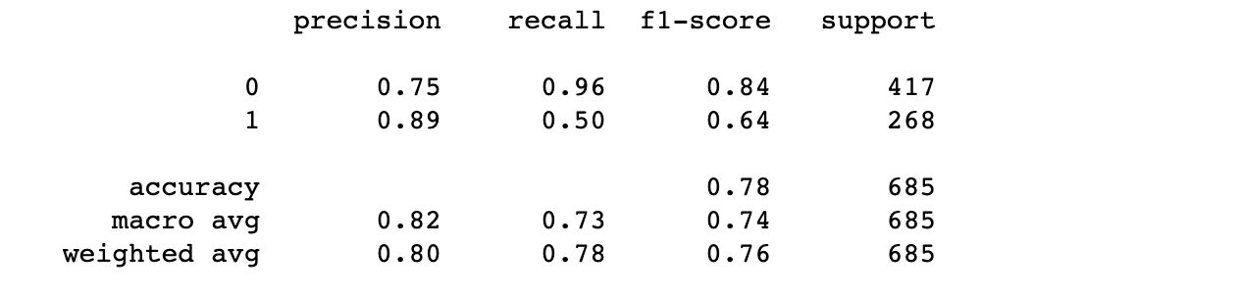
Model performance (SVM and Random Forest)

Slide 10
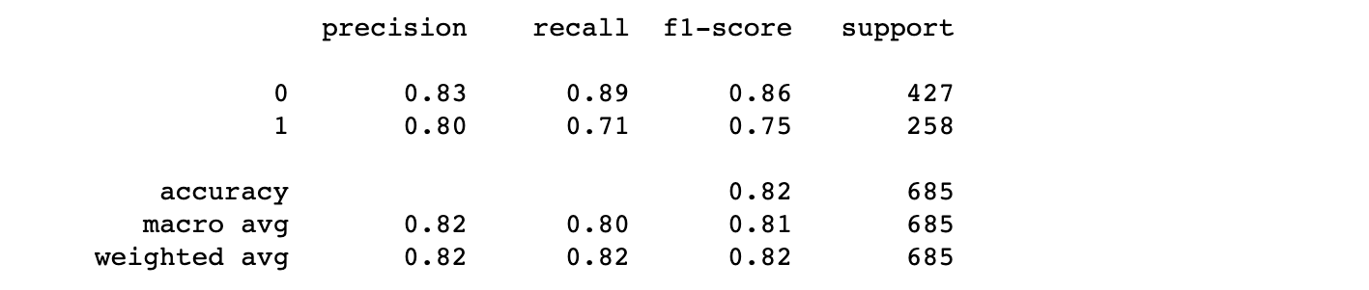
Model Performance (Gradient boosting)
With the highest F1-score the gradient boosting model is more capable of finding a balance in capturing and identifying non-persistent drugs correctly

Slide 11
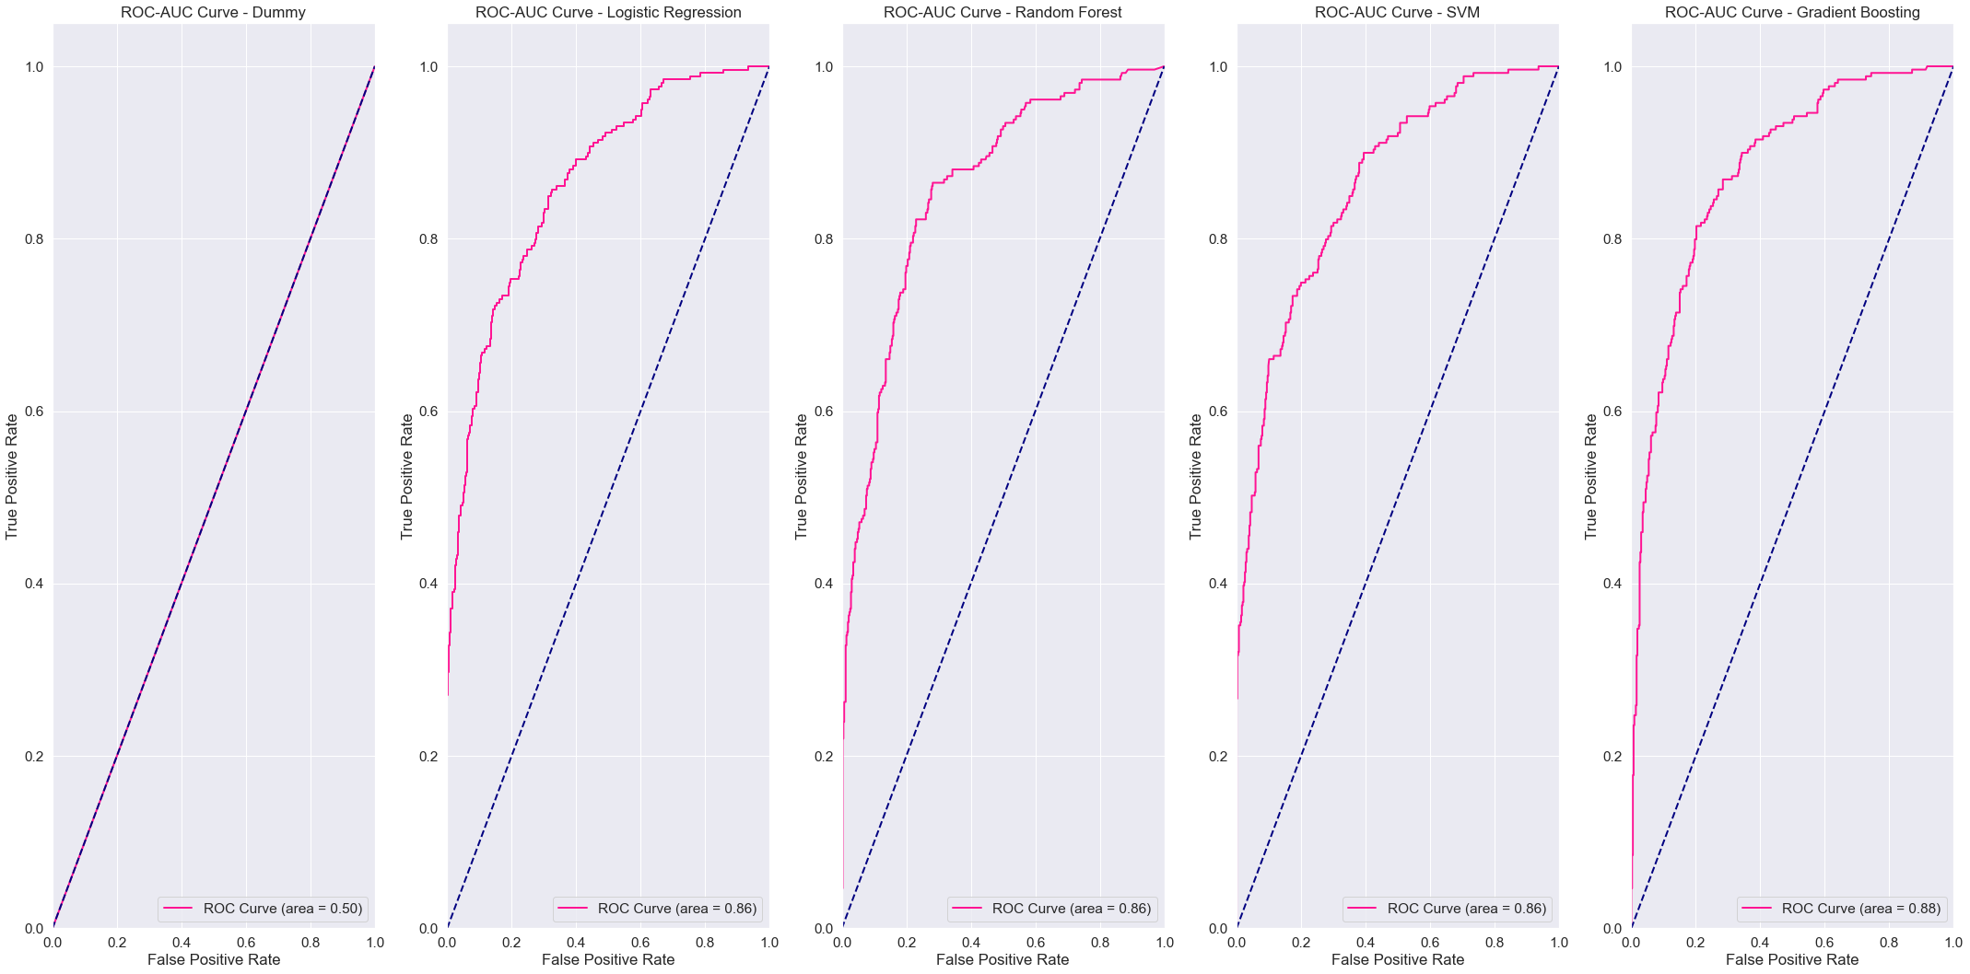
AUC-ROC curve
Worst performance
Best performance

Slide 12

Thank you

