Slide 1
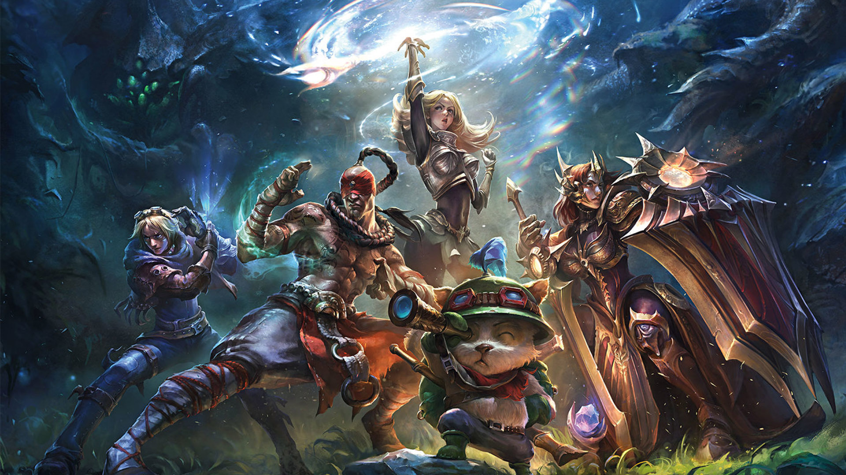



Predict the outcome of the ranked game in league of legends
Yunxuan Zeng
Data Science Initiative
Brown University
10/15/2020
https://github.com/YunxuanZeng/1030Project

Slide 2


Outline
Introduction
Exploratory Data Analysis
Data Splitting
Data Preprocessing

Slide 3

Introduction
Dataset: League of Legends Diamond Ranked Games (10 min)
9879 ranked games
19 features per team (38 in total)
Target variable: blueWins (0/1)
Link: https://www.kaggle.com/bobbyscience/league-of-legends-diamond-ranked-games-10-min
Classification Problem:
Predict the winner of a ranked game based on the statistics of two teams in the first 10 minutes
Significance:
Popularity
Diversity and Inclusion
Fairness

Slide 4
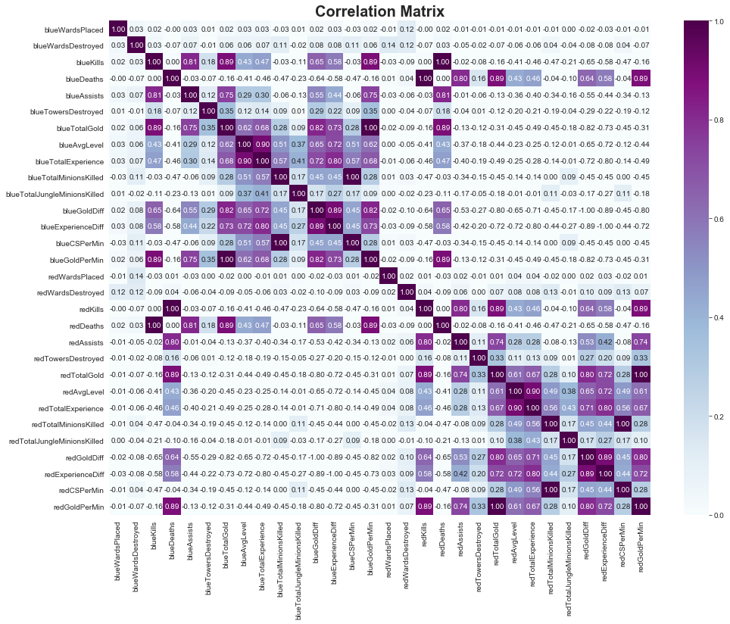
Exploratory Data Analysis
Positive Relation:
Blue total gold & blue kills/assists
Blue total gold & blue gold/experience diff
Blue Avg Level & blue total experience
Negative Relation:
Blue total gold & blue deaths
Blue Avg Level & blue deaths

Slide 5
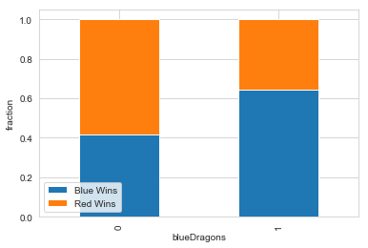
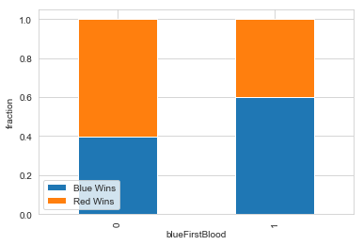
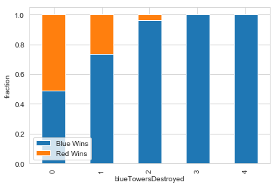
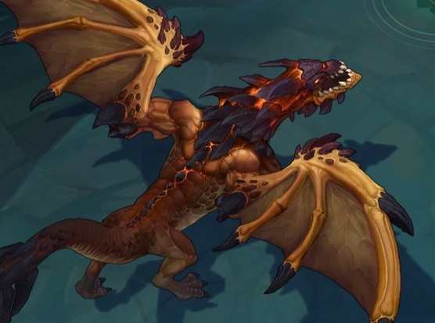
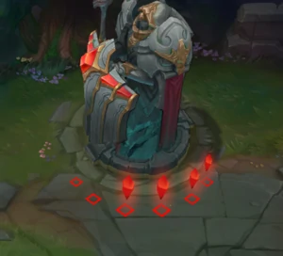
Exploratory Data Analysis
Dragon: grants armor, magic resistance, or bonus damage
First blood: first champion kill in the game
Towers: deal damage to enemies and provide vision
Teams which kill first dragon, get first blood or destroy more towers has a higher win rate.

Slide 6
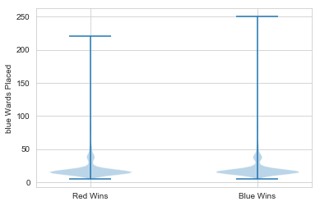
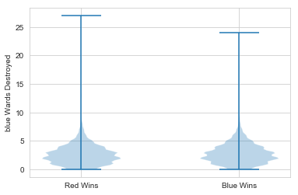

Exploratory Data Analysis
Ward: Vision in the game
The distributions for both teams have the similar shape.
Placing and destroying wards has low impact on game results.

Slide 7
Data Splitting
IID Data
No missing values
No group structure
No time series data
No need to preprocess labels
StratifiedKFold

Slide 8
Data preprocessing
OneHotEncoder
blueFirstBlood
redFirstBlood
blueHeralds
redHeralds
blueDragons
redDragons
blueWins
StandardScaler
blueWardsPlaced
blueWardsDestroyed
blueKills
blueDeaths
blueAssists
blueTotalExperience
blueTotalMinionsKilled
blueTotalJungleMinionsKilled
blueCSPerMin
blueTotalGold
blueGoldDiff'
blueExperienceDiff
blueGoldPerMin
…Same for the red team
Training set:
X:(8003,44) y:(8003, 2)
Validation set:
X: (888, 44)
y: (888, 2)
Testing set:
X: (988, 44)
y: (988, 2)
MinMaxScaler
blueAvgLevel: 1 -18
redAvgLevel: 1 - 18
blueTowersDestroyed: 0 - 9
redTowersDestroyed: 0 - 9
blueEliteMonsters: 0 - 3
redEliteMonsters: 0 - 3

Slide 9

Thank you for listening!

