Slide 1
Final Project
- Download Manager-
201911471 Yunju Jo

Slide 2

Contents
0. Introduction
Development environment
Design
Flow Chart
Explain Code(Implement)
Execution
Conclusion

Slide 3
Introduction
I find it annoying to collect images for assignments, because when I download images without thinking, I often end up downloading things that aren't images. (Some weird stuff with unknown paths...) I'm going through the process of using and categorizing those images.
So I created Download Manager with the idea that I could attach a link to all the image addresses or a link to the pdf address in one txt file and get the downloads all at once.

Slide 4

Development environment

Slide 5
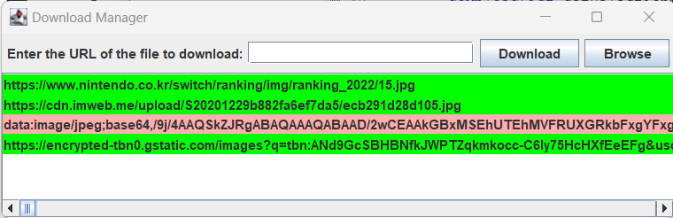
Design

Slide 6
Flow Chart
Start
Create GUI window
Initialize Components
Create layout
Display GUI window

Slide 7
Flow Chart
Start
Wait the user input
Browse Button Click
&File upload
Add URL &
Download Button Click
Read File
Download Queue empty?
No
Error message
Yes
Download
Yes
No
Highlight URL Item (Green Color)
Highlight URL Item (Red Color)
Display Error Message
Error?
Display Success Message

Slide 8
Explain Code(Class structure)
DownloadManager
- downloadQueue : Queue<String> - isDownloading : boolean - urlField : JTextField - downloadButton : JButton - browseButton : JButton - downloadListModel : DefaultListModel<String> - downloadList : JList<String> - downloadItemColors : Map<String,Color>
+ DownloadManager() - initializeComponents() : void - createLayout() : void + addToQueue(String) : void - startDownload() : void + notifyDownloadComplete(String, boolean) : void - showDownloadCompleteMessage(String) : void +showErrorMessage(String) +addToDownloadList(String) : void - loadUrlsFromFile : void - highlightDownloadItem(String, Color) : void
DownloadTask (implements Runnable)
- url : String - downloadManager : DownloadManager
+ DownloadTask(String, DownloadManager) + run() : void - downloadImage(URL, String) : void -getFileNameFromUrl(URL) : String
MyListCellRenderer (extends DefaultListCellRenderer)
+getListCellRendererComponent(JList<?>, Object, int, boolean, boolean) : Component

Slide 9
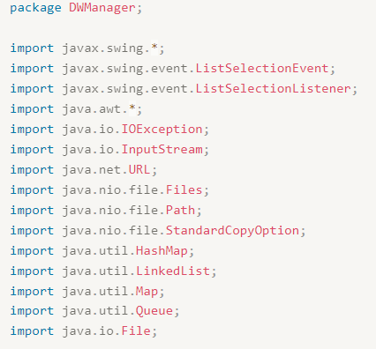
Explain Code (import)

Slide 10
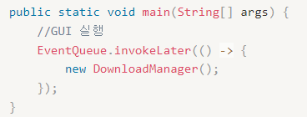
Explain Code (main)
EventQueue.invokeLater()
: Create GUI
() -> { new DownloadManager(); }
: Lambda expression / Create a DownloadManager object

Slide 11
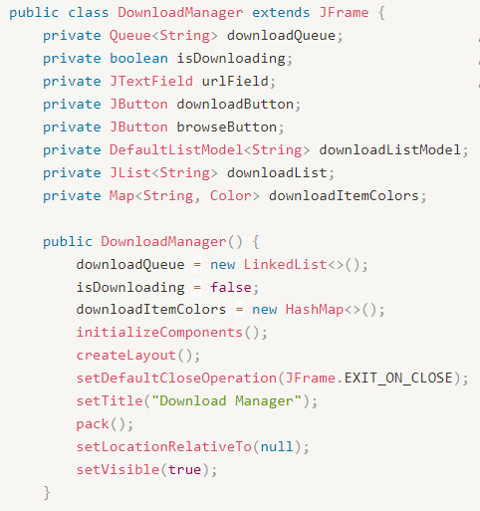
Explain Code(DownloadManager- member variables)
private Queue<String> downloadQueue; : Queue to store the download list
private boolean isDownloading; : Variable to indicate if a download is in progress
private JTextField urlField; : Text field for entering the URL
private JButton downloadButton; : Download button
private JButton browseButton; : Browse button for selecting files
private DefaultListModel<String> downloadListModel; : List model for displaying the download list
private JList<String> downloadList; : List for displaying the download list
private Map<String, Color> downloadItemColors; : Map to store cell background colors for download items

Slide 12
Explain Code(DownloadManager)
The DownloadManager() method is effectively a main function. It initializes several variables before starting.
It initializes the list and download status, item colors and components, and creates the layout. It also makes some simple settings for the frame.

Slide 13
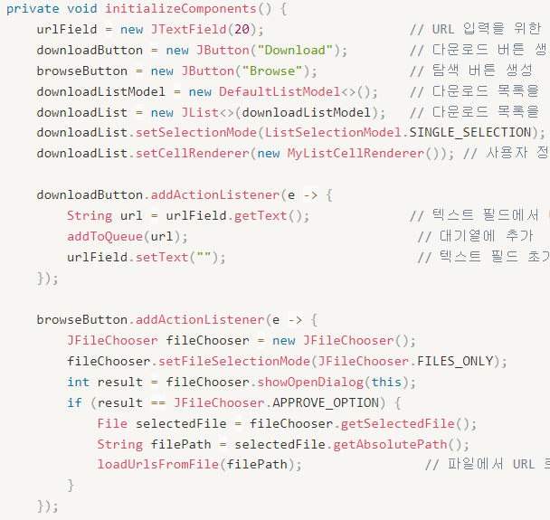
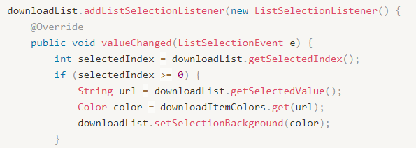
Explain Code(initializeComponents method)
This is pretty much the frontend.
It's the code that creates and sets up the buttons or lists you see.
It uses javax.swing.

Slide 14
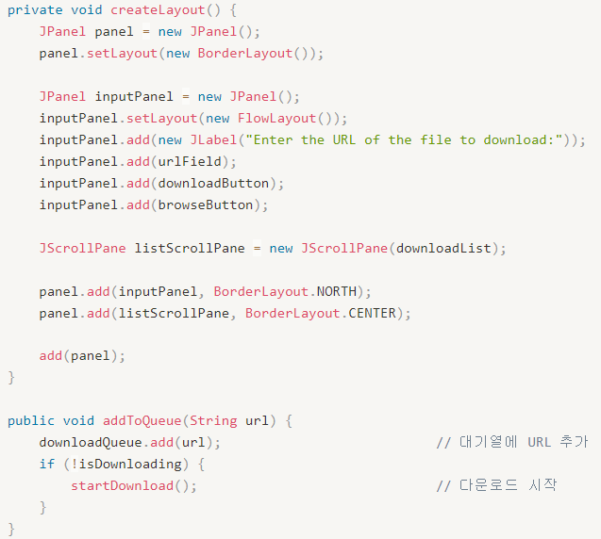
Explain Code(CreateLayout, addToQueue methods)
The createLayout() method is responsible for creating the layout of the UI and placing the components.
The addToQueue(String url) method adds the given URL to the download queue and starts the download if it is not already downloading

Slide 15
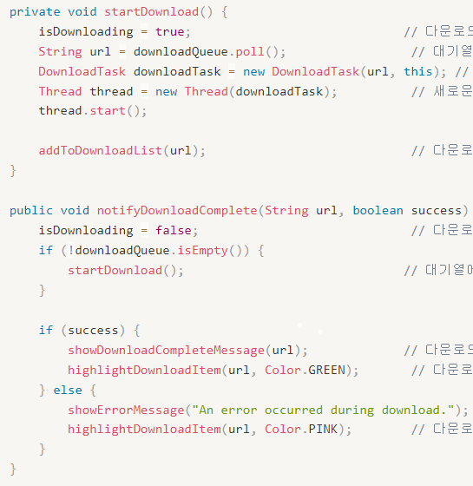
Explain Code(startDownload, notifyDownloadComplete methods)
The startDownload() method is responsible for starting the download.
It creates a new thread and tells it to run the download operation in the new thread.
(DownloadTask is meke the thread)
The notifyDownloadComplete(String url, boolean success) method is called when the download operation is complete to perform processing.
If the download was successful, the list is colored green with a completion message, and if the download was unsuccessful, the list is colored pink with an error message.

Slide 16
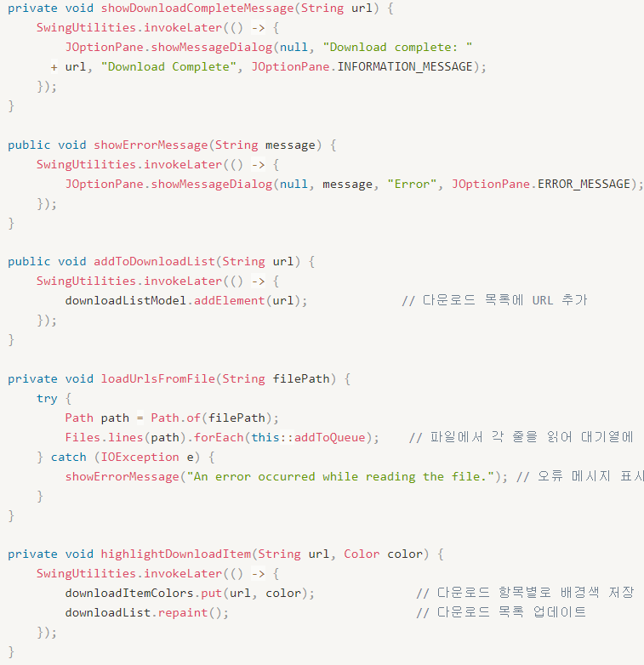
showDownloadCompleteMessage(String url): Method to display a download complete message when the download is complete.
showErrorMessage(String message): Method to display an error message.
addToDownloadList(String url): Method to add a URL to the download list.
loadUrlsFromFile(String filePath): Method to load URLs from a file and add them to the queue.
It uses Files.lines() to read each line of the file and calls the addToQueue() method to add each URL to the queue.
highlightDownloadItem(String url, Color color): This method highlights the download item.
It stores the URL and its corresponding background color in the downloadItemColors map, and updates the download list by redrawing the downloadList

Slide 17
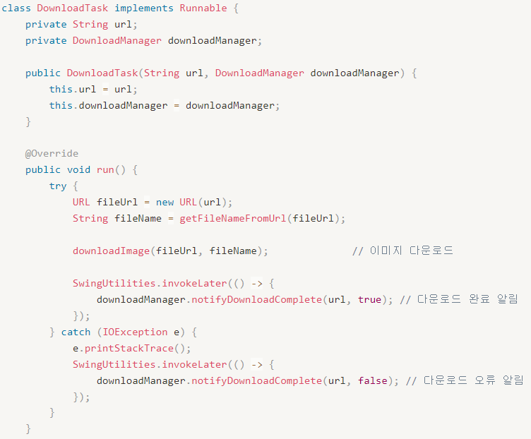
Explain Code(class DownloadTask -1)
The Runnable interface is the fundamental interface for implementing multithreading in Java.
Runnable allows for threaded and isolated operations.
(Only
DownloadTask is a class that implements the Runnable interface and is responsible for performing download tasks.
The run() method is a required method of the Runnable interface and is where the actual download operation is performed.

Slide 18
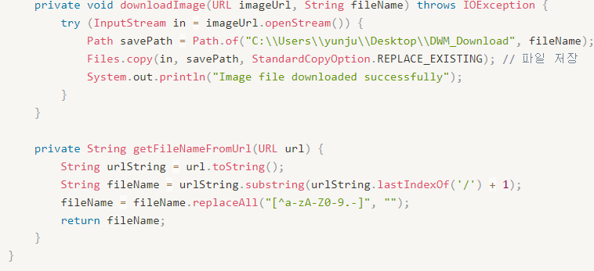
Explain Code(class DownloadTask -2)
The downloadImage(URL imageUrl, String fileName) method is responsible for downloading an image from imageUrl and saving it as fileName.
You can replace the path here.
The getFileNameFromUrl(URL url) method extracts the file name from the url and returns it. However, since URLs aren't always clear, it removes as many alphabetic, numeric, and hyphenated characters as possible from the URL to return a refined filename.

Slide 19
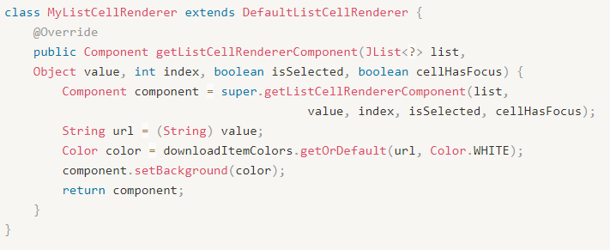
Explain Code(class MyListCellRender)
DefaultListCellRenderer: In Swing, this class is responsible for the default rendering of list cells in components like JList.
The MyListCellRenderer class is defined and used inside the DownloadManager class. The MyListCellRenderer class inherits from the DefaultListCellRenderer class and is used to customize the rendering of list cells.

Slide 20
Execution
Actually going to run it.

Slide 21
Conclusion
There are no major errors in this project, but I want to be able to download even the files that are not downloadable.
So I thought about different ways to do it, and after searching, I found Jsoup.
Jsoup is an HTML parsing and manipulation library written in Java that provides the ability to parse an HTML document, select the desired elements, and extract or manipulate data.
I kept trying to make it work better, but it didn't. If I get a chance, I'd like to integrate Jsoup into my download manager.

