Slide 1
Final Project
Find the maximum Netflix stock price by year
201911471 Yunju Jo

Slide 2

Contents
0. Overview
Focused code - MapReduce
Java Code
Compare the original code
Result
Input/output file
Conclusion
Reference

Slide 3
Overview
This takes all the stocks of NETFLIX from 2002 to 2022 and selects only the highest peak for each year.
This allows you to quickly see when netflix had its highest stock price,
and the company's stock price on a year-by-year basis.

Slide 4
Focused code(Map-reduce)
#Compile Java
cd -
javac -d netflix netflix/ProcessUnits.java -cp $(hadoop classpath)
jar -cvf netflix.jar -C netflix/ .
# Copy sample data into hadoop/DFS file system $HADOOP_HOME/bin/hadoop fs -mkdir /input_netflix
$HADOOP_HOME/bin/hadoop fs -put /home/hdoop/NETFLIX.csv /input_netflix
$HADOOP_HOME/bin/hadoop fs -ls /input_netflix/
#excute the hadoop
$HADOOP_HOME/bin/hadoop jar netflix.jar ProcessUnits /input_netflix /output_netflix5
# start hadoop
$HADOOP_HOME/sbin/start-dfs.sh $HADOOP_HOME/sbin/start-yarn.sh
#make directory
mkdir netflix
cd netflix
#make ProcessUnits.java code
touch ProcessUnits.java
nano ProcessUnits.java

Slide 5
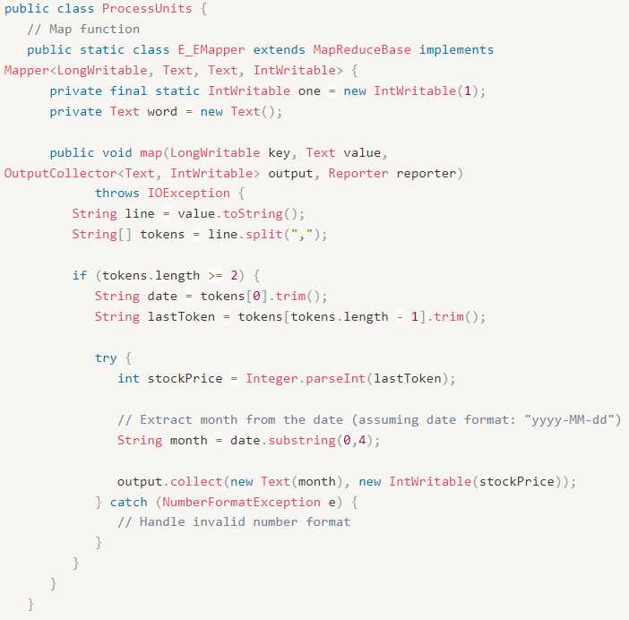
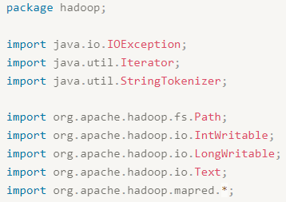
Java code

Slide 6
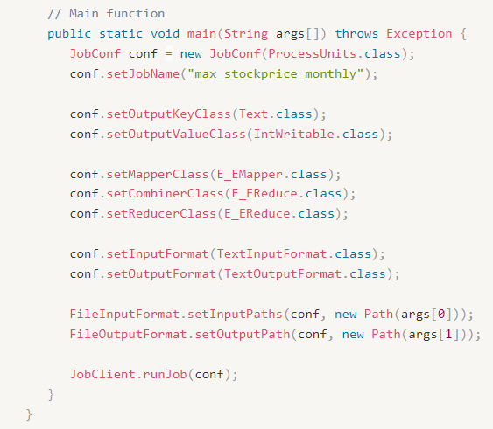
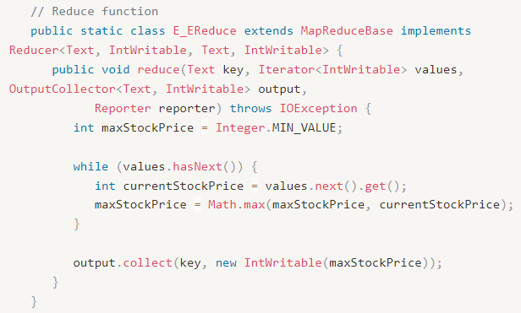
Java code

Slide 7
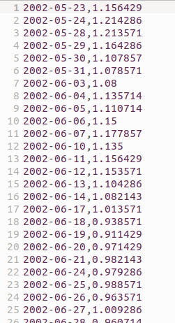
Compare the original code (1)
Input Data Format
Original code | My code
Each line of the input data is in a tab-separated format, such as "year \t value". | Each line of the input data is in a comma-separated format, such as "date, value1, value2, value3, ...".

Slide 8
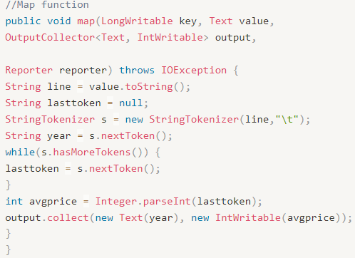
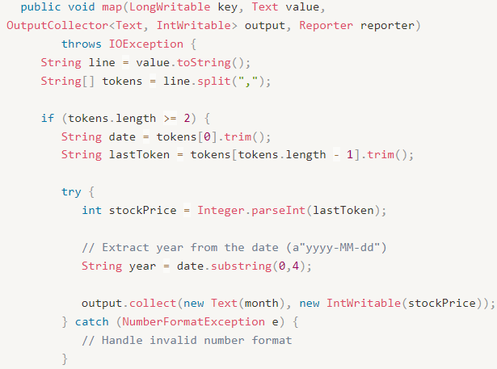
Compare the original code (2)
Map Function (Mapper)
Original code | My code
The input data is split using StringTokenizer with tab as the delimiter. The first token is used as the year, and the last token is used as the average price. | The input data is split using commas and stored in an array. And extract only 0-4 from the first value to get only the year. The first element is used as the year, and the last element is used as the stock price.

Slide 9
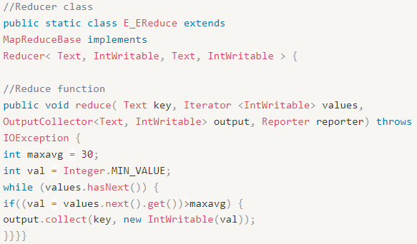
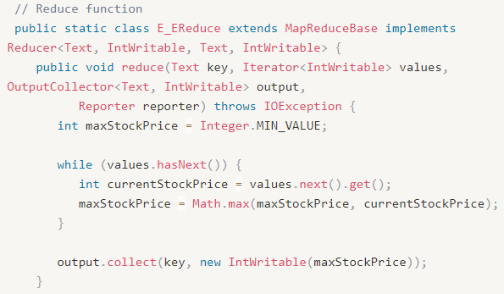
Compare the original code (3)
Reduce Function (Reducer)
Original code | My code
Only the values with an average price greater than 30 are selected for output | The maximum stock price among the input values is selected for output.

Slide 10
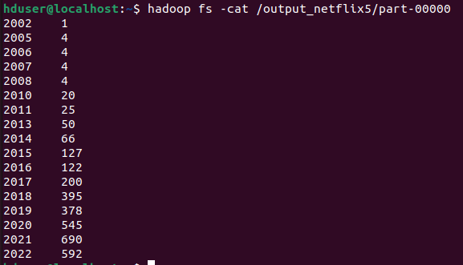
Result

Slide 11
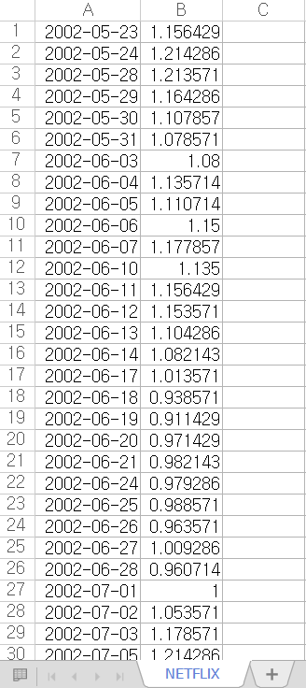
Input/Output file
stocks of NETFLIX
from 2002 to 2022

Slide 12
Conclusion
Through this project, I learned about the structure of Hadoop and how it can be used to easily and fast process large amounts of data.
However, My project has an error. In the result window, several years are missing. I tried to fix this, but I couldn’t.
I need to study Hadoop more and fix this error next time.

Slide 13
Reference
Netflix Stock Price Data set 2002-2022
https://www.kaggle.com/datasets/meetnagadia/netflix-stock-price-data-set-20022022
How does Hadoop read input file?
https://stackoverflow.com/questions/19470453/how-does-hadoop-read-input-file
MapReduce Tutorial – Apache Hadoop
https://hadoop.apache.org/docs/r1.2.1/mapred_tutorial.html

