Slide 1
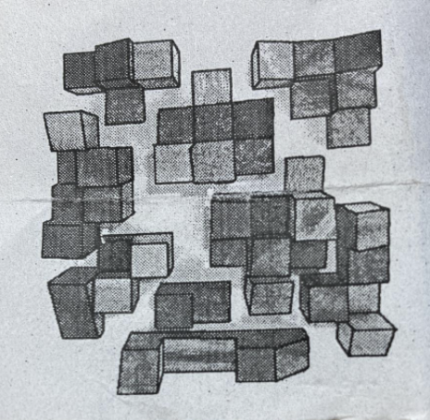
P0
P1
P3
P2
P4
P5
P6
P7
P8

