Slide 1
Transform kandinsky-painting to picasso cubism style
Yupeng Gao and Rui Wang

Slide 2

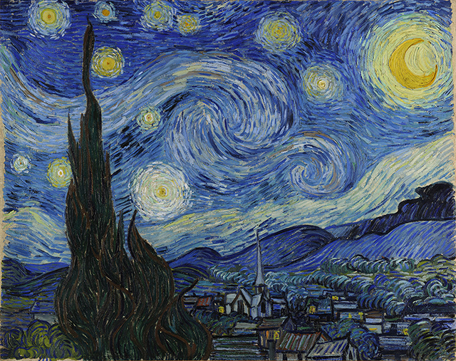
Previous Review

Slide 3
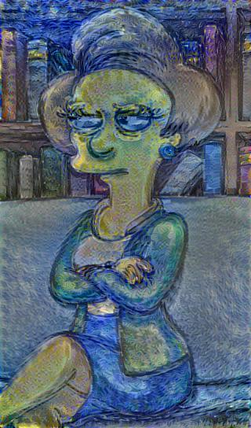
result

Slide 4
Continue…
In the next step, we did the following things:
1. Tuning parameters:
CONTENT_WEIGHT = 5e0 STYLE_WEIGHT = 1e2 LEARNING_RATE = 1e1 STYLE_SCALE = 1.0 ITERATIONS = 1000

Slide 5
What we found:
1. TensorFlow seems to be slower than a lot of the other deep learning frameworks
As of now, it seems to be around 3x slower than implementations using Torch.
This can be improved by either optimizing our code or take improvement in Tensorflow itself
So we can’t see too much rules or pattern with limited numbers of experiments
However…..

Slide 6
We still found
1. Running it for 500-2000 iterations seems to produce nice results. With certain images or output sizes, you might need some hyperparameter tuning (especially --content-weight, --style-weight, and --learning-rate).

Slide 7
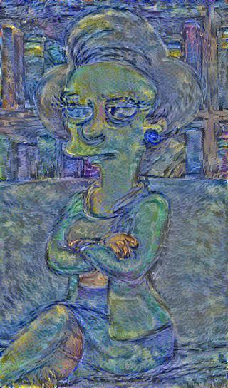
100 iteration
1000 iteration

Slide 8
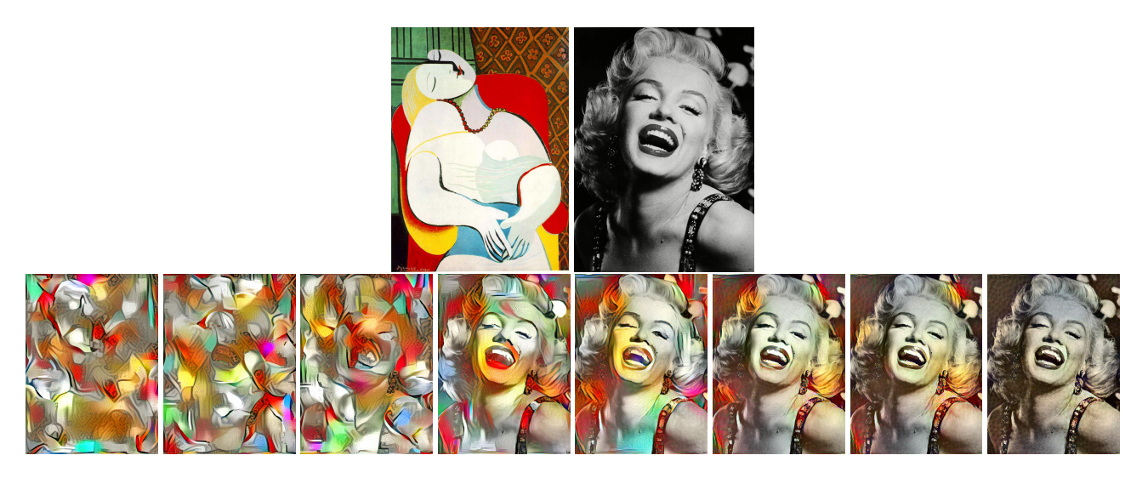
2.The pattern when modulating the content weight to style weight ratio
low content-to-style weight ratio on the left to a very high content-to-style weight ratio on the right

Slide 9
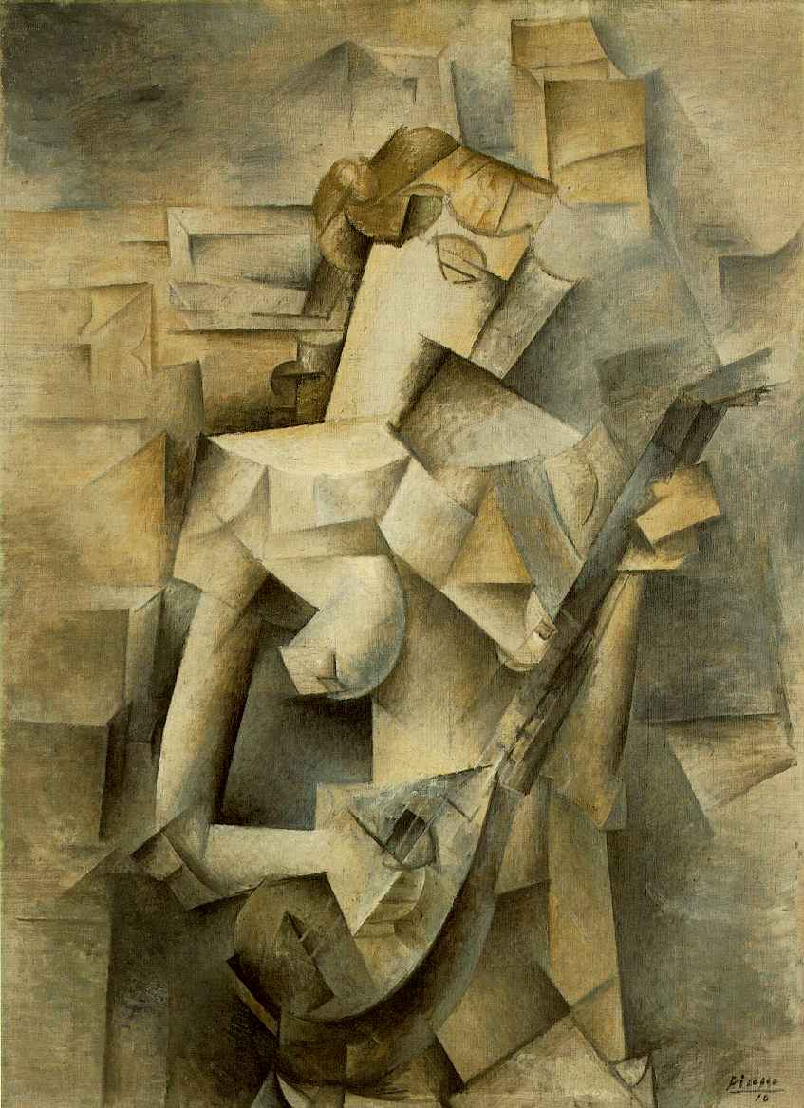
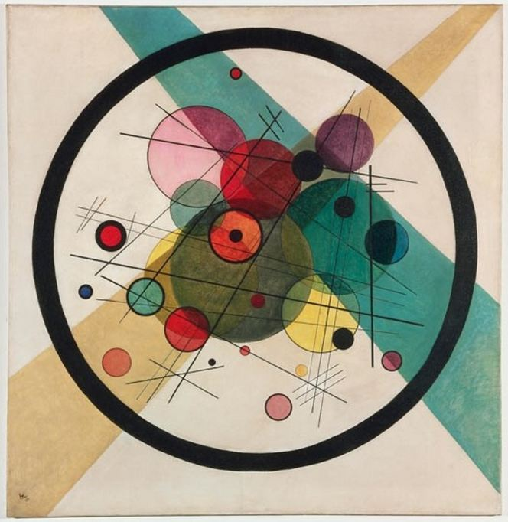
Now let me show you our results

Slide 10
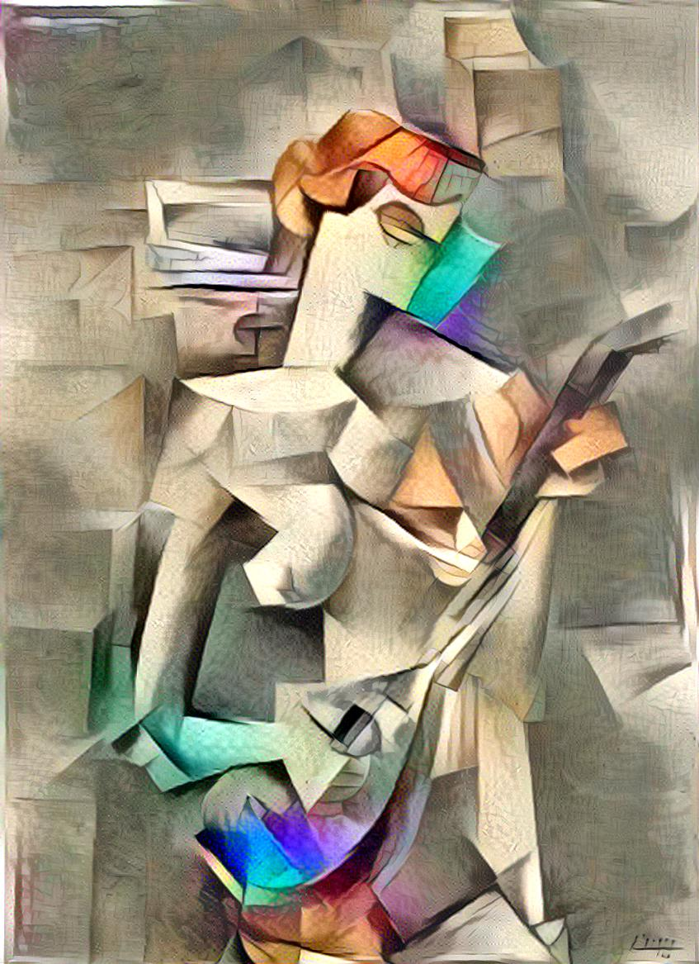

Slide 11
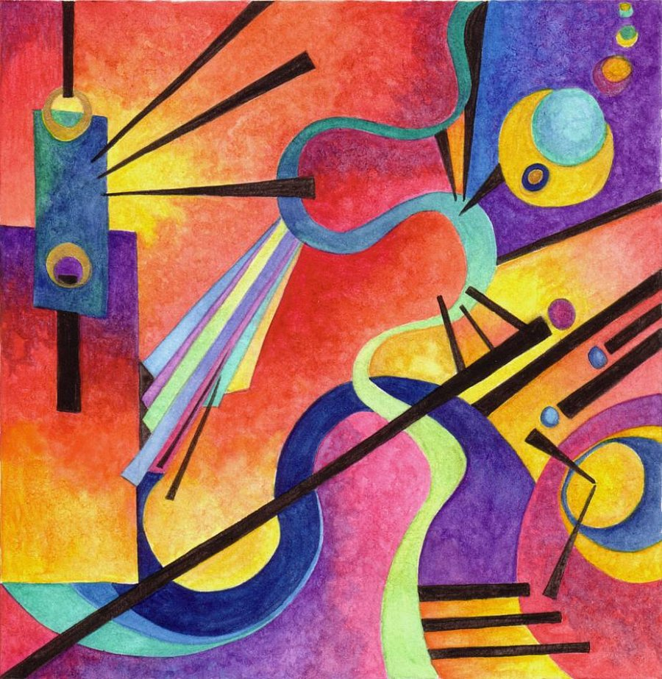

Slide 12


Slide 13
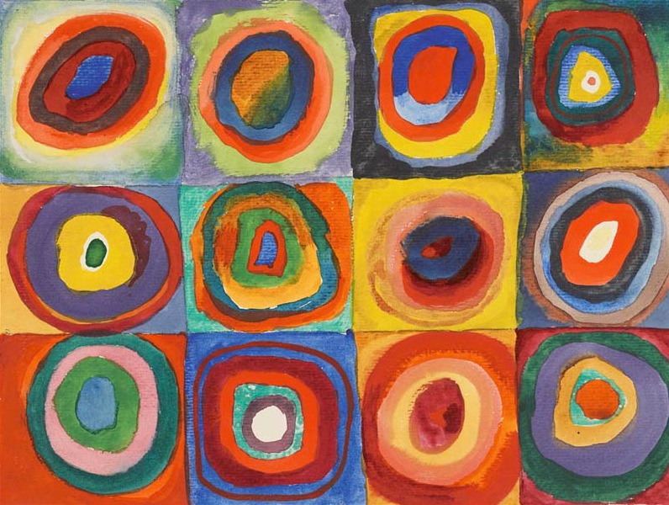

Slide 14


Slide 15
Thank you!

