Slide 1
Deep Patient Representation of Clinical Notes via Multi-Task Learning for Mortality Prediction
BMI 6319 Data Analysis for Scientific Research in Biomedical Informatics
Final Presentation
Yuqi Si
04/23/2019

Slide 2
Presentation Part I
Background
A significant amount of patient information is documented in unstructured data within Electronic Health Records (EHRs)
Most existing machine learning methods largely focus on just a single task and fail to realize the possible shared information between related tasks
There has been relatively few studies attempting to optimize on multiple tasks at the same time

Slide 3
Presentation Part I
Research Question and Hypothesis
Whether MTL architecture enables multi-task learning on clinical notes?
The performance of MTL is better than single-task learning (STL)?
Can MTL efficiently handle patient clinical notes than STL?
MTL can achieve generalized learning among multiple predictions?
Can we obtain a generalized representation by MTL on clinical notes?

Slide 4
Presentation Part I
Current main findings
The gains of MTL over STL are small but generally consistent in MTL. Specifically, the 3-task model achieved the best performance on in-hospital and 30-day mortality predictions. The 20-task model performs the best on the task of 1-year mortality prediction.
MTL does not negatively affect learning efficiency and achieves a well-matched performance among all tasks. The total training time is dramatically reduced while the representations still achieving comparable performance.
We further explore how the representation performs on forecasting length of stay (LOS), the result showing the patient vector extracted from the 3-task model of 30-day, 1-year mortality and 6-day LOS reached out the best performance on the target task of 14-day LOS prediction.
In this manner, the generalizability of the multi-task representation can be achieved among different clinical outcomes

Slide 5
Presentation Part I
Overarching Goal
To build a general-purpose patient representation by incorporating multiple resources and predicting interesting clinical outcomes
This representation will be an effective tool to support a variety of clinical research problems from quality care improvement (e.g., readmission prediction) to clinical prediction (e.g., mortality prediction, early diagnosis detection).
Further, the patient representation will be evaluated on rare disease problems to consolidate the result. We may expect an appropriate reasoning of rare disease prediction by fine-tuning on the patient representation learned from the large population.

Slide 6
Presentation Part I
Unmet needs for the field of research
Predictions limited to solely mortality and LOS, will include phenotyping to encode more medical-related knowledge
Intend to incorporate multiple modalities of data like numerical features and categorical features
Bring forward new research insights for patient treatment by choosing more detailed target task
To increase the performance of MTL by adopting more advanced MTL architectures (e.g. attention mechanisms, fusion techniques)

Slide 7
Presentation Part I
Questions?

Slide 8
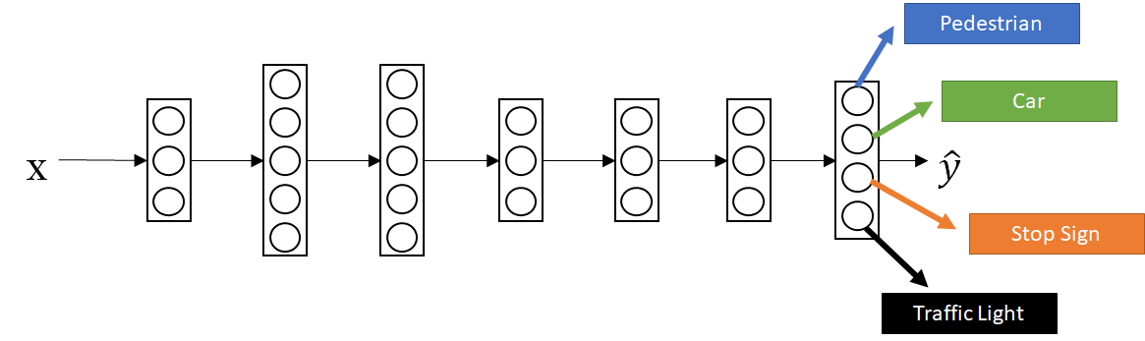
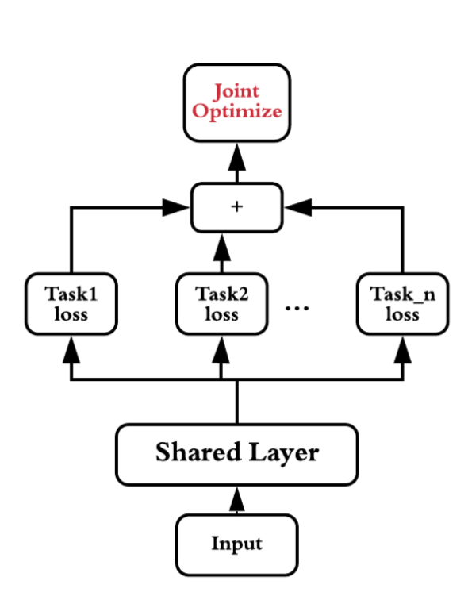
Presentation Part II
Background
MTL is adopted from the field of computer vision (e.g. to recognize people, road signs, road lines, etc.). It is now well-established that MTL can enhance learning efficiency if the model is able to selectively share information in a manner between related tasks including pattern recognition, natural language processing, and speech recognition.
MTL is an inductive transfer mechanism in which multiple related tasks are trained simultaneously and the learned parameters are partly shared
Numerous studies have highlighted the trend for adopting MTL based on lab tests or physiological variables in clinical settings
Meanwhile, several studies have developed patient representations from free-text clinical data
Figure 1: multi-task learning for self-diving car recognition
Figure 2: joint training of multi-task learning

Slide 9
Presentation Part II
Research Question
Little research has investigated the usage of MTL to develop the patient representation from clinical notes
To demonstrate the feasibility of utilizing MTL to efficiently learn meaningful knowledge from patient clinical notes
Focus on building an encoded patient vector representation from publicly accessible clinical notes via multi-task deep learning across multiple clinical predictions

Slide 10
Presentation Part II
Data
Clinical notes from MIMIC-III
Preprocessing:
keep adult patients;
keep patients with only one admission;
remove discharge summary;
attach note type (e.g. ECG, nursing);
combine multiple notes into one document
Pre-trained word embedding:
tokenize the notes with regular expressions
keeping only the 300K most frequent words
word2vec model via gensim
Label
Patient mortality prediction
In-hospital
30-day
1-year
60-day ----
Length of stay in ICU
6-day LOS --
14-day LOS --
Source task
Target task
Source task
Target task

Slide 11
Presentation Part II
Prediction setting 1: only patient mortality
Multi-task constituent
3-task [in-hospital, 30-day and 1-year mortality]
5-task [in-hospital, 30-day, 3-month, 1-year, 3-year]
20-task [in-hospital, 5-, 14-, 30-, 43-, 68-, 103-, 142-, 196-, 269-, 366-, 453-, 573-, 711-, 893-, 1092-, 1342-, 1626-, 1997-, 2548-day]
Source task & target task
50-dimension patient representations extracted from above three multi-task models
target task: 60-day mortality
Also trained a single model for each individual task

Slide 12
Presentation Part II
Prediction setting 2: involved with length of stay
Multi-task constituent
3-task [30-day,1-year mortality, and 6-day LOS]
Source task & target task
50-dimension patient representations extracted from above multi-task model
target task: 14-day LOS
Also trained a single model for each individual task

Slide 13
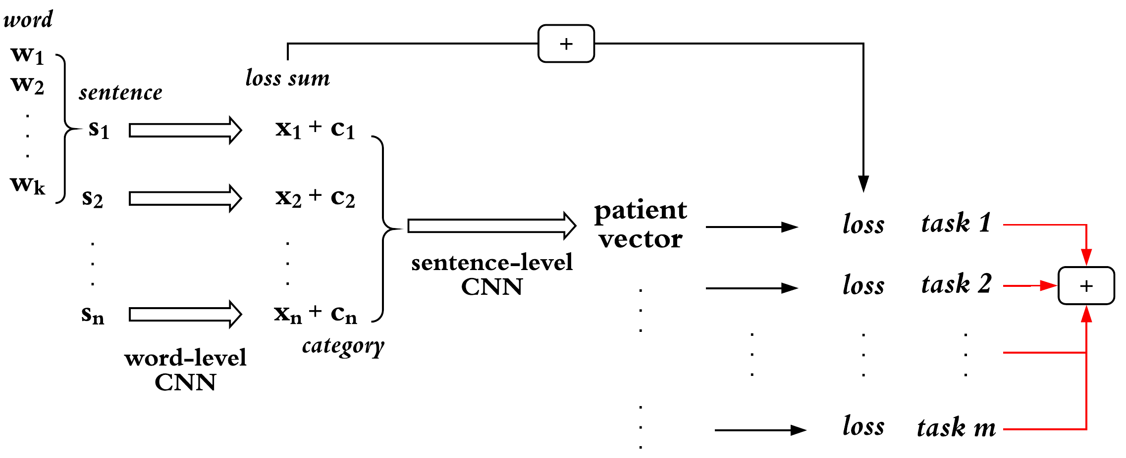
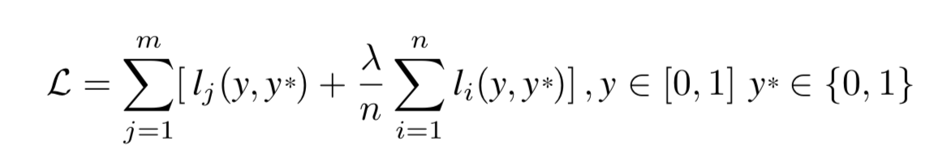
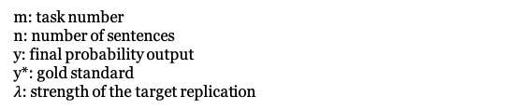
Presentation Part II
Multi-task architecture: two-level CNN
Word embeddings are first aggregated into a sentence representation
Sentence representations are used to generate a single patient representation
The loss of each sentence derived from the word-level CNN with the loss function of the sentence-level CNN
For each task, we apply a softmax function after the final layer and each task is optimized for cross entropy loss
To achieve joint multi-task learning, we sum up losses from all the tasks and optimize the final loss
Figure 3: Model architecture
m: task number
n: number of sentences
y: final probability output
y*: gold standard
$λ$: strength of the target replication

Slide 14
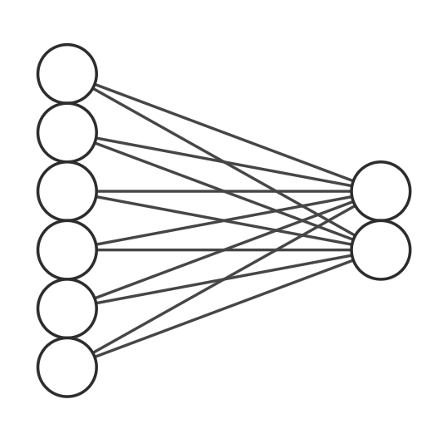
matrix computation
Presentation Part II
Target task model
A neural network with single dense layer
Save a great deal of time and effort compared with the CNN model in the source task
The multi-task architecture of mortality and LOS
Adding another fully-connected layer ahead of the softmax output since the patient mortality and length-of-stay are not entirely related
:
:
Output layer:
Binary classification
Input layer:
Pre-trained patient vector
Figure 4: Model architecture for target task

Slide 15
Presentation Part II
Experiment details: Tensorflow on an NVidia Tesla GPU with the cuDNN library
100-dimension pre-trained word embeddings; max doc length: 1000; max sentence length: 25
Category embedding had 10 dimensions (randomly initialized)
Word-level CNN: 50 convolutional filters each of sizes [3, 4, 5] with stride of 1 and valid padding
Sentence-level CNN: uses 50 filters each of size 3 with the same stride and padding format as the word-level CNN
Dropout probability of 0.8 after max-pooling layer to prevent overfitting
Batch size: 64 patients; Adam optimizer ; learning rate: 0.01; decay: 0.99; Early stop: 5 epochs

Slide 16
Presentation Part II
Evaluation details:
The entire dataset after preprocessing was split into training, testing, and development (dev) sets with a ratio of 8:1:1
We trained the model on the training set, evaluated the trained model on the dev set for early stopping before overfitting, and evaluated the final performance on the test set
Data is imbalanced with a large number of negative samples, thus we use the area under the ROC curve (AUROC) score as the evaluation metric
Visualization:
t-SNE visualization on the patient representation trained by MTL models
This representation visualization contains all the patient samples from test subset and each representation associates with its label.
The label is referred to the patient mortality date and stratified into different subgroups based on the design of MTL models.

Slide 17
Results: Descriptive analysis
Presentation Part II
Table 1:Partitioning of patient data
 | # Patient | # Notes
train | 30,668 | 969,574
dev | 3,833 | 125,559
test | 3,833 | 122,502
total | 38,334 | 1,217,635
Table 2: Positive class distribution
 | # Patient | Overall %
died in hospital | 4,063 | 10.60
died in 30 days after discharge | 1,202 | 3.14
died in 1 year after discharge | 2,560 | 6.68

Slide 18
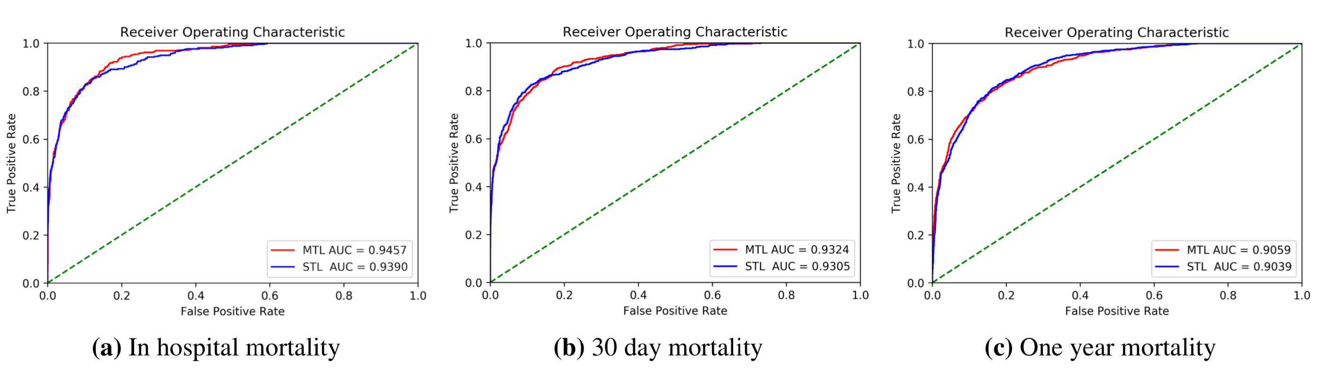
Results: comparison of MTL and STL models
Presentation Part II
Table 3: AUROC (%) of different models on each task
Task | Single task | 3-task | 5-task | 20-task
In-hospital | 93.90ª | 94.57 | 94.07 | 93.41
30-day | 93.05^{b} | 93.24 | 93.07 | 92.35
1-year | 90.39^{c} | 89.58 | 90.56 | 90.59
ª 95% Confidence Interval: [93.63 - 94.16]
^{b} 95% Confidence Interval: [92.76 - 93.33]
^{c} 95% Confidence Interval: [90.06 - 90.71]
Figure 5: ROC curve of MTL and STL for three tasks

Slide 19
Results: evaluation of patient representations on target task
Presentation Part II
Table 4: Performance comparison of pre-trained representations with the single-task model on the target task
 | AUROC (%) on 60-day task | Total time of training
single-task | 92.32ª | 18.45 hours
3-task patient vector | 91.97 | 3.53 mins
5-task patient vector | 92.42 | 4.24 mins
20-task patient vector | 92.12 | 5.12 mins
ª 95% Confidence Interval: [92.02 - 92.61]

Slide 20
Results: Performance evaluation of MTL model on patient mortality and LOS task
Presentation Part II
Table 5: Performance of 3-task model on each task
Task | Single-task AUROC (%) | 3-task model AUROC (%)
30-day | 93.05 | 92.91
1-year | 90.39 | 90.85
6-day LOS | 88.35 | 88.61
Table 6: Pre-trained representation on 14-day LOS task
 | AUROC (%) on 14-day LOS task
single-task | 89.00ª
3-task¹ patient vector | 90.39
3-task² patient vector | 74.71
5-task patient vector | 74.41
20-task patient vector | 74.91
1: 3-task of 30-day, 1-year mortality, 6-day LOS
2: 3-task of in-hospital, 30-day, 1-year mortality

Slide 21
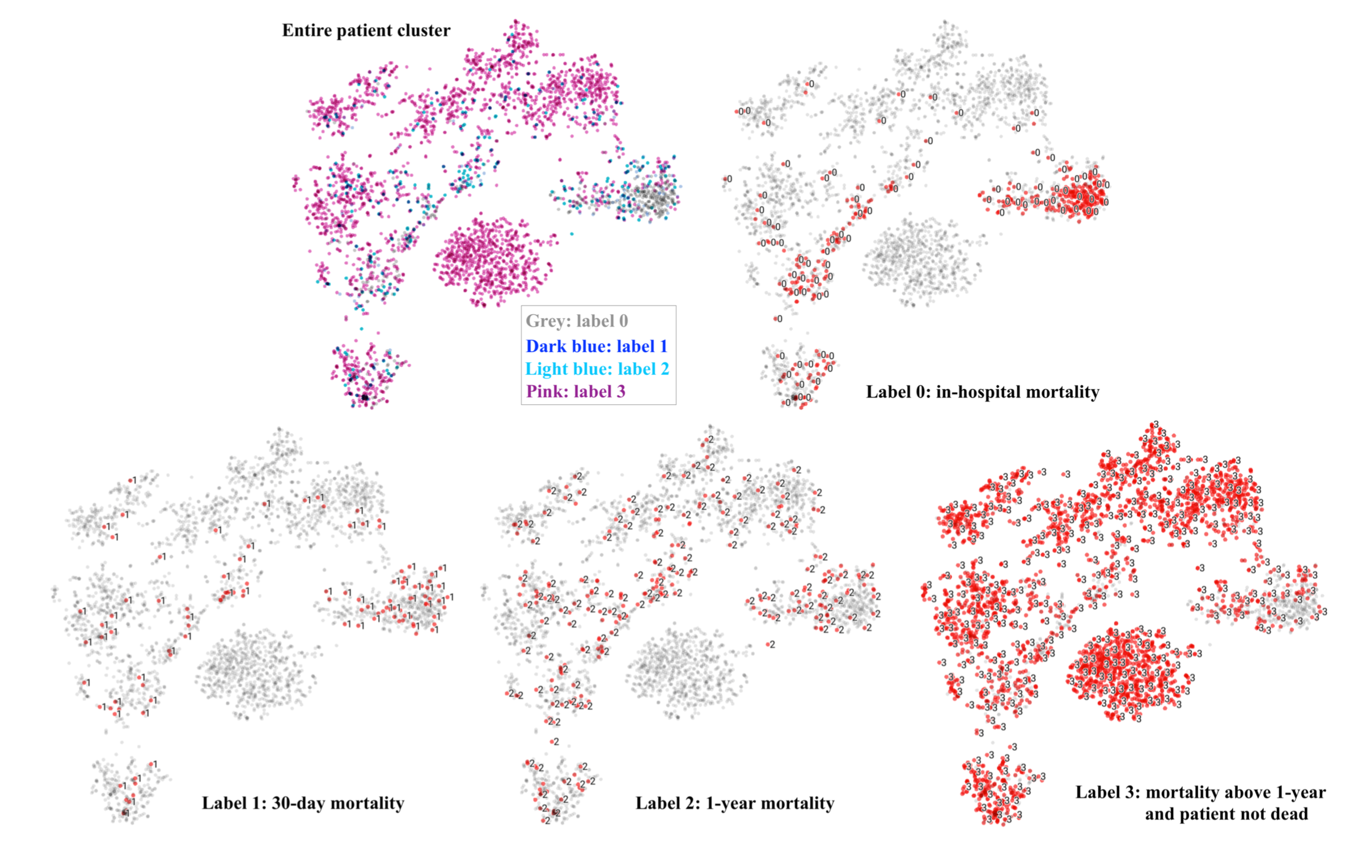
Results: t-SNE visualization
Presentation Part II
Figure 6: t-SNE visualization of 3-task patient distributed representation.

Slide 22
Presentation Part II
Conclusions
In this study, we provide insights into the feasibility of learning effective patient representations solely from clinical notes based on supervised multi-task deep learning. We employ a MTL neural network architecture to predict interesting clinical problems in the ICU.
This architecture contains a unified word-level and sentence-level CNN with a joint loss function that sums the individual task losses.
We obtain the encoded patient representation from the pre-trained neural network and use the representation to predict patient mortality of certain days with a neural network with single dense layer
We report the performance of those models to demonstrate the efficiency of MTL and present the t-SNE visualization of the patient representation.
It has been shown that the performances of proposed multi-task models slightly outperform that of single-task
Our pre-trained patient representation is convenient for other researchers who wish to develop and build machine learning models for patients upon our work since the dataset in this experiment is directly from a freely-accessible database

Slide 23
Presentation Part II
Future directions
In the future, we intend to incorporate multiple modalities of data, including structured information such as observational variables, to contribute the efficiency of representation learning
In addition, we intend to further investigate the challenges and opportunities of different MTL architectures
Neural networks like Bi-LSTM can be used to emphasize the long-term dependencies and consider the sequential correlation between clinical notes of different time

Slide 24
References
Caruana R. Multitask learning. Machine Learning. 1997 Jul 1;28(1):41-75.
Johnson AE, Pollard TJ, Shen L, Li-wei HL, Feng M, Ghassemi M, Moody B, Szolovits P, Celi LA, Mark RG. MIMIC-III, a freely accessible critical care database. Scientific Data. 2016 May 24;3:160035.
Grnarova P, Schmidt F, Hyland SL, Eickhoff C. Neural document embeddings for intensive care patient mortality prediction. arXiv preprint arXiv:1612.00467. 2016 Dec 1.
Zhang Y, Yang Q. A survey on multi-task learning. arXiv preprint arXiv:1707.08114. 2017 Jul 25.
Ruder S. An overview of multi-task learning in deep neural networks. arXiv preprint arXiv:1706.05098. 2017.
Li S, Liu ZQ, Chan AB. Heterogeneous multi-task learning for human pose estimation with deep convolutional neural network. Proceedings of the IEEE Conference on Computer Vision and Pattern Recognition Workshops 2014 (pp. 482-489).
Elhoseiny M, El-Gaaly T, Bakry A, Elgammal A. A comparative analysis and study of multiview CNN models for joint object categorization and pose estimation. International Conference on Machine Learning 2016 Jun 11 (pp. 888-897).
ChowdhuriS,PankajT,ZipserK.Multi-ModalMulti-TaskDeepLearningforAutonomousDriving.arXivpreprint arXiv:1709.05581. 2017 Sep 16.
Cao L, Li L, Zheng J, Fan X, Yin F, Shen H, Zhang J. Multi-task neural networks for joint hippocampus segmen- tation and clinical score regression. Multimedia Tools and Applications. 2018:1-8.
Pasunuru R, Bansal M. Multi-task video captioning with video and entailment generation. arXiv preprint arXiv:1704.07489. 2017 Apr 24.
Collobert R, Weston J. A unified architecture for natural language processing: Deep neural networks with mul- titask learning. Proceedings of the 25th International Conference on Machine Learning 2008 Jul 5 (pp. 160-167). ACM.
Dong D, Wu H, He W, Yu D, Wang H. Multi-task learning for multiple language translation. Proceedings of the 53rd Annual Meeting of the Association for Computational Linguistics and the 7th International Joint Conference on Natural Language Processing (Volume 1: Long Papers) 2015 (Vol. 1, pp. 1723-1732).
ReiM.Semi-supervisedmultitasklearningforsequencelabeling.arXivpreprintarXiv:1704.07156.2017Apr24. 14. Liu P, Qiu X, Huang X. Adversarial multi-task learning for text classification. arXiv preprint arXiv:1704.05742.
2017 Apr 19. CrichtonG,PyysaloS,ChiuB,KorhonenA.Aneuralnetworkmulti-tasklearningapproachtobiomedicalnamed entity recognition. BMC Bioinformatics. 2017 Dec;18(1):368. McCann B, Keskar NS, Xiong C, Socher R. The Natural Language Decathlon: Multitask Learning as Question Answering. arXiv preprint arXiv:1806.08730. 2018 Jun 20. Toshniwal S, Tang H, Lu L, Livescu K. Multitask learning with low-level auxiliary tasks for encoder-decoder based speech recognition. arXiv preprint arXiv:1704.01631. 2017 Apr 5. Kumar A, Daume III H. Learning task grouping and overlap in multi-task learning. arXiv preprint arXiv:1206.6417. 2012 Jun 27. Yang X, Kim S, Xing EP. Heterogeneous multitask learning with joint sparsity constraints. Advances in Neural information Processing Systems 2009 (pp. 2151-2159). Fa R, Cozzetto D, Wan C, Jones DT. Predicting human protein function with multi-task deep neural networks. PLoS ONE. 2018 Jun 11;13(6):e0198216. Ramsundar B, Kearnes S, Riley P, Webster D, Konerding D, Pande V. Massively multitask networks for drug discovery. arXiv preprint arXiv:1502.02072. 2015 Feb 6.
Nori N, Kashima H, Yamashita K, Ikai H, Imanaka Y. Simultaneous modeling of multiple diseases for mortality prediction in acute hospital care. Proceedings of the 21th ACM SIGKDD International Conference on Knowledge Discovery and Data Mining 2015 Aug 10 (pp. 855-864). ACM.
Lipton ZC, Kale DC, Elkan C, Wetzel R. Learning to diagnose with LSTM recurrent neural networks. arXiv preprint arXiv:1511.03677. 2015 Nov 11.
Che Z, Kale D, Li W, Bahadori MT, Liu Y. Deep computational phenotyping. Proceedings of the 21th ACM SIGKDD International Conference on Knowledge Discovery and Data Mining 2015 Aug 10 (pp. 507-516). ACM.
Caruana R, Baluja S, Mitchell T. Using the future to “sort out” the present: Rankprop and multitask learning for medical risk evaluation. Advances in Neural Information Processing Systems 1996 (pp. 959-965). FutomaJ,HariharanS,HellerK.LearningtodetectsepsiswithamultitaskgaussianprocessRNNclassifier.arXiv preprint arXiv:1706.04152. 2017 Jun 13. Futoma J, Hariharan S, Sendak M, Brajer N, Clement M, Bedoya A, O’Brien C, Heller K. An improved multi- output gaussian process rnn with real-time validation for early sepsis detection. arXiv preprint arXiv:1708.05894. 2017 Aug 19. Harutyunyan H, Khachatrian H, Kale DC, Galstyan A. Multitask learning and benchmarking with clinical time series data. arXiv preprint arXiv:1703.07771. 2017 Mar 22. Ngufor C, Upadhyaya S, Murphree D, Madde N, Kor D, Pathak J. A heterogeneous multi-task learning for pre- dicting RBC transfusion and perioperative outcomes. Conference on Artificial Intelligence in Medicine in Europe 2015 Jun 17 (pp. 287-297). Springer, Cham. Ngufor C, Upadhyaya S, Murphree D, Kor D, Pathak J. Multi-task learning with selective cross-task transfer for predicting bleeding and other important patient outcomes. Data Science and Advanced Analytics (DSAA), 2015. 36678 2015. IEEE International Conference on 2015 Oct 19 (pp. 1-8). IEEE. Razavian N, Marcus J, Sontag D. Multi-task prediction of disease onsets from longitudinal laboratory tests. Ma- chine Learning for Healthcare Conference 2016 Dec 10 (pp. 73-100). Wiens J, Guttag J, Horvitz E. Patient risk stratification with time-varying parameters: a multitask learning ap- proach. The Journal of Machine Learning Research. 2016 Jan 1;17(1):2797-819. Wang X, Wang F, Hu J, Sorrentino R. Exploring joint disease risk prediction. In AMIA Annual Symposium Pro- ceedings 2014 (Vol. 2014, p. 1180). American Medical Informatics Association. Nori N, Kashima H, Yamashita K, Kunisawa S, Imanaka Y. Learning Implicit Tasks for Patient-Specific Risk Modeling in ICU. AAAI 2017 Feb 12 (pp. 1481-1487). Lopez-MartinezD,PicardR.Multi-taskneuralnetworksforpersonalizedpainrecognitionfromphysiologicalsig- nals. Affective Computing and Intelligent Interaction Workshops and Demos (ACIIW), 2017 Seventh International Conference on 2017 Oct 23 (pp. 181-184). IEEE. Lopez-Martinez D, Rudovic O, Picard R. Physiological and behavioral profiling for nociceptive pain estimation using personalized multitask learning. arXiv preprint arXiv:1711.04036. 2017 Nov 10. Sushil M, uster S, Luyckx K, Daelemans W. Patient representation learning and interpretable evaluation using clinical notes. Journal of Biomedical Informatics. 2018 Aug 1;84:103-13. Dubois S, Romano N, Kale DC, Shah N, Jung K. Learning Effective Representations from Clinical Notes. arXiv preprint arXiv:1705.07025. 2017 May 19. Rehurek R, Sojka P. Software framework for topic modelling with large corpora. Proceedings of the LREC 2010 Workshop on New Challenges for NLP Frameworks 2010. Abadi M, Barham P, Chen J, Chen Z, Davis A, Dean J, Devin M, Ghemawat S, Irving G, Isard M, Kudlur M. Tensorflow: a system for large-scale machine learning. OSDI 2016 Nov 2 (Vol. 16, pp. 265-283). Le Q, Mikolov T. Distributed representations of sentences and documents. International Conference on Machine Learning 2014 Jan 27 (pp. 1188-1196). YangX,MolchanovP,KautzJ.Multilayerandmultimodalfusionofdeepneuralnetworksforvideoclassification. Proceedings of the 2016 ACM Conference on Multimedia 2016 Oct 1 (pp. 978-987). ACM.

Slide 25
Presentation Part II
Questions?

