Slide 1
Boston Housing Price Prediction Analysis
Yuqi Cao
June 2025

Slide 2
Outline
Introduction Dataset Overview Model Descriptions Actual vs. Predicted Prices Model Shortcomings Recommendations Conclusion
References

Slide 3
Introduction
► Boston Housing dataset: 506 entries, 14 features
► Goal: Predict median house prices (MEDV)
► Model analyzed: Ridge Regression
► Objective: Compare actual vs. predicted prices and identify model shortcomings

Slide 4
Dataset Overview
► Sou rce: UCI Machine Learning Repository (1970s data)
► Features: Crime rate (CRIM), rooms per dwelling (RM), lower-status population (LSTAT), etc.
► Target: MEDV (median house price in $1000s)
Feature | Description
CRIM | Per capita crime rate
RM | Average rooms per dwelling
LSTAT | % lower status population
PTRATIO | Pupil-teacher ratio
MEDV | Median house price

Slide 5
Model Descriptions
Approach: Ridge Regression (codestuff.txt)
► Features: LSTAT, LSTAT*RM, LSTAT², PTRATIO, RM
C_R, C_L, C_P
► Model: Ridge Regression (alpha=0.1)
► Features selected by correlation (> |0.5|)

Slide 6
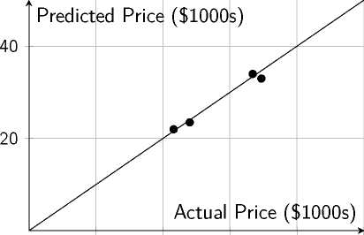
Actual vs. Predicted Prices
► Actual prices: MEDV from dataset (e.g., 24.0, 21.6, 34.7 $1000s)
► Predicted prices: Not explicitly provided in code
► Ridge Regression likely performs better due to regularization
Hypothetical Scatter Plot
10
20
30
40
50

Slide 7
Model Shortcomings
► Linearity Assumption: Fails to capture non-linear relationships
► Multicollinearity: Engineered features (e.g., RL, LSTAT) may correlate
► Data Censoring: MEDV capped at 50, skewing high-value predictions
► Feature Selection: Correlation-based selection may exclude key features (e.g., CHAS)
Example
76 houses have MEDV=50, potentially affecting model accuracy for high-end homes.

Slide 8
Recommendations
► Use non-linear models (e.g., Random Forests, Neural Networks)
► Apply feature transformations (e.g., logarithmic scaling)
► Implement advanced feature selection (e.g., Recursive Feature Elimination)
► Analyze residual plots to diagnose model fit

Slide 9
Conclusion
► Ridge Regression provide a baseline for price prediction
► Shortcomings limit accuracy for complex relationships
► Advanced techniques can improve model performance
► Future work: Explore non-linear models and robust feature engineering

Slide 10
References
·Agarwal, A. (2018). Linear Regression on Boston Housing Dataset - TDS Archive - Medium. Medium. https://medium.com/data-science/linear-regression-on-boston-housing-dataset-f409b7e4a155
·GeeksforGeeks. (2025). Linear Regression using Boston Housing Dataset ML. GeeksforGeeks. https://www.geeksforgeeks.org/machine-learning/ml-boston-housing-kaggle-challenge-with-linear-regression/
·Yao, E. (2025). Predict Housing Price using Linear Regression in Python. Towards Data Science. https://towardsdatascience.com/predict-housing-price-using-linear-regression-in-python-bfc0fcfff640

