Slide 1






Deterministic Frame-based Testing
Maintaining determinism and extracting module-tests for autonomous driving planning
Yuqi Huai
Yuntianyi Chen
Ziwen Wan
Qi Alfred Chen
Joshua Garcia
ICSE 2026
Research Track
Paper DOI
10.1145/3744916.3773252

Slide 2

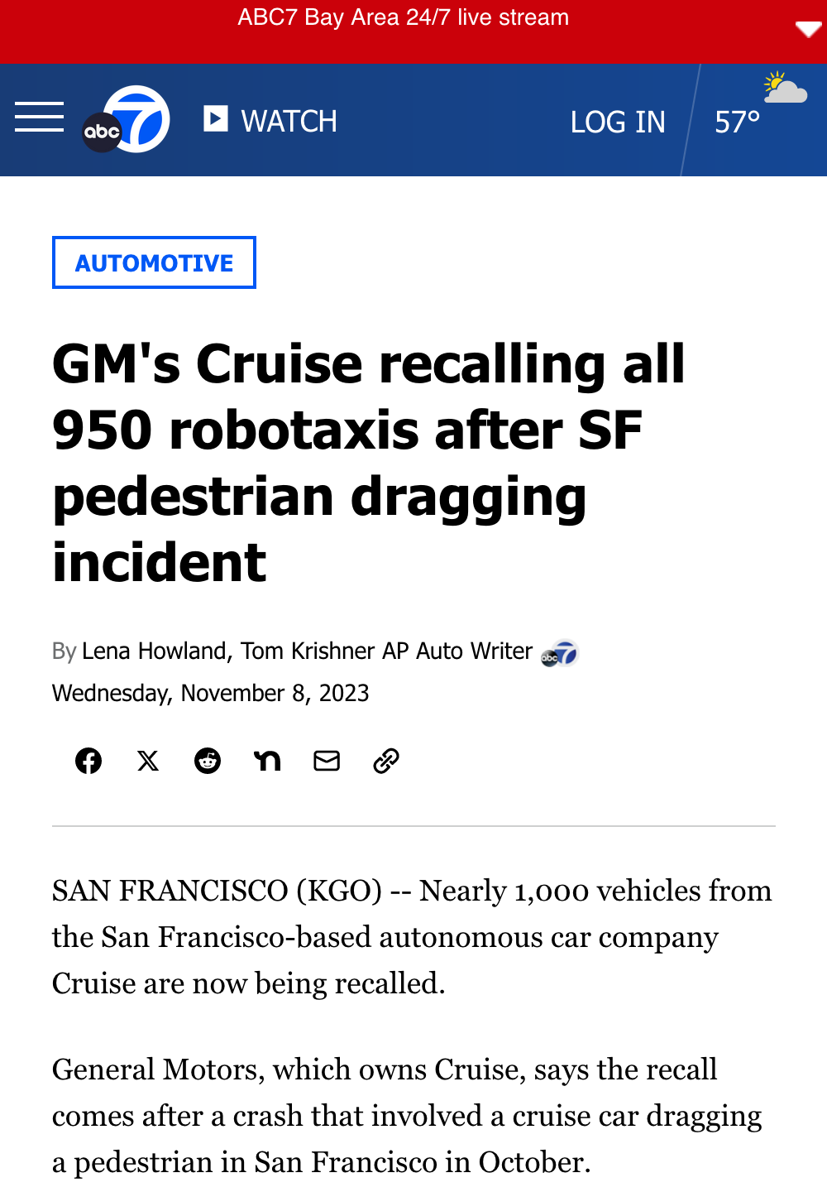

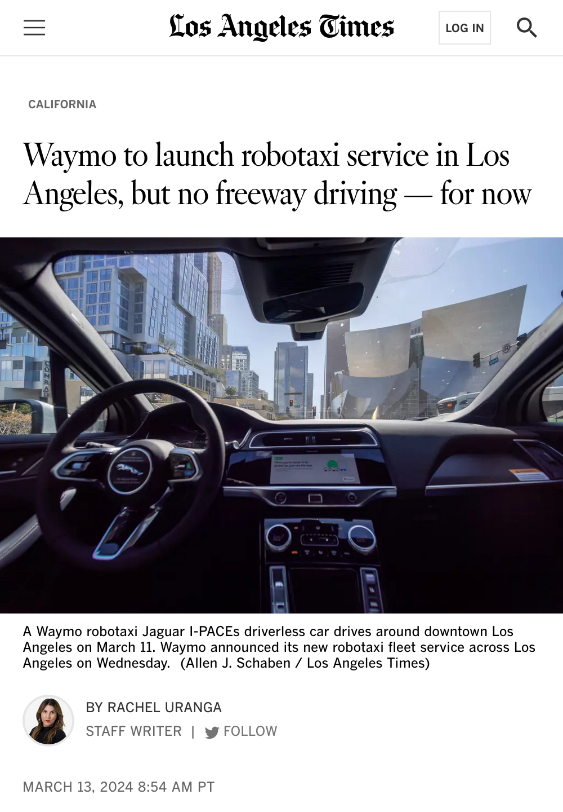
// Motivation
The National Highway Traffic Safety Administration (NHTSA)
In reality ...
“Types of automated technologies, such as advanced driver assistance system technologies already in use on the roads and future automated driving systems at their mature state, have the potential to reduce crashes, prevent injuries, and save lives. In some circumstances, automated technologies may be able to detect the threat of a crash and act faster than drivers. These technologies could greatly support drivers and reduce human errors and the resulting crashes, injuries, and economic tolls.”

Slide 3
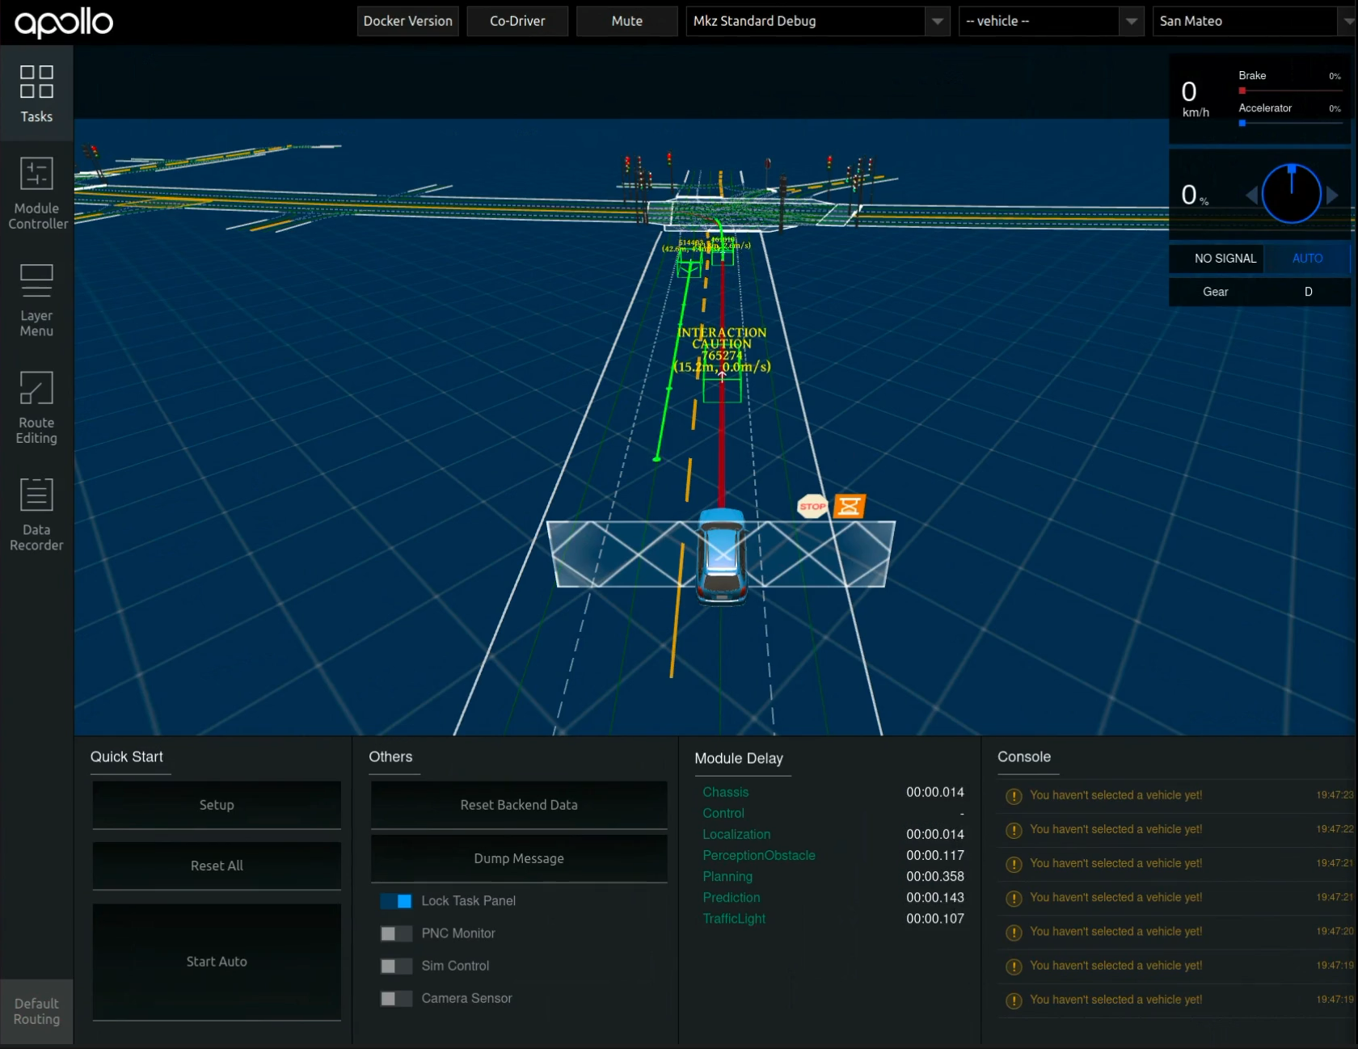
// Motivation
Bug Revealing Scenario!
20%
REPRODUCTION RATE

Slide 4
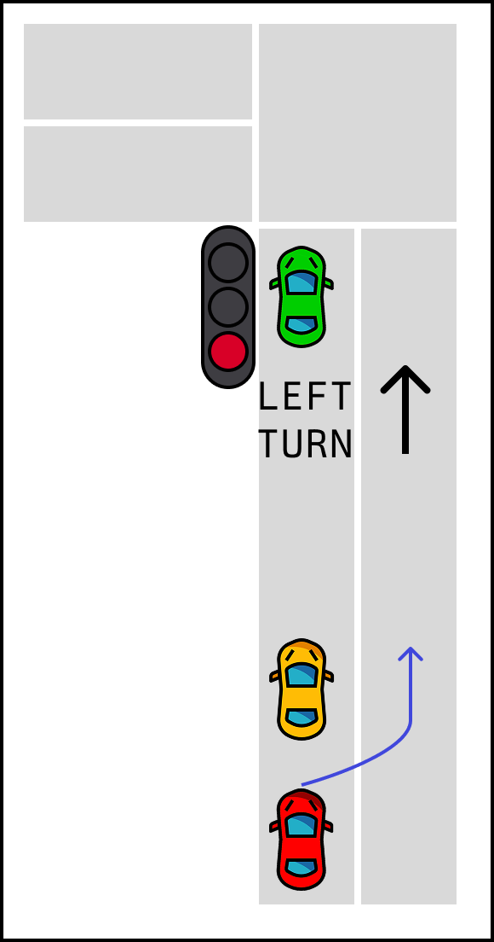
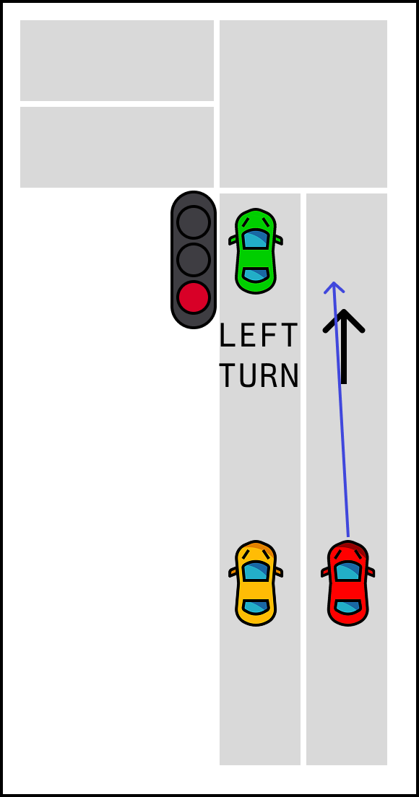
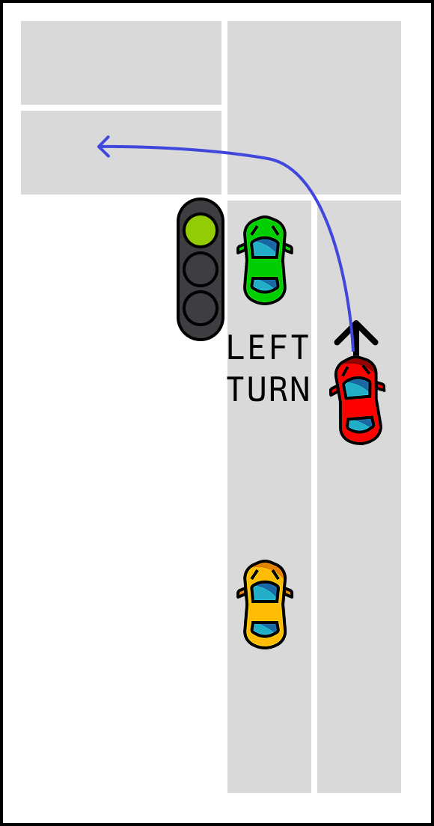
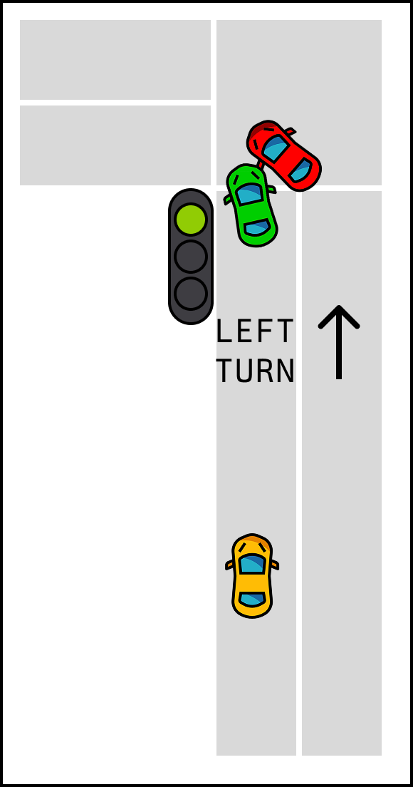
// Motivation
Failing Test Executions (4/20)
AV Cuts off another vehicle
>
>
>

Slide 5

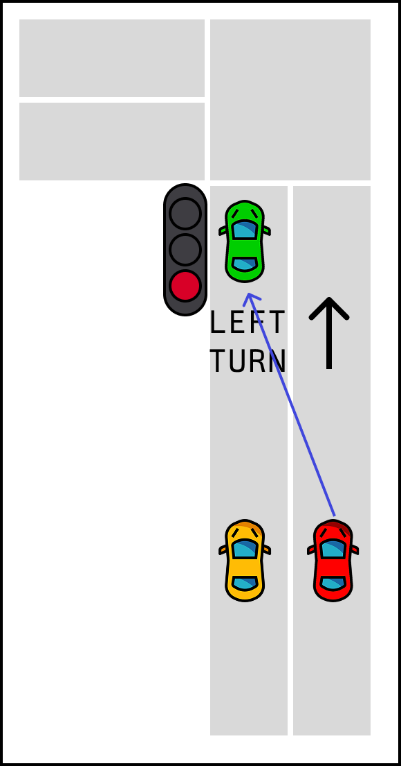
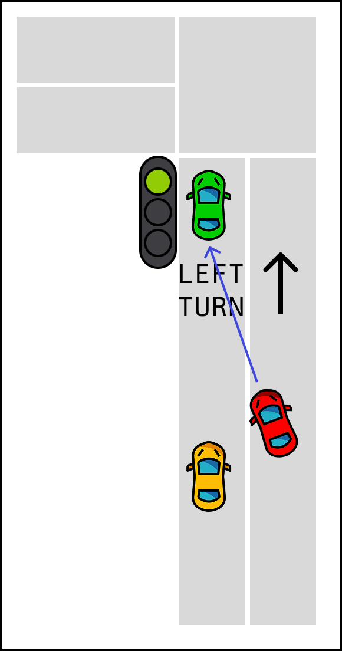
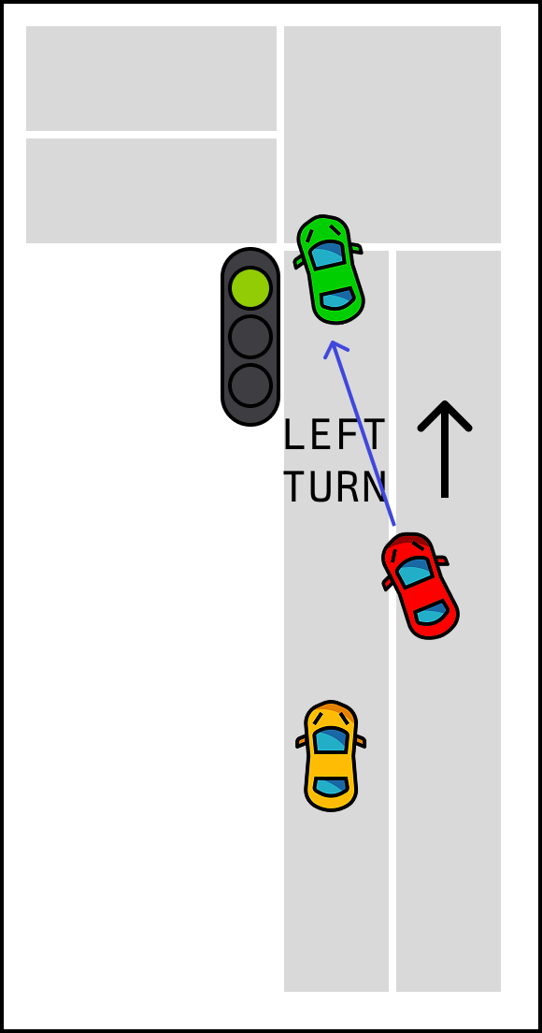
// Motivation
Failing Test Executions (4/20)
AV Cuts off another vehicle
>
>
>
Passing Test Executions (16/20)
AV Returns to its original lane
>
>
>
Notes:
to understand if non-determinism persists across other test scenarios

Slide 6
// Motivation
Failing Test Executions (4/20)
AV Cuts off another vehicle
Passing Test Executions (16/20)
AV Returns to its original lane
>
>
>
>
>
>
Extended Study
AV-FUZZER
BehAVExplor
6158 Scenario Tests
Decictor
DeepCollision
DoppelTest
DriveFuzz
SAMOTA
scenoRITA

Slide 7
// Motivation
Failing Test Executions (4/20)
AV Cuts off another vehicle
Passing Test Executions (16/20)
AV Returns to its original lane
>
>
>
>
>
>
Extended Study
AV-FUZZER
6158 Scenario Tests
BehAVExplor
Decictor
DeepCollision
658 Collisions
DoppelTest
DriveFuzz
SAMOTA
scenoRITA

Slide 8
// Motivation
Failing Test Executions (4/20)
AV Cuts off another vehicle
Passing Test Executions (16/20)
AV Returns to its original lane
>
>
>
>
>
>
Extended Study
AV-FUZZER
6158 Scenario Tests
BehAVExplor
Decictor
DeepCollision
658 Collisions
DoppelTest
DriveFuzz
187 Non-Deterministic Collisions
SAMOTA
(28.41%)
scenoRITA

Slide 9
// Motivation
Should we ignore 187 non-deterministic collisions?

Slide 10
// Motivation
Should we ignore 187 non-deterministic collisions?
YES
But ...
“since they lower the reliability of simulation-based tests” (Birchler et. al)
“Long-tail and rare event problems become crucial when autonomous driving algorithms are applied in the real world.” (Ding et. al)
“’If the test has a very low flake rate, it is not really worth the investigation’ (P10).”
(Habchi et. al)
Automatic generation targets rare and critical test scenarios. (Klischat and Althoff)
Notes:
Some research suggests that flaky tests reduce the reliability of scenario-based testing. There’s also survey evidence showing that developers choose to ignore flaky tests, especially when the flakiness rate is low.
However, other work frames ADS testing as a long-tail problem—where the goal is to uncover rare but meaningful edge cases.
So, the question becomes, after all the effort spent finding these edge cases, are we now ignoring them simply because they appear rare in simulation?

Slide 11
// Motivation
Should we ignore 187 non-deterministic collisions?
Where does non-determinism come from?

Slide 12
// Motivation
Where does non-determinism come from?

Slide 13
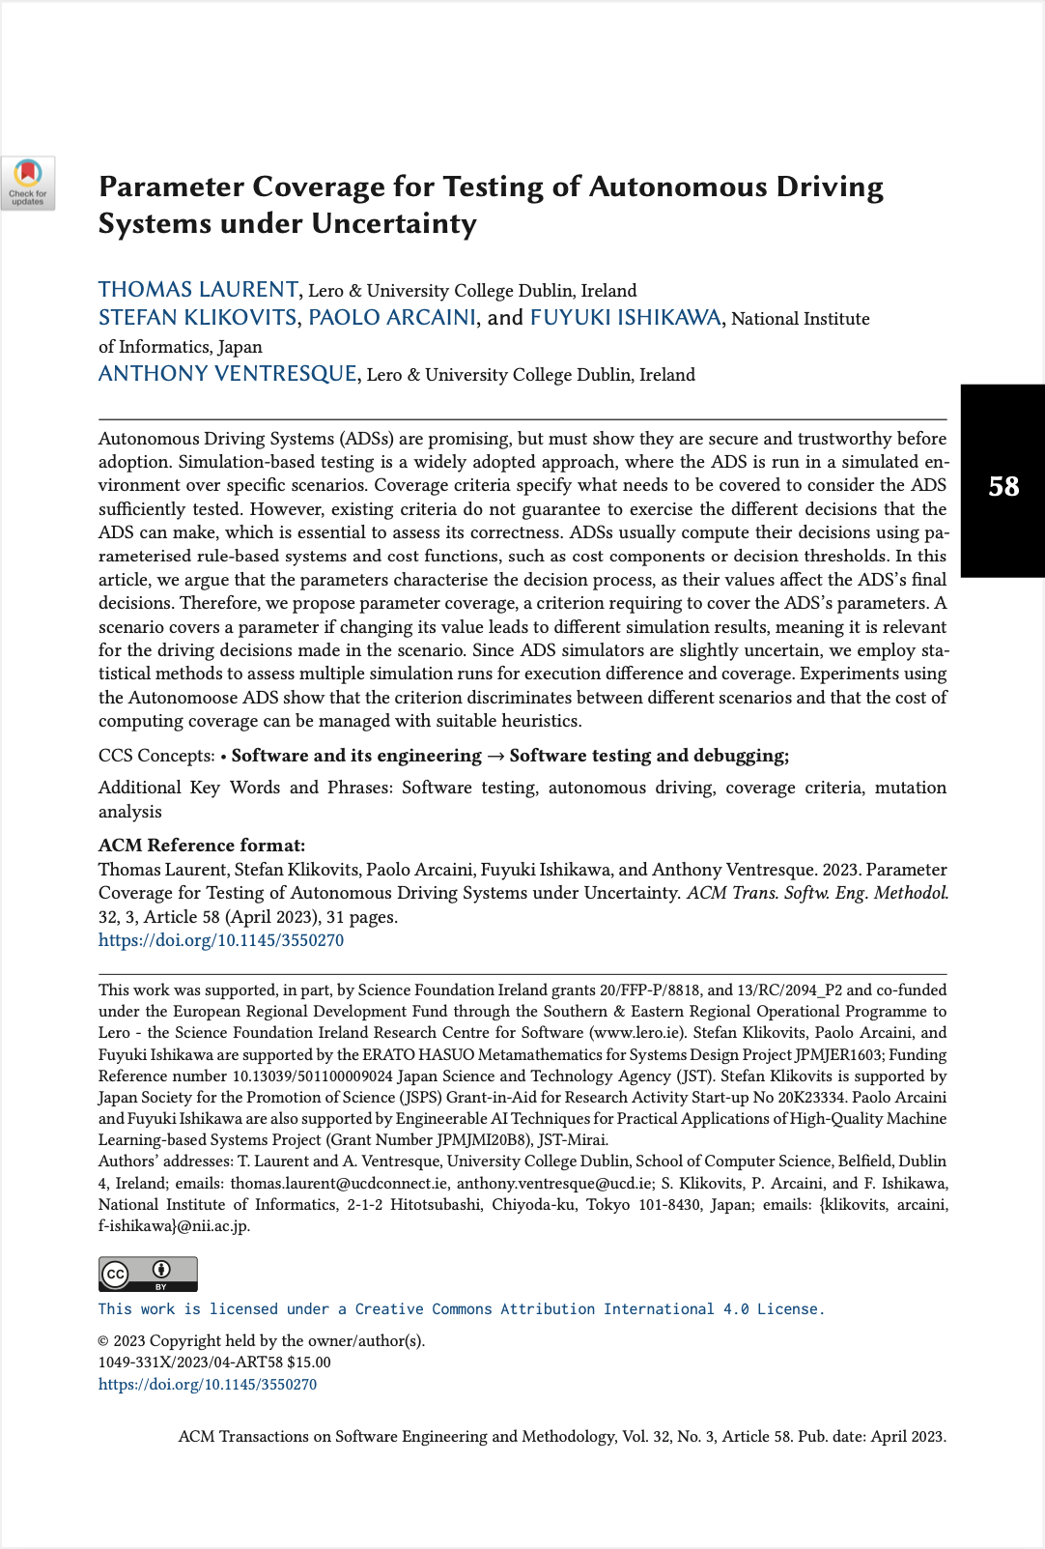
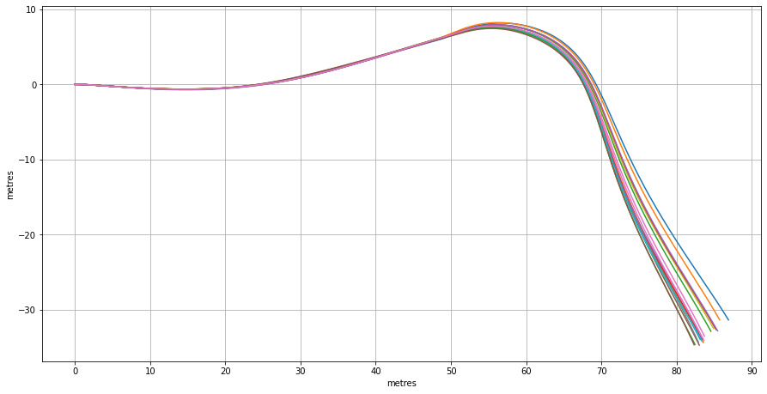
// Preliminary Studies
Laurent et. al
“Repeated executions of the exact same scenario and parameterization lead to diverging paths.”
ADS is non-deterministic at system level.

Slide 14


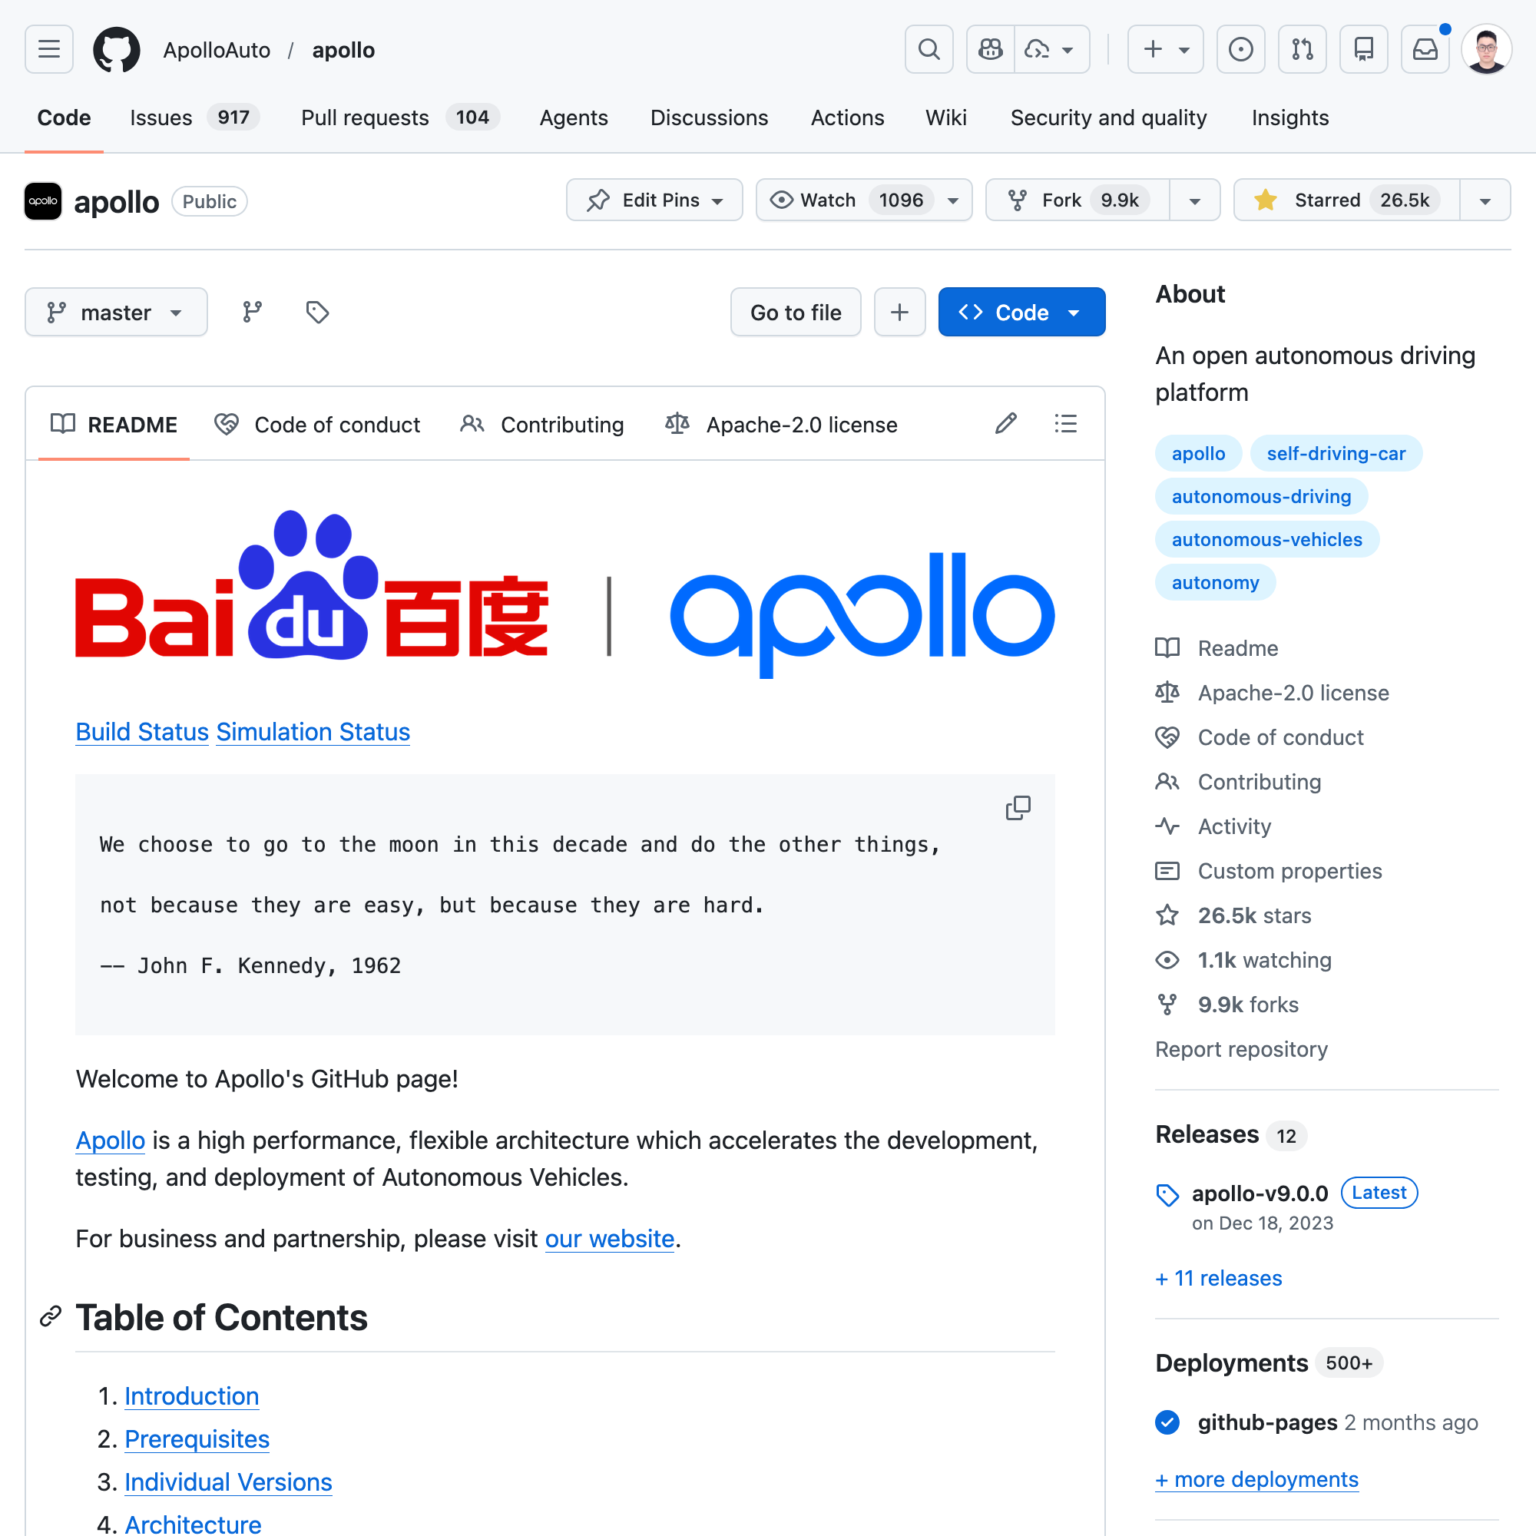

// Preliminary Studies
ApolloAuto/apollo | ★ 26.5k
autowarefoundation/autoware | ★ 11.3k

Slide 15
// Preliminary Studies
ApolloAuto/apollo | ★ 26.5k
autowarefoundation/autoware | ★ 11.3k
Multi-module
Architecture
Perception
Detect objects & lanes
Routing
Global route planning
Prediction
Others’ future motion
Planning
Ego trajectory selection
Control
Execute trajectory
Localization
Ego pose estimation

Slide 16
// Preliminary Studies
ApolloAuto/apollo | ★ 26.5k
autowarefoundation/autoware | ★ 11.3k
Multi-module
Publish-Subscribe
Architecture
Perception
Detect objects & lanes
Prediction
Others’ future motion
Routing
Global route planning
Planning
Ego trajectory selection
Localization
Ego pose estimation
Control
Execute trajectory
Middleware (ROS/CyberRT)
Message Bus
Communication between modules only implicitly exists through the message bus!

Slide 17
// Preliminary Studies
ApolloAuto/apollo | ★ 26.5k
autowarefoundation/autoware | ★ 11.3k
Multi-module
Publish-Subscribe
Architecture
Perception
Detect objects & lanes
Prediction
Others’ future motion
Routing
Global route planning
Planning
Ego trajectory selection
Localization
Ego pose estimation
Control
Execute trajectory
Middleware (ROS/CyberRT)
Message Bus
Simulator
LGSVL/CARLA
AV-FUZZER
BehAVExplor
DeepCollision

Slide 18
// Preliminary Studies
ApolloAuto/apollo | ★ 26.5k
autowarefoundation/autoware | ★ 11.3k
Multi-module
Publish-Subscribe
Architecture
Perception
Detect objects & lanes
Prediction
Others’ future motion
Routing
Global route planning
Planning
Ego trajectory selection
SimControl
Simulates Localization and Perfect Control
Localization
Ego pose estimation
Control
Execute trajectory
Middleware (ROS/CyberRT)
Message Bus
Simulator
LGSVL/CARLA
AV-FUZZER
BehAVExplor
DeepCollision
DoppelTest
Decictor
META-V2V

Slide 19
// Preliminary Studies
ApolloAuto/apollo | ★ 26.5k
autowarefoundation/autoware | ★ 11.3k
Multi-module
Publish-Subscribe
Architecture
Perception
Detect objects & lanes
Prediction
Others’ future motion
Routing
Global route planning
Planning
Ego trajectory selection
Localization
Ego pose estimation
(Sim)Control
Execute trajectory
Middleware (ROS/CyberRT)
Message Bus
Simulator
LGSVL/CARLA
AV-FUZZER
BehAVExplor
DeepCollision
DoppelTest
Decictor
META-V2V
No explicit control over when and what inputs are processed by ADS modules.

Slide 20
// Preliminary Studies
ApolloAuto/apollo | ★ 26.5k
autowarefoundation/autoware | ★ 11.3k
Planning
Ego trajectory selection
* Decides the AV’s trajectory (behavior)

Slide 21
// Preliminary Studies
ApolloAuto/apollo | ★ 26.5k
autowarefoundation/autoware | ★ 11.3k
Planning
Ego trajectory selection
* Decides the AV’s trajectory (behavior)
From: Developer Confirmation
- Implementation of the planning module is deterministic.
From: Literature Review
- Motion planning is a problem that can be solved by deterministic algorithms.
- Deterministic motion planning is favored in highway motion planning
From: Experiments
Planning module’s output varies during repeated simulations of the same scenario.

Slide 22
// Preliminary Studies
ApolloAuto/apollo | ★ 26.5k
autowarefoundation/autoware | ★ 11.3k
Planning
Ego trajectory selection
* Decides the AV’s trajectory (behavior)
From: Developer Confirmation
- Implementation of the planning module is deterministic.
From: Experiments
Planning module’s output varies during repeated simulations of the same scenario.

Slide 23
// Preliminary Studies
Can a testing method maintain determinism of ADS planning?

Slide 24
Frame-based Testing

Slide 25
Deterministic
Frame-based Testing
Deterministic when the module under test is deterministic.

Slide 26
//
Deterministic
Frame-based Testing
Scenario-based Testing
Test Generator
Simulator
Message Bus
m
m
m
m
m
m
m
m
m
m
Test Specification
m
Planning
m
Frame-based Testing
DeFT
Sequential Frame Tests
DeFT
Message Pool
Test Executor
m¹
m¹
m¹
m¹
P¹
Filter
module’s input messages
m
m
m
m
m
Input:
m^{n}
m^{n}
m^{n}
m^{n}
m²
m²
m²
m²
P²
m
m
m
m
m
Expected Output:
P^{n}
m³
m³
m³
m³
P³
Reconstruct
input combinations
m
m
m
m
m
m
m
m
m
m
...
Validate
module tests based on outputs
m
m
m
m
m
Planning
m^{n}
m^{n}
m^{n}
m^{n}
P^{n}
m
m
m
m
m

Slide 27
//
Deterministic
Frame-based Testing
Filter
Reconstruct
Validate
What are the messages that are relevant to the planning module?
M : all messages on the message bus. S : set of channels the planning module subscribes to. P : set of channels the planning module publishes to.
R={m∈M ∣ channel(m) ∈ S∪P}
Message Bus
Static Analysis
Relevant Msgs
bool PlanningComponent::Proc(
const std::shared_ptr<prediction::PredictionObstacles>&
prediction_obstacles,
const std::shared_ptr<canbus::Chassis>& chassis,
const std::shared_ptr<localization::LocalizationEstimate>&
localization_estimate) {
routing_reader_ = node_->CreateReader<RoutingResponse>(
PLANNING_TOPIC, routing_callback
});
...
planning_writer_ = node_->CreateWriter<ADCTrajectory>(
config_.topic_config().planning_trajectory_topic());
m
m
m
m
m
Message Pool
m
m
m
m
m
m
m
m
m
m
m
m
m
m
m
m
m
m
m
m
m
m
m
m
m
m
m
m
m
m
m
m
m
m
m
m
m
m
m
m
m
m
m
m
m
m
m
m
m
m
m
m
m
m
m

Slide 28
//
Deterministic
Frame-based Testing
Filter
Reconstruct
Validate
When and what combination did the planning module process?
During system-level testing, Planning module is triggered by events to aggregate messages from different cannels to construct input frame F = ⟨ m_{routing}, m_{localization}, m_{traffic_light}, m_{prediction} ⟩ at time t_{F} to produce m_{planning}.
Relevant Msgs
Time-Sensitive Input Search Engine
m
m
m
m
m
m
m
m
m
m
m
m
m
m
m
m
m
m
m
m
m
m
m
m
m
m
m
m
m
m
m
m
m
m
m
m
m
m
m
* Timing -> Input frames must be constructed at a valid timestamp bounded by the triggering event and the output time.
m
m
m
m
m
m
m
m
m
m
m
m
m
m
m
* Recency -> More recently published messages before the frame construction time are more likely to be part of the input.
* Monotonicity -> Each frame should not include older messages than those used in previous frames for the same message type.

Slide 29
//
Deterministic
Frame-based Testing
Filter
Reconstruct
Validate
When and what combination did the planning module process?
During system-level testing, Planning module is triggered by events to aggregate messages from different cannels to construct input frame F = ⟨ m_{routing}, m_{localization}, m_{traffic_light}, m_{prediction} ⟩ at time t_{F} to produce m_{planning}.
Relevant Msgs
Time-Sensitive Input Search Engine
m
m
m
m
m
m
m
m
m
m
m
m
m
m
m
m
m
m
m
m
m
m
m
m
m
m
m
m
m
m
m
m
m
m
m
m
m
m
m
Frame 1
m¹
m¹
m¹
m¹
P¹
m
m
m
m
m
m
m
m
m
m
m
m
m
m
m

Slide 30
//
Deterministic
Frame-based Testing
Filter
Reconstruct
Validate
When and what combination did the planning module process?
During system-level testing, Planning module is triggered by events to aggregate messages from different cannels to construct input frame F = ⟨ m_{routing}, m_{localization}, m_{traffic_light}, m_{prediction} ⟩ at time t_{F} to produce m_{planning}.
Relevant Msgs
Time-Sensitive Input Search Engine
m
m
m
m
m
m
m
m
m
m
m
m
m
m
m
m
m
m
m
m
m
m
m
m
m
m
m
m
m
m
m
m
m
m
m
m
m
m
m
Frame 1
m¹
m¹
m¹
m¹
P¹
Frame 2
m²
m²
m²
m²
P²
m
m
m
m
m
m
m
m
m
m
m
m
m
m
m

Slide 31
//
Deterministic
Frame-based Testing
Filter
Reconstruct
Validate
When and what combination did the planning module process?
During system-level testing, Planning module is triggered by events to aggregate messages from different cannels to construct input frame F = ⟨ m_{routing}, m_{localization}, m_{traffic_light}, m_{prediction} ⟩ at time t_{F} to produce m_{planning}.
Relevant Msgs
Time-Sensitive Input Search Engine
m
m
m
m
m
m
m
m
m
m
m
m
m
m
m
m
m
m
m
m
m
m
m
m
m
m
m
m
m
m
m
m
m
m
m
m
m
m
m
Frame 1
m¹
m¹
m¹
m¹
P¹
Frame 2
m²
m²
m²
m²
P²
Frame 3
m³
m³
m³
m³
P³
m
m
m
m
m
m
m
m
m
m
m
m
m
m
m

Slide 32
//
Deterministic
Frame-based Testing
Filter
Reconstruct
Validate
When and what combination did the planning module process?
During system-level testing, Planning module is triggered by events to aggregate messages from different cannels to construct input frame F = ⟨ m_{routing}, m_{localization}, m_{traffic_light}, m_{prediction} ⟩ at time t_{F} to produce m_{planning}.
Each planning module execution -> A single module-level frame-based test case.
Relevant Msgs
Time-Sensitive Input Search Engine
m
m
m
m
m
m
m
m
m
m
m
m
m
m
m
m
m
m
m
m
m
m
m
m
m
m
m
m
m
m
m
m
m
m
m
m
m
m
m
Frame 1
m¹
m¹
m¹
m¹
P¹
Frame 2
m²
m²
m²
m²
P²
Frame 3
m³
m³
m³
m³
P³
m
m
m
m
m
...
m
m
m
m
m
m
m
m
m
m
Frame N
m^{N}
m^{N}
m^{N}
m^{N}
P^{N}

Slide 33
//
Deterministic
Frame-based Testing
Filter
Reconstruct
Validate
When and what combination did the planning module process?
During system-level testing, Planning module is triggered by events to aggregate messages from different cannels to construct input frame F = ⟨ m_{routing}, m_{localization}, m_{traffic_light}, m_{prediction} ⟩ at time t_{F} to produce m_{planning}.
Each planning module execution -> A single module-level frame-based test case.
Module tests are executed sequentially s.t. executing frames 1 through n-1 restores the internal states of the planning module for the n^{th} frame.
Sequential Frame Tests
Frame 1
m¹
m¹
m¹
m¹
P¹
Produces P^{’1}; restores internal states for Frame 2.
Frame 2
m²
m²
m²
m²
P²
Produces P^{’2}; restores internal states for Frame 3.
Frame 3
m³
m³
m³
m³
P³
Produces P^{’2}; restores internal states for Frame 4.
...
Frame N
m^{N}
m^{N}
m^{N}
m^{N}
P^{N}
Produces P^{’N}; Last Frame corresponding to original system-test.
Notes:
Each planning module execution observed during simulation can be mapped to a single frame-based test case, effectively reverse engineering the planning module’s behavior into discrete, frame-level representations.

Slide 34
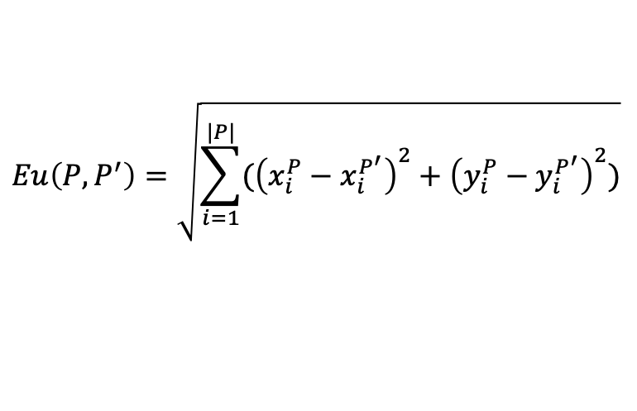
//
Deterministic
Frame-based Testing
Filter
Reconstruct
Validate
Does processing the reconstructed frame reproduce the expected output?
Each Planning output (P) consists of a list of Path Points (p) representing the it plans to reach position < x, y > at time t.
Frame 1
m¹
m¹
m¹
m¹
P¹
Trajectory Validator (Output Validation)
$$Eu\left(P, P^{′}\right)=\sqrt{\sum_{i=1}^{|P|}{({\left(x_{i}^{P}−x_{i}^{P^{′}}\right)}^{2}+{\left(y_{i}^{P}−y_{i}^{P^{′}}\right)}^{2})}}$$
DeFT
Test Executor
Input:
m¹
m¹
m¹
m¹
Expected Output:
P¹
+ Validate correctness of the input frame by comparing planning module’s output.
Planning
+ Uses Euclidean distance to calculate overall geometric difference across the entire planning trajectories.
Actual Output:
P’¹
+ Smaller distance = more accurate input frame construction.

Slide 35
// Evaluation
RQ1
Planning Reproducibility
To what extent do scenario tests and module tests reproduce planning-module executions?
RQ2
Failure Reproducibility
To what extent can module tests reproduce failures detected by test generation approaches?
RQ3
Efficiency
What is the run-time efficiency of DeFT and the produced module tests?

Slide 36
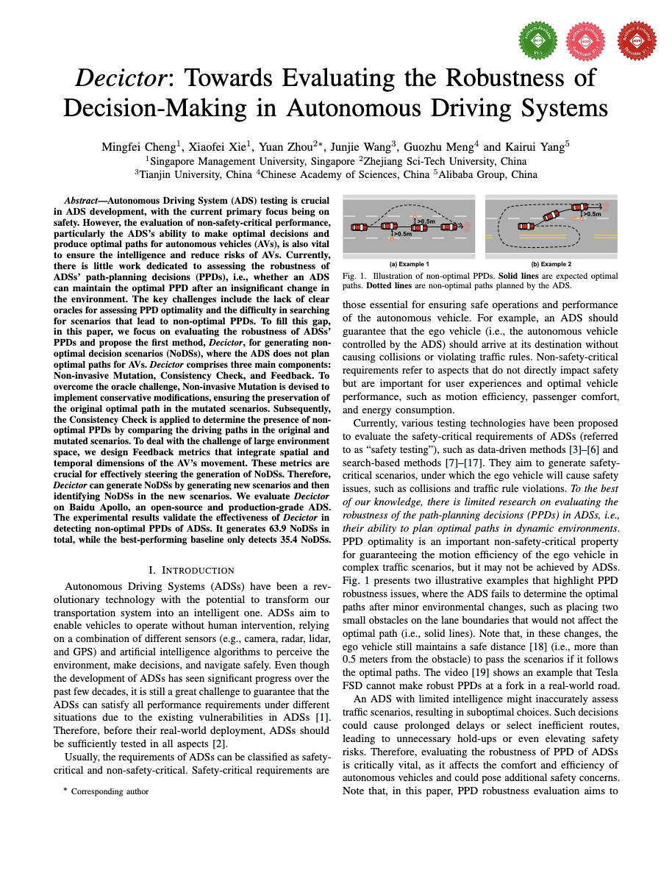
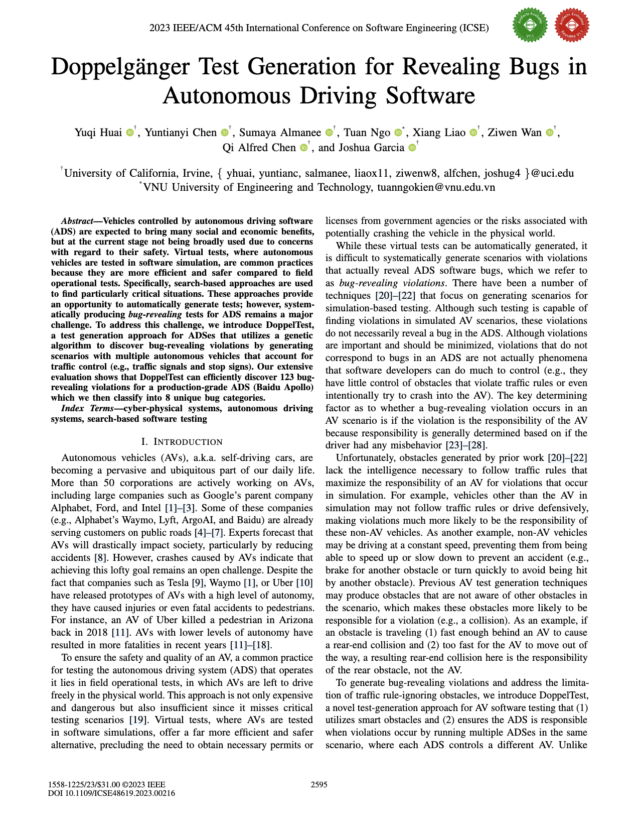
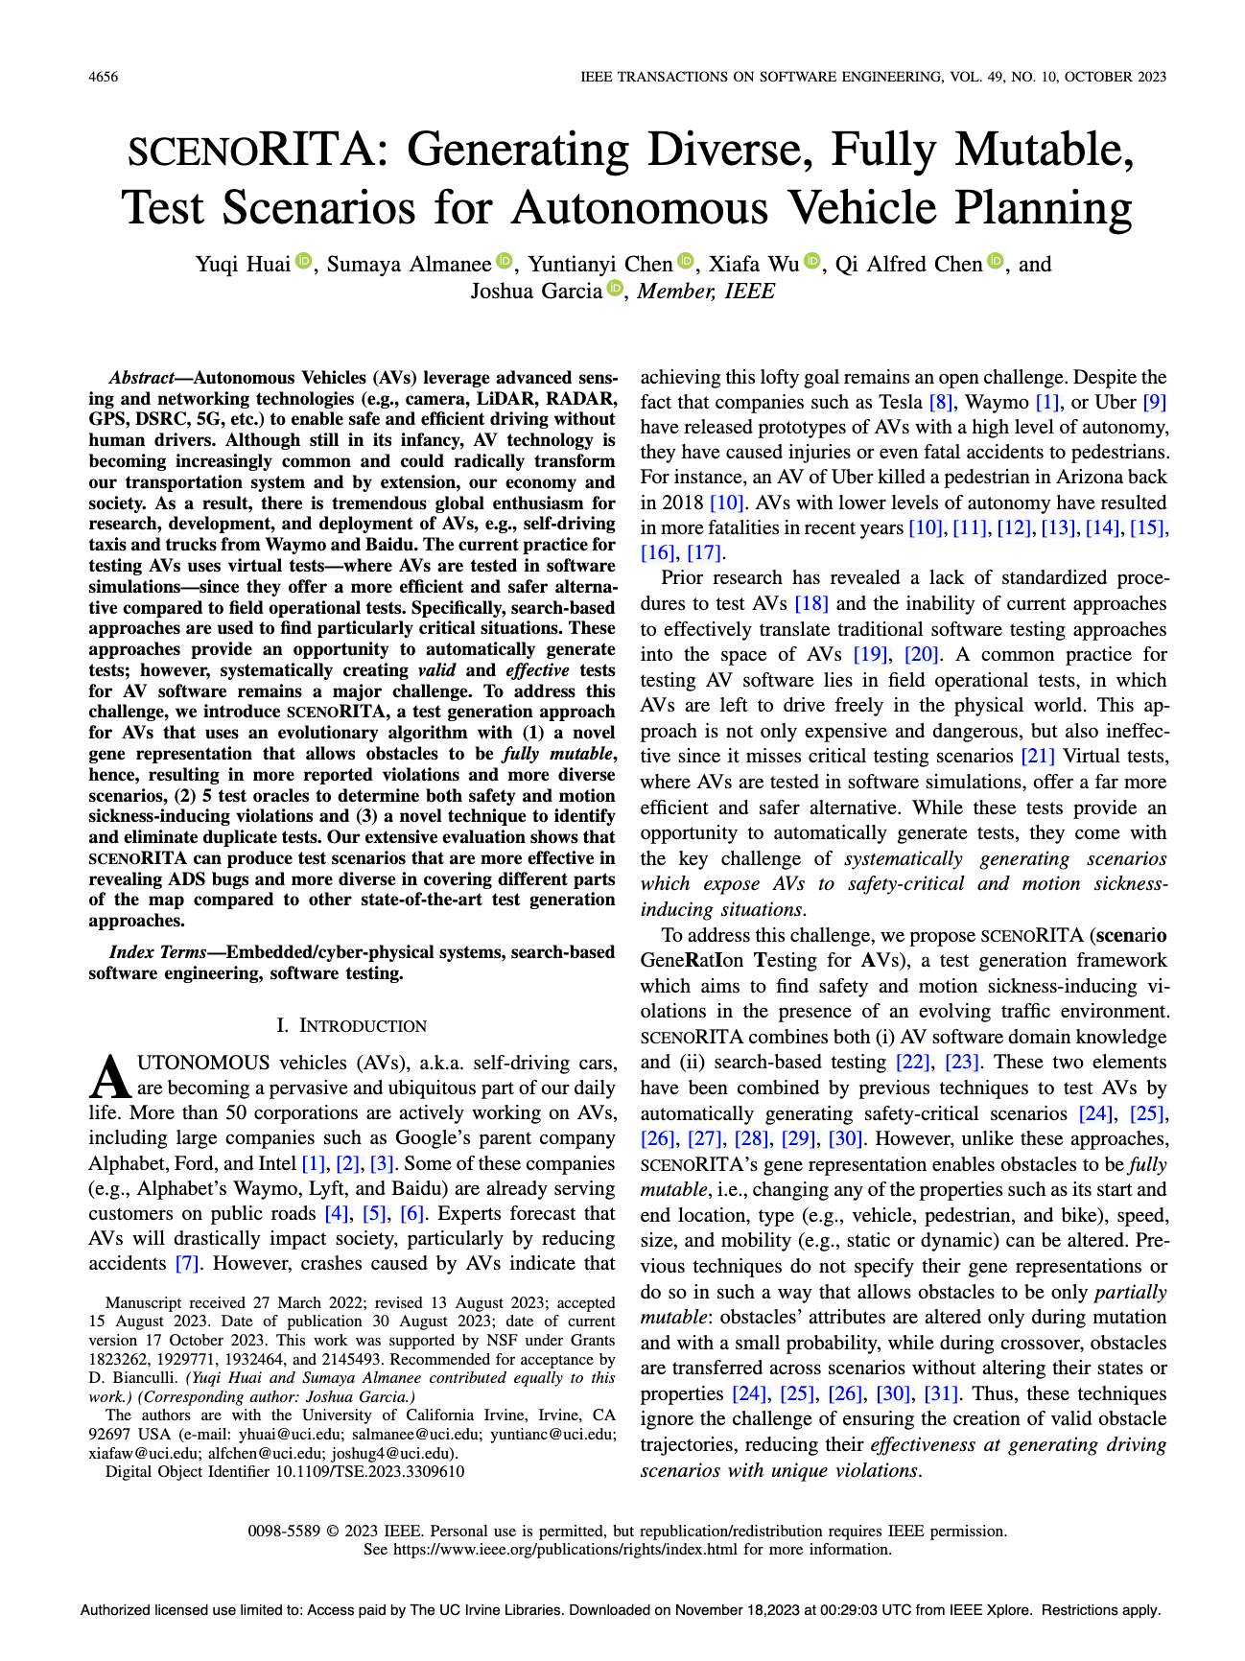
// Evaluation
Experiment Setup
ApolloAuto/apollo | ★ 26.5k
System Level Scenario Test Benchmark
8 Apollo Test Generators
Initial Test Suite
Reruns of system-level scenario-based tests
Scenario 1
S¹R¹
S¹R²
S¹R³
S¹R⁴
S¹R⁵
S¹R⁶
S¹R⁷
S¹R⁸
S¹R⁹
...
...
Scenario N
S^{N}R¹
S^{N}R²
S^{N}R³
S^{N}R⁴
S^{N}R⁵
S^{N}R⁶
S^{N}R⁷
S^{N}R⁸
S^{N}R⁹
ICSE 23, 25; TSE 23
DeFT-Apollo
Module Test Suites
Reruns of module-level frame-based tests
* Uses Apollo planning module’ output to reconstruct inputs. * Converts each scenario test into a module-level test suite.
MTS 1
M¹R¹
M¹R²
M¹R³
M¹R⁴
M¹R⁵
M¹R⁶
M¹R⁷
M¹R⁸
M¹R⁹
...
...
MTS N
M^{N}R¹
M^{N}R²
M^{N}R³
M^{N}R⁴
M^{N}R⁵
M^{N}R⁶
M^{N}R⁷
M^{N}R⁸
M^{N}R⁹

Slide 37
// Evaluation
RQ1
RQ2
RQ3
Planning Reproducibility
To what extent do scenario tests and module tests reproduce planning-module executions?
Planning reproducibility is meaningful with respect to failure reproducibility.
Collision Scenario
S¹R¹
S¹R²
S¹R³
S¹R⁴
S¹R⁵
S¹R⁶
S¹R⁷
S¹R⁸
S¹R⁹

Slide 38
// Evaluation
RQ1
RQ2
RQ3
Planning Reproducibility
To what extent do scenario tests and module tests reproduce planning-module executions?
Planning reproducibility is meaningful with respect to failure reproducibility.
Failure Reproduced Reruns
S¹R¹
S¹R³
S¹R⁶
S¹R⁸
S¹R⁹
Collision Scenario
S¹R²
S¹R⁴
S¹R⁵
S¹R⁷
Failure Not-Reproduced Reruns
Hypothesis 0:
Failures are not reproduced when ADS planning trajectories differ.

Slide 39
// Evaluation
RQ1
RQ2
RQ3
Planning Reproducibility
To what extent do scenario tests and module tests reproduce planning-module executions?
Measure | Failure Reproduced Edit Distances (m) | Failure Not-Reproduced Edit Distances (m)
1st Quartile | 0.10 | 1.62
2nd Quartile | 0.23 | 17.15
3rd Quartile | 6.99 | 308.71
min | 0.0 | 0.0
mean | 29.56 | 139.51
max | 2320.81 | 1453.06
Table 1. Summary statistics of planning trajectory edit distances across reruns of a system-level scenario test.
Failures revealed by system-level scenario tests tend to be reproduced when planning trajectories remain similar to the original simulation.

Slide 40
// Evaluation
RQ1
RQ2
RQ3
Planning Reproducibility
To what extent do scenario tests and module tests reproduce planning-module executions?
Compare planning trajectories from reruns of the scenario test or module tests with the initial simulation.
Scenario 1
S¹R¹
S¹R²
S¹R³
S¹R⁴
S¹R⁵
S¹R⁶
S¹R⁷
S¹R⁸
S¹R⁹
MTS 1
M¹R¹
M¹R²
M¹R³
M¹R⁴
M¹R⁵
M¹R⁶
M¹R⁷
M¹R⁸
M¹R⁹
Hypothesis 1:
Module tests resemble the executions occurred during system-level scenario testing; therefore, running module tests should replicate the planning trajectories observed in those system-level scenarios.

Slide 41
// Evaluation
RQ1
RQ2
RQ3
Planning Reproducibility
To what extent do scenario tests and module tests reproduce planning-module executions?
Threshold (m) | Module Test Rerun | System-Test Rerun
0.0 | 224,888 | 1,637
0.1 | 228,956 | 42,335
0.23 | 228,975 | 95,235
1.62 | 229,108 | 127,258
6.99 | 229,915 | 154,467
17.15 | 230,637 | 173,282
29.56 | 230,852 | 184,047
Table 2. Number of planning trajectories reproduced by DeFT module tests compared to rerunning scenario tests under different thresholds.
DeFT module tests reproduces more planning trajectories across different thresholds.
Notes:
causes of remaining non-reproduced
--

Slide 42
// Evaluation
RQ2
RQ3
Failure Reproducibility
To what extent can module tests reproduce failures detected by test generation approaches?
Compare test oracle outputs from reruns of the scenario or module tests with those from the initial simulation/execution.
Collision Scenario X
S^{X}R¹
S^{X}R²
S^{X}R³
S^{X}R⁴
S^{X}R⁵
S^{X}R⁶
S^{X}R⁷
S^{X}R⁸
S^{X}R⁹
Failure-inducing Module Tests
M¹R¹
M¹R²
M¹R³
M¹R⁴
M¹R⁵
M¹R⁶
M¹R⁷
M¹R⁸
M¹R⁹
Hypothesis 2:
System tests are non-deterministic, so collisions observed in the initial simulation may not occur again. In contrast, module tests are deterministic, meaning repeated executions should consistently yield the same outputs.
Notes:
- reproducibility rate

Slide 43
// Evaluation
RQ2
RQ3
Failure Reproducibility
To what extent can module tests reproduce failures detected by test generation approaches?
Rerunning simple scenario tests does not reliably reproduce all violations, whereas the DeFT module test provides deterministic results.
Notes:
- reproducibility rate

Slide 44
// Evaluation
RQ3
Efficiency
What is the run-time efficiency of DeFT and the produced module tests?
System Testing – Idle time occurs in each module execution cycle.
Time
Execution 1
Execution 2
Execution 3
Module Testing – Shorter frame input read intervals occur between module executions.
Time
Execution 1
Execution 2
Execution 3
Execution 4
Hypothesis 3:
Since a smaller portion of the ADS is exercised, and planning module is directly invoked, module-level testing is expected to reduce execution time.

Slide 45
// Evaluation
RQ3
Efficiency
What is the run-time efficiency of DeFT and the produced module tests?
Approach | Deterministic Frame-Based Testing |  |  | System Test (s) | Reduction
 | Extraction | Execution | Total
AV-FUZZER | 21.22 | 54.23 | 75.34 | 86.33 | 12.73%
BehAVExplor | 44.54 | 86.03 | 130.57 | 138.43 | 5.67%
Decictor | 22.50 | 54.55 | 77.05 | 84.85 | 9.19%
DeepCollision | 13.84 | 39.23 | 53.07 | 60.90 | 12.86%
DoppelTest | 12.77 | 18.69 | 31.46 | 35.77 | 12.04%
DriveFuzz | 22.11 | 57.17 | 79.27 | 88.47 | 10.40%
scenoRITA | 14.70 | 21.88 | 36.57 | 34.79 | -5.14%
Table 3. Run-time cost of running DeFT compared to system-level scenario tests.
Module-level testing offers a more efficient alternative to system-level testing in terms of runtime cost.

Slide 46
// Evaluation
RQ3
Efficiency
What is the run-time efficiency of DeFT and the produced module tests?
TTRF = Total Time Needed To Reproduce Failure

Slide 47
// Evaluation
RQ3
Efficiency
What is the run-time efficiency of DeFT and the produced module tests?
TTRF = Total Time Needed To Reproduce Failure
Approach | System Test (s) | Module Test (s) | Reduction
AV-FUZZER | 104.67 | 56.54 | 45.98%
BehAVExplor | 152.19 | 79.33 | 47.87%
Decictor | 334.46 | 74.78 | 77.64%
DeepCollision | 123.14 | 58.11 | 52.81%
DoppelTest | 59.68 | 15.38 | 74.23%
DriveFuzz | 132.09 | 71.87 | 45.59%
scenoRITA | 56.79 | 20.54 | 63.83%
Table 4. TTRF from each test generator by rerunning system tests and module tests.
Considering the non-deterministic nature of system-level testing, module-level tests greatly reduce the time needed to reproduce failures.

Slide 48
// DeFT
Deterministic Frame-Based Testing
Message Pool
DeFT
Sequential Frame Tests
DeFT
m
m
m
m
m
Filter
module’s input messages
m¹
m¹
m¹
m¹
P¹
Test Executor
m
m
m
m
m
m²
m²
m²
m²
P²
Input:
m^{n}
m^{n}
m^{n}
m^{n}
m
m
m
m
m
Reconstruct
input combinations
m³
m³
m³
m³
P³
Expected Output:
P^{n}
m
m
m
m
m
m
m
m
m
m
Validate
module tests based on outputs
...
Planning
m
m
m
m
m
m^{n}
m^{n}
m^{n}
m^{n}
P^{n}
Key Findings
Realistic
Deterministic
Efficient
Module-tests can accurately reproduce planning behaviors.
0.005% -> 97.16% Planning Reproduction
Module-tests yield predictable results when the module-under-test is deterministic.
71.58% -> 100% Failure Reproduction
Module-tests are faster to execute comparing to simulation.
5.67% – 12.86% Time Saving

Slide 49
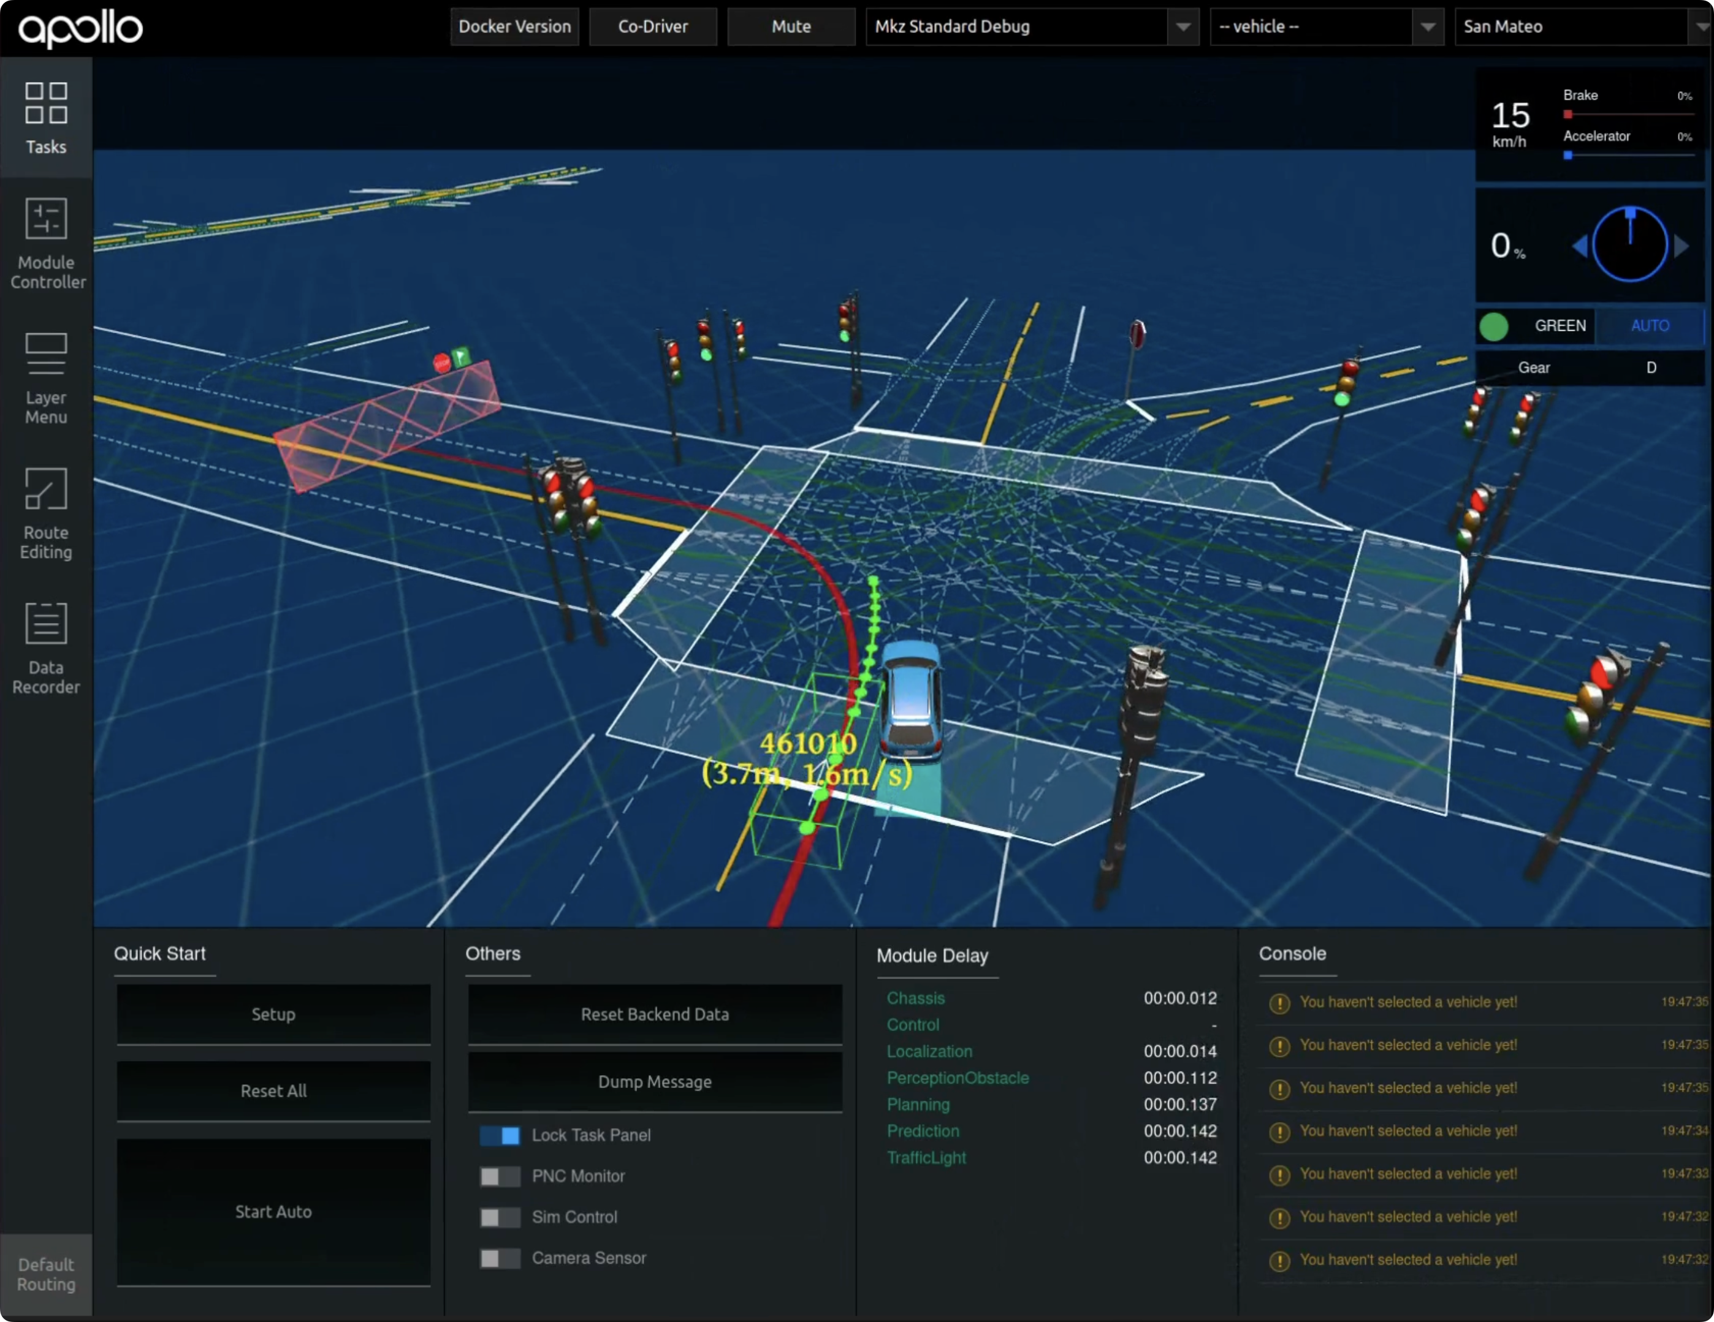
// DeFT In Action
Failing Test Executions (4/20)
AV Cuts off another vehicle
>
>
Passing Test Executions (16/20)
AV Returns to its original lane
>
>

Slide 50
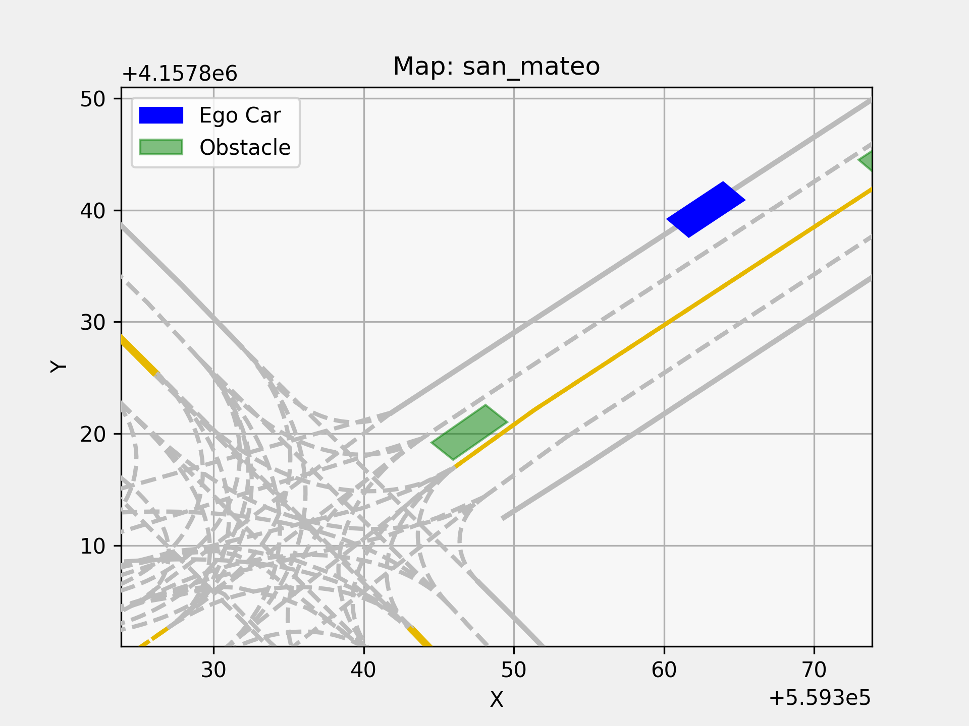
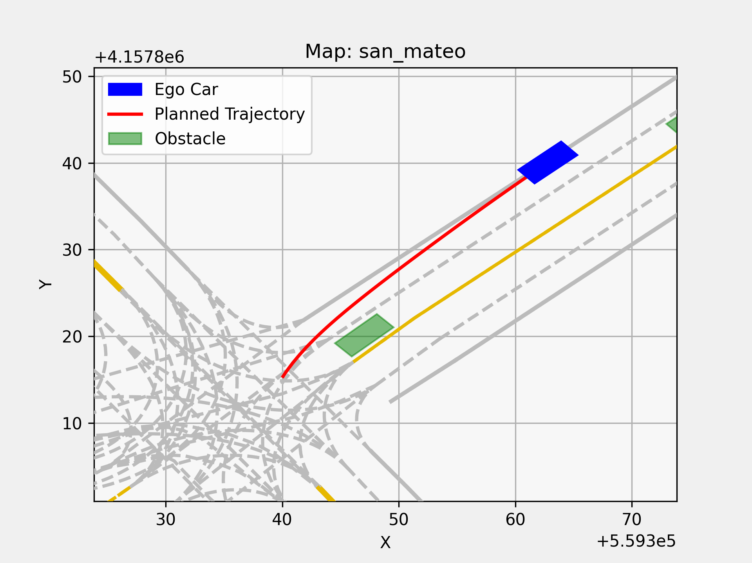
// DeFT In Action
In the scenario-based test world ...
Test Specification
Simulation
Hope for reproduction 😐
In the DeFT world ...
Sequential Module-Level Frame-Based Tests
Sets of Inputs and Expected Outputs
F₁
F₂
F₃
F₄
F₅
F₆
F₇
F₈
F₉
F₁₀
F₁₁
...
F₇₀
...
F₂₉₄
F₂₉₅
F₂₉₆
F₂₉₇
F₂₉₈
F₂₉₉
F₃₀₀
Visualization of the frame input.
Visualization of the faulty planning output.
Known collision from the system-test.
DETERMINISTIC!

Slide 51


// Conclusion
Scenario-based Testing ☹
Non-Deterministic!
Test Specification
Simulation
One observation
Deterministic Frame-based Testing ☺
Sequential Module—Level Frame-Based Tests
Frame 1
m¹
m¹
m¹
m¹
P¹
Frame 2
m²
m²
m²
m²
P²
Frame 3
m³
m³
m³
m³
P³
...
Frame N
Realistic
Deterministic
Efficient
Module-tests can accurately reproduce planning behaviors.
0.005% -> 97.16% Planning Reproduction
Module-tests yield predictable results when the module-under-test is deterministic.
71.58% -> 100% Failure Reproduction
Module-tests are faster to execute comparing to simulation.
5.67% – 12.86% Time Saving
Key Points // DeFT turns flaky system-level tests into deterministic, reproducible module-level tests.
* Non-determinism of system-level testing arises from real-time communication between modules.
* DeFT extract module-level tests that deterministically reproduces the planning module’s behavior.
* The planning module’s outputs can be used to both infer and validate its reconstructed inputs.
Future Work
Yuqi Huai <yhuai@uci.edu>
* Differential Testing // measure output change * Mutation Testing // mutant killing capability
University of California, Irvine

