Slide 1
组会汇报
王禹棋
2026年9月3日

Slide 2
Overview
一、Academic Papers
DTAC-Net: A Dual-Task Adaptive Collaborative Network for Remote Sensing Change Interpretation. TGRS, 2026. （审稿）
Burden-Free Distillation From Foundation Model for Efficient Remote Sensing Change Detection. TGRS, 2025.
PHENet: Toward Robust Fog-Resilient Change Detection in Remote Sensing Imagery With a Physics-Guided Height-Enhanced Network. TGRS, 2026.（复现）
二、Our Work
三、Future Work

Slide 3
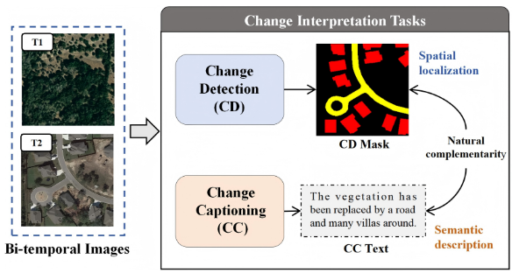
DTAC-Net（审稿）
任务：Remote Sensing Change Interpretation（CD/CC）
Motivation:
1.现有方法提取特征和构造变化特征时不对任务做区分，但是这俩是有任务差异的，CD 侧重空间细节、CC 侧重语义，强制共用会导致特征表达相互折中、相互纠缠
2. CD 与 CC 两个分支的交互不足，缺乏深度融合和双向信息，空间定位与语义理解之间无法充分互补
创新点：
1. HTA（分层任务注意力）做任务条件化调制，按层采用不同算子生成 CD 与 CC 各自的特征表示；
TOCM（任务导向变化建模）对拼接后的双时相特征，用不同类型卷积分别处理得到两套任务特定的变化特征
2. CTAI（跨任务注意力交互）以一个任务的变换特征为 Q、另一个为 K/V，在 CD 与 CC之间做双向交叉注意力
backbone：SegFormer
数据集：LEVIR-MCI 、LEVIR-CDC（只关注建筑） 、WHU-CDC
YANG Lei, MA Qi, LIU Bing, et al. DTAC-Net: A Dual-Task Adaptive Collaborative Network for Remote Sensing Change Interpretation[J]. TGRS, 2026.
Notes:
Li, Shuying, Zhenjian Qu, Yuemei Qin, San Zhang, and Qiang Li. “Global–Local Feature Collaborative Fusion and Edge Refinement Network for Remote Sensing Change Detection.” IEEE Transactions on Geoscience and Remote Sensing 63, 30 June 2025. https://doi.org/10.1109/TGRS.2025.3584115.

Slide 4
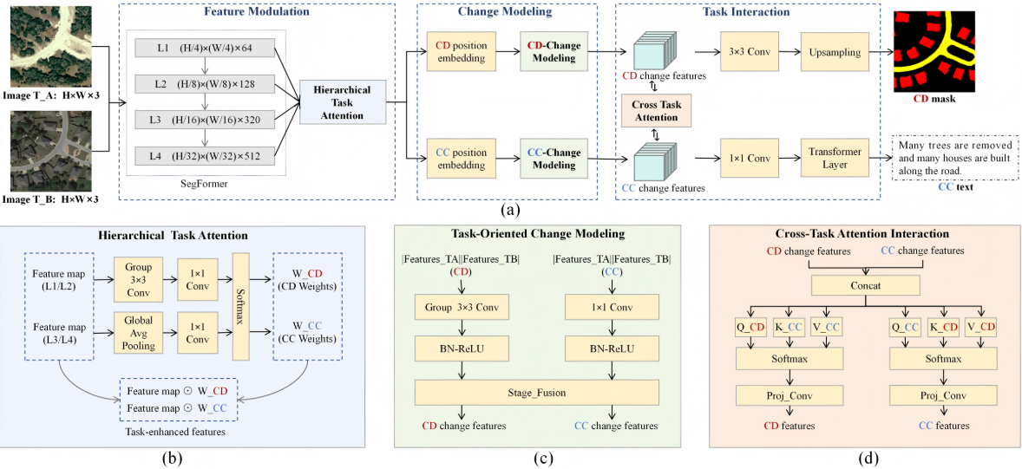
DTAC-Net（审稿）
YANG Lei, MA Qi, LIU Bing, et al. DTAC-Net: A Dual-Task Adaptive Collaborative Network for Remote Sensing Change Interpretation[J]. TGRS, 2026.
Notes:
Li, Shuying, Zhenjian Qu, Yuemei Qin, San Zhang, and Qiang Li. “Global–Local Feature Collaborative Fusion and Edge Refinement Network for Remote Sensing Change Detection.” IEEE Transactions on Geoscience and Remote Sensing 63, 30 June 2025. https://doi.org/10.1109/TGRS.2025.3584115.

Slide 5
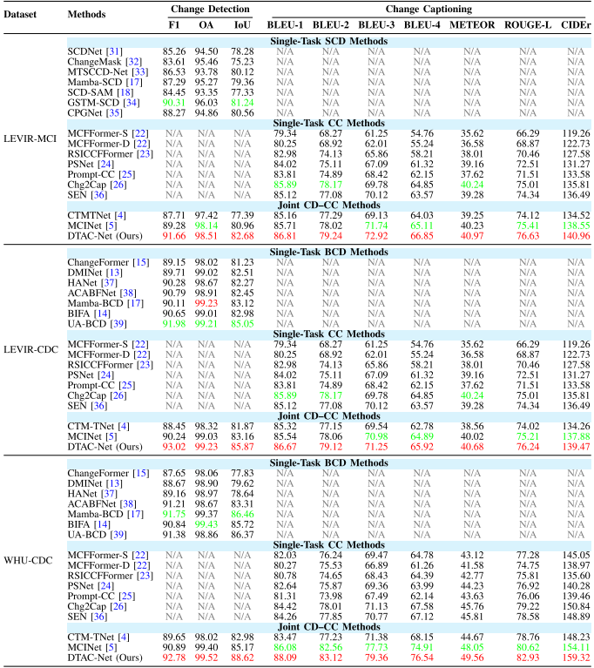
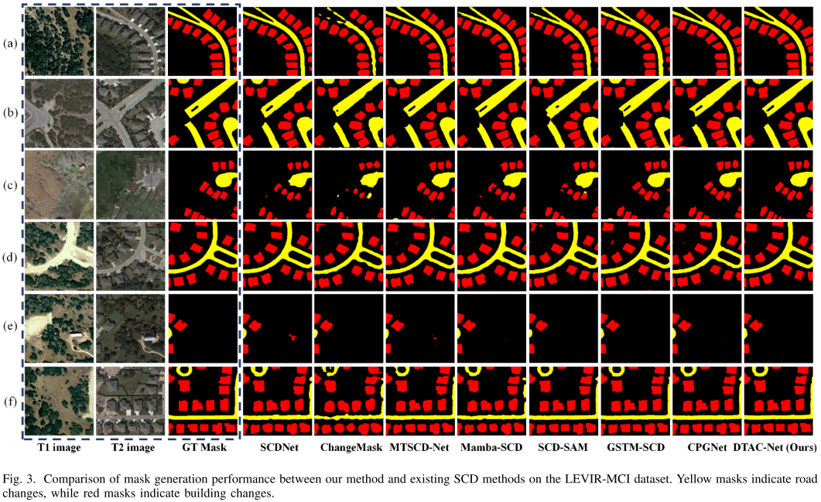
DTAC-Net（审稿）
YANG Lei, MA Qi, LIU Bing, et al. DTAC-Net: A Dual-Task Adaptive Collaborative Network for Remote Sensing Change Interpretation[J]. TGRS, 2026.
Notes:
Li, Shuying, Zhenjian Qu, Yuemei Qin, San Zhang, and Qiang Li. “Global–Local Feature Collaborative Fusion and Edge Refinement Network for Remote Sensing Change Detection.” IEEE Transactions on Geoscience and Remote Sensing 63, 30 June 2025. https://doi.org/10.1109/TGRS.2025.3584115.

Slide 6
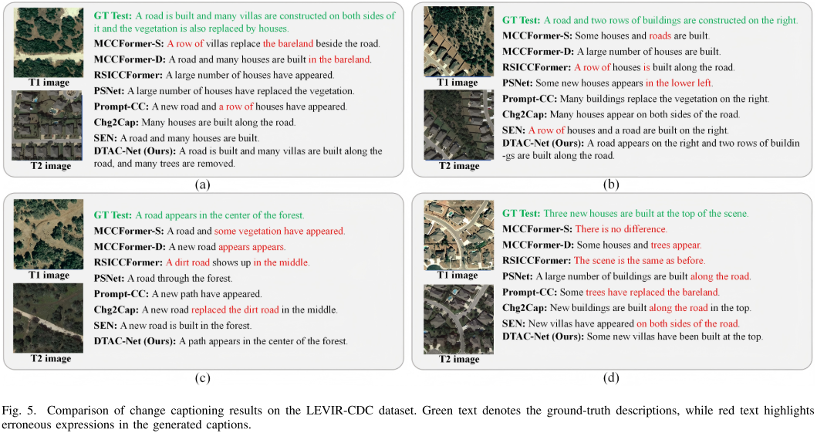
DTAC-Net（审稿）
YANG Lei, MA Qi, LIU Bing, et al. DTAC-Net: A Dual-Task Adaptive Collaborative Network for Remote Sensing Change Interpretation[J]. TGRS, 2026.
Notes:
Li, Shuying, Zhenjian Qu, Yuemei Qin, San Zhang, and Qiang Li. “Global–Local Feature Collaborative Fusion and Edge Refinement Network for Remote Sensing Change Detection.” IEEE Transactions on Geoscience and Remote Sensing 63, 30 June 2025. https://doi.org/10.1109/TGRS.2025.3584115.

Slide 7
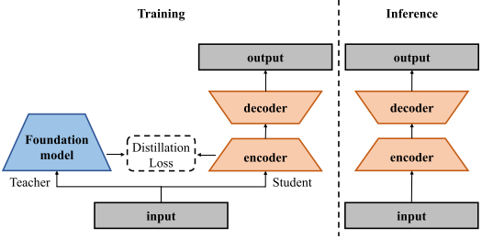
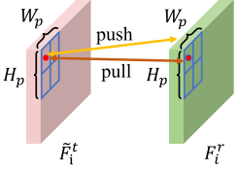
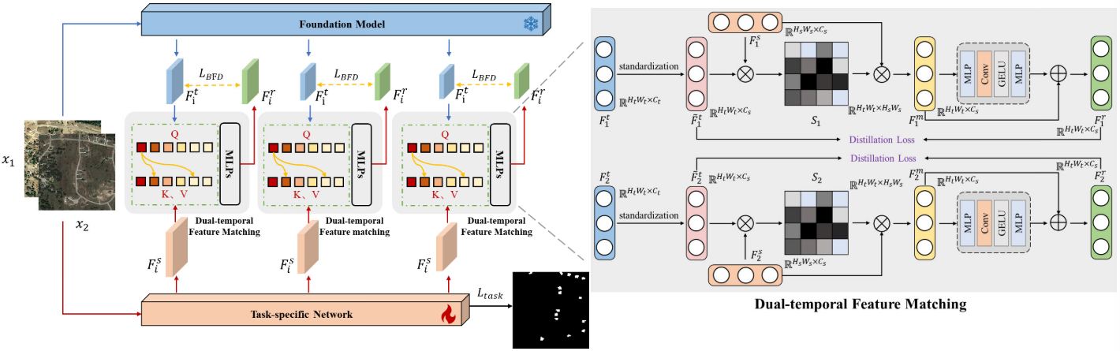
BFD
任务：RS_BCD
Motivation:能不能训练时借用大模型知识，但推理时完全不要大模型？
创新点：BFD：Foundation Model → DFM 双时相特征匹配 + PCD Patch 对比蒸馏 → CD Student。教师只训练期出现。
教师：CLIP ViT-B/16 ；学生：BIT和 ChangeFormer
Wang, S., Lv, C., Quan, D., Huyan, N., Cao, X., Sun, J., & Jiao, L. Burden-Free Distillation From Foundation Model for Efficient Remote Sensing Change Detection. TGRS, 2025.
Notes:
Li, Shuying, Zhenjian Qu, Yuemei Qin, San Zhang, and Qiang Li. “Global–Local Feature Collaborative Fusion and Edge Refinement Network for Remote Sensing Change Detection.” IEEE Transactions on Geoscience and Remote Sensing 63, 30 June 2025. https://doi.org/10.1109/TGRS.2025.3584115.

Slide 8
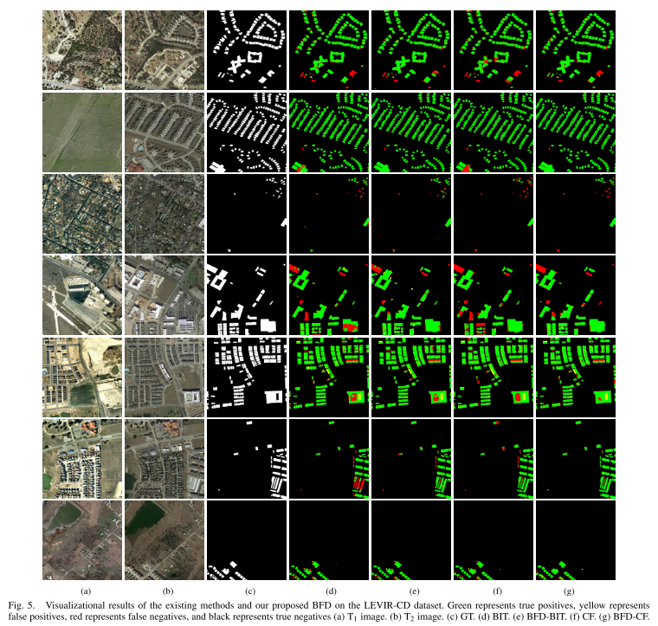
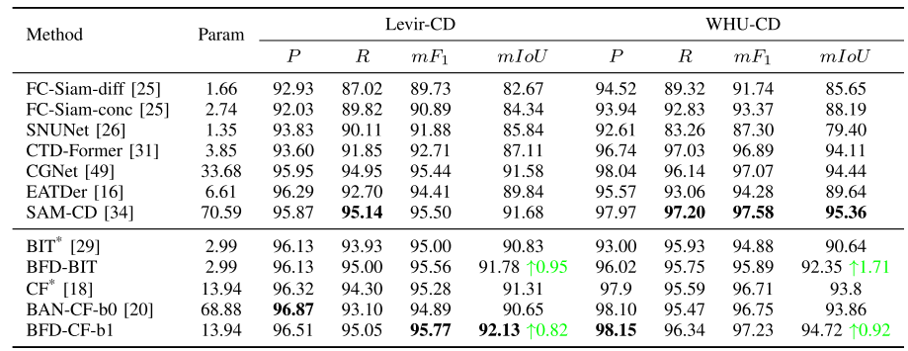
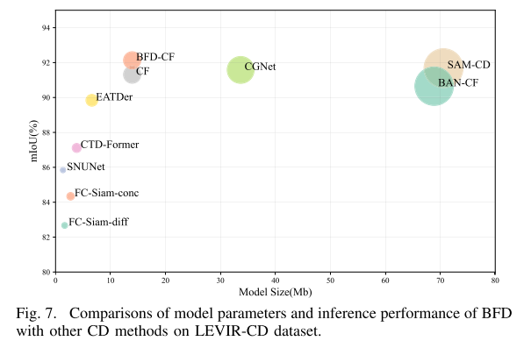
BFD
指标：LEVIR/WHU/CLCD 报的是 P、R、mF1、mIoU
Wang, S., Lv, C., Quan, D., Huyan, N., Cao, X., Sun, J., & Jiao, L. Burden-Free Distillation From Foundation Model for Efficient Remote Sensing Change Detection. TGRS, 2025.
Notes:
Li, Shuying, Zhenjian Qu, Yuemei Qin, San Zhang, and Qiang Li. “Global–Local Feature Collaborative Fusion and Edge Refinement Network for Remote Sensing Change Detection.” IEEE Transactions on Geoscience and Remote Sensing 63, 30 June 2025. https://doi.org/10.1109/TGRS.2025.3584115.

Slide 9
PHENet复现
PHENet 的输入需要： T1 RGB、T2 RGB、T1 height、T2 height。
1.高度图的生成代码没有。我自己找的方法：RGB → Depth Anything V2 相对深度 → RDAH-Net 高度估计 → Heightmap
2.论文和作者github里的变化检测损失不一致：论文采用 BCE + Dice；作者代码默认采用 CE + Dice (dice_ce)(我们现在用的是这个)。
3.数据增强存在差异：论文包含随机旋转；作者代码虽然实现了 rotation，但正式训练配置中没有开启随机旋转（我们开启了）。
4. PAC 损失权重不一致：论文为 TV=0.2、Dark=0.5、Adv=0.5；作者代码实际为 0.2、0.2、0.2。（我们采用论文值）
现有数据：
数据集 / 实验 | Params(M) | FLOPs(G) | FPS | GPU Mem(MB) | Recall | Precision | OA | F1 | IoU | Kappa
LEVIR-CD-foggy | 5.242 | 70.927 | 125.373 | 4861.28 | 72.3131 | 69.5936 | 96.9800 | 70.9273 | 54.9514 | 69.3352
SYSU-CD-foggy | 5.242 | 70.927 | 124.021 | 4861.28 | 67.2110 | 77.3316 | 87.6212 | 71.9170 | 56.1487 | 64.0277
LEVIR-CD+foggy | 5.242 | 70.927 | 121.988 | 4861.28 | 65.2694 | 65.2333 | 97.1677 | 65.2513 | 48.4245 | 63.7750
Jianjun Yuan, Siyu Chen, Jianjun Zhou, and Luoming Zhao. "PHENet: Toward Robust Fog-Resilient Change Detection in Remote Sensing Imagery With a Physics-Guided Height-Enhanced Network." TGRS, 2026.
Notes:
Li, Shuying, Zhenjian Qu, Yuemei Qin, San Zhang, and Qiang Li. “Global–Local Feature Collaborative Fusion and Edge Refinement Network for Remote Sensing Change Detection.” IEEE Transactions on Geoscience and Remote Sensing 63, 30 June 2025. https://doi.org/10.1109/TGRS.2025.3584115.

Slide 10
A2Net+LWGANet（baseline记录）
T1
F1_1
F1_2
F1_3
F1_4
SWA
GT
↓
主loss： BCE+Dice
4个
d1
d2
d3
d4
Shared LWGANet_L0
TFM
A2Net_Decoder
Stage1~4：SupervisedAttentionModule
S1
S2
S3
S4
changemap
4个
T1
F2_1
F2_2
F2_3
F2_4
SWA
Lu W, Yang X, Chen S B. LWGANet: Addressing spatial and channel redundancy in remote sensing visual tasks with light-weight grouped attention[C]//Proceedings of the AAAI Conference on Artificial Intelligence. 2026, 40(9): 7574-7582.
Notes:
Li, Shuying, Zhenjian Qu, Yuemei Qin, San Zhang, and Qiang Li. “Global–Local Feature Collaborative Fusion and Edge Refinement Network for Remote Sensing Change Detection.” IEEE Transactions on Geoscience and Remote Sensing 63, 30 June 2025. https://doi.org/10.1109/TGRS.2025.3584115.

Slide 11
Future Work
Lu W, Yang X, Chen S B. LWGANet: Addressing spatial and channel redundancy in remote sensing visual tasks with light-weight grouped attention[C]//Proceedings of the AAAI Conference on Artificial Intelligence. 2026, 40(9): 7574-7582.
Notes:
Li, Shuying, Zhenjian Qu, Yuemei Qin, San Zhang, and Qiang Li. “Global–Local Feature Collaborative Fusion and Edge Refinement Network for Remote Sensing Change Detection.” IEEE Transactions on Geoscience and Remote Sensing 63, 30 June 2025. https://doi.org/10.1109/TGRS.2025.3584115.

