Slide 1
组会汇报
王禹棋
2026年9月10日

Slide 2
Overview
一、Academic Papers
Mask-CDKD: A source-free and label-free cross-domain knowledge distillation framework from SAM for satellite onboard VHR land-cover mapping.ISPRS,2026.
BAN:A New Learning Paradigm for Foundation Model-Based Remote-Sensing Change Detection. TGRS,2024
二、Our Work
三、Future Work

Slide 3
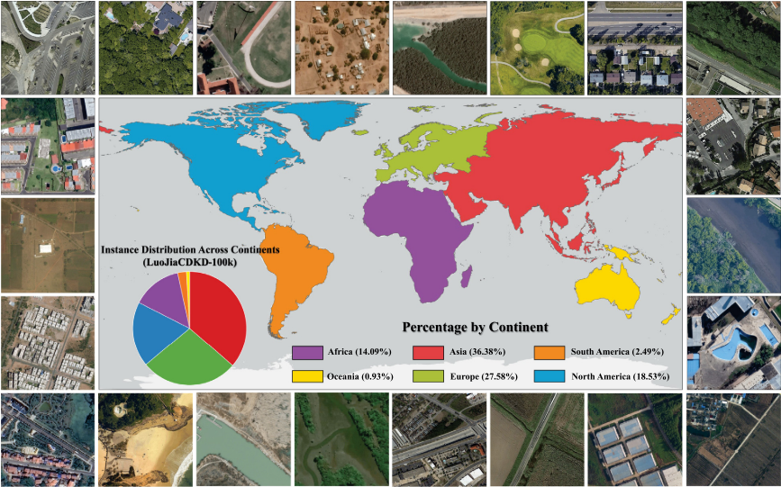
Mask-CDKD
任务：VHR 遥感土地覆盖语义分割（LULC Mapping），面向卫星星上轻量部署
Motivation：
1. SAM 很强，但模型太大，不适合星上部署
2. SAM 来自自然图像，直接蒸馏到遥感会带来域偏差
3.现有跨域蒸馏依赖源域数据/标签，且静态域分离不够灵活
创新点：
1. SAM→轻量 ViT-Small 蒸馏：训练时利用大模型知识，推理时只保留轻量学生。
2. MMoA 多尺度混合适配器：在冻结 SAM 主干的基础上，动态校准多尺度遥感特征，抑制自然图像域干扰。
3.无源无标签 + MIM + 双向协同蒸馏：只用无标签 VHR 遥感影像，通过重建自监督和教师-学生双向反馈完成域适配。
数据集：
LuoJiaCDKD-100K：100,801 张 1024×1024 VHR 遥感影像
Shu Daoyu, Zhang Zhan, Huang Xiao, Wang Ru, Jia Nan, Fu Xinzhe, Yang Bingnan, Wan Fang, Lu Jianzhong, Gong Jianya. Mask-CDKD: A source-free and label-free cross-domain knowledge distillation framework from SAM for satellite onboard VHR land-cover mapping[J]. ISPRS，2026
Notes:
Li, Shuying, Zhenjian Qu, Yuemei Qin, San Zhang, and Qiang Li. “Global–Local Feature Collaborative Fusion and Edge Refinement Network for Remote Sensing Change Detection.” IEEE Transactions on Geoscience and Remote Sensing 63, 30 June 2025. https://doi.org/10.1109/TGRS.2025.3584115.

Slide 4
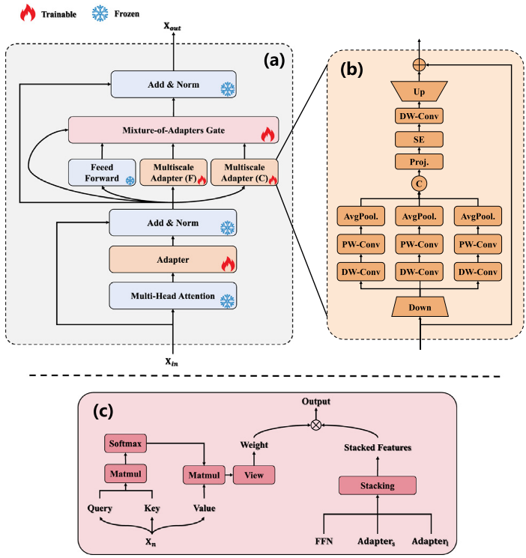
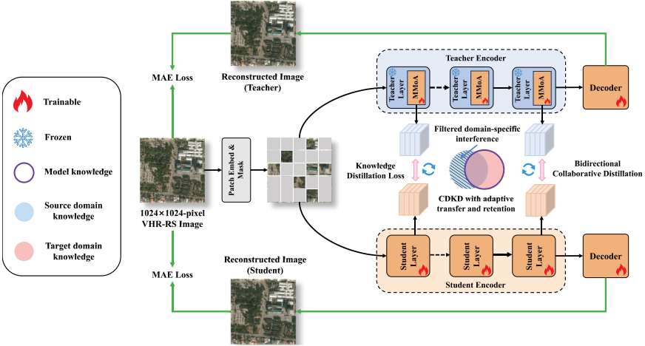
Mask-CDKD
CDKD：无需源域数据与像素标注。
MMoA：多尺度 Adapter + 动态 Gate，过滤域特定干扰。
Bidirectional KD：教师适配与学生学习协同优化。
MIM Reconstruction：增强目标域结构建模，仅部署轻量学生。
Shu Daoyu, Zhang Zhan, Huang Xiao, Wang Ru, Jia Nan, Fu Xinzhe, Yang Bingnan, Wan Fang, Lu Jianzhong, Gong Jianya. Mask-CDKD: A source-free and label-free cross-domain knowledge distillation framework from SAM for satellite onboard VHR land-cover mapping[J]. ISPRS，2026
Notes:
Li, Shuying, Zhenjian Qu, Yuemei Qin, San Zhang, and Qiang Li. “Global–Local Feature Collaborative Fusion and Edge Refinement Network for Remote Sensing Change Detection.” IEEE Transactions on Geoscience and Remote Sensing 63, 30 June 2025. https://doi.org/10.1109/TGRS.2025.3584115.

Slide 5
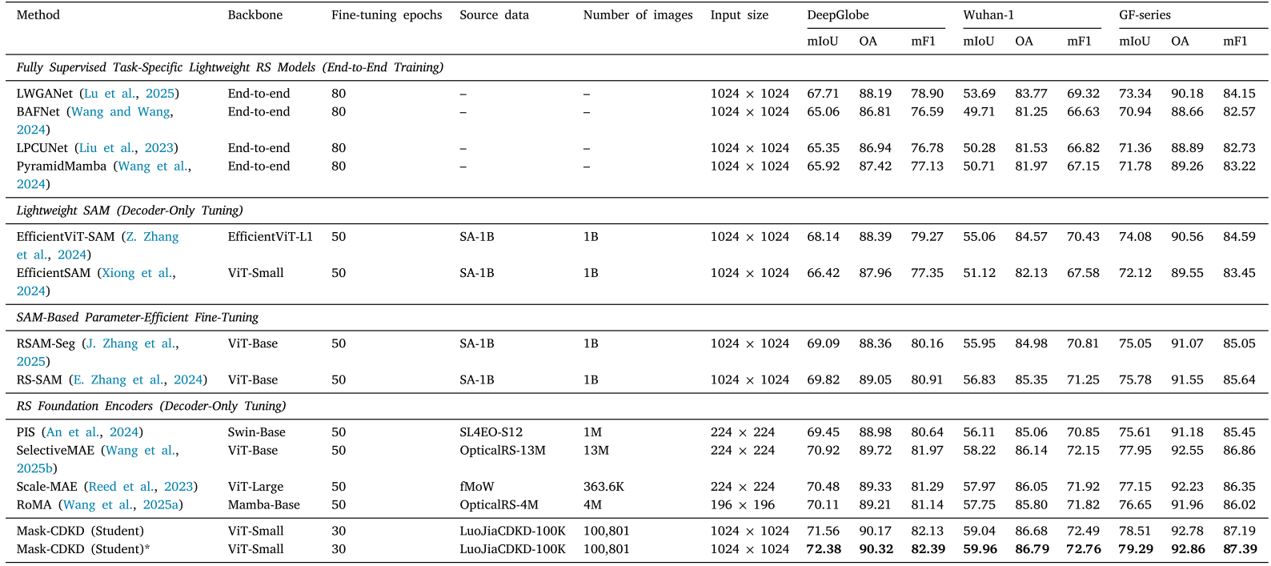
Mask-CDKD定量结果
Shu Daoyu, Zhang Zhan, Huang Xiao, Wang Ru, Jia Nan, Fu Xinzhe, Yang Bingnan, Wan Fang, Lu Jianzhong, Gong Jianya. Mask-CDKD: A source-free and label-free cross-domain knowledge distillation framework from SAM for satellite onboard VHR land-cover mapping[J]. ISPRS，2026
Notes:
Li, Shuying, Zhenjian Qu, Yuemei Qin, San Zhang, and Qiang Li. “Global–Local Feature Collaborative Fusion and Edge Refinement Network for Remote Sensing Change Detection.” IEEE Transactions on Geoscience and Remote Sensing 63, 30 June 2025. https://doi.org/10.1109/TGRS.2025.3584115.

Slide 6
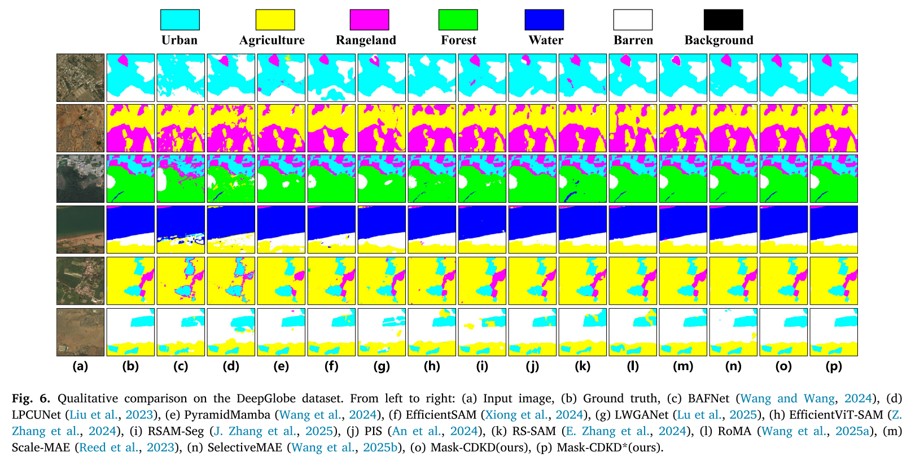
Mask-CDKD定性结果
Shu Daoyu, Zhang Zhan, Huang Xiao, Wang Ru, Jia Nan, Fu Xinzhe, Yang Bingnan, Wan Fang, Lu Jianzhong, Gong Jianya. Mask-CDKD: A source-free and label-free cross-domain knowledge distillation framework from SAM for satellite onboard VHR land-cover mapping[J]. ISPRS，2026
Notes:
Li, Shuying, Zhenjian Qu, Yuemei Qin, San Zhang, and Qiang Li. “Global–Local Feature Collaborative Fusion and Edge Refinement Network for Remote Sensing Change Detection.” IEEE Transactions on Geoscience and Remote Sensing 63, 30 June 2025. https://doi.org/10.1109/TGRS.2025.3584115.

Slide 7
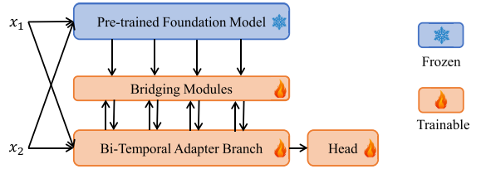
BAN
任务：RS_BCD
Motivation： CD 标注数据有限，且 Foundation Model 与遥感二时相 CD 存在域、任务和分辨率差异。
创新点： 提出 BAN，通过冻结 Foundation Model + Bi-TAB + Bridging Module 实现通用知识的选择、对齐与注入，并用 ARIS （非对称分辨率输入策略）解决分辨率不匹配。
Foundation Model可选：
CLIP ViT-L/14
RemoteCLIP
ImageNet-21K pretrained ViT 等
Kaiyu Li, Xiangyong Cao, Deyu Meng.A New Learning Paradigm for Foundation Model-Based Remote-Sensing Change Detection. TGRS,2024
Notes:
Li, Shuying, Zhenjian Qu, Yuemei Qin, San Zhang, and Qiang Li. “Global–Local Feature Collaborative Fusion and Edge Refinement Network for Remote Sensing Change Detection.” IEEE Transactions on Geoscience and Remote Sensing 63, 30 June 2025. https://doi.org/10.1109/TGRS.2025.3584115.

Slide 8
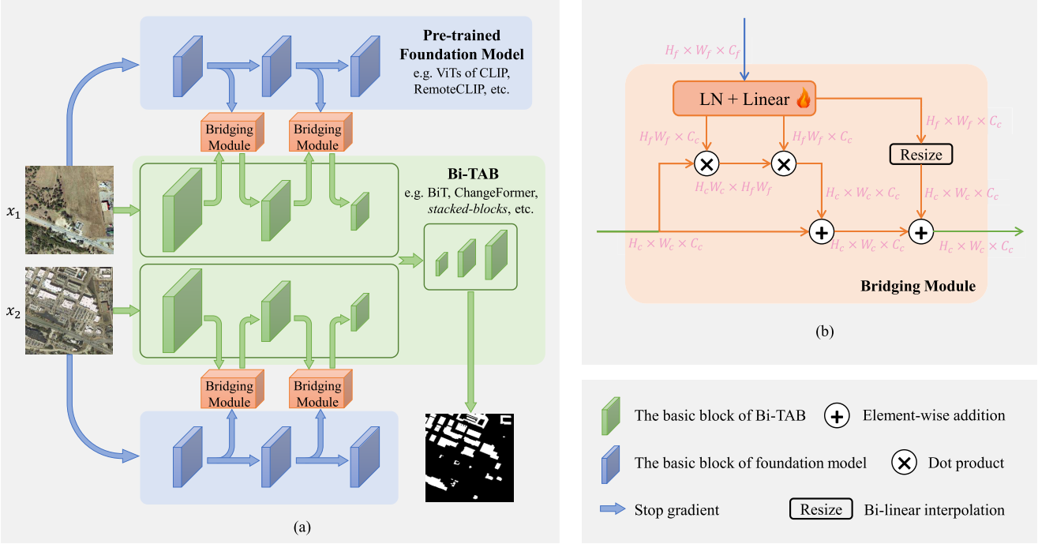
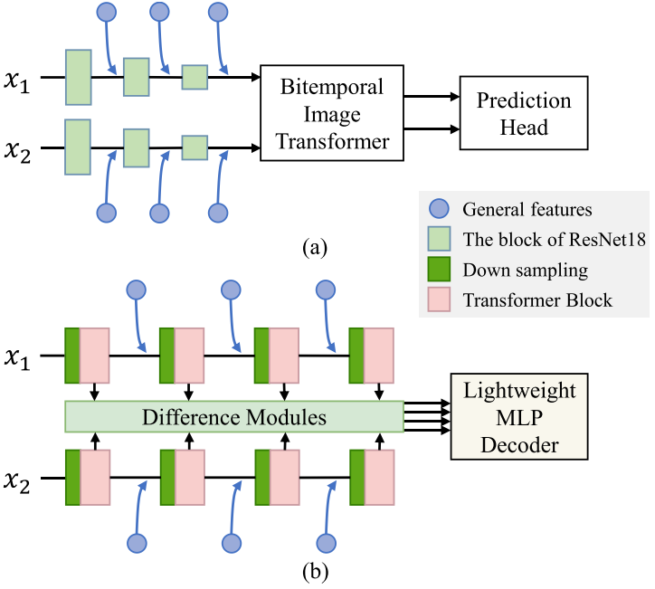
BAN
1.冻结 Foundation Model 提取双时相通用视觉特征，Bi-TAB 保留原有变化检测网络
2.Bridging Module 以 Bi-TAB 特征为查询，实现 Foundation 知识的选择、通道/尺度对齐与逐层注入。
3.Bi-TAB 可兼容 BiT、ChangeFormer 等不同 CD 架构，体现 BAN 的模型无关与即插即用能力。
Kaiyu Li, Xiangyong Cao, Deyu Meng.A New Learning Paradigm for Foundation Model-Based Remote-Sensing Change Detection. TGRS,2024
Notes:
Li, Shuying, Zhenjian Qu, Yuemei Qin, San Zhang, and Qiang Li. “Global–Local Feature Collaborative Fusion and Edge Refinement Network for Remote Sensing Change Detection.” IEEE Transactions on Geoscience and Remote Sensing 63, 30 June 2025. https://doi.org/10.1109/TGRS.2025.3584115.

Slide 9
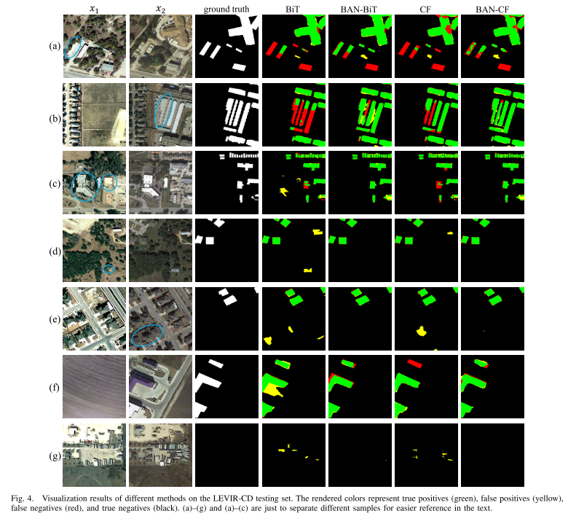
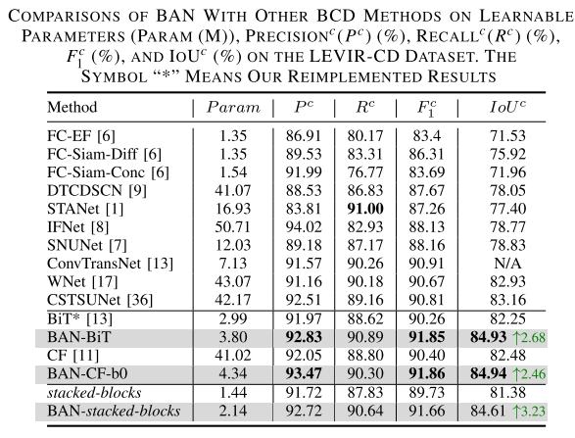
BAN
这里的Param只是 learnable parameters，推理的时候大模型参数也要算上
Kaiyu Li, Xiangyong Cao, Deyu Meng.A New Learning Paradigm for Foundation Model-Based Remote-Sensing Change Detection. TGRS,2024
Notes:
Li, Shuying, Zhenjian Qu, Yuemei Qin, San Zhang, and Qiang Li. “Global–Local Feature Collaborative Fusion and Edge Refinement Network for Remote Sensing Change Detection.” IEEE Transactions on Geoscience and Remote Sensing 63, 30 June 2025. https://doi.org/10.1109/TGRS.2025.3584115.

Slide 10
Our Work整体结构
仅训练：教师与辅助蒸馏分支（推理时删除）
偶：不随时相交换变号
奇：时相交换后反号
T1
保存 .pt
偶结构
（边界、局部等）
获取
实例编号
偶知识 | 它表达什么 | 为什么交换后不变
边界变化 Boundary | 两个时相的物体 边界有多大差异 | 只关心“差多少”， 不关心谁先谁后
局部关系变化 Local | 邻近像素/区域是 否仍属于同一实例 | 用绝对关系差异， 交换前后相同
几何变化 Geometry | 物体大小、形状、 内部结构等变化程度 | 也是绝对差异
稳定结构 Stable | 两个时相都存在、 且结构基本一致的区域 | “两边一致” 本身没有方向
SAM2 离线
同步
+
分解结构
边界图
T2
掩码质量
奇结构
（有向差异）
保存 .pt
辅助损失
分解结构
偶分量
学生4层特征
正/逆序共享编码
奇分量
推理时：仅保留主路径
作用于编码器4层输出
奇知识 | 表达什么
有向边界变化 | 边界是 T2 新增，还是 T1 原有部分消失
有向局部关系变化 | 局部实例关系是增强还是减弱
有向几何变化 | 物体结构是增大/增强还是减小/减弱
T1
F1_1
F1_2
F1_3
F1_4
SWA
GT
↓
主loss： BCE+Dice
4个
d1
d2
d3
d4
Shared LWGANet_L0
TFM
A2Net_Decoder
Stage1~4：SupervisedAttentionModule
S1
S2
S3
S4
changemap
4个
T1
F2_1
F2_2
F2_3
F2_4
SWA
配置 | SYSU F1
只有主路径 | 82.10
加教师 | 82.10
Notes:
Li, Shuying, Zhenjian Qu, Yuemei Qin, San Zhang, and Qiang Li. “Global–Local Feature Collaborative Fusion and Edge Refinement Network for Remote Sensing Change Detection.” IEEE Transactions on Geoscience and Remote Sensing 63, 30 June 2025. https://doi.org/10.1109/TGRS.2025.3584115.

Slide 11
Our Work整体结构
Notes:
Li, Shuying, Zhenjian Qu, Yuemei Qin, San Zhang, and Qiang Li. “Global–Local Feature Collaborative Fusion and Edge Refinement Network for Remote Sensing Change Detection.” IEEE Transactions on Geoscience and Remote Sensing 63, 30 June 2025. https://doi.org/10.1109/TGRS.2025.3584115.

Slide 12
A2Net+LWGANet（baseline记录）
T1
F1_1
F1_2
F1_3
F1_4
SWA
GT
↓
主loss： BCE+Dice
4个
d1
d2
d3
d4
Shared LWGANet_L0
TFM
A2Net_Decoder
Stage1~4：SupervisedAttentionModule
S1
S2
S3
S4
changemap
4个
T1
F2_1
F2_2
F2_3
F2_4
SWA
Lu W, Yang X, Chen S B. LWGANet: Addressing spatial and channel redundancy in remote sensing visual tasks with light-weight grouped attention[C]//Proceedings of the AAAI Conference on Artificial Intelligence. 2026, 40(9): 7574-7582.
Notes:
Li, Shuying, Zhenjian Qu, Yuemei Qin, San Zhang, and Qiang Li. “Global–Local Feature Collaborative Fusion and Edge Refinement Network for Remote Sensing Change Detection.” IEEE Transactions on Geoscience and Remote Sensing 63, 30 June 2025. https://doi.org/10.1109/TGRS.2025.3584115.

Slide 13
Future Work
1.将大模型的文本信息作为教师，看相关论文，更好的处理奇偶知识
2.看agent相关BCD论文
Lu W, Yang X, Chen S B. LWGANet: Addressing spatial and channel redundancy in remote sensing visual tasks with light-weight grouped attention[C]//Proceedings of the AAAI Conference on Artificial Intelligence. 2026, 40(9): 7574-7582.
Notes:
Li, Shuying, Zhenjian Qu, Yuemei Qin, San Zhang, and Qiang Li. “Global–Local Feature Collaborative Fusion and Edge Refinement Network for Remote Sensing Change Detection.” IEEE Transactions on Geoscience and Remote Sensing 63, 30 June 2025. https://doi.org/10.1109/TGRS.2025.3584115.

