Slide 1
组会汇报
王禹棋
2026年9月24日

Slide 2
Overview
一、Academic Papers
二、Our Work
三、Future Work

Slide 3
教师二阶段（单DINOv3/DINOv3与SAM2协同）
T1
T2
T1
T2
DINOv3
DINOv3
DINOv3
SAM2
f_mid
f_deep
f_mid
f_deep
语义+边界
教师特征
F_deep（两个deep相减）
RDT(可学习router)
F_mid（两个mid相减）
可靠性权重（让学生知道拒绝哪些错误，作用于TFM/S1）
KD蒸馏(作用于S4)
T1
F1_1
F1_2
F1_3
F1_4
SWA
GT
↓
主loss： BCE+Dice
4个
d1
d2
d3
d4
Shared LWGANet_L0
TFM
A2Net_Decoder
Stage1~4：SupervisedAttentionModule
S1
S2
S3
S4
changemap
4个
T2
F2_1
F2_2
F2_3
F2_4
SWA
Notes:
Li, Shuying, Zhenjian Qu, Yuemei Qin, San Zhang, and Qiang Li. “Global–Local Feature Collaborative Fusion and Edge Refinement Network for Remote Sensing Change Detection.” IEEE Transactions on Geoscience and Remote Sensing 63, 30 June 2025. https://doi.org/10.1109/TGRS.2025.3584115.

Slide 4
SAM2教师+奇偶结构分解
仅训练：教师与辅助蒸馏分支（推理时删除）
T1
保存 .pt
偶结构
（边界、局部等）
偶：不随时相交换变号
奇：时相交换后反号
获取
实例编号
SAM2 离线
同步
+
分解结构
边界图
偶知识 | 它表达什么 | 为什么交换后不变
边界变化 Boundary | 两个时相的物体 边界有多大差异 | 只关心“差多少”， 不关心谁先谁后
局部关系变化 Local | 邻近像素/区域是 否仍属于同一实例 | 用绝对关系差异， 交换前后相同
几何变化 Geometry | 物体大小、形状、 内部结构等变化程度 | 也是绝对差异
稳定结构 Stable | 两个时相都存在、 且结构基本一致的区域 | “两边一致” 本身没有方向
T1
掩码质量
奇结构
（有向差异）
保存 .pt
辅助损失
分解结构
偶分量
学生4层特征
正/逆序共享编码
奇分量
推理时：仅保留主路径
作用于编码器4层输出
T1
F1_1
F1_2
F1_3
F1_4
SWA
GT
↓
主loss： BCE+Dice
d1
d2
d3
d4
奇知识 | 表达什么
有向边界变化 | 边界是 T2 新增，还是 T1 原有部分消失
有向局部关系变化 | 局部实例关系是增强还是减弱
有向几何变化 | 物体结构是增大/增强还是减小/减弱
4个
Shared LWGANet_L0
TFM
A2Net_Decoder
Stage1~4：SupervisedAttentionModule
S1
S2
S3
S4
changemap
4个
T1
F2_1
F2_2
F2_3
F2_4
SWA
Notes:
Li, Shuying, Zhenjian Qu, Yuemei Qin, San Zhang, and Qiang Li. “Global–Local Feature Collaborative Fusion and Edge Refinement Network for Remote Sensing Change Detection.” IEEE Transactions on Geoscience and Remote Sensing 63, 30 June 2025. https://doi.org/10.1109/TGRS.2025.3584115.

Slide 5
教师二阶段
SYSU-CD-256
实验 | 教师 cache 类型 | Params (M) | FLOPs (G) | Recall | Precision | OA | F1 | IoU | Kappa
clean | 无 | 2.9131 | 2.7676 | 79.49 | 85.69 | 92.03 | 82.48 | 70.19 | 77.33
1 | DINOv3 | 2.9131 | 2.7676 | 80.43 | 84.61 | 91.94 | 82.47 | 70.17 | 77.24
2 | DINOv3 + SAM2 | 2.9131 | 2.7676 | 77.66 | 86.67 | 91.91 | 81.91 | 69.37 | 76.73
3 | SAM2 | 2.9131 | 2.7676 | 81.04 | 85.55 | 92.30 | 83.23 | 71.28 | 78.24
WHU-CD-256
实验 | 教师 cache 类型 | Params (M) | FLOPs (G) | Recall | Precision | OA | F1 | IoU | Kappa
clean | 无 | 2.9131 | 2.7676 | 92.78 | 95.37 | 99.53 | 94.05 | 88.78 | 93.81
1 | DINOv3 | 2.9131 | 2.7676 | 92.12 | 96.41 | 99.55 | 94.22 | 89.07 | 93.98
2 | DINOv3 + SAM2 | 2.9131 | 2.7676 | 91.96 | 95.82 | 99.52 | 93.85 | 88.42 | 93.60
3 | SAM2 | 2.9131 | 2.7676 | 93.02 | 94.38 | 99.50 | 93.70 | 88.15 | 93.44
Notes:
Li, Shuying, Zhenjian Qu, Yuemei Qin, San Zhang, and Qiang Li. “Global–Local Feature Collaborative Fusion and Edge Refinement Network for Remote Sensing Change Detection.” IEEE Transactions on Geoscience and Remote Sensing 63, 30 June 2025. https://doi.org/10.1109/TGRS.2025.3584115.

Slide 6
教师二阶段
LEVIR-CD-256
实验 | 教师 cache 类型 | Params (M) | FLOPs (G) | Recall | Precision | OA | F1 | IoU | Kappa
clean | 无 | 2.9131 | 2.7676 | 90.66 | 91.92 | 99.12 | 91.29 | 83.97 | 90.82
1 | DINOv3 | 2.9131 | 2.7676 | 90.35 | 91.75 | 99.09 | 91.04 | 83.56 | 90.57
2 | DINOv3 + SAM2 | 2.9131 | 2.7676 | 90.14 | 91.46 | 99.07 | 90.80 | 83.14 | 90.31
3 | SAM2 | 2.9131 | 2.7676 | 90.79 | 91.27 | 99.09 | 91.03 | 83.53 | 90.55
CDD-CD-256
实验 | 教师 cache 类型 | Params (M) | FLOPs (G) | Recall | Precision | OA | F1 | IoU | Kappa
clean | 无 | 2.9131 | 2.7676 | 97.71 | 97.87 | 99.46 | 97.79 | 95.68 | 97.48
1 | DINOv3 | 2.9131 | 2.7676 | 97.40 | 97.70 | 99.40 | 97.55 | 95.21 | 97.20
2 | DINOv3 + SAM2 | 2.9131 | 2.7676 | 97.87 | 97.63 | 99.44 | 97.75 | 95.60 | 97.44
3 | SAM2 | 2.9131 | 2.7676 | 97.70 | 97.86 | 99.45 | 97.78 | 95.66 | 97.47
Notes:
Li, Shuying, Zhenjian Qu, Yuemei Qin, San Zhang, and Qiang Li. “Global–Local Feature Collaborative Fusion and Edge Refinement Network for Remote Sensing Change Detection.” IEEE Transactions on Geoscience and Remote Sensing 63, 30 June 2025. https://doi.org/10.1109/TGRS.2025.3584115.

Slide 7
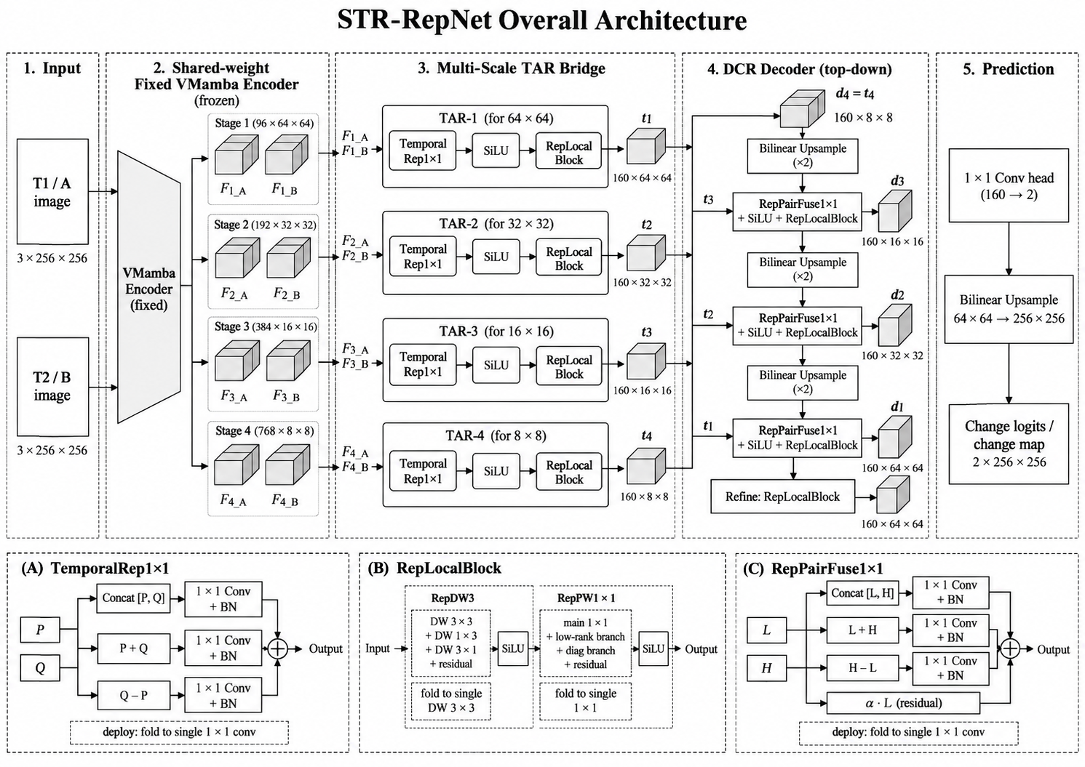
重参数化路线
Notes:
Li, Shuying, Zhenjian Qu, Yuemei Qin, San Zhang, and Qiang Li. “Global–Local Feature Collaborative Fusion and Edge Refinement Network for Remote Sensing Change Detection.” IEEE Transactions on Geoscience and Remote Sensing 63, 30 June 2025. https://doi.org/10.1109/TGRS.2025.3584115.

Slide 8
重参数化路线
Tag | Run | Experiment | Dataset | Recall | Precision | OA | F1 | IoU | Kappa | Params(M) | Trainable(M) | FLOPs(G)
TAR-DCR | Run2 | full_last2 | CDD-CD-256 | 98.49 | 98.35 | 99.61 | 98.42 | 96.89 | 98.20 | 29.57 | 27.46 | 12.61
TAR-DCR | Run2 | full_last2 | LEVIR-CD-256 | 90.32 | 92.60 | 99.14 | 91.44 | 84.24 | 90.99 | 29.57 | 27.46 | 12.61
TAR-DCR | Run2 | full_last2 | SYSU-CD-256 | 79.56 | 87.75 | 92.56 | 83.45 | 71.60 | 78.66 | 29.57 | 27.46 | 12.61
TAR-DCR | Run2 | full_last2 | WHU-CD-256 | 94.35 | 95.95 | 99.62 | 95.14 | 90.74 | 94.94 | 29.57 | 27.46 | 12.61
Notes:
Li, Shuying, Zhenjian Qu, Yuemei Qin, San Zhang, and Qiang Li. “Global–Local Feature Collaborative Fusion and Edge Refinement Network for Remote Sensing Change Detection.” IEEE Transactions on Geoscience and Remote Sensing 63, 30 June 2025. https://doi.org/10.1109/TGRS.2025.3584115.

Slide 9
拆除无损的外挂模块
F1_i
+
-
*
C ->1*1Conv+GN+GELU
C
F2_i
Notes:
Li, Shuying, Zhenjian Qu, Yuemei Qin, San Zhang, and Qiang Li. “Global–Local Feature Collaborative Fusion and Edge Refinement Network for Remote Sensing Change Detection.” IEEE Transactions on Geoscience and Remote Sensing 63, 30 June 2025. https://doi.org/10.1109/TGRS.2025.3584115.

Slide 10
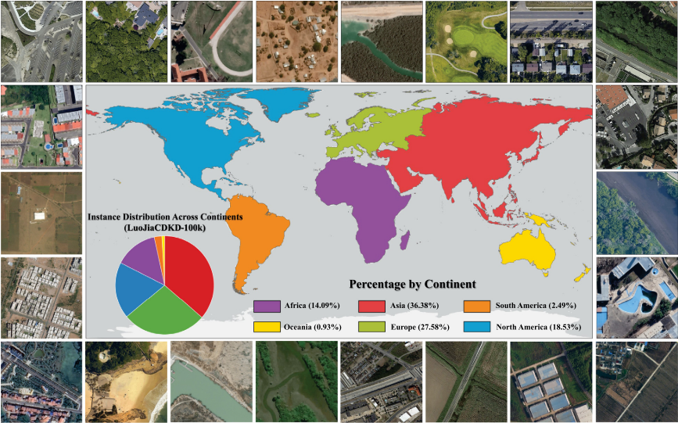
Mask-CDKD
任务：VHR 遥感土地覆盖语义分割（LULC Mapping），面向卫星星上轻量部署
Motivation：
1. SAM 很强，但模型太大，不适合星上部署
2. SAM 来自自然图像，直接蒸馏到遥感会带来域偏差
3.现有跨域蒸馏依赖源域数据/标签，且静态域分离不够灵活
创新点：
1. SAM→轻量 ViT-Small 蒸馏：训练时利用大模型知识，推理时只保留轻量学生。
2. MMoA 多尺度混合适配器：在冻结 SAM 主干的基础上，动态校准多尺度遥感特征，抑制自然图像域干扰。
3.无源无标签 + MIM + 双向协同蒸馏：只用无标签 VHR 遥感影像，通过重建自监督和教师-学生双向反馈完成域适配。
数据集：
LuoJiaCDKD-100K：100,801 张 1024×1024 VHR 遥感影像
Shu Daoyu, Zhang Zhan, Huang Xiao, Wang Ru, Jia Nan, Fu Xinzhe, Yang Bingnan, Wan Fang, Lu Jianzhong, Gong Jianya. Mask-CDKD: A source-free and label-free cross-domain knowledge distillation framework from SAM for satellite onboard VHR land-cover mapping[J]. ISPRS，2026
Notes:
Li, Shuying, Zhenjian Qu, Yuemei Qin, San Zhang, and Qiang Li. “Global–Local Feature Collaborative Fusion and Edge Refinement Network for Remote Sensing Change Detection.” IEEE Transactions on Geoscience and Remote Sensing 63, 30 June 2025. https://doi.org/10.1109/TGRS.2025.3584115.

Slide 11
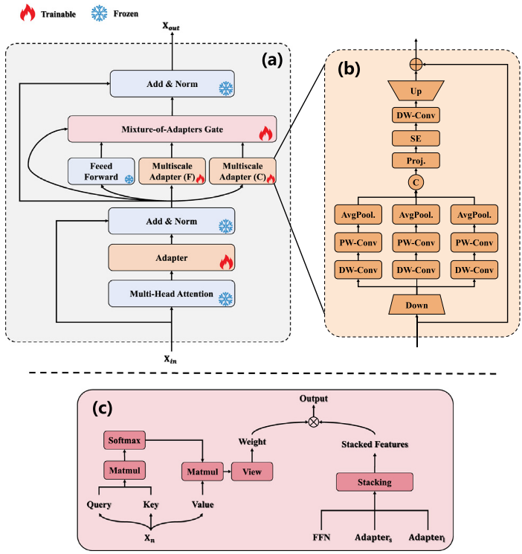
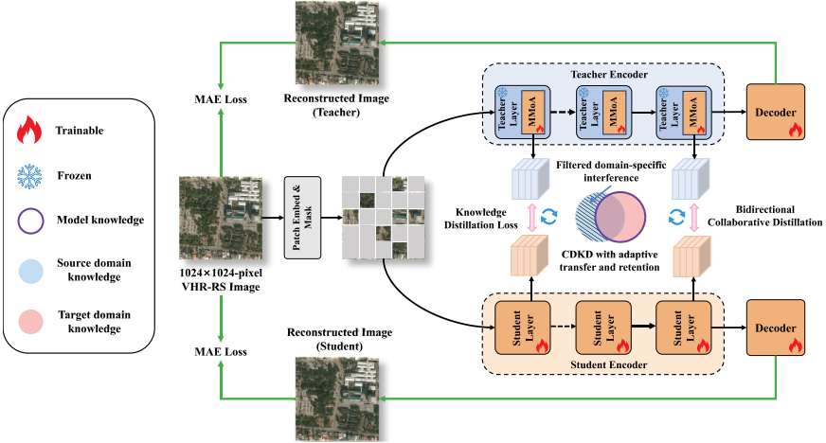
Mask-CDKD
CDKD：无需源域数据与像素标注。
MMoA：多尺度 Adapter + 动态 Gate，过滤域特定干扰。
Bidirectional KD：教师适配与学生学习协同优化。
MIM Reconstruction：增强目标域结构建模，仅部署轻量学生。
Shu Daoyu, Zhang Zhan, Huang Xiao, Wang Ru, Jia Nan, Fu Xinzhe, Yang Bingnan, Wan Fang, Lu Jianzhong, Gong Jianya. Mask-CDKD: A source-free and label-free cross-domain knowledge distillation framework from SAM for satellite onboard VHR land-cover mapping[J]. ISPRS，2026
Notes:
Li, Shuying, Zhenjian Qu, Yuemei Qin, San Zhang, and Qiang Li. “Global–Local Feature Collaborative Fusion and Edge Refinement Network for Remote Sensing Change Detection.” IEEE Transactions on Geoscience and Remote Sensing 63, 30 June 2025. https://doi.org/10.1109/TGRS.2025.3584115.

Slide 12
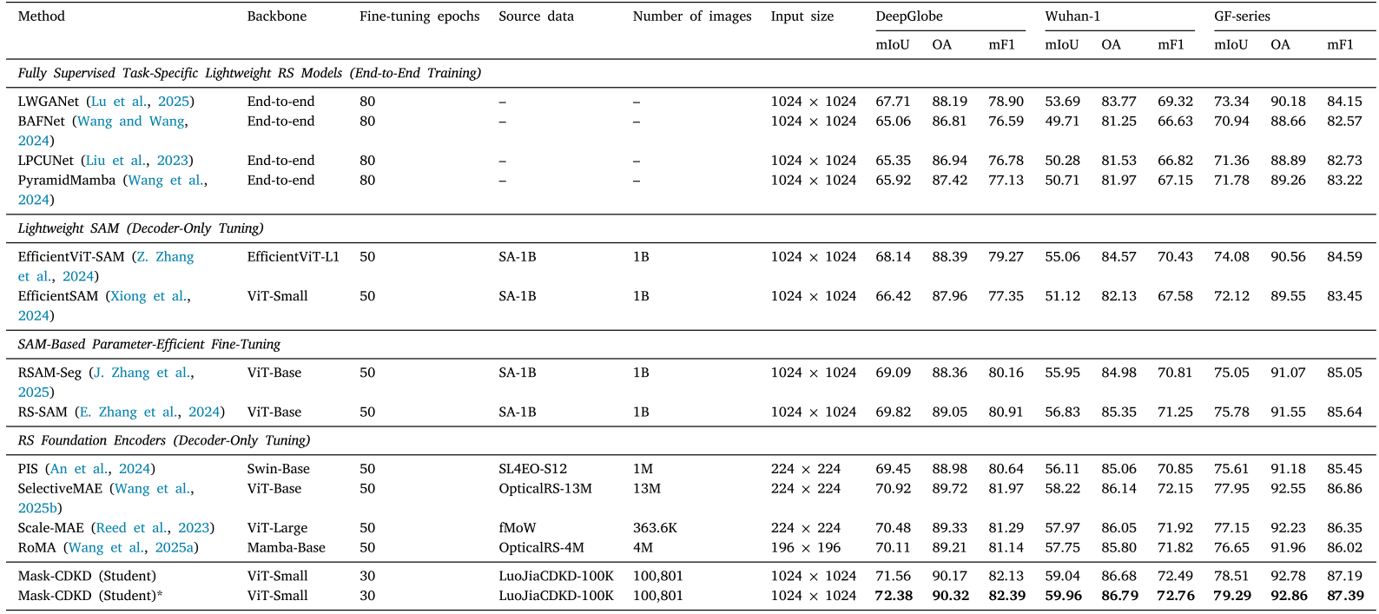
Mask-CDKD定量结果
Shu Daoyu, Zhang Zhan, Huang Xiao, Wang Ru, Jia Nan, Fu Xinzhe, Yang Bingnan, Wan Fang, Lu Jianzhong, Gong Jianya. Mask-CDKD: A source-free and label-free cross-domain knowledge distillation framework from SAM for satellite onboard VHR land-cover mapping[J]. ISPRS，2026
Notes:
Li, Shuying, Zhenjian Qu, Yuemei Qin, San Zhang, and Qiang Li. “Global–Local Feature Collaborative Fusion and Edge Refinement Network for Remote Sensing Change Detection.” IEEE Transactions on Geoscience and Remote Sensing 63, 30 June 2025. https://doi.org/10.1109/TGRS.2025.3584115.

Slide 13
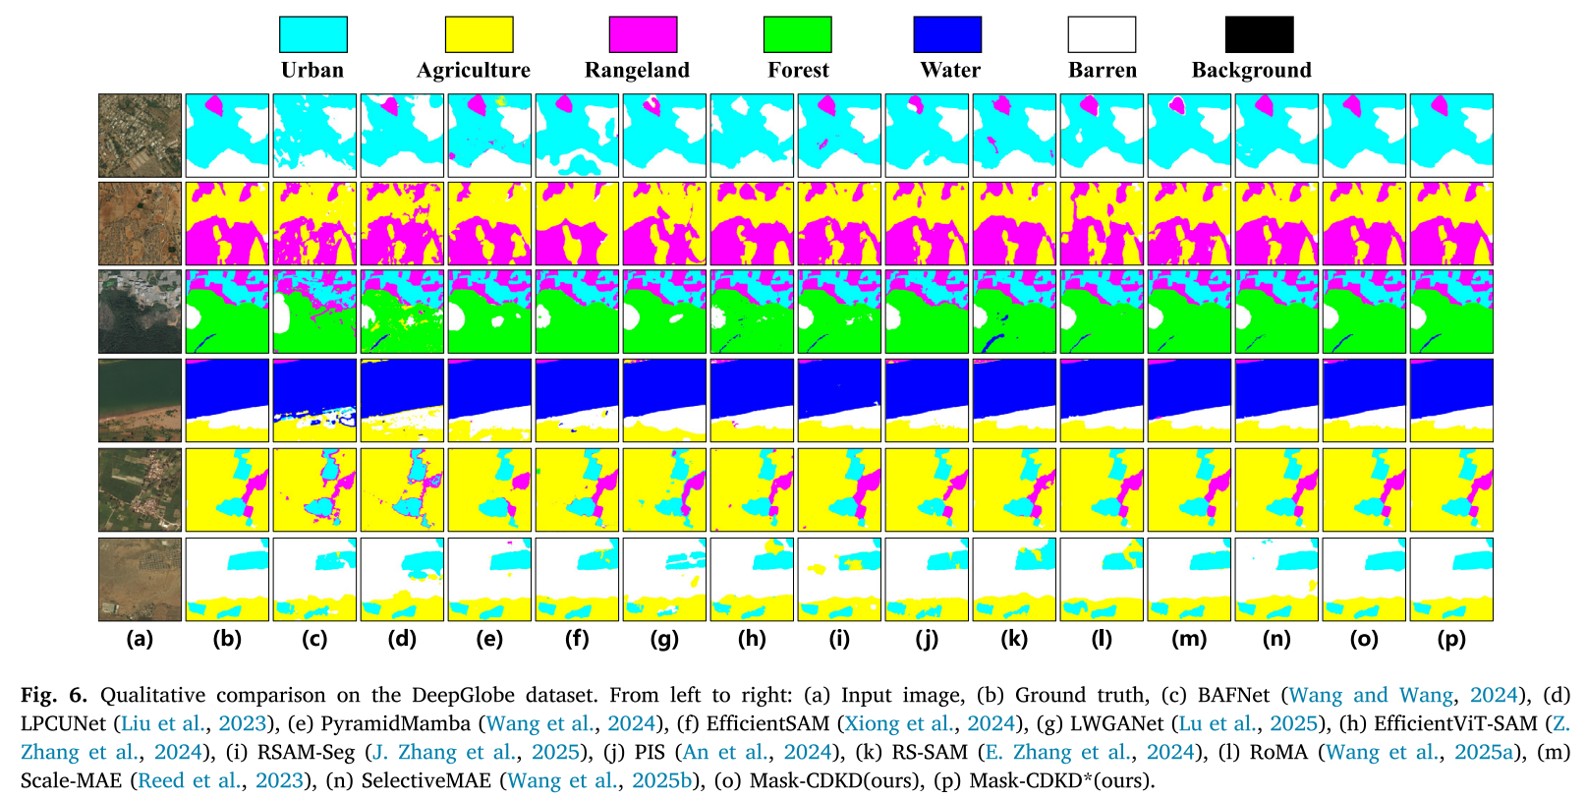
Mask-CDKD定性结果
Shu Daoyu, Zhang Zhan, Huang Xiao, Wang Ru, Jia Nan, Fu Xinzhe, Yang Bingnan, Wan Fang, Lu Jianzhong, Gong Jianya. Mask-CDKD: A source-free and label-free cross-domain knowledge distillation framework from SAM for satellite onboard VHR land-cover mapping[J]. ISPRS，2026
Notes:
Li, Shuying, Zhenjian Qu, Yuemei Qin, San Zhang, and Qiang Li. “Global–Local Feature Collaborative Fusion and Edge Refinement Network for Remote Sensing Change Detection.” IEEE Transactions on Geoscience and Remote Sensing 63, 30 June 2025. https://doi.org/10.1109/TGRS.2025.3584115.

Slide 14
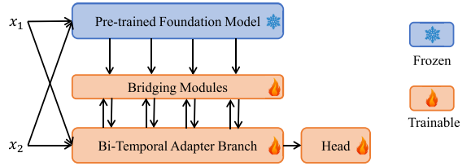
BAN
任务：RS_BCD
Motivation： CD 标注数据有限，且 Foundation Model 与遥感二时相 CD 存在域、任务和分辨率差异。
创新点： 提出 BAN，通过冻结 Foundation Model + Bi-TAB + Bridging Module 实现通用知识的选择、对齐与注入，并用 ARIS （非对称分辨率输入策略）解决分辨率不匹配。
Foundation Model可选：
CLIP ViT-L/14
RemoteCLIP
ImageNet-21K pretrained ViT 等
Kaiyu Li, Xiangyong Cao, Deyu Meng.A New Learning Paradigm for Foundation Model-Based Remote-Sensing Change Detection. TGRS,2024
Notes:
Li, Shuying, Zhenjian Qu, Yuemei Qin, San Zhang, and Qiang Li. “Global–Local Feature Collaborative Fusion and Edge Refinement Network for Remote Sensing Change Detection.” IEEE Transactions on Geoscience and Remote Sensing 63, 30 June 2025. https://doi.org/10.1109/TGRS.2025.3584115.

Slide 15
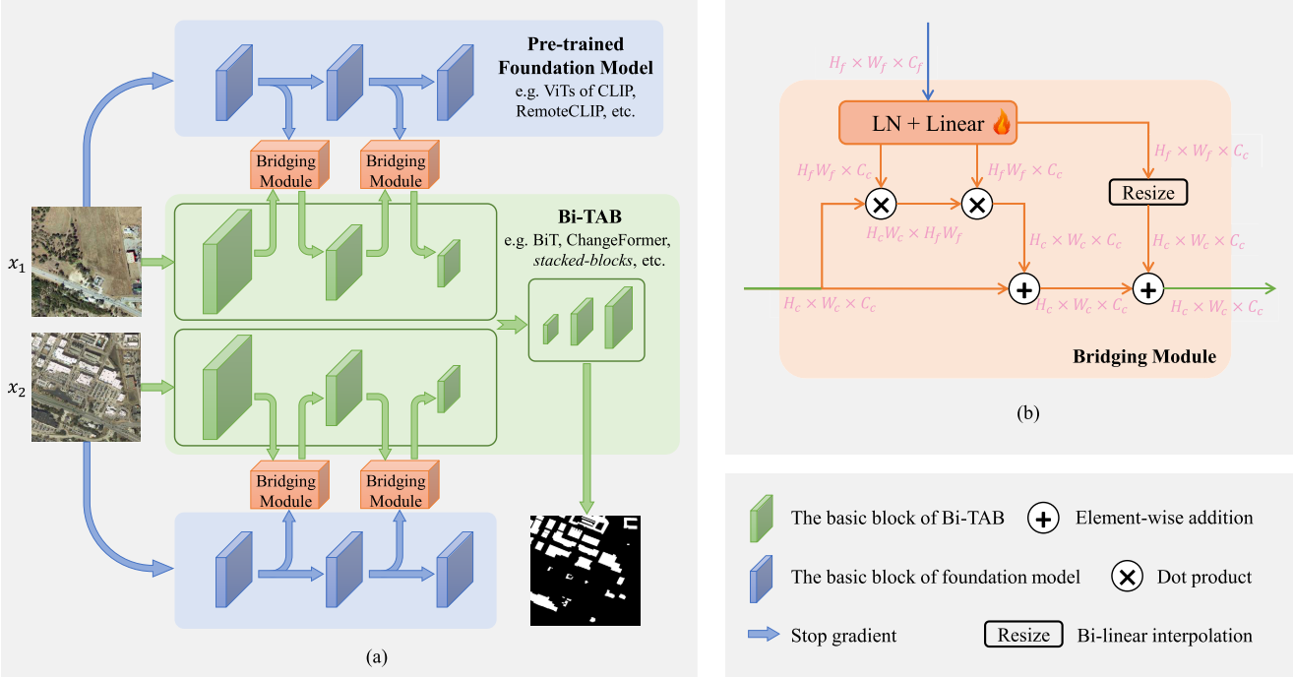
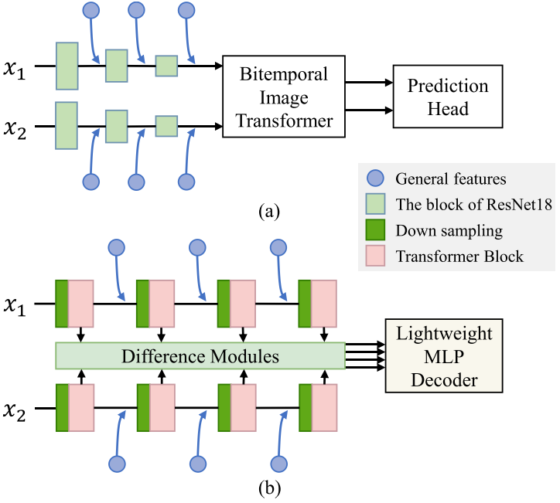
BAN
1.冻结 Foundation Model 提取双时相通用视觉特征，Bi-TAB 保留原有变化检测网络
2.Bridging Module 以 Bi-TAB 特征为查询，实现 Foundation 知识的选择、通道/尺度对齐与逐层注入。
3.Bi-TAB 可兼容 BiT、ChangeFormer 等不同 CD 架构，体现 BAN 的模型无关与即插即用能力。
Kaiyu Li, Xiangyong Cao, Deyu Meng.A New Learning Paradigm for Foundation Model-Based Remote-Sensing Change Detection. TGRS,2024
Notes:
Li, Shuying, Zhenjian Qu, Yuemei Qin, San Zhang, and Qiang Li. “Global–Local Feature Collaborative Fusion and Edge Refinement Network for Remote Sensing Change Detection.” IEEE Transactions on Geoscience and Remote Sensing 63, 30 June 2025. https://doi.org/10.1109/TGRS.2025.3584115.

Slide 16
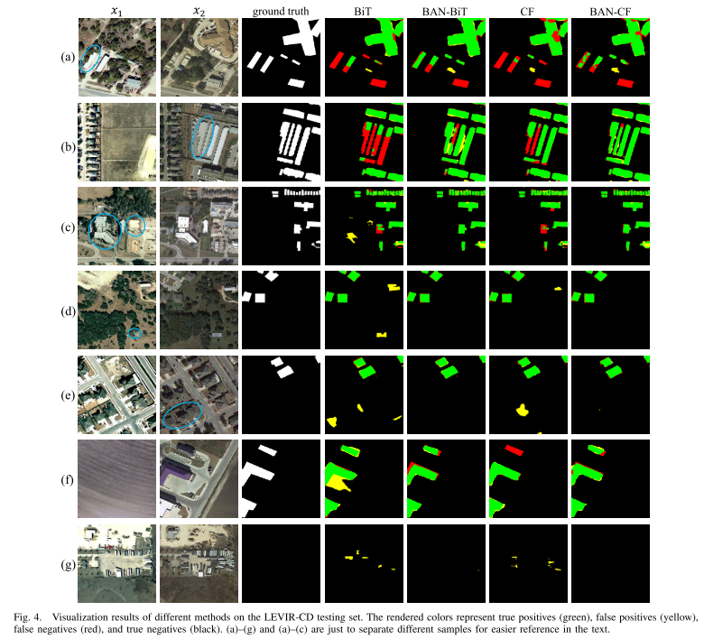
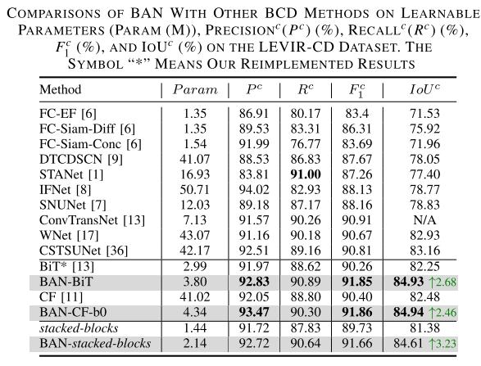
BAN
这里的Param只是 learnable parameters，推理的时候大模型参数也要算上
Kaiyu Li, Xiangyong Cao, Deyu Meng.A New Learning Paradigm for Foundation Model-Based Remote-Sensing Change Detection. TGRS,2024
Notes:
Li, Shuying, Zhenjian Qu, Yuemei Qin, San Zhang, and Qiang Li. “Global–Local Feature Collaborative Fusion and Edge Refinement Network for Remote Sensing Change Detection.” IEEE Transactions on Geoscience and Remote Sensing 63, 30 June 2025. https://doi.org/10.1109/TGRS.2025.3584115.

Slide 17
A2Net+LWGANet（baseline记录）
T1
F1_1
F1_2
F1_3
F1_4
SWA
GT
↓
主loss： BCE+Dice
4个
d1
d2
d3
d4
Shared LWGANet_L0
TFM
A2Net_Decoder
Stage1~4：SupervisedAttentionModule
S1
S2
S3
S4
changemap
4个
T1
F2_1
F2_2
F2_3
F2_4
SWA
Lu W, Yang X, Chen S B. LWGANet: Addressing spatial and channel redundancy in remote sensing visual tasks with light-weight grouped attention[C]//Proceedings of the AAAI Conference on Artificial Intelligence. 2026, 40(9): 7574-7582.
Notes:
Li, Shuying, Zhenjian Qu, Yuemei Qin, San Zhang, and Qiang Li. “Global–Local Feature Collaborative Fusion and Edge Refinement Network for Remote Sensing Change Detection.” IEEE Transactions on Geoscience and Remote Sensing 63, 30 June 2025. https://doi.org/10.1109/TGRS.2025.3584115.

Slide 18
Future Work
1.将大模型的文本信息作为教师，看相关论文，更好的处理奇偶知识
2.看agent相关BCD论文
Lu W, Yang X, Chen S B. LWGANet: Addressing spatial and channel redundancy in remote sensing visual tasks with light-weight grouped attention[C]//Proceedings of the AAAI Conference on Artificial Intelligence. 2026, 40(9): 7574-7582.
Notes:
Li, Shuying, Zhenjian Qu, Yuemei Qin, San Zhang, and Qiang Li. “Global–Local Feature Collaborative Fusion and Edge Refinement Network for Remote Sensing Change Detection.” IEEE Transactions on Geoscience and Remote Sensing 63, 30 June 2025. https://doi.org/10.1109/TGRS.2025.3584115.

Slide 19
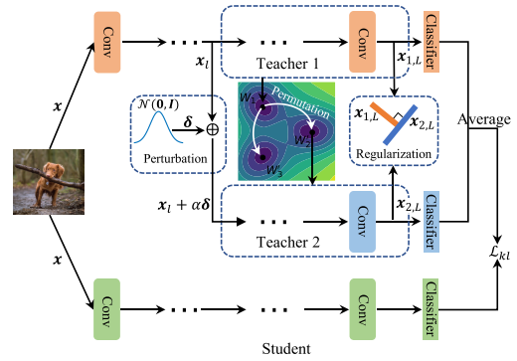
CLearining
任务:类增量学习(模型不断学习新类别，但测试时需要同时识别以前所有类别 + 当前新类别。)
Motivation:
单教师的知识比较单一,但是直接训练多个教师代价又太大
创新点：
通过权重置换 + 特征扰动 + 多样性正则化，从单个基础模型低成本构造多个高质量、多样化教师，再进行多教师蒸馏。
Haitao Wen, Lili Pan, Yu Dai, Heqian Qiu, Lanxiao Wang*, Qingbo Wu, Hongliang Li*. Class Incremental Learning, Multi-Teacher Distillation, Knowledge Distillation, Catastrophic Forgetting, Diversity Regularization.CVPR,2024
Notes:
Li, Shuying, Zhenjian Qu, Yuemei Qin, San Zhang, and Qiang Li. “Global–Local Feature Collaborative Fusion and Edge Refinement Network for Remote Sensing Change Detection.” IEEE Transactions on Geoscience and Remote Sensing 63, 30 June 2025. https://doi.org/10.1109/TGRS.2025.3584115.

Slide 20
Our Work整体结构
T1
保存 .pt
F1_1
F1_2
F1_3
F1_4
SWA
GT
↓
主loss： BCE+Dice
获取
T1
d1
d2
d3
d4
SAM2 Automatic Mask Generator
实例编号
4个
边界图
Shared LWGANet_L0
TFM
A2Net_Decoder
Stage1~4：SupervisedAttentionModule
S1
S2
S3
S4
changemap
T1
掩码质量
4个
T1
F2_1
F2_2
F2_3
F2_4
SWA
保存 .pt
阶段一（离线teacher）:SAM2对训练集每个图生成离线教师缓存Stage A cached teacher_pack
阶段二主路径（student）:A2Net+LWGANet（backbone）无改动，推理时也只剩这部分，2.91M
Student step
+ L_hard
Student wants L_hard↓
hard_F1 = F1 × retention
SWA
F1_1
F1_2
F1_3
F1_4
PLUG-Mentor
retention masks
TFM
A2Net_Decoder
hard_changemap
BCE+Dice VS GT
L_hard
F2_1
F2_2
F2_3
F2_4
SAM Structure Loss
boundary + affinity
↑
Stage A cached teacher_pack
hard_F2 = F2 × retention
SWA
Mentor step
- L_hard
Mentor wants L_hard↑
可拆卸外挂PLUG：PLUG另起一条困难路径（对主路径decoder进行min-max对抗训练）
可拆卸输出监督
Notes:
Li, Shuying, Zhenjian Qu, Yuemei Qin, San Zhang, and Qiang Li. “Global–Local Feature Collaborative Fusion and Edge Refinement Network for Remote Sensing Change Detection.” IEEE Transactions on Geoscience and Remote Sensing 63, 30 June 2025. https://doi.org/10.1109/TGRS.2025.3584115.

Slide 21
SAM Structure Loss
SAM boundary
SAM quality
提供
Stage A cached teacher_pack
Boundary Loss
来自A2Net_Decoder
边界要清楚
changemap
GT变化边界
附近区域
SAM Structure Loss
Lsam = 0.7 Lboundary+ 0.3 Laffinity
（权重暂时设置为0.7/0.3）
GT变化区域
对象内部要一致
组合为Total Loss
更新A2Net
Affinity Loss
SAM instance
SAM quality
提供
Stage A cached teacher_pack
+ 主 BCE + Dice Loss
1. Boundary :SAM 告诉学生“对象边缘在哪里”，GT 告诉学生“这里是不是真的发生变化”。只有两者重合或接近的位置，SAM 的边界知识才会被采用
2. Affinity:在 GT 已确认发生变化的可靠 SAM 对象内部，要求 Changemap 变化概率保持一致。
注：双时相的分割结果直接相减会把分割误差、配准误差和对象碎片化都变成伪变化，所以我们只利用 SAM2 的结构先验，真正的变化判断仍由 GT 监督下的 A2Net 完成。
Notes:
Li, Shuying, Zhenjian Qu, Yuemei Qin, San Zhang, and Qiang Li. “Global–Local Feature Collaborative Fusion and Edge Refinement Network for Remote Sensing Change Detection.” IEEE Transactions on Geoscience and Remote Sensing 63, 30 June 2025. https://doi.org/10.1109/TGRS.2025.3584115.

Slide 22
SAM Structure Loss
Stage A cached teacher_pack
1. Boundary :SAM 告诉学生“对象边缘在哪里”，GT 告诉学生“这里是不是真的发生变化”。只有两者重合或接近的位置，SAM 的边界知识才会被采用
2. Affinity:在 GT 已确认发生变化的可靠 SAM 对象内部，要求 Changemap 变化概率保持一致。
注：双时相的分割结果直接相减会把分割误差、配准误差和对象碎片化都变成伪变化，所以我们只利用 SAM2 的结构先验，真正的变化判断仍由 GT 监督下的 A2Net 完成。
Notes:
Li, Shuying, Zhenjian Qu, Yuemei Qin, San Zhang, and Qiang Li. “Global–Local Feature Collaborative Fusion and Edge Refinement Network for Remote Sensing Change Detection.” IEEE Transactions on Geoscience and Remote Sensing 63, 30 June 2025. https://doi.org/10.1109/TGRS.2025.3584115.

Slide 23
PLUG Mentor（先停止这个点）
F1
差异信息
|F2—F1|
Spatial
哪里容易？
Importance
空间 × 通道重要性
retention = 1 - α × importance （α ≤ 0.35）
特征强度|F1|+|F2|
Channel
哪些通道容易？
F1
SAME retention
hard_F1 = F1 × retention
hard_F2 = F2 × retention
Mentor 看双时相特征 → 找“容易证据” → 生成 retention → 软削弱这些证据 → A2Net 再做一次困难变化检测。
即主路径是正常做题，Mentor 会把学生最容易看的提示遮掉一点，再让它重新做同一道题。学生如果还能做对，说明它学到的变化表征更鲁棒。
Notes:
Li, Shuying, Zhenjian Qu, Yuemei Qin, San Zhang, and Qiang Li. “Global–Local Feature Collaborative Fusion and Edge Refinement Network for Remote Sensing Change Detection.” IEEE Transactions on Geoscience and Remote Sensing 63, 30 June 2025. https://doi.org/10.1109/TGRS.2025.3584115.

Slide 24
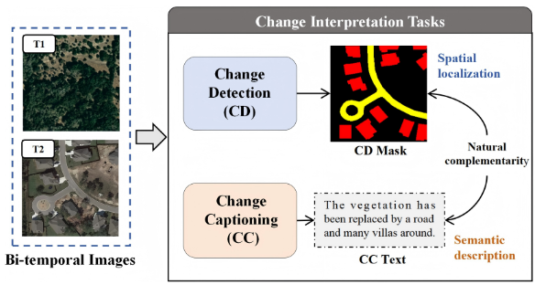
DTAC-Net（审稿）
任务：Remote Sensing Change Interpretation（CD/CC）
Motivation:
1.现有方法提取特征和构造变化特征时不对任务做区分，但是这俩是有任务差异的，CD 侧重空间细节、CC 侧重语义，强制共用会导致特征表达相互折中、相互纠缠
2. CD 与 CC 两个分支的交互不足，缺乏深度融合和双向信息，空间定位与语义理解之间无法充分互补
创新点：
1. HTA（分层任务注意力）做任务条件化调制，按层采用不同算子生成 CD 与 CC 各自的特征表示；
TOCM（任务导向变化建模）对拼接后的双时相特征，用不同类型卷积分别处理得到两套任务特定的变化特征
2. CTAI（跨任务注意力交互）以一个任务的变换特征为 Q、另一个为 K/V，在 CD 与 CC之间做双向交叉注意力
backbone：SegFormer
数据集：LEVIR-MCI 、LEVIR-CDC（只关注建筑） 、WHU-CDC
YANG Lei, MA Qi, LIU Bing, et al. DTAC-Net: A Dual-Task Adaptive Collaborative Network for Remote Sensing Change Interpretation[J]. TGRS, 2026.
Notes:
Li, Shuying, Zhenjian Qu, Yuemei Qin, San Zhang, and Qiang Li. “Global–Local Feature Collaborative Fusion and Edge Refinement Network for Remote Sensing Change Detection.” IEEE Transactions on Geoscience and Remote Sensing 63, 30 June 2025. https://doi.org/10.1109/TGRS.2025.3584115.

Slide 25
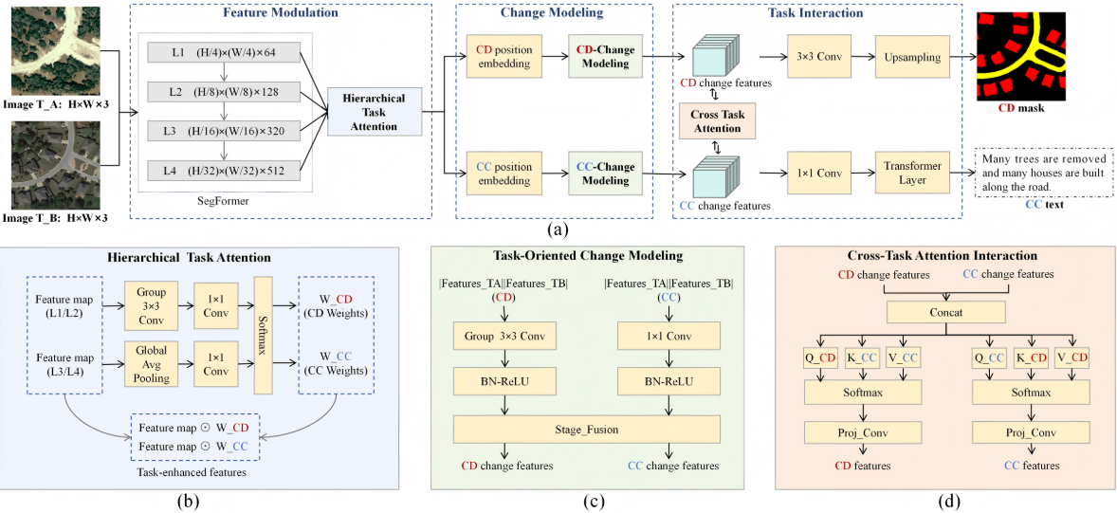
DTAC-Net（审稿）
YANG Lei, MA Qi, LIU Bing, et al. DTAC-Net: A Dual-Task Adaptive Collaborative Network for Remote Sensing Change Interpretation[J]. TGRS, 2026.
Notes:
Li, Shuying, Zhenjian Qu, Yuemei Qin, San Zhang, and Qiang Li. “Global–Local Feature Collaborative Fusion and Edge Refinement Network for Remote Sensing Change Detection.” IEEE Transactions on Geoscience and Remote Sensing 63, 30 June 2025. https://doi.org/10.1109/TGRS.2025.3584115.

Slide 26
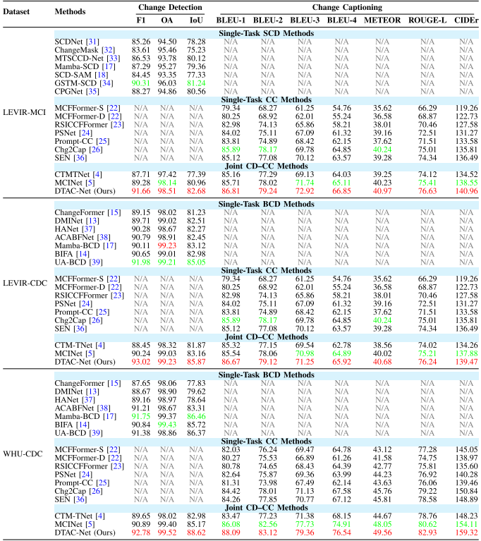
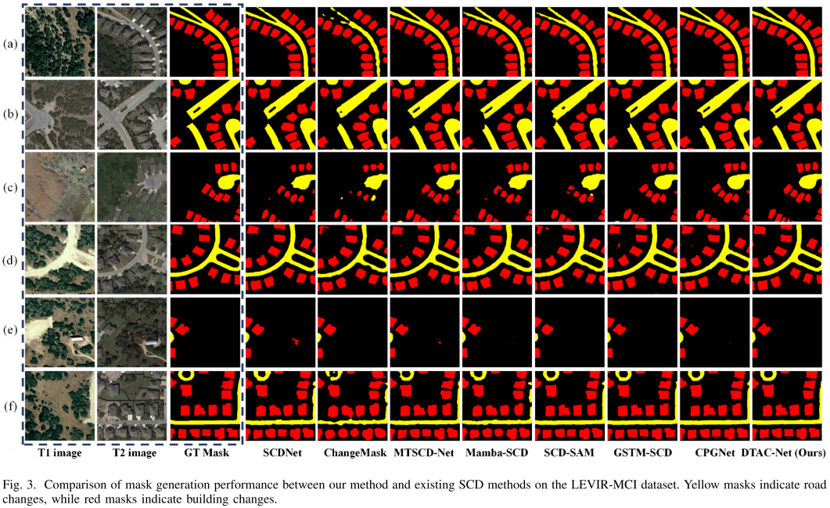
DTAC-Net（审稿）
YANG Lei, MA Qi, LIU Bing, et al. DTAC-Net: A Dual-Task Adaptive Collaborative Network for Remote Sensing Change Interpretation[J]. TGRS, 2026.
Notes:
Li, Shuying, Zhenjian Qu, Yuemei Qin, San Zhang, and Qiang Li. “Global–Local Feature Collaborative Fusion and Edge Refinement Network for Remote Sensing Change Detection.” IEEE Transactions on Geoscience and Remote Sensing 63, 30 June 2025. https://doi.org/10.1109/TGRS.2025.3584115.

Slide 27
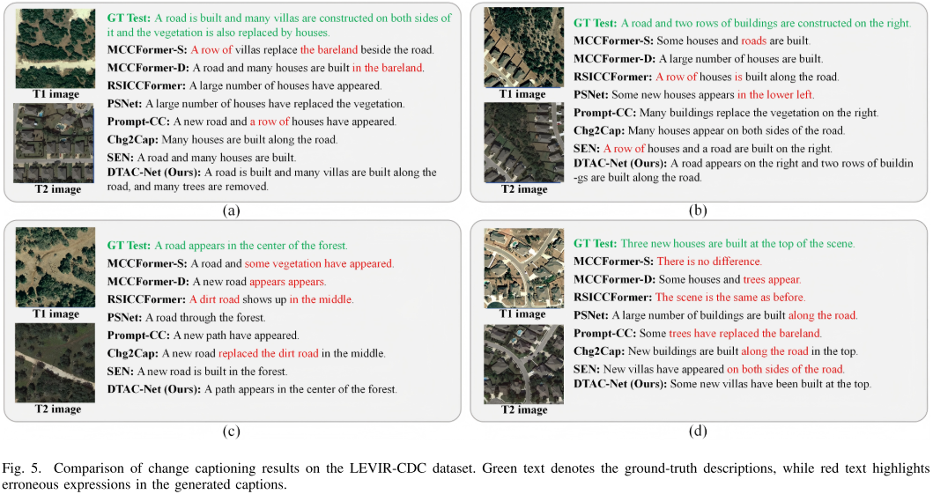
DTAC-Net（审稿）
YANG Lei, MA Qi, LIU Bing, et al. DTAC-Net: A Dual-Task Adaptive Collaborative Network for Remote Sensing Change Interpretation[J]. TGRS, 2026.
Notes:
Li, Shuying, Zhenjian Qu, Yuemei Qin, San Zhang, and Qiang Li. “Global–Local Feature Collaborative Fusion and Edge Refinement Network for Remote Sensing Change Detection.” IEEE Transactions on Geoscience and Remote Sensing 63, 30 June 2025. https://doi.org/10.1109/TGRS.2025.3584115.

Slide 28
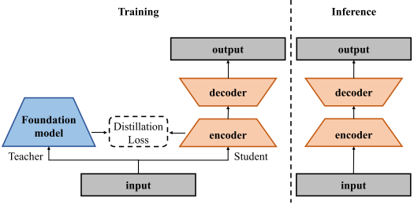
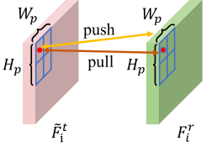
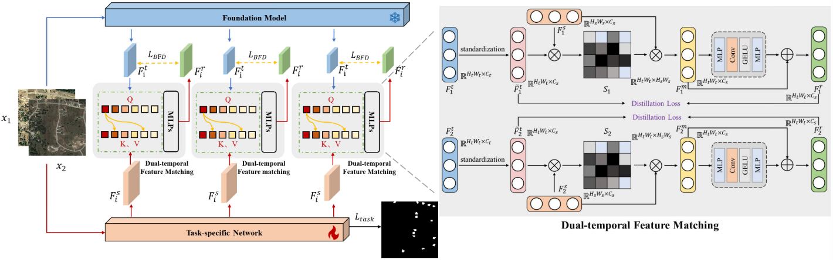
BFD
任务：RS_BCD
Motivation:能不能训练时借用大模型知识，但推理时完全不要大模型？
创新点：BFD：Foundation Model → DFM 双时相特征匹配 + PCD Patch 对比蒸馏 → CD Student。教师只训练期出现。
教师：CLIP ViT-B/16 ；学生：BIT和 ChangeFormer
Wang, S., Lv, C., Quan, D., Huyan, N., Cao, X., Sun, J., & Jiao, L. Burden-Free Distillation From Foundation Model for Efficient Remote Sensing Change Detection. TGRS, 2025.
Notes:
Li, Shuying, Zhenjian Qu, Yuemei Qin, San Zhang, and Qiang Li. “Global–Local Feature Collaborative Fusion and Edge Refinement Network for Remote Sensing Change Detection.” IEEE Transactions on Geoscience and Remote Sensing 63, 30 June 2025. https://doi.org/10.1109/TGRS.2025.3584115.

Slide 29
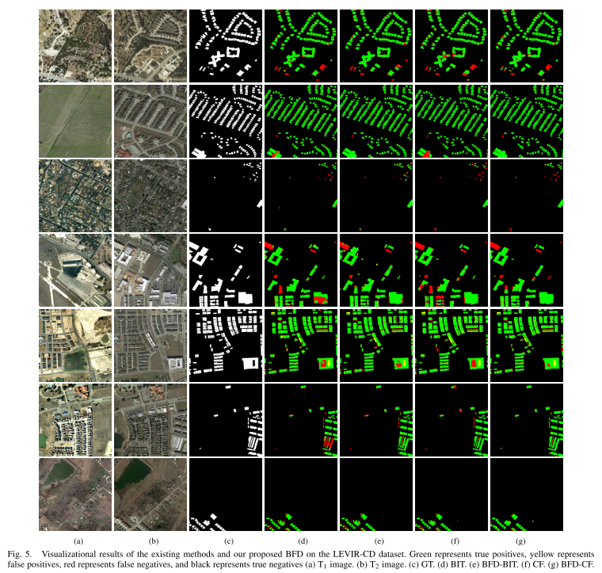
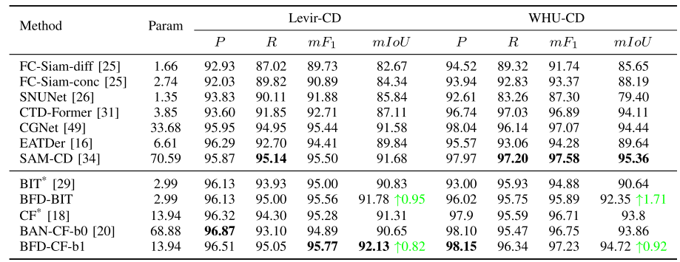
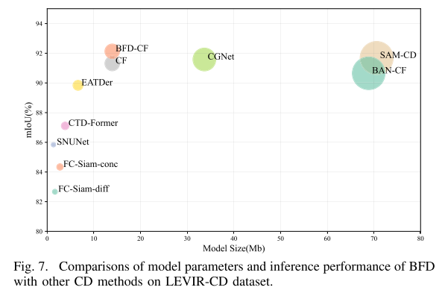
BFD
指标：LEVIR/WHU/CLCD 报的是 P、R、mF1、mIoU
Wang, S., Lv, C., Quan, D., Huyan, N., Cao, X., Sun, J., & Jiao, L. Burden-Free Distillation From Foundation Model for Efficient Remote Sensing Change Detection. TGRS, 2025.
Notes:
Li, Shuying, Zhenjian Qu, Yuemei Qin, San Zhang, and Qiang Li. “Global–Local Feature Collaborative Fusion and Edge Refinement Network for Remote Sensing Change Detection.” IEEE Transactions on Geoscience and Remote Sensing 63, 30 June 2025. https://doi.org/10.1109/TGRS.2025.3584115.

Slide 30
PHENet复现
PHENet 的输入需要： T1 RGB、T2 RGB、T1 height、T2 height。
1.高度图的生成代码没有。我自己找的方法：RGB → Depth Anything V2 相对深度 → RDAH-Net 高度估计 → Heightmap
2.论文和作者github里的变化检测损失不一致：论文采用 BCE + Dice；作者代码默认采用 CE + Dice (dice_ce)(我们现在用的是这个)。
3.数据增强存在差异：论文包含随机旋转；作者代码虽然实现了 rotation，但正式训练配置中没有开启随机旋转（我们开启了）。
4. PAC 损失权重不一致：论文为 TV=0.2、Dark=0.5、Adv=0.5；作者代码实际为 0.2、0.2、0.2。（我们采用论文值）
现有数据：
数据集 / 实验 | Params(M) | FLOPs(G) | FPS | GPU Mem(MB) | Recall | Precision | OA | F1 | IoU | Kappa
LEVIR-CD-foggy | 5.242 | 70.927 | 125.373 | 4861.28 | 72.3131 | 69.5936 | 96.9800 | 70.9273 | 54.9514 | 69.3352
SYSU-CD-foggy | 5.242 | 70.927 | 124.021 | 4861.28 | 69.0991 | 74.8845 | 87.2474 | 71.8756 | 56.0983 | 63.6470
Jianjun Yuan, Siyu Chen, Jianjun Zhou, and Luoming Zhao. "PHENet: Toward Robust Fog-Resilient Change Detection in Remote Sensing Imagery With a Physics-Guided Height-Enhanced Network." TGRS, 2026.
Notes:
Li, Shuying, Zhenjian Qu, Yuemei Qin, San Zhang, and Qiang Li. “Global–Local Feature Collaborative Fusion and Edge Refinement Network for Remote Sensing Change Detection.” IEEE Transactions on Geoscience and Remote Sensing 63, 30 June 2025. https://doi.org/10.1109/TGRS.2025.3584115.

Slide 31
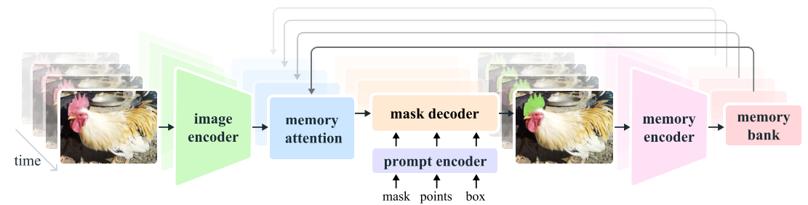
SAM2+AMG
我用了 SAM2+AMG 对 T1/T2 分别做单时相自动实例分割，提取结构先验
memory为空
AMG
SAM2 provides object structure, not change prediction.
AMG: grid point prompts → candidate masks → filtering
T1 / T2 are processed independently.
Offline prior: instance / boundary / quality.
SAM 2 is a segmentation model that enables fast, precise selection of any object in any video or image.
Notes:
Li, Shuying, Zhenjian Qu, Yuemei Qin, San Zhang, and Qiang Li. “Global–Local Feature Collaborative Fusion and Edge Refinement Network for Remote Sensing Change Detection.” IEEE Transactions on Geoscience and Remote Sensing 63, 30 June 2025. https://doi.org/10.1109/TGRS.2025.3584115.

Slide 32
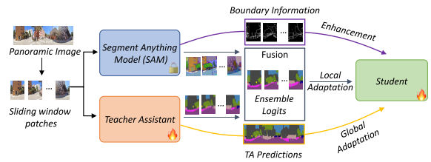
GoodSAM：利用 SAM 结构先验指导轻量模型
任务：无标注全景图像上的语义分割
Motivation：1.全景语义分割标注数据不足
2.想使用SAM的零样本分割能力作为教师
3. SAM 只给实例 Mask，不给语义类别
4.大模型知识不能简单直接塞给小模型
GoodSAM：SAM 结构先验先参与构造了一个更强的监督信号，TA补充语义，然后融合之后把这些知识迁移到轻量 Student
 | GoodSAM | 我们
任务 | 单幅全景语义分割 | 双时相二值变化检测
基础模型 | SAM | SAM2.1+ AMG
SAM 提供什么 | Instance mask、Boundary | Instance ID、Boundary、Quality
是否需要类别语义 | 需要，所以增加 TA | 不需要，最终只判断 Change / No Change
是否由 SAM 直接告诉学生答案 | 间接是，SAM+TA → Ensemble Logits | 不是
双时相匹配 | 无此问题 | T1/T2 独立，不做实例匹配
SAM 结构最终作用 | 构造更可靠的语义监督 | 对变化结果施加结构约束
推理时 | 学生独立推理 | SAM2 完全拆除，A2Net 2.91M
Weiming Zhang, Yexin Liu, Xu Zheng, Lin Wang; GoodSAM: Bridging Domain and Capacity Gaps via Segment Anything Model for Distortion-aware Panoramic Semantic Segmentation,CVPR, 2024, pp. 28264-28273
Notes:
Li, Shuying, Zhenjian Qu, Yuemei Qin, San Zhang, and Qiang Li. “Global–Local Feature Collaborative Fusion and Edge Refinement Network for Remote Sensing Change Detection.” IEEE Transactions on Geoscience and Remote Sensing 63, 30 June 2025. https://doi.org/10.1109/TGRS.2025.3584115.

Slide 33
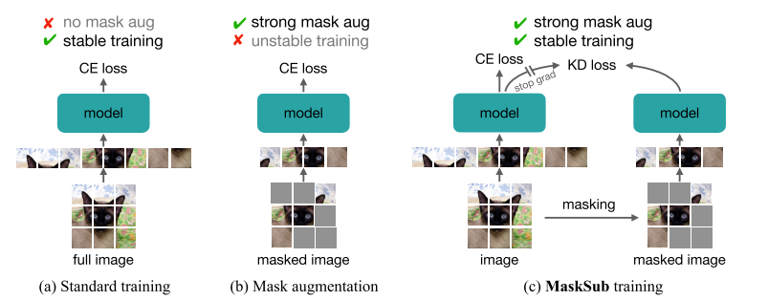
Masking meets Supervision
强扰动下的稳定监督学习
任务：提出一种 监督学习训练方法 / 正则化框架
Motivation：强 Masking 有利于表征学习，但直接用于监督学习会造成训练不稳定。
Masking meets Supervision：将强 Masking 放入独立 Sub-branch，并利用完整输入 Main-branch 的软预测进行自蒸馏监督，实现“强扰动 + 弱监督”，从而稳定训练。
MaskSub | 我们的项目
单图像分类为主要实验场景 | 双时相遥感变化检测
Mask 输入/Token | 扰动 T1/T2 中间特征
Main → Sub 自蒸馏 | Mentor 制造困难特征，Student 学习
强调稳定强正则 | 强调提升困难变化场景鲁棒性
训练期机制 | 同样是训练期外挂，部署拆除
Byeongho Heo; Taekyung Kim; Sangdoo Yun; Dongyoon Han. "Masking meets Supervision: A Strong Learning Alliance." CVPR, 2025,
Notes:
Li, Shuying, Zhenjian Qu, Yuemei Qin, San Zhang, and Qiang Li. “Global–Local Feature Collaborative Fusion and Edge Refinement Network for Remote Sensing Change Detection.” IEEE Transactions on Geoscience and Remote Sensing 63, 30 June 2025. https://doi.org/10.1109/TGRS.2025.3584115.

Slide 34
数据
SAM2 可学习参数：0M，离线教师，不参与训练和推理
PLUG Mentor参数：25.48M，推理时拆除。
训练时总参数量：28.388M
推理/部署时参数量：2.913M
Flops：2.75G
现在的训练策略：阶段一生成离线教师缓存，阶段二主路径在训练集训练，验证集验证。最后获得best在测试集推理。
没有直接在测试集上挑best
实验 | 数据集 | Val_ best F1 | R | Pre | OA | F1 | IoU | K | Train p | Infer p | FLOPs
base | SYSU | 80.99 | 78.93 | 86.25 | 92.06 | 82.43 | 70.11 | 77.32 | 2.91M | 2.91M | 2.75G
+PLUG_Full | SYSU | 81.46 | 79.99 | 86.44 | 92.32 | 83.09 | 71.07 | 78.13 | 102.67M | 2.91M | 2.75G
+SAM | SYSU | 81.21 | 78.37 | 86.45 | 92 | 82.21 | 69.8 | 77.07 | 2.91M | 2.91M | 2.75G
+PLUG_M | SYSU | — | — | — | — | — | — | — | 28.39M | 2.91M | 2.75G
+SAM +PLUG_M | SYSU | — | — | — | — | — | — | — | 28.39M | 2.91M | 2.75G
实验 | 数据集 | Val best F1 | R | Pre | OA | F1 | IoU | K | Train p | Infer p | FLOPs
base | WHU | — | 92.65 | 96.55 | 99.58 | 94.56 | 89.69 | 94.34 | 2.91M | 2.91M | 2.75G
+PLUG_Full | WHU | — | 93.06 | 95.60 | 99.55 | 94.32 | 89.24 | 94.08 | 102.67M | 2.91M | 2.75G
+SAM | WHU | — | — | — | — | — | — | — | 2.91M | 2.91M | 2.75G
+PLUG_M | WHU | — | — | — | — | — | — | — | 28.39M | 2.91M | 2.75G
+SAM+PLUG_M | WHU | — | — | — | — | — | — | — | 28.39M | 2.91M | 2.75G
Notes:
Li, Shuying, Zhenjian Qu, Yuemei Qin, San Zhang, and Qiang Li. “Global–Local Feature Collaborative Fusion and Edge Refinement Network for Remote Sensing Change Detection.” IEEE Transactions on Geoscience and Remote Sensing 63, 30 June 2025. https://doi.org/10.1109/TGRS.2025.3584115.

Slide 35
Overview
研究方向：轻量/高效/可部署变化检测系统
基础问题：减少参数与算力的情况下保持时空变化特征提取能力、使用结构重参数化、知识蒸馏或动态推理实现精度与速度的平衡
研究方向：模块剪枝、通道压缩、轻量backbone、时/空结构重参数化、推理时可拆卸的外挂模块、轻量化解码器等。

Slide 36
下一个工作Overview
思路+Academic Papers
使用LSNet的思想，结合时空结构重参数化，来做推理时轻量化的RS_BCD任务
（待解决的三个问题：骨干网络选择、轻量化编码器解码器主路设计、推理可拆卸的外挂模块设计）
（TIP2023）LSNet：Lightweight Spatial Boosting Network for Detecting Salient Objects in RGB-Thermal Images
（CVPR2024） Rep ViT: revisiting mobile CNN from ViT perspective
（AAAI 2026）LWGANet: Addressing spatial and channel redundancy in remote sensing visual tasks with light-weight grouped attention

Slide 37
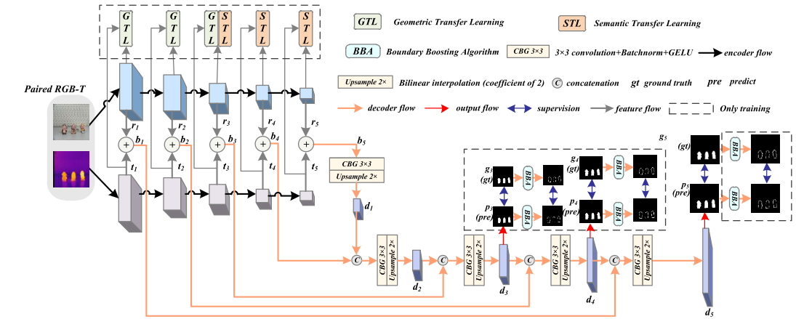
LSNet
创新点：在极轻量的双 MobileNetV2 编码器 + 逐层逐元素相加融合的架构上，引入注意力特征蒸馏（AFD，含语义/空间两级）作为训练的外挂模块——让 RGB 和 T两支特征在训练时互相模仿对齐、增强跨模态互补表达，和BBA（边界监督）也是外挂模块 ，同时用深度可分离空洞卷积 + 轻量上采样解码器保持推理时的极小参数量，从而在 RGB-T 显著性检测上以轻量代价实现 SOTA 精度
 | Recall | Precision | OA | F1 | IoU | Kappa
LEVIR-CD | 87.45 | 91.27 | 98.93 | 89.32 | 80.71 | 88.76
SYSU-CD | 70.71 | 85.91 | 90.36 | 77.57 | 63.37 | 71.51
WHU-CD | 91.29 | 93.08 | 99.39 | 92.18 | 85.49 | 91.86
CDD-CD | 92.28 | 93.01 | 98.19 | 92.64 | 86.29 | 91.61
Model | Backbone | Params | FLOPs
LSNet​ | MobileNetV2 | 5.52M | 1.61G
Zhou W, Zhu Y, Lei J, et al. LSNet: Lightweight spatial boosting network for detecting salient objects in RGB-thermal images[J]. IEEE Transactions on Image Processing, 2023, 32: 1329-1340.
Notes:
Li, Shuying, Zhenjian Qu, Yuemei Qin, San Zhang, and Qiang Li. “Global–Local Feature Collaborative Fusion and Edge Refinement Network for Remote Sensing Change Detection.” IEEE Transactions on Geoscience and Remote Sensing 63, 30 June 2025. https://doi.org/10.1109/TGRS.2025.3584115.

Slide 38
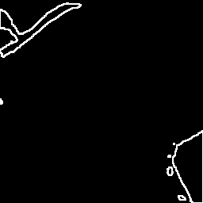

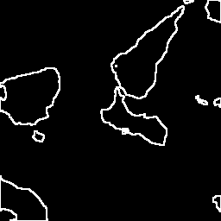
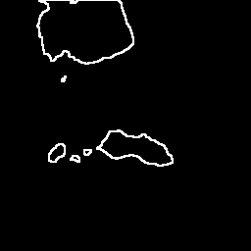
LSNet
但是我们不用GTL & STL / AFD (跨模态迁移学习) 和BBA这两个外挂模块原因：
1. GTL 和 STL（AFD） 是在RGB和T分支间进行语义和几何信息的互相模仿，互相蒸馏，这个模块在我们的变化检测双分支）之间会抹杀掉我们需要的变化差异，弃用。
2.BBA对于显著性目标边界有效，对于遥感化不规则变化区域只会引入大量噪声。并且其损失kd_loss，与变化检测模型存在逻辑和不匹配问题，弃用。变化检测的碎片
实验批次 | 模块配置状态 | CDD-CD-256 (F1) | LEVIR-CD-256 (F1) | SYSU-CD-256 (F1) | WHU-CD-256 (F1)
Run2_05_Baseline | 含 AFD 跨模态特征蒸馏 | 92.62 | 89.33 | 77.82 | 92.42
Run2_06_noAFD | 移除 AFD 蒸馏 | 93.27 | 89.07 | 78.96 | 93.71
Zhou W, Zhu Y, Lei J, et al. LSNet: Lightweight spatial boosting network for detecting salient objects in RGB-thermal images[J]. IEEE Transactions on Image Processing, 2023, 32: 1329-1340.
Notes:
Li, Shuying, Zhenjian Qu, Yuemei Qin, San Zhang, and Qiang Li. “Global–Local Feature Collaborative Fusion and Edge Refinement Network for Remote Sensing Change Detection.” IEEE Transactions on Geoscience and Remote Sensing 63, 30 June 2025. https://doi.org/10.1109/TGRS.2025.3584115.

Slide 39
RepViT
思考更换骨干网络：
理由： | 说明：
ImageNet 精度更高 | RepViT-M0.9 80.0% vs MobileNetV2 71.9%，高 8.1%
原生支持结构重参数化 | RepViT 本身就是「训练多分支→部署折叠单路径」；MBV2 不支持重参数化
轻量约束内精度最优 | ≤6M 参数下 ImageNet 最高的 CNN 之一，共享权重后 backbone 4.57M，达标
但是经过实验发现RepViT只在变化检测的简单数据集上更有效：
Backbone | LEVIR-CD-256 F1 (%) | SYSU-CD-256 F1 (%)
MobileNetV2（历史最佳 v1-v3） | 89.44 | 80.54
RepViT-M0.9（v5 E1） | 90.78 | 79.64
Wang A, Chen H, Lin Z, et al. Rep ViT: revisiting mobile CNN from ViT perspective[C]//2024 IEEE/CVF Conference on Computer Vision and Pattern Recognition (CVPR). IEEE, 2024: 15909-15920.
Notes:
Li, Shuying, Zhenjian Qu, Yuemei Qin, San Zhang, and Qiang Li. “Global–Local Feature Collaborative Fusion and Edge Refinement Network for Remote Sensing Change Detection.” IEEE Transactions on Geoscience and Remote Sensing 63, 30 June 2025. https://doi.org/10.1109/TGRS.2025.3584115.

Slide 40
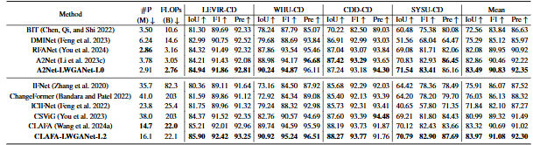
LWGANet
思考更换骨干网络：
1.遥感专用，并作了BCD专用设计
2. 1.92M
3.特点：将输入特征图按空间位置分成不重叠的 patch，只选择 Top-K 个最显著的 patch 进行全局交互，其余背景区域不参与计算，大幅降低计算量，通过稀疏采样 + 插值/恒等映射恢复完整特征图，解决空间冗余。
将通道分成 4 组，3*3、5*5、7*7卷积和identity，实现多尺度特征并行提取，避免特征干扰，解决通道冗余。
4.论文在A2Net（无mmcv）和CLAFA （有mmcv）这两个简单BCD框架下对4个数据集做了实验，LEVIR、WHU、SYSU上接近sota，说明在复杂遥感BCD任务上有效
Lu W, Yang X, Chen S B. LWGANet: Addressing spatial and channel redundancy in remote sensing visual tasks with light-weight grouped attention[C]//Proceedings of the AAAI Conference on Artificial Intelligence. 2026, 40(9): 7574-7582.
Notes:
Li, Shuying, Zhenjian Qu, Yuemei Qin, San Zhang, and Qiang Li. “Global–Local Feature Collaborative Fusion and Edge Refinement Network for Remote Sensing Change Detection.” IEEE Transactions on Geoscience and Remote Sensing 63, 30 June 2025. https://doi.org/10.1109/TGRS.2025.3584115.

Slide 41
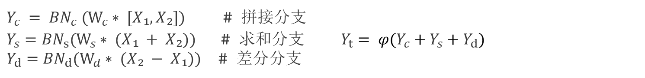
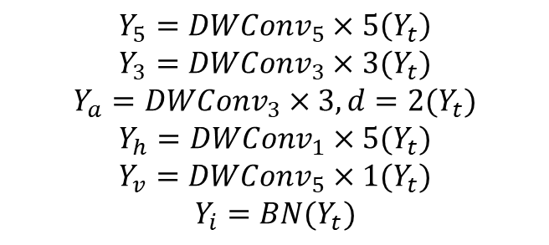
时空重参数化思想
时相结构重参数化
$Y_{c} = {BN}_{c} (W_{c}∗ [X₁, X₂])$ # 拼接分支
$Y_{s}={BN}_{s}(W_{s}∗ (X₁ + X₂))$# 求和分支$Y_{t}= φ(Y_{c}+Y_{s}+Y_{d})$
$Y_{d}={BN}_{d}(W_{d}∗ (X₂ − X₁))$ # 差分分支
空间异构结构重参数化
$$Y_{5}=DWConv_{5}×5\left(Y_{t}\right)$$
$$Y_{3}=DWConv_{3}×3(Y_{t})$$
$$Y_{a}=DWConv_{3}×3,d=2(Y_{t})$$
$$Y_{h}=DWConv_{1}×5(Y_{t})$$
$$Y_{v}=DWConv_{5}×1(Y_{t})$$
$$Y_{i}=BN(Y_{t})$$
较大范围上下文
局部细节
稀疏大感受野（空洞）
水平狭长边缘
垂直狭长边缘
恒等分支（保持原始信息）
推理等价：
$$[X₁, X₂] → {Conv}_{1×1} → DW{Conv}_{5×5}→{Conv}_{1×1}$$
Notes:
Li, Shuying, Zhenjian Qu, Yuemei Qin, San Zhang, and Qiang Li. “Global–Local Feature Collaborative Fusion and Edge Refinement Network for Remote Sensing Change Detection.” IEEE Transactions on Geoscience and Remote Sensing 63, 30 June 2025. https://doi.org/10.1109/TGRS.2025.3584115.

Slide 42




AFD模块详解
① 双分支每层输入 AFD
② 没有输出 AFD 只返回 `loss`，不修改特征
③ 仅训练时增强 `if self.training:`
④ 拆除不影响推理 `model.eval()` → AFD 跳过
⑤ 零推理成本 推理时 AFD 完全不参与
AFD 是通过损失函数的梯度来训练编码器，不是在特征上做前向变换。训练时用损失约束增强编码器，推理时拆掉无损。
降维
空间注意力
测试AFD在A2Net（LWGANet骨干）有效性：
数据集 | Baseline F1 | +AFD F1 | ΔF1 | 结论
LEVIR | 89.08 | 90.59 | +1.51 | 有效
SYSU | 82.54 | 82.11 | −0.43 | 轻微有害
WHU | 93.64 | 90.37 | −3.27 | 明显有害
CDD | 96.95 | 96.97 | +0.02 | 无影响
spatial_map
升维
Sigmoid
attention_map
Sigmoid
$α∙x$_teacher
$(1−α)∙x$_student
$x\text{_}\text{teacher}∙x$_student
$α∙x$_teacher
$(1−α)∙x$_student
$x\text{_}\text{teacher}∙x$_student
loss_afd
loss_afd
结论：外挂模块需要重新设计，因为它会把两个分支的特征拉近/对齐。
我们需要外挂模块加强编码器的差异保持或者变化感知。
AFD_semantic: 语义注意力蒸馏
AFD_spatial: 空间注意力蒸馏
注：LEVIR:未变化区占绝对主导且高度相似,变化区与未变化区差异足够大，SYSU与WHU的未变化区伪变化局多
Notes:
Li, Shuying, Zhenjian Qu, Yuemei Qin, San Zhang, and Qiang Li. “Global–Local Feature Collaborative Fusion and Edge Refinement Network for Remote Sensing Change Detection.” IEEE Transactions on Geoscience and Remote Sensing 63, 30 June 2025. https://doi.org/10.1109/TGRS.2025.3584115.

