Slide 1

Chapter 1: Overview of Artificial Intelligence
General Knowledge of Artificial Intelligence (High School Edition)

Slide 2
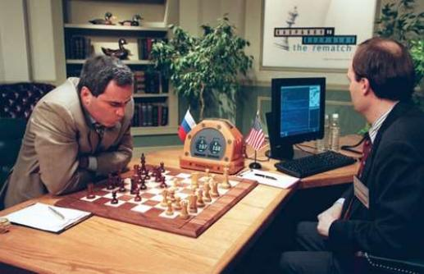
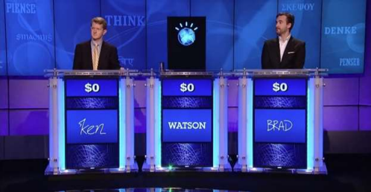
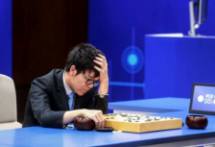
Section 8: History of Artificial Intelligence (2)
General Knowledge of Artificial Intelligence (High School Edition)
Producer: Yang Lan / Qinhan School

Slide 3
Learning Objectives
Understand the three major driving forces of modern AI development (data, computing power, algorithms). Master the core features and application scenarios of deep learning and large models. Learn about the landmark events in the history of AI (Deep Blue, AlphaGo, AlphaFold, ChatGPT).

Slide 4
Table of Contents
1. Pragmatism and Resurgence (1993-2011)
2. The Deep Learning Era (2011-2020)
3. The Large Model Era (2020-Present)
4. Summary

Slide 5

Scenario Creation
What AI tools have you used? (e.g., ChatGPT, ERNIE Bot, Suno music generation?) Give a brief introduction.

Slide 6


Pragmatism and Resurgence (1993-2011)
After reflection in the late 1980s and early 1990s, a large number of down-to-earth researchers shed the glamorous facade of AI and began to seriously study solutions to specific problems in specific fields, achieving a series of breakthroughs in areas such as speech recognition, image recognition, and natural language processing.
During this process, researchers became increasingly aware of the importance of data and the value of statistical models. Bayesian models and neural networks received growing attention, and machine learning became the mainstream approach in AI.
In 1997, IBM's Deep Blue defeated world chess champion Garry Kasparov.
In 2011, IBM's Watson defeated human contestants in the game show Jeopardy!

Slide 7
Notes:
3分40秒的视频，关于IBM Watson战胜人类选手

Slide 8
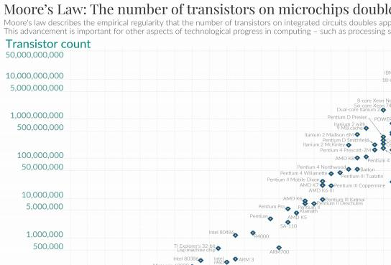
Pragmatism and Resurgence (1993-2011)
Accumulation of Data and Improvement of Hardware
After the 1990s, with the popularization of the internet and mobile internet, people began to create and share large amounts of data online, including news webpages, knowledge-sharing communities, social media, and public paper repositories. The accumulation of this data provided rich learning material for the development of artificial intelligence.
At the same time, computer performance steadily improved. Moore's Law states that the number of transistors that can be placed on an integrated circuit doubles approximately every two years. This trend drove increases in computer speed and memory capacity, which in turn provided powerful computing resources for the development of artificial intelligence.

Slide 9
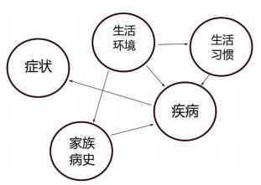
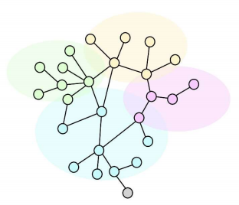
Pragmatism and Resurgence (1993-2011)
Machine Learning Methods
Machine learning refers to the method of enabling machines to autonomously learn knowledge and patterns from data.
After the 1990s, with the accumulation of data and advances in computer hardware, machine learning truly began to demonstrate its application capabilities. During this period, probabilistic statistical models and neural networks became the two main machine learning methods.
Probabilistic statistical models can be considered an extension of symbolic systems, using probability to describe the uncertainty of events and the correlation between different events.
Artificial neural networks, on the other hand, simulate the working mechanism of the brain, achieving functions by interconnecting neurons into a network. Although each neuron is simple, when these neurons are connected in complex ways, they can perform extremely complex functions.

Slide 10
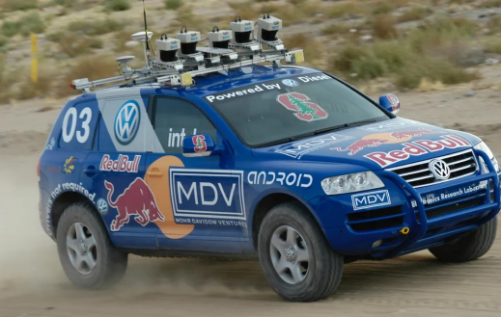
Pragmatism and Resurgence (1993-2011)
Representative Achievements
During this period, artificial intelligence achieved many landmark accomplishments.
For example, in 1997, IBM's Deep Blue computer defeated world chess champion Garry Kasparov, proving that machines could potentially surpass top human players in board games with clear rules.
In 2005, Stanford University's self-driving car, Stanley, won first place in the DARPA Grand Challenge, promoting the rapid development of autonomous driving technology.
In 2011, IBM's Watson AI system defeated two human champions on the American TV show 'Jeopardy!', demonstrating significant progress in natural language processing technology.

Slide 11
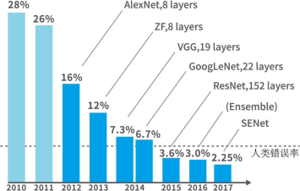
The Deep Learning Era (2011-2020)
Breakthroughs in Image Recognition
In 2012, Geoffrey Hinton and his team first applied deep learning technology in the ImageNet Large Scale Visual Recognition Challenge, training an 8-layer convolutional neural network called AlexNet, which reduced the error rate by 10% in one fell swoop.
This breakthrough marked the rise of deep learning methods in the field of computer vision. After 5 years of research, the image recognition performance on ImageNet dropped to an error rate of 2.25%, even surpassing human recognition accuracy (5.1%).

Slide 12
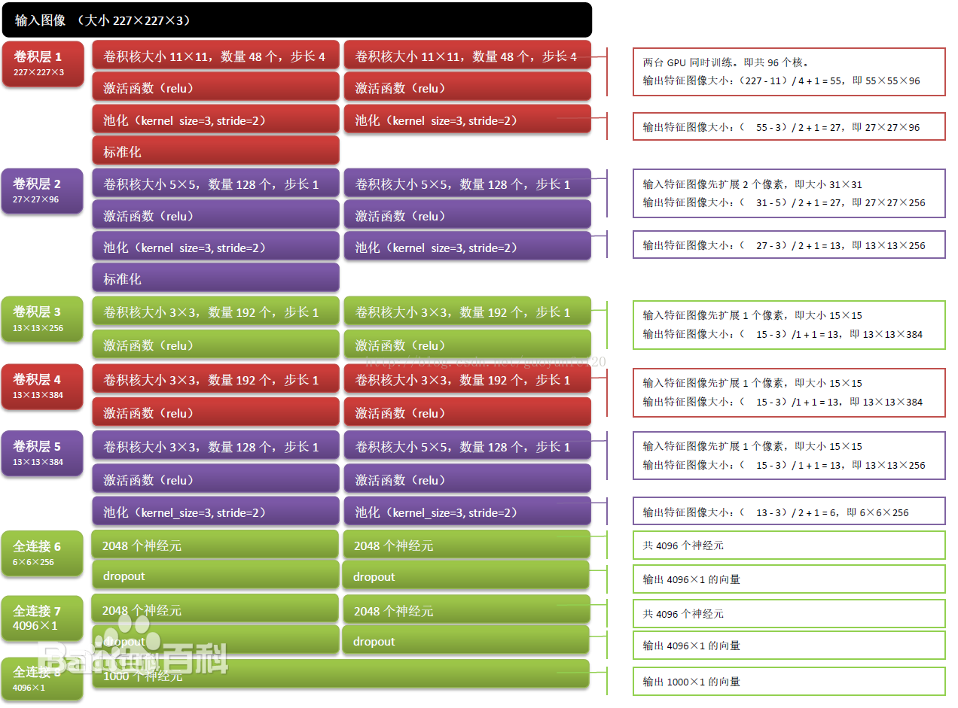
The Deep Learning Era (2011-2020)
Breakthroughs in Image Recognition
The success of AlexNet was not only a milestone in the field of machine vision but also a milestone for deep learning, greatly boosting researchers' confidence in it.
Soon after, deep learning made great strides in various fields such as facial recognition, speech recognition, and natural language understanding, achieving one brilliant success after another and opening a new chapter for artificial intelligence.

Slide 13
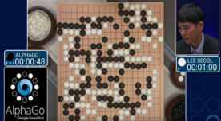
The Deep Learning Era (2011-2020)
New Progress in Human-Computer Games
In 2016, DeepMind's AlphaGo achieved brilliant results in the game of Go, further sparking public interest in artificial intelligence.
In 2017, AlphaGo defeated Ke Jie 3-0 and was awarded the professional 9-dan rank by the Chinese Weiqi Association, although Nie Weiping 9-dan claimed its level was 'at least 20-dan'.

Slide 14
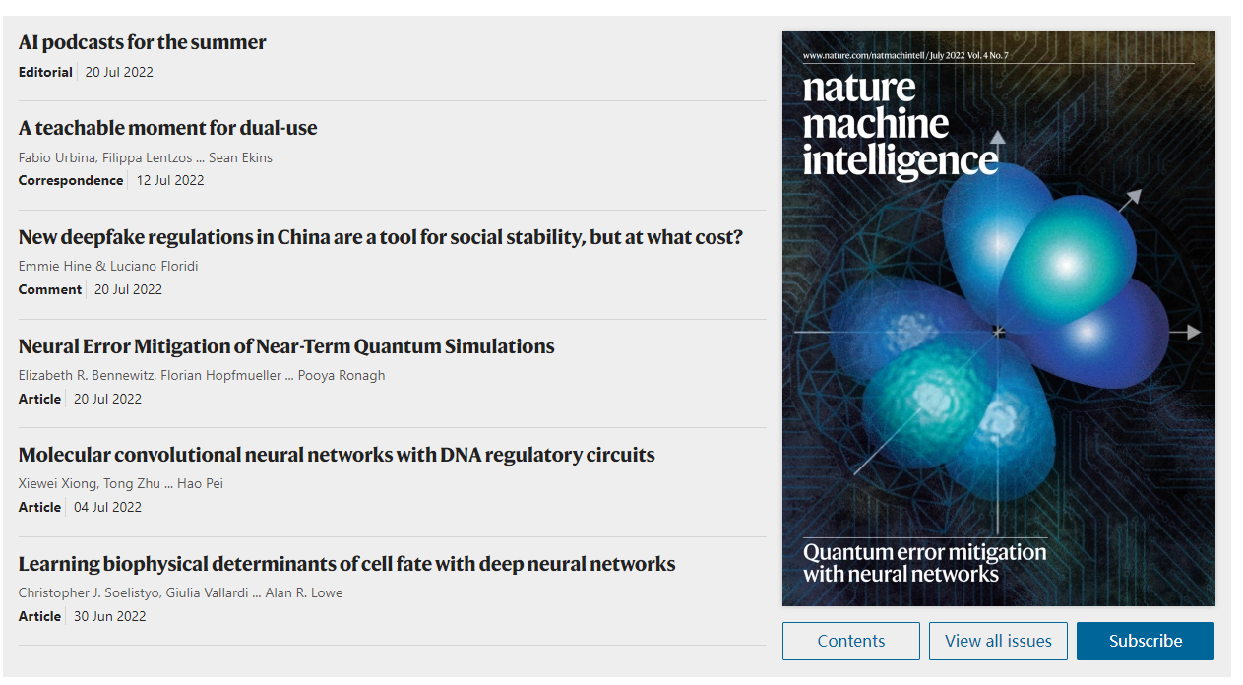
The Deep Learning Era (2011-2020)
Interdisciplinary Fusion in Science
The success of AlphaGo sparked people's imagination about artificial intelligence. Researchers began to apply deep learning methods to various fields such as physics, materials science, chemistry, medicine, astronomy, geology, and biology. By combining the powerful learning capabilities of deep neural networks with the accumulated knowledge and data from various disciplines, they expanded the knowledge boundaries of each field and achieved a series of surprising results.
In the renowned journal 'Nature Machine Intelligence', the vast majority of articles involve interdisciplinary research related to artificial intelligence.

Slide 15
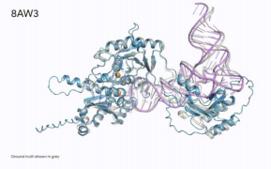
The Deep Learning Era (2011-2020)
Interdisciplinary Fusion in Science
For example, DeepMind's AlphaFold system can predict the spatial structure of proteins, completely revolutionizing molecular biology research.
AlphaFold 3 can predict the results of biomolecular interactions. In the figure, the blue part is a protein molecule, the pink part is a nucleic acid, and the small yellow spheres are ions. The gray part shows the experimental results, and the colored part shows the results predicted by AlphaFold 3.

Slide 16

The Large Model Era (2020-Present)
The Transformer Architecture and GPT Model
In 2017, researchers at Google proposed a neural network architecture called the Transformer, which can learn from long sequences.
In 2018, researchers at OpenAI, based on the Transformer, proposed a pre-trained language model called GPT (Generative Pre-trained Transformer). This model can predict the next word based on a long history of information. The GPT model was trained on 40GB of text data, had 117 million parameters, and used a history of 512 tokens (each English word contains 1-3 tokens depending on its length). Because of its massive size and training data, it is vividly called a Large Language Model (LLM).
OpenAI launched ChatGPT in 2022

Slide 17
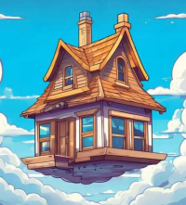
The Large Model Era (2020-Present)
Generative Artificial Intelligence
Large language models possess powerful language understanding and generation capabilities. They can not only chat smoothly with people but also write novels, perform translations, offer suggestions, polish papers, and more, demonstrating powerful intelligence.
At the end of 2022, OpenAI released the GPT-3.5 version, commercially named ChatGPT. Its powerful capabilities caused a sensation, reaching 100 million registered users within two months. In addition to making amazing progress in understanding and generating human language, deep learning has also achieved great success in the fields of image and video generation. For example, OpenAI's DALL·E can generate realistic, high-definition images, and Sora can generate high-definition videos up to a minute long.
Example of a Large Language Model Writing an Essay
Me: You are a scientist. Write a 50-word short text describing a flying house.
LLM: Driven by high-efficiency energy and anti-gravity technology, flying houses float in the air, navigating autonomously. Equipped with intelligent navigation systems, they can avoid bad weather, follow the sun and fresh air, allowing living environments to change dynamically with human needs.

Slide 18
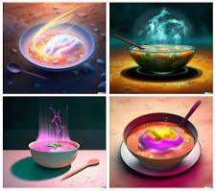

The Large Model Era (2020-Present)
Multimodal Large Models
Researchers are attempting to have a single, unified model process various types of information such as text, audio, and images. This type of model is called a 'multimodal large model'.
For example, GPT-4o, released by OpenAI in April 2024, is a multimodal large model that integrates vision, hearing, reading, and writing. This model can communicate freely with people through voice, video, and other means, like a smart friend you can ask anything.
Image generated by DALL·E

Slide 19
Thinking and Activities
Activity 1: Creating an AI Technology Timeline
Group Task:
Use cards to mark key AI events from 1993-2024 (e.g., 1997 Deep Blue, 2012 AlexNet, 2022 ChatGPT).
Discussion: 'Which events are the result of the combined effects of data, computing power, and algorithms?'

Slide 20
Thinking and Activities
Activity 2: Designing a Generative AI Application
Task:
Each group chooses a field (e.g., healthcare, education, environmental protection) and designs a generative AI tool.
Example: 'AI Eco-Consultant: Input environmental data, generate a protection plan, and create a promotional video.'
Presentation and Critique:
Share design ideas, discuss technical feasibility and social value.

Slide 21
Course Summary
Artificial intelligence technology has developed rapidly over the past decade, and this progress can be attributed to three main factors:
The accumulation of massive amounts of data;
Powerful computing capabilities;
Deep learning algorithms.
These three factors have jointly driven the current artificial intelligence revolution. In the future, artificial intelligence, in the form of general intelligent agents, will gradually permeate all aspects of our lives and bring profound changes to many fields.

Slide 22
Homework
Write a short essay analyzing the impact and challenges of AI on a specific profession (e.g., teacher, doctor, artist).
Think: If AI could predict natural disasters or cure cancer, what would the world be like? What preparations do we need to make?

