Slide 1

Ознакомительная практика Дьяченко Юрий УВП-211

Slide 2
Слайд 2 с анализом проекта
Задачи
Разработать REST API сервис:
4-5 сущностей со связями many-to-many
CRUD-репозитории
Кастомные запросы под сценарии использования
REST-контроллеры + DTO Automapping

Slide 3
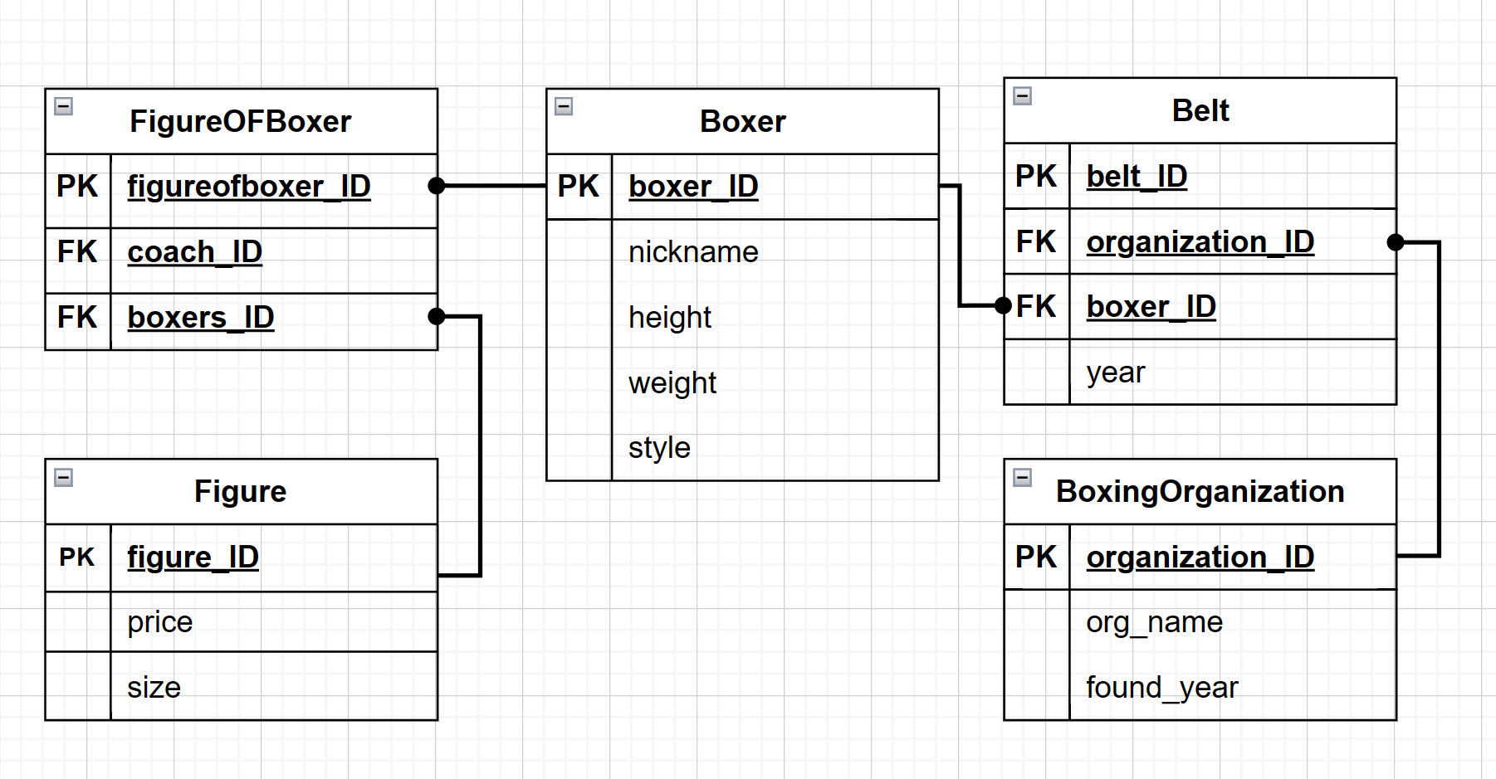
Слайд 2 с анализом проекта
Сущности IDEF1X

Slide 4
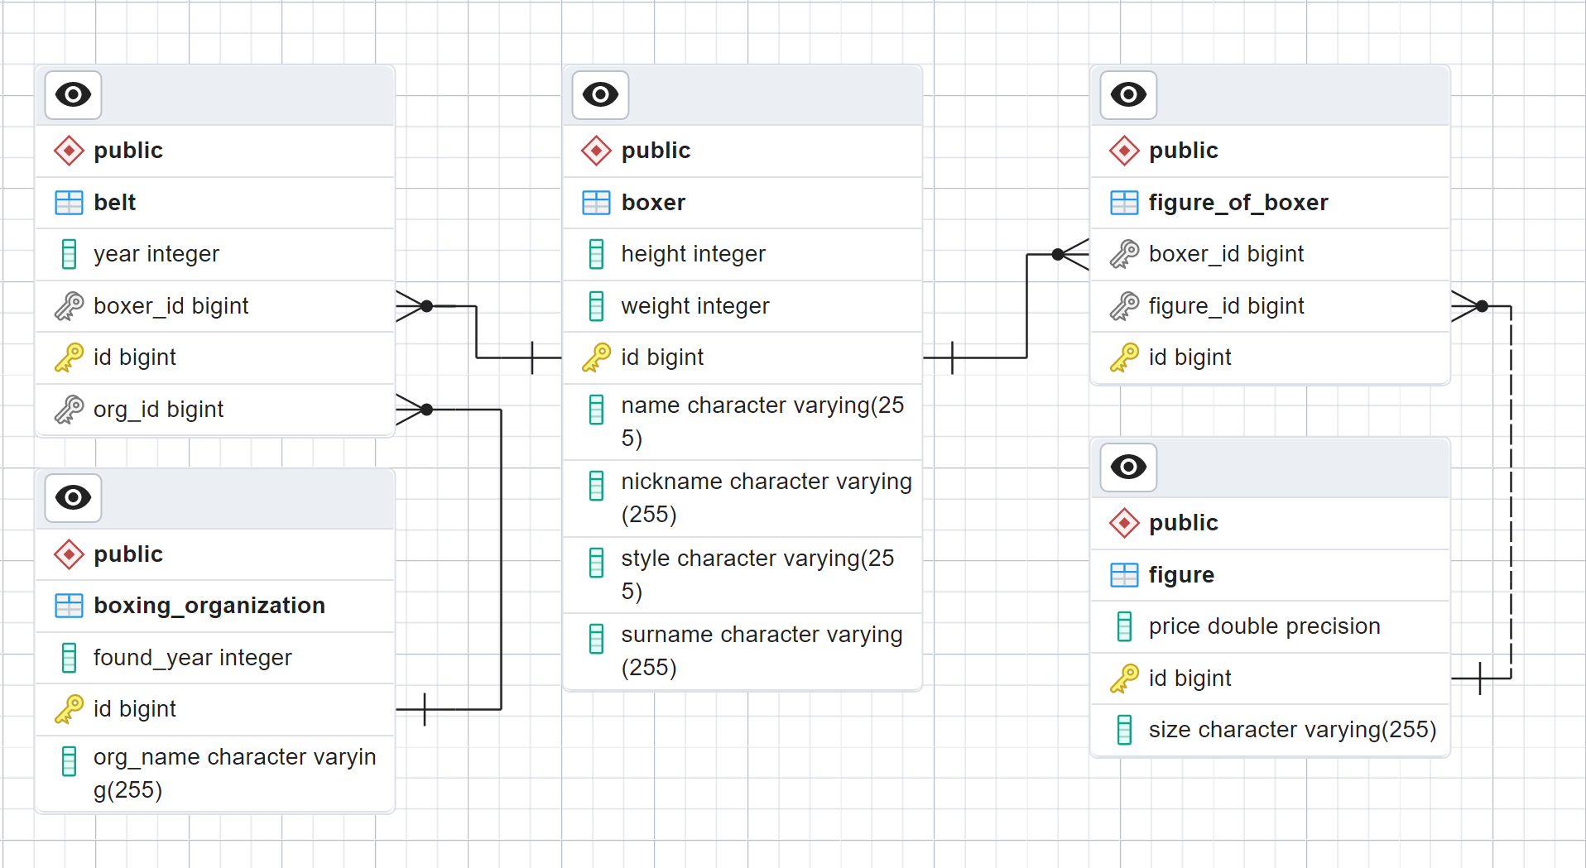
Слайд 2 с анализом проекта
Таблицы БД

Slide 5
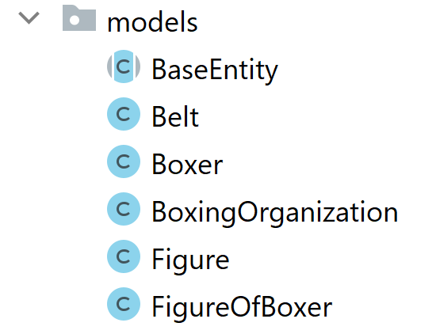
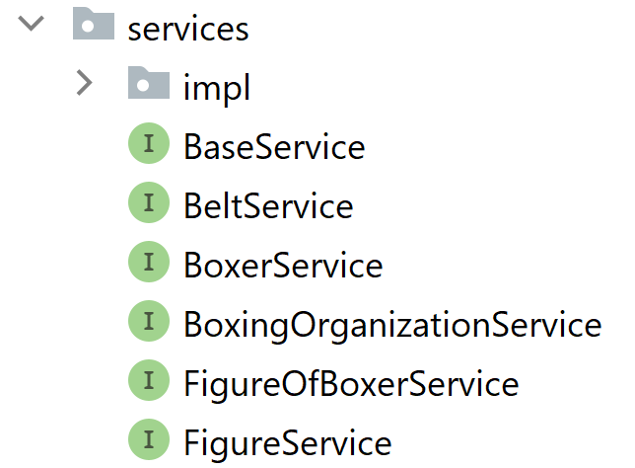
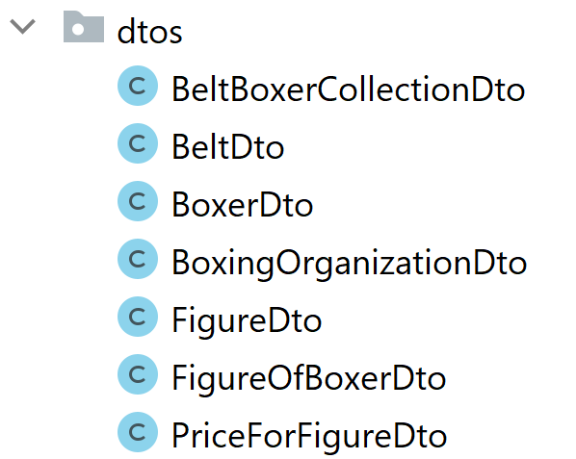
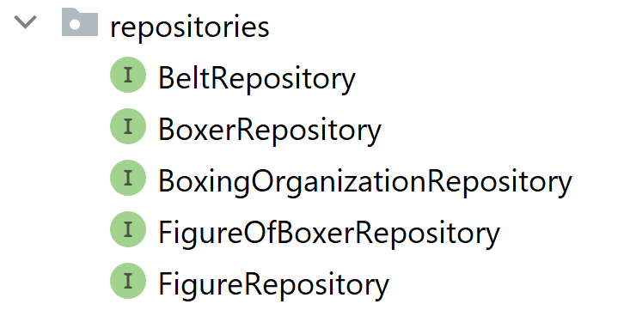
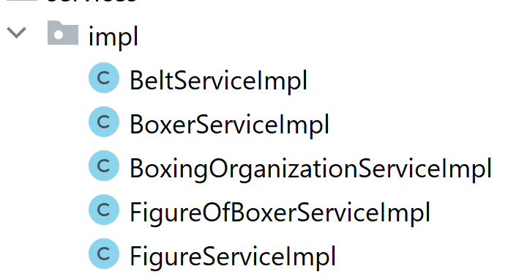
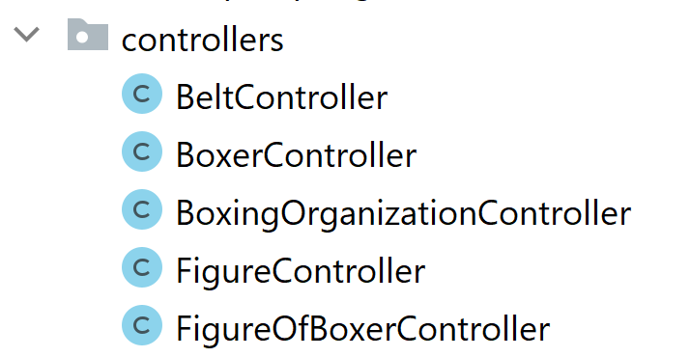
Слайд 2 с анализом проекта
Packages

Slide 6
Слайд 2 с анализом проекта
Models
@MappedSuperclass public abstract class BaseEntity implements Serializable { @Id @GeneratedValue(strategy = GenerationType.IDENTITY) @Column(name = "id") public Long id;
//getters, setters and constructors }
@Entity @Table(name = "Boxer") public class Boxer extends BaseEntity {
//fields, atributes and coloumns @OneToMany(mappedBy = "boxer") private Set<Belt> belts = new HashSet<>();
@OneToMany(mappedBy = "boxer") private Set<FigureOfBoxer> figureOfBoxers = new HashSet<>();
//getters, setters and constructors }
@Entity @Table(name = "Belt") public class Belt extends BaseEntity {
//fields, atributes and coloumns
@ManyToOne @JoinColumn( name = "boxer_ID", insertable = false, updatable = false)
private Boxer boxer; @ManyToOne @JoinColumn( name = "org_ID", insertable = false, updatable = false) private BoxingOrganization org;
//getters, setters and constructors }
@Entity @Table(name = "BoxingOrganization") public class BoxingOrganization extends BaseEntity { //fields, atributes and coloumns
@OneToMany(mappedBy = "org") private Set<Belt> belts = new HashSet<>();
//getters, setters and constructors }

Slide 7
Слайд 2 с анализом проекта
Models
@Entity @Table(name = "FigureOfBoxer") public class FigureOfBoxer extends BaseEntity {
//fields, atributes and coloumns @ManyToOne(optional = true) @JoinColumn( name = "boxer_id", insertable = false, updatable = false) private Boxer boxer; @ManyToOne(optional = true) @JoinColumn( name = "figure_id", insertable = false, updatable = false) private Figure figure;
//getters, setters and constructors }
@Entity @Table(name = "Figure") public class Figure extends BaseEntity {
//fields, atributes and coloumns @OneToMany(mappedBy = "figure", fetch = FetchType.LAZY) private Set<FigureOfBoxer> figureOfBoxers = new HashSet<>();
//getters, setters and constructors }

Slide 8
Слайд 2 с анализом проекта
Repositories
@Repository public interface FigureRepository extends JpaRepository <Figure, Long> { //Найти фигурки по прозвищу боксёра @Query(value = "SELECT f FROM Figure AS f " + "INNER JOIN FigureOfBoxer as fb ON f.id = fb.figure_id " + "INNER JOIN boxer AS b ON b.id = fb.boxer_id WHERE b.nickname = :nickname") List<Figure> findAllByNickname(@Param(value = "nickname") String nickname); //Найти фигурки по организации @Query(value = "SELECT fb FROM Figure AS f " + "INNER JOIN FigureOfBoxer as fb ON f.id = fb.figure_id " + "INNER JOIN boxer AS b ON b.id = fb.boxer_id " + "INNER JOIN Belt AS be ON be.boxer_ID=b.id " + "INNER JOIN BoxingOrganization AS org ON org.id=be.org_ID " + "WHERE org.org_name=:name") List<FigureOfBoxer> findAllByBelt(@Param(value = "name") String name); }
@Repository public interface BoxerRepository extends JpaRepository<Boxer, Long> { }

Slide 9
Слайд 2 с анализом проекта
Services
public interface BaseService<T, ID>{ T create(T t); void destroy(T t); void destroyById(ID id); Optional<T> find(ID id); List<T> getAll(); }
public interface FigureService extends BaseService<FigureDto, Long> { List<PriceForFigureDto> findPriceOfFigureByNickname(String nickname); List<BeltBoxerCollectionDto> findFiguresByOrganization(String org); }
public interface BoxerService extends BaseService<BoxerDto, Long>{
}

Slide 10
Слайд 2 с анализом проекта
FigureServiceImpl
@Service public class FigureServiceImpl implements FigureService { @Autowired private FigureRepository figureRepository; @Autowired private ModelMapper modelMapper; @Override public FigureDto create(FigureDto figure) {...} @Override public Optional<FigureDto> find(Long id) {...} @Override public void destroyById(Long id) {...} @Override public void destroy(FigureDto figure) {...} @Override public List<FigureDto> getAll() {...}
@Override public List<BeltBoxerCollectionDto> findFiguresByOrganization(String org) {...}
@Override public List<PriceForFigureDto> findPriceOfFigureByNickname(String nickname) {...}
}

Slide 11
Слайд 2 с анализом проекта
DTOs
public class BoxerDto { private Long id; private String nickname; private String name; private String surname; private int height; private int weight; private String style;
//getters, setters and constructors }
public class BeltDto { private Long id; private Long boxer_id; private Long org_id; private int year;
private BoxerDto boxer; private BoxingOrganizationDto org;
//getters, setters and constructors }
public class BoxingOrganizationDto { private Long id; String org_name; int found_year;
//getters, setters and constructors }
public class FigureDto { private Long id; private Double price; private String size;
//getters, setters and constructors }
public class FigureOfBoxerDto { private Long id; private Long boxer_id; private Long figure_id; private BoxerDto boxer; private FigureDto figure;
//getters, setters and constructors }

Slide 12
Слайд 2 с анализом проекта
Mapping(Авто)
@Override public List<PriceForFigureDto> findPriceOfFigureByNickname(String nickname) { return figureRepository .findAllByNickname(nickname).stream() .map((s) -> modelMapper.map(s, PriceForFigureDto.class)) .collect(Collectors.toList()); }
public class PriceForFigureDto {
int price;
//getters, setters and constructors
}

Slide 13
Слайд 2 с анализом проекта
Mapping(Явный, Java 8)
@Override public List<BeltBoxerCollectionDto> findFiguresByOrganization(String org) { TypeMap<FigureOfBoxer, BeltBoxerCollectionDto> typeMap = modelMapper.createTypeMap( FigureOfBoxer.class, BeltBoxerCollectionDto.class); typeMap.addMapping((src -> src.getBoxer().getNickname()),BeltBoxerCollectionDto::setNickname); typeMap.addMapping((src -> src.getFigure().getPrice()), BeltBoxerCollectionDto::setPrice); typeMap.addMapping((src -> src.getFigure().getSize()), BeltBoxerCollectionDto::setSize); typeMap.addMapping((src -> src.getBoxer().getName()), BeltBoxerCollectionDto::setName); typeMap.addMapping((src -> src.getBoxer().getSurname()), BeltBoxerCollectionDto::setSurname); List<BeltBoxerCollectionDto> beltBoxerCollectionDtos = new ArrayList<>(); for (FigureOfBoxer s: figureRepository.findAllByBelt(org)) { beltBoxerCollectionDtos.add(typeMap.map(s)); } return beltBoxerCollectionDtos; }
public class BeltBoxerCollectionDto { String nickname;
String name;
String surname;
int price;
String size;
//getters, setters and constructors }

Slide 14
Слайд 2 с анализом проекта
Controllers
@RestController public class FigureController { @Autowired private FigureService figureService; @GetMapping("/figures") Iterable<FigureDto> all() {...} @PostMapping("/figures") FigureDto newFigure(@RequestBody FigureDto newFigure) {{...} @GetMapping("/figures/{id}") Optional<FigureDto> one(@PathVariable Integer id) throws Throwable {...} @RequestMapping(value = "/figures/getBy", method = RequestMethod.GET) List<PriceForFigureDto> oneByNickname( @RequestParam(name = "nickname") String nickname) throws Throwable {...} @RequestMapping(value = "/figures/byOrg", method = RequestMethod.GET) List<BeltBoxerCollectionDto> oneByOrg( @RequestParam(name = "name") String name) throws Throwable {...} @DeleteMapping("/figures/{id}") void deleteStudent(@PathVariable Integer id) {...} }

Slide 15
Слайд 2 с анализом проекта
Демонстрация работы
@Component public class CommandLineRunnerImpl implements CommandLineRunner {
//@Autowired fields of services and constructors @Override public void run(String... args) throws Exception { seedData(); printAllPriceByNickname("Money"); } private void seedData() throws IOException { BoxerDto boxer1 = new BoxerDto("Money", "Floyd", "Maywether", 173, 75, "phily shell"); FigureDto figure1 = new FigureDto(100.0, "small"); FigureOfBoxerDto figureOfBoxer1 = new FigureOfBoxerDto(boxerService.create(boxer1), figureService.create(figure1)); figureOfBoxerService.create(figureOfBoxer1); BoxingOrganizationDto boxingOrganizationDto = new BoxingOrganizationDto("WBC", 1961); BeltDto beltDto = new BeltDto(boxer1, boxingOrganizationService.create(boxingOrganizationDto), 1998); beltService.create(beltDto); figureService.findPriceOfFigureByNickname("Money"); figureService.findFiguresByOrganization("WBC").forEach(System.out::println); } }
PriceForFigureDto{price=100}
BeltBoxerCollectionDto{nickname='Money', name='Floyd', surname='Maywether', price=100, size='small'}

Slide 16
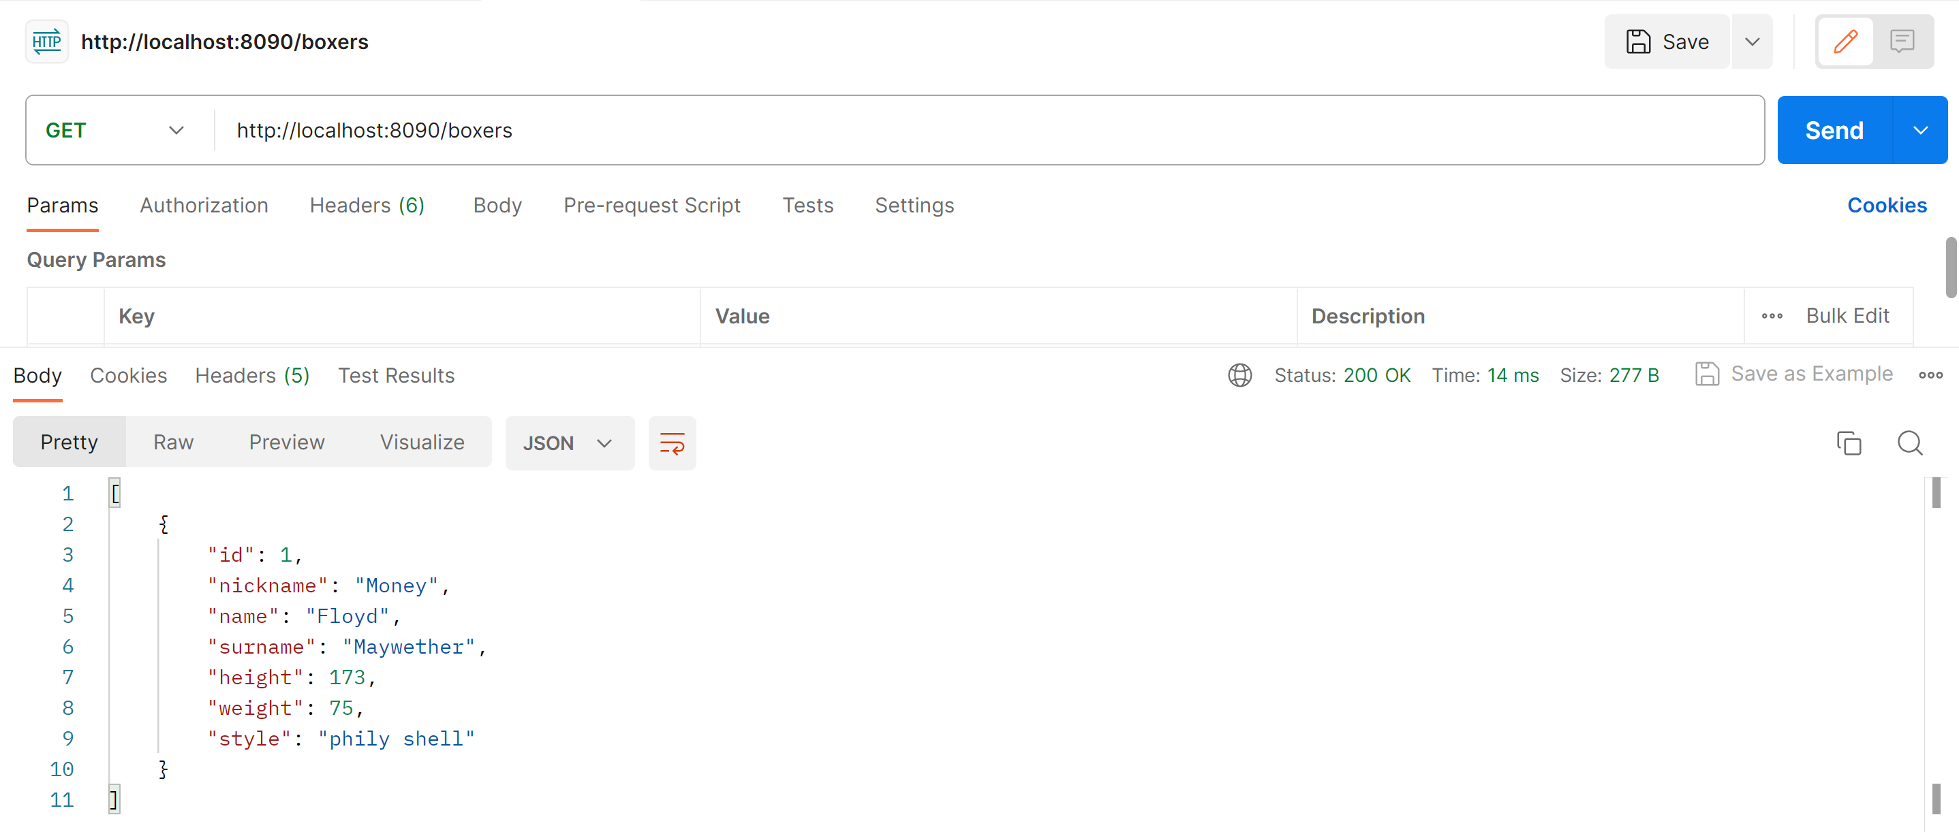
Слайд 2 с анализом проекта
Демонстрация(Postman)

Slide 17
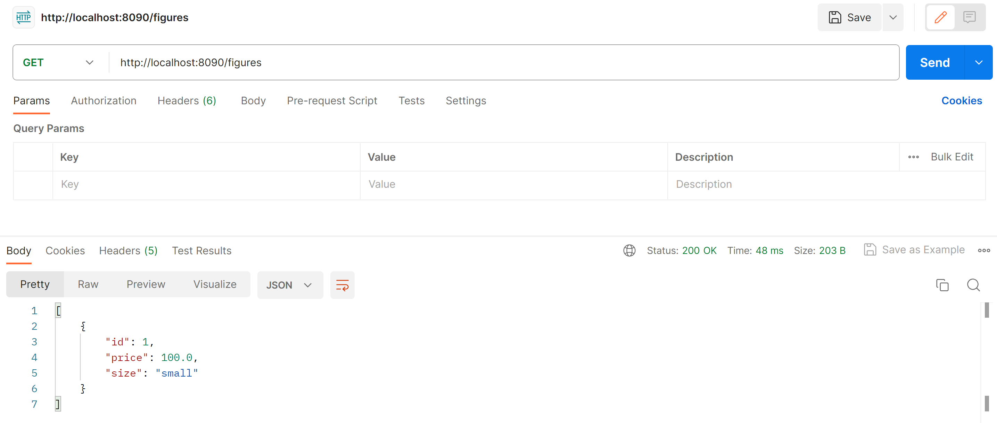
Слайд 2 с анализом проекта
Postman

Slide 18
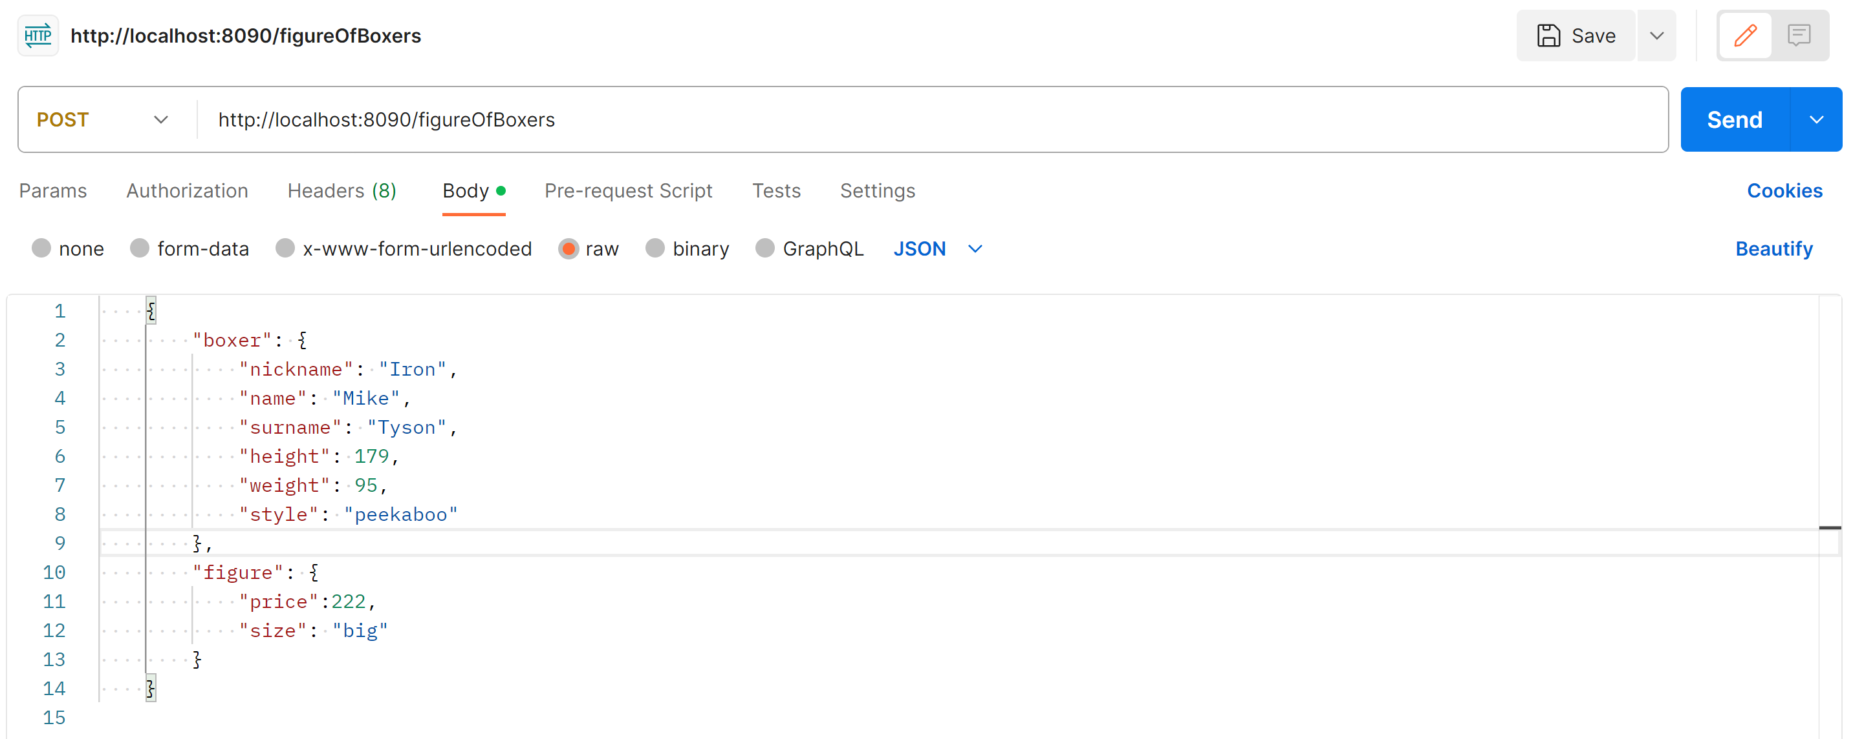
Слайд 2 с анализом проекта
Добавление фигурки

Slide 19
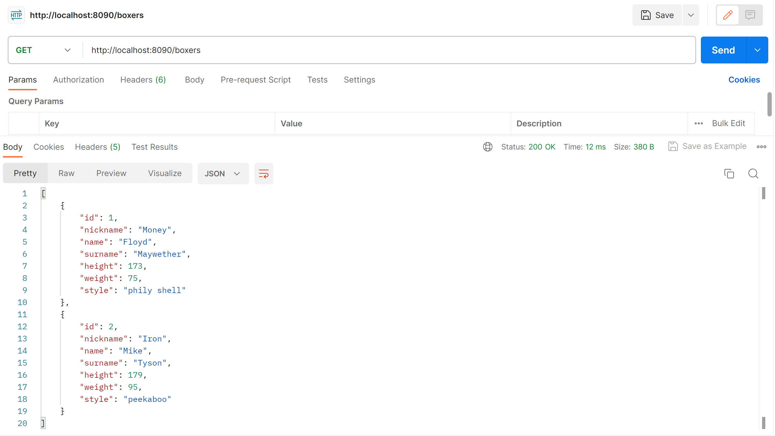
Слайд 2 с анализом проекта
Добавление фигурки

Slide 20
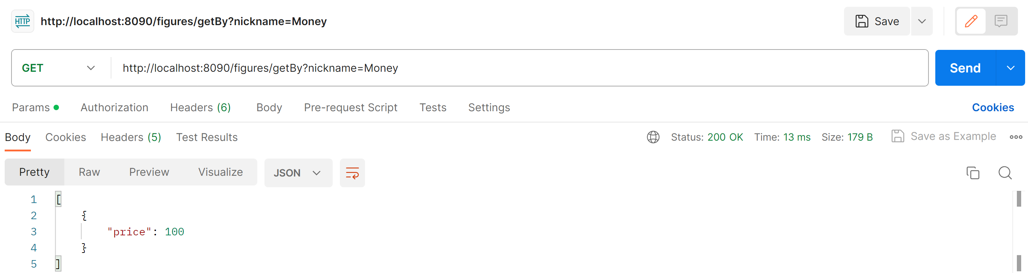
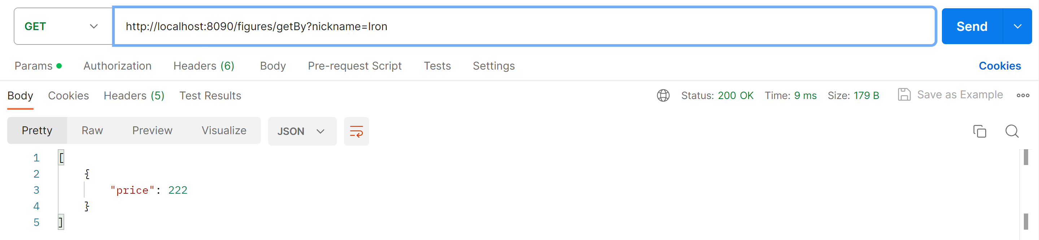
Слайд 2 с анализом проекта
Кастомный запрос 1

Slide 21
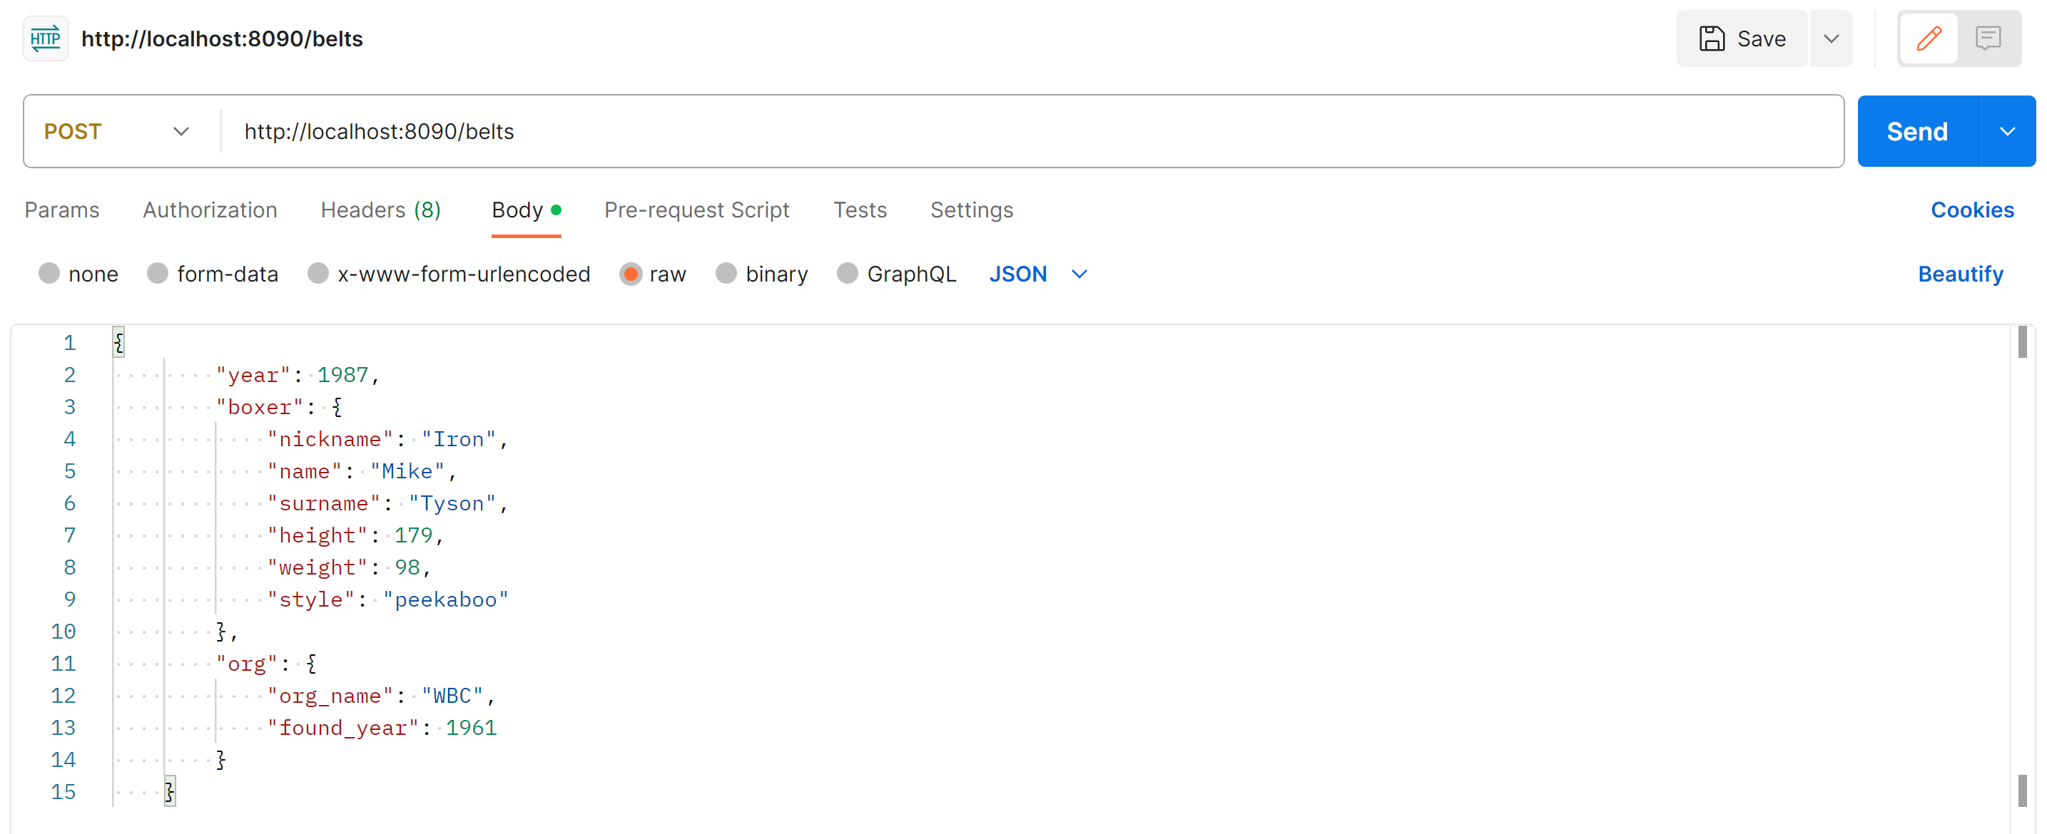
Слайд 2 с анализом проекта
Добавим Тайсону пояс

Slide 22
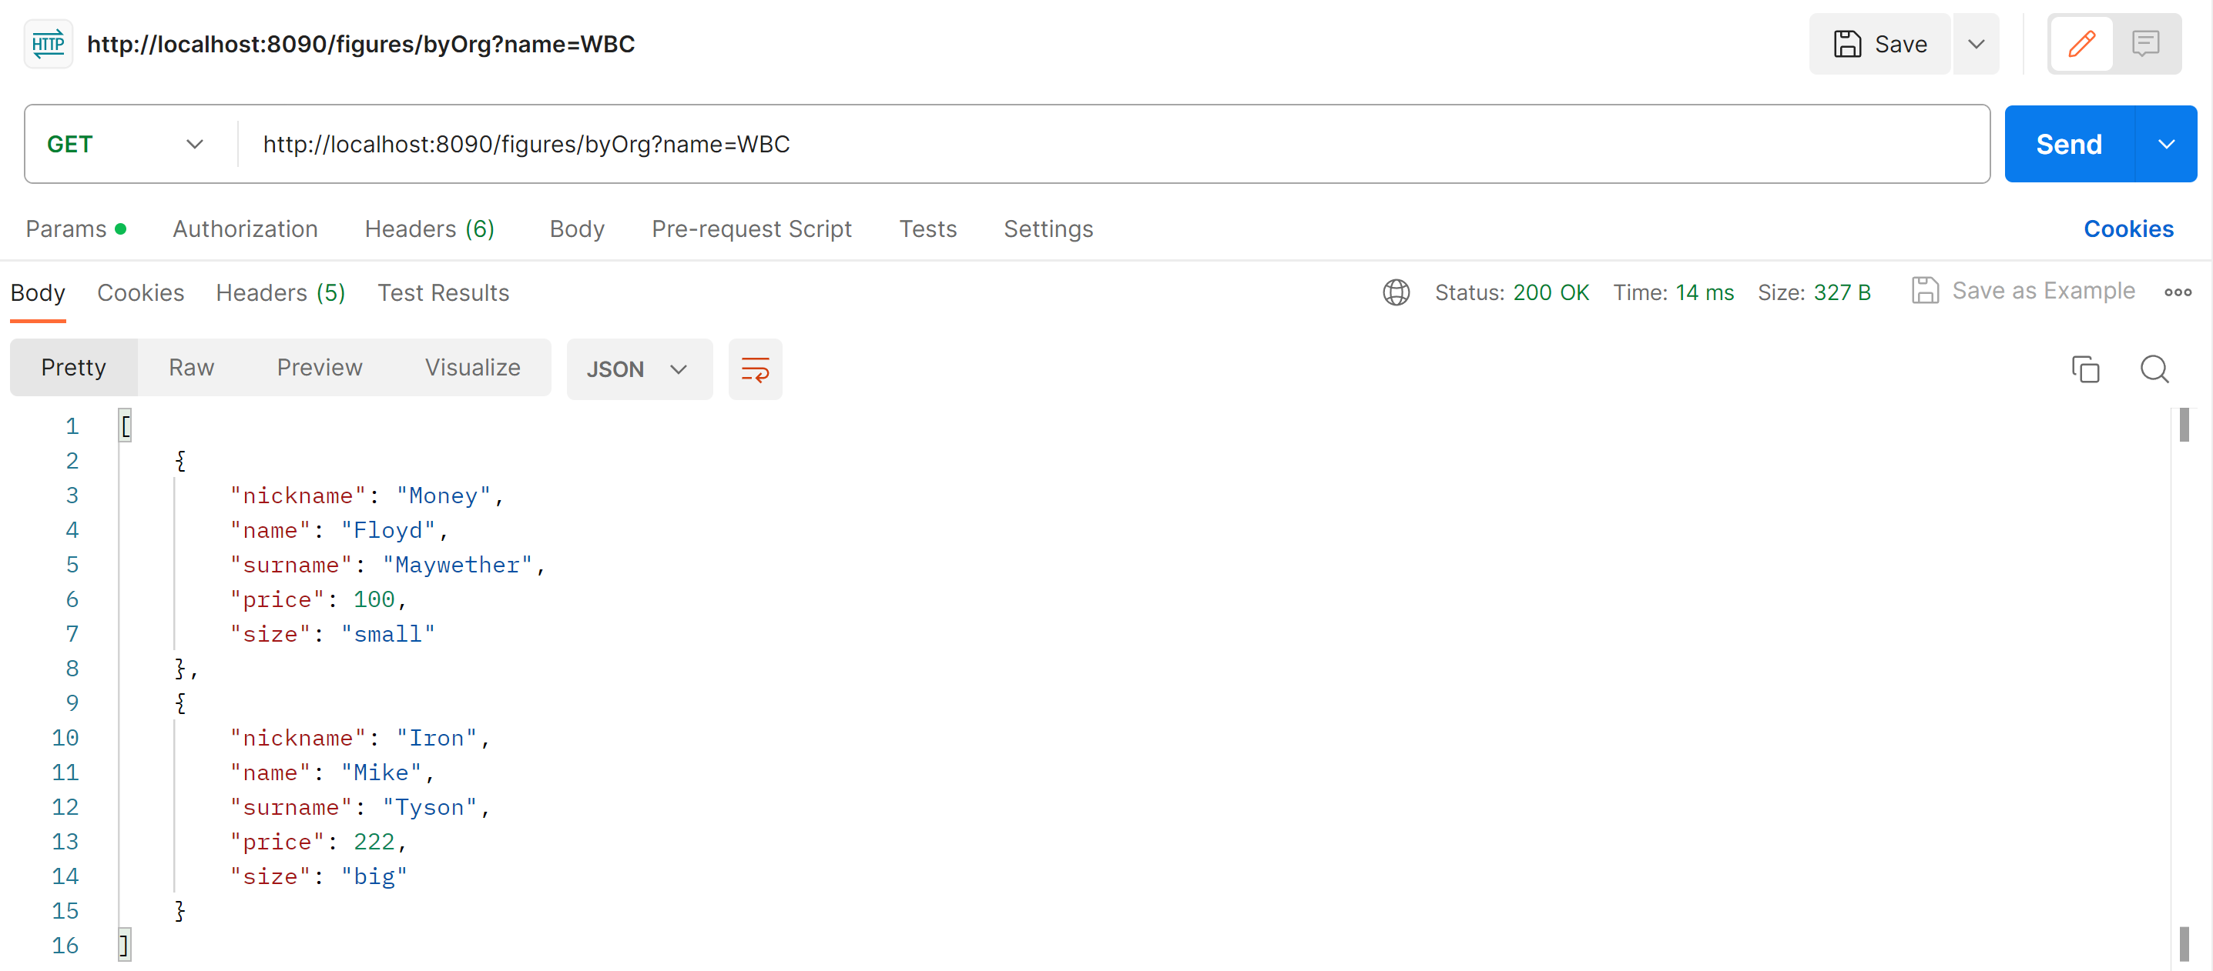
Слайд 2 с анализом проекта
Кастомный запрос 2

Slide 23
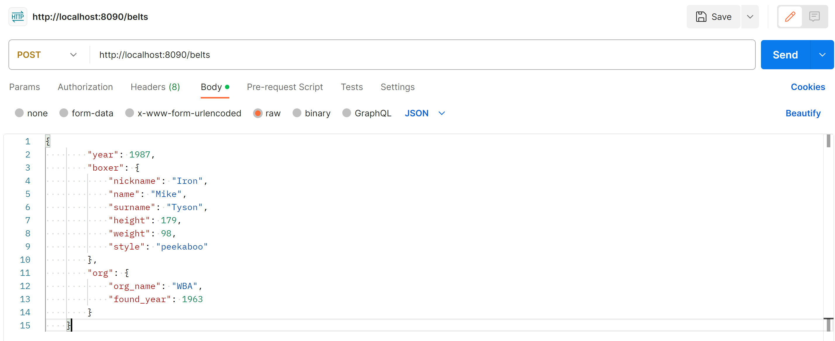
Слайд 2 с анализом проекта
И ещё один

Slide 24
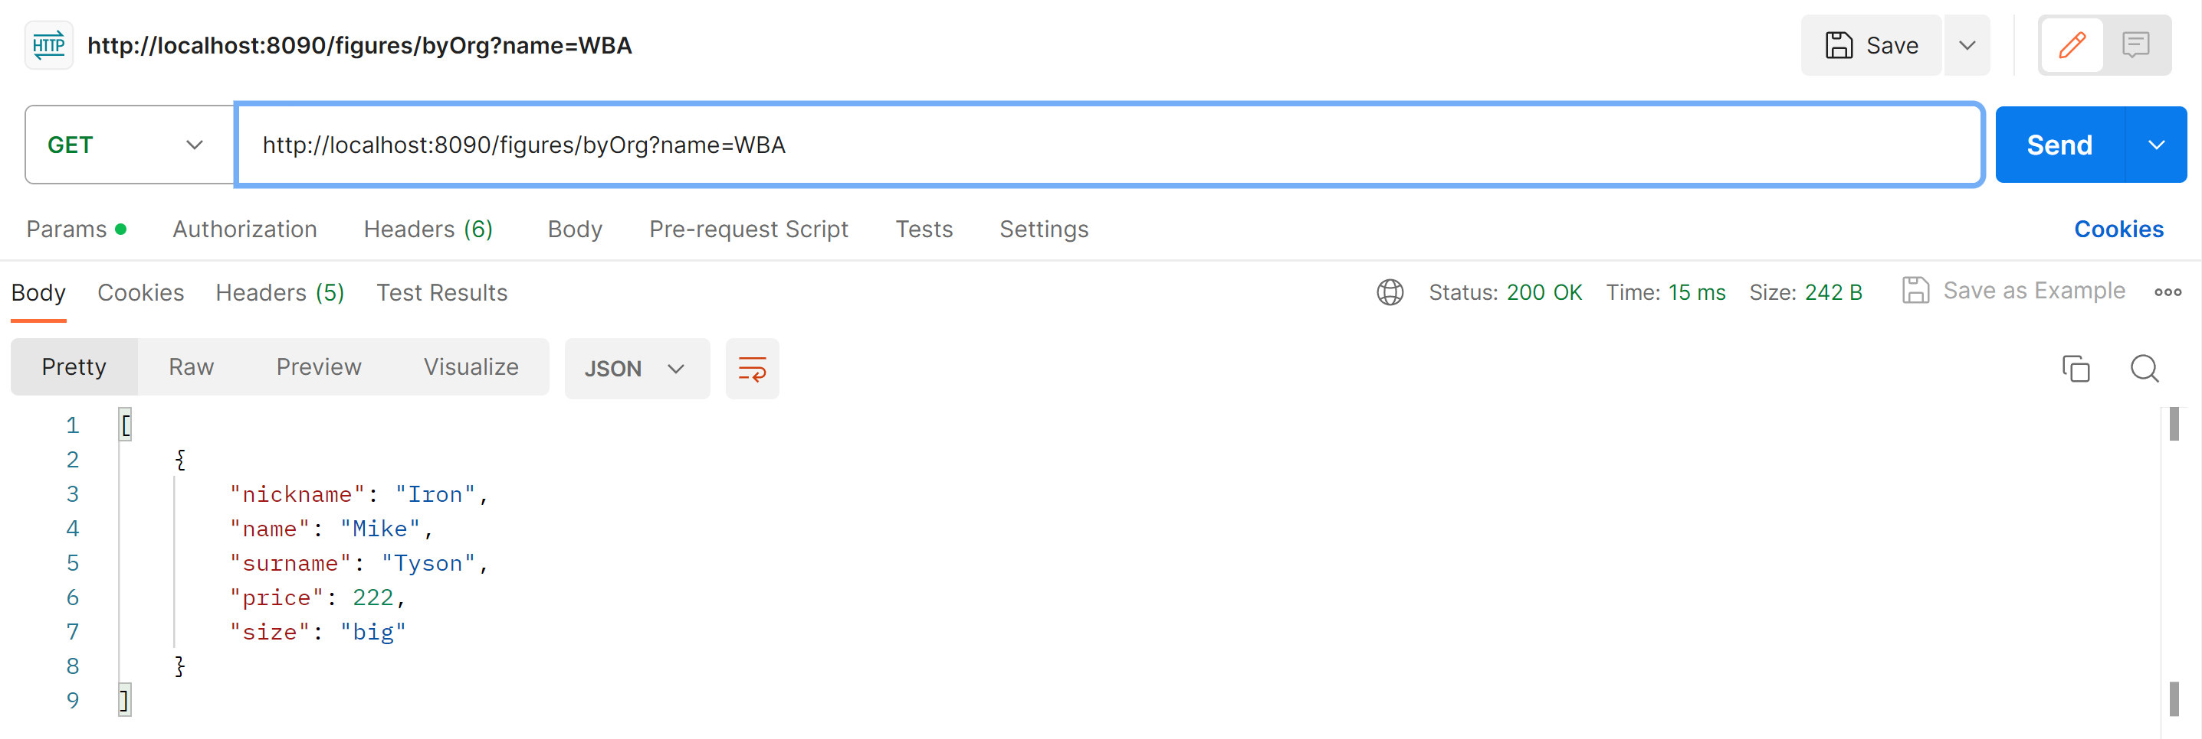
Слайд 2 с анализом проекта
Кастомный запрос 2

Slide 25
Спасибо за внимание

