Slide 1
Practical Keras Deep Learning Framework Tutorials
YIFAT YULEVICH
LEONID GORELIK
RAANON REUTLINGER
LASER NAHOOM-KABAKOV
ALEXANDER PYASIK
YURA ZHARKOVSKY
https://github.ibm.com/yurazhar/Practical-Deep-Learning
Notes:
1

Slide 2











Slide 3
Agenda
Tutorial 1: Predicting Houses Prices (Regression tutorial)
Tutorial 2:
Tutorial 3:
Tutorial 4:
Tutorial 5:
Tutorial 6:
Tutorial 7:

Slide 4
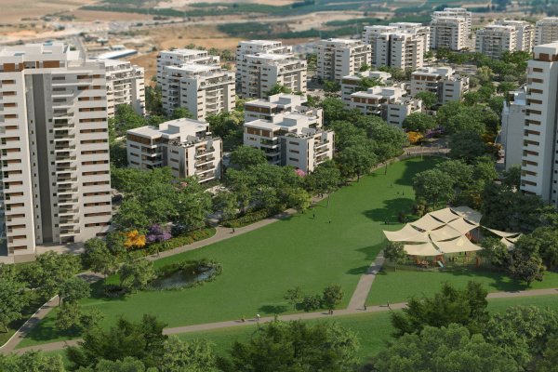
Tutorial 1: How to value a house price?
Predicting Houses Prices (Regression tutorial)

Slide 5
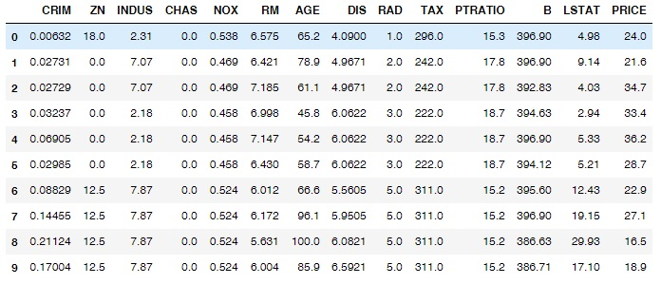
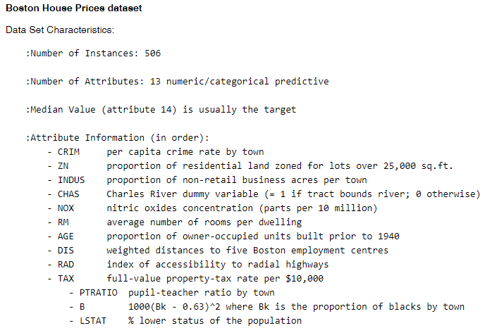
Tutorial 1: House Dataset Inspection
For demonstrating evaluation of the house prices we will use Boston dataset example

Slide 6
Tutorial 1: What we want to achieve ?
On any given house (list of the 13 features) predict its price.

Slide 7
Tutorial 1: Overview
Dense
Input
House Features
compile
Model compiled to C++ Code
Dense
fit
1
13
13
predict
24.75
N

Slide 8
Tutorial 1: Summary
This tutorial demonstrate how to estimate some feature value based on the other features (This is basic regression problem)
We learned:
How to inspect dataset
How to build a basic Keras model
How to use Dense Layer
How to estimate an accuracy for the regression problem

Slide 9
References
Practical Deep Learning Repository: https://github.ibm.com/yurazhar/Practical-Deep-Learning
Regression Tutorial with the Keras Deep Learning Library in Python: http://machinelearningmastery.com/regression-tutorial-keras-deep-learning-library-python/

Slide 10

Thank you
10

