Slide 1
Practical Keras Deep Learning Framework Tutorials
YIFAT YULEVICH
LEONID GORELIK
RAANON REUTLINGER
LASER NAHOOM-KABAKOV
ALEXANDER PYASIK
YURA ZHARKOVSKY
https://github.ibm.com/yurazhar/Practical-Deep-Learning
Notes:
1

Slide 2











Slide 3
Agenda
Tutorial 1: Predicting Houses Prices (Regression tutorial)
Tutorial 2: Material Classification (Binary Classification)
Tutorial 3: Iris Flowers Dataset (Multi-Class Classification)
Tutorial 4:
Tutorial 5:
Tutorial 6:
Tutorial 7:

Slide 4
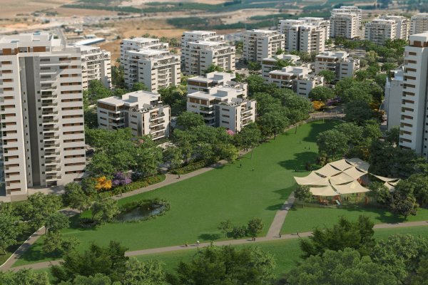
Tutorial 1: How to value a house price?
Predicting Houses Prices (Regression tutorial)

Slide 5
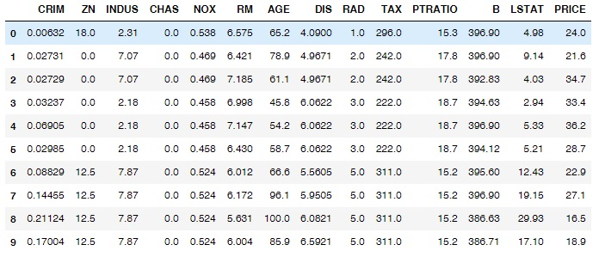
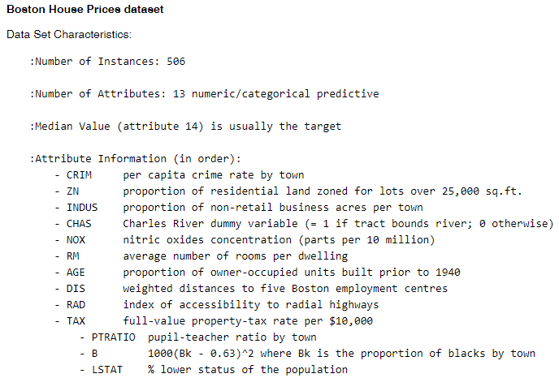
Tutorial 1: Dataset Inspection
For demonstrating evaluation of the house prices we will use Boston dataset example

Slide 6
Tutorial 1: What we want to achieve ?
On any given house (list of the 13 features) predict its price.

Slide 7
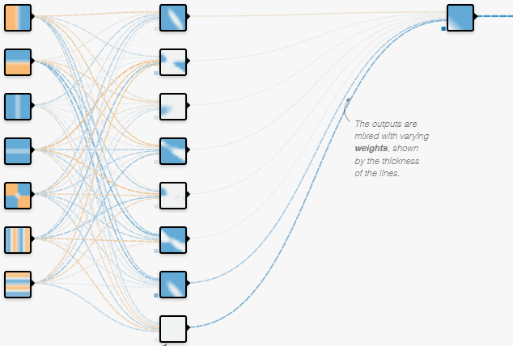
Tutorial 1: Model
House Features
Input
Dense + ReLu
Dense
13
13

Slide 8
Tutorial 1: Overview
506
Designed Keras Model
Houses Features
Compiled Keras Model
Fit
predict
Trained Model
25.75
[13x506]
13

Slide 9
Tutorial 1: Summary
This tutorial demonstrate how to estimate some feature value based on the other features (This is basic regression problem)
We learned:
How to inspect dataset
How to build a basic Keras model
How to use Dense, Input, Activation Layers
How to estimate an accuracy for the regression problem

Slide 10

Tutorial 2: How to classify a cylinder material ?
Material Classification (Binary Classification)

Slide 11
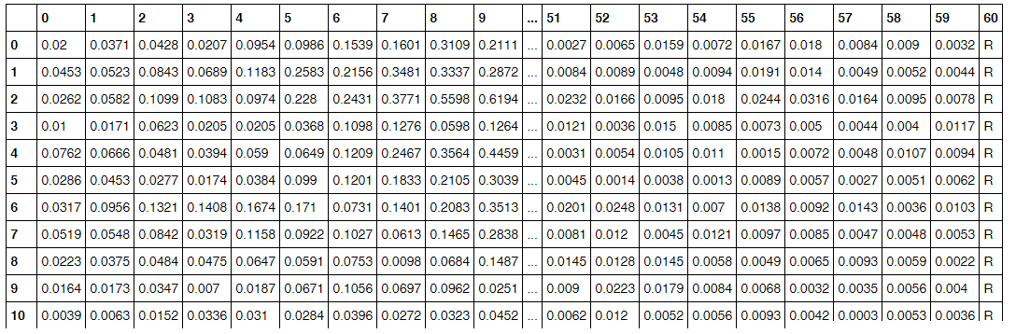
Tutorial 2: Dataset Inspection
On any given observation (list of the 59 features) predict its class (metal cylinder [M=0] or rock cylinder [R=1] ).

Slide 12
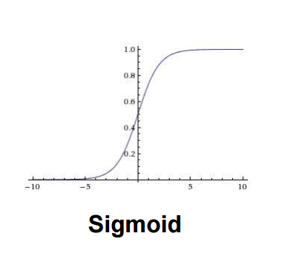
Tutorial 2: Model
Features
Input
Dense + ReLu
Dense
59
59

Slide 13
Tutorial 2: Binary Cross Entropy Loss
Sonar Chirp Returns
Y
Prediction
1
1
0
0
0
1
0
1
1
1
1
0
0
0.95
0.9
0.2
0.1
0.17
0.8
0.3
0.78
0.99
0.6
0.77
0.45
0.05

Slide 14
Tutorial 2: Summary
This tutorial demonstrate how classify material based on the features chirp returns (This is basic binary classification problem)
We learned:
How to inspect dataset
How to build a basic Keras model
How to use Dense, Input, Activation and Dropout Layers
How to estimate an accuracy for a classification problem
How to use Binary Cross Entropy Loss

Slide 15
Tutorial 3: How to classify iris flowers?
Iris Flowers Dataset (Multi-Class Classification)

Slide 16
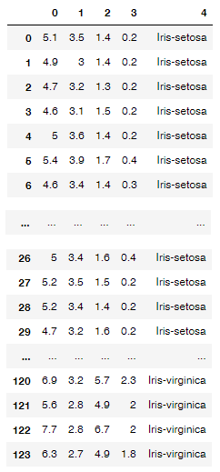
Tutorial 3: Dataset Inspection
For any given iris (list of the 4 features) predict its class (Iris-setosa, Iris-versicolor, Iris-virginica).

Slide 17
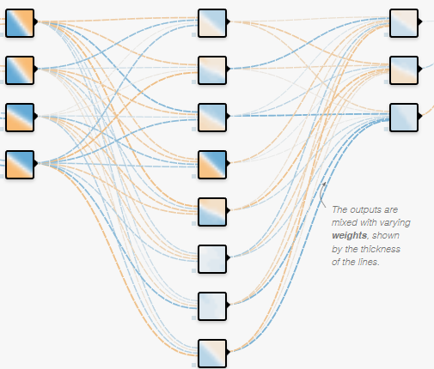
Tutorial 3: Model
Iris Features
Input
Dense + ReLu
Dense
Softmax
Each output class represents probability to be specific iris type.
13
8

Slide 18
Tutorial 3: One Hot Encoding
Iris-setosa | Iris-versicolor | Iris-virginica
1 | 0 | 0
0 | 1 | 0
0 | 0 | 1

Slide 19
Tutorial 3: Summary
This tutorial demonstrate how predict specific iris specie based on the list of a flower features (multi-class classification problem)
We learned:
How to inspect dataset
How to encode dataset before running prediction
How to build a basic Keras model
How to use Dense, Input, Activation Layers
How to estimate an accuracy for a classification problem
How to use Categorical Cross Entropy Loss

Slide 20
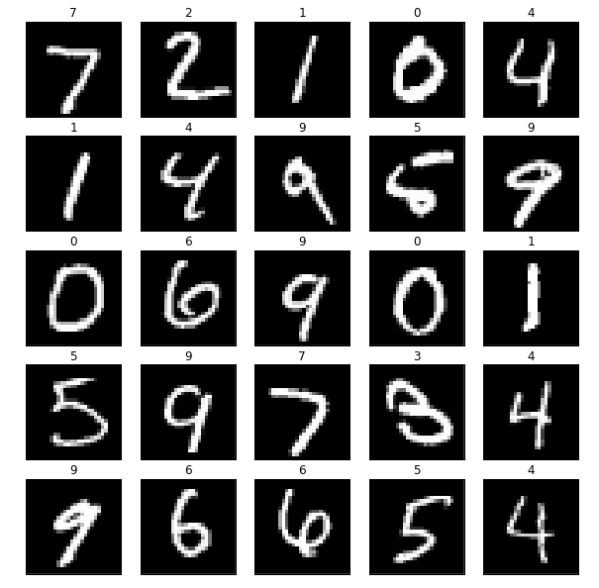
Tutorial 4: How to classify hand written digits?
Hand Written Digit Recognition (Convolutional Neural Network)

Slide 21
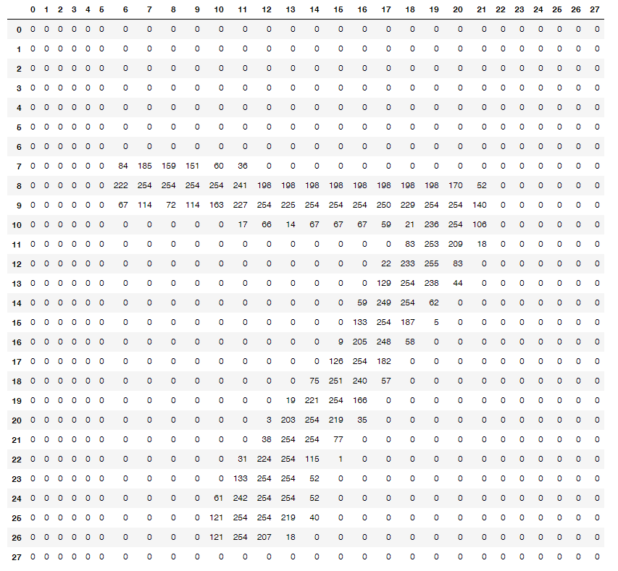
Tutorial 4: Dataset Inspection
Each image is matrix 28x28
60,000 train images
10,000 test images
Each image has label (represents) number between [0..9]

Slide 22
Tutorial 4: Model
3
3
3
3
1
32
2
2
3
3
3
32
3
1
Convolution
with 32 Filters
Convolution
with 64 Filters
Max pooling
(2x2) window
Fully
Connected
Fully
Connected
Digit Image
Dropout
Flatten
Softmax
12544
128
10
28
28
14
14
28
28
28
14
14
28
1
32
64
64
1
1
1
64

Slide 23
Tutorial 4: Summary
This tutorial demonstrate how classify hand written digits using convolutional neural network (multi-class classification problem)
We learned:
How to inspect dataset
How to encode dataset before running prediction
How to build a convolutional Keras model
How to use Dense, Input, Activation, Conv2D, Dropout, Flatten Layers
How to estimate an accuracy for a classification problem
How to use Categorical Cross Entropy Loss

Slide 24

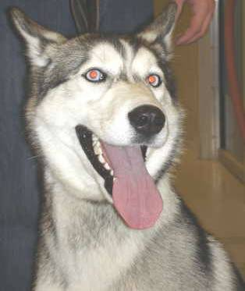
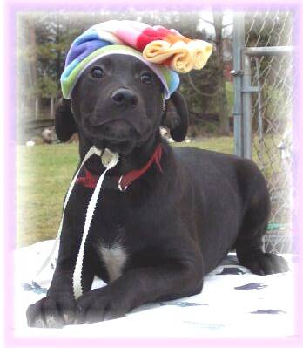
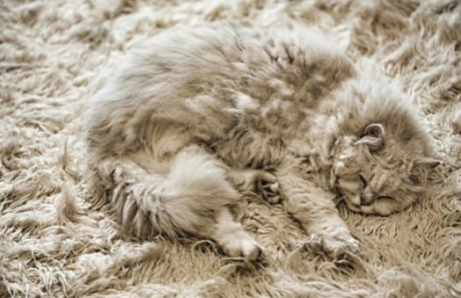
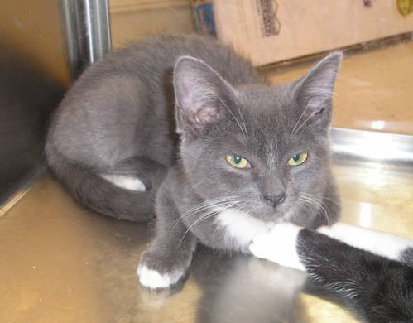
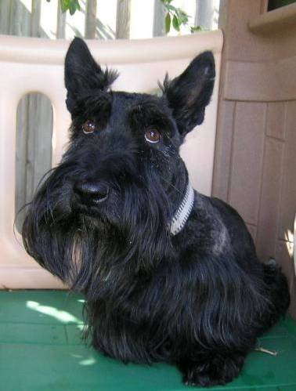
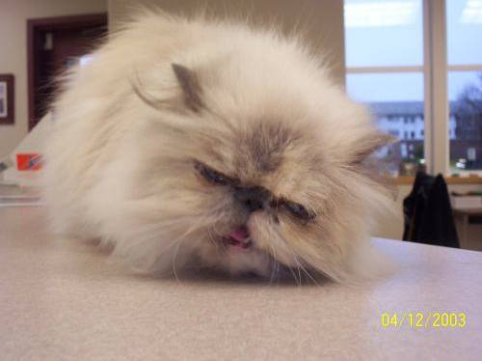
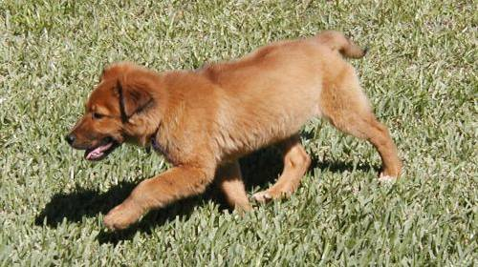
Tutorial 5: Dogs vs Cats Classification (Transfer Learning)
Dogs vs Cats Classification (Transfer Learning)
Notes:
24

Slide 25





Tutorial 5: Dataset Inspection
Data
Train – 2000 images
Dogs
Cats
Validation – 800 images
Dogs
Cats
Notes:
25

Slide 26

Tutorial 5: Transfer Learning – Small dataset
Download model which weights are already trained (trained on ImageNet).
Freeze this features
Set learning rate = 0
Train this layer
Set original value for training rate

Slide 27
Tutorial 5: Model
GlobalAveragePooling2D
Fully
Connected
Dropout
Fully
Connected
Digit Image
224
ResNet 50
1
Softmax
14
1
2048
2048
1024
1024
2
224
3
1
1
1
1

Slide 28
References
Practical Deep Learning Repository: https://github.ibm.com/yurazhar/Practical-Deep-Learning
Regression Tutorial with the Keras Deep Learning Library in Python: http://machinelearningmastery.com/regression-tutorial-keras-deep-learning-library-python/

Slide 29

Thank you
29

