Slide 1
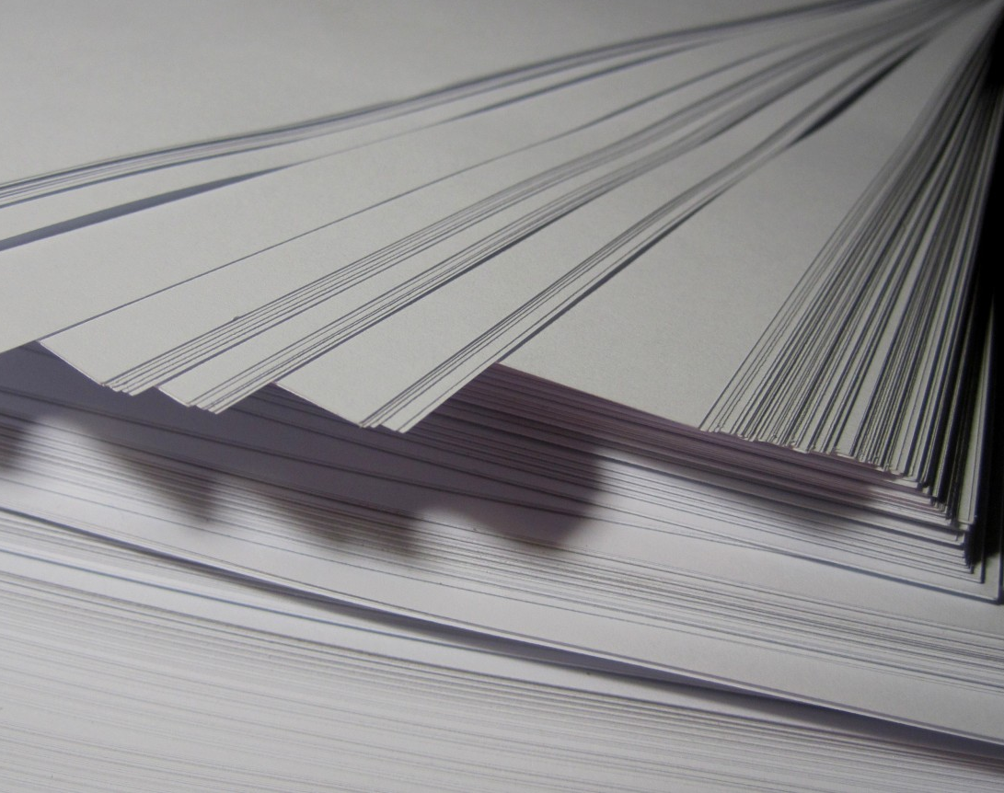

DATA DUMBLEDORE'S ARMY
BOOK GENIE
SEJAL SHREEYA VEDANT YURAJA

Slide 2

PROBLEM STATEMENT
Lack of a streamlined mechanism to assist individuals in choosing the right books from the extensive library catalog.
The abundance of options leading to decision fatigue, making it difficult for individuals to make a confident selection.
The manual process of going through numerous book titles becomes time-consuming and may hinder the efficient use of library resources.

Slide 3
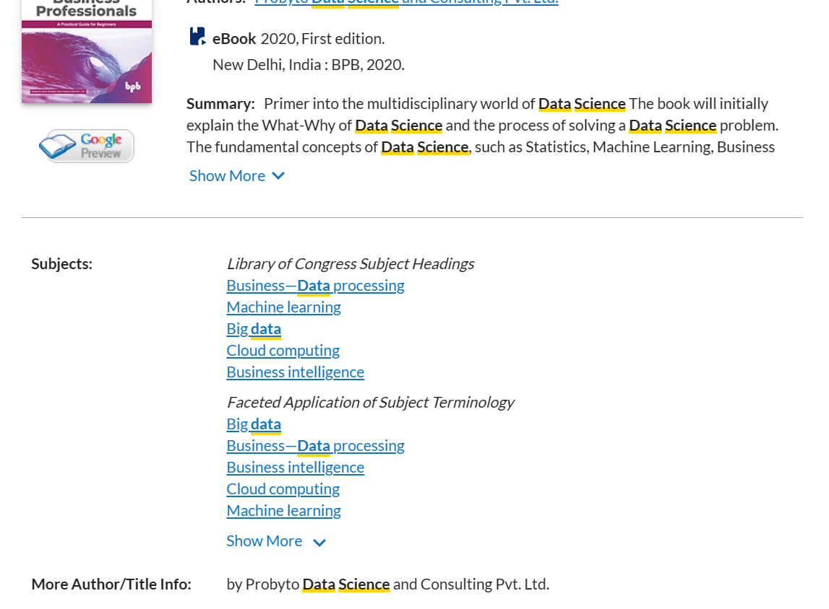
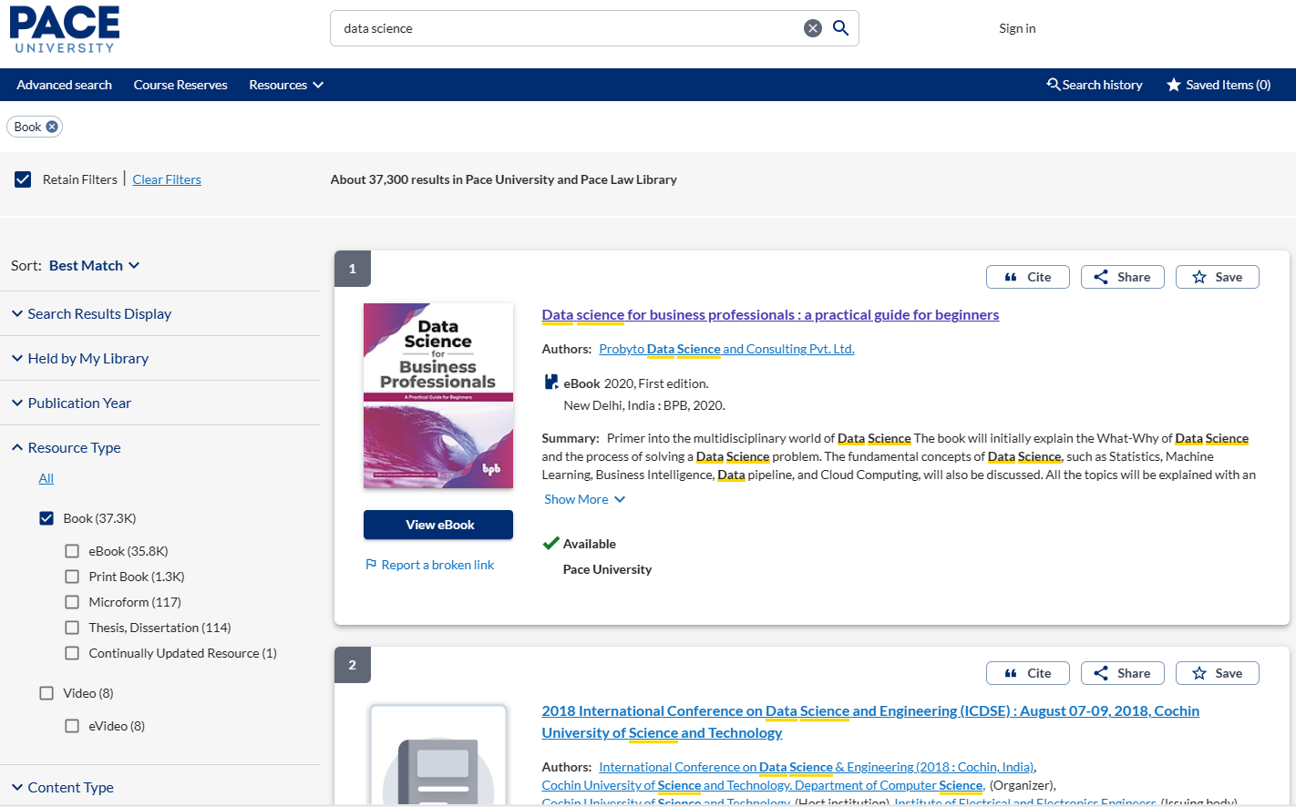
APPROACH OVERVIEW
Understanding Data Source
Explored university library website, identified WorldCat as the primary data source for book details.
API Access Hurdle
Faced security restrictions with WorldCat API, hindering direct access.
Adaptation with Google Books API
Transitioned to Google Books API for fetching book details.
Scrapped from Anna's archive directory
Explore Alternate options
Searched for existing datasets (Kaggle,dataworld)

Slide 4
WHY GOOGLE BOOKS
1. Direct API Access: Restricted API access in WorldCat forced us to switch to Google Books' open API.
2. Simplified Extraction: This streamlined the data gathering process compared to the potentially complex methods required for WorldCat.
3. Scalability: Google Books API provided a robust and scalable platform for retrieving book information. This allowed for handling larger datasets easily.
4. Data Alignment: The extracted information from Google Books API aligned seamlessly with the existing dataset from WorldCat, ensuring consistency and compatibility
5. Openness and Accessibility: Google Books promotes an open access philosophy, providing a vast collection of books and resources publicly available.
6. Technology Stack Alignment: As Google Books is a widely used platform with established libraries and frameworks, switching to its API facilitated easier integration.

Slide 5
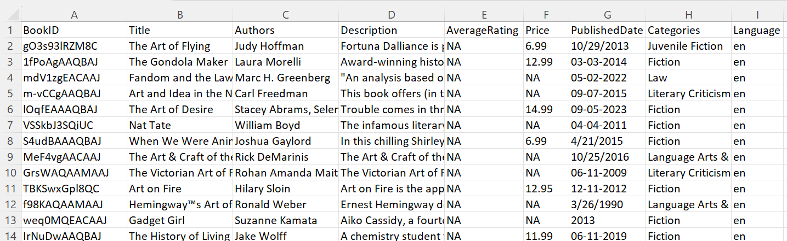
DATA COLLECTION
Extract & Store Data
Google Books API Integration:
Use multiple API Key
Identify Books
Send API Requests
Limitations of Google Books API:
Daily Quota: Faced constraints on the number of requests allowed per day with Google Books API.
Extraction Time: Due to the daily quota limitations, it took us three weeks to extract over 100,000 book entries.

Slide 6
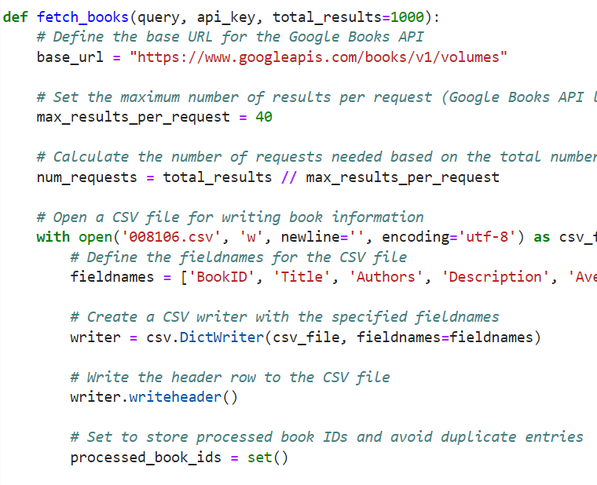
DATA EXTRACTION
Purpose: Fetches book data from Google Books API and stores it in a CSV file.
Key Steps:
Sets up API parameters and CSV file.
Defines CSV structure.
Makes API requests, processes responses, and writes data to the CSV file.
Uses a set to avoid duplicate entries.
Efficiency: Manages API limitations and prevents duplicates in the CSV file.

Slide 7
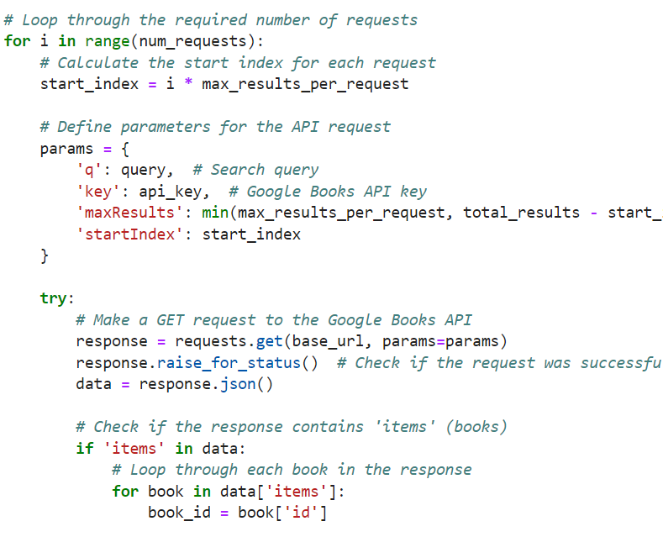
DATA EXTRACTION
Request Loop:
Iterates through the required number of Google Books API requests.
Request Setup:
Sets up parameters for each API request, including the search query, API key, and result range.
API Call:
Makes a GET request to the Google Books API and checks for success.
Book Iteration:
Loops through each book in the response.
Book Handling:
Extracts the book ID.
Skips processing if the book has already been processed to avoid duplicates.
This code efficiently fetches book data from the API, handling multiple requests and preventing duplicate entries.

Slide 8
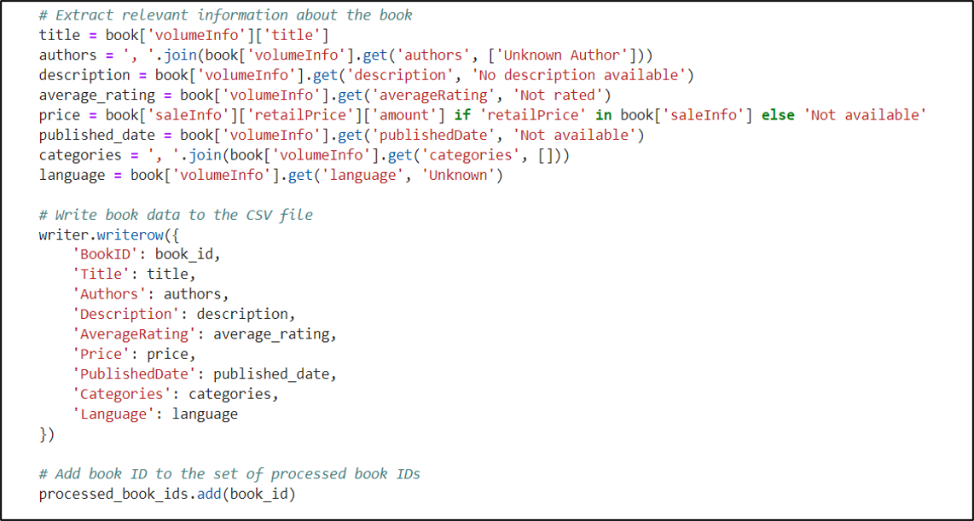
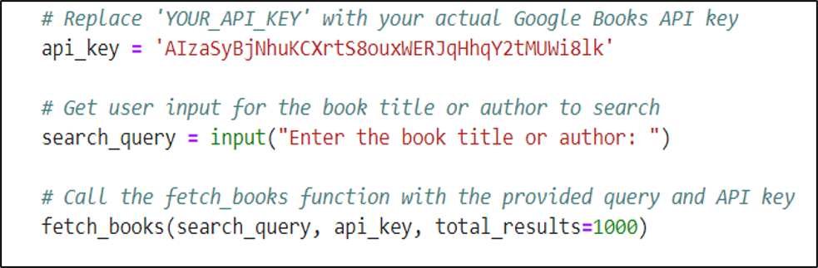
DATA EXTRACTION
Book Information Extraction:
Extracts relevant information about each book from the Google Books API response.
CSV Writing:
Writes the extracted book data to the CSV file.
Processed Book IDs:
Adds the book ID to the set of processed book IDs to avoid duplicates.
Error Handling:
Catches and prints HTTP errors if they occur during API requests.
The code extracts and organizes book information from the Google Books API response, writes it to a CSV file, and handles potential HTTP errors

Slide 9
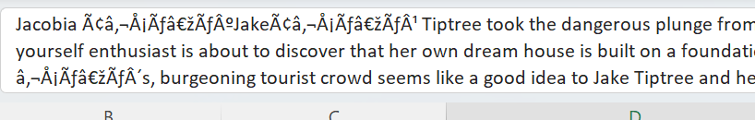
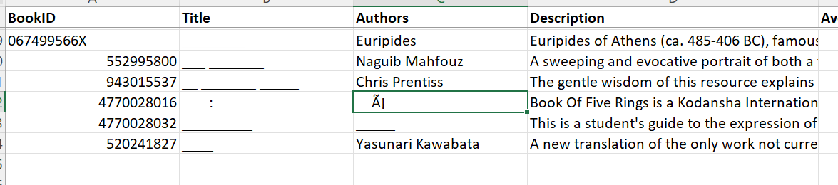
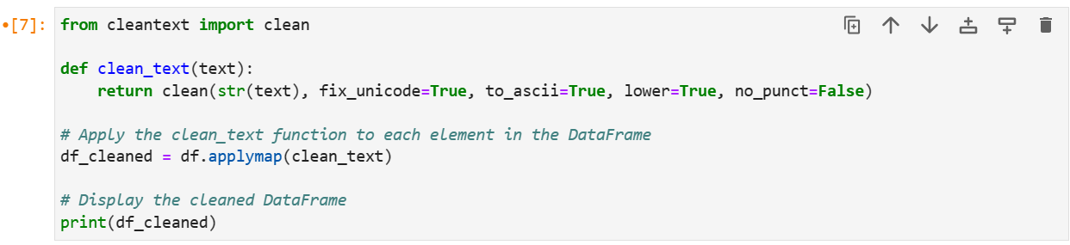
DATA CLEANING
Data Extraction Milestone:
Successfully extracted over 100,000 records using the Google Books API.
Utilizing Excel for Cleaning:
Employed Excel for efficient data cleaning and processing.
Removing Duplicates:
Initial step involved identifying and eliminating duplicate entries within the dataset.
Handling Missing Values:
Checked for missing values across columns, replacing them with 'NA' for consistency.
Special Character Removal:
Identified and removed special characters and Chinese characters in the dataset.
Standardization:
Standardized entries where information was unavailable or not rated, marking them as 'NA.'
Using clean_text function to take a text input, converts it to a string (str(text)), and then apply various cleaning operations.
Apply the clean_text function to each element in the DataFrame df using the applymap method.

Slide 10
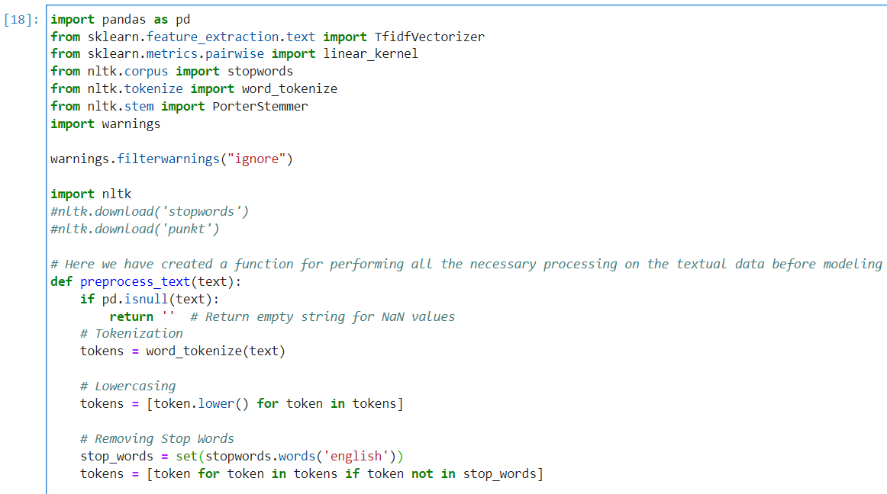
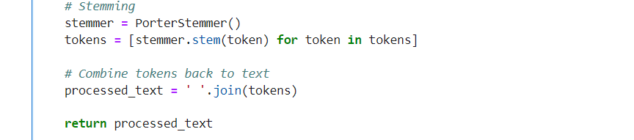
DATA ANALYSIS- MODEL CREATION ( PRE-PROCESSING )
Purpose: The purpose is to preprocess and clean textual data in a Pandas DataFrame.
Key Steps:
Define Text Preprocessing Function:
The preprocess_text function performs Tokenization, Lowercasing, Stopword Removal, Stemming and Combining Tokens
Apply Preprocessing to DataFrame Columns:
The preprocess_text function is applied to specific columns in the DataFrame ('Authors' and 'Categories')
Combine Processed Features:
The preprocessed text from 'Description', 'Processed_Authors', and 'Processed_Categories' columns is combined into a new column called 'Combined_Features'.
Suppression of Warnings:
The code uses warnings.filterwarnings("ignore") to suppress unnecessary warnings, which can be helpful for cleaner output during execution.

Slide 11
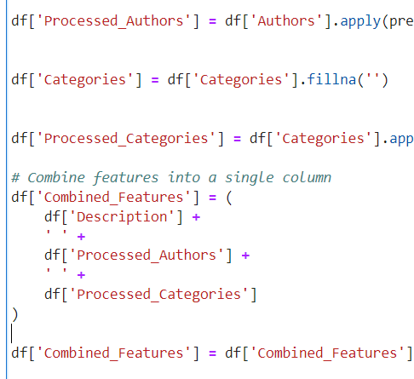
The code combines the preprocessed text from
'Description'
'Processed_Authors', and 'Processed_Categories' columns into a new column 'Combined_Features'.
Any Na values are filled with an empty string.

Slide 12
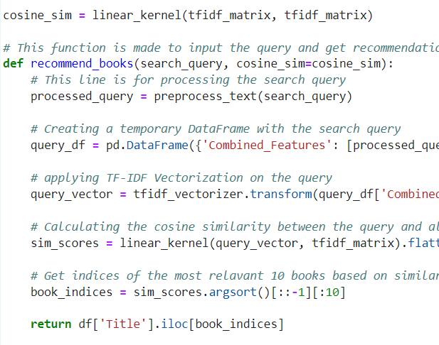
DATA ANALYSIS- MODEL EVALUATION
recommend_books is a function designed for user queries to get book recommendations.
processed_query is the preprocessed form of the input search query.
A temporary DataFrame (query_df) is created with the preprocessed query.
The preprocessed query is then vectorized using the same TF-IDF vectorizer (tfidf_vectorizer) used for the original data.
Cosine similarity between the query vector and all book vectors is calculated.
The function returns the titles of the 10 most relevant books based on the computed similarity scores.

Slide 13
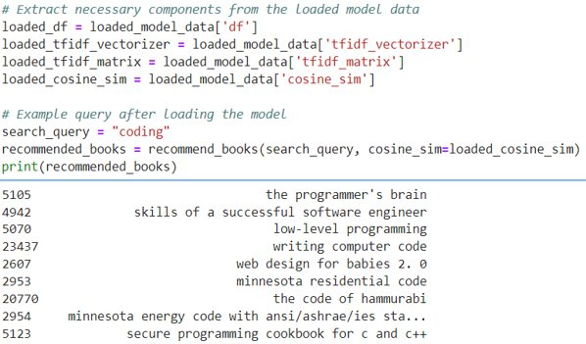
This demonstrates the practical use of the loaded recommendation model.
It extracts the necessary components from the loaded model data and then applies the model to make book recommendations for a specific search query ("coding").
The result is a list of recommended books printed to the console.

Slide 14
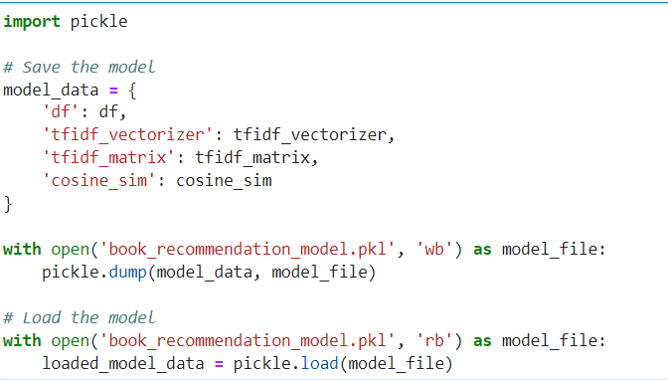
this saves the essential components of the book recommendation model to a pickle file and later loads them back for reuse.
Pickle is used to store the model data in a serialized format, preserving the structure and relationships between objects.

Slide 15
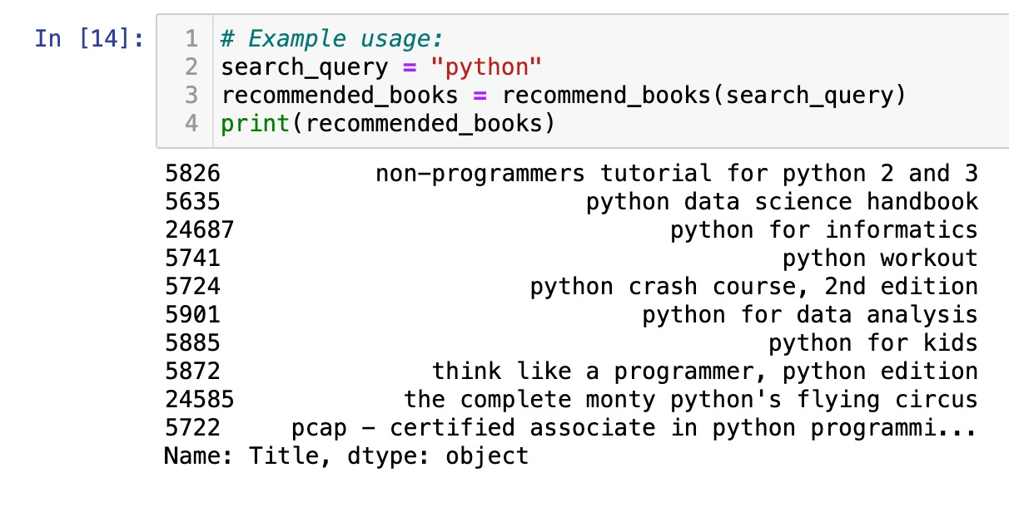
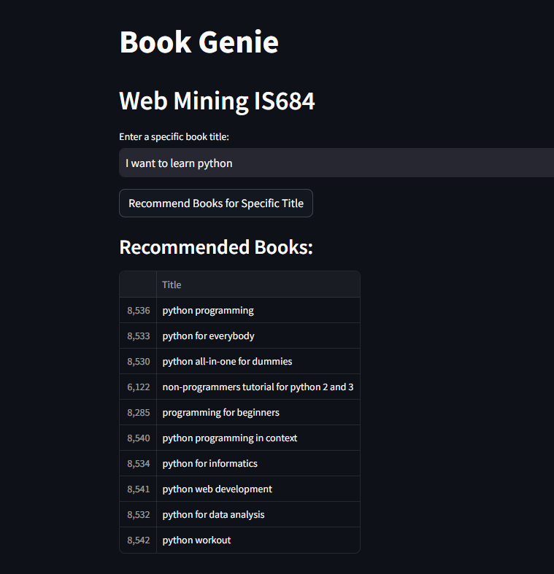
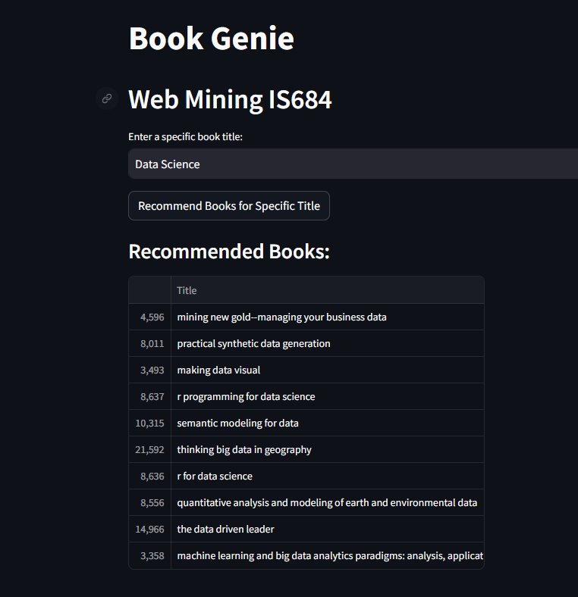
RESULT

Slide 16

THANK YOU ANY QUESTIONS ??

