Slide 1

Fluxograma de Suporte
Luminous
Felipe Pereira – 01202123
João Arnout – 01202055
Luis Gustavo – 01202112
Luis Berto – 01202087
Yuri Geremias - 01202033

Slide 2
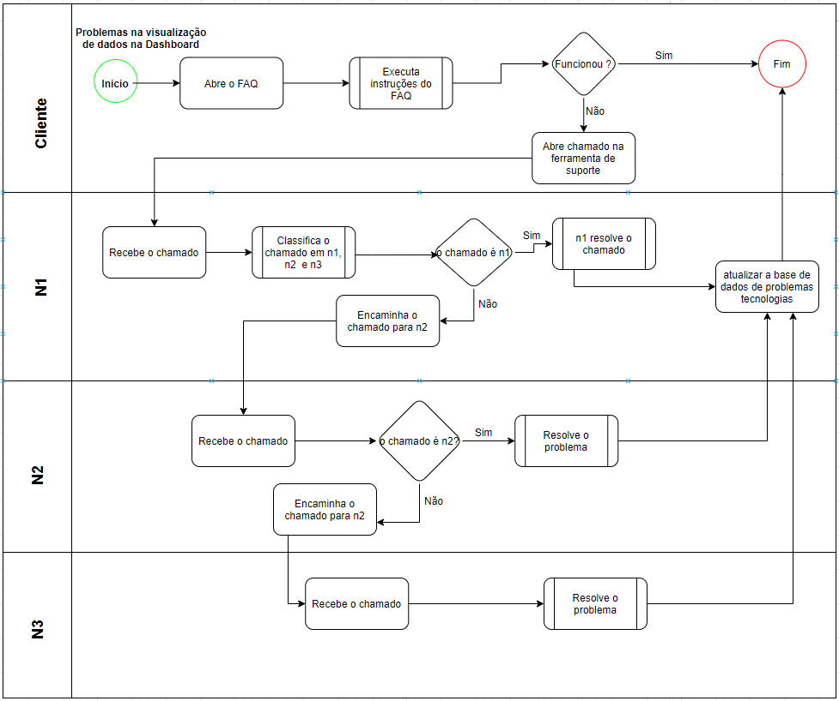
Luminous

Slide 3
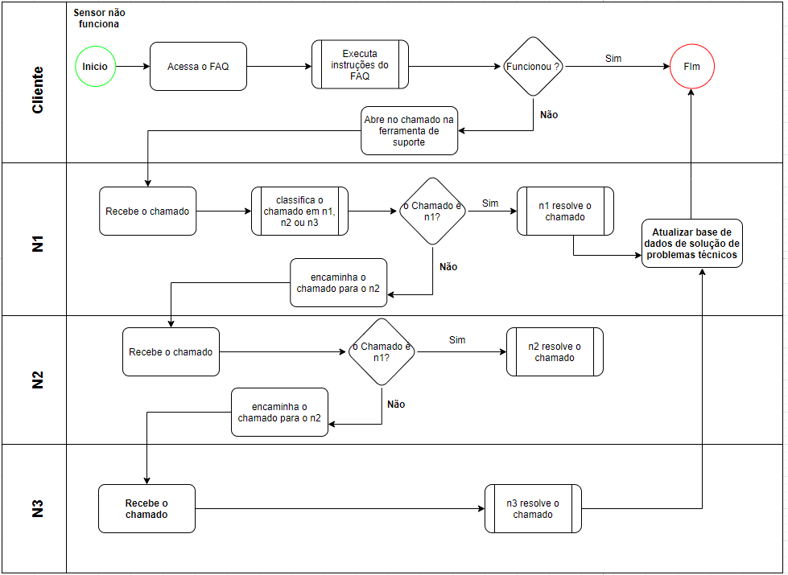
Luminous

