Slide 1




BESS Techno-Economic Framework for Kenya's C&I Sector
Optimizing Industrial Loads via Peak Shaving and Intelligent Energy Management
Peter Mwiti & Yuri Njathi

Slide 2
Kenya C&I Energy Landscape: Grid Vulnerabilities & Tariff Drivers
TRANSMISSION & GRID BOTTLENECKS
Structural Unreliability
Transmission and distribution vulnerabilities create severe power quality risks for industrial operators .
Cascade tripping at key grid hubs causes widespread blackouts e.g. Suswa node.
Localized fires and overloaded transformers at substations affects manufacturing hubs.
Voltage dips affect industries where stable power is a necessity for equipment longevity.
KPLC DEMAND CHARGES (BY TIER)
KES 1,100 / kVA
Punitive monthly peak charges scale inversely with connection voltage :
CI1 (Low Voltage 415V): KES 1,100 / kVA
CI2 (Medium 11kV): KES 700 / kVA
CI3 (Medium 33kV): KES 370 / kVA
CI4/CI5 (High 66/132kV): KES 300 / kVA
CI6 (Extra High 220kV): KES 200 / kVA
VARIABLE SURCHARGES & TAXES
+60% Effective Markup
Pass-through costs inflate base tariffs (e.g. KES 13.74/kWh for CI1) substantially
Fuel Cost Charge: ~KES 3.14 / kWh
Forex Adjustment: ~KES 0.72 / kWh
Taxes & Levies: 16% VAT + Water Resource Management levies .
Power Factor Penalty: 2% surcharge per 1% drop below 0.9 PF .

Slide 3
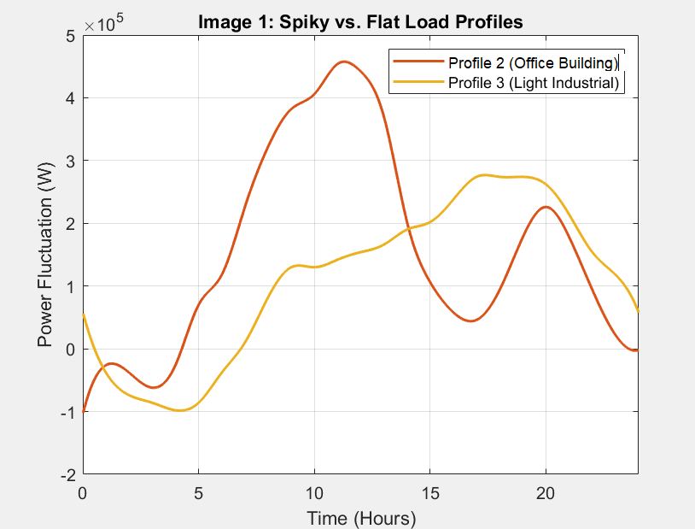
Industrial Load Typologies: Spiky vs. Flat-Lined Consumption
Spiky Loads
Sudden, massive power surges lasting 15 to 45 minutes before returning to a lower baseline.
Manufacturing Impact: Common in plastics extrusion during intense equipment heating phases and heavy metal fabrication.
Financial Penalty
These short-duration surges trigger exorbitant utility maximum demand charges based on a single peak.
Flat-Lined Loads
Predictable, stable baseline consumption allowing for optimal utility rate structures and minimal demand charge penalties.
Typical Applications: Common in water utilities, agri-logistics, and continuous process facilities.

Slide 4
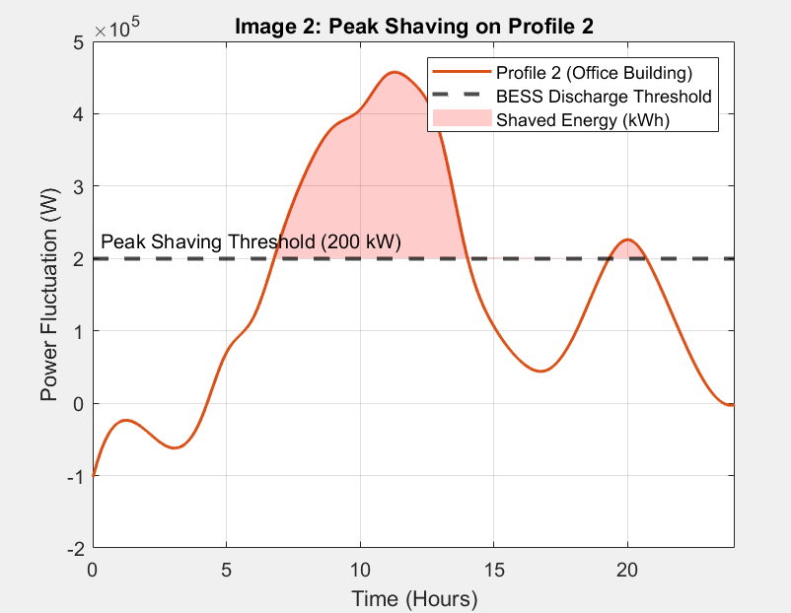
EPRA Tariff Architectures & Incremental TOU (ITOU) Logic
INCREMENTAL TOU (ITOU) FRAMEWORK
ITOU DISCOUNT
50% Off-Peak Energy Rate
50% discount on the base energy rate during off-peak hours .
BASELINE RESTRICTION
Historical Consumption Threshold
The off-peak discount strictly applies only to energy consumed above a facility-specific historical baseline .

Slide 5
Techno-Economic Evaluation Architecture
& Algorithmic Pipeline
01
PYTHON ENGINE
02
FINANCIAL BASELINE
03
BESS APPLICATIONS
04
SYNTHESIS & SIZING
Parametric Core
Object-oriented bess_feasibility.py algorithm.
10-year discounted cash flow modeling framework.
Simulates battery capacity fade and degradation curves.
Key Assumptions
8% Discount Rate: Regional commercial debt baseline.
$300/kWh CAPEX: Turnkey BESS installation cost.
$0.1881/kWh LCOS: Benchmark storage cost levelized.
4 Value Streams
Peak Shaving: Clips 15-45m kVA demand spikes.
TOU Arbitrage: Shifts load across temporal bands.
Diesel Offset: Hybrid Solar+BESS fuel replacement.
Industrial UPS: Sub-cycle outage protection.
Multi-Factor Model
Synthesizes EPRA tariffs & grid SAIDI/SAIFI indices.
Envelope sizing max(kWh) prevents double counting.
Evaluates transformer thermal relief & 10-yr NPV.

Slide 6
Case Study
Setup
LOAD PROFILE
GRID VULNERABILITY
500 kW (350 kVA Shaved)
8 Outages/Yr
Inductive motor batch surges hit peak loads in 15-minute intervals, requiring 350 kVA shaved.
8 annual grid outage events driven by Suswa substation trips, costing $85k/event ($680k/yr total).
Nairobi Plastics Extrusion Plant
Tier: CI1
CRITICAL OPERATIONAL RISK
Molten Plastic Solidification
Momentary voltage drops or outages freeze molten plastic in extruders, causing $85,000 in ruined materials per event and days of manual cleaning downtime.
FACILITY TYPE
TARIFF & RISK SUMMARY
• Demand Charge: KES 1,100/kVA
• Outage Cost: $85,000 / Event
• Surge Time: 15-Min Peaks
Plastics Extrusion
Continuous Thermal Process

Slide 7
Kenya Results
BESS Sizing Architecture (1,000 kWh Envelope)
Sized via envelope function max(kWh) to avoid capital double-counting. Standalone peak shaving requires 335.6 kWh, while full multi-application integration deploys 1,000 kWh.
INDUSTRIAL UPS (LOSS PREVENTION)
$680,000/yr
Dominant financial benefit. Prevents molten plastic solidification and extruder downtime across 8 annual grid outages.
PEAK SHAVING (DEMAND CHARGES)
$35,538/yr
High-return core application. Neutralizes punitive KES 1,100/kVA CI1 capacity charges by clipping 350 kVA motor start surges.
BESS Sizing & Value Stream Comparison
TOU ARBITRAGE (LOAD SHIFTING)
Sub-Economic ($0)
TOU spread ($0.1205/kWh) fails to cover BESS LCOS ($0.1881/kWh) without pairing with on-site Solar PV.
DIESEL DISPLACEMENT
Marginal ($682/yr)
Minimal direct runtime savings in Kenya due to brief outages; primary fuel value is subsumed by Industrial UPS resilience.

Slide 8
Role of AI-Driven EMS in Dispatch Optimization
EMS DISPATCH CONTROL SCHEMATIC
MARKET REALITY: TOU ARBITRAGE
Pure grid-to-battery TOU arbitrage is sub-economic in Kenya.
INPUT DATA
• EPRA Tariff Structures
• Historical & Forecasted Load Profile
• Presence & Forecasted On-Site Solar
• BESS State of Charge (SoC)
CORE ENGINE
DISPATCH ACTION
AI-DRIVEN EMS
Dynamic Dispatch Aggregation
AI-driven EMS aggregates real-time load profiles and tariff structures into a unified operational model, continuously adjusting charge/discharge schedules to maximize financial yield.
TARGET METRIC
Navigating ITOU Baselines
kVA Peak shaving, Diesel Displacement, and an Industrial UPS
Intelligent software is mandatory to navigate EPRA's strict historical baseline logic and execute precise kVA peak clipping to eliminate severe demand charges.

Slide 9

Questions?
Thank you for your attention.
Peter Mwiti
BSc Electrical Engineering, DeKUT
Email: mwitipeter750@gmail.com
Phone: 0791632980

