Slide 1
Нейронные сети
Transformer

Slide 2
Занятие 6
Архитектура
Self-Attention
Positional Encoding
FNNet
BERT

Slide 3
Архитектура
1

Slide 4
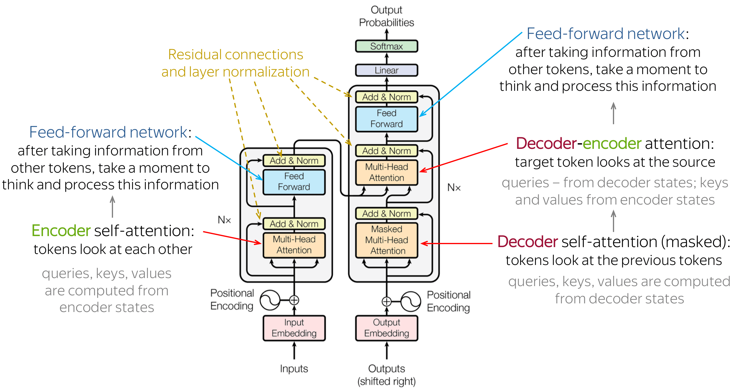
Архитектура

Slide 5
Self-Attention
1

Slide 6
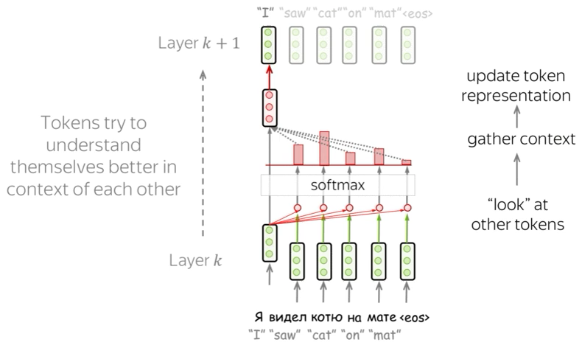
Self-Attention

Slide 7
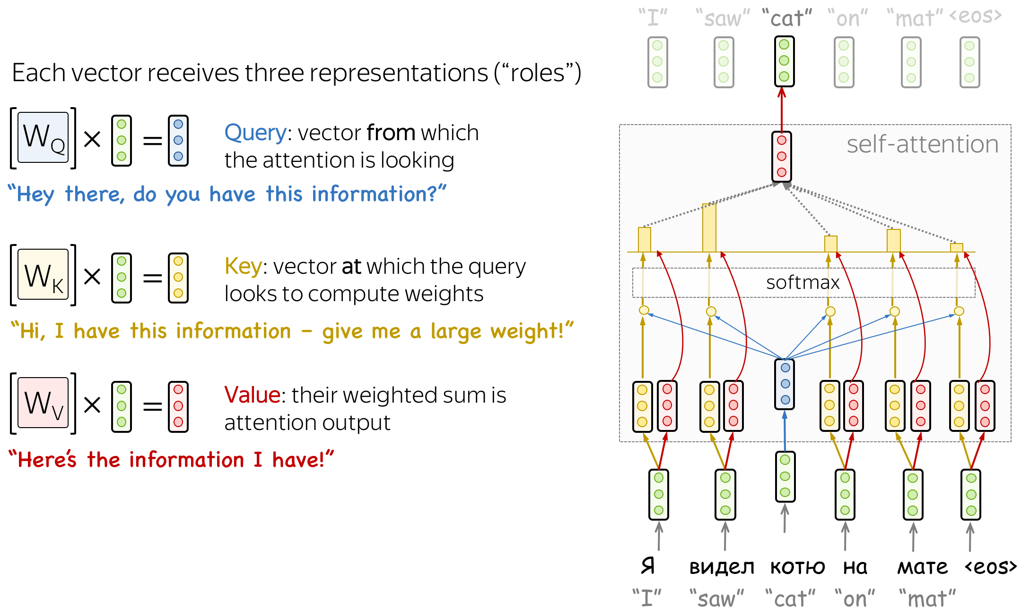
Self-Attention

Slide 8
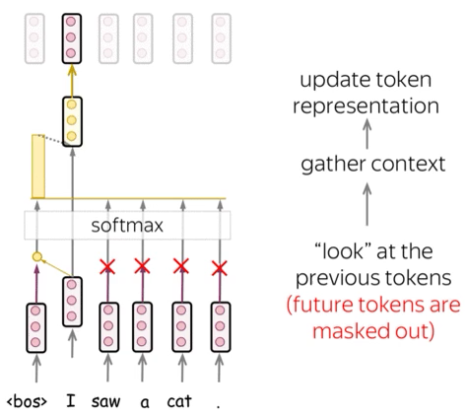
Masked Self-Attention

Slide 9
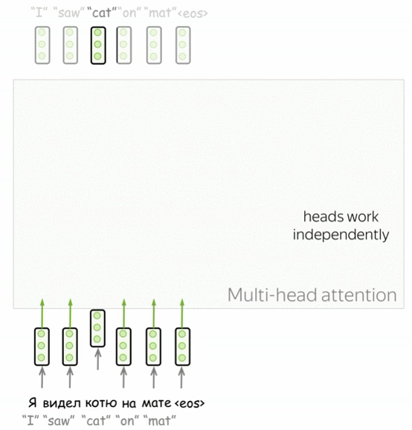
Multihead Self-Attention

Slide 10
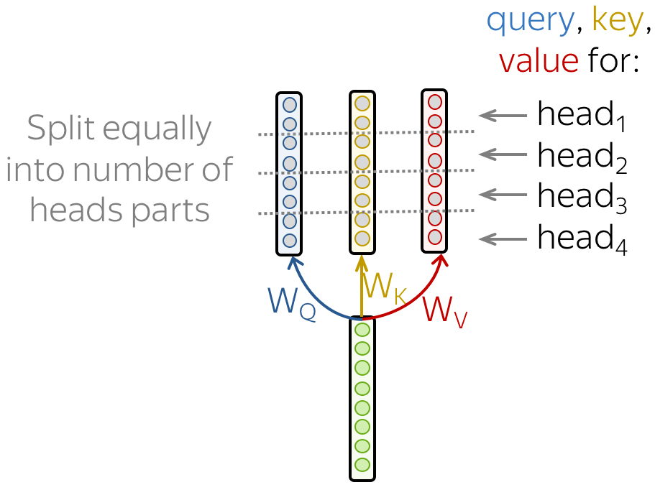

Multihead Self-Attention

Slide 11
Positional Encoding
1

Slide 12
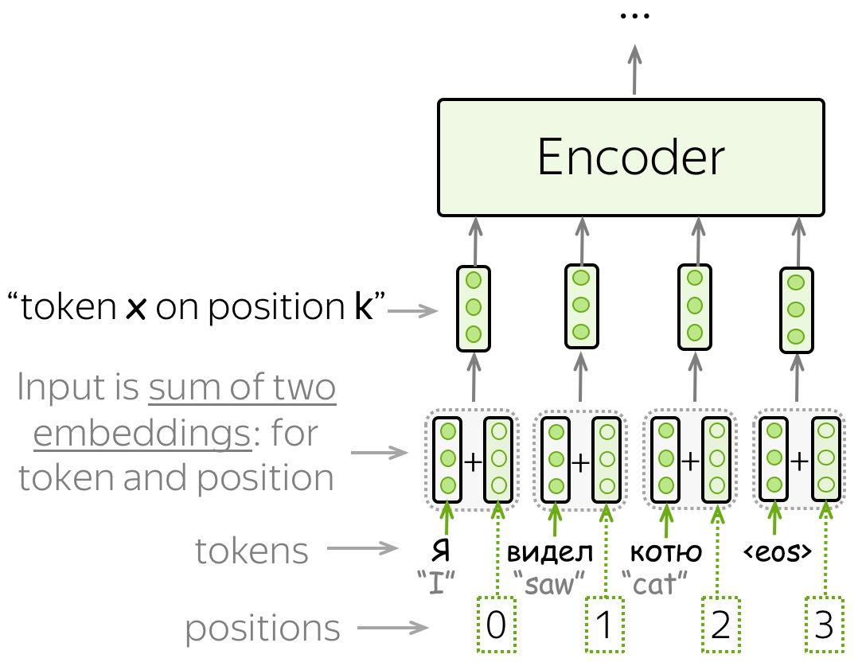
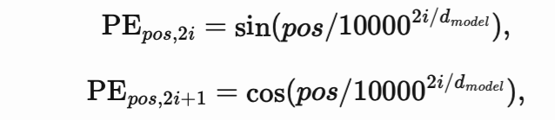
Positional Encoding

Slide 13
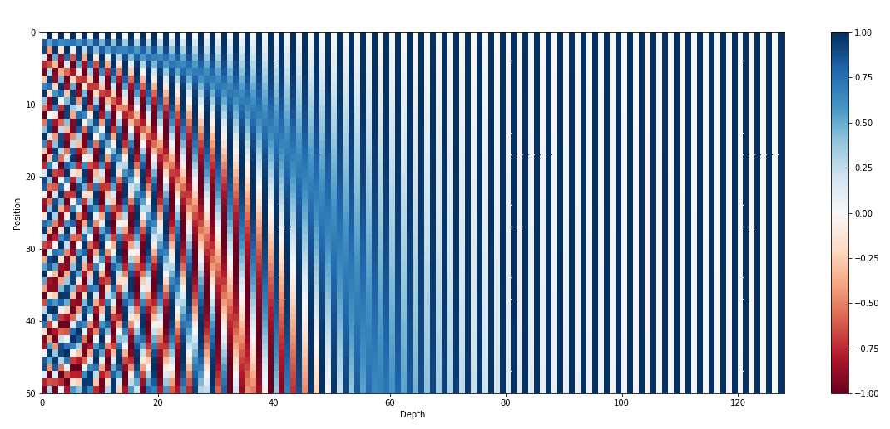
Positional Encoding

Slide 14
FFNet
1

Slide 15
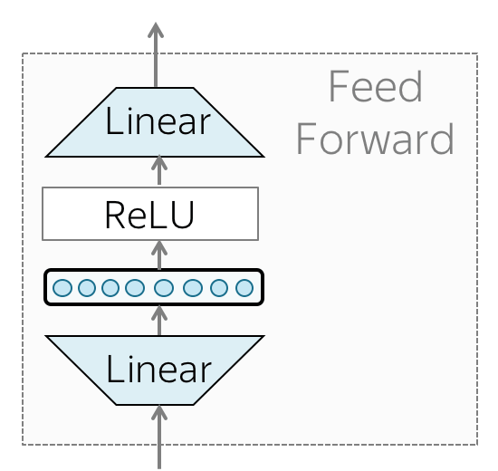

FFNet

Slide 16
BERT
1

Slide 17
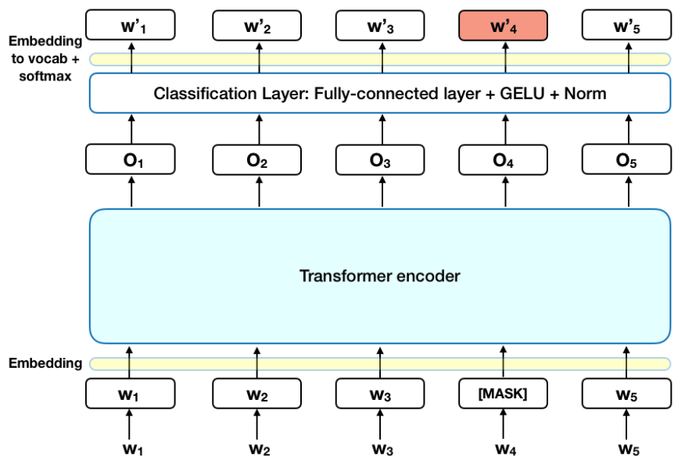
BERT

Slide 18
Спасибо за внимание!

