Slide 1
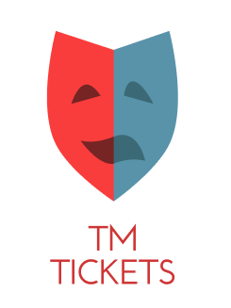
TM TICKETS Theatre
Team 5:
Alessandra 21565
Taiane 21913
Yuri 21789

Slide 2
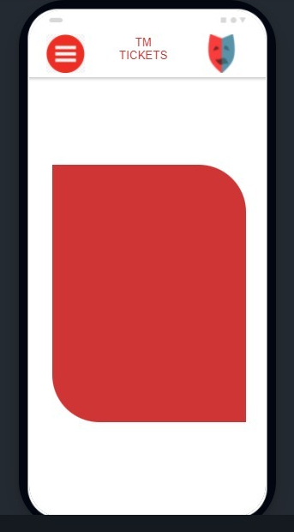
Splash screen

Slide 3
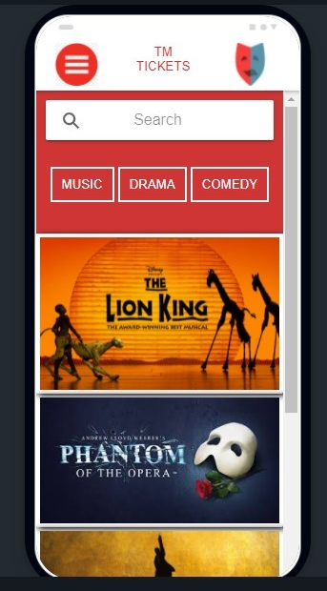
Main Screen
Search Bar
Concerts

Slide 4
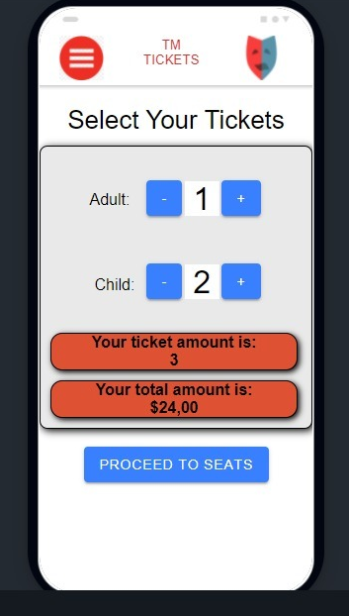
Ticket Screen
Select the ticket

Slide 5
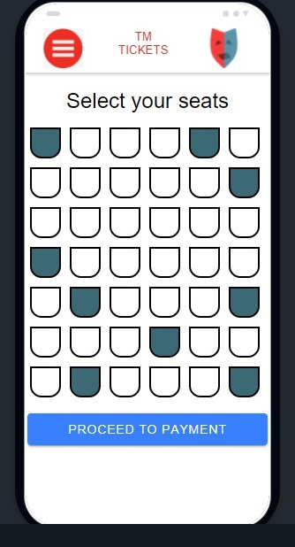
Select seats screen

Slide 6
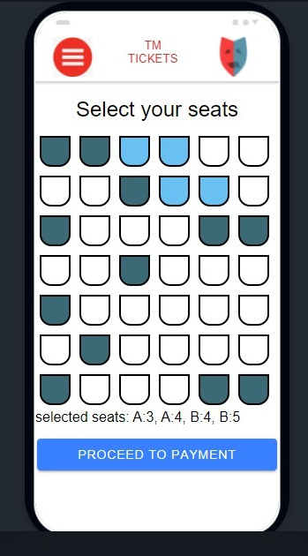
X
X
Selected seats
X
X

Slide 7
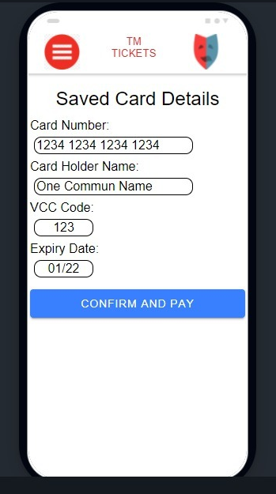
Payment Screen

Slide 8
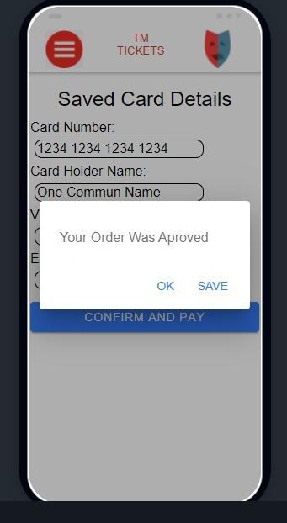
Approved Payment

Slide 9
