Slide 1

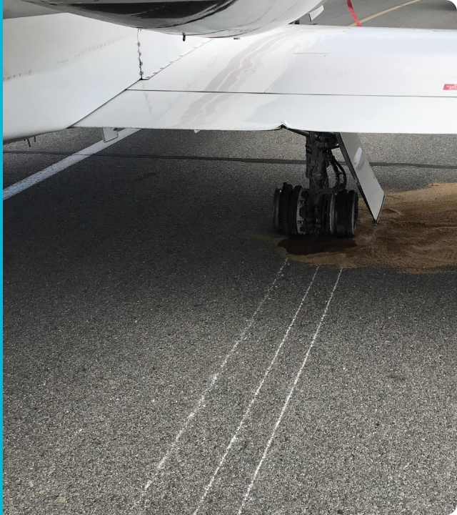
Motivating Use Case
The $13B Problem
Foreign Object Debris (FOD) on runways poses a critical safety risk to aviation, costing the industry over $13 billion annually in direct and indirect damages.
The Challenge: Detecting small, low-contrast debris (nuts, bolts, wildlife) across vast runway surfaces under varying weather conditions.
Current Solutions: Manual drive-by inspections are slow and error-prone. Radar systems are expensive and suffer from high false alarm rates.

Slide 2

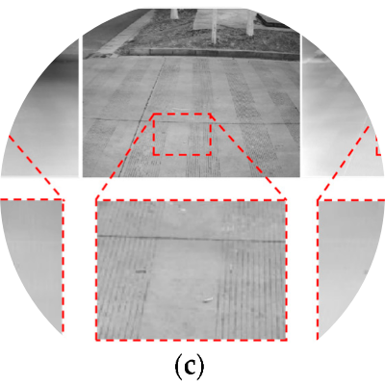
Project Task Description
Formal Problem Statement
Develop an automated, end-to-end computer vision system to detect, localize, and classify runway hazards in real-time with high precision.
Input & Output
•
Input: High-resolution RGB runway imagery (simulated drone/CCTV feed).
•
Output: Bounding Box coordinates (x, y, w, h) and Class Label (e.g., "Metal", "Rubber", “Ice”, “Oil Spills”).
Project Novelty
Addressing the "data scarcity" bottleneck by utilizing a Generative AI pipeline to create a massive, diverse synthetic training dataset of rare hazard scenarios.

Slide 3

Models & Processing Pipeline
1. Generation
2. Labeling
3. Training
4. Evaluation
Stable Diffusion + ControlNet used to inpaint diverse debris onto clean runway backgrounds.
Auto-Labeling pipeline leverages the generation masks to create pixel-perfect Ground Truth bounding boxes.
Fine-tuning state-of-the-art detectors like YOLOv8 or Faster R-CNN on the hybrid dataset.
Rigorous testing using k-fold cross-validation on a separate set of real-world benchmarks.

Slide 4

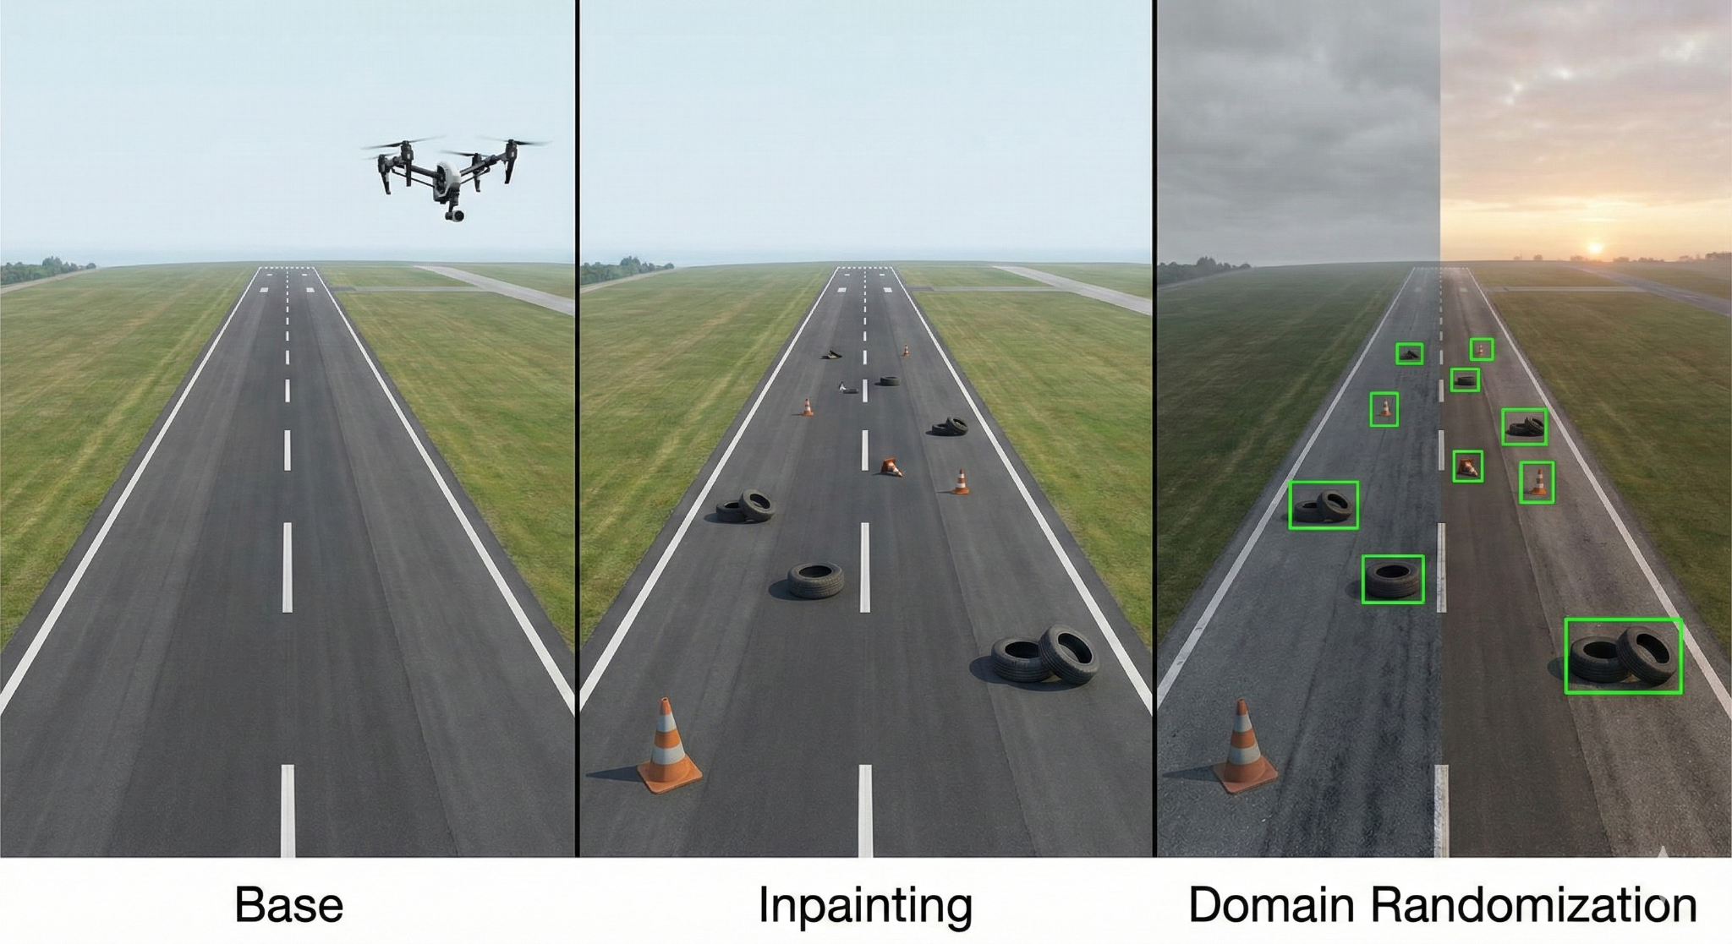
Data Specification & Generation
Training Requirements
The model requires high diversity in lighting (dawn, dusk, noon), weather (clear, overcast), and debris types to generalize well.
Synthetic Data Strategy
We generate 10,000+ synthetic samples using GenAI:
•
Base: Clean runway textures from CCTV/drone data.
•
Inpainting: Inserting hazards naturally with shadow consistency.
•
Domain Randomization: varying textures and debris scale.
Labeling Protocol
Zero-manual effort. Bounding boxes are derived mathematically from the inpainting mask coordinates.

Slide 5
Metrics & Evaluation KPIs
Metric Category | Specific Protocol | Target KPI
Detection Accuracy | F1-Score, Confusion Matrix | > 85.0%
Localization | Center offset error | < 20 pixels
Synthetic Quality | FID (Fréchet Inception Distance) | < 30.0 (Photorealistic)
Processing Speed | FPS | 30+ FPS (Real-time)
Safety Critical | Recall, High precision | > 90%

