Slide 1
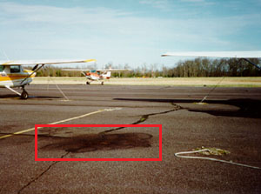
1. Project Summary
Motivation & Specs
Oil spills on runways are invisible hazards causing loss of friction. Our goal is to build a Real-time Computer Vision System (30 FPS) to detect and localize these spills using semantic segmentation on edge hardware.
Changes from Proposal
We pivoted from generic FOD (screws, trash) to exclusively Oil Spills. This shifts the challenge to identifying amorphous, transparent liquid textures.
Novelty & Contributions
Due to extreme data scarcity, we developed a Generative AI Pipeline (Stable Diffusion + ControlNet) to synthesize realistic oil spill datasets.

Slide 2
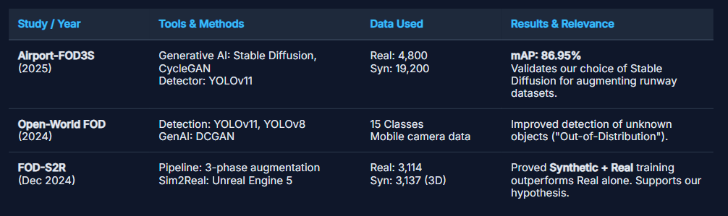
2. Related Work

Slide 3

3. Dataset Generation & EDA
Generation Pipeline Flow
Dataset Composition
Input Image Source runway background
Clean Runway Images 1,000
Segmentation Model (SegFormer) Propose spill area
Generated Images (Synthetic) 800
Masking Create binary mask for inpainting
Real Oil Spill Images 200
Inpaint (Stable Diffusion) Synthesize oil texture in masked area
TOTAL IMAGES
Final synthetic dataset The dataset we use to train the model
2,000
Final Dataset

Slide 4
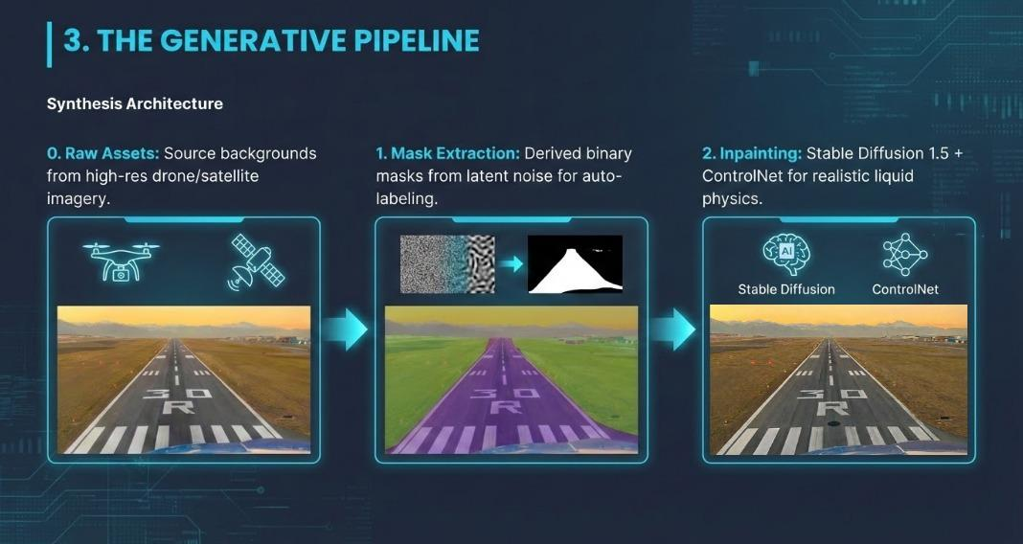

Slide 5

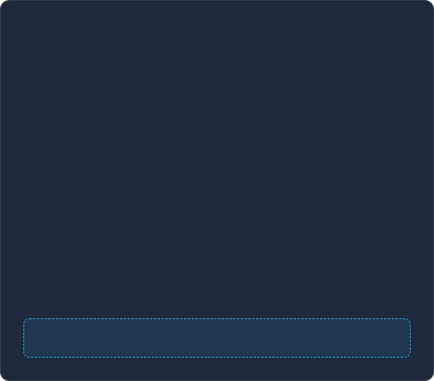
4. Preliminary Results (Epoch 14)
Metric Snapshot
Error Analysis
Comparison against COCO Baseline
Low Precision (High False Positives): Model currently predicts "oil" on most dark shadows and wet patches. Threshold refinement needed.
mAP @ 0.50 40%
Low Recall (Underfitting): Model misses >85% of spills. Likely due to early training stage (Epoch 14) and difficult synthetic-to-real domain transfer.
Recall 14.8%
The model failed to train properly

Slide 6



5. Project Timeline & Scope
We are currently iterating on the dataset generation process to improve model generalization before the final defense.
Current Focus
Next Step
Final Step
Improve Synthetic Data
Retrain & Validate
Final Presentation
Optimizing the generation pipeline for better realism. Focusing on lighting consistency and texture blending to reduce false positives.
Fine-tune the YOLO model on the improved hybrid dataset. Validate performance metrics on real-world holdout set.
Compile results, error analysis, and demo video into the final defense deck. Showcase the finalized edge-ready model.

