Slide 1

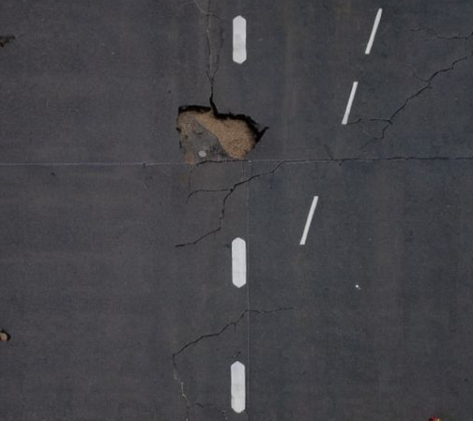
Project Definition & Scope
Motivation
Runway safety is critical. Manual inspection is slow and prone to human error. Our goal is to automate the detection of foreign object debris, mainly Ice, potholes and oil spills
Core Methodology
We leverage generative AI to create synthetic training data and fine-tune advanced object detection models.
Input: Drone-captured imagery.
Targets: Ice, Oil Spills, Potholes.
Model: Fine-tuned YOLO Architecture.
Metrics
We use different metrics to evaluate our model
mAP (Mean Average Precision)
Box Loss (Localization Error) Confusion Matrix
F1 Confidence Curve
Visual Validation

Slide 2


Novelty & Achievements
The Novelty
Key Achievements
Traditionally, runway inspection relies on manual visual checks from watchtowers or ground vehicles, which are labor-intensive and sporadic.
We have successfully developed a proof-of-concept model capable of distinguishing between three distinct classes of runway hazards.
Our Solution: A fully automated, drone-based vision system that provides continuous, high-resolution monitoring without disrupting operations.
•
Detection: Accurate localization of Oil, Ice, and Holes.
•
Performance: Achieved a robust running model suitable for deployment.
•
Pipeline: Established a complete end-to-end data and inference pipeline.

Slide 3





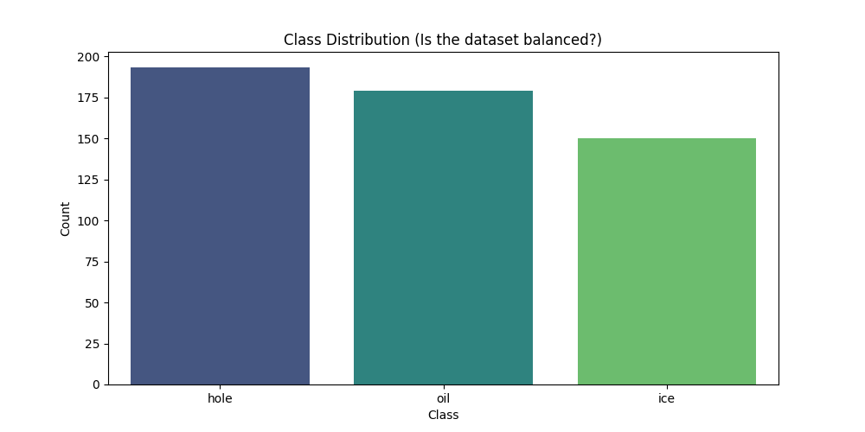
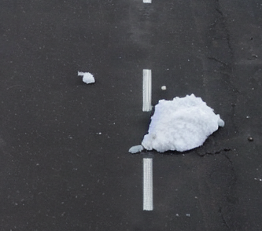
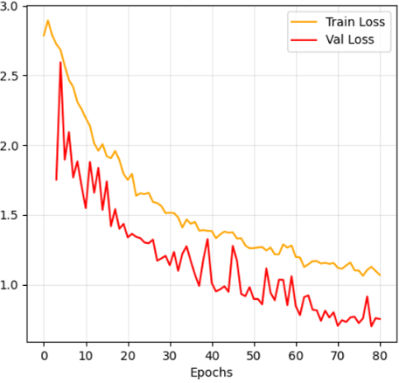
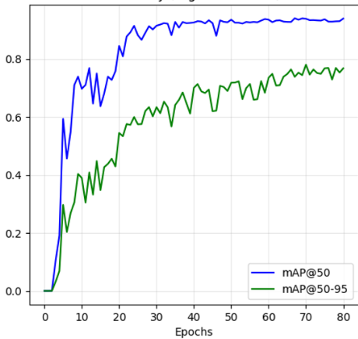
METHODOLOGY & EXECUTION
End-to-End Pipeline
Step 01
Step 02
Step 03
Step 04
Synthetic Generation
Labeling
Model Training
Evaluation
Implementation of Stable Diffusion with extensive prompt engineering and dynamic masking to create realistic images of runways featuring oil spills or ice chunks.
Utilization of dynamic generation masks as ground-truth bounding boxes, creating a perfectly labeled dataset ready for model fine-tuning.
Training phase involving the fine-tuning of a YOLOv26 architecture on the custom synthetic dataset to specialize in FOD detection.
Final validation phase confirming the model trained perfectly, with high precision metrics across all generated hazard classes.

Slide 4
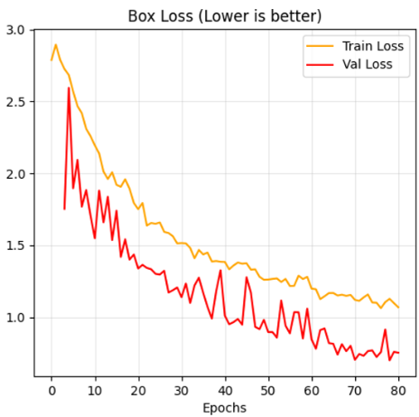
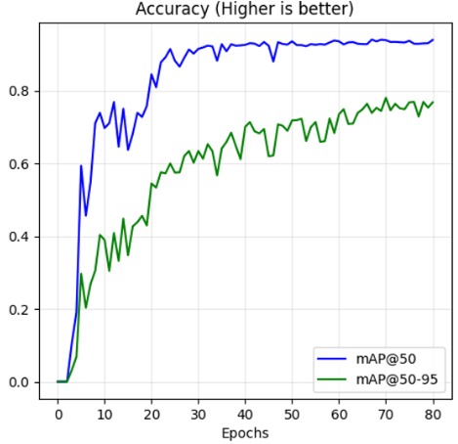
Results - part 1
Key Observations
Rapid Convergence: The mAP@50 climbs steeply in the first 20 epochs, stabilizing at approximately 0.85-0.90, indicating efficient feature learning.
Stability: Training and Validation loss curves show a consistent downward trend, converging around Epoch 60 with no signs of overfitting.
High Confidence: The mAP@50-95 metric confirms that bounding boxes are tightly aligned with ground truth.

Slide 5
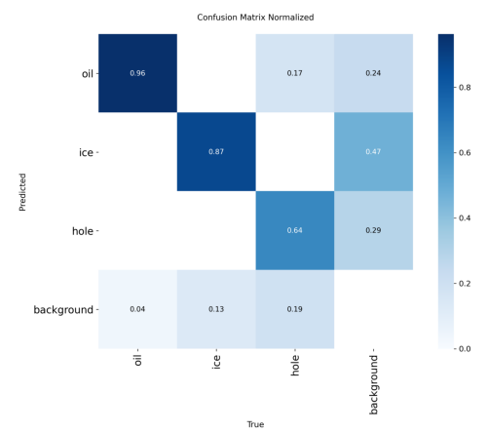
Results - part 2
The confusion matrix provides a visual validation of our model's classification performance:
•
Strong Diagonal: The prominent diagonal line confirms effective class separation across all three categories.
•
Key Challenge: Minor confusion is observed between Potholes and Oil Spills, likely due to similar dark textures on asphalt.
•
Next Steps: Targeted data augmentation for low-contrast pavement features will resolve this overlap.

Slide 6

Results - part 3
Our model demonstrates robust detection capabilities, with Ice Patches achieving the highest precision due to distinct textural features.
Class Target | Precision | Recall | F1 Score | Accuracy | Support (N)
Ice Patches | 0.92 | 0.91 | 0.92 | 98.5% | 121
Oil Spills | 0.85 | 0.85 | 0.85 | 96.2% | 175
Potholes | 0.78 | 0.91 | 0.84 | 92.1% | 200
Macro Average | 0.85 | 0.89 | 0.87 | 95.6% | 496
*Metrics calculated based on the validation set confusion matrix.

Slide 7
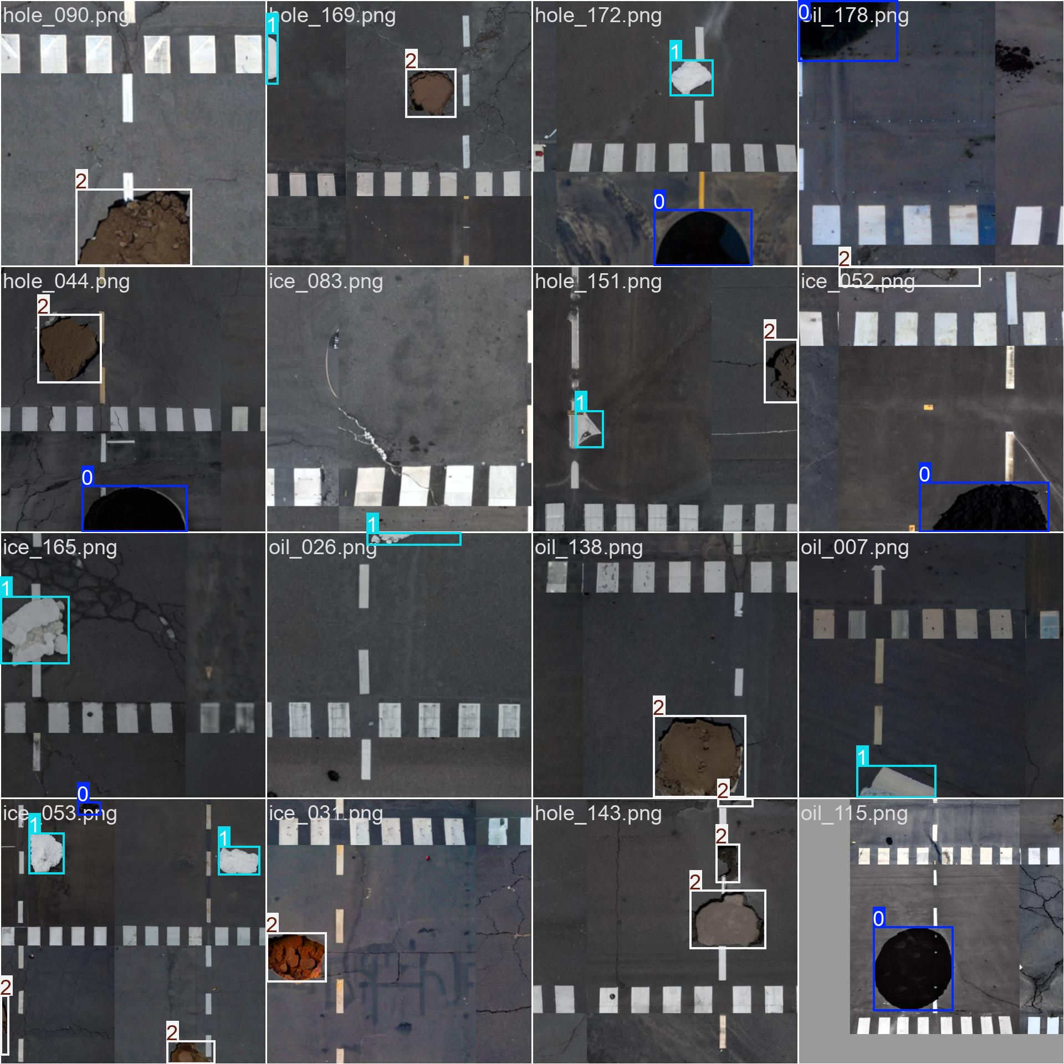
Results
Final Showcase

Slide 8

Conclusion & Future Work
Project Status
We have successfully achieved our desired results, validating the feasibility of drone-based automated runway inspection.
Lessons Learned
While effective, the three-class limitation is not yet fully realistic for commercial deployment. A wider variety of FOD is needed.
Future Roadmap
Expand dataset to include dirt and grass runways found in rural areas, for bush craft planes.
Increase class diversity (e.g., rubber deposits, metal parts).
•
•
•
Real-time edge deployment on drone hardware.

