Slide 1


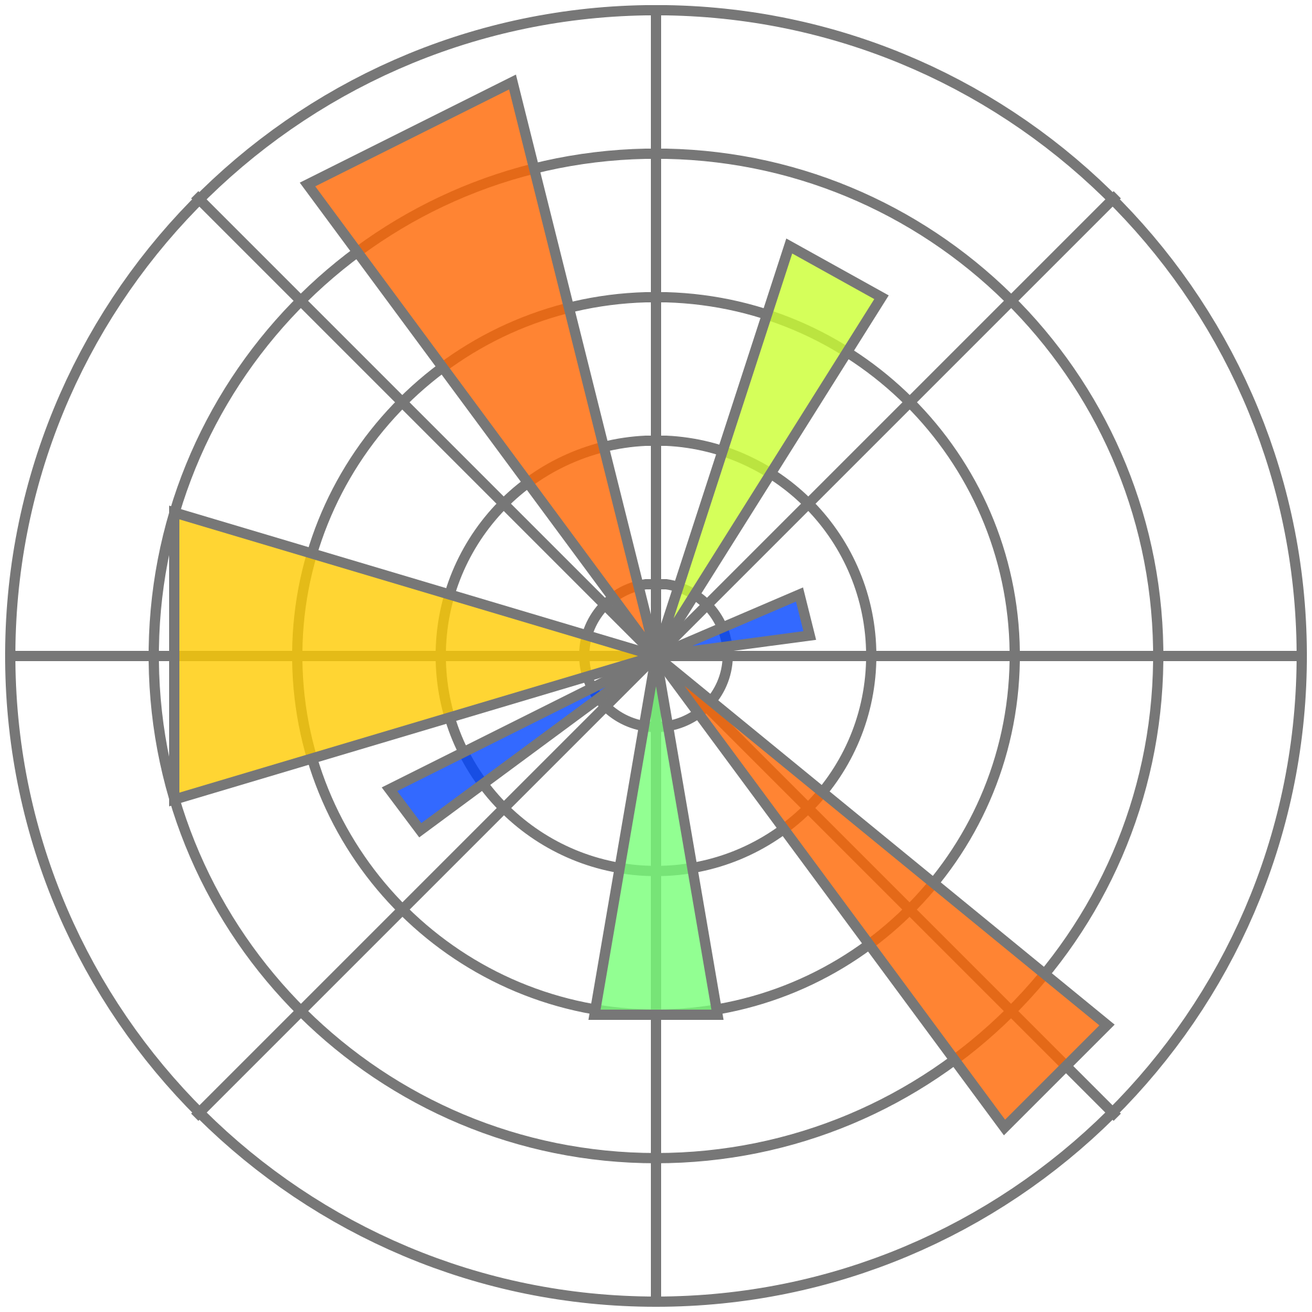

Testing
To test our system, we have used python 2 with requests, matplotlib and mininet modules

Slide 2
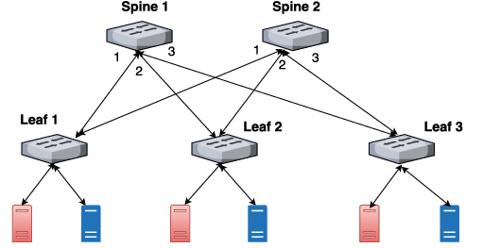

Link Failure Test
In this test we have tryed to manually generate a link failure, to demostrate the capacity of our system to automatically recompiute a functional path
2 Spines – 3 Leafs – 2 hosts per Leaf
Wireshark to monitoring link and control packet

Slide 3
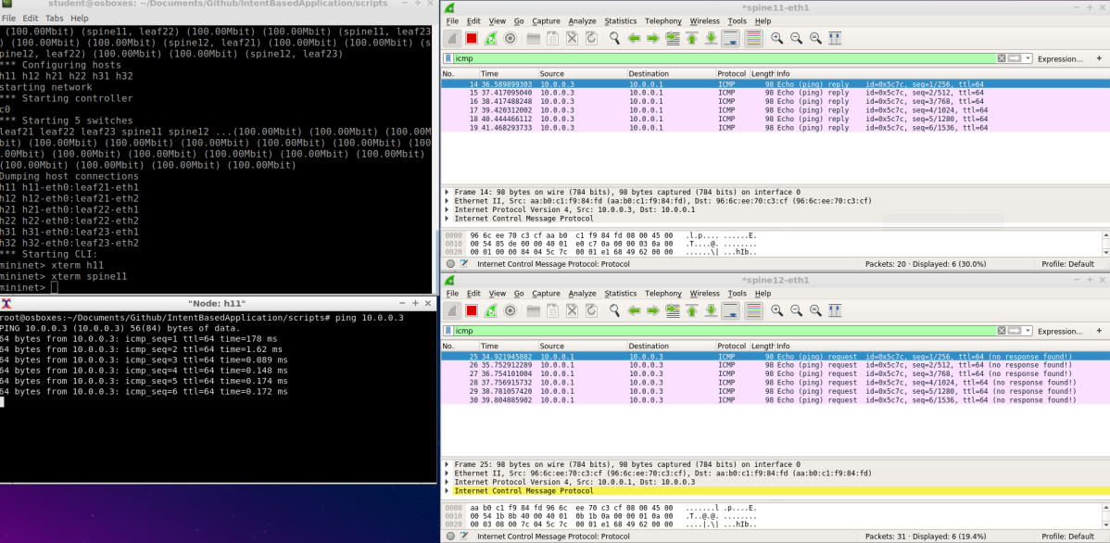
Link Failure Test
As picture shows, wireshark was put into 2 links:
Spine11-eth1, link between leaf 1 and spine 1
Spine12-eth0, link between leaf 1 and spine 2
Then 2 host in diffirent leafs have been ping each other

Slide 4
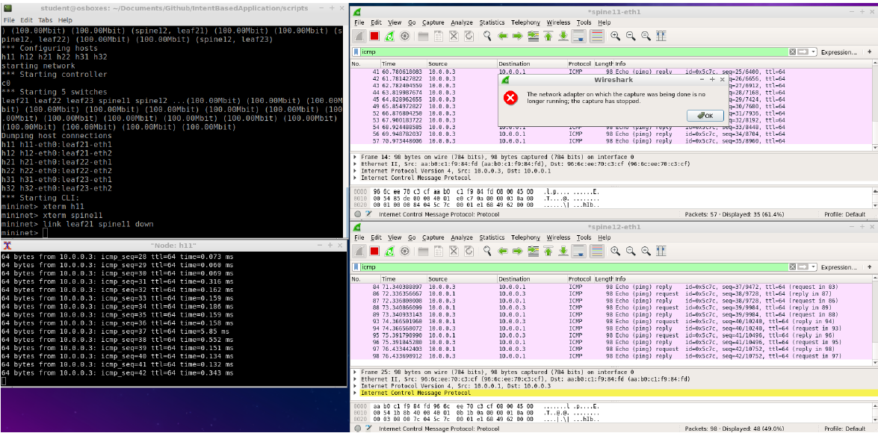
Link Failure Test
If we try to stop link Spine11-eth1 (first wireshark istance) we can see that it generate an error, but icmp packets still exchange between hosts, thanks to the new path recompiuted by system (second wireshark istance)
High ping time at the faiulure moment

Slide 5

Ping Latency Test
This test was done to evaluate network performance. We have consider a scenario like before (2 spines, 3 lifes) but with 4 hosts connected to each leaf
Is established a random intent for each host
Is started a 10 - ping session for each host and round trip time of each packet is measured
Is measured also the number of DESTINATION HOST UNREACHABLE and DUPLICATE messages

Slide 6
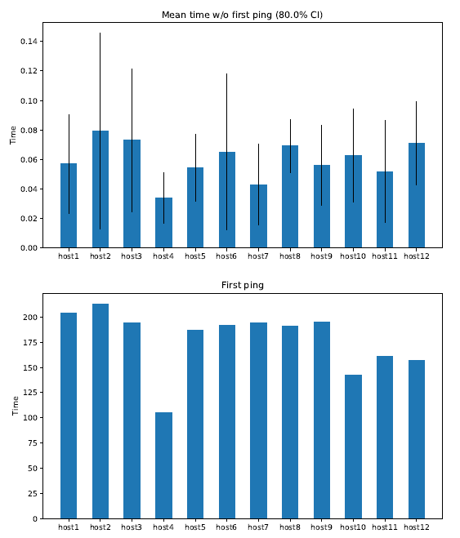
Ping Latency Test
Mean round trip time of each host without first packet
Round trip time of first packet of each host
First sent packet is normally more slower couse is processed by controller, triggering the route establishment

Slide 7
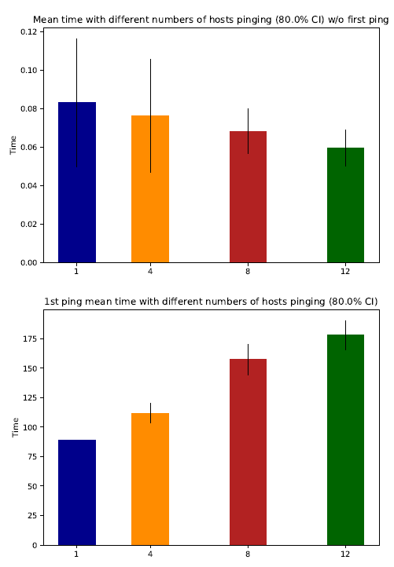
Ping Latency Test
Then these graphs shown the elasticity of our system, measuring mean round trip tipe of all packets with 1,4,8,12 hosts that pinging each other at the same time
Also at this time time for first packet and time about all other packets was splitted in 2 differents graphs

Slide 8
THANK YOU

