Slide 1
SIMULATION ENVIRONMENT
The enviroment in which we have performed the simulations has the following characteristics:
Simulation Time: 200 hours
Step Simulation Time: 5 hours
Firewall Sensitivity: [0, 1, 2]
Intrusion Detection System Sensitivity [0, 1]
Code Obfuscation [0, 1]

Slide 2
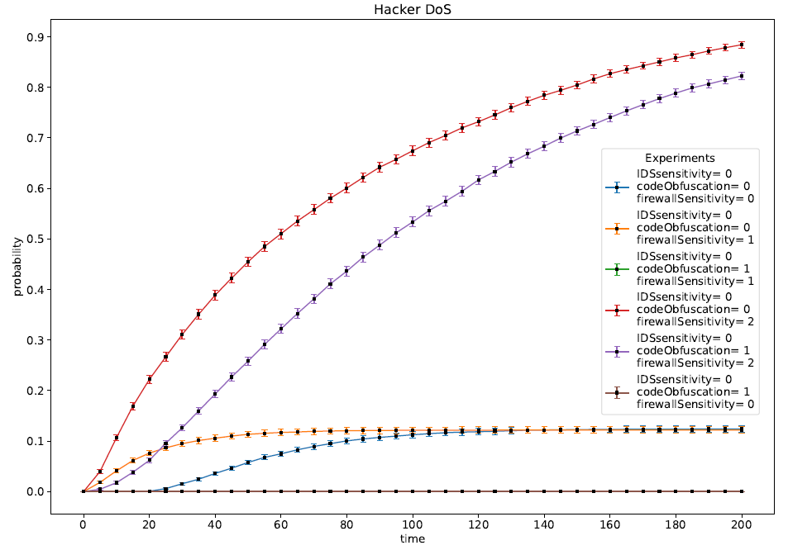
DoS - Hacker

Slide 3
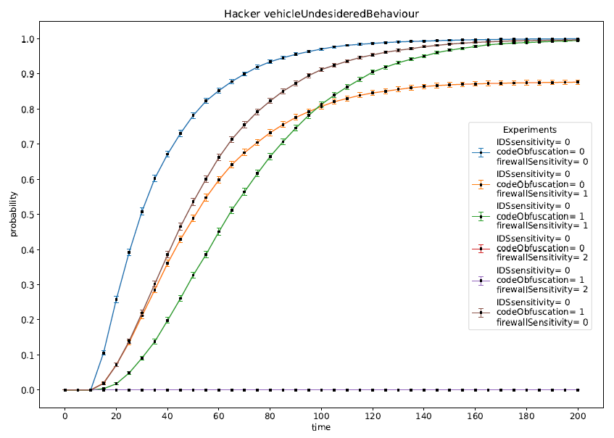
Vehicle Undesidered Behaviour - Hacker

Slide 4
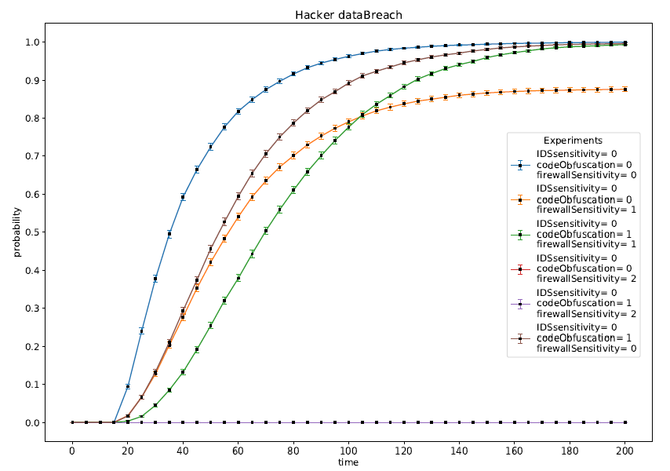
Data Breach - Hacker

Slide 5



Countermeasures Effectiveness Against Hacker
Firewall
Code Obfuscation
IDS
Impact heavily on the effectiveness of the attacks
It makes slower the attacks
No impact

Slide 6
Why Not Data Leakage?
The Insider and the Physical Intruder choice the attack paying very attention about the risk of being Detected. For this reason they will avoid the Data Breach Attack.
Goals | Prob. Of Success | Prob. Of Detection | Reward
Data Breach | 0.9 | 0.2 (S) / 0.1 (F) | 150
Vehicle Undesidered Behaviour | 0.9 | 0.1 (S) / 0.1 (F) | 300
DoS | - | - | -
Thus the only goal that they try to reach is the Vehicle Undesidered Behaviour.

Slide 7
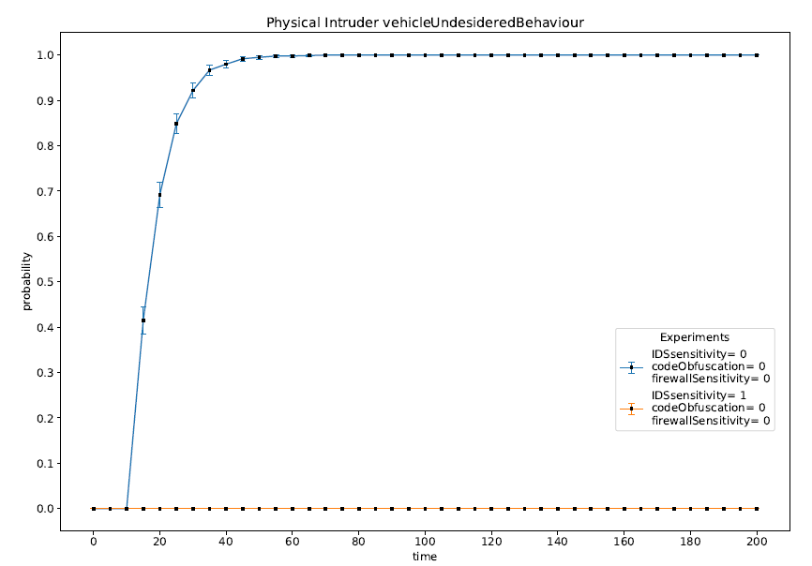
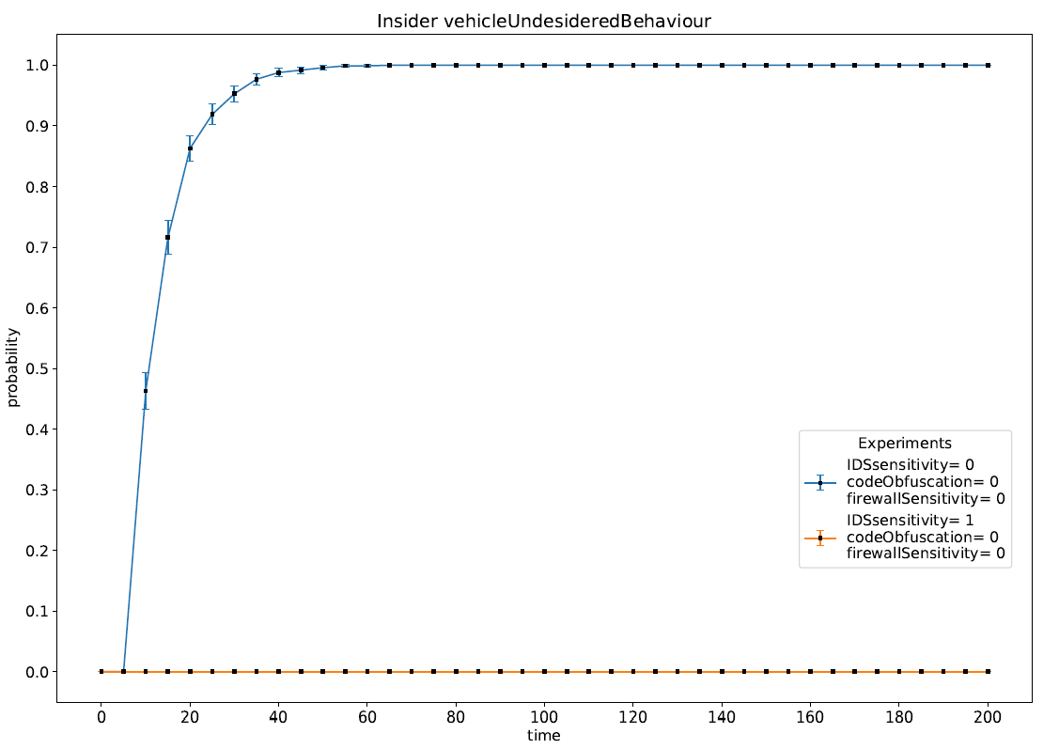
Physical Intruder & Insider

Slide 8
Countermeasure Against Insider & Physical Intruder
Firewall
Code Obfuscation
IDS
No impact
No Impact
It discourages the attacks because the risk of being detected is too high

Slide 9
CONLUSION
Problem
Solution
How we can improve the security of the overall system?
Good Firewall
Code Obfuscation
Intrusion Detection System

Slide 10

THANKS! Any Questions?

Slide 11
References
”Agreement Concerning the Adoption of Harmonized Technical United Nations Regulations for Wheeled Vehicles, Equipment and Parts which can be Fitted and/or be Used on Wheeled Vehicles and the Conditions for Reciprocal Recognition of Approvals Granted on the Basis of these United Nations Regulations” – United Nations – March 2021
” A Survey of Autonomous Driving: Common Practices and Emerging Technologies ” – Yurtsever et al. – March 2020

