Slide 1

ADVISE model for attacks on autonomous vehicles back-end servers
Yuri Mazzuoli
Francesco Iemma
Marco Pinna

Slide 2
Scenario Overview
Objectives
Simulation
01
Actors
Attacker’s Profile
02
Goals
Countermeasures
Attack Tree
03
Results
Observations

Slide 3
Scenario Overview
Self-driving vehicles are managed by back-end servers
Attackers will try to introduce in the system in order to reach some goals
Attackers will try to steal information and/or cause a malfunction

Slide 4



ACTORS
Insider
Physical Intruder
Hacker
Someone who belongs to the company or works for it
Someone who has direct access to a server room
External actor with penetration skills but without prior knowledges or accesses

Slide 5
PROFILES
INSIDER
Has only basic level IT skills
They know information about login credentials (website, LAN, VPN, DB), employees info, vulnerabilities in company’s security system
They have some unprivileged access to the Internal Network and to the target servers
Will care 10% about the attack cost, 40% of not being discovered and 50% about the final reward

Slide 6
PROFILES
PHYSICAL INTRUDER
Has only basic level IT skills
They only know public information about the company’s systems
They have access to buildings and rooms with one or more computers connected to the Internal Network
Will care 20% about the attack cost, 30% of not being discovered and 50% about the final reward

Slide 7
PROFILES
Has advanced IT skills, like scripting and reverse engineering
They only know public information about the company’s systems
They have access to a copy of the firmware from one or more vehicles. Only the binary, without source code
Will care 10% about the attack cost, 10% of not being discovered and 80% about the final reward
HACKER

Slide 8



GOALS
Denial of Service
Data Breach
Vehicle undesired behaviour
https://unece.org/sites/default/files/2021-03/R155e.docx (p. 20 table A1)

Slide 9
Denial of Service (DoS)
The service from the back-end server is disrupted, affecting the operation of the vehicles
Usually obtained by flooding the servers with a huge number of requests
Availability is lost

Slide 10
Data Breach
Vehicle related data held on back-end servers is lost or compromised
Requires access to server
Confidentiality is lost

Slide 11
Vehicle undesired behaviour
Back-end servers used as a means to attack a vehicle or extract data
Requires access to the server
Integrity and/or confidentiality are lost

Slide 12



COUNTERMEASURES
Code Obfuscation
Intrustion Detection System (IDS)
Firewall

Slide 13
Code obfuscation
Source code is made more difficult to understand for humans
It affects the Firmware Reversing attack step

Slide 14
Intrusion Detection System (IDS)
A software that inspects the network and detects unauthorized accesses or changes in privileges
It affects the Privilege Escalation attack step

Slide 15
Firewall
It analyses and filters packets to detect malicious connection attempts
It affects the Port scan attack step

Slide 16
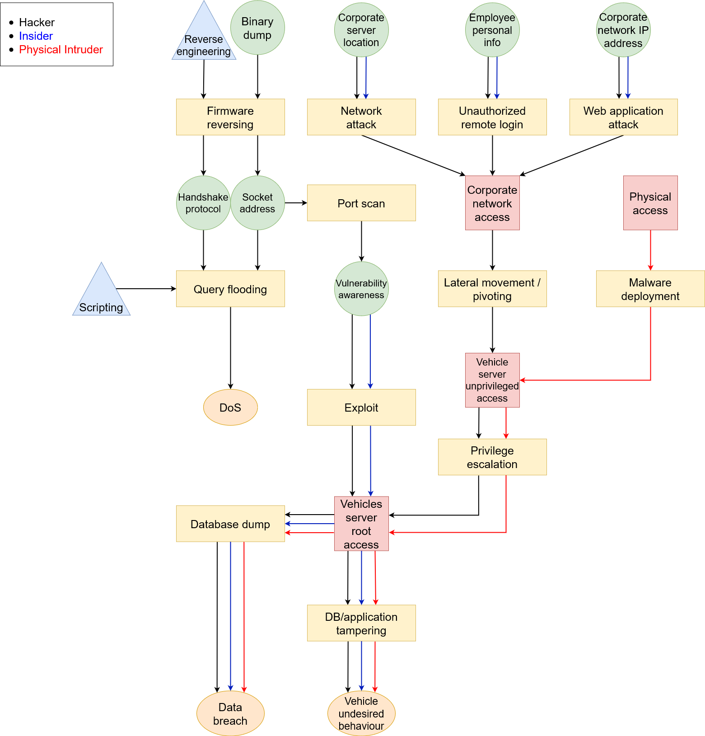
Attack tree

Slide 17
SIMULATION ENVIRONMENT
The enviroment in which we have performed the simulations has the following characteristics:
Simulation Time: 200 hours
Step Size: 5 hours
Firewall Sensitivity: [0, 1, 2]
Intrusion Detection System Sensitivity [0, 1]
Code Obfuscation [0, 1]

Slide 18
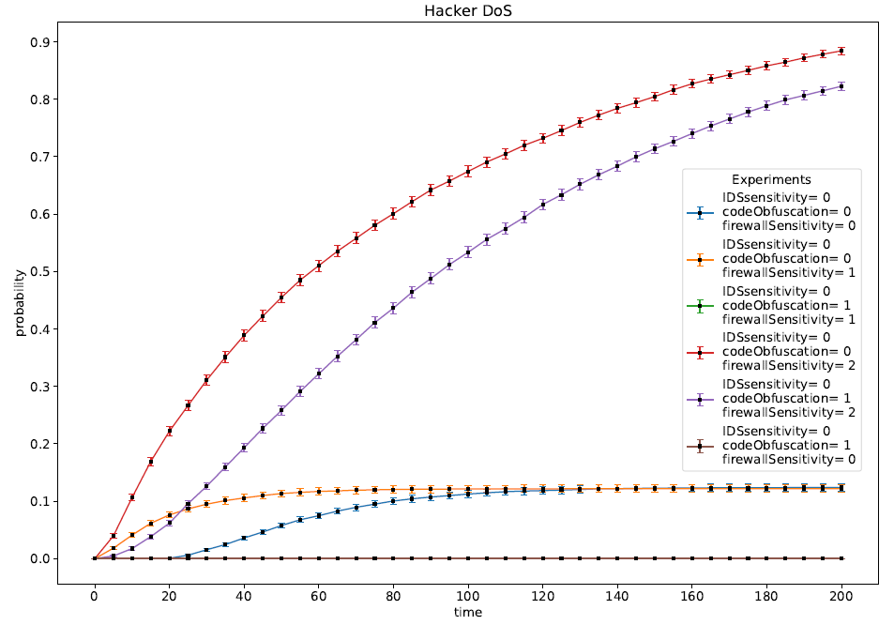
DoS - Hacker

Slide 19
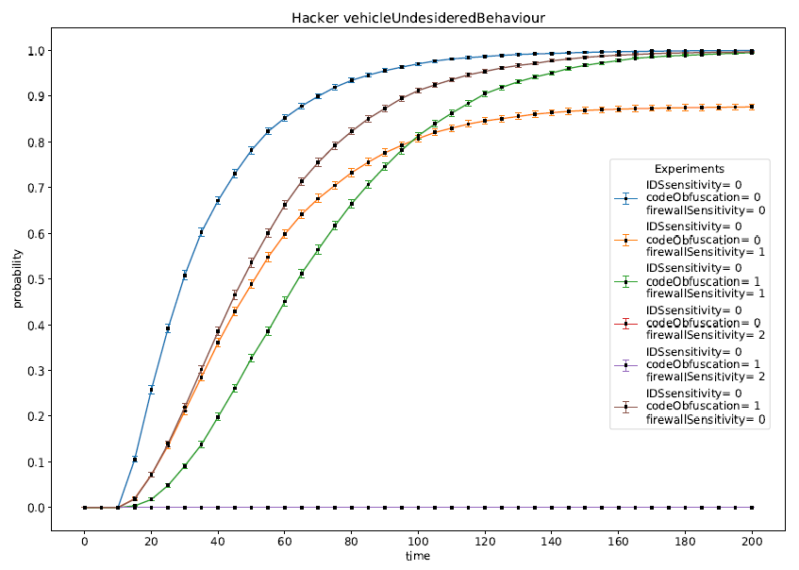
Vehicle Undesidered Behaviour - Hacker

Slide 20
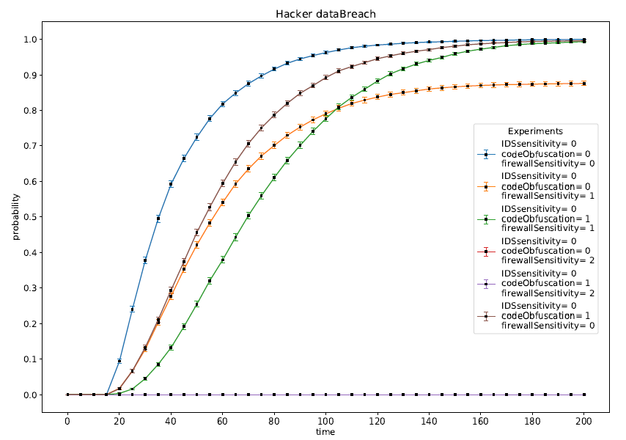
Data Breach - Hacker

Slide 21



Countermeasures Against Hacker
Firewall
Code Obfuscation
IDS
Impacts heavily on the effectiveness of the attacks
It makes the attacks slower
No impact

Slide 22
Why Not Data Leakage?
The Insider and the Physical Intruder choose the attack paying much attention about the risk of being Detected. For this reason they will avoid the Data Breach Attack.
Goals | Prob. Of Success | Prob. Of Detection | Reward
Data Breach | 0.9 | 0.2 (S) / 0.1 (F) | 150
Vehicle Undesidered Behaviour | 0.9 | 0.1 (S) / 0.1 (F) | 300
DoS | - | - | -
Thus the only goal that they try to reach is the Vehicle Undesidered Behaviour.

Slide 23
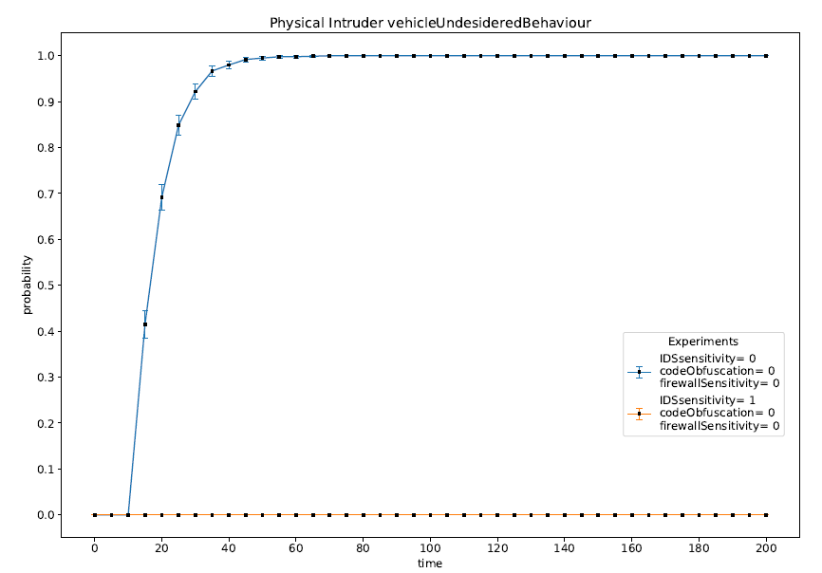
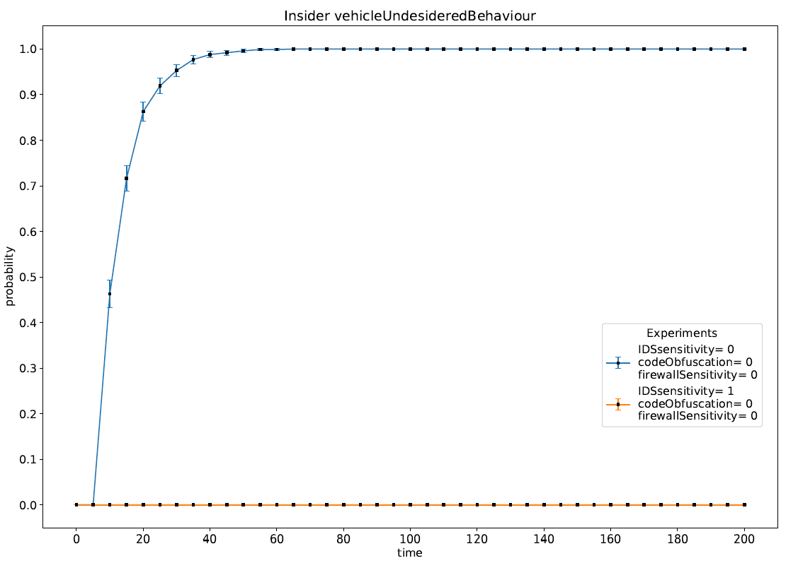
Physical Intruder & Insider

Slide 24
Countermeasure Against Insider & Physical Intruder
Firewall
Code Obfuscation
IDS
No impact
No Impact
It discourages the attacks because the risk of being detected is too high

Slide 25
CONLUSION
Problem
Solution
How we can improve the security of the overall system?
Good Firewall
Code Obfuscation
Intrusion Detection System

Slide 26

THANKS! Any Questions?

Slide 27
References
”Agreement Concerning the Adoption of Harmonized Technical United Nations Regulations for Wheeled Vehicles, Equipment and Parts which can be Fitted and/or be Used on Wheeled Vehicles and the Conditions for Reciprocal Recognition of Approvals Granted on the Basis of these United Nations Regulations” – United Nations – March 2021
”A Survey of Autonomous Driving: Common Practices and Emerging Technologies” – Yurtsever et al. – March 2020

