Slide 1



GOALS
Denial of Service
Data Breach
Vehicle undesired behaviour
https://unece.org/sites/default/files/2021-03/R155e.docx (p. 20 table A1)

Slide 2
Denial of Service (DoS)
The service from the back-end server is disrupted, affecting the operation of the vehicles
Usually obtained by flooding the servers with a huge number of requests
Availability is lost

Slide 3
Data Breach
Vehicle related data held on back-end servers is lost or compromised
Requires access to server
Confidentiality is lost

Slide 4
Vehicle undesired behaviour
Back-end servers used as a means to attack a vehicle or extract data
Requires access to the server
Integrity and/or confidentiality are lost

Slide 5

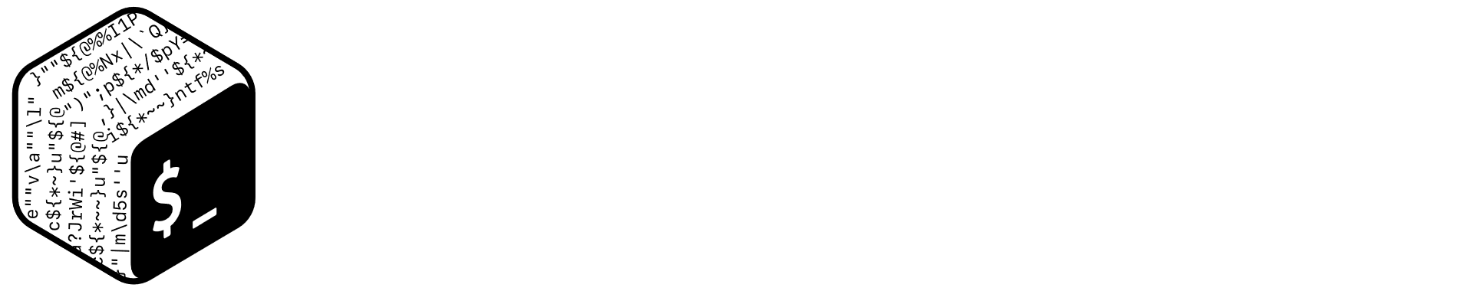

COUNTERMEASURES
Code Obfuscation
Intrustion Detection System (IDS)
Firewall

Slide 6
Code obfuscation
Source code is made more difficult to understand for humans
It affects the Firmware Reversing attack step

Slide 7
Intrusion Detection System (IDS)
A software that inspects the network and detects unauthorized accesses or changes in privileges
It affects the Privilege Escalation attack step

Slide 8
Firewall
It analyses and filters packets to detect malicious connection attempts
It affects the Port scan attack step

Slide 9
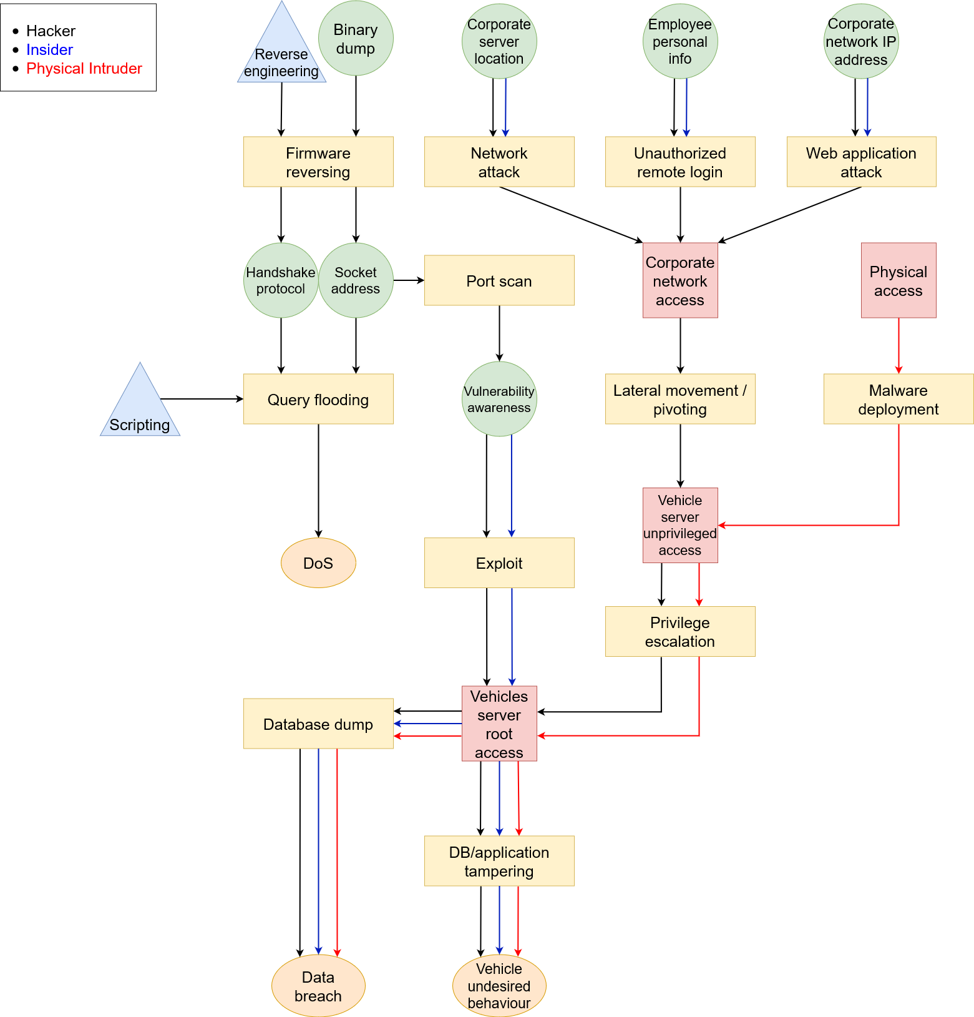
Attack tree

