Slide 1
Debugging assembly code with gdbtui
CS33 UCLA CSD

Slide 2
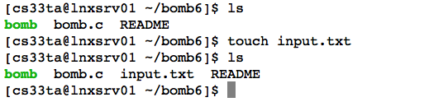
Pre-knowledge before debugging
bomb read input either from stdin or a file
We will try a few times to defuse each bomb
To save effort retyping the strings, the latter approach is recommended.
  Create a input file
  Type a random word into the file
    vim input.txt
    or emacs input.txt
    or transfer a file from your laptop .....

Slide 3

First view of gdbtui
Start gdbtui
Inside gdbtui, start the bomb with input.txt as its first parameter
  start input.txt

Slide 4
Gdb commands
Source code line execution
  next or n: execute next line of code; will not enter functions.
  step or s: step to next line of code. will step into a function.
Machine instruction execution
  nexti or ni: next machine instruction rather than source line
  stepi or si: step by machine instructions rather than source lines

Slide 5
Execute to interesting point
next .....
You may need to refresh screen
  Ctrl+l
change to assembly code layout
  layout asm
Show registers
  layout regs

