Slide 1
FOMICS SummerSchool July 2013 CMake
John Biddiscombe

Slide 2
What is CMake (and why do we need it)
Cross platform Makefile generator
One script for all machines
Linux, Windows, Mac, ARM, embedded devices, Compute nodes
Makefiles can be quite complex and hard to understand
Rules
Dependencies
Obscure syntax (hard to read)
CMake has a more straightforward syntax (language)
Allows rules, dependencies to be expressed simply in most cases
Can also generate project files for integrated environments like Visual Studio, Eclipse, Xcode, etc
CMakeLists.txt
create one in each directory and add commands to it

Slide 3
Definitions
Target
A target is the output of a makefile, usually it is an executable, library, but can also be a generated file (like a config header)
A target may use other targets. If a target uses other targets, the rules and dependencies of the sub-target are inherited (transitive)
Rules
A rule is usually a compile/link statement “if the target is older than one of it’s dependencies, then compile and link to generate the new target”
Dependency
A dependency is any file which contributes to a target. if hello.c is used to build hello.exe then hello.c is a dependecy of hello.exe. CMake scans most source files and adds sub-dependencies like hello.h (if hello.c has #include “hello.h”) as dependencies too, so if you modify hello.h then next time to make the project, hello.c will be recompiled/linked into hello.exe

Slide 4
Simplest project example
CMakeLists.txt
project (hello)
add_executable(hello hello.c)
target = hello (exe)
dependency = hello.c
rule = add_executable – the rule is not explicitly written, CMake knows that to build an exe, it must create compile and link rules.
Very easy to setup a simple project for quick testing
Only gets hard when you have complex dependencies and rules :
CMake commands can be used to generate files for more sophisticated projects

Slide 5
Project 2, more complex
CMakeLists.txt
project(HELLO)
set(HELLO_SRCS hello.c)
find_package(MPI REQUIRED)
include_directories(${MPI_C_INCLUDE_PATH})
add_executable(hello ${HELLO_SRCS})
target_link_libraries(hello
${MPI_LIBRARY} ${MPI_EXTRA_LIBRARY})
set is used to declare a variable, here it is just one source file.
find_package is used to locate headers and libraries we need
target_link_libraries adds the libraries as dependencies (of the target) and links them (to the target)

Slide 6
All the commands (but we mostly use these)
add_custom_command
add_custom_target
add_definitions
add_dependencies
add_executable
add_library
add_subdirectory
add_test
aux_source_directory
break
build_command
cmake_minimum_required
cmake_policy
configure_file
create_test_sourcelist
define_property
else
elseif
enable_language
enable_testing
endforeach
endfunction
endif
endmacro
endwhile
execute_process
export
file
find_file
find_library
find_package
find_path
find_program
fltk_wrap_ui
foreach
function
get_cmake_property
get_directory_property
get_filename_component
get_property
get_source_file_property
get_target_property
get_test_property
if
include
include_directories
include_external_msproject
include_regular_expression
install
link_directories
list
load_cache
load_command
macro
mark_as_advanced
math
message
option
project
qt_wrap_cpp
qt_wrap_ui
remove_definitions
return
separate_arguments
set
set_directory_properties
set_property
set_source_files_properties
set_target_properties
set_tests_properties
site_name
source_group
string
target_link_libraries
try_compile
try_run
unset
variable_watch
while

Slide 7
cache vars and simple vars
set(optionA ON)
if (optionA)
message(“option A is on”)
endif (optionA)
set(optionA OFF)
if (optionA)
message(“option A is on”)
endif (optionA)
#####
set(optionB "ON" CACHE STRING "an option") #persistent option
if (optionB)
message("option B is on")
endif (optionB)
set(optionB "OFF" CACHE STRING "an option")
if (optionB)
message("option B is on")
endif (optionB)
option A is on
option B is on
option B is on
Why is this the result? It’s not obvious at first.

Slide 8
add_subdirectory
Variables are inherited in subdirectories
But changing variables in subdirectories does not affect the parent directory.
Adding targets in subdirectories is ok
project(xxx)
add_subdirectory(libstuff)
add executable(my_exe ${EXE_SRCS})
target_link_libraries(my_exe my_lib)
if you need to set variables in subdirectories, look up GLOBAL_SCOPE options to set(…)

Slide 9
One example from the SWE CMakelists
#--------------------------------------------------------------------------
# provide a wave model option for user selection
#--------------------------------------------------------------------------
set(SWE_WaveModel "AugRie" CACHE STRING "WaveModel : one of 'Hybrid FWave AugRie AugRieGeoClaw Rusanov FWavevec'")
set_property(CACHE SWE_WaveModel PROPERTY STRINGS Hybrid FWave AugRie AugRieGeoClaw Rusanov FWavevec)
string(TOLOWER "${SWE_WaveModel}" WaveModel_lower )
if (${WaveModel_lower} STREQUAL "hybrid")
add_definitions(-D"WAVE_PROPAGATION_SOLVER=0")
elseif (${WaveModel_lower} STREQUAL "fwave")
add_definitions(-D"WAVE_PROPAGATION_SOLVER=1")
elseif (${WaveModel_lower} STREQUAL "augrie")
add_definitions(-D"WAVE_PROPAGATION_SOLVER=2")
elseif (${WaveModel_lower} STREQUAL "augriegeoclaw")
add_definitions(-D"WAVE_PROPAGATION_SOLVER=3")
else()
message(STATUS "${WaveModel_lower} not yet implemented, using hybrid")
add_definitions(-D"WAVE_PROPAGATION_SOLVER=0")
endif (${WaveModel_lower} STREQUAL "hybrid")

Slide 10
cmake, ccmake and cmake-gui
Cmake provides several interfaces for generating your project/makefiles
on linux:
cmake – we almost never use this. It is a command line driven interface, useful for scripts, but usually we use
ccmake – provides a simple text based GUI, which we use constantly
On windows (or gui based linux boxes)
cmake-gui (just cmake from a shortcut)
Process is simple,
configure, repeat until all options are satisfied
generate, just once, to write project/makefiles to disk
then make or load project with IDE

Slide 11
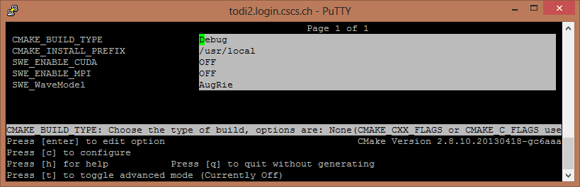
ccmake
c = configure
g = generate
t = show advanced options
e = exit from messages
Hot tip : use “make VERBOSE=1” when you have trouble

Slide 12
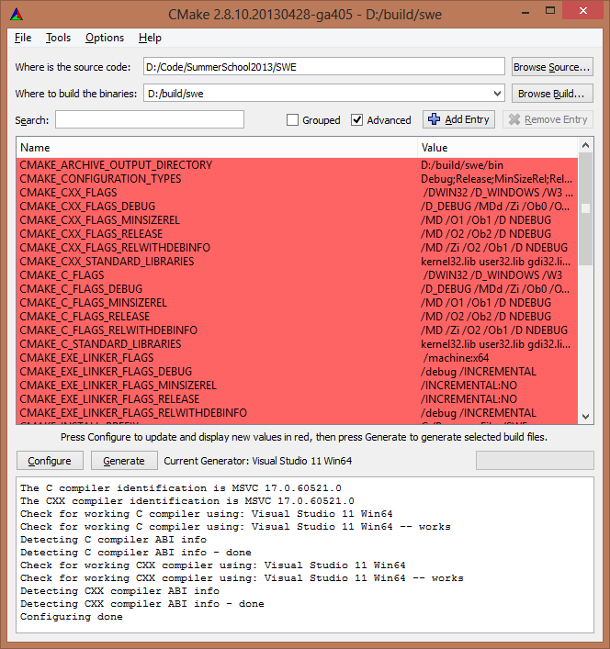
CMake GUI on windows

Slide 13
Find Package in swe
#--------------------------------------------------------------------------
# provide parallelization options for user selection
#--------------------------------------------------------------------------
option(SWE_ENABLE_MPI "Enable MPI Parallel version" OFF)
option(SWE_ENABLE_CUDA "Enable CUDA Parallel version" OFF)
if (SWE_ENABLE_MPI)
find_package(MPI REQUIRED)
endif (SWE_ENABLE_MPI)
if (SWE_ENABLE_CUDA)
find_package(CUDA REQUIRED)
endif (SWE_ENABLE_CUDA)

Slide 14
include_directories in swe
#--------------------------------------------------------------------------
# include directories
#
# any includes listed here apply to this project and
# any projects in sub dirs
#--------------------------------------------------------------------------
include_directories(
src
submodules/swe_solvers/src
)
# fix for getopt on windows
if(WIN32)
include_directories(src/tools/win32)
set(WIN32_SRCS src/tools/win32/getopt.c)
endif(WIN32)

Slide 15
Define the sources and the main target
set(SWE_SRCS
src/blocks/SWE_Block.cpp
src/blocks/SWE_WavePropagationBlock.cpp
src/writer/VtkWriter.cpp
src/tools/Logger.cpp
src/examples/swe_simple.cpp
${WIN32_SRCS}
)
#--------------------------------------------------------------------------
# simple non mpi example
#--------------------------------------------------------------------------
add_executable(swe_simple
${SWE_SRCS}
)

Slide 16
CTest
CMake comes with CTest (testing) and Cpack (packaging releases)
CTest is very simple to setup for straightforward tests which execute some function and return 0 or 1 for pass or fail. Like most unic processes,
return 0 = nothing unusual = pass
Return 1 = something happened = fail
Slightly odd when you usually write tests with
ok = Do setup stuff
if (ok) {
Do complicated stuff
}
return ok
// we need return !ok for tests
NB. Paraview has over 1000 unit tests

Slide 17
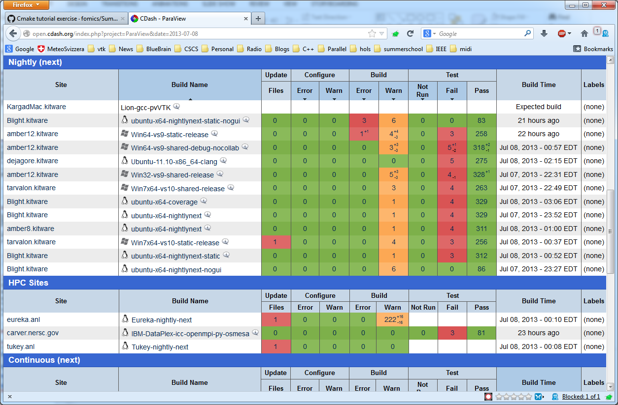
Dash (Dashboard testing)
Ctest can submit results to Dash

Slide 18
Adding a simple test to SWE
In main CMakeLists.txt
include(CTest)
if (BUILD_TESTING)
enable_testing()
add_subdirectory(test)
endif(BUILD_TESTING)
In subdirectory ‘test’ add CMakeLists.txt with contents
add_executable(test_simple test.c)
add_test(
NAME SimpleTest
COMMAND $<TARGET_FILE:test_simple>
)
test.c is very simple
int main() {
return 1; // return 0
}

Slide 19

You’ll thank me later

Slide 20
Complex netCDF Test
We want to
run the solver (swe_simple) using known params
take the output (a netCDF file)
examine output (netCDFTest) and see if it is what we expect
Ctest won’t let us run two programs in a single test (i.e. a chained series of commands)
But it will allow us to run a script
on linux, bash, on windows bat, on other devices ???
CMake can run cmake scripts!!!! and so we write a cmake script to run our two step test and make that the test.

Slide 21
Create a test executable
in test/CMakeLists.txt
#--------------------------------------------------------------------------
# complex test to try netCDF check
#--------------------------------------------------------------------------
add_executable(test_netcdf netcdf_test.cpp)
target_link_libraries(test_netcdf ${NETCDF_LIBRARIES})
contents of netcdf_test.cpp are on wiki and will load a file and check the size of the dataset stored inside it. (params=file sizex sizey)
Not a proper test (size does not guarantee solver is ok), but a good example of testing the IO (for example)

Slide 22
Add the test with all its params
set(X_SIZE 64)
set(Y_SIZE 64)
add_test(NAME NetCDF_IO_TEST
COMMAND ${CMAKE_COMMAND}
-DCMD1=$<TARGET_FILE:swe_simple>
-DARG1=--grid-size-x=${X_SIZE}
-DARG2=--grid-size-y=${Y_SIZE}
-DARG3=--output-basepath=${CMAKE_CURRENT_BINARY_DIR}/temp
-DCMD2=$<TARGET_FILE:test_netcdf>
-DARG4=${CMAKE_CURRENT_BINARY_DIR}/temp_00.nc
-DARG5=${X_SIZE}
-DARG6=${Y_SIZE}
-P ${CMAKE_CURRENT_SOURCE_DIR}/run_test.cmake
)

Slide 23
run_test.cmake
macro(EXEC_CHECK CMD A1 A2 A3)
execute_process(COMMAND ${CMD} ${A1} ${A2} ${A3} RESULT_VARIABLE CMD_RESULT)
if(CMD_RESULT)
message("Result was ${CMD_RESULT}")
message(FATAL_ERROR "Error running ${CMD}")
endif()
endmacro()
EXEC_CHECK(${CMD1} ${ARG1} ${ARG2} ${ARG3})
EXEC_CHECK(${CMD2} ${ARG4} ${ARG5} ${ARG6})
we use arg1, arg2 arg3 variables because we can’t pass command line params : bit of a hack really, but quite effective.

