Slide 1
FOMICS SummerSchool July 2013 Git
John Biddiscombe

Slide 2
Introduction
Git is a distributed version control system
Distributed means that many people can have local copies of the repository and it’s easy to synchronize between them.
A collection of command-line tools
Though GUI tools are available.
Has lots of commands
And they can be piped/scripted nicely, so it’s more like a toolbox of utilities than a single program. Think of it as an environment in which you can manage source code.
Branches and branch management
Are marvellously implemented and conceptually sound.
Commits are atomic
Each commit represents a changeset (and maintains tree history)
Too many commands/concepts to cover in this short intro.

Slide 3
Distributed
Real Origin
(github)
todi
(cscs)
Users/
others
MyRepo
(desktop)
User_001…
SSH Firewall
Secret branch
Another
(laptop)
Secret machine (eiger)

Slide 4
How does it work
It is straightforward
Edit some source code
Add the files you’ve changed (to the next commit)
You can now add some more if you want (or remove some)
Commit the files
Here you can see the effect of a number of straightforward commits

Slide 5
Commits
What is a commit
Each commit represents a new state of the repository
Each commit has a parent
But when you merge branches you create a merge commit which has two parents (or more if you do an octopus merge!)
Here we see development on a branch has been merged in. And then continued and merged in again. The merge commits have two parents.

Slide 6
What is a branch
A branch is just a commit that has a special name
Except that when you commit to a ‘named’ branch, the pointer to the branch commit is updated to point to the new commit
Every commit can be a branch if you want
You can create a branch any time, from any commit
You can go back to an earlier commit and make a branch from there
A branch that has no name is referred to as a “Detached Head”, you’ll get onto one of those from time to time.

Slide 7
When do you want a branch
Nearly Always!
Assuming the main development is in branch ‘master’, then anything you do should probably be in branch ‘mystuff’, or topic_fixfeature or feature_algorithm, or something of that kind.
You can create and delete branches very easily, so when in doubt, just create a branch with a good name and commit to it.
Sometimes you’ll fix two bugs and realize that they ought to be on two branches rather than the same one, so you can quickly create temp branch, commit two patches, then later copy those patches into the branches you want them to be in (cherry-pick – see later)

Slide 8
Branch workflow
Common practice is to have branches like
Master
Where new topics are merged into and where you branch from to create a new topic, new development will assume this is the starting point
Next
What will eventually become the next release version (candidate). Topics can be merged into here
Release
When the next branch is ready for release, you merge into the release branch
Tags or branches can be used to mark individual releases
Lots of great stuff about workflows here
http://www.vtk.org/Wiki/Git/Workflow/Topic

Slide 9
Tags
Are just names to commits that you want to find easily
Same as branches, except they don’t update themselves the way a branch does when you add to it.
You can point them anywhere and update them like these
v3.98.1
v3.98.1-RC1
v3.98.1-RC2
v4.0.0
v4.0.0-RC1
v4.0.0-RC2
v4.0.0-RC3
v4.0.1
When you need to patch an old release, just create a branch from that tag, add commits and re tag when done

Slide 10
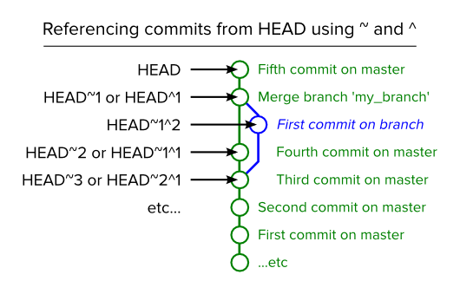
~ and ^
^ = parent
~ = ancestor
so we can use
git diff HEAD HEAD~4
but parent ^2 is only
useful if a commit has two parents
I use this kind of thing often
git diff --name-only HEAD~x
Image credit: Paul Boxley, Blog

Slide 11
Remotes
When you clone a repo, you have a remote called ‘origin’
You can add as many other remotes as you like and get copies of branches from all of them.
When you want to see if something new has been added to a remote, you ‘fetch’ changes from the remote. This updates your copies of the remote branches, but does not change any of your local branches.
Nothing changes on the remote until you push your local branch to the remote.
What’s the difference between a local branch and a copy of a remote branch?

Slide 12
Merging
You will usually merge your work into a (master/next) branch - if other people want to get your stuff synced with theirs.
Or merge master into your work branch - because someone else has added to the master branch and you want it too. You do this by doing a pull from the master. (pull=fetch+merge)
From time to time you’ll want to merge friend’s work branch into your work branch – this might be because you’re both working on something related and before it’s ready to go into master, you want to sync with each other.
10962_find_data_initialization
10968_convert_query_seln
10968_freezier_frozen_selection
12742_scalar_bar_improvements
13024-debug-leaks-view
Some project use a branch for each bug fix, and you want one.

Slide 13
Local branches
After you clone a repo, you may have many branches
remotes/origin/augrie_geoclaw
remotes/origin/exercise_mv
remotes/origin/gitcourse1
remotes/origin/gitcourse2
remotes/origin/master
remotes/origin/master_cmake
They are just points on a tree
When you checkout one of those branches, you create a local branch which is initially at the same point on the tree.
As you commit to your local branch, it diverges from the remote copy you made. When you push your local branch to a remote, the remote is updated and your copy of the remote is updated.

Slide 14
Merges and Conflicts
When you push your local branch to a remote, you may be refused.
If someone else has already pushed to the same remote branch, then the stuff you want to add on top of it is not a “Fast Forward”, so git will say, sorry, but your branch is not up to date.
You have to first pull the changes into your branch (which may produce a conflict, which you must fix), before you can push your changes.
Two commits were made by user A, one by user B. The second user to push has to merge first. Then the merge commit become the new HEAD. The commits exist as forked regions and remain independent commits, but the merge commit fixes them into the branch.

Slide 15
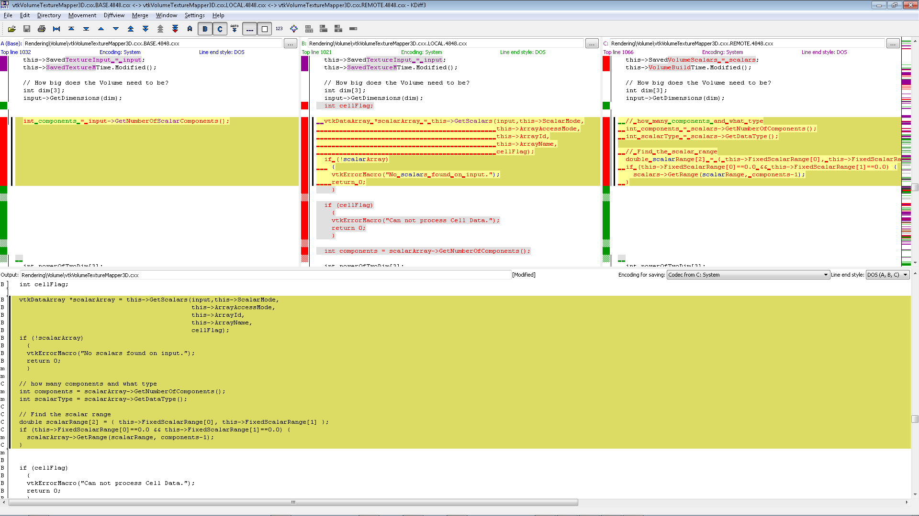
3-Way merge : KDiff3, will use later

Slide 16
Rebase, squashing, editing history … ask me
When this happens
commit 050c638ef14fc327a676f5aabc276dfdf0bb0609
Introduction to summer school and software engineering
:000000 100644 0000000... cbf549a... A PRESENTATIONS/2013_07_08_Intro_Software_Eng.pdf
commit 81126fca1f1efe0e68d8f4949d104875cd2e6ea3
Was in wrong directory
:100644 000000 cbf549a... 0000000... D PRESENTATIONS/git/2013_07_08_Intro_Software_Eng.pdf
commit 095081bdf2d391e2ef87e81816925e348d3ffc4f
Added introduction to summer school and software engineering.
:000000 100644 0000000... cbf549a... A PRESENTATIONS/git/2013_07_08_Intro_Software_Eng.pdf
You will want to know about rebasing, or merge –squash,
git rebase allows you to go back and change/combine/remove commits earlier in the tree, but can lead to big trouble because commits made by others in their copies of the branch, now sit in different branches (even if the names are the same).

Slide 17
Rebase, squashing, editing history … ask me
Rebasing is very useful and frequently used, but only if you know what you’re doing and are sure that nobody else will have conflicts caused by you rewriting branches.
git pull --rebase
is the most commonly used variant (because it won’t damage other people). It allows you to replay your commits on top of the remote changes, rather than doing a normal merge.
The main advantage is that it keeps the history linear.

Slide 18
SHA values
Every commit has a SHA, the long sequence of hex values that you see by every commit log.
The SHA is a hash which encode the patch you made, plus the log message, plus the parent commits, date time etc.
The SHA represents an atomic state of the working tree at that moment because it represents the state of ‘all’ the files as the point on the tree.
You will read that git is different because each commit represents a complete working tree – it isn’t just a patch representing the diffs, it encodes its place in the tree of commits and from a SHA the whole repo at that point can be reconstructed.

Slide 19
Examples of Git Usage
Slides taken from older presentations which can be used for ideas follow now if time permits.
Otherwise, exercises should be followed.

Slide 20
Setup
Do this just once.
git config --global user.name “John Biddiscombe"
git config --global user.email “biddisco@cscs.ch"
or edit ~/.gitconfig
[user]
name = John Biddiscombe
email = biddisco@cscs.ch
All git config commands edit this (global) or local (repo) repo/.git/config files

Slide 21
Creating/Cloning
git clone url/to/repo
is what you’d normally use for a working repo
git init --bare
sets up a new repo with no working files.
Just the ‘index’
git clone --bare url/to/repo
is good for making a copy of a remote repo which
you will use like a server (push/pull)

Slide 22
Clones/Copies/Working trees
What happens when you clone?
You get a copy of the remote index (which includes all the remote branches)
What happens when you checkout a branch?
You get a working tree which represents what’s stored in the index for that branch.
What happens when you commit to your local repo?
Your local copy of the remote index gets updated, and you have now diverged
Nothing gets changed on the remote until you push

Slide 23
Clones/Copies/Working trees
git add somefile
git commit -m ‘adding a new file’
updates our local index. only. Commits are a two stage process - unlike CVS/SVN
git rm is not git unadd.
git add, is used to add an initial file, or just a ‘hunk’ of changes -
to unadd a change, you really want to just remove the file you added from the index before the add
git reset HEAD -- file

Slide 24
Customization
git config --global alias.st status
git config --global alias.wc whatchanged
git config --global alias.dn 'diff --name-only‘
git st or wc or dn
cat ~/.gitconfig
[user]
...
[alias]
st = status
wc = whatchanged

Slide 25
External diff program
in ~/.gitconfig
[diff]
external = c:/Users/biddisco/git-diff.sh
and in c:/Users/biddisco/git-diff.sh
#!/bin/sh
"C:/Program Files (x86)/WinMerge/WinMergeU.exe" -e -ub "$2" "$5" | cat

Slide 26
The basics
git add path/filename …
git commit
git branch branchname
git checkout branchname
git checkout -b branchname
git checkout -t remote/branchname
git checkout branchname -- path/filename (* useful)
git reset -- path/filename (to unadd path/filename)
git reset --hard 31281c1

Slide 27
Log
git log
shows you whats on your branch
git log -5
shows the last 5 logs
git whatchanged -5
git log --pretty=oneline
git log --diff-filter=D --summary
summarize commits when files got deleted
git log --diff-filter=A --summary
summarize commits when files got added

Slide 28
Log
git log -Sstring
searches logs for the string so you can find when a certain line of code got tweaked.
git log -- file
show the logs that affected a certain file
the suffix --[space] path is used on many git commands to restrict the operation to the file/path in question. very handy.
Get used to git command --option -- path

Slide 29
Log+branches
git log master..topic_pvfixes
git diff master topic_pvfixes --name-only
git diff master topic_time --name-only
shows unusual files - because the merge base if not correct (our master is way ahead of when we created topic_time)
try
git merge-base master topic_time
git diff f7156718f61 topic_time --name-only
git wc master..topic_time

Slide 30
Show
what happened in this commit
git show 83f7324d1ae
Too much detail
git show 83f7324d1ae --name-only
git show 83f7324d1ae -- DSMManager/XdmfUtil/XdmfGenerator.cxx

Slide 31
Diff
I’d like to see the diff between the file I changed in that last example and now
git show 83f7324d1ae -- DSMManager/XdmfUtil/XdmfGenerator.cxx
git diff 83f7324d1ae -- DSMManager/XdmfUtil/XdmfGenerator.cxx

Slide 32
Diff
I’d like to see all files changed between two branches
git diff master steering --name-only
how about the diff between the current head, and the version on branch sttering
git diff steering -- XdmfSteeringParser.cxx
the diff between commit XXX on branch YYY and AAA on branch BBB
git diff

Slide 33
Show
show commit logs for all commits on volrender that are not on jb.
You can list multiple branches to include and exclude, e.g.
git log volrender ^jb --no-merges --author biddisco --name-only
for your copy of a remote branch
git log origin/topic_cosmo ^master

Slide 34
rerere
You work on a topic
o---*---o topic
/
o---o---o---*---o---o master
and merge back with master to be sure all is still ok
o---*---o---+ topic
/ /
o---o---o---*---o---o master
and resolve the conflicts,

Slide 35
rerere
you could just carry on with the merged version
o---*---o---+---o---o topic
/ / \
o---o---o---*---o---o---o---o---+ master
but you end up with lots of merge commits
and you might want to keep your topic clean, so you ditch the merged stuff and carry on as before.
next time you merge with master - you’ll have to resolve those same conflicts again.
git rerere remembers conflicts resolutions for you and reapplies them with a prompt

Slide 36
Merge-Commits
git log --no-merges
helps to remove them, but why are they there.
because if the merge is not a fast forward (ie just copy one tree onto the other) then
1)the commits being replayed from one tree to the other are not actually identical any more, so some record that they were modified is necessary. The extra merge comit basically holds the difference between the original commits and the modified commits. often it is actually empty
2)if you merge a topic branch and later delete the topic, you can’t ever recover that branch without the merge commit records that tell you where those commits are/came from. (also force merge commits)

Slide 37
Undoing a merge
you can always return to the pre-merge state with
git reset --hard HEAD
git merge --abort
Or, if you've already committed the merge that you want to throw away,
git reset --hard ORIG_HEAD
i.e. git always remembers the HEAD just before you start doing a merge so that you can go back to it.
You can always just look at the logs and
git reset --hard @#$@$@#$

Slide 38
Cherry Pick
git cherry-pick ######
Pick one commit and apply the diffs from it to the current HEAD.
Extremely useful if you commit multiple small patches to a temp branch and then later cherry pick them onto topic branches.

Slide 39
Headless branches (submodules)
if you checkout some arbitrary SHA, and then start making changes, you can still commit those changes.
but they go into a headless branch. They are just commits hanging off an unnamed tree.
this happens with submodules all the time. because the submodule reference is not a branch, just a SHA
When you make commits on a headless branch, git will warn you that you ought to create a branch to help find those commits (tey still exist, but are hard to find. Google ‘git reflog’ for tips.

Slide 40
Stash
A cheap temporary branch that you can store changes on.
Use :
edit some files
Realize that you want to commit them onto a specific branch
git stash save “temp work for topic X”
git checkout topic_X
git stash pop
pops those changes off the stash stack and puts them into the working tree.
git commit --m ‘….message’

