Slide 2
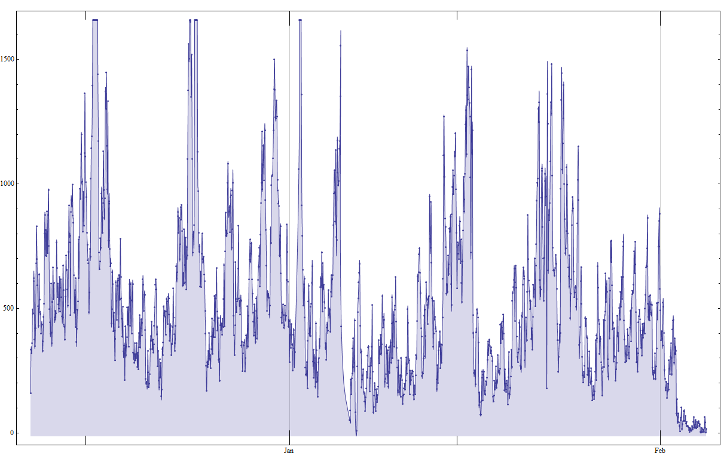
Number of Compilations done on the Server per Hour

Slide 3
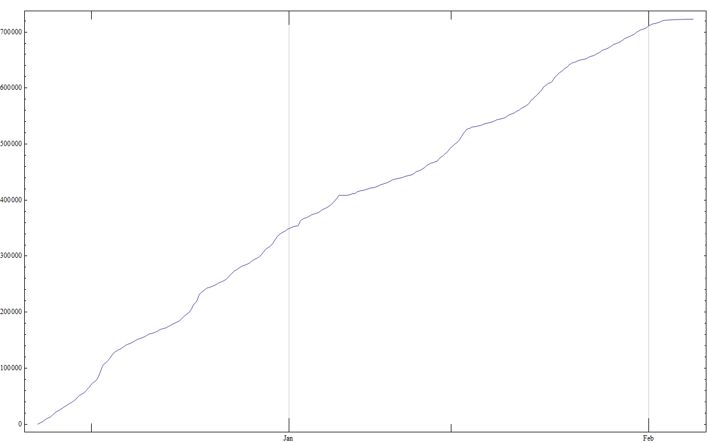
Accumulated Number of Compilations done on the Server

Slide 4
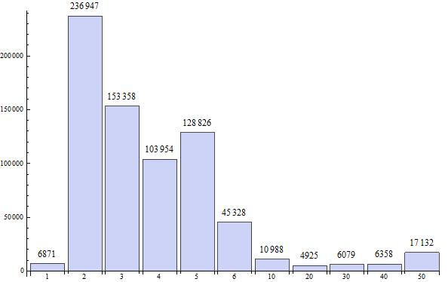
Number of Compilations for each MP

Slide 5
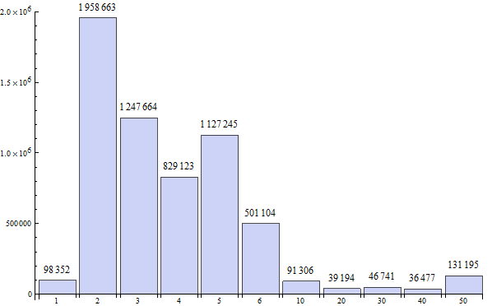
Number of Recorded Programs for each MP

Slide 6
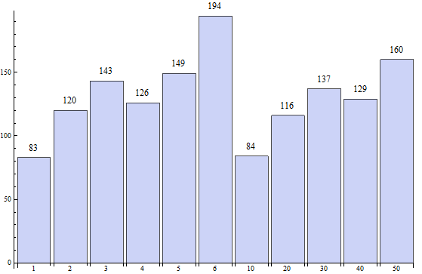
Program Line Count for each MP

Slide 7
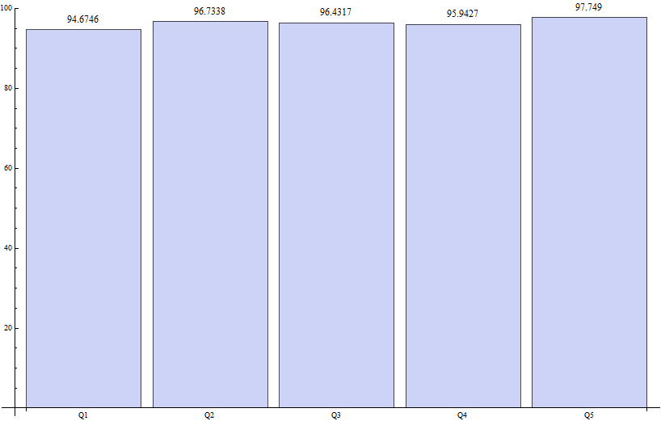
Mean Quiz Grade Distribution
Ignoring the people who did not try the quiz

Slide 8
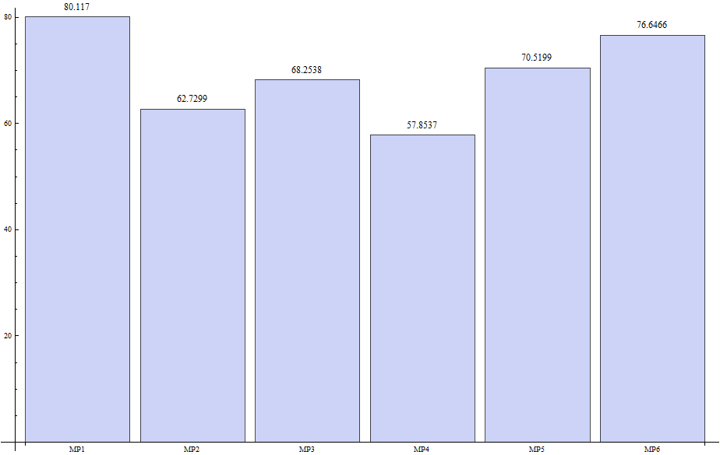
Mean MP Grade Distribution
Ignoring the people who did not try the MP

Slide 9
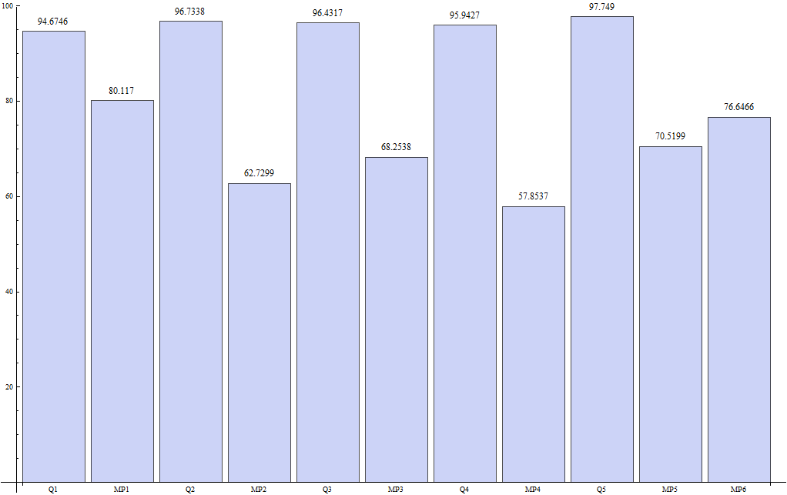
Mean MP and Quiz Grade Distribution
Ignoring the people who did not try the MP or Quiz

Slide 10
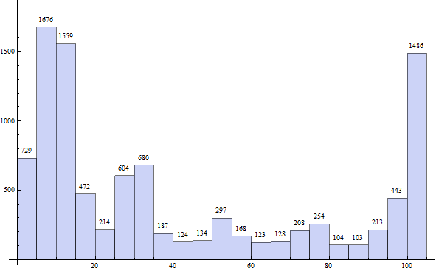
Total MP Grade Distribution

Slide 11
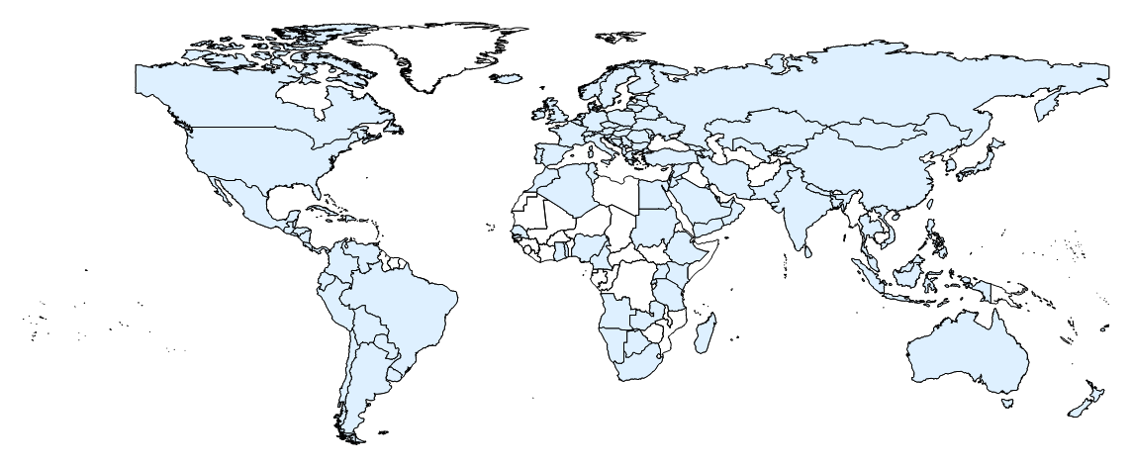
Visitors from each Country

Slide 12
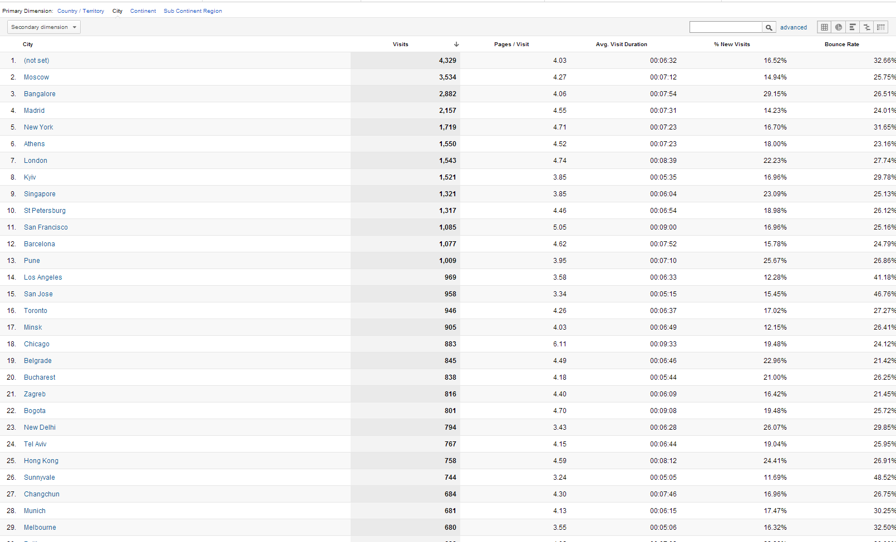
Visitors from Each City

Slide 13
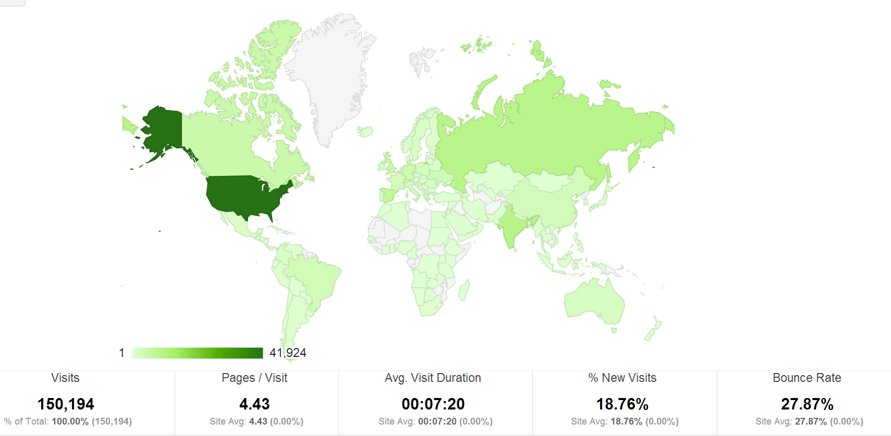
Visitors from each Country

Slide 14
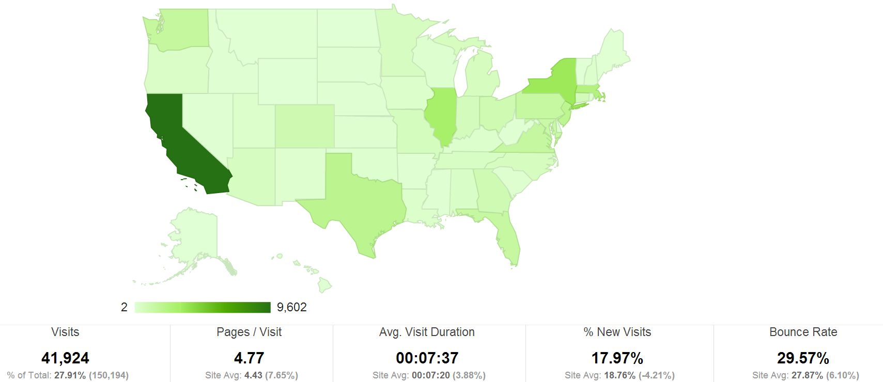
Visitors from the US

Slide 15
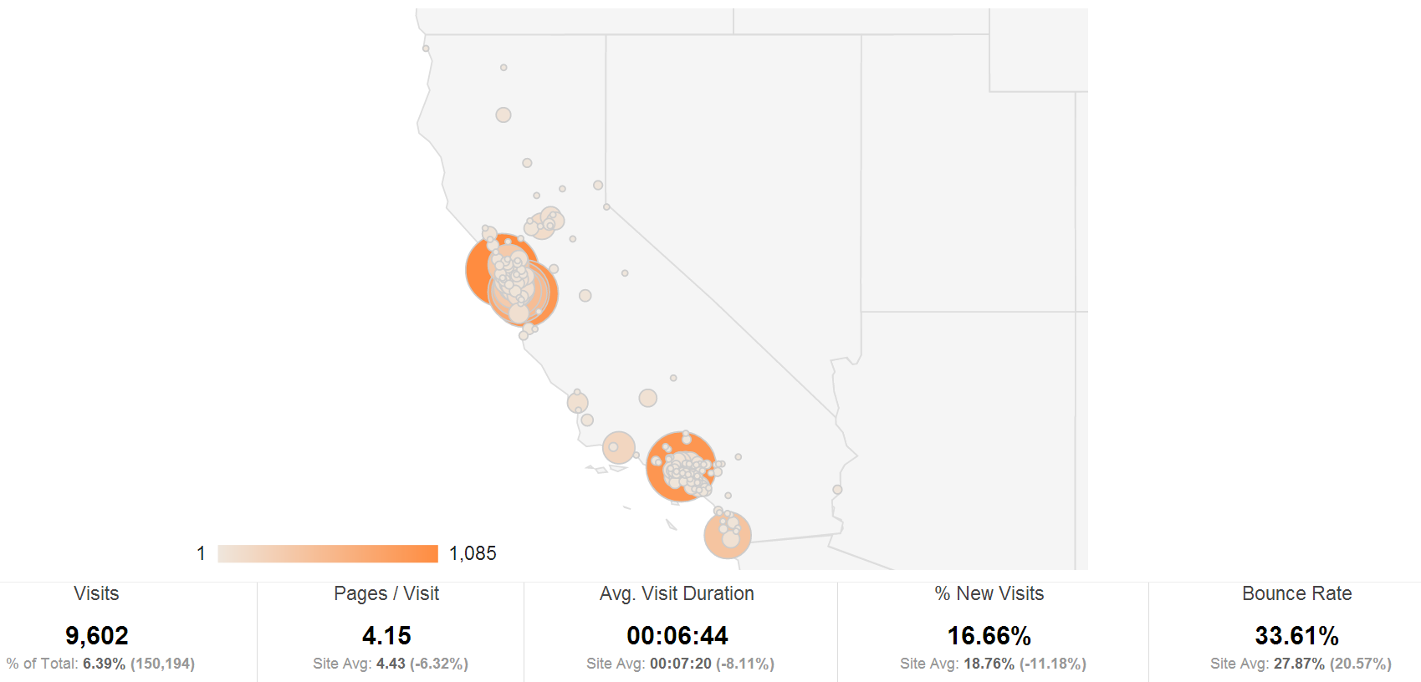
Visitors from California

Slide 16
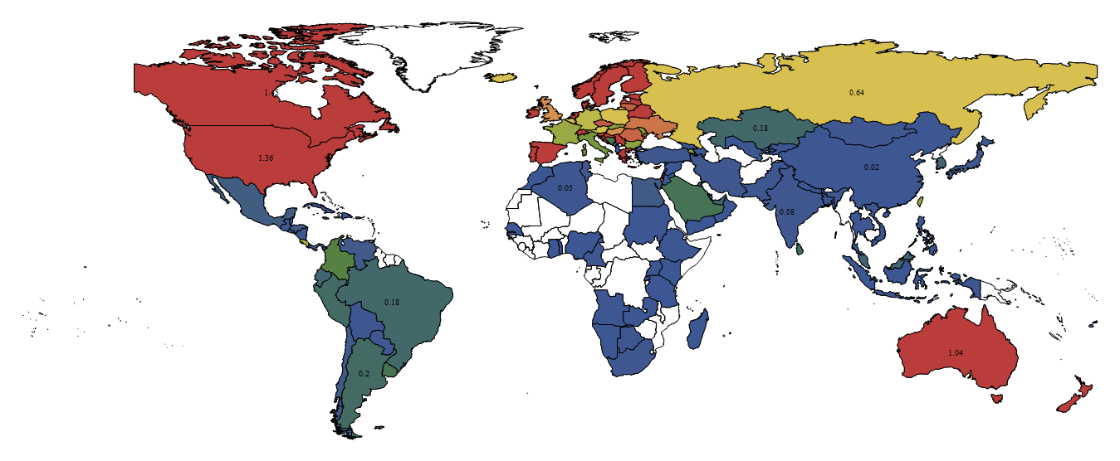
Visitors from each Country / Population
Formula = number of visitors * 10000 / population

Slide 17
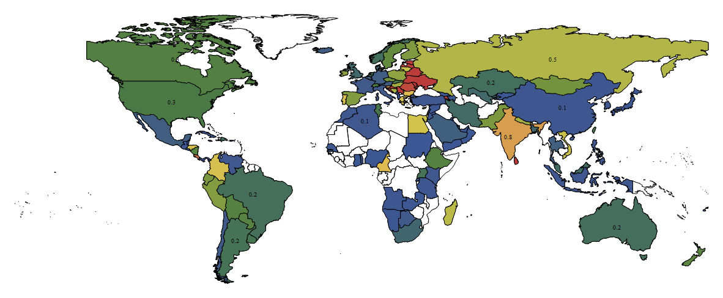
Visitors from each Country / GDP
Formula = number of visitors * 100000000/ population

Slide 18
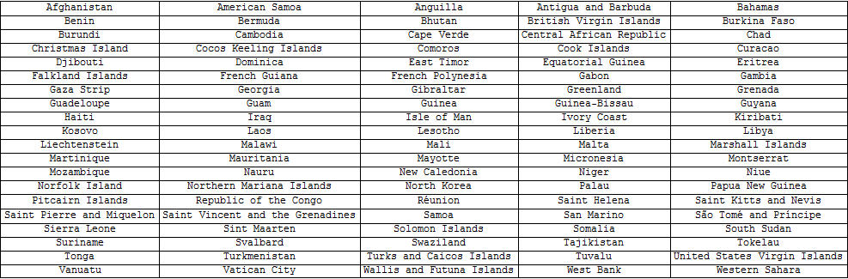
Countries with no Visits
Visits from 144 Countries

Slide 19
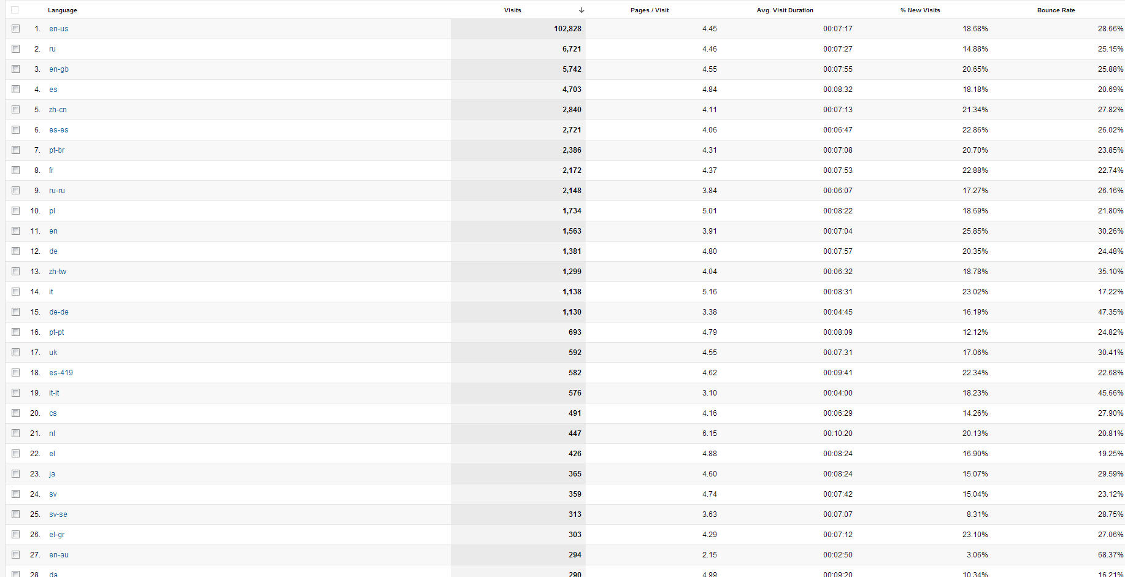
Language of Visitors

Slide 20
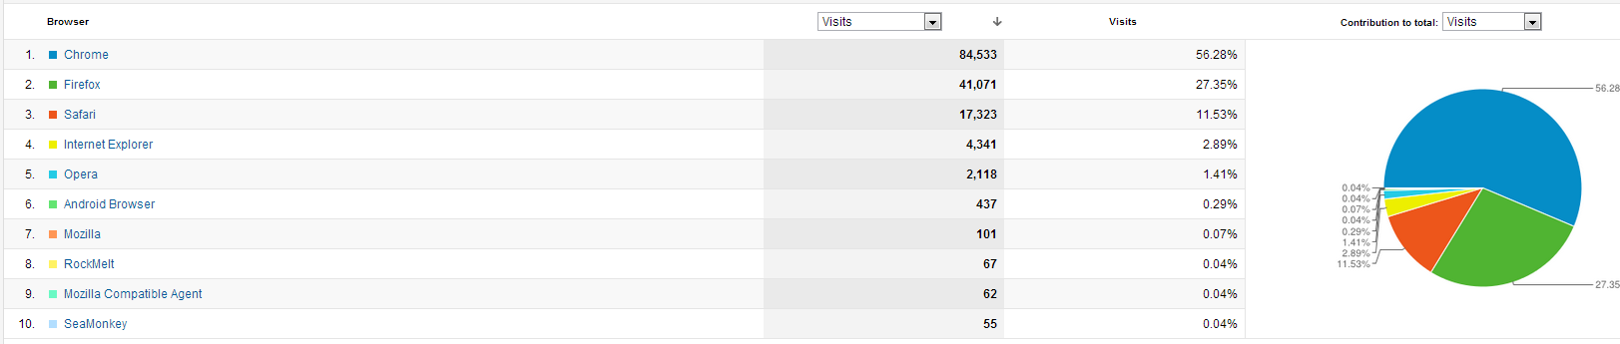
Browser

Slide 21
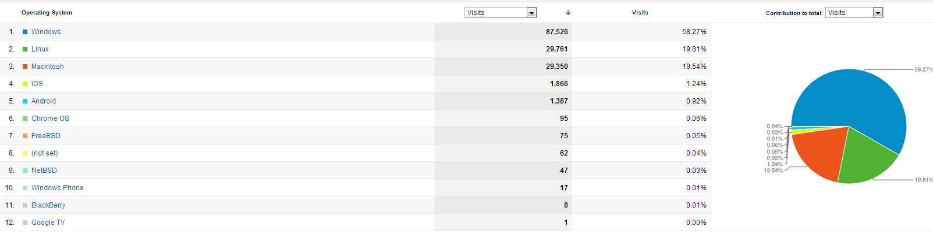
OS

