Slide 1
wbGPU
A way to have 10,000 people participate in a CUDA course with just a web browser.

Slide 2
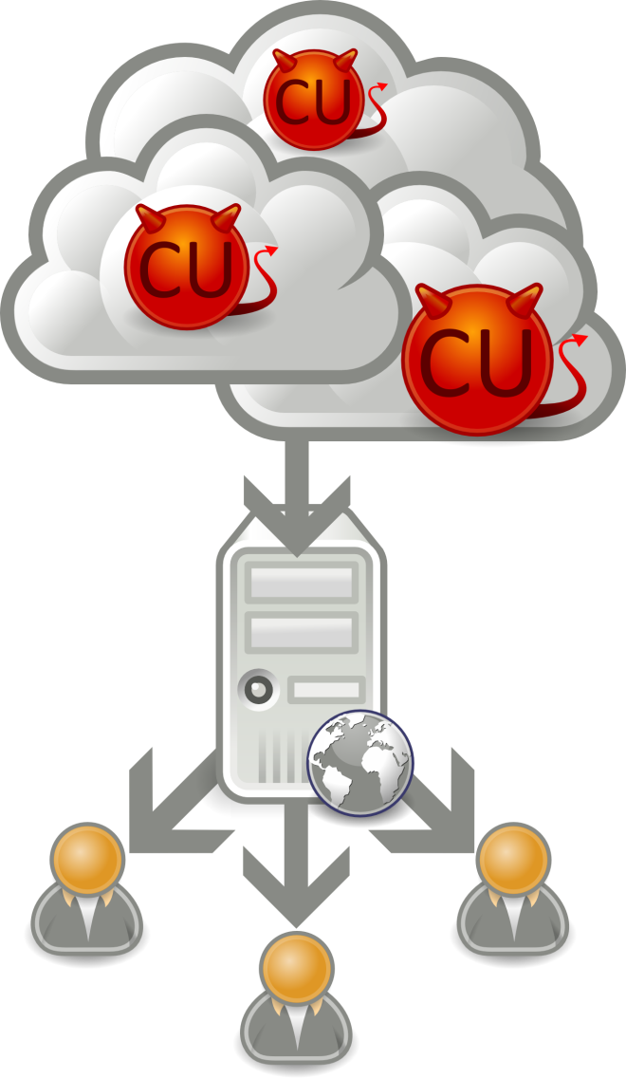
Architecture
Some CU daemons live in the cloud.
They register their services with a server.
The users communicate with the web server which then distributes the job to one of the daemons.
Highly parallel and fault tolerant.

Slide 3
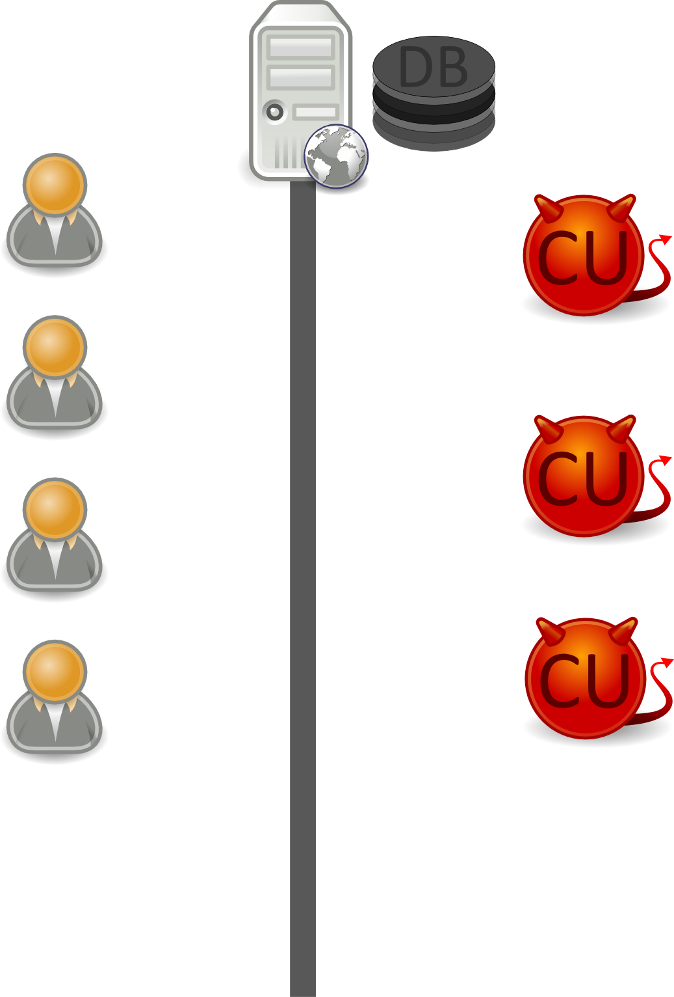
Flow –

Slide 4
Status
Almost done.
Third implementation (in the third language) must account for something.

Slide 5
Demo

Slide 6
Scenarios
User inputs a program that won’t compile – return an error.
User wants to time sections of the code – a timer library is included in the code.
User wants to see the values of expressions in the code – a logging library is included in the code.
User wants to look at previous attempts – all previous attempts are recorded and shown.
User submits a program that’s an infinite loop – the daemon launches the program as a separate application and kills it after a certain time.

Slide 7
Next Steps
Port the MPs to this interface (this may require adjusting the wording of the MPs).
Add some code that checks if the output returned is what is expected.
Come up with a formula to fairly grade the MPs based on timing and correctness.
Beef up the scheduler, currently it nonexistent.
Testing especially with AWS (we need to create an account that would charge the right people).
Need to test on browsers other than chrome.
Implement login system.
Allow people to submit jobs and see the results at a later time (useful when we exhausted all our cloud resources).

