Slide 1
Decision Trees and Randomforest
Jony Sugianto
jony@evolvemachinelearners.com
0812-13086659
github.com/jonysugianto

Slide 2
Example of a Decision Tree
categorical
categorical
continuous
class
Splitting Attributes
Refund
Yes
No
NO
MarSt
Single, Divorced
Married
TaxInc
NO
< 85K
>= 85K
NO
YES
Training Data
Model: Decision Tree

Slide 3
Example of a Decision Tree
categorical
categorical
continuous
class
Splitting Attributes
Refund
Yes
No
NO
MarSt
Single, Divorced
Married
TaxInc
NO
< 85K
>= 85K
NO
YES
Training Data
Model: Decision Tree

Slide 4
Another Example of Decision Tree
categorical
categorical
continuous
class
MarSt
Single, Divorced
Married
NO
Refund
Yes
No
NO
TaxInc
< 80K
> 80K
NO
YES
There could be more than one tree that fits the same data!

Slide 5
kategori
Bil kontinu
kategori
Kelas (y)
MarSt
Single, Divorced
Married
NO
Refund
Yes
No
NO
TaxInc
< 85K
>=85K
NO
YES
Selalu terdapat kemungkinan ada lebih dari satu model pohon yang cocok dengan data yang sama!

Slide 6
Apply Model to Test Data
Start from the root of tree.
Test Data
Refund
Yes
No
NO
MarSt
Single, Divorced
Married
TaxInc
NO
< 80K
> 80K
NO
YES

Slide 7
Aplikasi model
Dimulai dari akar pohon
Test Data
Refund
Yes
No
NO
MarSt
Single, Divorced
Married
TaxInc
NO
< 85K
> =85K
NO
YES

Slide 8
Apply Model to Test Data
Test Data
Refund
Yes
No
NO
MarSt
Single, Divorced
Married
TaxInc
NO
< 80K
> 80K
NO
YES

Slide 9
Apply Model to Test Data
Test Data
Refund
Yes
No
NO
MarSt
Single, Divorced
Married
TaxInc
NO
< 80K
> 80K
NO
YES

Slide 10
Apply Model to Test Data
Test Data
Refund
Yes
No
NO
MarSt
Single, Divorced
Married
TaxInc
NO
< 80K
> 80K
NO
YES

Slide 11
Apply Model to Test Data
Test Data
Refund
Yes
No
NO
MarSt
Single, Divorced
Married
TaxInc
NO
< 80K
> 80K
NO
YES

Slide 12
Apply Model to Test Data
Test Data
Refund
Yes
No
NO
MarSt
Single, Divorced
Married
Assign Cheat to “No”
TaxInc
NO
< 80K
> 80K
NO
YES

Slide 13
Test Data
Refund
Yes
No
NO
MarSt
Single, Divorced
Married
Jawaban yang tepat untuk kelas cheat adalah “No”
TaxInc
NO
< 85K
> =85K
NO
YES

Slide 14
Tree Induction
Greedy strategy.
  Split the records based on an attribute test that optimizes certain criterion.
Issues
  Determine how to split the records
    How to specify the attribute test condition?
    How to determine the best split?
  Determine when to stop splitting

Slide 15
Tree Induction
Greedy strategy.
  Split the records based on an attribute test that optimizes certain criterion.
Issues
  Determine how to split the records
    How to specify the attribute test condition?
    How to determine the best split?
  Determine when to stop splitting

Slide 16
How to Specify Test Condition?
Depends on attribute types
  Nominal
  Ordinal
  Continuous
Depends on number of ways to split
  2-way split
  Multi-way split

Slide 17
Splitting Based on Nominal Attributes
Multi-way split: Use as many partitions as distinct values.
Binary split: Divides values into two subsets.
Need to find optimal partitioning.
CarType
Family
Luxury
Sports
CarType
OR
CarType
{Sports, Luxury}
{Family,
Luxury}
{Family}
{Sports}

Slide 18
Splitting Based on Ordinal Attributes
Multi-way split: Use as many partitions as distinct values.
Binary split: Divides values into two subsets.
Need to find optimal partitioning.
What about this split?
Size
Small
Large
Medium
Size
Size
{Small, Medium}
OR
{Medium,
Large}
{Large}
{Small}
Size
{Small, Large}
{Medium}

Slide 19
Splitting Based on Continuous Attributes
Different ways of handling
  Discretization to form an ordinal categorical attribute
    Static – discretize once at the beginning
    Dynamic – ranges can be found by equal interval bucketing, equal frequency bucketing
    (percentiles), or clustering.
  Binary Decision: (A < v) or (A ≥ v)
    consider all possible splits and finds the best cut
    can be more compute intensive

Slide 20
Splitting Based on Continuous Attributes

Slide 21
Tree Induction
Greedy strategy.
  Split the records based on an attribute test that optimizes certain criterion.
Issues
  Determine how to split the records
    How to specify the attribute test condition?
    How to determine the best split?
  Determine when to stop splitting

Slide 22
How to determine the Best Split
Before Splitting: 10 records of class 0,
10 records of class 1
Yang manakah kondisi tes terbaik?

Slide 23
Own Car | Car type | Student ID | Kelas
Yes | Fam | 1 | c0
Yes | Sprt | 2 | c0
Yes | Sprt | 3 | c0
Yes | Sprt | 4 | c0
Yes | Sprt | 5 | c0
Yes | Sprt | 6 | c0
Yes | Fam | 11 | c1
Yes | Fam | 12 | c1
Yes | Fam | 13 | c1
Yes | Lux | 14 | c1
Own Car | Car type | Student ID | Kelas
No | Sprt | 7 | c0
No | Sprt | 8 | c0
No | Sprt | 9 | c0
No | Lux | 10 | c0
No | Lux | 15 | c1
No | Lux | 16 | c1
No | Lux | 17 | c1
No | Lux | 18 | c1
No | Lux | 19 | c1
No | Lux | 20 | c1

Slide 24
How to determine the Best Split
Greedy approach:
  Nodes with homogeneous class distribution are preferred
Need a measure of node impurity:
Non-homogeneous,
High degree of impurity
Homogeneous,
Low degree of impurity

Slide 25
Tidak homogen,Tingkat ketidakmurnian yang tinggi
Homogen,Tingkat ketidakmurnian rendah

Slide 26
Measures of Node Impurity
Gini Index
Entropy
Misclassification error

Slide 27
How to Find the Best Split
Before Splitting:
M0
A?
B?
Yes
No
Yes
No
Node N1
Node N2
Node N3
Node N4
M1
M2
M3
M4
M12
M34
Gain = M0 – M12 vs M0 – M34

Slide 28
Sebelum Splitting:
M0
c = kelas
M = model
A?
B?
Yes
No
Yes
No
Node N1
Node N2
Node = simpul
Node N3
Node N4
M1
M2
M3
M4
M12
M34
Gain = M0 – M12 vs M0 – M34

Slide 29
Measure of Impurity: GINI
Gini Index for a given node t :
    (NOTE: p( j | t) is the relative frequency of class j at node t).
  Maximum (1 - 1/n_{c}) when records are equally distributed among all classes, implying least interesting information
  Minimum (0.0) when all records belong to one class, implying most interesting information

Slide 30
Examples for computing GINI
P(C1) = 0/6 = 0 P(C2) = 6/6 = 1
Gini = 1 – P(C1)² – P(C2)² = 1 – 0 – 1 = 0
P(C1) = 1/6 P(C2) = 5/6
Gini = 1 – (1/6)² – (5/6)² = 0.278
P(C1) = 2/6 P(C2) = 4/6
Gini = 1 – (2/6)² – (4/6)² = 0.444

Slide 31
Splitting Based on GINI
Used in CART, SLIQ, SPRINT.
When a node p is split into k partitions (children), the quality of split is computed as,
where, n_{i} = number of records at child i,
n = number of records at node p.

Slide 32
Binary Attributes: Computing GINI Index
Splits into two partitions
Effect of Weighing partitions:
  Larger and Purer Partitions are sought for.
B?
Yes
No
Gini(N1)
= 1 – (5/6)² – (2/6)²
= 0.194
Gini(N2)
= 1 – (1/6)² – (4/6)²
= 0.528
Node N1
Node N2
Gini(Children)
= 7/12 * 0.194 +
5/12 * 0.528
= 0.333

Slide 33
Categorical Attributes: Computing Gini Index
For each distinct value, gather counts for each class in the dataset
Use the count matrix to make decisions
Multi-way split
Two-way split
(find best partition of values)

Slide 34
Continuous Attributes: Computing Gini Index
Use Binary Decisions based on one value
Several Choices for the splitting value
  Number of possible splitting values
  = Number of distinct values
Each splitting value has a count matrix associated with it
  Class counts in each of the partitions, A < v and A ≥ v
Simple method to choose best v
  For each v, scan the database to gather count matrix and compute its Gini index
  Computationally Inefficient! Repetition of work.

Slide 35
Continuous Attributes: Computing Gini Index...
For efficient computation: for each attribute,
  Sort the attribute on values
  Linearly scan these values, each time updating the count matrix and computing gini index
  Choose the split position that has the least gini index
Sorted Values
Split Positions

Slide 36
Alternative Splitting Criteria based on INFO
Entropy at a given node t:
    (NOTE: p( j | t) is the relative frequency of class j at node t).
  Measures homogeneity of a node.
    Maximum (log n_{c}) when records are equally distributed among all classes implying least information
    Minimum (0.0) when all records belong to one class, implying most information
  Entropy based computations are similar to the GINI index computations

Slide 37
Examples for computing Entropy
P(C1) = 0/6 = 0 P(C2) = 6/6 = 1
Entropy = – 0 log 0 – 1 log 1 = – 0 – 0 = 0
P(C1) = 1/6 P(C2) = 5/6
Entropy = – (1/6) log₂ (1/6) – (5/6) log₂ (1/6) = 0.65
P(C1) = 2/6 P(C2) = 4/6
Entropy = – (2/6) log₂ (2/6) – (4/6) log₂ (4/6) = 0.92

Slide 38
Splitting Based on INFO...
Information Gain:
    Parent Node, p is split into k partitions;
    n_{i} is number of records in partition i
  Measures Reduction in Entropy achieved because of the split. Choose the split that achieves most reduction (maximizes GAIN)
  Used in ID3 and C4.5
  Disadvantage: Tends to prefer splits that result in large number of partitions, each being small but pure.

Slide 39
Splitting Based on INFO...
Gain Ratio:
    Parent Node, p is split into k partitions
    n_{i} is the number of records in partition i
  Adjusts Information Gain by the entropy of the partitioning (SplitINFO). Higher entropy partitioning (large number of small partitions) is penalized!
  Used in C4.5
  Designed to overcome the disadvantage of Information Gain

Slide 40
Splitting Criteria based on Classification Error
Classification error at a node t :
Measures misclassification error made by a node.
    Maximum (1 - 1/n_{c}) when records are equally distributed among all classes, implying least interesting information
    Minimum (0.0) when all records belong to one class, implying most interesting information

Slide 41
Examples for Computing Error
P(C1) = 0/6 = 0 P(C2) = 6/6 = 1
Error = 1 – max (0, 1) = 1 – 1 = 0
P(C1) = 1/6 P(C2) = 5/6
Error = 1 – max (1/6, 5/6) = 1 – 5/6 = 1/6
P(C1) = 2/6 P(C2) = 4/6
Error = 1 – max (2/6, 4/6) = 1 – 4/6 = 1/3

Slide 42
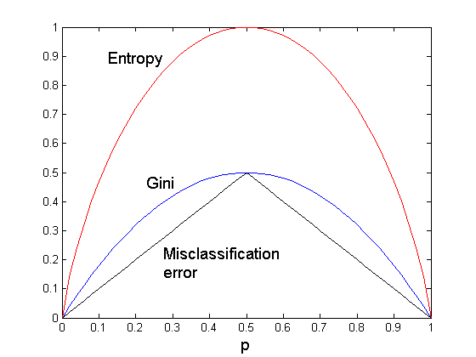
Comparison among Splitting Criteria
For a 2-class problem:

Slide 43
Tree Induction
Greedy strategy.
  Split the records based on an attribute test that optimizes certain criterion.
Issues
  Determine how to split the records
    How to specify the attribute test condition?
    How to determine the best split?
  Determine when to stop splitting

Slide 44
Stopping Criteria for Tree Induction
Stop expanding a node when all the records belong to the same class
Stop expanding a node when all the records have similar attribute values
Early termination (to be discussed later)

Slide 45
Decision Tree Based Classification
Advantages:
  Inexpensive to construct
  Extremely fast at classifying unknown records
  Easy to interpret for small-sized trees
  Accuracy is comparable to other classification techniques for many simple data sets

Slide 46
Comparison Randomforest and Decision Tree
Decision Tree is one tree.
Random Forest is many trees

Slide 47
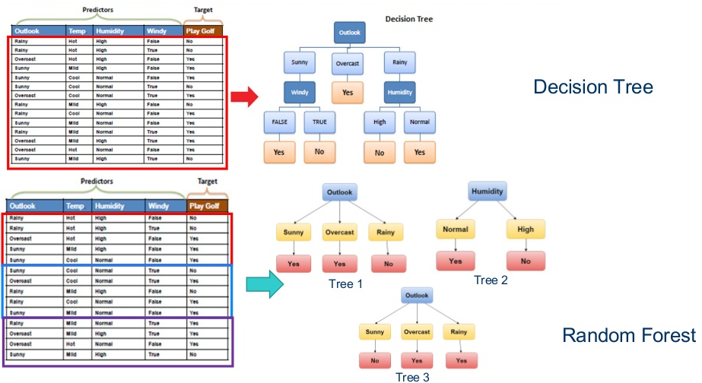
Comparison Randomforest and Decision Tree

Slide 48
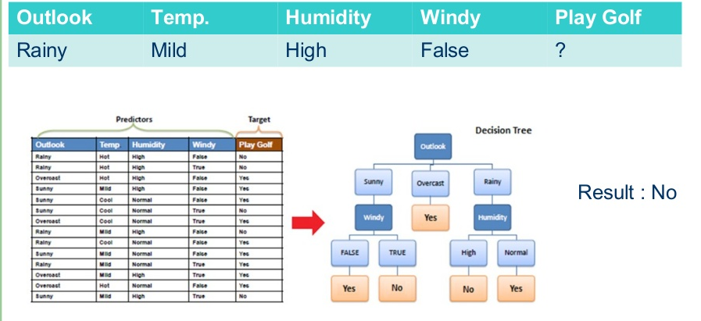
Decision Tree Result

Slide 49
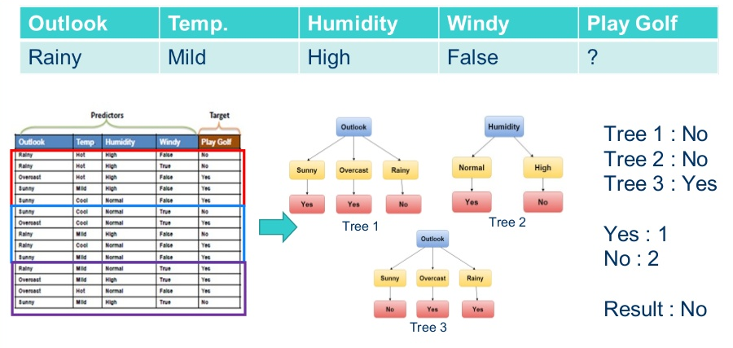
Random Forest Result

Slide 50
Random Forest Advantages
Can handle missing data
Robust to outlier in training data
Better generalization than decision tree.
Variable importances

Slide 51
Scikit-Learn Decision Tree Classifier
class sklearn.tree.DecisionTreeClassifier(criterion=’gini’, splitter=’best’, max_depth=None, min_samples_split=2, min_samples_leaf=1, min_weight_fraction_leaf=0.0, max_features=None, random_state=None, max_leaf_nodes=None, min_impurity_decrease=0.0, min_impurity_split=None, class_weight=None, presort=False)
Criterion:
  Gini
  Entropy

Slide 52
Scikit-Learn Decision Tree Regressor
class sklearn.tree.DecisionTreeRegressor(criterion=’mse’, splitter=’best’, max_depth=None, min_samples_split=2, min_samples_leaf=1, min_weight_fraction_leaf=0.0, max_features=None, random_state=None, max_leaf_nodes=None, min_impurity_decrease=0.0, min_impurity_split=None, presort=False)
Criterion:
  mse
  mae

Slide 53
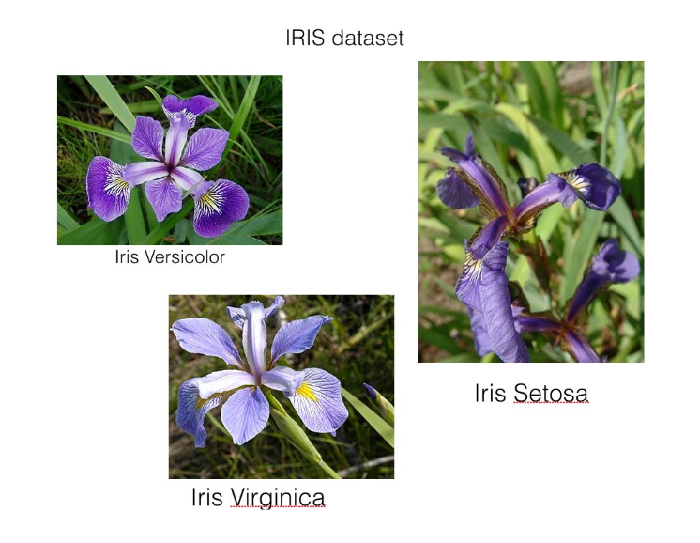
Irish Flower Dataset

Slide 54
Decision Tree Irish flower classification
# Import
from sklearn.tree import DecisionTreeClassifier
from sklearn.cross_validation import train_test_split
# Load irisdewfre dataset
from sklearn.datasets import load_iris
from sklearn import metrics
# Instantiate
iris = load_iris()
# Create training and feature
X = iris.data
y = iris.target
# Split data
X_train, X_test, y_train, y_test = train_test_split(X, y, random_state=0, test_size=0.25)

Slide 55
Decision Tree Irish flower classification
# 1. Instantiate
# default criterion=gini
# you can swap to criterion=entropy
dtc = DecisionTreeClassifier(random_state=0, criterion='gini')
# 2. Fit
dtc.fit(X_train, y_train)
# 3. Predict, there're 4 features in the irisdewfre dataset
y_test_pred_class = dtc.predict(X_test)
y_train_pred_class = dtc.predict(X_train)
result_test=metrics.accuracy_score(y_test, y_test_pred_class)
result_train=metrics.accuracy_score(y_train, y_train_pred_class)
print('accuracy on train dataset', result_train)
print('accuracy on test dataset', result_test)

Slide 56
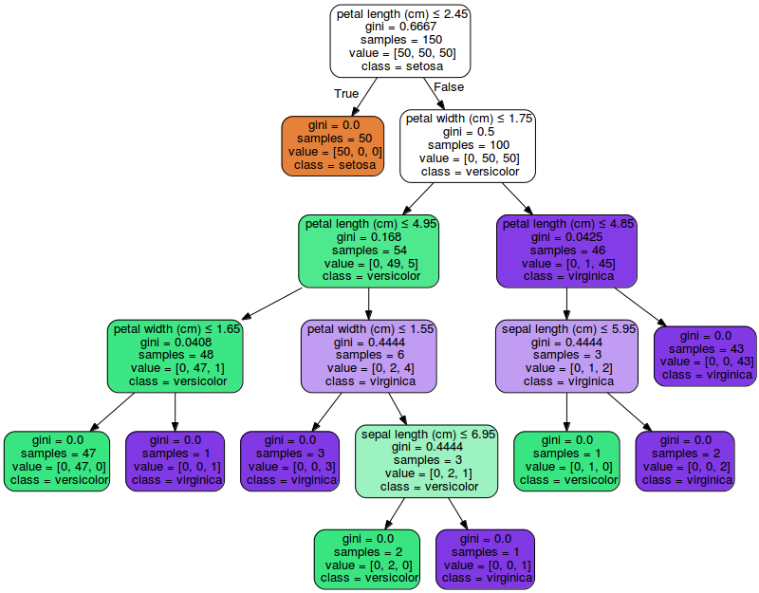
Learned Tree

Slide 57
Randomforest Irish flower classification
# Import
from sklearn.ensemble import RandomForestClassifier
from sklearn.cross_validation import train_test_split
# Load irisdewfre dataset
from sklearn.datasets import load_iris
from sklearn import metrics
# Instantiate
iris = load_iris()
# Create training and feature
X = iris.data
y = iris.target
# Split data
X_train, X_test, y_train, y_test = train_test_split(X, y, random_state=0, test_size=0.25)

Slide 58
Randomforest Irish flower classification
rfc = RandomForestClassifier(n_jobs=2, random_state=0, n_estimators=5)
# 2. Fit
rfc.fit(X_train, y_train)
# 3. Predict, there're 4 features in the irisdewfre dataset
y_test_pred_class = rfc.predict(X_test)
y_train_pred_class = rfc.predict(X_train)
result_test=metrics.accuracy_score(y_test, y_test_pred_class)
result_train=metrics.accuracy_score(y_train, y_train_pred_class)
print('accuracy on train dataset', result_train)
print('accuracy on test dataset', result_test)

Slide 59

Euro Banknotes Authentification

Slide 60
Computed Features
Data Set Information:
  The Banknotes images have 400x 400 pixels. Wavelet Transform tool were used to extract features from images.
Attribute Information:
  variance of Wavelet Transformed image (continuous)
  skewness of Wavelet Transformed image (continuous)
  curtosis of Wavelet Transformed image (continuous)
  entropy of image (continuous)
  class (integer)

Slide 61
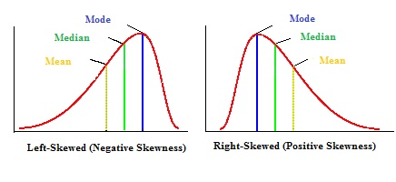
Skewness

Slide 62
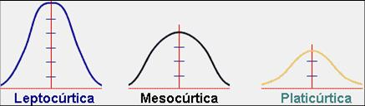
curtosis

Slide 63
Computed Features
Variance, Skewness, Curtosis, Entropy, Class
4.6499,7.6336,-1.9427,-0.37458,0
4.0127,10.1477,-3.9366,-4.0728,0
3.2414,0.40971,1.4015,1.1952,0
2.2504,3.5757,0.35273,0.2836,0
-1.3971,3.3191,-1.3927,-1.9948,1
0.39012,-0.14279,-0.031994,0.35084,1
-2.2804,-0.30626,1.3347,1.3763,1
-1.7582,2.7397,-2.5323,-2.234,1

Slide 64
Random forest banknote authentification
Import library
from sklearn.ensemble import RandomForestClassifier
import numpy as np
import random
from sklearn import metrics
import pickle

Slide 65
Random forest banknote authentification
load data
def load_data(filename, percentfortrain):
data=np.genfromtxt(filename, delimiter=',')
size=len(data)
x_train=[]
y_train=[]
x_test=[]
y_test=[]
for i in range(size):
x_data = data[i][0:4]
y_data = data[i][4]
rn=random.random()
if rn<percentfortrain:
#train
x_train.append(x_data)
y_train.append(y_data)
#for j in range(0, 3):
# x_train.append(data[i])
else:
#test
x_test.append(x_data)
y_test.append(y_data)
return x_train, y_train, x_test, y_test

Slide 66
Random forest banknote authentification
# Set random seed
np.random.seed(0)
x_train, y_train, x_test, y_test=load_data('data_banknote_authentication.csv', 0.75)
# Create a random forest Classifier. By convention, clf means 'Classifier'
clf = RandomForestClassifier(n_jobs=2, random_state=0)

Slide 67
Random forest banknote authentification
clf.fit(x_train, y_train)
# Create actual english names for the plants for each predicted plant class
y_train_pred = clf.predict(x_train)
y_test_pred = clf.predict(x_test)

Slide 68
Random forest banknote authentification
print ('========features importances=====================')
# Create confusion matrix
# View a list of the features and their importance scores
print (clf.feature_importances_)
accuracy_train = metrics.accuracy_score(y_train, y_train_pred)
print ('accuracy_train',accuracy_train)
accuracy_test = metrics.accuracy_score(y_test, y_test_pred)
print ('accuracy_test',accuracy_test)
# save to file
with open('randomforest_model.mdl', 'wb') as output:
pickle.dump(clf, output)

