Slide 1

Pipeline Instructions
Xinyu Xie

Slide 2
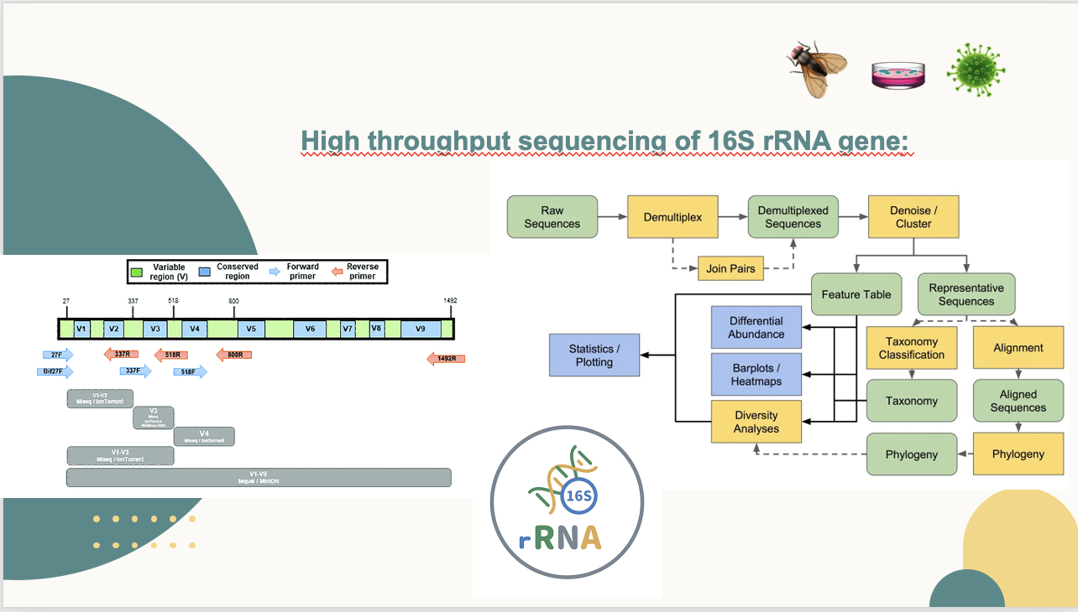

Slide 3

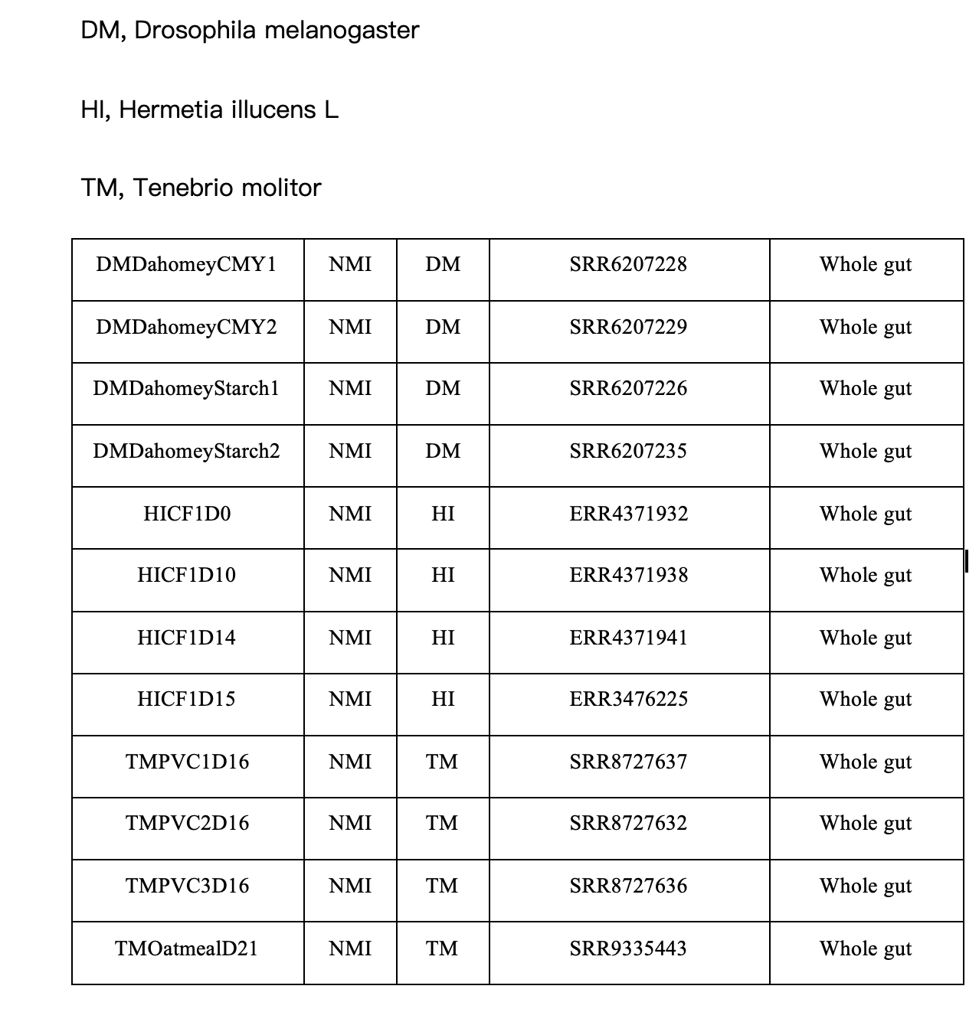
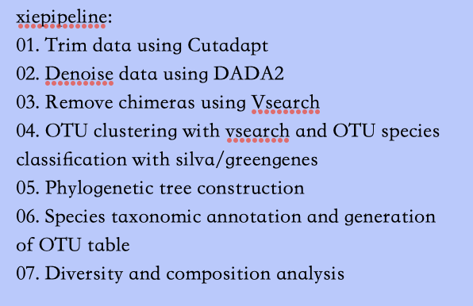
Guideline

Slide 4
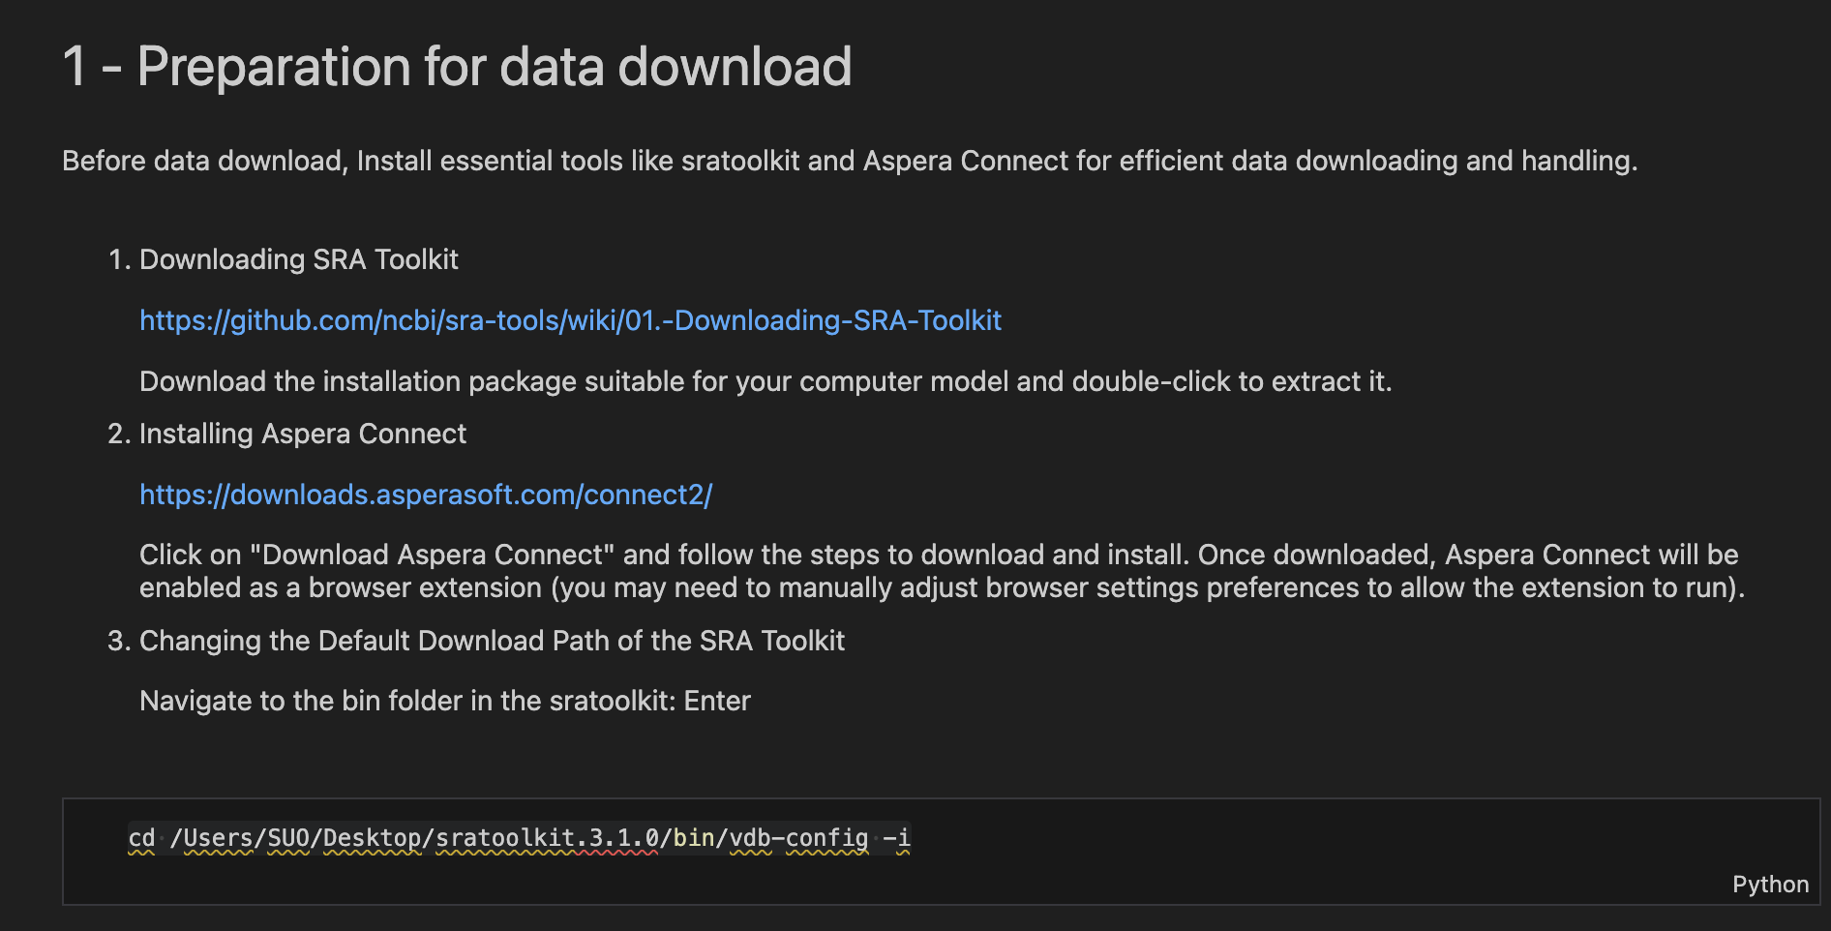
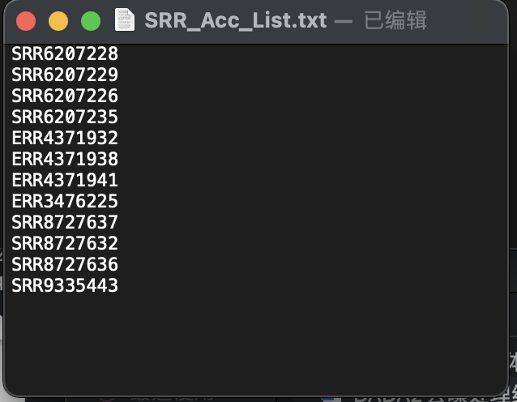
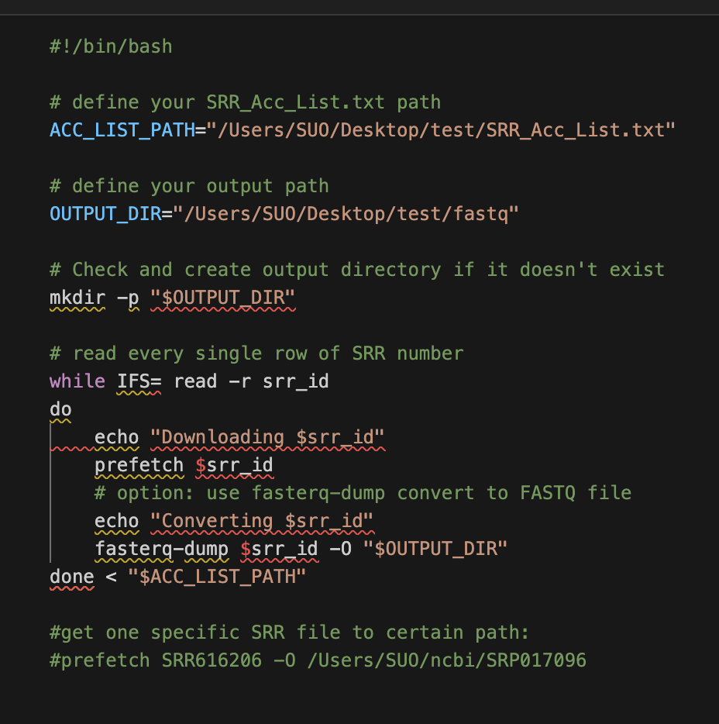


Slide 5

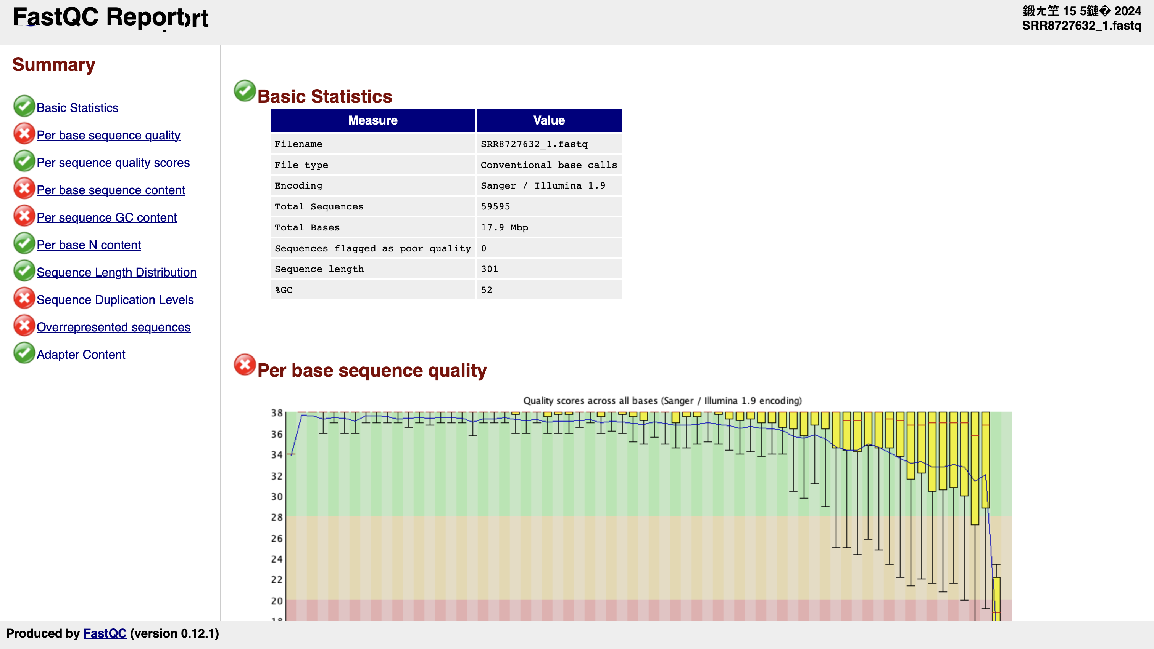

Slide 6

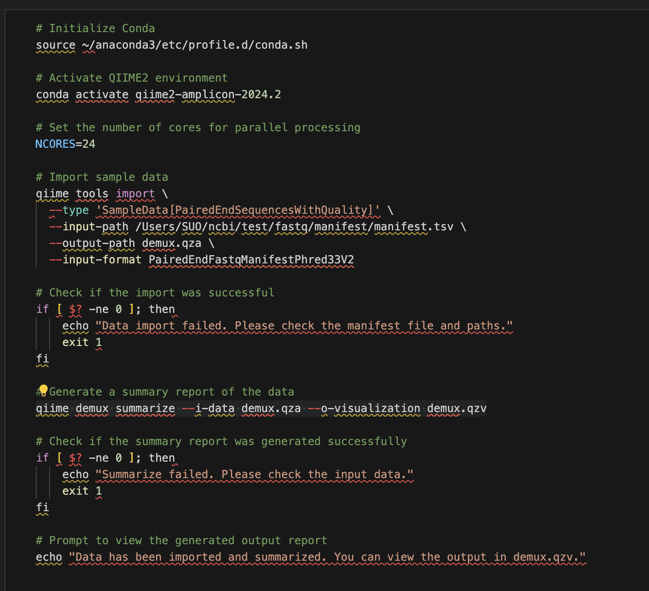
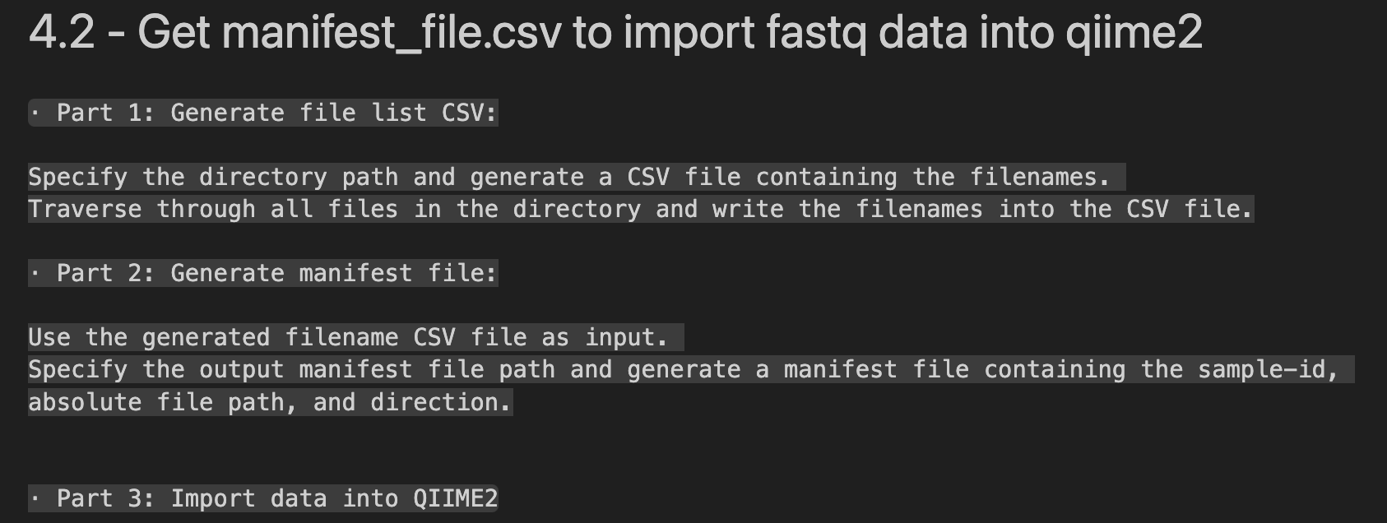


Slide 7
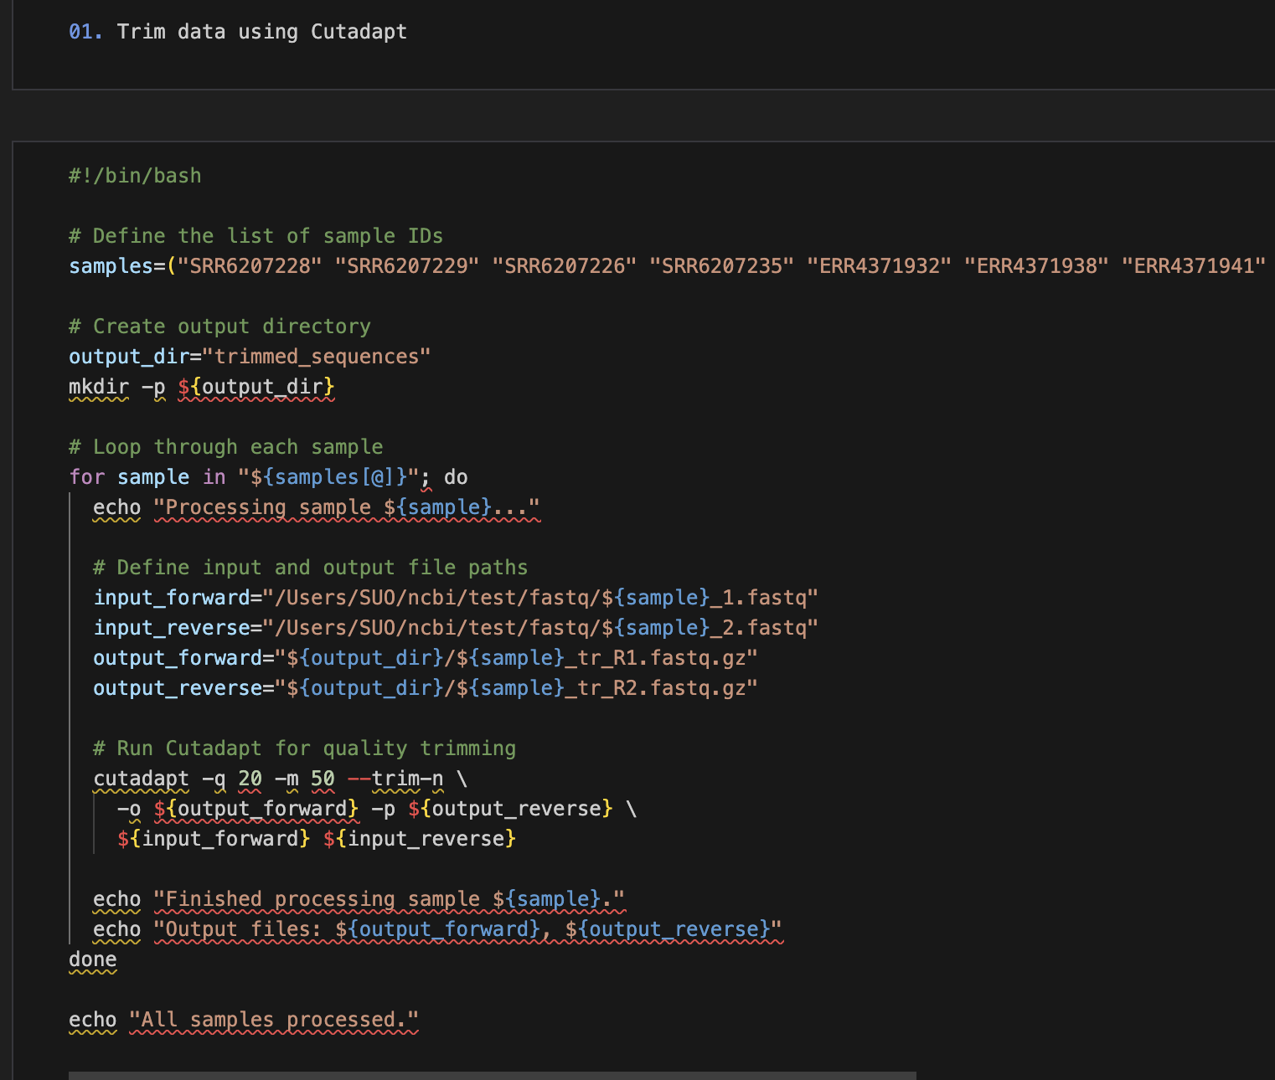
This runs the Cutadapt tool to perform quality trimming:
-q 20: Trims bases with quality below 20.
-m 50: Ensures that the minimum length of each read is 50 bases.
--trim-n: Trims 'N' bases from the end of sequences.
-o and -p: Specify the output paths for the forward and reverse trimmed files, respectively.
${input_forward} and ${input_reverse}: Specify the input paths for the forward and reverse FASTQ files, respectively.

Slide 8
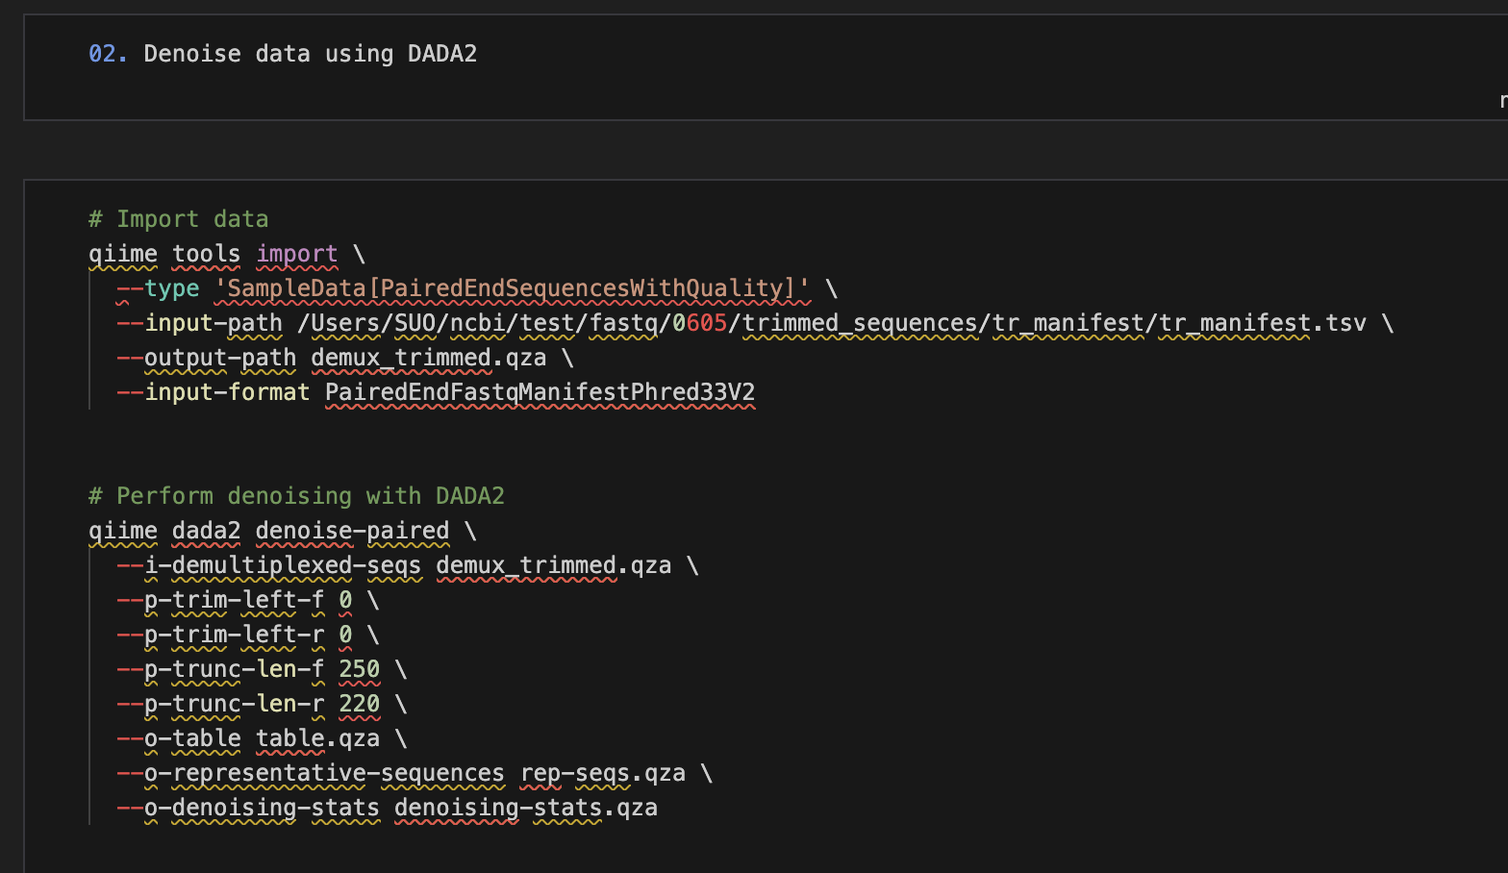
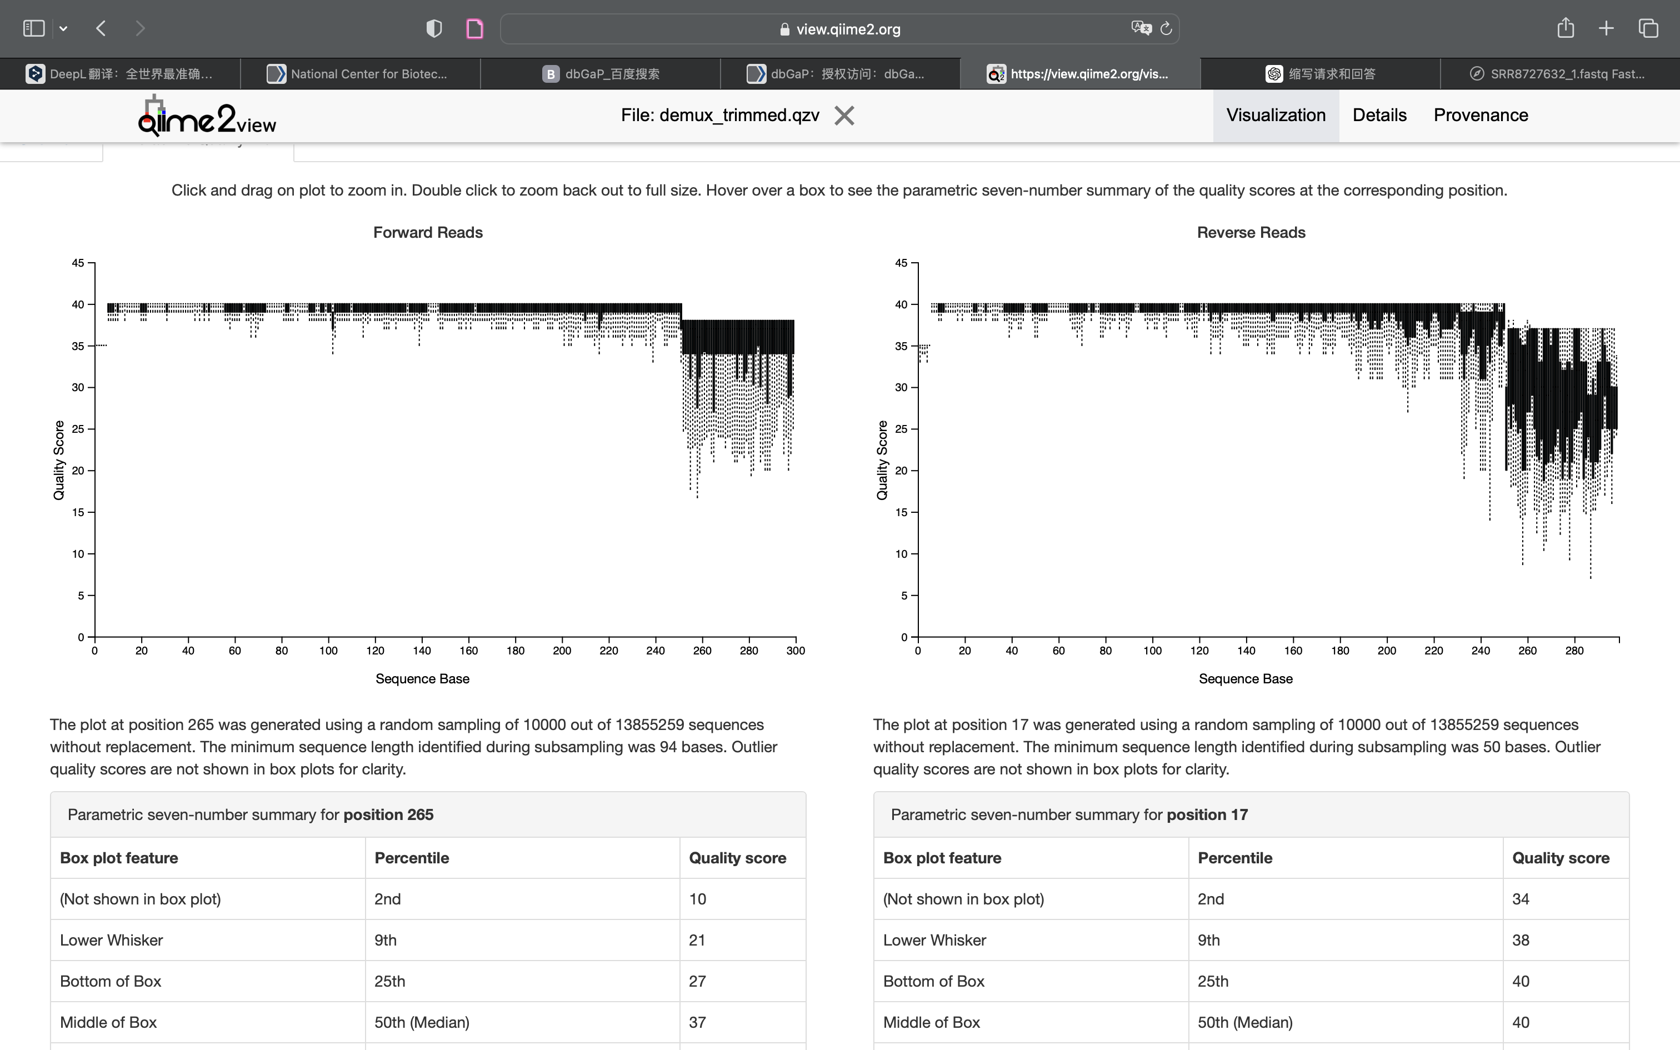

Slide 9
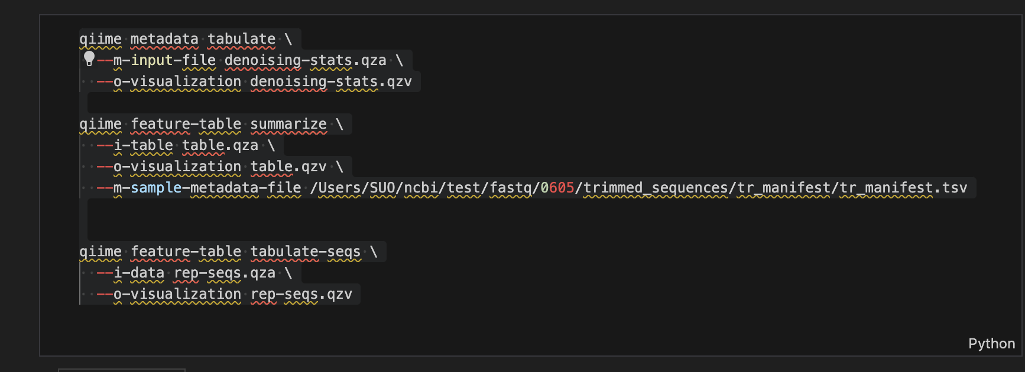
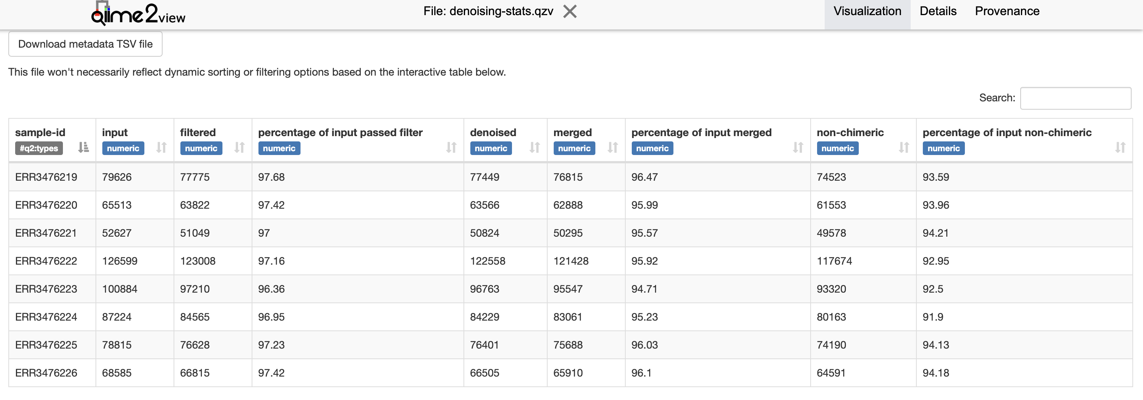

Slide 10
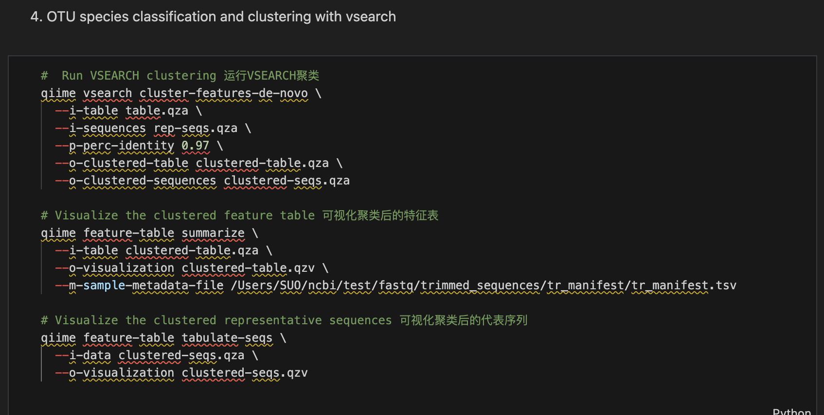
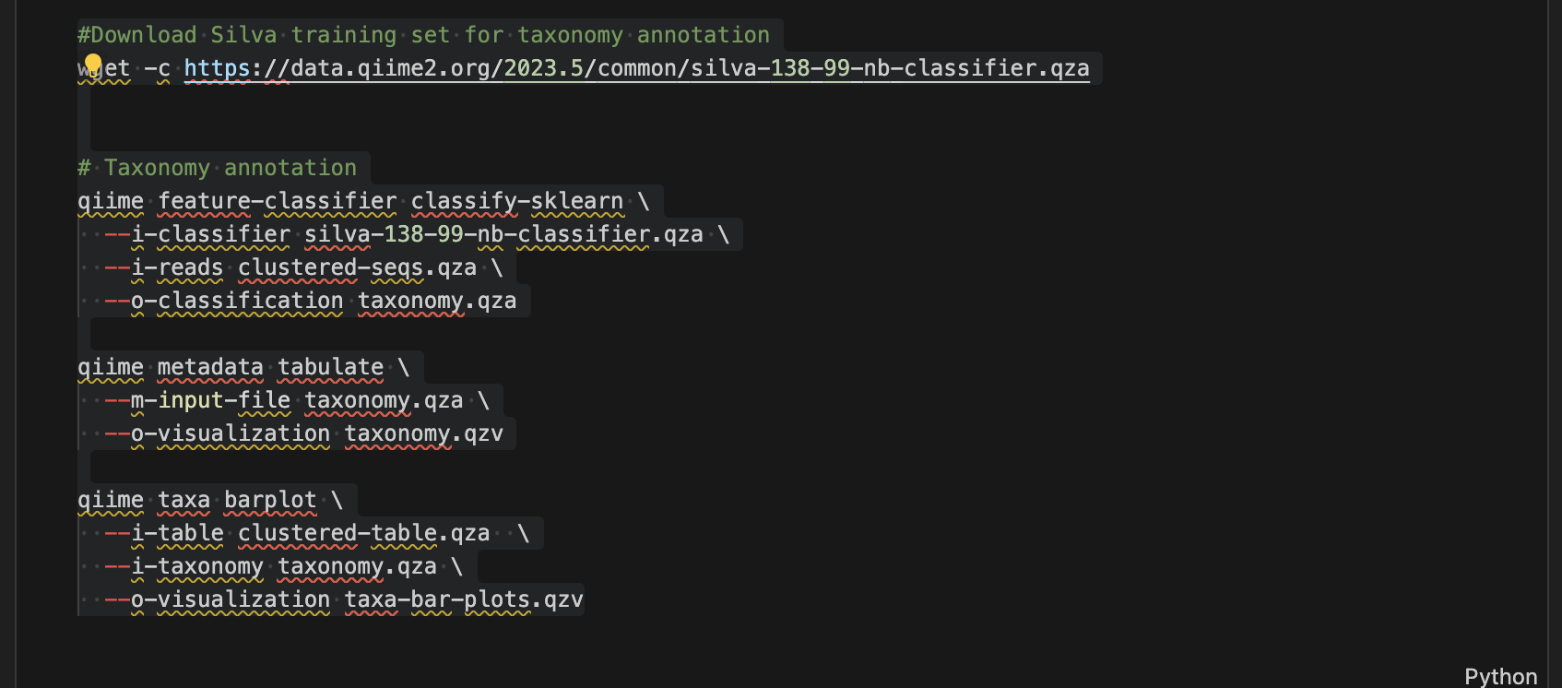

Slide 11
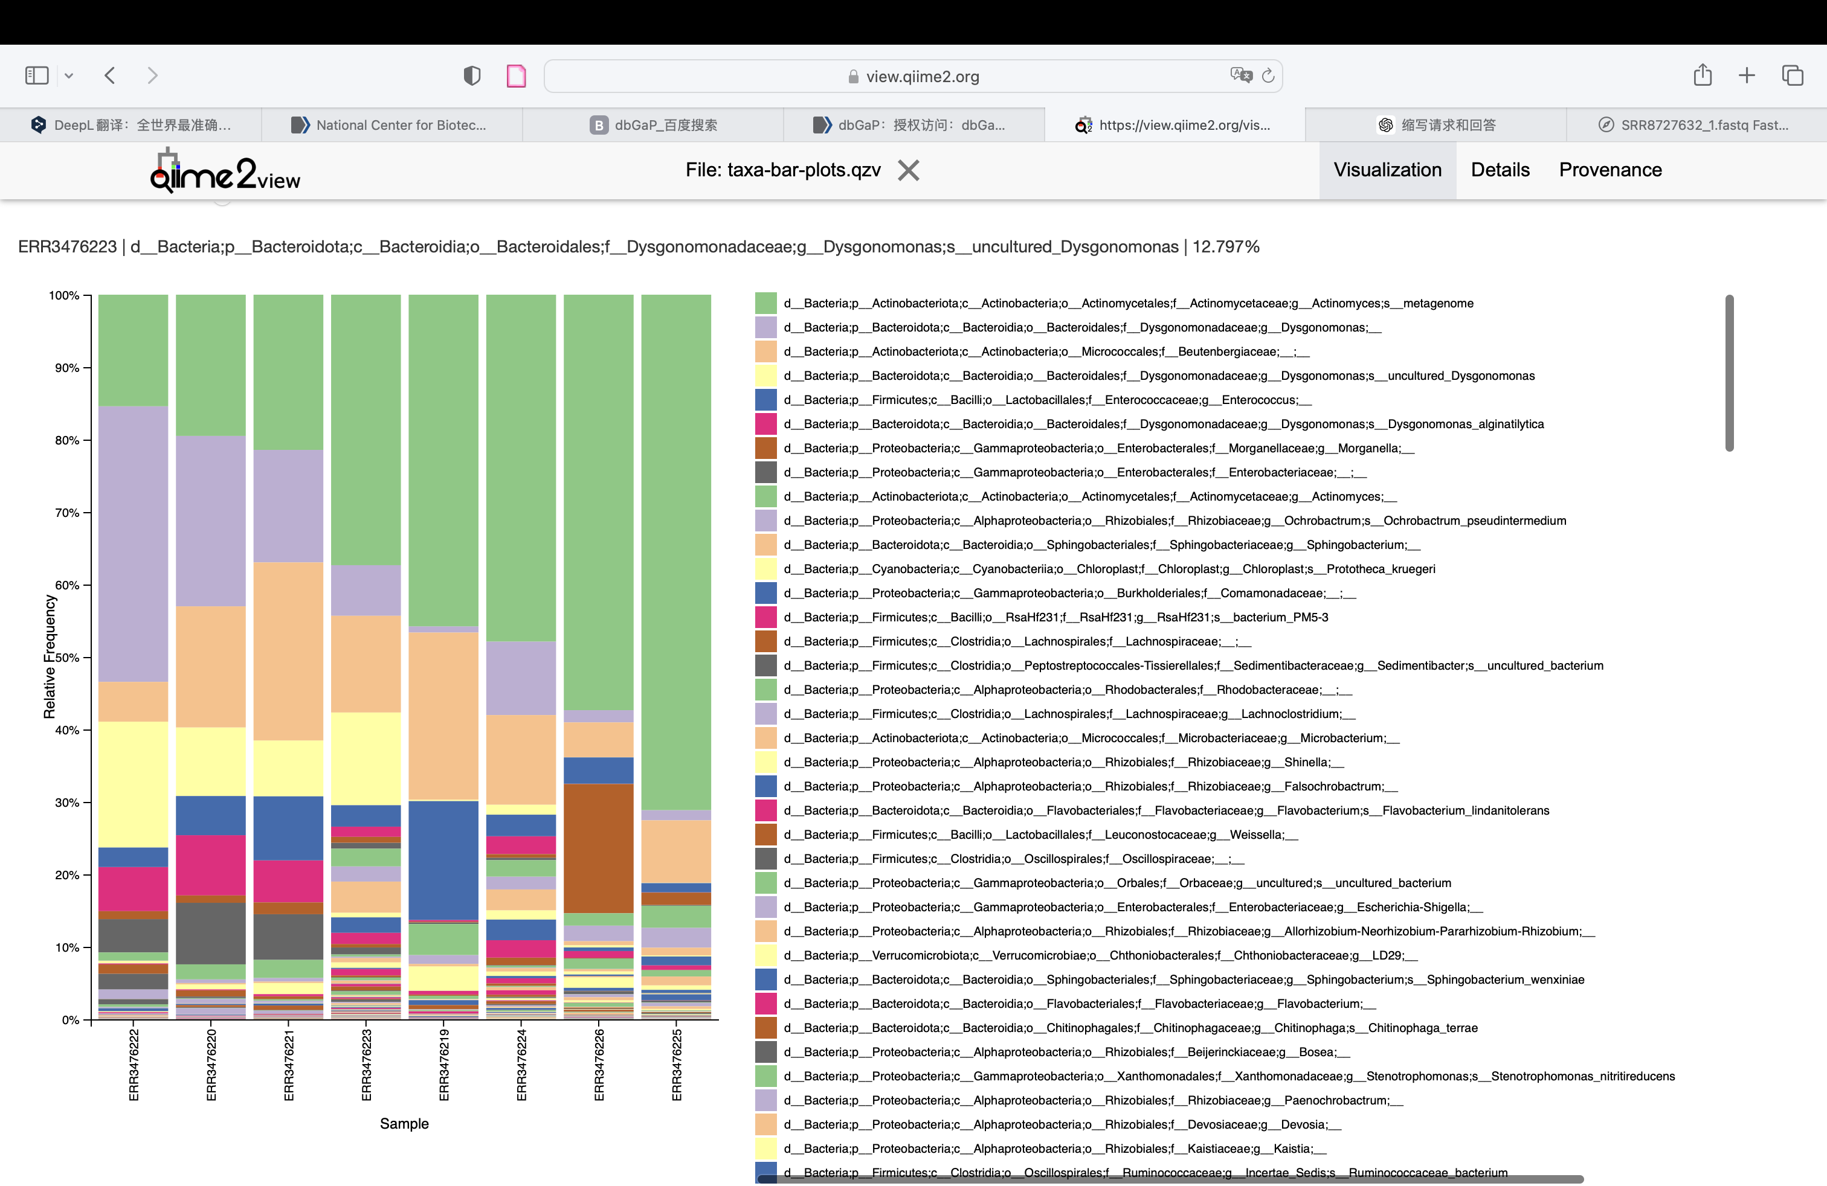

Slide 12
Thank you

