Slide 1
CI/CD pipeline for java app
DevOps External Online Course
Final Project
Yurii Pelykh

Slide 2
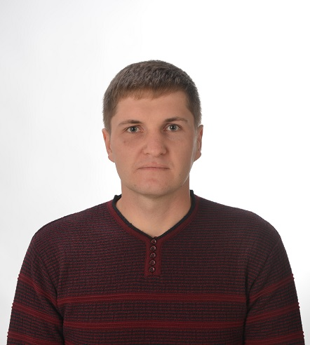
System engineer in middle company, providing outsourcing contact-center services
Experience of system administration for over than 6 years
Mostly work with VoIP

Slide 3
Motivation
I've always wondered what happens next with tons of code that programmers write and push to storages like GitHub.
Goal
Provide an automated continuous way of code’s changes integration and its deploy to required environments. Get acquaintance with constant code integration and constant delivery/deployment processes in a context of Java applications development. Get practical experience of work with main CI/CD tools.

Slide 4
Tasks
Build artifact
Infrastructure provision and configuration for:
Development (Dev) and Test environments
Production (Prod) environment
Delivery to dev/test environment
Deploy to production
Technology Stack
Jenkins – tasks automation and management tool
Terraform – infrastructure provisioning
Ansible – infrastructure configuration
Docker – services containerization on Dev/Test

Slide 5
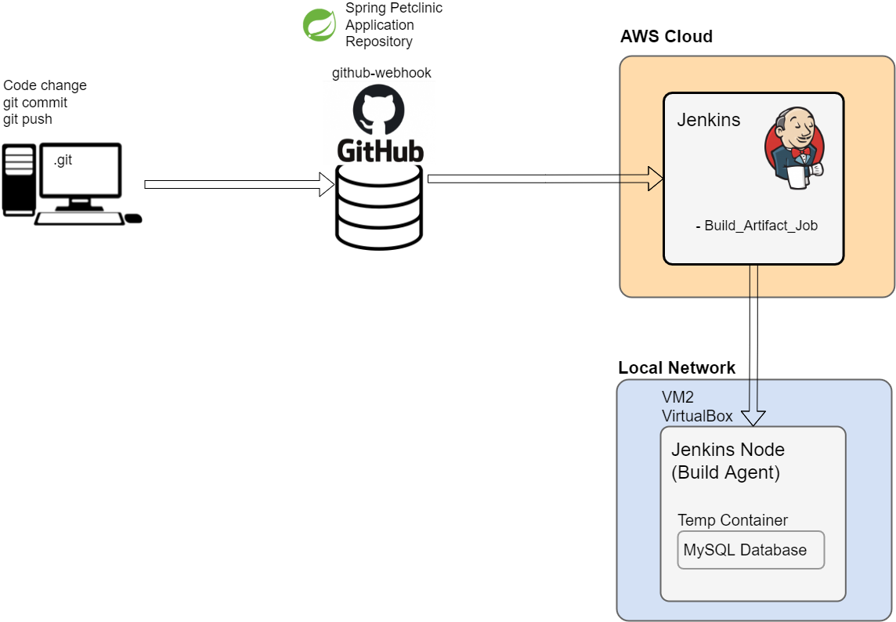
Integration
Build_Artifact_Job steps:
Poll changed files from GitHub
Creates a Docker container with MySQL DB for testing
Builds jar with Maven Integration plugin
Destroys Docker container
Packages an artifact to be sent to other jobs
Triggers Dev_Delivery_Job
Jenkins Build Agent was moved from Cloud to local PC for better productivity (than on t2.micro) and save costs.

Slide 6

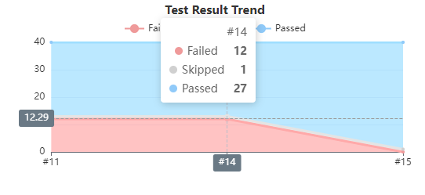
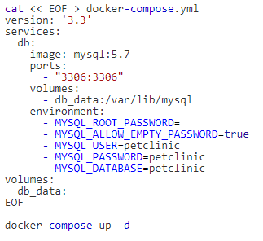
Build Artifact Job
Default DB in Spring Petclinic – h2. If switch it to external BD usage, part of integration tests failed because of database can not be found:
Solution – to use Docker and run a container with MySQL DB in it.

Slide 7
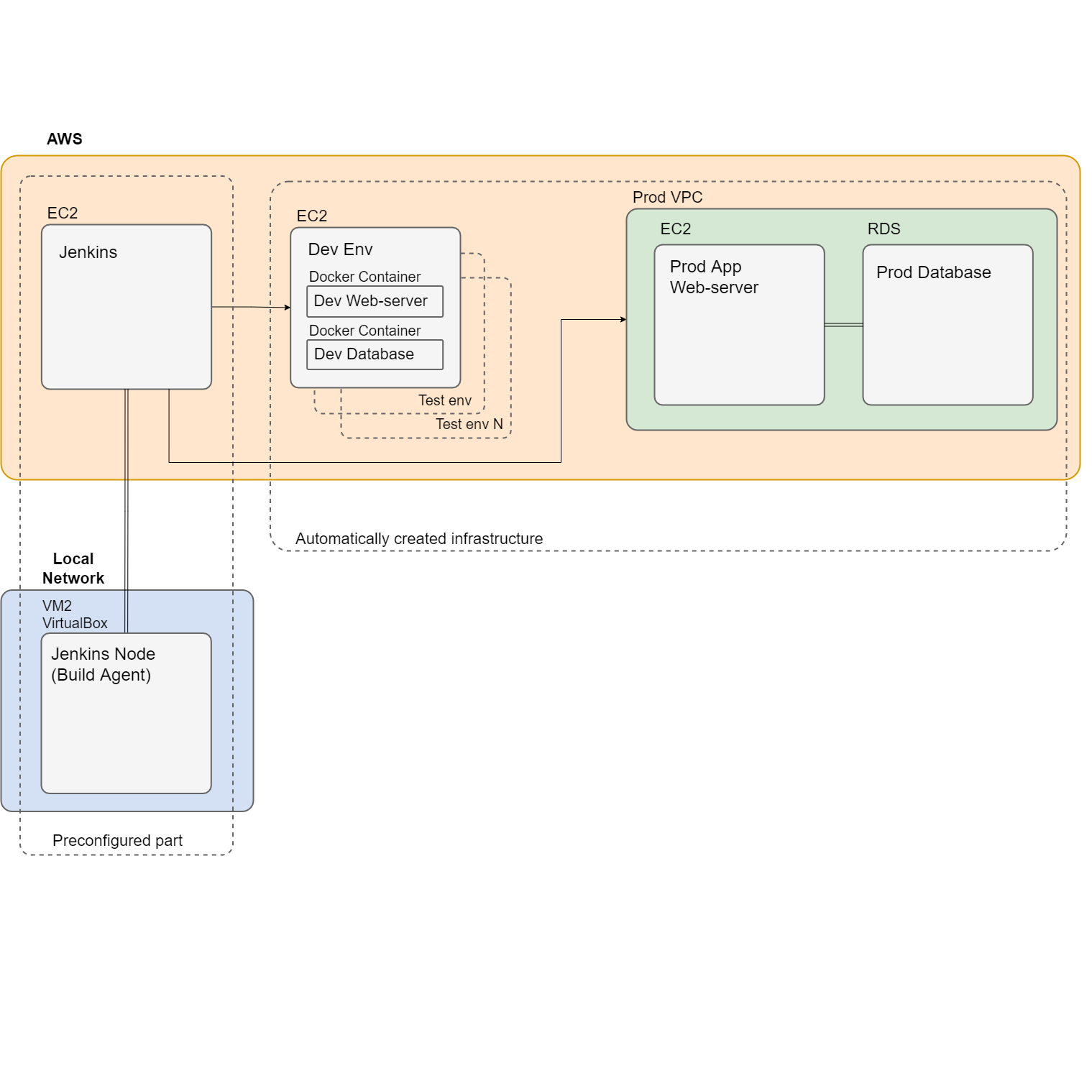
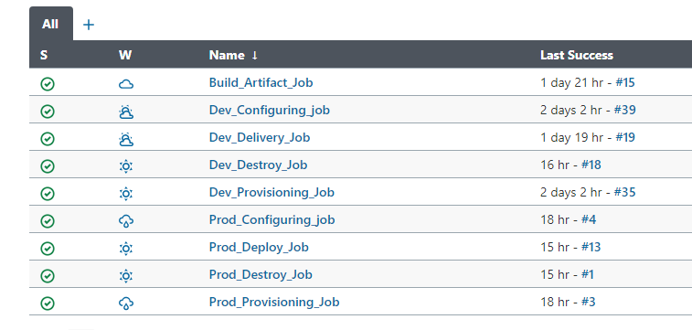
Infrastructure Design and Jobs Required List

Slide 8
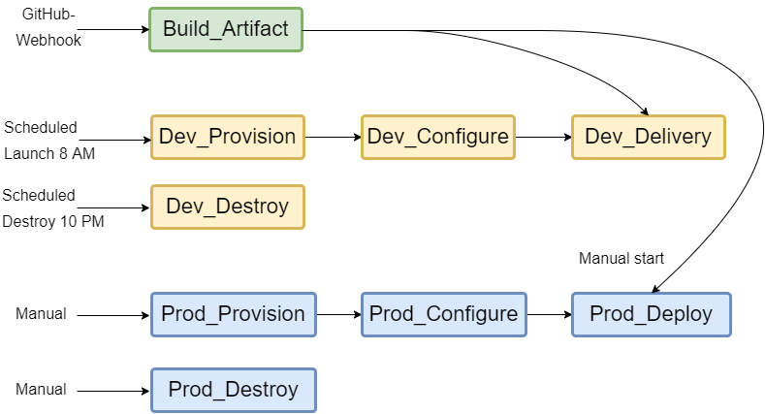
Jobs relations scheme

Slide 9
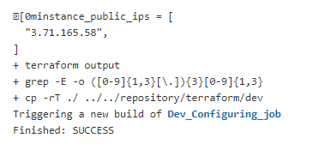
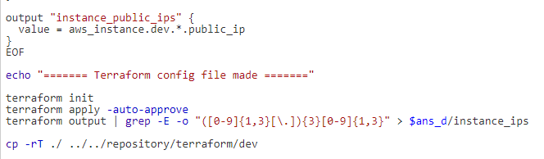
Dev Environment Provisioning
Dev_Provisioning_Job steps:
Creates a Terraform file
Launches terraform apply
Finds in Terraform ouputs IP-adresses of all created instances and saves list to instance_ips file to be passed to configuring with Ansible job
Saves terraform.tfstate file in environment repo
Triggers Dev_Configuring_job
Link to full script on GitHub

Slide 10
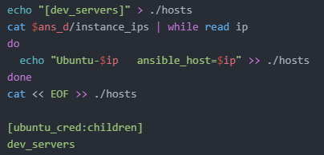
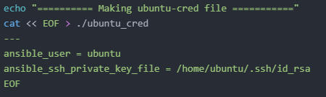
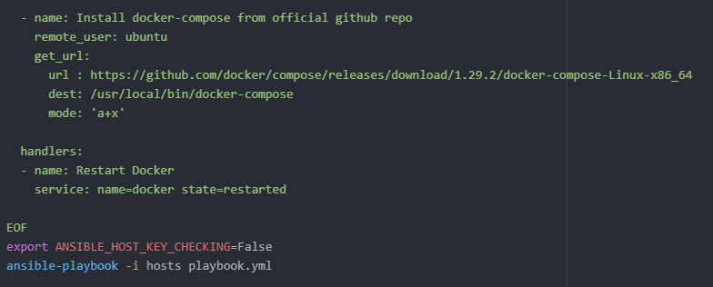
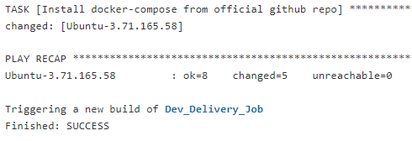
Dev Environment Configuration
Dev_Configuring_Job steps:
Reads instance_ips file created by Terraform
Makes hosts file for Ansible
Makes ubuntu_cred and playbook.yml, with tasks Docker and doker-compose to be installed.
Starts Ansible playbook to apply configuration on all instances
Triggers Dev_Delivery_Job
Link to full script on GitHub

Slide 11
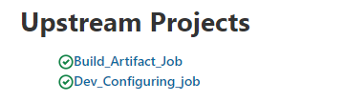
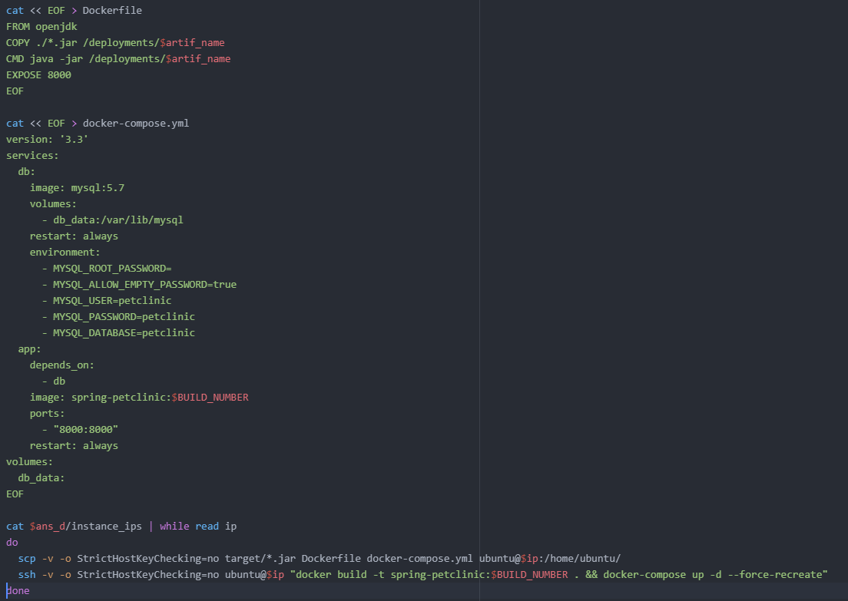
Deploy To Dev
Dev_Delivery_Job steps:
Checks if infrastructure exists
Copys artifact fom Build_Artifact_Job project via Copy Artifact plugin.
Makes Dockerfile with artifarc jar-file specified in it
Makes docker-compose.
Sends docker config files and artifact to all created instances
Sends on instances a command to build an image and to launch the containers (app and db)
Link to full script on GitHub

Slide 12
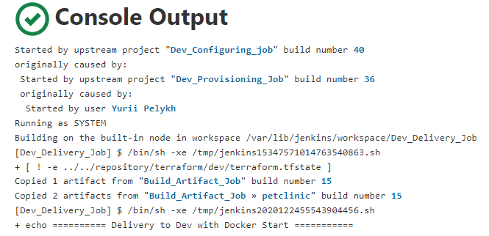
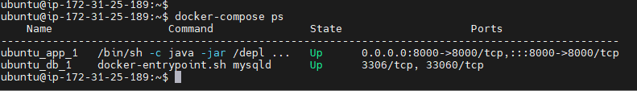
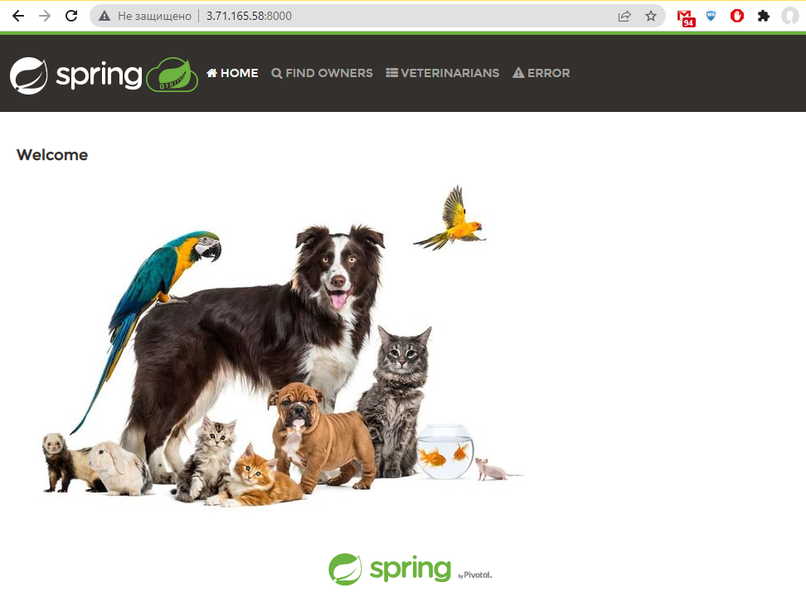
Deploy to Dev Result

Slide 13
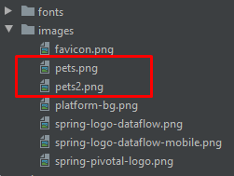

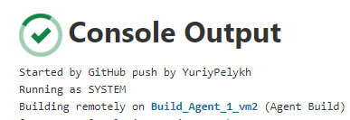
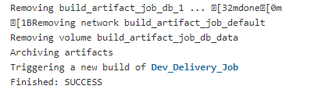
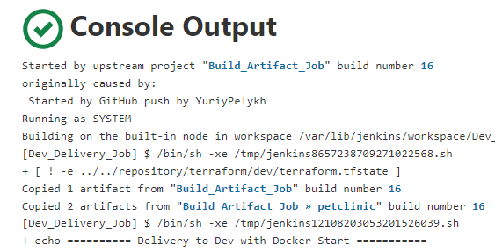
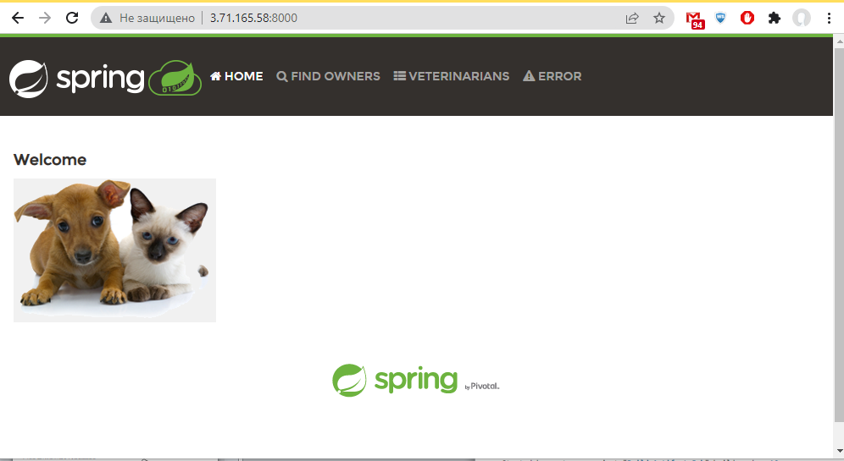
Pipeline in Action

Slide 14
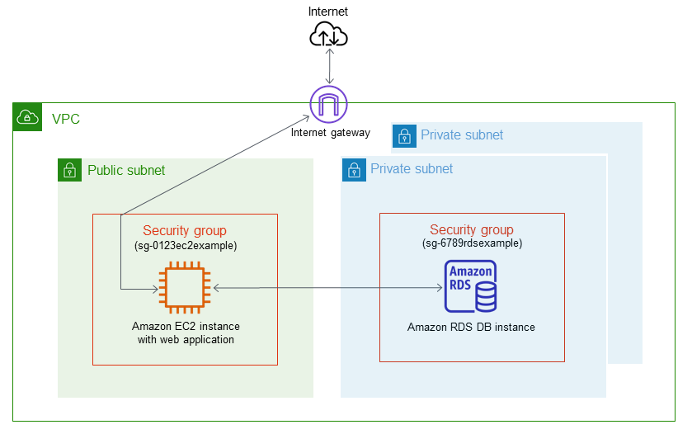
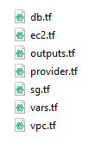
Prod Environment Architecture
Prod__Provisioning_Job:
Takes already wrote config .tf – files from repo
Creates instances with Terraform
Creates instance_ips file for Ansible
Saves terraform.tfstate file in environment repo
Triggers Prod_Configuring_Job
Prod__Configuring_Job:
Reads instance_ips file created by Terraform
Configures instances with Ansible (java runtime environment installation)
Triggers job for application deploy
Entities were created:
aws_vpc
aws_subnet
aws_internet_gateway
aws_route_table
aws_route_table_association
6. aws_vpc
7. aws_db_instance
8. aws_db_subnet_group
Link to all terraform scripts on GitHub

Slide 15
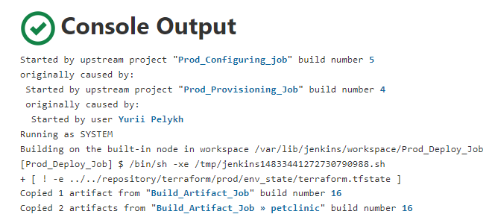
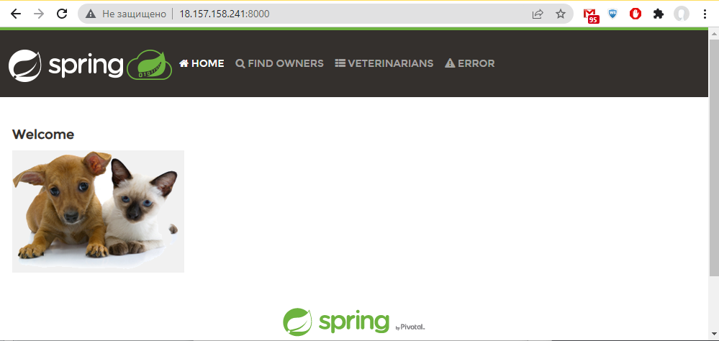
Deploy to Prod
Prod_Deploy_Job:
Reads instance_ips file created by Terraform
Sends .jar file to each instance
Makes export to environment variables of MySQL DB address, got from Terraform’s outputs earlier.
Starts Java application on remote instsnce(s)

Slide 16
Conclusions
In final project an automated conveyor of new code continuous integration and deploy was configured on a basis of Jenkins.
Got acquaintance with main CI/CD tools and technologies, their configuration and usage.
Were learned a principles of automated cloud infrastructure creation with Terraform, its’ configuration management with Ansible and got a practical experience of work with this tools.

