Slide 1
β-VAE: LEARNING BASIC VISUAL CONCEPTS WITH A CONSTRAINED VARIATIONAL FRAMEWORK
Irina Higgins, et al.
Google DeepMind
ICLR 2017

Slide 2
Introduction
Background:
The data representation is significant; → The disentangled representation can be useful; (and what is the disentangled).
Motivation and Problem Setting:
Unsupervised learning of a disentangled representation is a major challenge; <-- most previous attempts required a prior knowledge; → It is not feasible in the real world;
InfoGAN maximize the MI between a subset of the generating noise variable and the output of the recognition network; → However, comes at the cost of training instability and reduced sample diversity; → Furthermore, InfoGAN requires some a priori knowledge of the data;
Finally, there is no general method for quantifying the degree of learnt disentanglement.
Contributions:
We propose β-VAE (augmenting the original VAE framework with a single hyperparameter β that modulates the learning constraints applied to the model);
β-VAE with β = 1 corresponds to the original VAE framework;
With β > 1 the model is pushed to learn a more efficient latent representation of the data, which is disentangled if the data contains at least some underlying factors of variation that are independent.

Slide 3
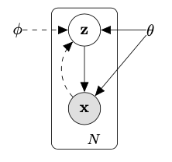
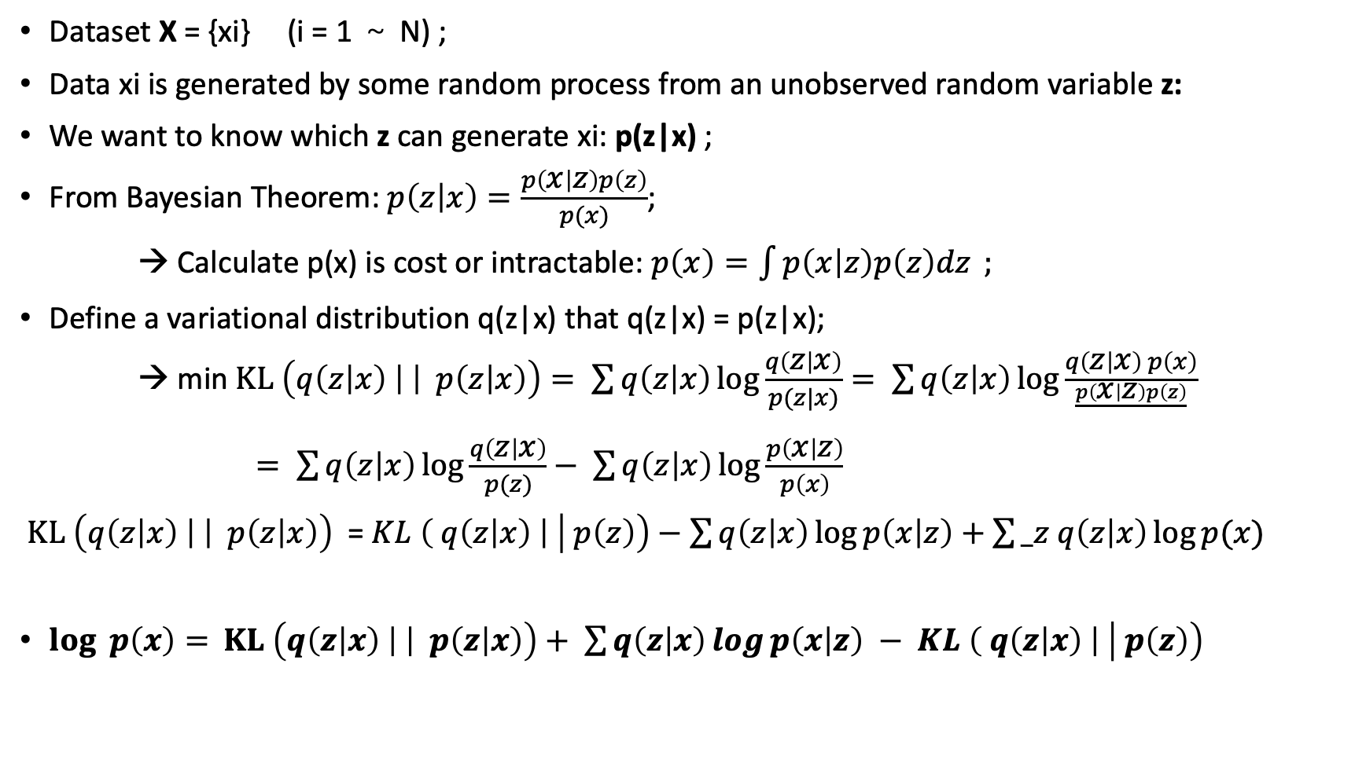

Background Knowledge:
Dataset X = {xi} (i = 1 ～ N) ;
Data xi is generated by some random process from an unobserved random variable z:
We want to know which z can generate xi: p(z|x) ;
From Bayesian Theorem: $p\left(z | x\right)=\frac{p\left(x | z\right)p\left(z\right)}{p(x)}$;
→ Calculate p(x) is cost or intractable: $p\left(x\right)=\int{p\left(x | z\right)p\left(z\right)dz} ;$
Define a variational distribution q(z|x) that q(z|x) = p(z|x);
→ min $KL \left(q\left(z | x\right) \left| \right| p\left(z | x\right)\right)= \sum{q\left(z | x\right)\log{\frac{q\left(z | x\right)}{p(z|x)}}}= \sum{q\left(z | x\right)\log{\frac{q\left(z | x\right) p\left(x\right)}{\frac{p\left(x | z\right)p\left(z\right)}{}}}}$
$= \sum{q\left(z | x\right)\log{\frac{q\left(z | x\right)}{p(z)}− }}$ $\sum{q\left(z | x\right)\log{\frac{p\left(x | z\right)}{p\left(x\right)} }}$
$KL \left(q\left(z | x\right) \left| \right| p\left(z | x\right)\right)$ = $KL \left( q\left(z | x\right) \right| \left| p\left(z\right)\right)−\sum{q\left(z | x\right)\log{p\left(x | z\right)+\sum{_z q\left(z | x\right)\log{p(x) }}}}$
$\log{ p\left(x\right)= }$ $KL \left(q\left(z | x\right) \left| \right| p\left(z | x\right)\right)+ \sum{q\left(z | x\right)\log{p\left(x | z\right) − }}$ $KL \left( q\left(z | x\right) \right| \left| p\left(z\right)\right)$
$$Evidence Lower Bound (L)$$

Slide 4
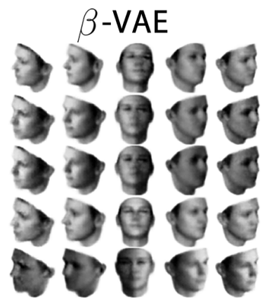
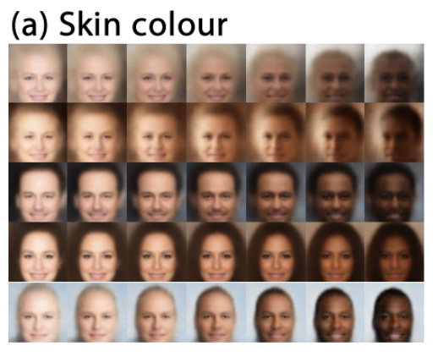
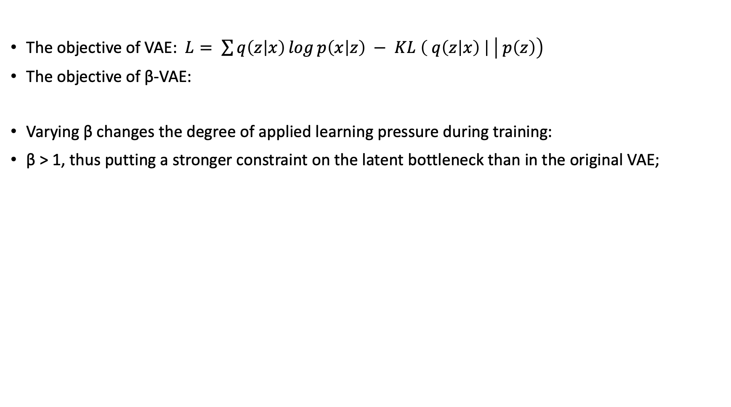
Method
The objective of VAE: $L= \sum{q\left(z | x\right)\log{p\left(x | z\right) − }}$ $KL \left( q\left(z | x\right) \right| \left| p\left(z\right)\right)$
The objective of β-VAE:
Varying β changes the degree of applied learning pressure during training:
β > 1, thus putting a stronger constraint on the latent bottleneck than in the original VAE;

